Slide 1






$$I_{L}$$
$$C$$
$$V_{in}$$
$$D$$
$$R_{L}$$
$$V_{O}$$

Slide 2



$$C$$
$$I_{L}$$
$$V_{in}$$
$$R_{L}$$
$$V_{O}=V_{in}$$

Slide 3



$${V_{p}}_{ }$$
$$V_{in}$$
$$R_{L}$$
$$V_{O}=0$$
$$I_{sc}$$

Slide 4

$${V_{p}}_{ }$$
$$V_{in}=−V_{p}$$
$$R_{L}$$
$$V_{O}=0$$

Slide 5
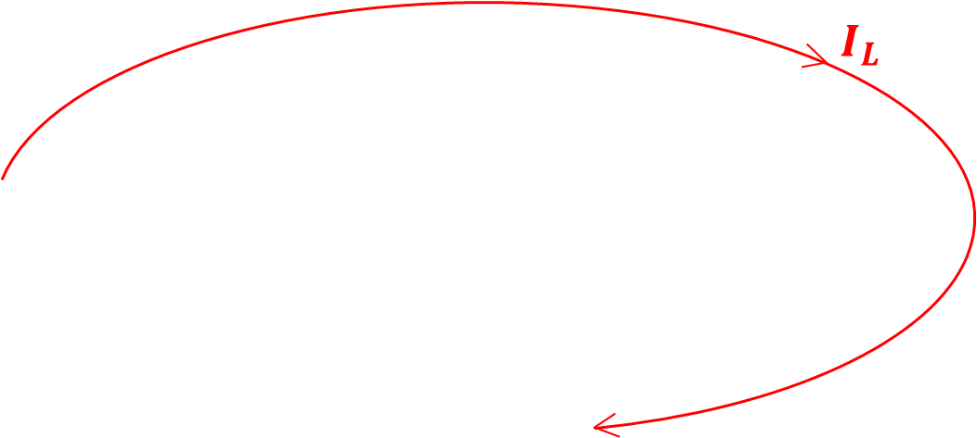


$${V_{p}}_{ }$$
$$V_{in}$$
$$R_{L}$$
$${(V}_{in}+V_{p})$$

Slide 6
$$I_{L}$$
$$C$$
$$V_{in}$$
$$D$$
$$R_{L}$$
$$V_{O}$$

