Slide 1

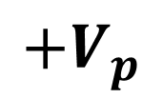
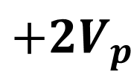

$${+2V}_{p}$$
$${+V}_{p}$$
$$0$$
$$wt$$

Slide 2

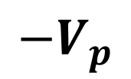
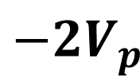

$$0$$
$$wt$$
$${−V}_{p}$$
$${−2V}_{p}$$

Slide 3

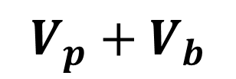
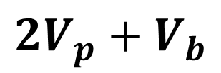


$${2V}_{p}+V_{b}$$
$$V_{p}+V_{b}$$
$$V_{b}$$
$$wt$$
$$0$$

Slide 4

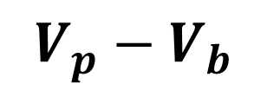
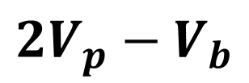


$${2V}_{p}−V_{b}$$
$$V_{p}−V_{b}$$
$$0$$
$$wt$$
$${−V}_{b}$$

Slide 5

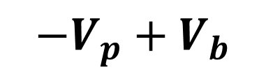
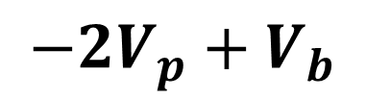


$$V_{b}$$
$$0$$
$$wt$$
$${−V}_{p}+V_{b}$$
$${−2V}_{p}+V_{b}$$

Slide 6

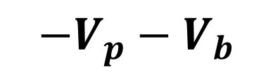
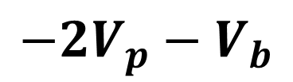


$$0$$
$$wt$$
$${−V}_{b}$$
$${−V}_{p}−V_{b}$$
$${−2V}_{p}−V_{b}$$

