Slide 1
Arduino Codes

Slide 2
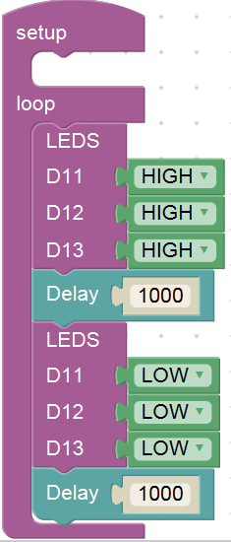
3 LEDs Blinking

Slide 3
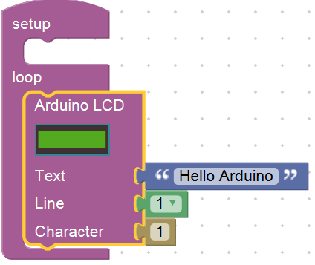
LCD Connection

Slide 4
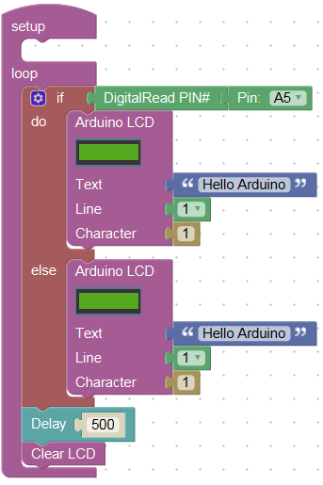
IR Proximity Testing

Slide 5
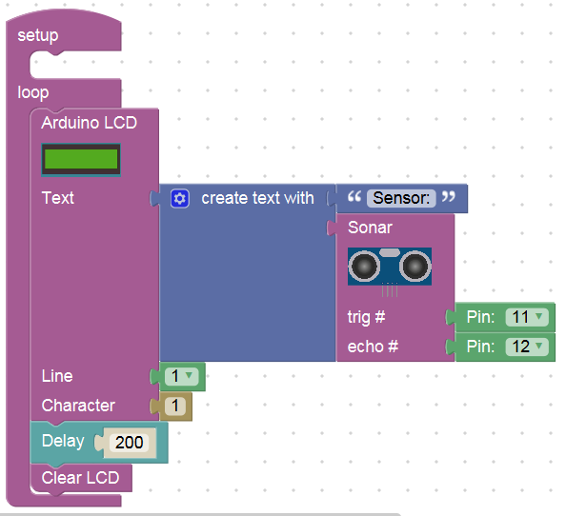
Ultrasonic Sensor Testing

Slide 6
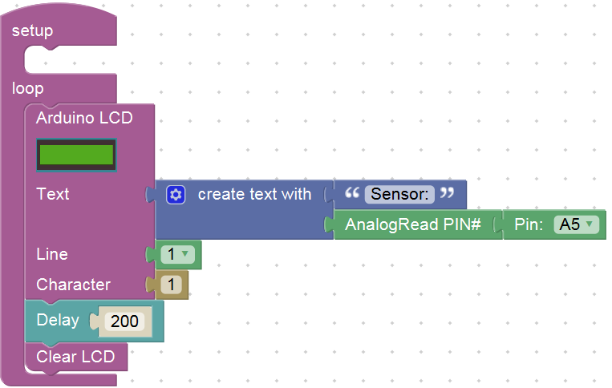
Photodiode/LDR Testing

Slide 7
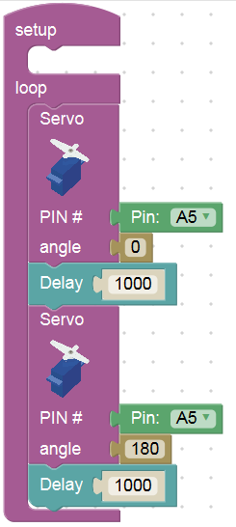
Servo Testing

Slide 8
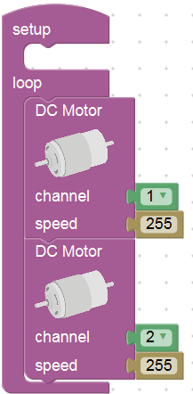
DC Motor Testing

Slide 9
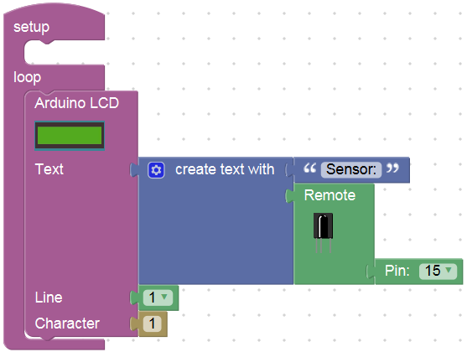
Remote Sensor Connection (Optional)

