Slide 1
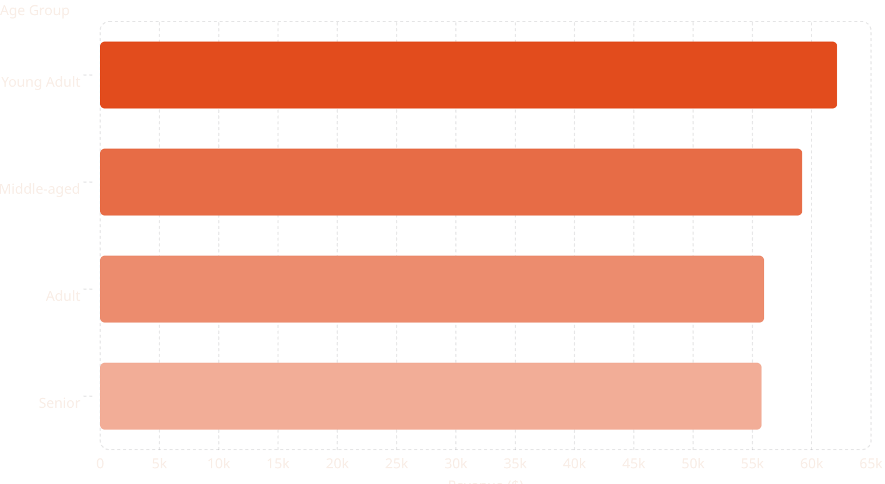
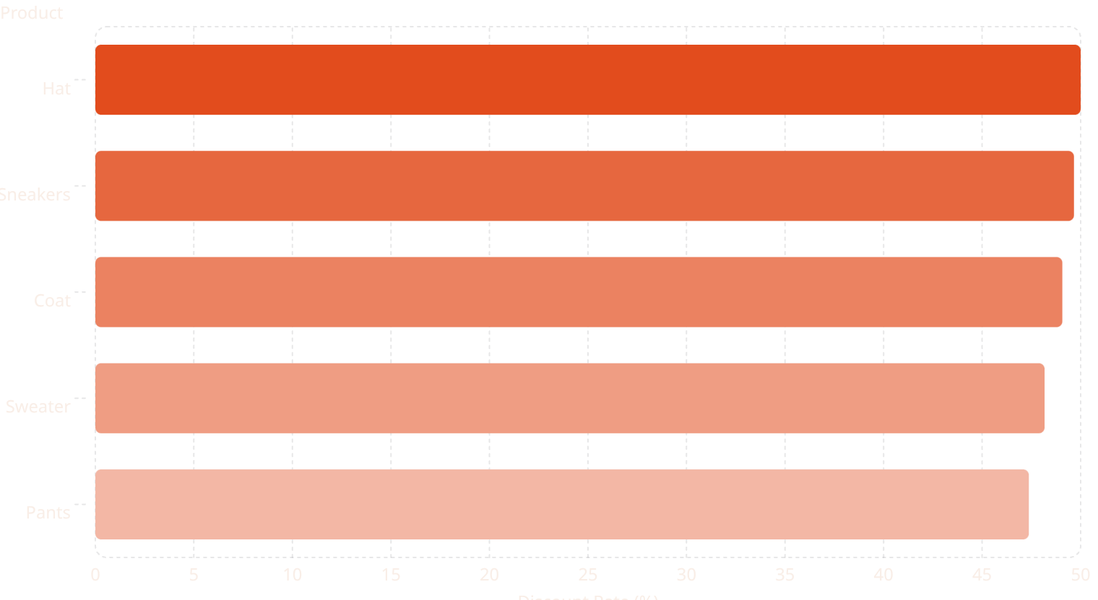
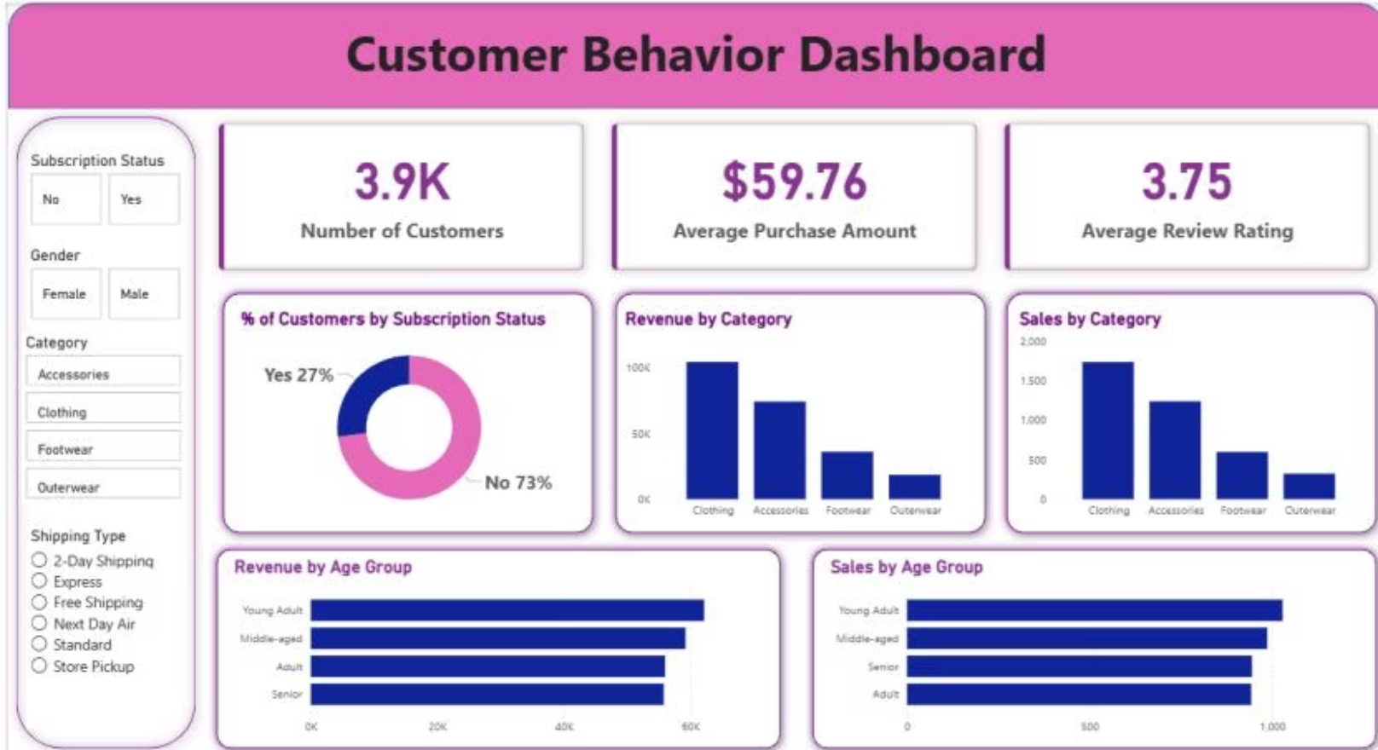

Customer Behavior & Sales Analysis
Analyzing 3,900 transactions across 18 features — demographics, purchase details, and shopping behavior — to uncover insights that guide strategic business decisions.
Dataset
Tools Used
Avg. Purchase
Top Category
3,900 rows · 18 columns · 37 missing review ratings (imputed by category median)
Python (pandas) → PostgreSQL (SQL analysis) → Power BI (dashboard)
$59.76 · Avg. Rating: 3.75 · Age range: 18–70
Clothing leads with ~$100K revenue and ~1,800 sales
SQL Business Insights
Revenue by Gender
Discount Users
Male: $157,890 · Female: $75,191
839 customers used discounts yet spent above average
Top-Rated Products
Shipping Comparison
Gloves (3.86), Sandals (3.84), Boots (3.82), Hat (3.80), Skirt (3.78)
Express avg: $60.48 vs. Standard: $58.46
Subscribers vs. Non
Customer Segments
Subscribers (1,053): avg $59.49 · Non-subscribers (2,847): avg $59.87 · Total revenue: $233K
Loyal: 3,116 · Returning: 701 · New: 83
Revenue by Age Group
Discount-Dependent Products
Power BI Dashboard Of The Sales analysis
Business Recommendations
Boost Subscriptions
Loyalty Programs
Promote exclusive benefits to grow the 27% subscriber base
Reward repeat buyers to accelerate movement into the Loyal segment
Review Discount Policy
Targeted Marketing
Balance sales boosts with margin control — especially for Hat, Sneakers, Coat
Focus on Young Adults (highest revenue) and express-shipping users

