Slide 1
Model-Backed Thresholding (Tab 3)
Business Confidence in ML & Statistical Forecasting for FX Volatility

Slide 2
1. Why Use Multiple Models
- Different models detect different behaviors
- Some are better at short-term trends, others at structural shifts
- Using multiple models gives a more robust and explainable alerting system

Slide 3
2. What Each Model Brings
- Prophet: Forecasts expected volatility + uncertainty (CI)
- GARCH: Captures volatility clustering, reacts to shocks
- Bollinger Bands: Responds to trend + deviation in real time
- Random Forest / LSTM: Learn from complex patterns
- HMM: Detects hidden regimes (e.g., stable vs volatile market)

Slide 4
3. Regime Shifts via HMM
- HMM segments volatility into discrete regimes (e.g., low vs high risk)
- Useful for identifying shift zones and long-term trend changes
- Can adapt thresholds or alert logic depending on regime

Slide 5
4. Confidence & Control for Ops
- All models are validated against actual data
- You always see manual threshold as baseline
- Flags only raised when multiple signals agree
- You stay in control: models enhance, not replace manual review

Slide 6
5. Summary & Next Steps
- Multi-model approach provides better coverage
- HMM adds long-term trend awareness
- Manual logic remains visible as fallback
- Your feedback loop will guide final tuning

Slide 7
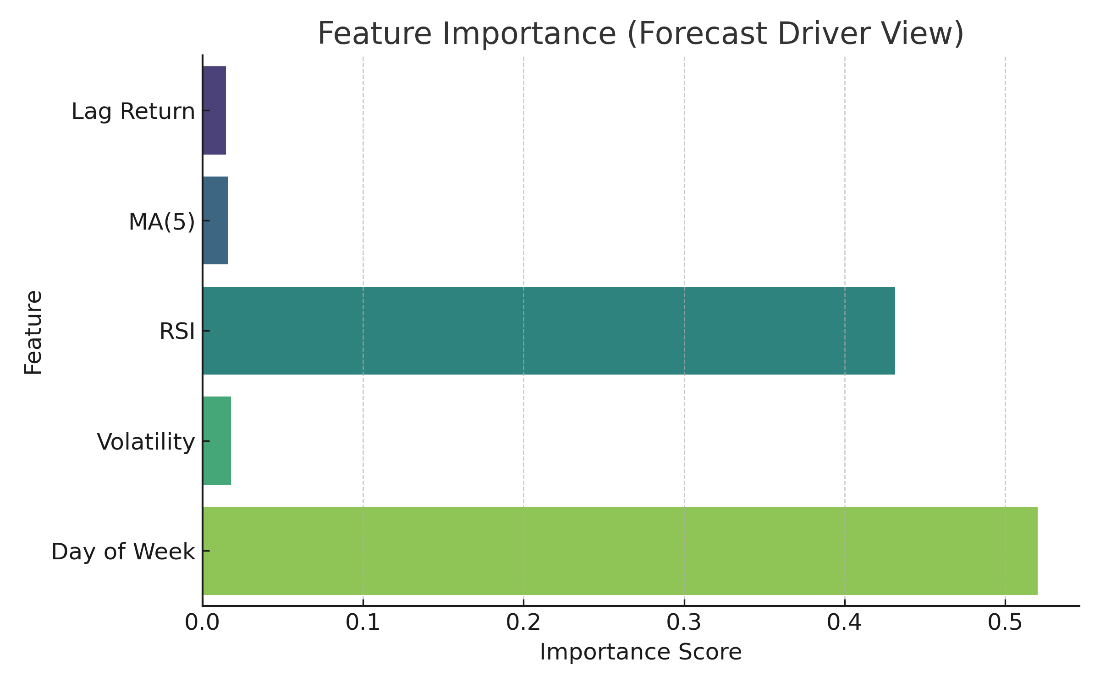
Forecast Drivers (Tab 3 Model Explainability)

