Slide 1
Dance Studio
Presented by-
Surjani Biswas
Employee ID: 46001701

Slide 2
Problem Statement:
Dance Studio is an online website which provides a platform for all age groups to learn dance.
Here Student will be able to :
SignUp by entering valid details.
Login into his/her account using valid user details.
Search for Choreographers.
Register for a dance course.
Choreographer will be able to:
SignUp by entering valid details.
Login into his/her account using valid user details.
View all the courses which has been assigned to him.
Admin will be able to:
Login into his/her account.
Approve the Choreographers and Students after they sign up.

Slide 3
Technology Used:
Java 1.8
Spring framework 4.0.0
Spring Boot 2.2.4
MySQL 8.0.18
Postman 7.17.0
NodeJS 12.13.1
Angular CLI 8.3.21

Slide 4
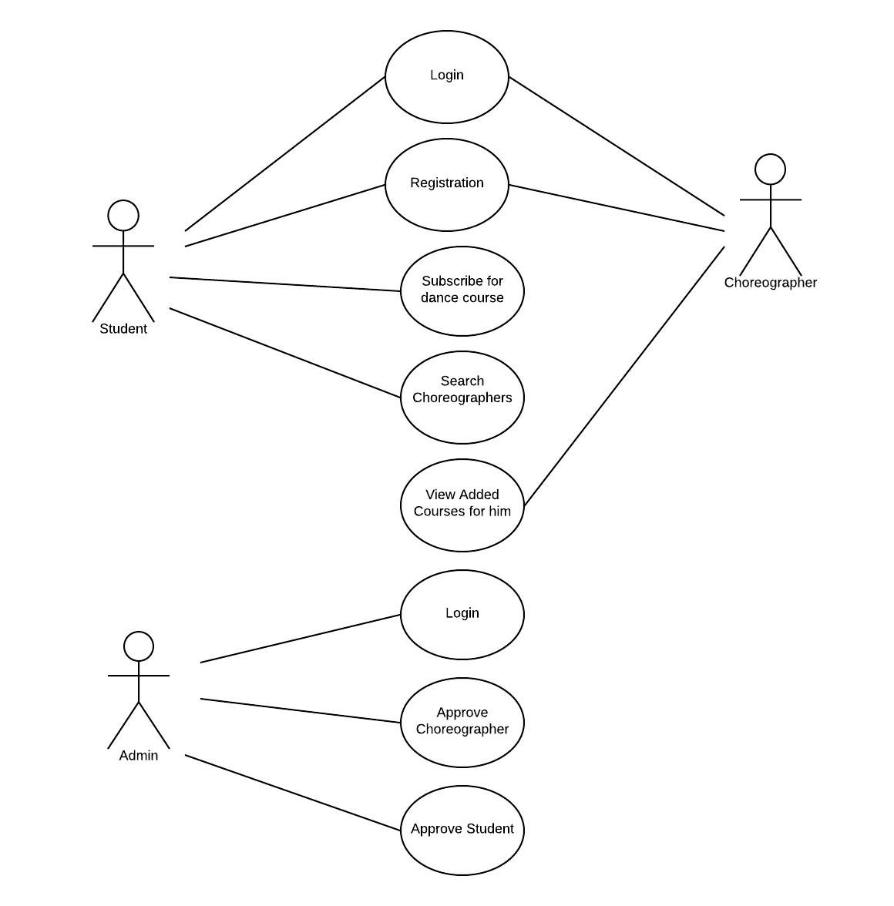
Use Case Diagram:

Slide 5
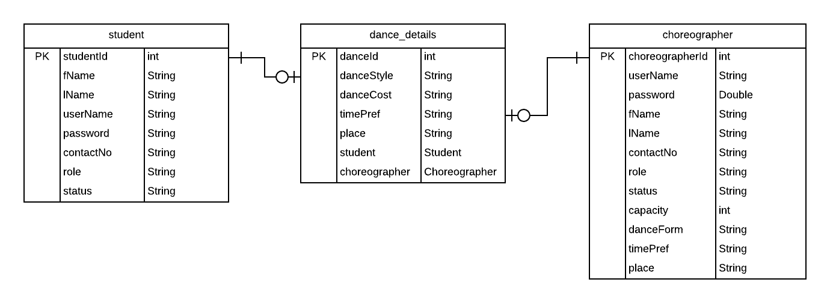
ER Diagram:

Slide 6
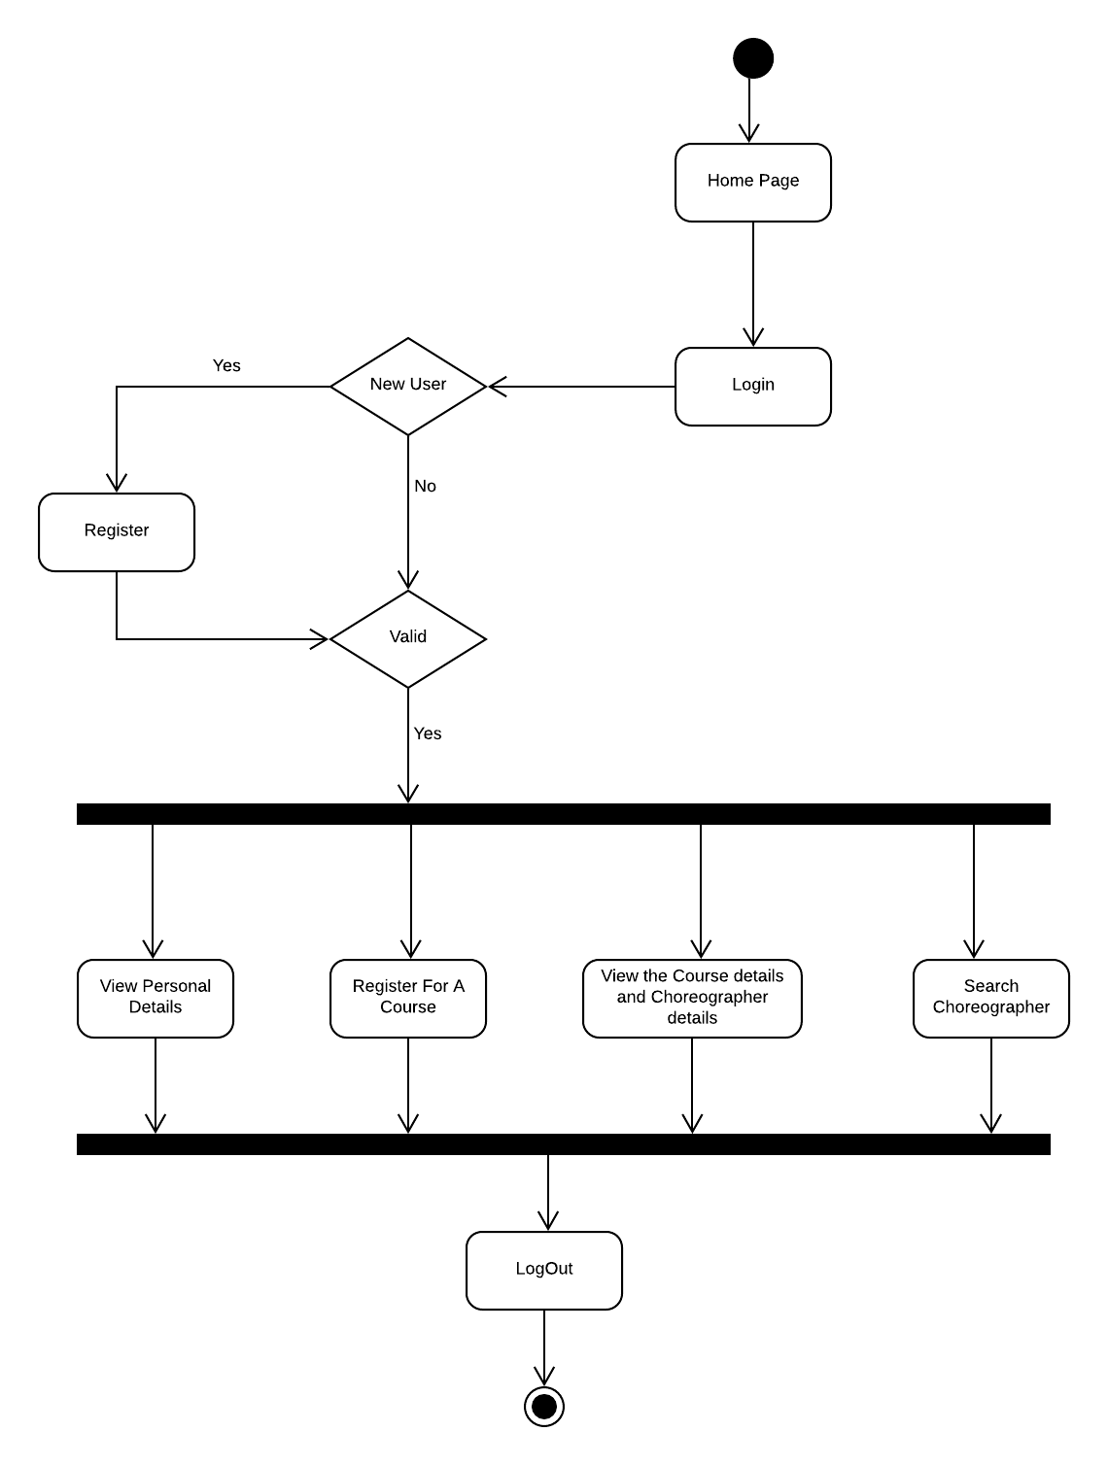
Activity Diagram (For Student)

Slide 7
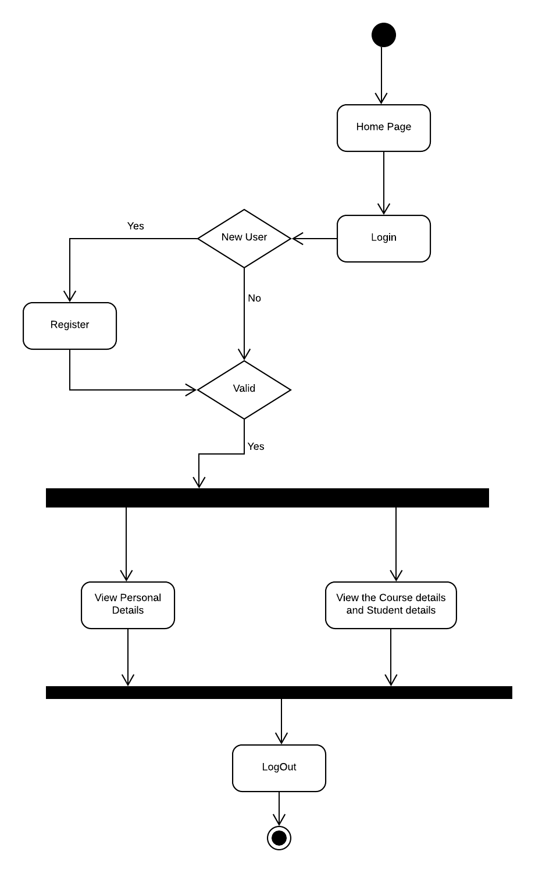
Activity Diagram (For Choreographer)

Slide 8
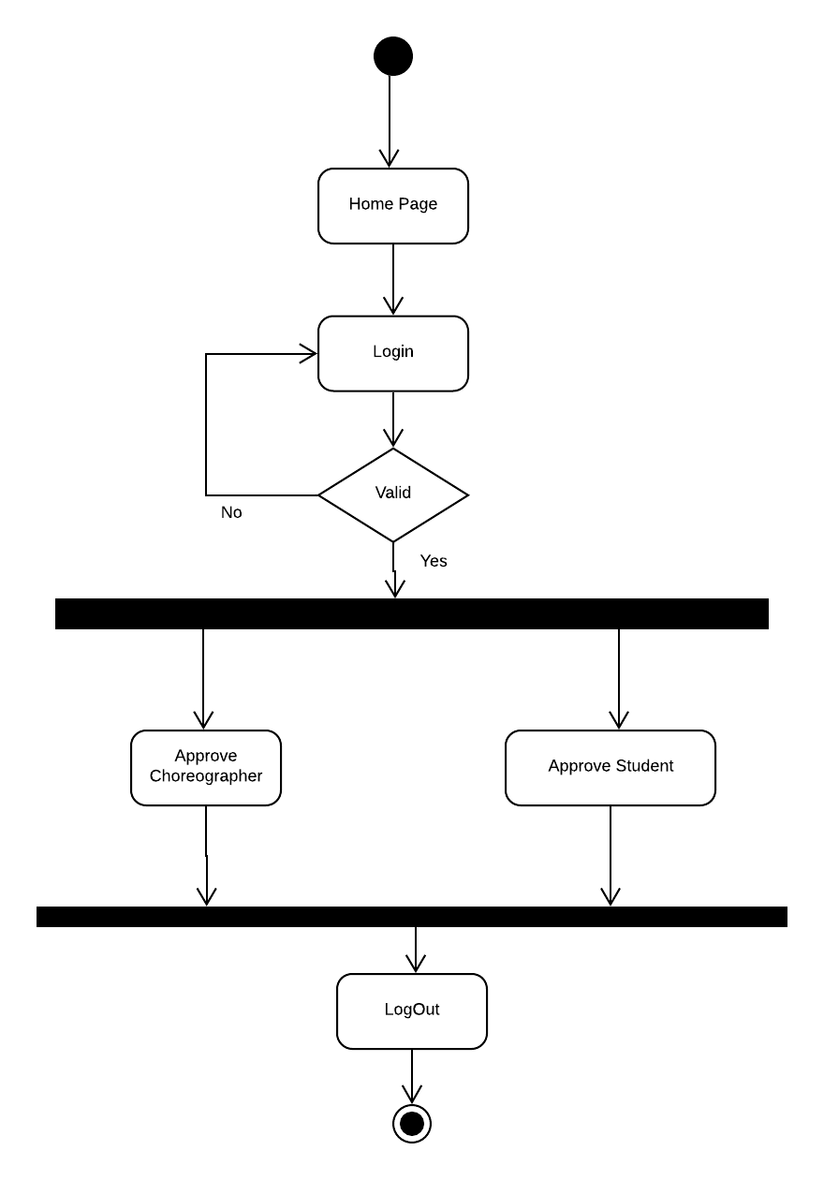
Activity Diagram (For Admin)

