Slide 1
FLIPKART GRIDLOCK HACKATHON 2.0 // THEME 3 SUBMISSION
SMARTVISION X
Autonomous AI-Powered Traffic Enforcement & Safety Platform
PROJECT OVERVIEW
Presented by: Surjeet Yadav
Live Demo: smartvision-x-gridlock-c579.vercel.app
Architecture: React / Vite + Express MVC + YOLOv8 + MongoDB Atlas Sync

Slide 2
SMARTVISION X // EXECUTIVE SUMMARY
Our Vision & Mission
THE VISION
To construct a fully autonomous urban mobility nervous system that eliminates human delays in traffic enforcement, instantly detects life-threatening safety violations, and secures Indian roads using real-time Edge Artificial Intelligence.
THE MISSION
Deploy an end-to-end MERN stack + Python CV application that processes live CCTV streams to:
• Detect Helmetless Riders & Triple Riding
• Identify Sidewalk/Illegal Parking Blockages
• Auto-generate legal evidence & PDF Challans
• Dispatch patrol officers based on GPS proximity.
LIVE PLATFORM DEMO: smartvision-x-gridlock-c579.vercel.app

Slide 3
SMARTVISION X // PROBLEM STATEMENT
The Urban Traffic Crisis
METRIC 01
60% Fatalities
Critical Safety Violations
Riders ignoring helmet mandates and practicing dangerous triple-riding habits cause 60%+ of two-wheeler road casualties.
METRIC 02
Severe Congestion
Junction Bottlenecks
Illegal parking on major urban arterial roads blocks sidewalks and creates severe choke points (e.g., Silk Board Jn).
METRIC 03
80% Missed Tickets
Enforcement Leakage
Manual operators miss over 80% of transient parking and helmet violations due to sheer feed volume and visual fatigue.
LIVE PLATFORM DEMO: smartvision-x-gridlock-c579.vercel.app

Slide 4
SMARTVISION X // PROBLEM STATEMENT
Limitations of Manual Enforcement
Traditional traffic policing methods cannot scale with mega-city volumes due to:
HUMAN VISUAL FATIGUE | Impossible for control room officers to monitor hundreds of CCTV streams concurrently 24×7 without missing violations.
HIGH PROCESSING LATENCY | Manual e-challans take days to process and dispatch, losing the psychological impact of immediate traffic fine warnings.
OFF-LINE DISPATCH LOOP | No active connection between cameras flagging violations and nearby patrol cars, leaving field units unrouted.
DISCONNECTED REPEAT HISTORIES | No system queries registration numbers against history to identify high-risk drivers in real-time.
LIVE PLATFORM DEMO: smartvision-x-gridlock-c579.vercel.app

Slide 5
SMARTVISION X // THE SOLUTION
Introducing SmartVision X
The Ultimate AI-Powered Traffic Nervous System
An end-to-end platform that captures street streams, detects violations using custom-quantised YOLOv8 models, reads license plates with OCR, and dispatches responders via a real-time web portal.
01
CCTV CAPTURE
RTSP video feeds from high-density junctions stream directly to edge servers.
02
EDGE AI INFERENCE
Optimised YOLOv8 instantly locates riders, cars, helmets, and plates.
03
PLATE OCR READ
EasyOCR extracts alphanumeric text from HSRP plates on violation frames.
04
CLOUD ENFORCEMENT
MongoDB Atlas stores record. Dispatch triggers closest patrol car.
➔
➔
➔
LIVE PLATFORM DEMO: smartvision-x-gridlock-c579.vercel.app

Slide 6
SMARTVISION X // PLATFORM CAPABILITIES
Key Modules Overview
Live Violation Detection
Real-time camera feed analysis with bounding boxes for motorcycles, riders, helmet status, and illegal parking.
Automated Evidence Center
Frictionless dashboard showing violation snapshots, confidence rates, plate crops, and PDF download buttons.
Smart Patrol Dispatcher
GPS-tracked patrol dispatches. Calculates nearest active responder using coordinates and dispatches with route details.
Offenders Database (Risk)
Alphanumeric query interface retrieving history records from VAHAN database simulator to calculate recidivism risk scores.
AI Configuration Console
Interactive threshold tuners allowing operators to live-adjust YOLOv8 confidence rates, OCR sensitivity, and IR exposure.
Emergency Override Module
VIP Corridor simulator which triggers green lights sequentially across junctions to ensure gridlock clearance.
LIVE PLATFORM DEMO: smartvision-x-gridlock-c579.vercel.app

Slide 7
SMARTVISION X // TECHNOLOGY DEEP DIVE
AI Vision Pipeline
How raw CCTV camera feeds are processed into legally binding traffic citations in milliseconds:
CCTV CAPTURE
RTSP Stream
---------------------
1080p stream at 30 FPS. Weather filters simulation (Rain/Night) adjust exposure.
YOLOv8 DETECT
YOLOv8-nano
---------------------
Localises class boxes: car, motorcycle, rider, helmet, plate.
EASYOCR ENGINE
CRNN OCR
---------------------
Processes cropped plate image. Applies perspective warp and Otsu thresholding.
DECISION RULES
Rule Compiler
---------------------
Triple riding check (>2 rider boxes in vehicle box). No-helmet threshold logic.
REST ENGINE
Express Controller
---------------------
Persists violation to MongoDB. Auto-sends challan notice.
➔
➔
➔
➔
LIVE PLATFORM DEMO: smartvision-x-gridlock-c579.vercel.app

Slide 8
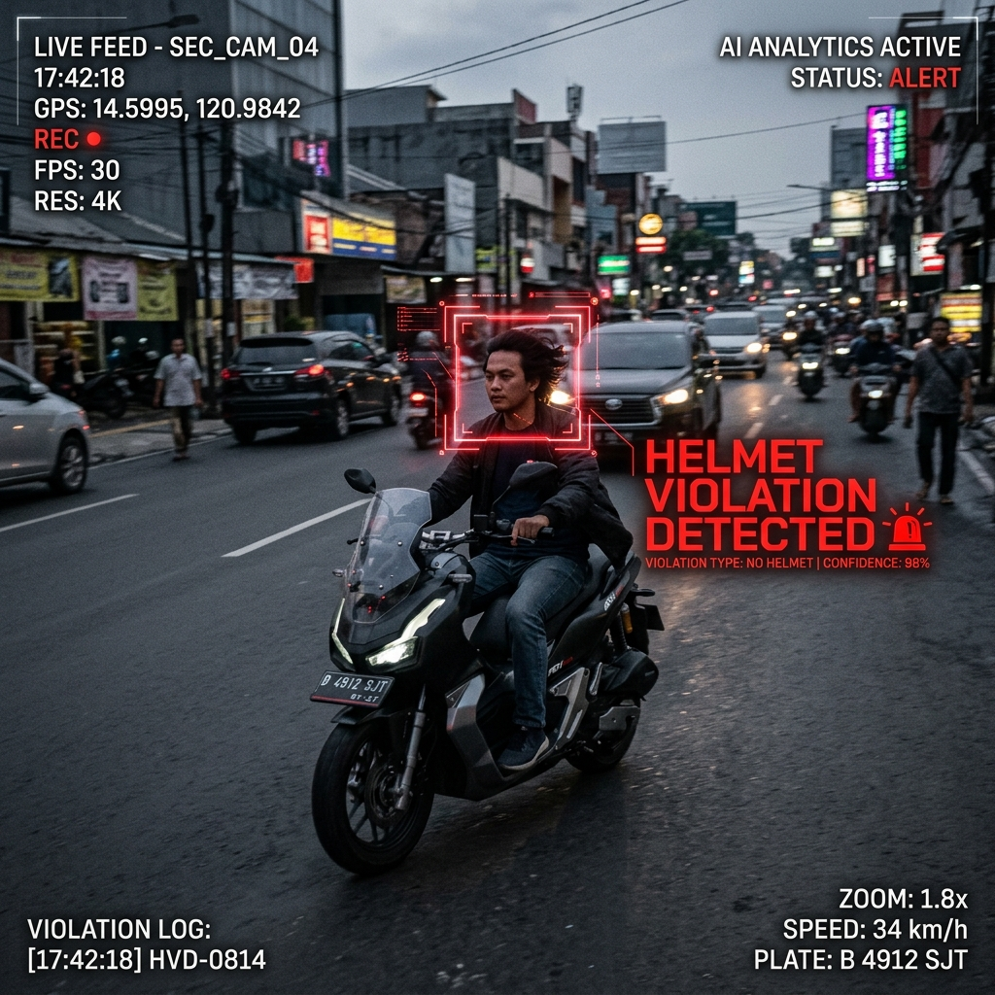
SMARTVISION X // LIVE DETECTION CORE
AI Vision Demo: Helmet Violation
YOLOv8 + OCR PIPELINE IN ACTION
• Vehicle Bounding Box: YOLOv8 locates the motorcycle and crops the regional coordinates.
• Helmet Status Classifier: Specifically isolates the rider head box to run binary prediction (Helmet/No Helmet).
• Automatic Plate Localization: Identifies HSRP plate location and applies OCR perspective warping.
• Real-time Confidence Rating: The AI engine returns a 94.6% prediction confidence.
LIVE PLATFORM DEMO: smartvision-x-gridlock-c579.vercel.app

Slide 9

SMARTVISION X // LIVE INTERFACE
SmartVision X Dashboard
INTEGRATED CONTROL ROOM
• Live CCTV Grid: Stream switcher simulating camera junctions across Silk Board and Majestic.
• AI Brain Panel: Audio/visual alerts switch with live CPU/GPU tracking.
• Violations Center: Instant table rendering with OCR read outs.
• Weather Toggles: Simulates clear, rain, or night exposure conditions.
LIVE PLATFORM URL
smartvision-x-gridlock-c579.vercel.app/command
LIVE PLATFORM DEMO: smartvision-x-gridlock-c579.vercel.app

Slide 10
SMARTVISION X // CORE MODULE
Automated E-Challan Generation
E-CHALLAN GENERATION ENGINE
• Operator Verification: The platform keeps a human in the loop. The control officer reviews the auto-cropped plate frame before confirming.
• Automated Fine Calculation: System auto-assigns fine amounts (₹1,000 for helmet violations, ₹2,000 for triple riding).
• RTO Vahan Sync: Connects license plates to registered owner mobile data for automated SMS alert simulations.
• High-fidelity PDF Receipt: Exports clean legal tickets complete with plate crops, maps, and barcode elements.
BENGALURU TRAFFIC POLICE
OFFICIAL E-CHALLAN RECEIPT
Challan Number:
BTP-9082-2026-X
Date & Time:
20-June-2026 | 10:00 AM
Junction Area:
Silk Board Junction (CAM-04)
Vehicle Plate:
KA-03-MX-8891
Violation Class:
Helmet Non-Compliance
Fine Amount:
₹ 1,000.00
VERIFIED & PAID
LIVE PLATFORM DEMO: smartvision-x-gridlock-c579.vercel.app

Slide 11
SMARTVISION X // DATABASE ARCHITECTURE
MongoDB Atlas Live Cloud Sync
ENTERPRISE DATA PERSISTENCE
• Hybrid Mode: Connects to live MongoDB Atlas Cloud cluster. Automatically falls back to local JSON persistence if internet drops.
• Real-time Schema Validation: Mongoose models enforce validation rules, timestamp audits, and geospatial coordinates.
• Query Optimization: Indexes on vehicle license plates and violation timestamps allow instant search queries.
• Global Accessibility: Command Center dashboard queries sync instantly, giving city inspectors access to active logs.
mongoose.model("Violation")
{
"_id": ObjectId("66741b21efb34"),
"plate_number": "KA03MX8891",
"violation_type": "No Helmet",
"location": "Silk Board Junction",
"confidence": 0.946,
"evidence_image": "uploads/ KA03MX.jpg",
"challan_amount": 1000,
"status": "pending_operator_review",
"timestamp": ISODate("2026-06-20T10:00:00Z")
}
LIVE PLATFORM DEMO: smartvision-x-gridlock-c579.vercel.app

Slide 12
SMARTVISION X // OPERATIONS
Smart Dispatch System
HAVERSINE NEAREST OFFICER ROUTING
• Real-time GPS Tracking: Field officers update their live coordinate pairs back to the dashboard.
• Haversine Metric: When an operator verifies a critical block or triple-riding event, the backend runs the Haversine formula to compute distance.
• Dynamic dispatch: Instantly orders patrol vehicles closest to the target coordinate (e.g. Officer Surjeet located 1.2km away).
• Interactive Route Map: Highlights target coordinates on the CommandCenter dispatch console.
1
1. CRITICAL INCIDENT FLAGGED
CAM-04 identifies illegal parking gridlock.
2
2. PROXIMITY ENGINE COMPUTES
Backend filters active patrol coordinate arrays.
3
3. CLOSEST CO-ORDINATE ROUTE
Officer dispatch instructions pushed automatically.
LIVE PLATFORM DEMO: smartvision-x-gridlock-c579.vercel.app

Slide 13
SMARTVISION X // ENGINEERING
Technology Stack
FRONTEND MODULES
Stack: React.js, Vite Builder, Tailwind CSS, Lucide Icons, React Router DOM v6
Usage: Dynamic route-based views, theme controllers, responsive dashboards.
BACKEND SYSTEM
Stack: Node.js, Express Framework, Multer File Uploads, REST controllers
Usage: MVC structure: split models, controllers, and JSON local mock storage fallbacks.
CLOUD PERSISTENCE
Stack: MongoDB Atlas, Mongoose ORM, Connection Status Flags
Usage: Auto-sync loop triggers collection upserts, online dashboard flag updates.
COMPUTER VISION ENGINE
Stack: Python 3.13, Flask API, YOLOv8 (Ultralytics), EasyOCR, OpenCV
Usage: Flask server runs YOLO inference and EasyOCR reader inside isolated venv.
LIVE PLATFORM DEMO: smartvision-x-gridlock-c579.vercel.app

Slide 14
SMARTVISION X // VALUE PROPOSITION
Business Impact & ROI
90%
Time Reduced
40%
Junction Clearance
3.5x
Enforcement Yield
90% Processing Efficiency
Automated YOLO/OCR identification reduces time-to-issue for challans from 3 days to under 5 seconds.
40% Congestion Relief
Proximity dispatch clears illegal street parking blockers from sidewalk junctions before gridlocks expand.
3.5x Fine Collection
Eliminates human observation leakage. Multiple cameras stream 24/7 without fatigue, checking every vehicle registration.
LIVE PLATFORM DEMO: smartvision-x-gridlock-c579.vercel.app

Slide 15
SMARTVISION X // ROADMAP
Future Roadmap & Milestones
Strategic roadmap for scaling SmartVision X across regional state grids:
Q3 2026
Edge Hardware Port
Q4 2026
NIC Vahan Integration
H1 2027
Citizen Complaint App
H2 2027
AI-Predictive Signals
Deploy YOLOv8-nano onto NVIDIA Jetson Orin Nano modules for physical CCTV cam placement.
Establish direct API handshakes with NIC Vahan/Sarathi databases for real-time owner registry search.
Launch crowdsourced reporting app. Citizens upload pictures which run auto YOLO checks.
Direct intersection overrides to green corridor routing based on neural traffic forecasts.
Autonomous Urban Safety Platform — Ready to Scale.
LIVE PLATFORM DEMO: smartvision-x-gridlock-c579.vercel.app

