Slide 1
Fundamentals of Networking for Effective Backend Applications
husseinnasser
Understanding the first principles of networking to build low latency and high throughput backends

Slide 2
Introduction
husseinnasser

Slide 3
Introduction
husseinnasser
Welcome
Who this course is for?
Course Outline

Slide 4
Fundamentals of Networking
husseinnasser
The first principles of computer networking

Slide 5

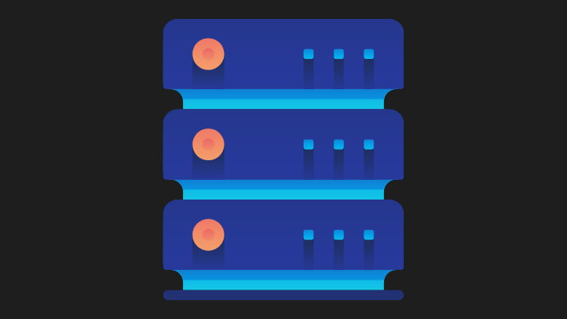
Client-Server Architecture
A revolution in networking

Slide 6
Client-Server Architecture
Machines are expensive, applications are complex
Seperate the application into two components
Expensive workload can be done on the server
Clients call servers to perform expensive tasks
Remote procedure call (RPC) was born

Slide 7
Client-Server Architecture Benefits
Servers have beefy hardware
Clients have commodity hardware
Clients can still perform lightweight tasks
Clients no longer require dependencies
However, we need a communication model

Slide 8

OSI Model
husseinnasser
Open Systems Interconnection model

Slide 9
Why do we need a communication model?
husseinnasser
Agnostic applications
Without a standard model, your application must have knowledge of the underlying network medium
Imagine if you have to author different version of your apps so that it works on wifi vs ethernet vs LTE vs fiber
Network Equipment Management
Without a standard model, upgrading network equipments becomes difficult
Decoupled Innovation
Innovations can be done in each layer separately without affecting the rest of the models

Slide 10
What is the OSI Model?
husseinnasser
7 Layers each describe a specific networking component
Layer 7 - Application - HTTP/FTP/gRPC
Layer 6 - Presentation - Encoding, Serialization
Layer 5 - Session - Connection establishment, TLS
Layer 4 - Transport - UDP/TCP
Layer 3 - Network - IP
Layer 2 - Data link - Frames, Mac address Ethernet
Layer 1 - Physical - Electric signals, fiber or radio waves

Slide 11
The OSI Layers - an Example (Sender)
husseinnasser
Example sending a POST request to an HTTPS webpage
Layer 7 - Application
POST request with JSON data to HTTPS server
Layer 6 - Presentation
Serialize JSON to flat byte strings
Layer 5 - Session
Request to establish TCP connection/TLS
Layer 4 - Transport
Sends SYN request target port 443
Layer 3 - Network
SYN is placed an IP packet(s) and adds the source/dest IPs
Layer 2 - Data link
Each packet goes into a single frame and adds the source/dest MAC addresses
Layer 1 - Physical
Each frame becomes string of bits which converted into either a radio signal (wifi), electric signal (ethernet), or light (fiber)
Take it with a grain of salt, it's not always cut and dry

Slide 12
The OSI Layers - an Example (Receiver)
husseinnasser
Receiver computer receives the POST request the other way around
Layer 1 - Physical
Radio, electric or light is received and converted into digital bits
Layer 2 - Data link
The bits from Layer 1 is assembled into frames
Layer 3 - Network
The frames from layer 2 are assembled into IP packet.
Layer 4 - Transport
The IP packets from layer 3 are assembled into TCP segments
Deals with Congestion control/flow control/retransmission in case of TCP
If Segment is SYN we don’t need to go further into more layers as we are still processing the connection request
Layer 5 - Session
The connection session is established or identified
We only arrive at this layer when necessary (three way handshake is done)
Layer 6 - Presentation
Deserialize flat byte strings back to JSON for the app to consume
Layer 7 - Application
Application understands the JSON POST request and your express json or apache request receive event is triggered
Take it with a grain of salt, it's not always cut and dry

Slide 13
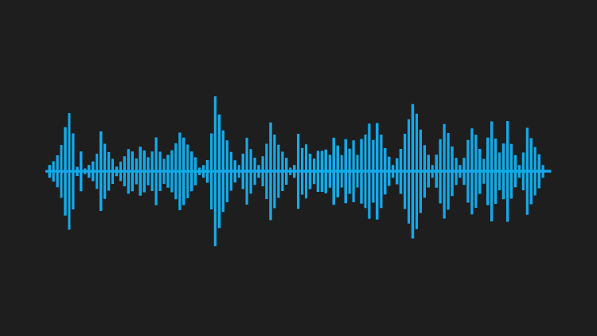
Client sends an HTTPS POST request
Client
Server
Application
Application
Presentation
Presentation
Session
Session
Transport
Segment
Transport
Network
Packet
Network
Data Link
Frame
Data Link
Physical
Physical

Slide 14
Client
Server
SPORT
DPORT
SPORT
DPORT
SIP
DIP
SIP
DIP
SMAC
DMAC
SMAC
DMAC

Slide 15
Across networks
Client
Server
Application
Application
Presentation
Presentation
Session
Session
Transport
Router
Transport
Network
Switch
Network
Network
Data Link
Data Link
Data Link
Data Link
Physical
Physical
Physical
Physical

Slide 16
Across networks
Layer 7 Load Balancer/CDN
Client
Backend Server
Application
Application
Application
Presentation
Presentation
Presentation
Layer 4 Proxy, Firewall
Session
Session
Session
Transport
Transport
Transport
Transport
Network
Network
Network
Network
Data Link
Data Link
Data Link
Data Link
Physical
Physical
Physical
Physical

Slide 17
The shortcomings of the OSI Model
husseinnasser
OSI Model has too many layers which can be hard to comprehend
Hard to argue about which layer does what
Simpler to deal with Layers 5-6-7 as just one layer, application
TCP/IP Model does just that

Slide 18
TCP/IP Model
husseinnasser
Much simpler than OSI just 4 layers
Application (Layer 5, 6 and 7)
Transport (Layer 4)
Internet (Layer 3)
Data link (Layer 2)
Physical layer is not officially covered in the model

Slide 19
OSI Model Summary
husseinnasser
Why do we need a communication model?
What is the OSI Model?
Example
Each device in the network doesn’t have to map the entire 7 layers
TCP/IP is simpler model

Slide 20
Host to Host communication
husseinnasser
A
B
How messages are sent between hosts

Slide 21
Host to Host communication
husseinnasser
I need to send a message from host A to host B
Usually a request to do something on host B (RPC)
Each host network card has a unique Media Access Control address (MAC)
E.g. 00:00:5e:00:53:af
A
B
00:00:5e:00:53:aa
00:00:3a:12:31:0b

Slide 22
Host to Host communication
husseinnasser
A sends a message to B specifying the MAC address
Everyone in the network will “get” the message but only B will accept it
B
A
C
D

Slide 23
Host to Host communication
husseinnasser
Imagine millions of machines?
We need a way to eliminate the need to send it to everyone
The address needs to get better
We need routability, meet the IP Address

Slide 24
Host to Host communication
husseinnasser
The IP Address is built in two parts
One part to identify the network, the other is the host
We use the network portion to eliminate many networks
The host part is used to find the host
Still needs MAC addresses!

Slide 25
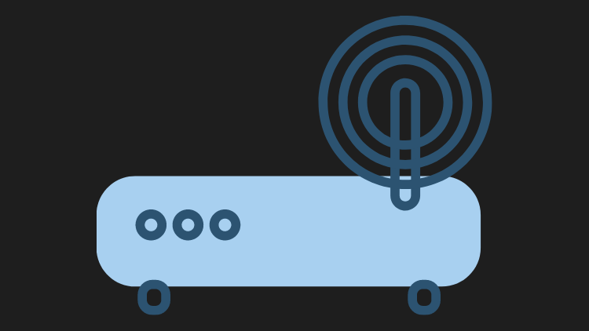
Host A on network N1 wants to talk to Host B on network N2
A
A
B
B
C
C
N1
N2

Slide 26
Host 192.168.1.3 wants to talk to 192.168.2.2
192.168.1.3
192.168.2.3
192.168.1.2
192.168.2.2
192.168.1.1
192.168.2.1
192.168.1.0/24
192.168.2.0/24

Slide 27
But my host have many apps!
husseinnasser
It's not enough just to address the host
The host is runnings many apps each with different requirements
Meet ports
You can send an HTTP request on port 80, a DNS request on port 53 and an SSH request on port 22 all running on the same server!

Slide 28
Host to Host communication - Summary
husseinnasser
Host needs addresses
MAC Addresses are great but not scalable in the Internet
Internet Protocol Address solves this by routing
Layer 4 ports help create finer addressability to the process level

Slide 29
The IP building blocks
husseinnasser
1.2.3.4
Understanding the IP Protocol

Slide 30
IP Address
husseinnasser
Layer 3 property
Can be set automatically or statically
Network and Host portion
4 bytes in IPv4 - 32 bits

Slide 31
Network vs Host
husseinnasser
a.b.c.d/x (a.b.c.d are integers) x is the network bits and remains are host
Example 192.168.254.0/24
The first 24 bits (3 bytes) are network the rest 8 are for host
This means we can have 2^24 (16777216) networks and each network has 2^8 (255) hosts
Also called a subnet

Slide 32
Subnet Mask
husseinnasser
192.168.254.0/24 is also called a subnet
The subnet has a mask 255.255.255.0
Subnet mask is used to determine whether an IP is in the same subnet

Slide 33
Default Gateway
husseinnasser
Most networks consists of hosts and a Default Gateway
Host A can talk to B directly if both are in the same subnet
Otherwise A sends it to someone who might know, the gateway
The Gateway has an IP Address and each host should know its gateway

Slide 34
E.g. Host 192.168.1.3 wants to talk to 192.168.1.2
192.168.1.3 applies subnet mask to itself and the destination IP 192.168.1.2
255.255.255.0 & 192.168.1.3 = 192.168.1.0
255.255.255.0 & 192.168.1.2 = 192.168.1.0
Same subnet ! no need to route
192.168.1.3
192.168.2.3
192.168.1.2
192.168.2.2
192.168.1.1
192.168.2.1
192.168.1.0/24
192.168.2.0/24

Slide 35
E.g. Host 192.168.1.3 wants to talk to 192.168.2.2
192.168.1.3 applies subnet mask to itself and the destination IP 192.168.2.2
255.255.255.0 & 192.168.1.3 = 192.168.1.0
255.255.255.0 & 192.168.2.2 = 192.168.2.0
Not the subnet ! The packet is sent to the Default Gateway 192.168.1.100
192.168.2.100
192.168.1.3
192.168.2.3
192.168.1.2
192.168.1.100
192.168.2.2
192.168.1.1
192.168.2.1
192.168.1.0/24
192.168.2.0/24

Slide 36
Summary
husseinnasser
IP Address
Network vs Host
Subnet and subnet mask
Default Gateway

Slide 37
The IP Packet
husseinnasser
Anatomy of the IP Packet

Slide 38
IP Packet
husseinnasser
The IP Packet has headers and data sections
IP Packet header is 20 bytes (can go up to 60 bytes if options are enabled)
Data section can go up to 65536

Slide 39
IP Packet to the Backend Engineer
husseinnasser
Source IP Address
Data
Destination IP Address

Slide 40
Actual IP Packet
husseinnasser
Offsets | Octet | 0 |  |  |  |  |  |  |  | 1 |  |  |  |  |  |  |  | 2 |  |  |  |  |  |  |  | 3
Octet | Bit | 0 | 1 | 2 | 3 | 4 | 5 | 6 | 7 | 8 | 9 | 10 | 11 | 12 | 13 | 14 | 15 | 16 | 17 | 18 | 19 | 20 | 21 | 22 | 23 | 24 | 25 | 26 | 27 | 28 | 29 | 30 | 31
0 | 0 | Version |  |  |  | IHL |  |  |  | DSCP |  |  |  |  |  | ECN |  | Total Length
4 | 32 | Identification |  |  |  |  |  |  |  |  |  |  |  |  |  |  |  | Flags |  |  | Fragment Offset
8 | 64 | Time To Live |  |  |  |  |  |  |  | Protocol |  |  |  |  |  |  |  | Header Checksum
12 | 96 | Source IP Address
16 | 128 | Destination IP Address
20 | 160 | Options (if IHL > 5)
⋮ | ⋮
56 | 448
Data
https://datatracker.ietf.org/doc/html/rfc791 https://en.wikipedia.org/wiki/IPv4

Slide 41
Version - The Protocol version
husseinnasser
Offsets | Octet | 0 |  |  |  |  |  |  |  | 1 |  |  |  |  |  |  |  | 2 |  |  |  |  |  |  |  | 3
Octet | Bit | 0 | 1 | 2 | 3 | 4 | 5 | 6 | 7 | 8 | 9 | 10 | 11 | 12 | 13 | 14 | 15 | 16 | 17 | 18 | 19 | 20 | 21 | 22 | 23 | 24 | 25 | 26 | 27 | 28 | 29 | 30 | 31
0 | 0 | Version |  |  |  | IHL |  |  |  | DSCP |  |  |  |  |  | ECN |  | Total Length
4 | 32 | Identification |  |  |  |  |  |  |  |  |  |  |  |  |  |  |  | Flags |  |  | Fragment Offset
8 | 64 | Time To Live |  |  |  |  |  |  |  | Protocol |  |  |  |  |  |  |  | Header Checksum
12 | 96 | Source IP Address
16 | 128 | Destination IP Address
20 | 160 | Options (if IHL > 5)
⋮ | ⋮
56 | 448
Data

Slide 42
Internet Header Length - Defines the Options length
husseinnasser
Offsets | Octet | 0 |  |  |  |  |  |  |  | 1 |  |  |  |  |  |  |  | 2 |  |  |  |  |  |  |  | 3
Octet | Bit | 0 | 1 | 2 | 3 | 4 | 5 | 6 | 7 | 8 | 9 | 10 | 11 | 12 | 13 | 14 | 15 | 16 | 17 | 18 | 19 | 20 | 21 | 22 | 23 | 24 | 25 | 26 | 27 | 28 | 29 | 30 | 31
0 | 0 | Version |  |  |  | IHL |  |  |  | DSCP |  |  |  |  |  | ECN |  | Total Length
4 | 32 | Identification |  |  |  |  |  |  |  |  |  |  |  |  |  |  |  | Flags |  |  | Fragment Offset
8 | 64 | Time To Live |  |  |  |  |  |  |  | Protocol |  |  |  |  |  |  |  | Header Checksum
12 | 96 | Source IP Address
16 | 128 | Destination IP Address
20 | 160 | Options (if IHL > 5)
⋮ | ⋮
56 | 448
Data

Slide 43
Total Length - 16 bit Data + header
husseinnasser
Offsets | Octet | 0 |  |  |  |  |  |  |  | 1 |  |  |  |  |  |  |  | 2 |  |  |  |  |  |  |  | 3
Octet | Bit | 0 | 1 | 2 | 3 | 4 | 5 | 6 | 7 | 8 | 9 | 10 | 11 | 12 | 13 | 14 | 15 | 16 | 17 | 18 | 19 | 20 | 21 | 22 | 23 | 24 | 25 | 26 | 27 | 28 | 29 | 30 | 31
0 | 0 | Version |  |  |  | IHL |  |  |  | DSCP |  |  |  |  |  | ECN |  | Total Length
4 | 32 | Identification |  |  |  |  |  |  |  |  |  |  |  |  |  |  |  | Flags |  |  | Fragment Offset
8 | 64 | Time To Live |  |  |  |  |  |  |  | Protocol |  |  |  |  |  |  |  | Header Checksum
12 | 96 | Source IP Address
16 | 128 | Destination IP Address
20 | 160 | Options (if IHL > 5)
⋮ | ⋮
56 | 448
Data

Slide 44
Fragmentation - Jumbo packets
husseinnasser
Offsets | Octet | 0 |  |  |  |  |  |  |  | 1 |  |  |  |  |  |  |  | 2 |  |  |  |  |  |  |  | 3
Octet | Bit | 0 | 1 | 2 | 3 | 4 | 5 | 6 | 7 | 8 | 9 | 10 | 11 | 12 | 13 | 14 | 15 | 16 | 17 | 18 | 19 | 20 | 21 | 22 | 23 | 24 | 25 | 26 | 27 | 28 | 29 | 30 | 31
0 | 0 | Version |  |  |  | IHL |  |  |  | DSCP |  |  |  |  |  | ECN |  | Total Length
4 | 32 | Identification |  |  |  |  |  |  |  |  |  |  |  |  |  |  |  | Flags |  |  | Fragment Offset
8 | 64 | Time To Live |  |  |  |  |  |  |  | Protocol |  |  |  |  |  |  |  | Header Checksum
12 | 96 | Source IP Address
16 | 128 | Destination IP Address
20 | 160 | Options (if IHL > 5)
⋮ | ⋮
56 | 448
Data

Slide 45
Time To Live - How many hops can this packet survive?
husseinnasser
Offsets | Octet | 0 |  |  |  |  |  |  |  | 1 |  |  |  |  |  |  |  | 2 |  |  |  |  |  |  |  | 3
Octet | Bit | 0 | 1 | 2 | 3 | 4 | 5 | 6 | 7 | 8 | 9 | 10 | 11 | 12 | 13 | 14 | 15 | 16 | 17 | 18 | 19 | 20 | 21 | 22 | 23 | 24 | 25 | 26 | 27 | 28 | 29 | 30 | 31
0 | 0 | Version |  |  |  | IHL |  |  |  | DSCP |  |  |  |  |  | ECN |  | Total Length
4 | 32 | Identification |  |  |  |  |  |  |  |  |  |  |  |  |  |  |  | Flags |  |  | Fragment Offset
8 | 64 | Time To Live |  |  |  |  |  |  |  | Protocol |  |  |  |  |  |  |  | Header Checksum
12 | 96 | Source IP Address
16 | 128 | Destination IP Address
20 | 160 | Options (if IHL > 5)
⋮ | ⋮
56 | 448
Data

Slide 46
Protocol - What protocol is inside the data section?
husseinnasser
Offsets | Octet | 0 |  |  |  |  |  |  |  | 1 |  |  |  |  |  |  |  | 2 |  |  |  |  |  |  |  | 3
Octet | Bit | 0 | 1 | 2 | 3 | 4 | 5 | 6 | 7 | 8 | 9 | 10 | 11 | 12 | 13 | 14 | 15 | 16 | 17 | 18 | 19 | 20 | 21 | 22 | 23 | 24 | 25 | 26 | 27 | 28 | 29 | 30 | 31
0 | 0 | Version |  |  |  | IHL |  |  |  | DSCP |  |  |  |  |  | ECN |  | Total Length
4 | 32 | Identification |  |  |  |  |  |  |  |  |  |  |  |  |  |  |  | Flags |  |  | Fragment Offset
8 | 64 | Time To Live |  |  |  |  |  |  |  | Protocol |  |  |  |  |  |  |  | Header Checksum
12 | 96 | Source IP Address
16 | 128 | Destination IP Address
20 | 160 | Options (if IHL > 5)
⋮ | ⋮
56 | 448
Data

Slide 47
Source and Destination IP
husseinnasser
Offsets | Octet | 0 |  |  |  |  |  |  |  | 1 |  |  |  |  |  |  |  | 2 |  |  |  |  |  |  |  | 3
Octet | Bit | 0 | 1 | 2 | 3 | 4 | 5 | 6 | 7 | 8 | 9 | 10 | 11 | 12 | 13 | 14 | 15 | 16 | 17 | 18 | 19 | 20 | 21 | 22 | 23 | 24 | 25 | 26 | 27 | 28 | 29 | 30 | 31
0 | 0 | Version |  |  |  | IHL |  |  |  | DSCP |  |  |  |  |  | ECN |  | Total Length
4 | 32 | Identification |  |  |  |  |  |  |  |  |  |  |  |  |  |  |  | Flags |  |  | Fragment Offset
8 | 64 | Time To Live |  |  |  |  |  |  |  | Protocol |  |  |  |  |  |  |  | Header Checksum
12 | 96 | Source IP Address
16 | 128 | Destination IP Address
20 | 160 | Options (if IHL > 5)
⋮ | ⋮
56 | 448
Data

Slide 48
Explicit Congestion Notification
husseinnasser
Offsets | Octet | 0 |  |  |  |  |  |  |  | 1 |  |  |  |  |  |  |  | 2 |  |  |  |  |  |  |  | 3
Octet | Bit | 0 | 1 | 2 | 3 | 4 | 5 | 6 | 7 | 8 | 9 | 10 | 11 | 12 | 13 | 14 | 15 | 16 | 17 | 18 | 19 | 20 | 21 | 22 | 23 | 24 | 25 | 26 | 27 | 28 | 29 | 30 | 31
0 | 0 | Version |  |  |  | IHL |  |  |  | DSCP |  |  |  |  |  | ECN |  | Total Length
4 | 32 | Identification |  |  |  |  |  |  |  |  |  |  |  |  |  |  |  | Flags |  |  | Fragment Offset
8 | 64 | Time To Live |  |  |  |  |  |  |  | Protocol |  |  |  |  |  |  |  | Header Checksum
12 | 96 | Source IP Address
16 | 128 | Destination IP Address
20 | 160 | Options (if IHL > 5)
⋮ | ⋮
56 | 448
Data
Notes:
ECN is an IP and TCP option, if the router experienced congestion,dont’ drop the packet instead set this bit so the TCP layer can half the congestion window and slow down.

Slide 49
Summary
husseinnasser
The IP Packet has headers and data sections
IP Packet header is 20 bytes (can go up to 60 bytes if options are enabled)
Data section can go up to 65536
Packets need to get fragmented if it doesn’t fit in a frame

Slide 50
ICMP
husseinnasser
Internet Control Message Protocol

Slide 51
ICMP
husseinnasser
Stands for Internet Control Message Protocol
Designed for informational messages
Host unreachable, port unreachable, fragmentation needed
Packet expired (infinite loop in routers)
Uses IP directly
PING and traceroute use it
Doesn’t require listeners or ports to be opened

Slide 52
ICMP header
husseinnasser
Offsets | Octet | 0 |  |  |  |  |  |  |  | 1 |  |  |  |  |  |  |  | 2 |  |  |  |  |  |  |  | 3
Octet | Bit | 0 | 1 | 2 | 3 | 4 | 5 | 6 | 7 | 8 | 9 | 10 | 11 | 12 | 13 | 14 | 15 | 16 | 17 | 18 | 19 | 20 | 21 | 22 | 23 | 24 | 25 | 26 | 27 | 28 | 29 | 30 | 31
0 | 0 | Type |  |  |  |  |  |  |  | Code |  |  |  |  |  |  |  | Checksum
4 | 32 | Rest of header
https://en.wikipedia.org/wiki/Internet_Control_Message_Protocol
https://datatracker.ietf.org/doc/html/rfc792

Slide 53
ICMP
husseinnasser
Some firewalls block ICMP for security reasons
That is why PING might not work in those cases
Disabling ICMP also can cause real damage with connection establishment
Fragmentation needed
PING demo

Slide 54
Ping
husseinnasser
192.168.10.100
192.168.5.100
192.168.10.3
192.168.1.3
192.168.10.3
192.168.1.3
192.168.1.100
TTL96 ICMP echo request
192.168.10.3
192.168.1.3
TTL100 ICMP echo request
192.168.1.3
192.168.10.3
TTL100 ICMP echo reply
192.168.1.3
192.168.10.3
TTL96 ICMP echo reply
192.168.3.100

Slide 55
Ping - unreachable
husseinnasser
192.168.10.100
192.168.5.100
192.168.10.3
192.168.10.3
192.168.1.3
TTL0 ICMP echo request
192.168.1.3
192.168.5.100
192.168.1.3
TTL100 ICMP dest unreachable
192.168.1.100
192.168.10.3
192.168.1.3
TTL3 ICMP echo request
192.168.1.3
192.168.5.100
TTL96 ICMP echo reply
192.168.3.100

Slide 56
TraceRoute
husseinnasser
Can you identify the entire path your IP Packet takes?
Clever use of TTL
Increment TTL slowly and you will get the router IP address for each hop
Doesn’t always work as path changes and ICMP might be blocked

Slide 57
Traceroute
husseinnasser
192.168.10.100
192.168.5.100
192.168.10.3
192.168.1.3
192.168.1.100
192.168.10.3
192.168.1.3
TTL1 ICMP echo request
192.168.1.3
192.168.1.100
ICMP dest unreach.
192.168.10.3
192.168.1.3
TTL2 ICMP echo request
192.168.1.3
192.168.3.100
192.168.3.100
ICMP dest unreach.
192.168.10.3
192.168.1.3
TTL3 ICMP echo request
192.168.1.3
192.168.5.100
ICMP dest unreach.
192.168.10.3
192.168.1.3
TTL4 ICMP echo request
192.168.1.3
192.168.10.100
ICMP dest unreach
192.168.10.3
192.168.1.3
TTL5 ICMP echo request
192.168.1.3
192.168.10.3
ICMP Echo reply

Slide 58
Summary
husseinnasser
ICMP is an IP level protocol used for information messages
Critical to know if the host is available or port is opened
Used for PING and TraceRoute
Can be blocked which can cause problems

Slide 59
ARP
husseinnasser
Address Resolution Protocol

Slide 60
Why ARP?
We need the MAC address to send frames (layer 2)
Most of the time we know the IP address but not the MAC
ARP Table is cached IP->Mac mapping

Slide 61
Network Frame
aa:bc:32:7f:c0:07
10.0.0.2
2312
GET /
8080
10.0.0.3
bb:ab:dd:11:22:33
aa
2
GET /
3
bb
IP : 10.0.0.2
MAC: aa:bc:32:7f:c0:07
IP : 10.0.0.3
MAC: bb:ab:dd:11:22:33
Port: 8080

Slide 62
IP 10.0.0.2 (2) wants to connect to IP 10.0.0.5 (5)
Host 2 checks if host 5 is within its subnet, it is.
Host 2 needs the MAC address of host 5
Host 2 checks its ARP tables and its not there
EXIP : 122.1.2.4
IP : 10.0.0.1 (1)
MAC: ff
aa
2
GET /
5
??
ip | mc
2 | aa
ip | mc
3 | bb
ip | mc
4 | cc
ip | mc
5 | dd
IP : 2
GW : 1
MAC: aa
IP : 3
GW : 1
MAC: bb
IP : 4
GW : 1
MAC: cc
IP : 5
GW : 1
MAC: dd

Slide 63
Host 2 sends an ARP request broadcast to all machines in its network
Who has IP address 10.0.0.5?
Host 5 replies with dd
Host 2 updates its ARP Table
EXIP : 122.1.2.4
IP : 10.0.0.1 (1)
MAC: ff
aa
2
GET /
5
dd
ip | mc
2 | aa
5 | dd
ip | mc
3 | bb
ip | mc
4 | cc
ip | mc
5 | dd
IP : 2
GW : 1
MAC: aa
IP : 3
GW : 1
MAC: bb
IP : 4
GW : 1
MAC: cc
IP : 5
GW : 1
MAC: dd

Slide 64
IP 10.0.0.2 (2) wants to connect to IP 1.2.3.4 (x)
Host 2 checks if 1.2.3.4 is within its subnet, it is NOT!
Host 2 needs to talk to its gatway
Host 2 needs the MAC address of the gateway
EXIP : 122.1.2.4
IP : 10.0.0.1 (1)
MAC: ff
1.2.3.4 (x)
aa
2
GET /
x
??
ip | mc
2 | aa
5 | dd
ip | mc
3 | bb
ip | mc
4 | cc
ip | mc
5 | dd
IP : 2
GW : 1
MAC: aa
IP : 3
GW : 1
MAC: bb
IP : 4
GW : 1
MAC: cc
IP : 5
GW : 1
MAC: dd

Slide 65
Host 2 checks its local ARP table, 10.0.0.1 is not it in
Host 2 sends an ARP request to everybody in the network
Who has 10.0.0.1? (A DANGEROUS QUESTION)
Gateway reply with ff
NAT than kicks in.
EXIP : 122.1.2.4
IP : 10.0.0.1 (1)
MAC: ff
1.2.3.4
aa
2
GET /
x
ff
ip | mc
2 | aa
5 | dd
1 | ff
ip | mc
3 | bb
ip | mc
4 | cc
ip | mc
5 | dd
IP : 2
GW : 1
MAC: aa
IP : 3
GW : 1
MAC: bb
IP : 4
GW : 1
MAC: cc
IP : 5
GW : 1
MAC: dd

Slide 66
Summary
husseinnasser
ARP stands for Address resolution protocol
We need MAC address to send frames between machines
Almost always we have the IP address but not the MAC
Need a lookup protocol that give us the MAC from IP address
Attacks can be performed on ARP (ARP poisoning)

Slide 67
Routing Example
husseinnasser
How IP Packets are routed in Switches and Routers

Slide 68
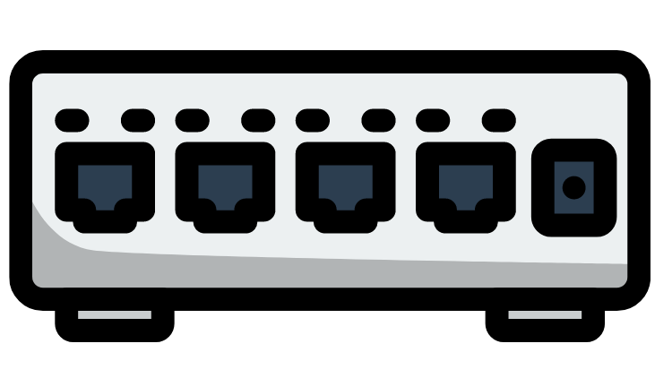
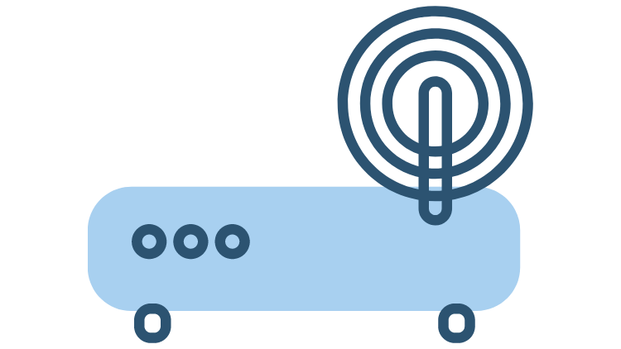

A
B
Switch (S)
10.0.0.2
10.0.0.4
C
Router (R)
10.0.0.5
D
X
10.0.0.100
10.0.0.3
192.168.1.1
A -> B
D -> X
B -> G
192.168.1.2
1.2.3.4
Internet
8.8.8.8 (G)

Slide 69
UDP
husseinnasser
User Datagram Protocol

Slide 70
UDP
husseinnasser
Stands for User Datagram Protocol
Layer 4 protocol
Ability to address processes in a host using ports
Simple protocol to send and receive data
Prior communication not required (double edge sword)
Stateless no knowledge is stored on the host
8 byte header Datagram

Slide 71
UDP Use cases
husseinnasser
Video streaming
VPN
DNS
WebRTC
A
B

Slide 72
Multiplexing and demultiplexing
husseinnasser
IP target hosts only
Hosts run many apps each with different requirements
Ports now identify the “app” or “process”
Sender multiplexes all its apps into UDP
Receiver demultiplex UDP datagrams to each app
App1-port 5555
App2-port 7712
App3-port 2222
AppX-port 53
AppY-port 68
AppZ-port 6978
10.0.0.1
10.0.0.2

Slide 73
Source and Destination Port
husseinnasser
App1 on 10.0.0.1 sends data to AppX on 10.0.0.2
Destination Port = 53
AppX responds back to App1
We need Source Port so we know how to send back data
Source Port = 5555
10.0.0.1
5555
53
10.0.0.2
App1-port 5555
App2-port 7712
App3-port 2222
AppX-port 53
AppY-port 68
AppZ-port 6978
10.0.0.1
10.0.0.2
53
5555
10.0.0.1
10.0.0.2

Slide 74
Summary
husseinnasser
UDP is a simple layer 4 protocol
Uses ports to address processes
Stateless

Slide 75
UDP Datagram
husseinnasser
The anatomy of the UDP datagram

Slide 76
UDP Datagram
husseinnasser
UDP Header is 8 bytes only (IPv4)
Datagram slides into an IP packet as “data”
Port are 16 bit (0 to 65535)

Slide 77
UDP Datagram header
husseinnasser
Offsets | Octet | 0 |  |  |  |  |  |  |  | 1 |  |  |  |  |  |  |  | 2 |  |  |  |  |  |  |  | 3
Octet | Bit | 0 | 1 | 2 | 3 | 4 | 5 | 6 | 7 | 8 | 9 | 10 | 11 | 12 | 13 | 14 | 15 | 16 | 17 | 18 | 19 | 20 | 21 | 22 | 23 | 24 | 25 | 26 | 27 | 28 | 29 | 30 | 31
0 | 0 | Source port |  |  |  |  |  |  |  |  |  |  |  |  |  |  |  | Destination port
4 | 32 | Length |  |  |  |  |  |  |  |  |  |  |  |  |  |  |  | Checksum
Data
https://www.ietf.org/rfc/rfc768.txt
https://en.wikipedia.org/wiki/User_Datagram_Protocol

Slide 78
Source Port and Destination Port
husseinnasser
Offsets | Octet | 0 |  |  |  |  |  |  |  | 1 |  |  |  |  |  |  |  | 2 |  |  |  |  |  |  |  | 3
Octet | Bit | 0 | 1 | 2 | 3 | 4 | 5 | 6 | 7 | 8 | 9 | 10 | 11 | 12 | 13 | 14 | 15 | 16 | 17 | 18 | 19 | 20 | 21 | 22 | 23 | 24 | 25 | 26 | 27 | 28 | 29 | 30 | 31
0 | 0 | Source port |  |  |  |  |  |  |  |  |  |  |  |  |  |  |  | Destination port
4 | 32 | Length |  |  |  |  |  |  |  |  |  |  |  |  |  |  |  | Checksum
Data

Slide 79
Length & Checksum
husseinnasser
Offsets | Octet | 0 |  |  |  |  |  |  |  | 1 |  |  |  |  |  |  |  | 2 |  |  |  |  |  |  |  | 3
Octet | Bit | 0 | 1 | 2 | 3 | 4 | 5 | 6 | 7 | 8 | 9 | 10 | 11 | 12 | 13 | 14 | 15 | 16 | 17 | 18 | 19 | 20 | 21 | 22 | 23 | 24 | 25 | 26 | 27 | 28 | 29 | 30 | 31
0 | 0 | Source port |  |  |  |  |  |  |  |  |  |  |  |  |  |  |  | Destination port
4 | 32 | Length |  |  |  |  |  |  |  |  |  |  |  |  |  |  |  | Checksum
Data

Slide 80
UDP Pros and Cons
husseinnasser
The power and drawbacks of UDP

Slide 81
UDP Pros
husseinnasser
Simple protocol
Header size is small so datagrams are small
Uses less bandwidth
Stateless
Consumes less memory (no state stored in the server/client)
Low latency - no handshake , order, retransmission or guaranteed delivery

Slide 82
UDP Cons
husseinnasser
No acknowledgement
No guarantee delivery
Connection-less - anyone can send data without prior knowledge
No flow control
No congestion control
No ordered packets
Security - can be easily spoofed

Slide 83
TCP
husseinnasser
Transmission Control Protocol

Slide 84
TCP
husseinnasser
Stands for Transmission Control Protocol
Layer 4 protocol
Ability to address processes in a host using ports
“Controls” the transmission unlike UDP which is a firehose
Connection
Requires handshake
20 bytes headers Segment (can go to 60)
Stateful

Slide 85
TCP Use cases
husseinnasser
Reliable communication
Remote shell
Database connections
Web communications
Any bidirectional communication
A
B

Slide 86
TCP Connection
husseinnasser
Connection is a Layer 5 (session)
Connection is an agreement between client and server
Must create a connection to send data
Connection is identified by 4 properties
SourceIP-SourcePort
DestinationIP-DestinationPort

Slide 87
TCP Connection
husseinnasser
Can’t send data outside of a connection
Sometimes called socket or file descriptor
Requires a 3-way TCP handshake
Segments are sequenced and ordered
Segments are acknowledged
Lost segments are retransmitted

Slide 88
Multiplexing and demultiplexing
husseinnasser
IP target hosts only
Hosts run many apps each with different requirements
Ports now identify the “app” or “process”
Sender multiplexes all its apps into TCP connections
Receiver demultiplex TCP segments to each app based on connection pairs
App1-port 5555
App2-port 7712
App3-port 2222
AppX-port 53
AppY-port 68
AppZ-port 6978
10.0.0.1
10.0.0.2

Slide 89
Connection Establishment
husseinnasser
App1 on 10.0.0.1 want to send data to AppX on 10.0.0.2
App1 sends SYN to AppX to synchronous sequence numbers
AppX sends SYN/ACK to synchronous its sequence number
App1 ACKs AppX SYN.
Three way handshake
10.0.0.1
5555
SYN
22
10.0.0.2
AppX-port 22
AppY-port 443
AppZ-port 80
App1-port 5555
App2-port 7712
App3-port 2222
10.0.0.2
22
SYN/ACK
5555
10.0.0.1
10.0.0.1
10.0.0.2
10.0.0.1:5555:10.0.0.2:22
10.0.0.1:5555:10.0.0.2:22
10.0.0.1
5555
ACK
22
10.0.0.2
File descriptor
File descriptor

Slide 90
Sending data
husseinnasser
App1 sends data to AppX
App1 encapsulate the data in a segment and send it
AppX acknowledges the segment
Hint: Can App1 send new segment before ack of old segment arrives?
10.0.0.1
5555
ls
22
10.0.0.2
AppX-port 22
AppY-port 443
AppZ-port 80
App1-port 5555
App2-port 7712
App3-port 2222
10.0.0.2
22
ACK
5555
10.0.0.1
10.0.0.1
10.0.0.2
10.0.0.1:5555:10.0.0.2:22
10.0.0.1:5555:10.0.0.2:22
File descriptor
File descriptor

Slide 91
Acknowledgment
husseinnasser
App1 sends segment 1,2 and 3 to AppX
AppX acknowledge all of them with a single ACK 3
10.0.0.1
5555
seq1
22
10.0.0.2
AppX-port 22
AppY-port 443
AppZ-port 80
App1-port 5555
App2-port 7712
App3-port 2222
10.0.0.1
5555
seq2
22
10.0.0.2
10.0.0.1
10.0.0.1
5555
seq3
22
10.0.0.2
10.0.0.1:5555:10.0.0.2:22
10.0.0.2
10.0.0.1:5555:10.0.0.2:22
File descriptor
File descriptor
10.0.0.2
22
ACK3
5555
10.0.0.1

Slide 92
Lost data
husseinnasser
App1 sends segment 1,2 and 3 to AppX
Seg 3 is lost, AppX acknowledge 3
App1 resend Seq 3
10.0.0.1
5555
seq1
22
10.0.0.2
AppX-port 22
AppY-port 443
AppZ-port 80
App1-port 5555
App2-port 7712
App3-port 2222
10.0.0.1
5555
seq2
22
10.0.0.2
10.0.0.1
10.0.0.1
5555
seq3
22
10.0.0.2
10.0.0.1:5555:10.0.0.2:22
10.0.0.2
10.0.0.1:5555:10.0.0.2:22
10.0.0.2
22
ACK2
5555
10.0.0.1
File descriptor
File descriptor
10.0.0.1
5555
seq3
22
10.0.0.2
10.0.0.2
22
ACK3
5555
10.0.0.1

Slide 93
Closing Connection
husseinnasser
App1 wants to close the connection
App1 sends FIN, AppX ACK
AppX sends FIN, App1 ACK
Four way handshake
10.0.0.1
5555
FIN
22
10.0.0.2
AppX-port 22
AppY-port 443
AppZ-port 80
App1-port 5555
App2-port 7712
App3-port 2222
10.0.0.2
22
ACK
5555
10.0.0.1
10.0.0.1
10.0.0.2
10.0.0.1:5555:10.0.0.2:22
10.0.0.1:5555:10.0.0.2:22
10.0.0.2
22
FIN
5555
10.0.0.1
File descriptor
File descriptor
10.0.0.1
5555
ACK
22
10.0.0.2

Slide 94
Summary
husseinnasser
Stands for Transmission Control Protocol
Layer 4 protocol
“Controls” the transmission unlike UDP which is a firehose
Introduces Connection concept
Retransmission, acknowledgement, guaranteed delivery
Stateful, connection has a state

Slide 95
TCP Segment
husseinnasser
The anatomy of the TCP Segment

Slide 96
TCP Segment
husseinnasser
TCP segment Header is 20 bytes and can go up to 60 bytes
TCP segments slides into an IP packet as “data”
Port are 16 bit (0 to 65535)
Sequences, Acknowledgment, flow control and more

Slide 97
TCP Segment
husseinnasser
Offsets | Octet | 0 |  |  |  |  |  |  |  | 1 |  |  |  |  |  |  |  | 2 |  |  |  |  |  |  |  | 3
Octet | Bit | 7 | 6 | 5 | 4 | 3 | 2 | 1 | 0 | 7 | 6 | 5 | 4 | 3 | 2 | 1 | 0 | 7 | 6 | 5 | 4 | 3 | 2 | 1 | 0 | 7 | 6 | 5 | 4 | 3 | 2 | 1 | 0
0 | 0 | Source port |  |  |  |  |  |  |  |  |  |  |  |  |  |  |  | Destination port
4 | 32 | Sequence number
8 | 64 | Acknowledgment number (if ACK set)
12 | 96 | Data offset |  |  |  | Reserved 0 0 0 |  |  | NS | CWR | ECE | URG | ACK | PSH | RST | SYN | FIN | Window Size
16 | 128 | Checksum |  |  |  |  |  |  |  |  |  |  |  |  |  |  |  | Urgent pointer (if URG set)
20 | 160 | Options (if data offset > 5. Padded at the end with "0" bits if necessary.)
⋮ | ⋮
60 | 480
https://en.wikipedia.org/wiki/Transmission_Control_Protocol
https://datatracker.ietf.org/doc/html/rfc793

Slide 98
Ports
husseinnasser
Offsets | Octet | 0 |  |  |  |  |  |  |  | 1 |  |  |  |  |  |  |  | 2 |  |  |  |  |  |  |  | 3
Octet | Bit | 7 | 6 | 5 | 4 | 3 | 2 | 1 | 0 | 7 | 6 | 5 | 4 | 3 | 2 | 1 | 0 | 7 | 6 | 5 | 4 | 3 | 2 | 1 | 0 | 7 | 6 | 5 | 4 | 3 | 2 | 1 | 0
0 | 0 | Source port |  |  |  |  |  |  |  |  |  |  |  |  |  |  |  | Destination port
4 | 32 | Sequence number
8 | 64 | Acknowledgment number (if ACK set)
12 | 96 | Data offset |  |  |  | Reserved 0 0 0 |  |  | NS | CWR | ECE | URG | ACK | PSH | RST | SYN | FIN | Window Size
16 | 128 | Checksum |  |  |  |  |  |  |  |  |  |  |  |  |  |  |  | Urgent pointer (if URG set)
20 | 160 | Options (if data offset > 5. Padded at the end with "0" bits if necessary.)
⋮ | ⋮
60 | 480

Slide 99
Sequences and ACKs
husseinnasser
Offsets | Octet | 0 |  |  |  |  |  |  |  | 1 |  |  |  |  |  |  |  | 2 |  |  |  |  |  |  |  | 3
Octet | Bit | 7 | 6 | 5 | 4 | 3 | 2 | 1 | 0 | 7 | 6 | 5 | 4 | 3 | 2 | 1 | 0 | 7 | 6 | 5 | 4 | 3 | 2 | 1 | 0 | 7 | 6 | 5 | 4 | 3 | 2 | 1 | 0
0 | 0 | Source port |  |  |  |  |  |  |  |  |  |  |  |  |  |  |  | Destination port
4 | 32 | Sequence number
8 | 64 | Acknowledgment number (if ACK set)
12 | 96 | Data offset |  |  |  | Reserved 0 0 0 |  |  | NS | CWR | ECE | URG | ACK | PSH | RST | SYN | FIN | Window Size
16 | 128 | Checksum |  |  |  |  |  |  |  |  |  |  |  |  |  |  |  | Urgent pointer (if URG set)
20 | 160 | Options (if data offset > 5. Padded at the end with "0" bits if necessary.)
⋮ | ⋮
60 | 480

Slide 100
Flow Control Window Size
husseinnasser
Offsets | Octet | 0 |  |  |  |  |  |  |  | 1 |  |  |  |  |  |  |  | 2 |  |  |  |  |  |  |  | 3
Octet | Bit | 7 | 6 | 5 | 4 | 3 | 2 | 1 | 0 | 7 | 6 | 5 | 4 | 3 | 2 | 1 | 0 | 7 | 6 | 5 | 4 | 3 | 2 | 1 | 0 | 7 | 6 | 5 | 4 | 3 | 2 | 1 | 0
0 | 0 | Source port |  |  |  |  |  |  |  |  |  |  |  |  |  |  |  | Destination port
4 | 32 | Sequence number
8 | 64 | Acknowledgment number (if ACK set)
12 | 96 | Data offset |  |  |  | Reserved 0 0 0 |  |  | NS | CWR | ECE | URG | ACK | PSH | RST | SYN | FIN | Window Size
16 | 128 | Checksum |  |  |  |  |  |  |  |  |  |  |  |  |  |  |  | Urgent pointer (if URG set)
20 | 160 | Options (if data offset > 5. Padded at the end with "0" bits if necessary.)
⋮ | ⋮
60 | 480

Slide 101
9 bit flags
husseinnasser
Offsets | Octet | 0 |  |  |  |  |  |  |  | 1 |  |  |  |  |  |  |  | 2 |  |  |  |  |  |  |  | 3
Octet | Bit | 7 | 6 | 5 | 4 | 3 | 2 | 1 | 0 | 7 | 6 | 5 | 4 | 3 | 2 | 1 | 0 | 7 | 6 | 5 | 4 | 3 | 2 | 1 | 0 | 7 | 6 | 5 | 4 | 3 | 2 | 1 | 0
0 | 0 | Source port |  |  |  |  |  |  |  |  |  |  |  |  |  |  |  | Destination port
4 | 32 | Sequence number
8 | 64 | Acknowledgment number (if ACK set)
12 | 96 | Data offset |  |  |  | Reserved 0 0 0 |  |  | NS | CWR | ECE | URG | ACK | PSH | RST | SYN | F I N | Window Size
16 | 128 | Checksum |  |  |  |  |  |  |  |  |  |  |  |  |  |  |  | Urgent pointer (if URG set)
20 | 160 | Options (if data offset > 5. Padded at the end with "0" bits if necessary.)
⋮ | ⋮
60 | 480

Slide 102
Maximum Segment Size
husseinnasser
Segment Size depends the MTU of the network
Usually 512 bytes can go up to 1460
Default MTU in the Internet is 1500 (results in MSS 1460)
Jumbo frames MTU goes to 9000 or more
MSS can be larger in jumbo frames cases

Slide 103
Flow Control
husseinnasser
How much the receiver can handle?

Slide 104
Flow Control
husseinnasser
A want to send 10 segments to B
A sends segment 1 to B
B acknowledges segment 1
A sends segment 2 to B
B acknowledges segment 2
VERY SLOW!
SEG 1
A
ACK 1
B
SEG 2
ACK 2
SEG 3
ACK 3

Slide 105
Flow Control
husseinnasser
A can send multiple segments and B can acknowledge all in 1 ACK
The question is … how much A can send?
This is called flow control
SEG 1
SEG 2
SEG 3
A
ACK 3
B

Slide 106
Flow Control
husseinnasser
When TCP segments arrive they are put in receiver’s buffer
If we kept sending data the receiver will be overwhelmed
Segments will be dropped
Solution? Let the sender know how much you can handle
A
B

Slide 107
Flow Control Window Size (Receiver Window)
husseinnasser
Offsets | Octet | 0 |  |  |  |  |  |  |  | 1 |  |  |  |  |  |  |  | 2 |  |  |  |  |  |  |  | 3
Octet | Bit | 7 | 6 | 5 | 4 | 3 | 2 | 1 | 0 | 7 | 6 | 5 | 4 | 3 | 2 | 1 | 0 | 7 | 6 | 5 | 4 | 3 | 2 | 1 | 0 | 7 | 6 | 5 | 4 | 3 | 2 | 1 | 0
0 | 0 | Source port |  |  |  |  |  |  |  |  |  |  |  |  |  |  |  | Destination port
4 | 32 | Sequence number
8 | 64 | Acknowledgment number (if ACK set)
12 | 96 | Data offset |  |  |  | Reserved 0 0 0 |  |  | NS | CWR | ECE | URG | ACK | PSH | RST | SYN | FIN | Window Size
16 | 128 | Checksum |  |  |  |  |  |  |  |  |  |  |  |  |  |  |  | Urgent pointer (if URG set)
20 | 160 | Options (if data offset > 5. Padded at the end with "0" bits if necessary.)
⋮ | ⋮
60 | 480

Slide 108
Window Size (Receiver Window) RWND
husseinnasser
16 bit - Up to 64KB
Updated with each acknowledgment
Tells the sender how much to send before waiting for ACK
Receiver can decide to decrease the Window Size (out of memory) more important stuff
RWND
A
1
B
Window size 3 segments (bytes)
ACK1
2
3
4
ACK4
5
6
7
ACK7

Slide 109
Sliding Window
husseinnasser
Can’t keep waiting for receiver to acknowledge all segments
Whatever gets acknowledge moves
We “slide” the window
Sender maintains the sliding window for the receiver
A
B
1
2
3
4
5
6
1
2
3
1
2
3
Can be dropped
1
2
3
4
5
6
ACK2
3
1
2
3
4
5
6
4
5
4
5
3
1
2
3
4
5
6
ACK3
4
5
1
2
3
4
5
6
6
4
5
6

Slide 110
Window Scaling
husseinnasser
B
64 KB is too small
We can’t increase the bits on the segment
Meet Window Scaling factor (0-14)
Window Size can go up to 1GB ((2^16-1) x 2^14)
Only exchanged during the handshake
1
2
3

Slide 111
Summary
husseinnasser
Receiver host has a limit
We need to let the sender know how much it can send
Receiver Window is in the segment
Sender maintains the Sliding Window to know how much it can send
Window Scaling can increase that

Slide 112
Congestion Control
husseinnasser
How much the network can handle?

Slide 113
Congestion Control
husseinnasser
The receiver might handle the load but the middle boxes might not
The routers in the middle have limit
We don’t want to congest the network with data
We need to avoid congestion
A new window: Congestion Window (CWND)
A
B

Slide 114
Two Congestion algorithms
husseinnasser
TCP Slow Start
Start slow goes fast!
CWND + 1 MSS after each ACK
Congestion Avoidance
Once Slow start reaches its threshold this kicks in
CWND + 1 MSS after complete RTT
CWND must not exceeds RWND
A
B
RWND
How large can this get?

Slide 115
Slow Start
husseinnasser
CWND starts with 1 MSS (or more)
Send 1 Segment and waits for ACK
With EACH ACK received CWND is incremented by 1 MSS
Until we reach slow start threshold (ssthresh) we switch to congestion avoidance algorithm
A
B
1
2
3
4
5
6
7
1
1
CWND + 1
1
2
3
4
5
6
7
ACK1
1
2
3
4
5
6
7
2
3
2
3
CWND + 2
7
ACK2
ACK3
1
2
3
4
5
6
1
2
3
4
5
6
7
4
5
6
7
4
5
6
7

Slide 116
Congestion Avoidance
husseinnasser
Send CWND worth of Segments and waits for ACK
Only when ALL segments are ACKed add UP to one MSS to CWND
Precisely CWND = CWND + MSS*MSS/CWND
A
B
1
2
3
4
5
6
7
1
1
CWND + 1
1
2
3
4
5
6
7
ACK1
1
2
3
4
5
6
7
2
3
2
3
CWND + 1
7
ACK2
ACK3
1
2
3
4
5
6
1
2
3
4
5
6
7
4
5
6
4
5
6

Slide 117
Congestion Detection
husseinnasser
The moment we get timeouts, dup ACKs or packet drops
The slow start threshold reduced to the half of whatever unacknowledged data is sent (roughly CWND/2 if all CWND worth of data is unacknowledged)
The CWND is reset to 1 and we start over.
Min slow start threshold is 2*MSS
A
B
1
2
3
4
5
6
7
1
2
3
4
1
CWND
1
1
2
3
4
5
6
7

Slide 118
Congestion Notification
husseinnasser
We don’t want routers dropping packets
Can Routers let us know when congestion hit?
Meet ECN (Explicit Congestion Notification)
Routers and middle boxes can tag IP packets with ECN
The receiver will copy this bit back to the sender
ECN is IP Header bit
So Routers don’t drop packets just let me know you are reaching your limit

Slide 119
Summary
husseinnasser
While the receiver may handle large data middle boxes might not
Middle routers buffers may fill up
Need to control the congestion in the network
Sender can send segments up to CWND or RWND without ACK
Isn’t normally a problem in hosts connected directly (LAN)

Slide 120
Congestion Detection
husseinnasser
Slow Start vs Congestion Avoidance

Slide 121
Two Congestion algorithms
husseinnasser
TCP Slow Start
Start slow goes fast!
CWND + 1 MSS after each ACK
Congestion Avoidance
Once Slow start reaches its threshold this kicks in
CWND + 1 MSS after complete RTT
CWND must not exceeds RWND
A
B
RWND
How large can this get?

Slide 122
Congestion Detection
husseinnasser
The moment we get timeouts, dup ACKs or packet drops
The slow start threshold reduced to the half of whatever unacknowledged data is sent (roughly CWND/2 if all CWND worth of data is unacknowledged)
The CWND is reset to 1 and we start over.
Min slow start threshold is 2*MSS
A
B
1
2
3
4
5
6
7
1
2
3
4
1
CWND
1
1
2
3
4
5
6
7

Slide 123
Slow start vs Congestion Avoidance
CWND
bytes
Congestion triggered
Slow start ends
2*SMSS
(can’t go lower)
1SMSS
Slow Start
Congestion Avoidance
RFC 5681 Page 7
Time
husseinnasser
Slow Start threshold

Slide 124
Network Address Translation
husseinnasser
How the WAN sees your internal devices

Slide 125
NAT
husseinnasser
IPv4 is limited only 4 billion
Private vs Public IP Address
E.g. 192.168.x.x , 10.0.0.x is private not routable in the Internet
Internal hosts can be assigned private addresses
Only your router need public IP address
Router need to translate requests

Slide 126

Local Network
192.168.1.1
DDD
192.168.1.2
AAA
192.168.1.4
CCC
8080

Slide 127
Request
192.168.1.1
DDD
192.168.1.2
AAA
8992
192.168.1.2
GET/
192.168.1.4
8080
192.168.1.4
CCC
8080

Slide 128
Response
192.168.1.1
DDD
192.168.1.2
AAA
8080
192.168.1.4
JSON
192.168.1.2
8992
192.168.1.4
CCC
8080

Slide 129
NAT
192.168.1.1
DDD
(Private)
44.11.5.17
DDD
(Public)
192.168.1.2
AAA
55.11.22.33
FFF
8080

Slide 130
Request
192.168.1.1
DDD
(Private)
44.11.5.17
DDD
(Public)
192.168.1.2
AAA
8992
192.168.1.2
GET/
55.11.22.33
8080
55.11.22.33
FFF
8080

Slide 131
Router NAT
NAT Table
192.168.1.1
DDD
(Private)
44.11.5.17
DDD
(Public)
8992
192.168.1.2
7777
44.11.5.17
GET/
55.11.22.33
8080
192.168.1.2:8892 | 44.11.5.17:7777 | 55.11.22.33:8080
192.168.1.2
AAA
55.11.22.33
FFF
8080

Slide 132
Request
192.168.1.1
DDD
(Private)
44.11.5.17
DDD
(Public)
192.168.1.2
AAA
7777
44.11.5.17
GET/
55.11.22.33
8080
55.11.22.33
FFF
8080

Slide 133
Response
192.168.1.1
DDD
(Private)
44.11.5.17
DDD
(Public)
192.168.1.2
AAA
8080
55.11.22.33
JSON
44.11.5.17
7777
55.11.22.33
FFF
8080

Slide 134
Router NAT
NAT Table
192.168.1.1
DDD
(Private)
44.11.5.17
DDD
(Public)
8080
55.11.22.33
JSON
192.168.1.2
8992
44.11.5.17
7777
192.168.1.2:8892 | 44.11.5.17:7777 | 55.11.22.33:8080
192.168.1.2
AAA
55.11.22.33
FFF
8080

Slide 135
Response
192.168.1.1
DDD
(Private)
44.11.5.17
DDD
(Public)
192.168.1.2
AAA
8080
55.11.22.33
JSON
192.168.1.2
8992
55.11.22.33
FFF
8080

Slide 136
NAT Applications
husseinnasser
Private to Public translations
So we don't run out IPv4
Port forwarding
Add a NAT entry in the router to forward packets to 80 to a machine in your LAN
No need to have root access to listen on port 80 on your device
Expose your local web server publically
Layer 4 Load Balancing
HAProxy NAT Mode - Your load balancer is your gateway
Clients send a request to a bogus service IP
Router intercepts that packet and replaces the service IP with a destination server
Layer 4 reverse proxying

Slide 137
Summary
husseinnasser
IPv4 is limited only 4 billion
Need to translate private to public
Port forward/load balancing

Slide 138
TCP Connection States
husseinnasser
Stateful protocol must have states

Slide 139
TCP Connection States
husseinnasser
TCP is a stateful protocol
Both client and server need to maintain all sorts of state
Window sizes, sequences and the state of the connection
The connection goes through many states

Slide 140
ESTABLISHED
ESTABLISHED
FIN_WAIT_1
FIN
CLOSE_WAIT
ACK
LAST_ACK
FIN_WAIT_2
FIN
TIME_WAIT
ACK
….
4 minutes (2MSL)
CLOSED
CLOSED
husseinnasser

Slide 141
TCP Pros and Cons
husseinnasser
The power and drawbacks of TCP

Slide 142
TCP Pros
husseinnasser
Guarantee delivery
No one can send data without prior knowledge
Flow Control and Congestion Control
Ordered Packets no corruption or app level work
Secure and can’t be easily spoofed

Slide 143
TCP Cons
husseinnasser
Large header overhead compared to UDP
More bandwidth
Stateful - consumes memory on server and client
Considered high latency for certain workloads (Slow start/ congestion/ acks)
Does too much at a low level (hence QUIC)
Single connection to send multiple streams of data (HTTP requests)
Stream 1 has nothing to do with Stream 2
Both Stream 1 and Stream 2 packets must arrive
TCP Meltdown
Not a good candidate for VPN

Slide 144
Overview of Popular Networking Protocols

Slide 145
DNS
husseinnasser
Domain Name System

Slide 146
Why DNS
www.husseinnasser.com
husseinnasser
People can’t remember IPs
A domain is a text points to an IP or a collection of IPs
Additional layer of abstraction is good
IP can change while the domain remain
We can serve the closest IP to a client requesting the same domain
Load balancing

Slide 147
DNS
husseinnasser
A new addressing system means we need a mapping. Meet DNS
If you have an IP and you need the MAC, we use ARP
If you have the name and you need the IP, we use DNS
Built on top of UDP
Port 53
Many records (MX, TXT, A, CNAME)
Google.com
(142.251.40.46)

Slide 148
How DNS works
husseinnasser
DNS resolver - frontend and cache
ROOT Server - Hosts IPs of TLDs
Top level domain server - Hosts IPs of the ANS
Authoritative Name server - Hosts the IP of the target server
ANS
TLD
server
Resolver
ROOT

Slide 149
How DNS works
husseinnasser
What is the IP of google.com (6)
Its 142.251.40.46 (7)
ANS1
What is the IP of google.com (1)
Where is the Authoritative name server of google.com (4)
Its 142.251.40.46 (8)
Here it is ANS1 (5)
TCP handshake (9)
Resolver
TLD1
Where is the .COM servers (2)
Here is a TLD server TLD1 (3)
Google.com
(142.251.40.46)
ROOT

Slide 150
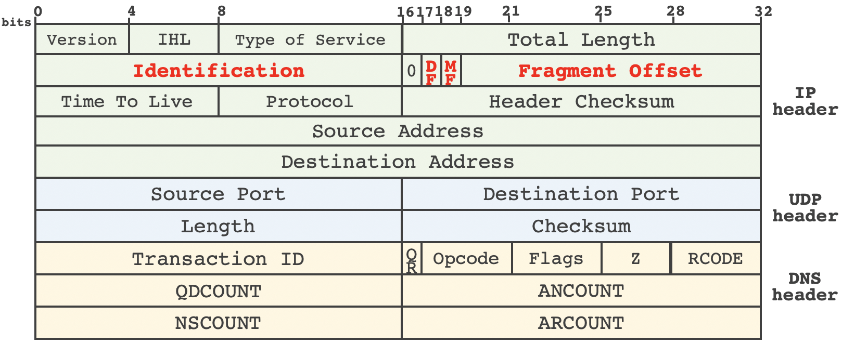
DNS Packet
Source: https://www.usenix.org/system/files/sec20-zheng.pdf
RFC: https://datatracker.ietf.org/doc/html/rfc1035

Slide 151
Notes about DNS
husseinnasser
Why so many layers?
DNS is not encrypted by default.
Many attacks against DNS (DNS hijacking/DNS poisoning)
DoT / DoH attempts to address this

Slide 152
Example
husseinnasser
Let us use nslookup to look up some DNS

Slide 153
TLS
husseinnasser
Transport Layer Security

Slide 154
TLS
Vanilla HTTP
HTTPS
TLS 1.2 Handshake
Diffie Hellman
TLS 1.3 Improvements

Slide 155
HTTP
open
close
80
GET /
Headers+ index.html
<html>...
….

Slide 156


HTTPS
open
close
443
Handshake
GET /
Headers+ index.html
<html>...
….

Slide 157
Why TLS
We encrypt with symmetric key algorithms
We need to exchange the symmetric key
Key exchange uses asymmetric key (PKI)
Authenticate the server
Extensions (SNI, preshared, 0RTT)

Slide 158


TLS1.2
open
close
RSA Public key
RSA Private key
Client hello
Server hello (cert)
Change cipher, fin
Change cipher, fin
GET /
Headers+ index.html
<html>...
….

Slide 159

Diffie Hellman
Private x
+
=
Public g,n
Symmetric key
+
Private y

Slide 160
Diffie Hellman
Public/
Unbreakable
/can be shared
g^x % n
+
Public/
Unbreakable
/can be shared
g^y % n
+
(g^x % n)^y = g^xy % n
(g^y % n)^x = g^xy % n

Slide 161
TLS1.3
open
close
client hello / key /fin
server hello/ change cipher/ fin
GET /
Headers+ index.html
<html>...
….
(g^x % n)^y = g^xy % n
(g^y % n)^x = g^xy % n

Slide 162
TLS Summary
Vanilla HTTP
HTTPS
TLS 1.2 Handshake (two round trips)
Diffie Hellman
TLS 1.3 Improvements (one round trip can be zero)

Slide 163
HTTP
husseinnasser
Hypertext Transfer Protocol

Slide 164
SSH
husseinnasser
Secure Shell

Slide 165
Networking Concepts for Effective Backend Applications

Slide 166
MSS/MTU and Path MTU
husseinnasser
How large the packet can get

Slide 167
Overview
husseinnasser
TCP layer 4 unit is segment
The segment slides into an IP Packet in layer 3
The IP Packet now has the segment + headers
The IP Packet slides into a layer 2 frame
The frame has a fixed size based on the networking configuration.
The size of the frame determines the size of the segment

Slide 168
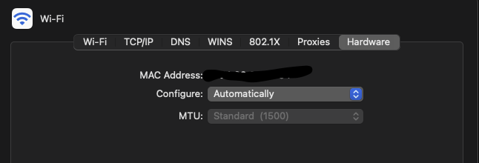
Hardware MTU
husseinnasser
Maximum Transmission Unit (MTU) is the size of the frame
It is a network interface property default 1500
Some networks have jumbo frames up to 9000 bytes
Are there are networks with larger MTUs?

Slide 169
IP Packets and MTU
husseinnasser
The IP MTU usually equals the Hardware MTU
One IP packet “should” fit a single frame
Unless IP fragmentation is in place
Larger IP Packets will be fragmented into multiple frames

Slide 170
MSS
husseinnasser
Maximum Segment size is determined based on MTU
Segment must fit in an IP packet which “should” fit in a frame
MSS = MTU - IP Headers - TCP Headers
MSS = 1500 - 20 - 20 = 1460
If you are sending 1460 bytes exactly that will fit nicely into a single MSS
Which fits in a single frame

Slide 171
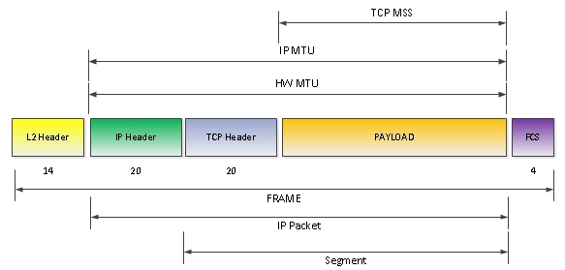
husseinnasser
Credit Cisco
https://learningnetwork.cisco.com/s/question/0D53i00000Kt7CXCAZ/mtu-vs-pdu

Slide 172
Path MTU Discovery (PMTUD)
MTU : 1500
MTU : 1500
MTU : 9000
MTU : 512
husseinnasser
MTU is network interface property each host can have different value
You really need to use the smallest MTU in the network
Path MTU help determine the MTU in the network path
Client sends a IP packet with its MTU with a DF flag
The host that their MTU is smaller will have to fragment but can’t
The host sends back an ICMP message fragmentation needed which will lower the MTU

Slide 173
Summary
husseinnasser
MTU is the maximum transmission unit on the device
MSS is the maximum segment size at layer 4
If you can fit more data into a single segment you lower latency
It lowers overhead from headers and processing
Path MTU can discover the network lowest MTU with ICMP
Flow control/congestion control still allows sending multiple segments without ack

Slide 174
Nagle's algorithm
husseinnasser
Delay in the client side

Slide 175
Nigel Algorithm
husseinnasser
In the telnet days sending a single byte in a segment is a waste
Combine small segments and send them in a single one
The client can wait for a full MSS before sending the segment
No wasted 40 bytes header (IP + TCP) for few bytes of data

Slide 176
Nagle's algorithm
Delay
husseinnasser
Assume MSS = 1460, A sends 500 bytes
500 < 1460 client waits to fill the segment
A sends 960 bytes, segment fills and send
If there isn’t anything to ACK data will be immediately sent
A
B
2
500
2
1460
1460

Slide 177
Problem with Nagle's algorithm
Delay
husseinnasser
Sending large data causes delay
A want to send 5000 bytes on 1460 MSS
3 full segments of 1460 with 620 bytes
4th segment is not sent!
4th not full segment are only sent when an ACK is received
A
1460
1460
1460
B
2
620
ACK
2
620

Slide 178
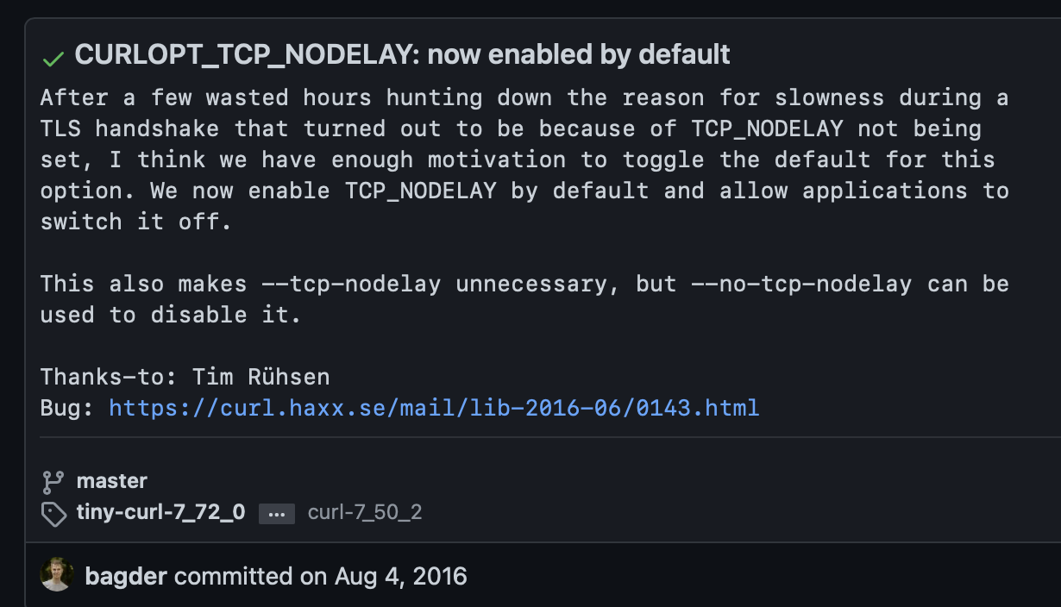
Disabling Nagle's algorithm
husseinnasser
Most clients today disable Nagle's algorithm
I rather get performance than small bandwidth
TCP_NODELAY
Curl disabled this back in 2016 by default because TLS handshake was slowed down
https://github.com/curl/curl/commit/4732ca5724072f132876f520c8f02c7c5b654d9

Slide 179
Delayed Acknowledgement
husseinnasser
Less packets are good but performance is better

Slide 180
Delayed Acknowledgment algorithm
Delay
ACK all at once
husseinnasser
Waste to acknowledge segments right away
We can wait little more to receive more segment and ack once
2
1
B
A
4
3
5
ACK 5

Slide 181
Problem with delayed ACK
Delay
Delay
400 ms in some cases
husseinnasser
Causes delays in some clients that may lead to timeout and retransmission
Noticeable performance degradation
Combined with Nagle's algorithm can lead to 400ms delays!
Each party is waiting on each other
A
1460
1460
1460
B
2
620
ACK
2
620

Slide 182
Disabling Delayed acknowledgement algorithm
husseinnasser
Disable delayed ack algorithm can be done with TCP_QUICKACK option
Segments will be acknowledged “quicker”

Slide 183
The Cost of Connections
husseinnasser
Understanding the cost of connections

Slide 184
Connection establishment is costly
husseinnasser
TCP three way handshake
The further apart the peers, the slower it is to send segments
Slow start keeps the connection from reaching its potential right away
Congestion control and flow control limit that further
Delayed and Nigel algorithm can further slow down
Destroying the connection is also expensive

Slide 185
Connection Pooling
husseinnasser
Most implementation database backends and reverse proxies use pooling
Establish a bunch of TCP connection to the backend and keep them running!
Any request that comes to the backend use an already opened connection
This way your connections will be “warm” and slow start would have already kicked in
Don’t close the connection unless you absolutely don’t need it

Slide 186
Eager vs Lazy Loading
husseinnasser
Depending on what paradigm you take you can save on resources
Eager loading -> Load everything and keep it ready
Start up is slow but requests will be served immediately
Some apps send warm up data to kick in the slow start but be careful of bandwidth and scalability
Lazy Loading -> only load things on demand
Start up is fast but requests will suffer initially

Slide 187
TCP Fast Open
husseinnasser
Wait I can send data during the handshake?

Slide 188
Handshake is Slow
husseinnasser
We know it, the handshake is slow
I already know the server I have established a connection prior
Can we use a predetermined token to send data immediately during the handshake?
Meet TCP Fast open

Slide 189
TCP Fast Open (TFO)
husseinnasser
Client and Server establishes connection 1, server sends an encrypted cookie
Client stores the TFO cookie.
Client want to create another connection
Client sends SYN, data and TFO cookie in TCP options
Server authenticate the cookie and sends response + SYN/ACK
SYN+TFO+Data
SYN/ACK+Response
ACK

Slide 190
TCP Fast Open (TFO)
husseinnasser
TFO is enabled by default in linux 3.13 >
You can enable TFO in curl --tcp-fastopen
Goes without saying, you still get TCP Slow start with TCP Fast open
You can take advantage of this feature to send early data

Slide 191
Listening Server
husseinnasser
Understanding what to listen on

Slide 192
Listening
husseinnasser
You create a server by listening on a port on a specific ip address
Your machine might have multiple interfaces with multiple IP address
listen(127.0.0.1, 8080) -> listens on the local host ipv4 interface on port 8080
listen(::1, 8080) -> listens on localhost ipv6 interface on port 8080
listen(192.168.1.2, 8080) -> listens on 192.168.1.2 on port 8080
listen(0.0.0.0, 8080) -> listens on all interfaces on port 8080 (can be dangerous)

Slide 193
Listening
husseinnasser
You can only have one process in a host listening on IP/Port
No two processes can listen on the same port
P1->Listen(127.0.0.1,8080)
P2->Listen(127.0.0.1,8080) error

Slide 194
There is always an exception
husseinnasser
There is a configuration that allows more than one process to listen on the same port
SO_PORTREUSE
Operating systems balance segments among processes
OS creates a hash source ip/source port/dest ip/ dest port
Guarantees always go to the same process if the pair match
Goes to AppX
10.0.0.1
5555
8080
10.0.0.2
App1-port 5555
App2-port 7712
AppX-port 8080
AppY-port 8080
Goes to AppY
10.0.0.1
7712
8080
10.0.0.2
10.0.0.1
10.0.0.2

Slide 195
TCP HOL
husseinnasser
Head of line blocking

Slide 196
TCP head of line blocking
husseinnasser
TCP orders packets in the order they are sent
The segments are not acknowledged or delivered to the app until they are in order
This is great! But what if multiple clients are using the same connection
1
2
3
4
2
3
4
1
2
3
4
1
2
3
4

Slide 197
TCP head of line blocking
Request 1
Request 2
Blocked! As one segment is missing
husseinnasser
HTTP requests may use the same connection to send multiple requests
Request 1 is segments 1,2
Request 2 is segments 3,4
Segments 2,3,4 arrive but 1 is lost?
Request 2 technically was delivered but TCP is blocking it
Huge latency in apps, big problem in HTTP/2 with streams
QUIC solves this
1
2
3
4
2
3
4

Slide 198
Layer 4 vs Layer 7
Load balancers
A fundamental component of backend networking

Slide 199
Agenda
Layer 4 vs Layer 7
Load Balancer
Layer 4 Load Balancer (pros and cons)
Layer 7 Load Balancer (pros and cons)

Slide 200
Layer 7 Application
Application
Layer 6 Presentation
Presentation
Layer 5 Session
Session
Layer 4 Transport
Transport
Layer 3 Network
Network
Layer 2 Data Link
Data Link
Layer 1 Physical
Physical

Slide 201
Load Balancer (aka fault tolerant)
Backend server 1
Load Balancer
Backend server 2

Slide 202
Layer 4 Load Balancer
TCP Connection
SYN
SYN/ACK
ACK
Backend server 1
44.1.1.3
TCP Connection
SYN
SYN/ACK
ACK
44.1.1.1
L4 Load Balancer
44.1.1.2
Backend server 2
44.1.1.4

Slide 203
Layer 4 Load Balancer
Backend server 1
44.1.1.3
TCP Connection
SYN
SYN/ACK
ACK
44.1.1.1
L4 Load Balancer
44.1.1.2
When a client connects to the L4 load balancer, the LB chooses one server and all segments for that connections go to that server
Backend server 2
44.1.1.4

Slide 204
Layer 4 Load Balancer
44.1.1.3
Data
44.1.1.2
Backend server 1
44.1.1.3
44.1.1.1
Data
44.1.1.2
44.1.1.1
L4 Load Balancer
44.1.1.2
Backend server 2
44.1.1.4

Slide 205
Layer 4 Load Balancer
44.1.1.2
RES
44.1.1.3
Backend server 1
44.1.1.3
44.1.1.2
RES
44.1.1.1
44.1.1.1
L4 Load Balancer
44.1.1.2
Backend server 2
44.1.1.4

Slide 206
Layer 4 Load Balancer
3
2
1
Backend server 1
44.1.1.3
HTTP GET /1
1
2
3
44.1.1.1
L4 Load Balancer
44.1.1.2
Backend server 2
44.1.1.4

Slide 207
Layer 4 Load Balancer
7
6
5
Backend server 1
44.1.1.3
HTTP GET /2
5
6
7
44.1.1.1
L4 Load Balancer
44.1.1.2
Backend server 2
44.1.1.4

Slide 208
Layer 4 Load Balancer
Backend server 1
44.1.1.3
44.1.1.1
1
2
1
2
3
L4 Load Balancer
44.1.1.2
3
(New connection)
HTTP GET /3
Backend server 2
44.1.1.4

Slide 209
Layer 4 Load Balancer (Pros and Cons)
Pros
Cons
Simpler load balancing
Efficient (no data lookup)
More secure
Works with any protocol
One TCP connection (NAT)
No smart load balancing
NA microservices
Sticky per connection
No caching
Protocol unaware (can be dangerous) bypass rules

Slide 210
Layer 7 Load Balancer
TCP Connection
SYN
SYN/ACK
ACK
Backend server 1
44.1.1.3
TCP Connection
SYN
SYN/ACK
ACK
44.1.1.1
L7 Load Balancer
44.1.1.2
Backend server 2
44.1.1.4

Slide 211
Layer 7 Load Balancer
Backend server 1
44.1.1.3
TCP Connection
SYN
SYN/ACK
ACK
44.1.1.1
L7 Load Balancer
44.1.1.2
When a client connects to the L7 load balancer, it becomes protocol specific. Any logical “request” will be forwarded to a new backend server. This could be one or more segments
Backend server 2
44.1.1.4

Slide 212
Layer 7 Load Balancer
44.1.1.3
Data
44.1.1.2
Backend server 1
44.1.1.3
44.1.1.1
Data
44.1.1.2
44.1.1.1
L7 Load Balancer
44.1.1.2
Backend server 2
44.1.1.4

Slide 213
Layer 7 Load Balancer
44.1.1.2
RES
44.1.1.3
Backend server 1
44.1.1.3
44.1.1.2
RES
44.1.1.1
44.1.1.1
L7 Load Balancer
44.1.1.2
Backend server 2
44.1.1.4

Slide 214
Layer 7 Load Balancer
LB parsers and understand the segments
3
2
1
2
3
1
Backend server 1
44.1.1.3
HTTP GET /1
1
2
3
44.1.1.1
L7 Load Balancer
44.1.1.2
Backend server 2
44.1.1.4

Slide 215
Layer 7 Load Balancer
Backend server 1
44.1.1.3
HTTP GET /2
5
6
7
44.1.1.1
5
L7 Load Balancer
44.1.1.2
6
7
Backend server 2
44.1.1.4

Slide 216
Layer 7 Load Balancer
3
2
1
Backend server 1
44.1.1.3
44.1.1.1
1
2
3
L7 Load Balancer
44.1.1.2
(New connection)
HTTP GET /3
Backend server 2
44.1.1.4

Slide 217
Layer 7 Load Balancer (Pros and Cons)
Pros
Cons
Smart load balancing
Caching
Great for microservices
API Gateway logic
Authentication
Expensive (looks at data)
Decrypts (terminates TLS)
Two TCP Connections
Must share TLS certificate
Needs to buffer
Needs to understand protocol

Slide 218
Summary
Layer 4 vs Layer 7
Load Balancer
Layer 4 Load Balancer (pros and cons)
Layer 7 Load Balancer (pros and cons)

