Slide 1
Employee Management Analysis using Java Full Stack
Summer Internship Review | IT3711
Surjith S (810023205031)
B.Tech Information Technology, VII Semester
University College of Engineering (BIT Campus), Anna University, Tiruchirappalli
Company: Besant Technologies, Chennai | 01.06.2026 – 30.06.2026

Slide 2
Company Profile
Besant Technologies – technology training organisation in Velachery, Chennai, Tamil Nadu
Instructor-led training and internship programmes in software development
Offer letter (10 May 2026), internship letter and certificate of attendance issued by Manager – HR
Learning through explanation, demonstration, guided practice and project work
My project: Employee Management Analysis (Java, HTML, CSS, JavaScript, SQL)

Slide 3
Introduction
Full Stack Java combines front end, back end and database in one web application
Front end: HTML, CSS, JavaScript | Back end: Java | Data: SQL
Project manages employee records through CRUD operations
Workflow: Login → Dashboard → Add / View / Search → Update → Delete → Report
Hands-on experience in web development, database handling and testing

Slide 4
Objectives of the Internship
Gain practical knowledge of Full Stack Java development
Learn Java, HTML, CSS, JavaScript and SQL
Design web pages, application logic and data management with CRUD
Understand request-response communication and input validation
Improve problem-solving, teamwork and time management
Bridge the gap between academic learning and industry practice

Slide 5
Motivation
Accuracy
Speed
Control
Validation and constraints stop duplicate and invalid records
Search and retrieve an employee record in seconds
Role-based access for Admin and Viewer users
Manual registers and separate spreadsheets lead to duplicate, inconsistent and slow-to-search employee data.

Slide 6
Existing System – Limitations
Data redundancy – same record stored in many files
Data inconsistency – updates not reflected in every copy
Slow retrieval – many files or pages to search
Human errors – spelling mistakes, wrong dates, missing fields
Poor security – files copied or changed without control
Difficult reporting – department-wise summaries take time
No validation; limited access control

Slide 7
Proposed System
Web-based Employee Management Analysis system built with Java Full Stack
HTML, CSS and JavaScript for an interactive interface; Java for application logic
Relational database with SQL, keys and constraints for data integrity
CRUD: add, view, search, update and delete employee records
Stored details: ID, name, department, designation, email, joining date, status
Department-wise summary report

Slide 8
Technologies Studied
Technology | What was learned
Java | OOP, collections, exception handling, JDBC
HTML | Page structure, forms, tables, input fields
CSS | Colours, fonts, spacing, layout
JavaScript | Client-side validation, events, messages
SQL | CRUD, joins, GROUP BY, constraints
Database | Relational database with SQL support
Tools | Java IDE, code editor, web browser, MS Word

Slide 9
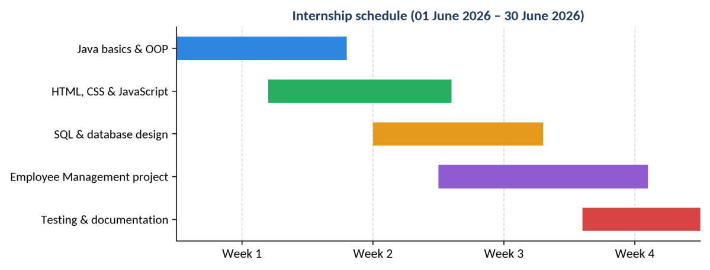
Internship Schedule
Week 1
Week 2
Week 3
Week 4
Java & OOP
HTML, CSS, JS
SQL & CRUD
Project & Testing

Slide 10
System Architecture
Presentation Layer HTML, CSS, JavaScript in the web browser
▼
Application Layer Java servlets / controllers, business logic, DAO classes (JDBC)
▼
Database Layer SQL – employee, department and users tables
Browser sends HTTP requests to Java; Java sends SQL queries to the database; results travel back to the user.

Slide 11
Modules
Authentication
Employee Mgmt
Update
Deletion
Database Mgmt
Login and authentication – only authorised users enter the system
Add, view and search employee records
Edit and save updated employee details
Delete invalid or duplicate records with confirmation
CRUD operations and SQL query execution in the database

Slide 12
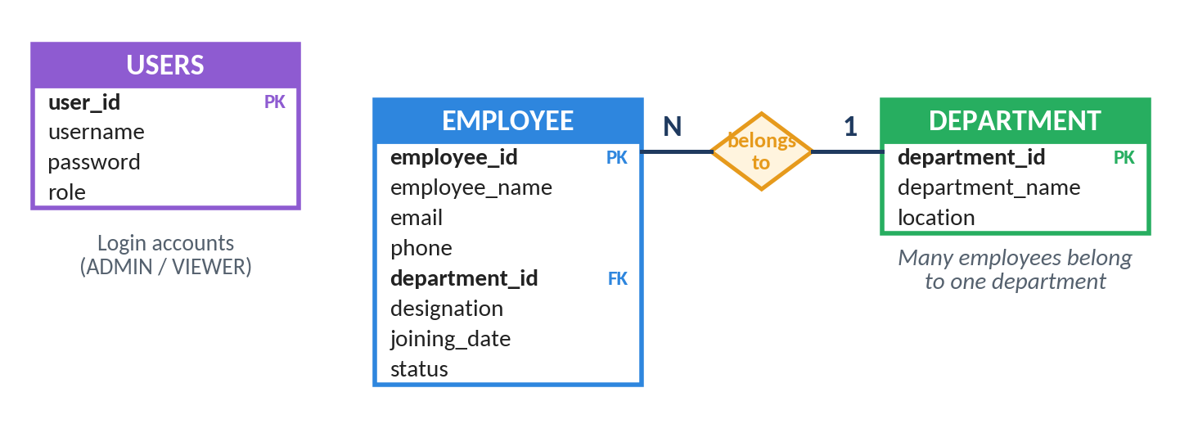
Database Design
Three tables: employee, department and users
employee.department_id is a foreign key – many employees belong to one department

Slide 13
Functional Requirements
No. | Requirement
FR1 | User login with username and password
FR2 | Add employee with all required details
FR3 | View employee list in a table
FR4 | Search by ID, name or department
FR5 | Update existing employee details
FR6 | Delete / deactivate after confirmation
FR7 | Validate mandatory fields, formats, duplicate IDs
FR8 | Department-wise summary report

Slide 14
User Roles & Access
Operation | Admin | Viewer
Login | Yes | Yes
View / search employees | Yes | Yes
Add employee | Yes | No
Update employee | Yes | No
Delete / deactivate | Yes | No
Access is checked in the Java application, not only on the page – hidden buttons can still be called directly.

Slide 15
Code Highlight: Add Employee
String sql = "INSERT INTO employee "
+ "(employee_id, employee_name, email, department) "
+ "VALUES (?, ?, ?, ?)";
try (Connection con = DBConnection.getConnection();
PreparedStatement ps = con.prepareStatement(sql)) {
ps.setInt(1, e.getId());
ps.setString(2, e.getName());
ps.setString(3, e.getEmail());
ps.setString(4, e.getDepartment());
return ps.executeUpdate() > 0;
}
Data-access method: a PreparedStatement binds values as data, protecting the application from SQL injection.

Slide 16
Test Cases
ID | Test Case | Expected Result
TC-01 | Valid login | User reaches the home page
TC-02 | Invalid login | Error message displayed
TC-04 | Empty name | Form rejected with a message
TC-05 | Duplicate employee ID | Duplicate rejected
TC-06 | Email without @ | Validation message shown
TC-07 | Search existing ID | Correct record displayed
TC-09 | Change designation | New designation saved
TC-10 | Delete with confirmation | Record removed from list

Slide 17
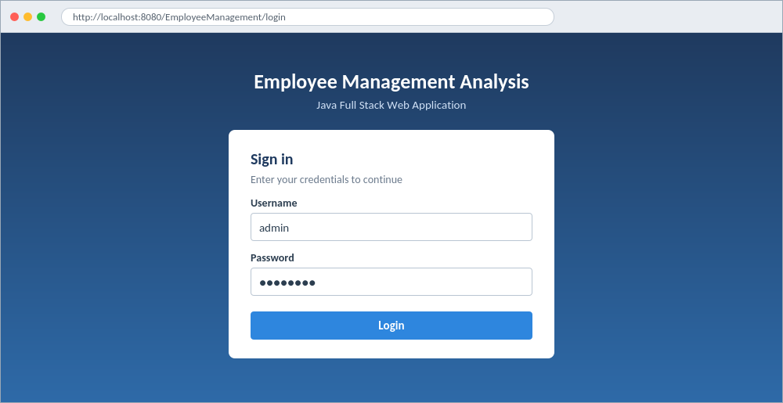
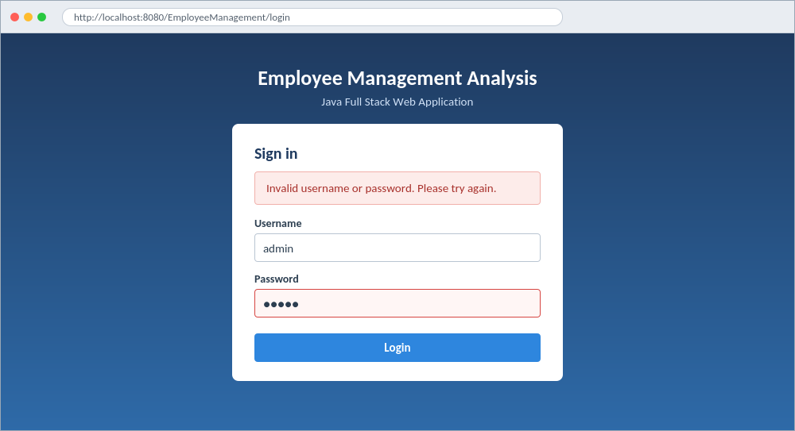
Output: Login & Invalid Login
Login page – password masked
Invalid login – error message, no access

Slide 18
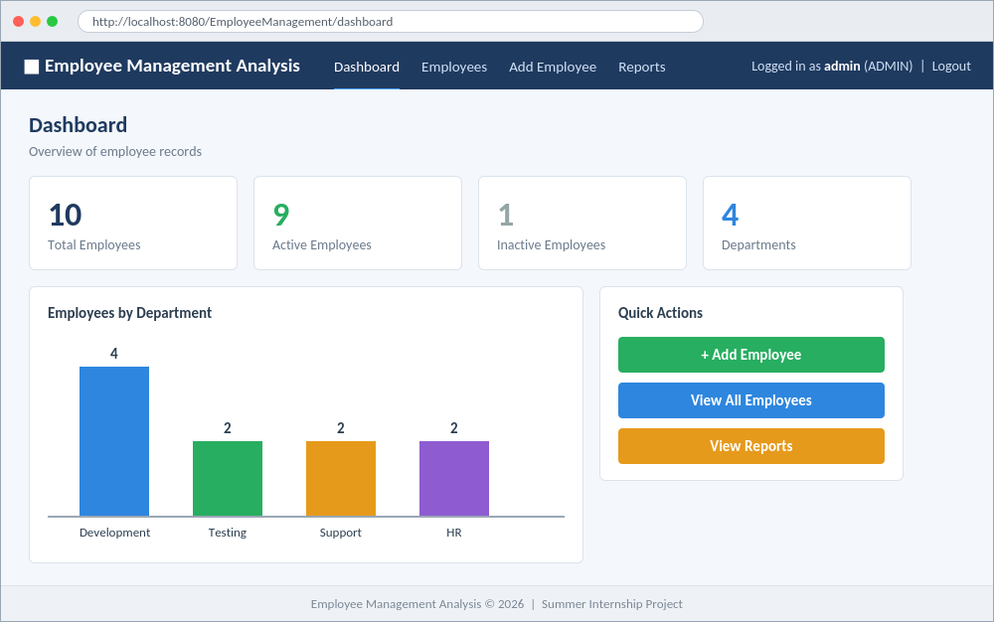
Output: Dashboard
Dashboard – totals, employees by department, quick actions

Slide 19
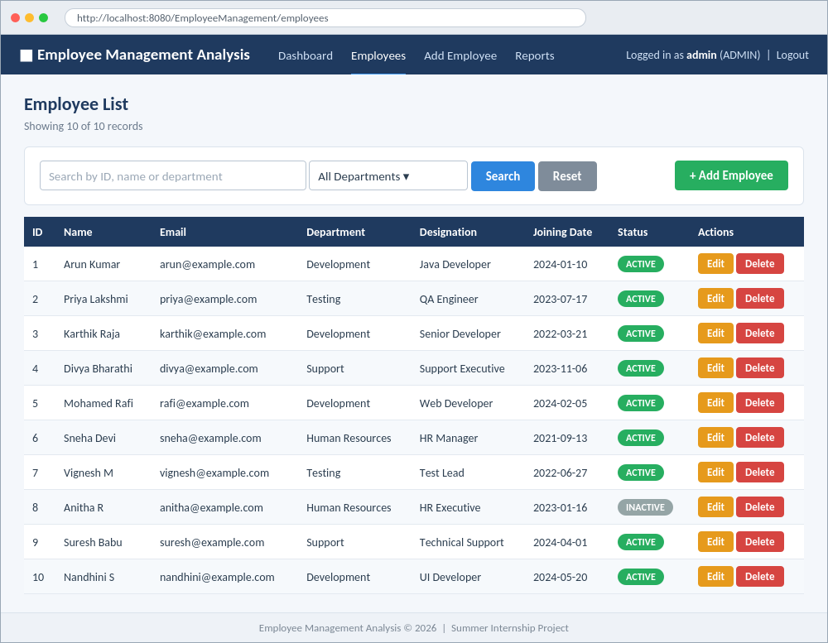
Output: Employee List
Employee list – search, filter, status labels, Edit and Delete

Slide 20
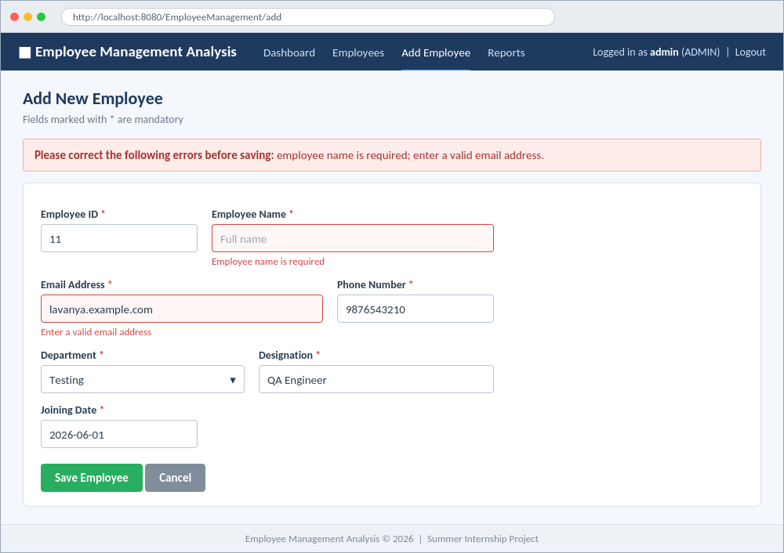
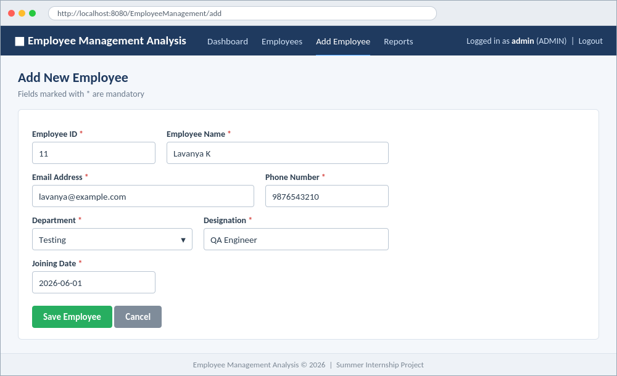
Output: Add Employee & Validation
Add employee form
Client-side validation messages

Slide 21
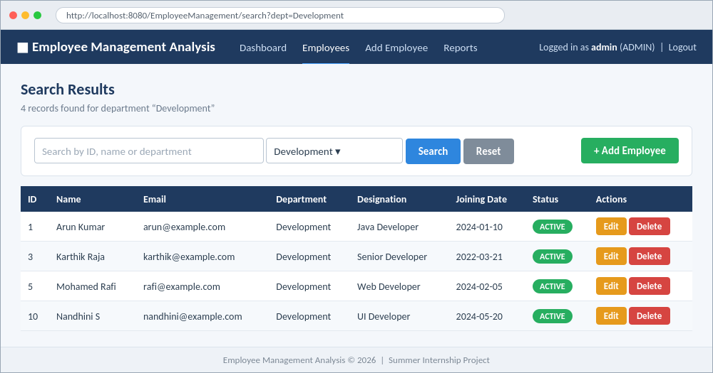
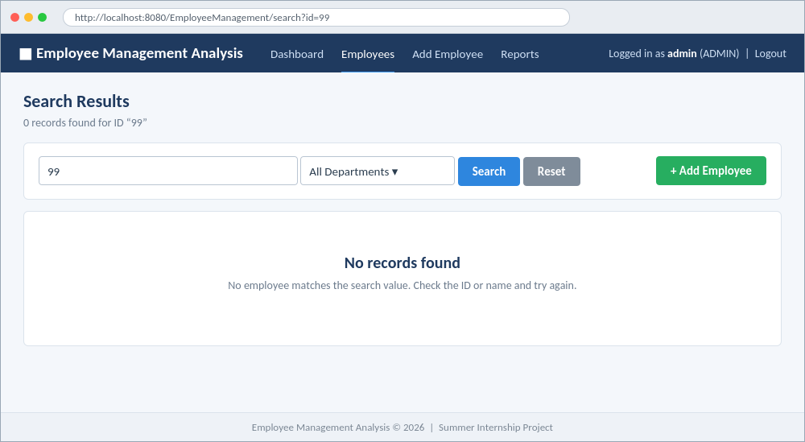
Output: Search
Search by department – 4 records
No records found message

Slide 22
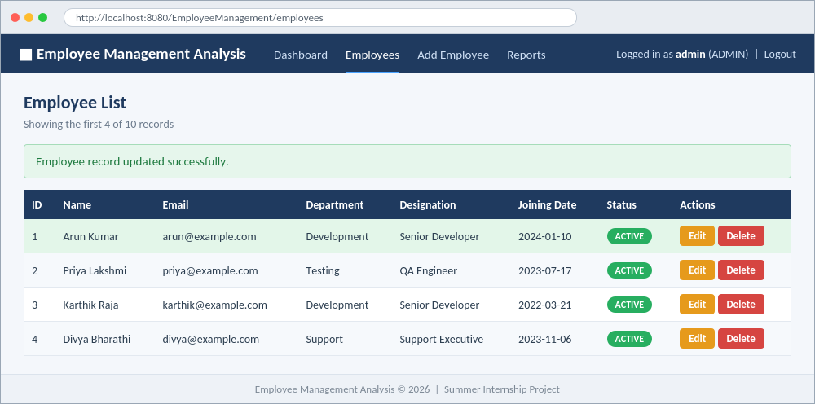
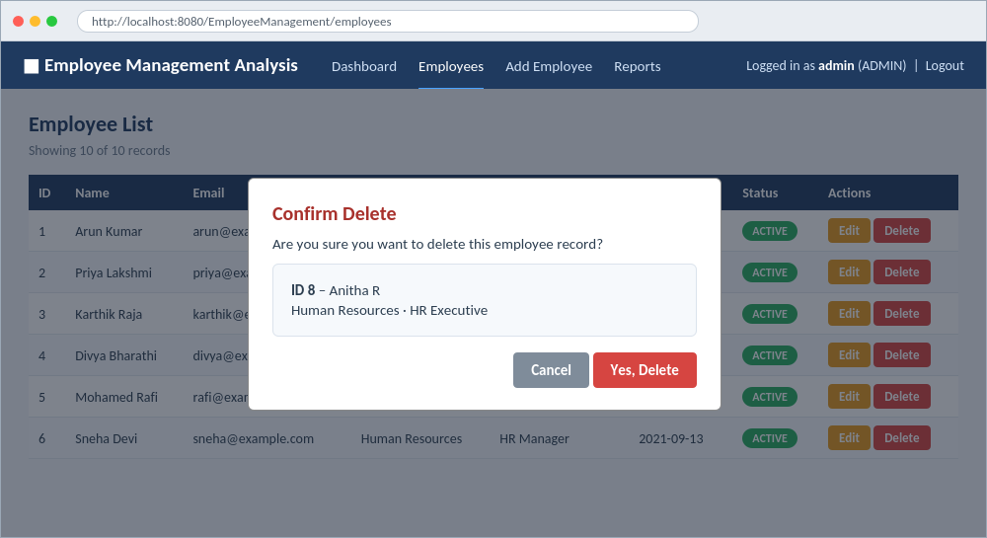
Output: Update & Delete
Record updated successfully
Confirmation before deleting

Slide 23
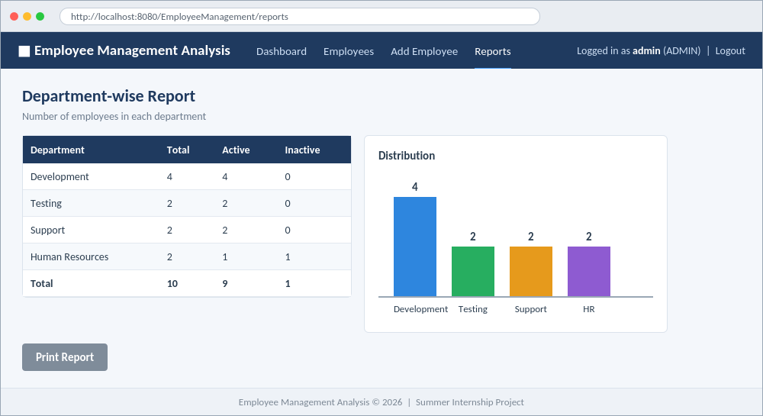
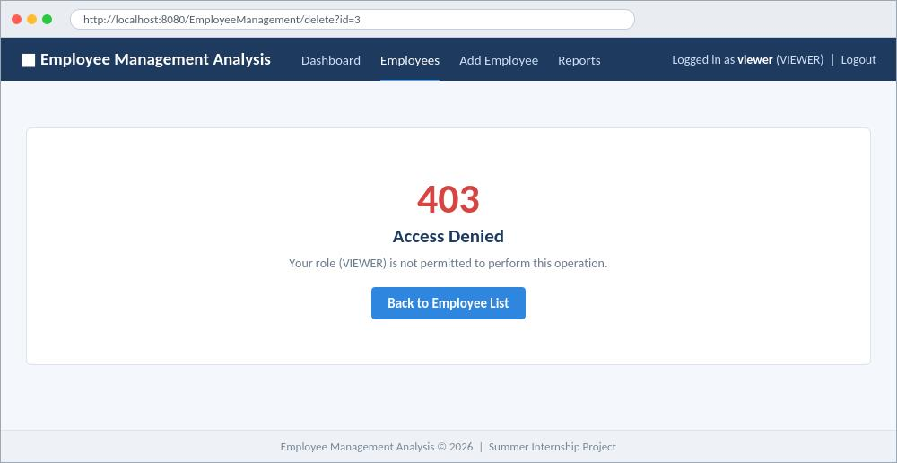
Output: Report & Access Control
Department-wise report
Access denied for a viewer

Slide 24
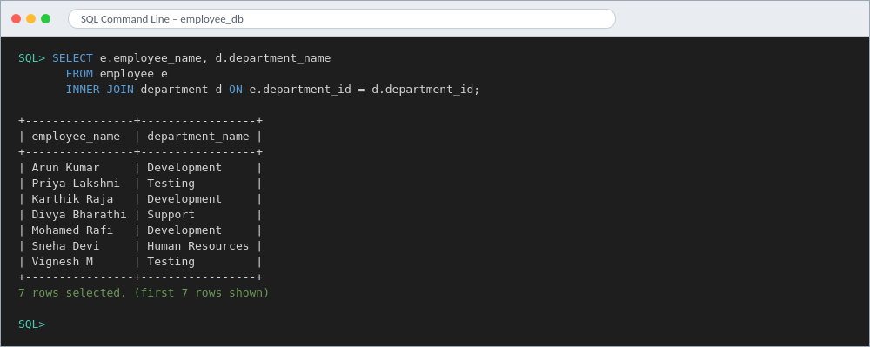
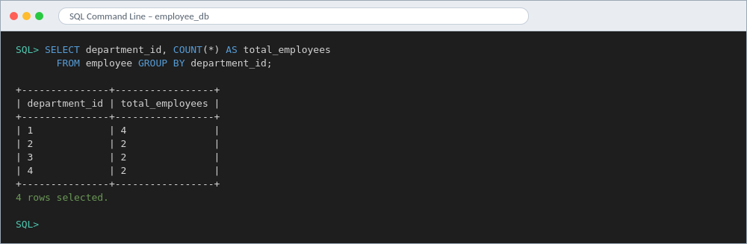
Output: SQL Results
GROUP BY with COUNT
INNER JOIN of employee and department

Slide 25
Challenges & Solutions
Challenge | Solution
Connecting browser, Java code and database | Traced one operation from form to database step by step
Errors in SQL statements | Tested each query separately on sample data
Duplicate and incomplete data | Mandatory fields, unique constraints, validation messages
Logic and SQL mixed together | Moved database code into a data-access class
Time in a one-month period | Weekly goals for learning, design, implementation, documentation

Slide 26
Conclusion & Future Work
Conclusion
Future Work
Practical skills in Java, HTML, CSS, JavaScript and SQL
Employee records managed efficiently with CRUD operations
Bridged academic learning and industry practice
Attendance and leave management
Payroll and salary slips
PDF / Excel report export
Spring Boot REST API
Password hashing, responsive design

Slide 27
Thank You
Questions?

