Slide 1



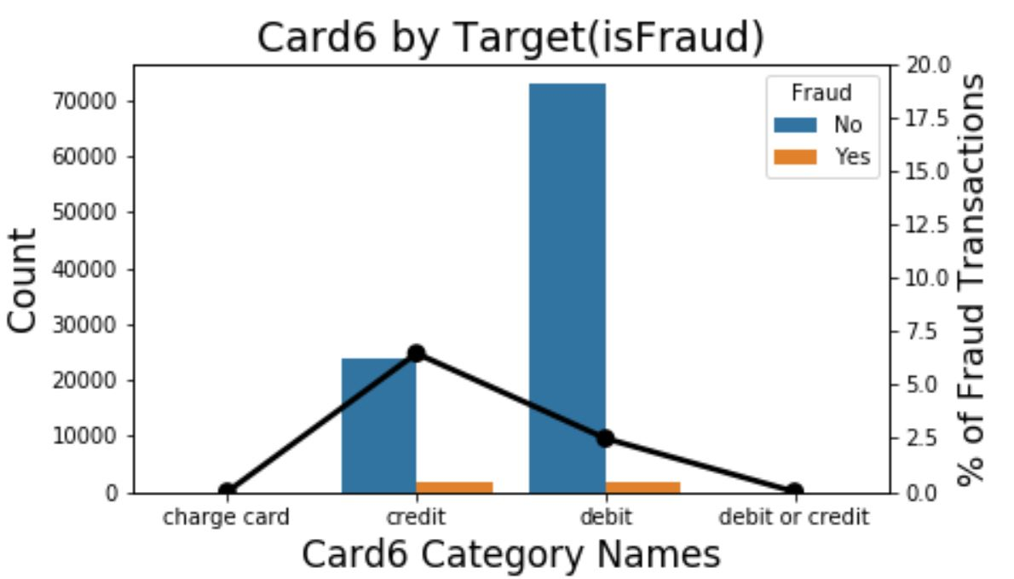
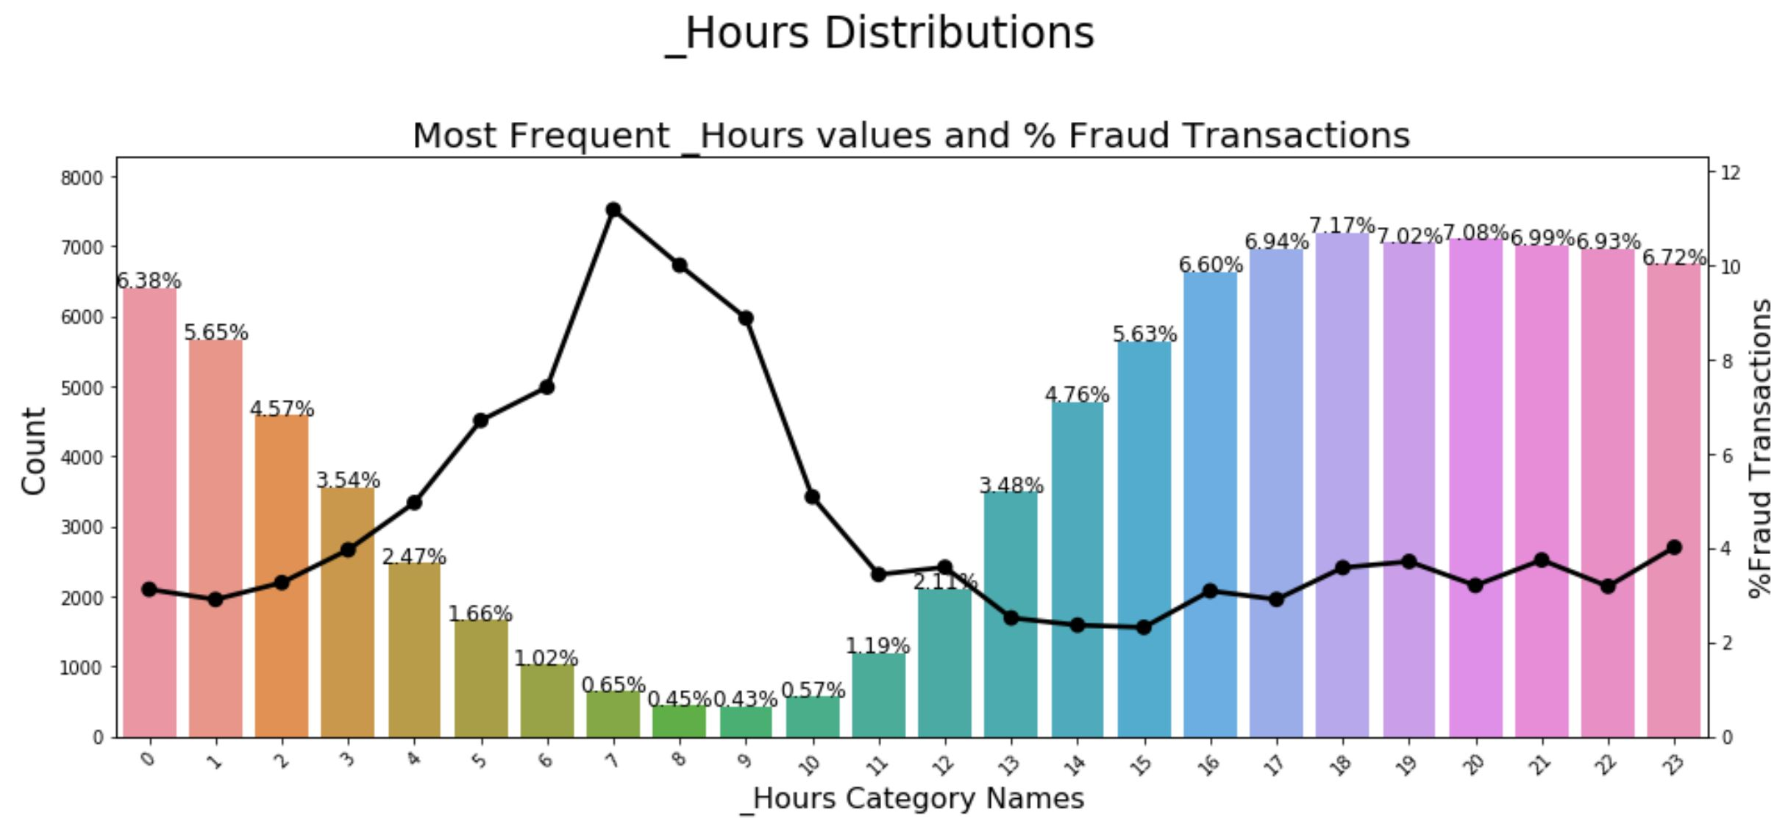
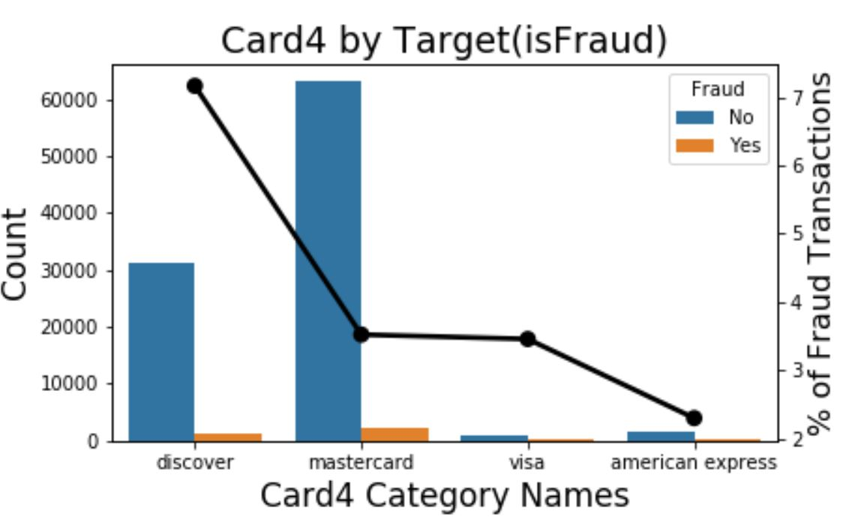
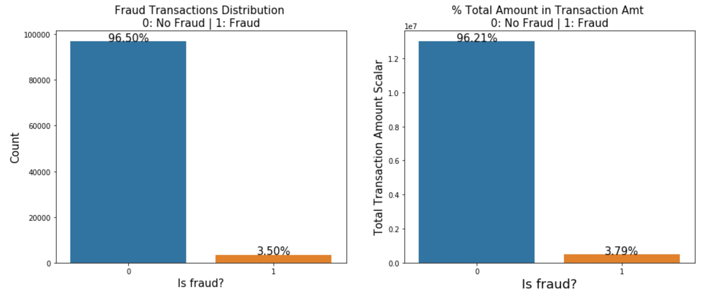
Fraud Detection System
Instructor: Professor Ying Lin
Video Link
https://youtu.be/4ZPMGGcv8cM
By Hitesh Thadhani, Surjit Singh, Yerraguntla Aditya Sai
Problem Statement
Online transactions on ecommerce websites card-not-present (CNP) transactions
CNP transactions occur when neither the customer nor the card is physically present
CNP transactions leave the customers vulnerable in the event that the credit card or credit card information is stolen
Fraud detection systems are automated systems to detect and prevent fraudulent transactions.
Exploratory Data Analysis
Project Objective
The object of the project is to build a fraud detection system to detect fraudulent transactions in near-real time to assist in fraud prevention
The fraud detection system will help vesta corporation, an ecommerce payment solutions company, provide security guarantees to their customers and save millions of dollars every year by preventing fraudulent transactions
The project tries to identify important features for determining if a transaction is fraudulent or legitimate
Pre-Processing Techniques
Methodology
Conclusion
Prevention of fraud is essential for an online payment solutions company. The model we have built shows that it generalizes well and can save a company like Vesta Corporation a lot of money
Extreme Gradient Boosting is our best performing model with a ROC-AUC score of 0.9152
We also know the factors that are important for predicting if a transaction is fraudulent
Techniques | Purpose
Stratified Sampling | Reducing the huge size of the dataset to a manageable size to accommodate for the limited computing resources
Variance Inflation Factor | Determining attributes which are extremely similar and don’t provide additional information. Helps in reducing unnecessary attributes
Multiple Imputation by Chained Equations (MICE) | Imputation technique used to fill the NaN values of the numeric data
Label Encoding | Encoding the categorical columns into numeric to ensure the algorithm can use it
SMOTE Sampling | The dataset is highly imbalanced, and we perform SMOTE sampling to oversample and balance the train dataset.
Feature Importance | Light GBM was used to determine the important attributes to predict the target
Model | Description | Evaluation
Light GBM | Used for feature importance | Receiver Operating Characteristics (ROC) – Area Under the Curve
Logistic Regression | Used for Prediction | Receiver Operating Characteristics (ROC) – Area Under the Curve
Naïve Bayes Classifier | Used for Prediction | Receiver Operating Characteristics (ROC) – Area Under the Curve
Random Forest | Used for Feature Importance and Prediction | Receiver Operating Characteristics (ROC) – Area Under the Curve
Extreme Gradient Boosting (XGBoost) | Used for Prediction | Receiver Operating Characteristics (ROC) – Area Under the Curve
Dataset Description
The IEEE-CIS fraud detection dataset is Kaggle competition dataset with two separate files containing transaction and identity information
There are a total of 435 attributes across the transaction and identity datasets. 404 attributes are numeric and 36 are categorical
The ratio between legitimate and fraudulent transactions is 27:1
We implemented stratified sampling to reduce the size of the massive dataset. We ensured that the target distribution is maintained.
Future Scope
The model built was on a reduced sample. Providing more data will improve the performance of the models.
The attribute names are masked to ensure compliance with privacy policy of Vesta Corporation. Availability of additional attribute metadata will greatly help with feature engineering and model performance.
More complex algorithms can be experimented with additional computing resources to improve model performance
Feature Importance
Results (ROC – AUC)
References
https://www.kaggle.com/c/ieee-fraud-detection
https://towardsdatascience.com/methods-for-dealing-with-imbalanced-data-5b761be45a18
https://www.kaggle.com/ogrellier/feature-selection-with-null-importances
Video and Web Application
https://youtu.be/4ZPMGGcv8cM
https://fraud-detection-system.herokuapp.com/

