Slide 1
ARP/RARP
By
Vickie Pickett

Slide 2
Address Resolution Protocol
Three types of address information are used on TCP/IP internetworks:
  Physical addresses - Used by the Data Link and Physical layers.
  IP Addresses - Provide logical network and host IDs. IP addresses consists of four numbers typically expressed in dotted-decimal form.
  Logical node names - Identify specific hosts with alphanymeric identifiers, which are easier for users to recall than the numeric IP addresses.

Slide 3
Address Resolution Protocol
Physical addresses:
  Unique addresses associated with the networking hardware in the computer
  In most cases the physical device address is burned into the NIC at the time the card is manufactured
  The physical address is also referred to as the MAC address
  With older devices such as ARCnet, the address is set by changing DIP switches on the card

Slide 4
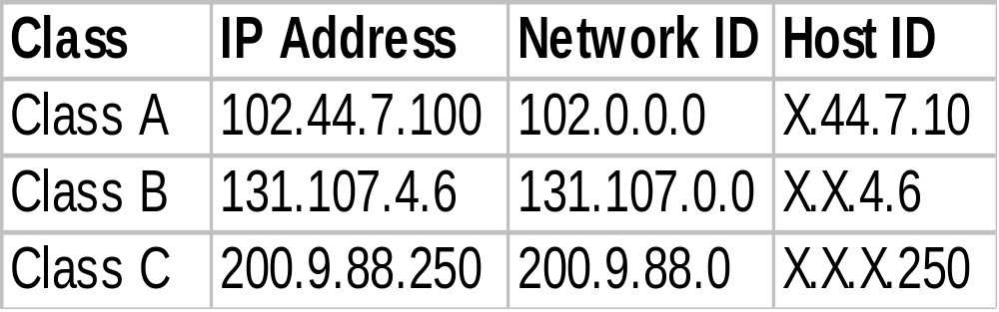
Address Resolution Protocol
IP Addresses:
  Unique numbering scheme that encapsulates the network note address into a set of numbers
  These addresses are broken down into three classes - class A, class B and class C

Slide 5
Address Resolution Protocol
Logical Node Names:
  Each node on the network can have a unique name that makes it easier to identify the node
  Examples of these names would be
    Lab-A
    Lab-B
    Lab-C

Slide 6
Address Resolution Protocol
Given an IP address, the Address Resolution Protocol (ARP) can determine the physical address used by the device containing the IP address.
ARP maintains tables of addresses on the network segment or use previously cached entries.

Slide 7
Address Resolution Protocol
ARP Tables are cached in memory and are maintained automatically.
Each computer on a network maintains its own ARP table.

Slide 8
Address Resolution Protocol
Given an IP address, the Address Resolution Protocol (ARP) can determine the physical address used by the device containing the IP address.
When a network device wants to send data on the network it uses information provided by its ARP table.

Slide 9
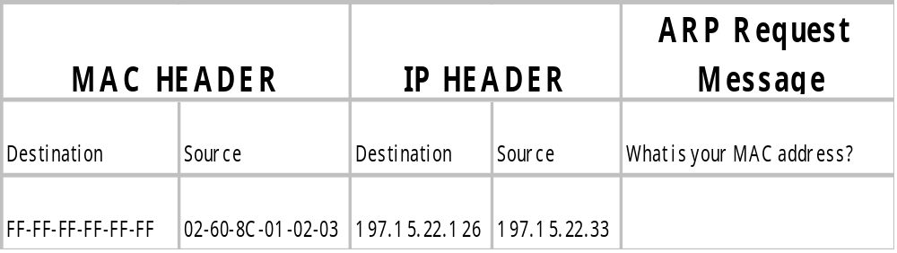
Address Resolution Protocol
When a device does not know the MAC address of the device it is sending to it sends an ARP request .
The request is a broadcast message in the form of a frame header and the ARP message

Slide 10

Reverse Address Resolution Protocol
RARP is the protocol that a device uses when it does not know its IP address
Since the IP address is stored in the permanent memory of the computer, dumb terminals do not know their own addresses.
Who am I?

Slide 11
Reverse Address Resolution Protocol
To send data to another device, a device must include both its IP address and its MAC address. Therefore a RARP request is sent.
Devices using RARP require that a RARP server be present on the network to answer RARP request.

Slide 12
Reverse Address Resolution Protocol
To send a RARP request, a RARP request packet must be built.
To ensure that all devices on the network will see the request, the source uses a broadcast IP address.

Slide 13
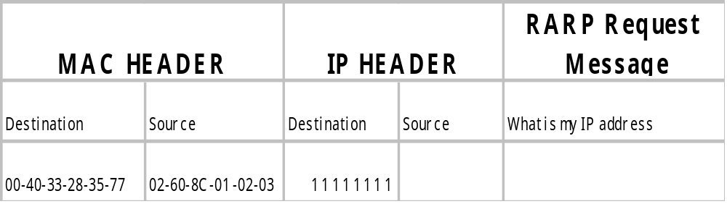
Reverse Address Resolution Protocol
When a device does not know its IP address it sends a RARP request
The request is similar to that of an ARP in that it is a broadcast message in the form of a frame header and the RARP message

Slide 14
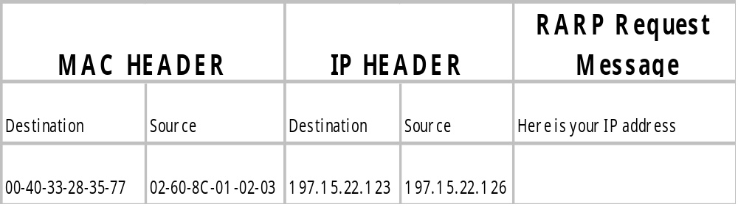
Reverse Address Resolution Protocol
The designated RARP server will respond to the request by sending a reply containing the IP address of the device that originated the RARP request.
The reply has the same structure as an ARP reply

Slide 15
Reverse Address Resolution Protocol
For as long as the session lasts the dumb terminal can use the information it obtained from the RARP request.
I am 197.15.22.123!

