Slide 1
Address Resolution Protocol
(ARP)
Relates to Lab 2.
This module is about the address resolution protocol.

Slide 2
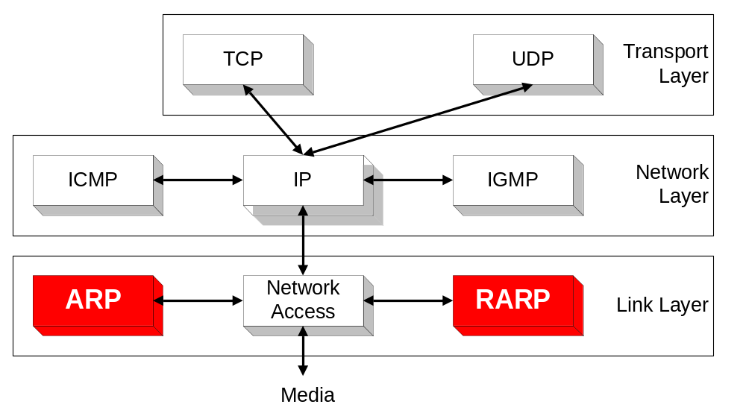
Overview

Slide 3
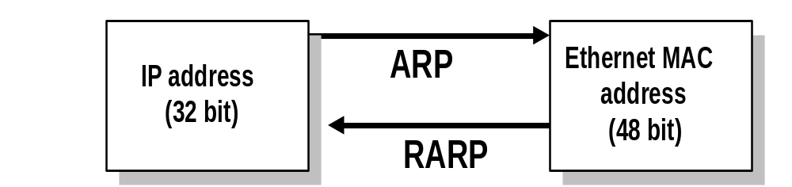
ARP and RARP
Note:
  The Internet is based on IP addresses
  Data link protocols (Ethernet, FDDI, ATM) may have different (MAC) addresses
The ARP and RARP protocols perform the translation between IP addresses and MAC layer addresses
We will discuss ARP for broadcast LANs, particularly Ethernet LANs

Slide 4
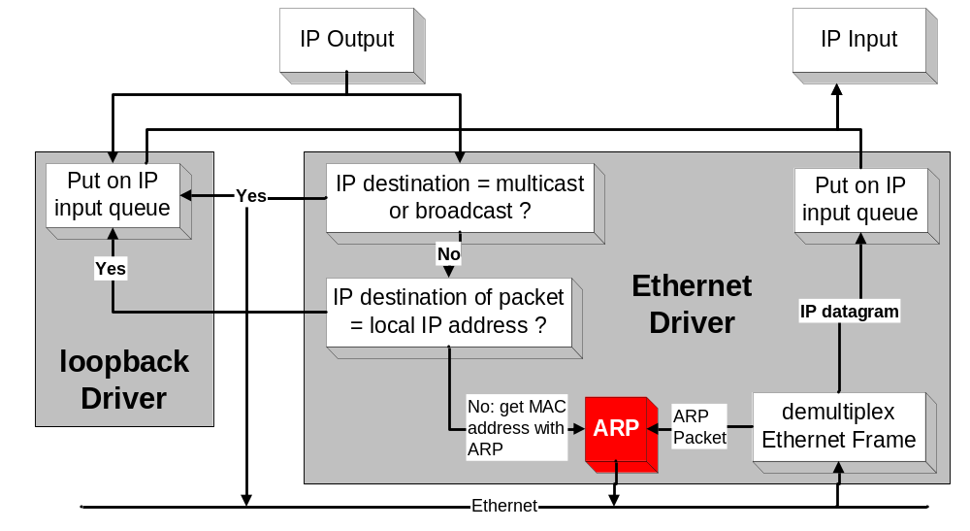
Processing of IP packets by network drivers

Slide 5
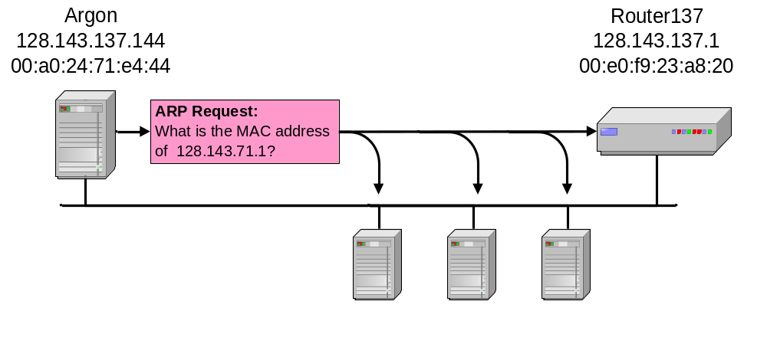
Address Translation with ARP
ARP Request:
Argon broadcasts an ARP request to all stations on the network: “What is the hardware address of Router137?”

Slide 6
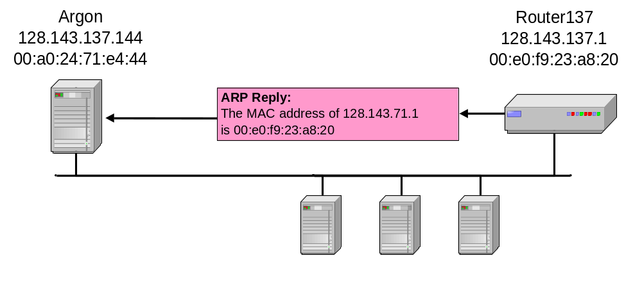
Address Translation with ARP
ARP Reply:
Router 137 responds with an ARP Reply which contains the hardware address

Slide 7
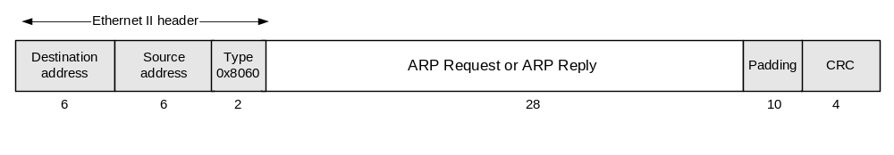
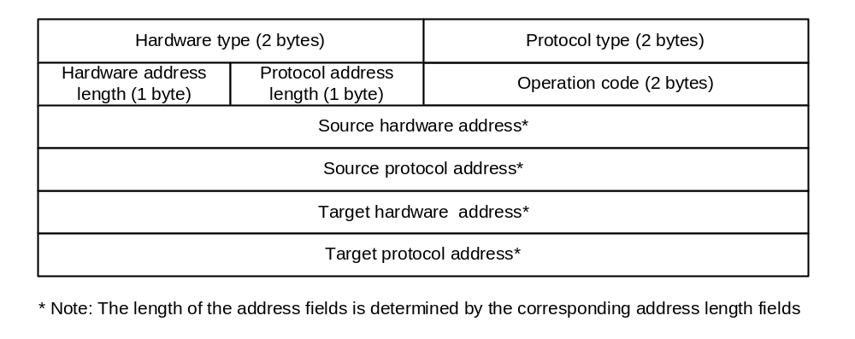
ARP Packet Format

Slide 8
Example
ARP Request from Argon:
Source hardware address: 00:a0:24:71:e4:44
Source protocol address: 128.143.137.144
Target hardware address: 00:00:00:00:00:00
Target protocol address: 128.143.137.1
ARP Reply from Router137:
Source hardware address: 00:e0:f9:23:a8:20
Source protocol address: 128.143.137.1
Target hardware address: 00:a0:24:71:e4:44
Target protocol address: 128.143.137.144

Slide 9
ARP Cache
Since sending an ARP request/reply for each IP datagram is inefficient, hosts maintain a cache (ARP Cache) of current entries. The entries expire after 20 minutes.
Contents of the ARP Cache:
  (128.143.71.37) at 00:10:4B:C5:D1:15 [ether] on eth0
  (128.143.71.36) at 00:B0:D0:E1:17:D5 [ether] on eth0
  (128.143.71.35) at 00:B0:D0:DE:70:E6 [ether] on eth0
  (128.143.136.90) at 00:05:3C:06:27:35 [ether] on eth1
  (128.143.71.34) at 00:B0:D0:E1:17:DB [ether] on eth0
  (128.143.71.33) at 00:B0:D0:E1:17:DF [ether] on eth0

Slide 10
Things to know about ARP
What happens if an ARP Request is made for a non-existing host?
Several ARP requests are made with increasing time intervals between requests. Eventually, ARP gives up.
What if a host sends an ARP request for its own IP address?
The other machines respond (gratuitous ARP) as if it was a normal ARP request.
This is useful for detecting if an IP address has already been assigned.

Slide 11
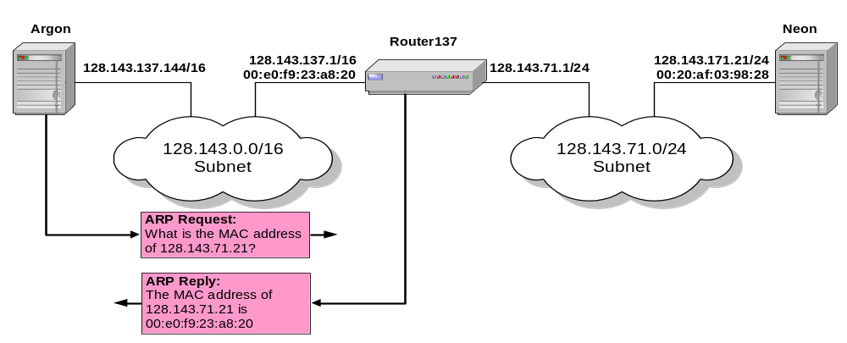
Proxy ARP
Proxy ARP: Host or router responds to ARP Request that arrives from one of its connected networks for a host that is on another of its connected networks.

