Slide 1
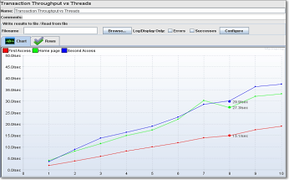
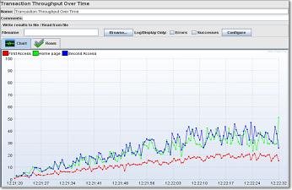
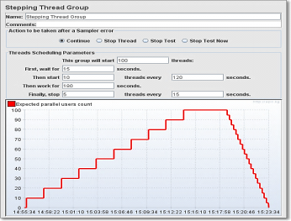

JMeter Plugins
@
Every load test needs some sexy features!
JMeter Plugins
at Google Code
Every load test needs some sexy features!
JMeter Plugins
at Google Code

