Slide 1
Cluster-Adaptive Prompting for Multi-Turn Travel and Tourism Conversational Systems
End-to-End Neuro-Symbolic Storyline: Identify (RQ1) → Personalize (RQ2) → Govern (RQ3) → Optimize (RQ4)
Author: Surnella Sandeep | Course: QM640: Data Analytics Capstone (Department of Data Analytics, Walsh College)
Instructor & Capstone Mentor: Mr. Smitraj Raut | Date: 10th Nov 2026
Reproducible Code & Data Repository: https://github.com/surnella/QM640-Dialogue-Clustering-Capstone
Empirical Scope: 2,833 Analytic Human Dialogues (Microsoft Frames N = 1,334; MultiWOZ 2.2 N = 1,499) + ~8,900 Gemini 2.5 Flash/Pro Evaluations
Notes:
Welcome to the 15-minute capstone defense presentation. This presentation follows a cohesive four-stage engineering and statistical storyline: Identify the traveler persona early (RQ1), Personalize response style and pacing (RQ2), Govern responses for zero entity leakage and policy compliance (RQ3), and Optimize multi-turn negotiation efficiency (RQ4).

Slide 2
1. PROBLEM STATEMENT & MOTIVATION
Slide 2
The Real-World Business Problem: Why Static Travel Chatbots Fail
Travelers do not all shop the same way—yet commercial chatbots force every customer through one static script
Customer Type A: The Decisive Booker (45.0%)
Customer Type B: The Open Explorer (25.5%)
Customer Type C: Rigid-Constraint Seeker (29.5%)
• How they talk (Frames ID e2c09f7a):
▪ 'I need a 5-night package from Dallas to Cancun departing Aug 12 for 2 adults under $2,400.'
• What they want: Immediate confirmation of the best matching package and direct booking.
• How a Static Chatbot fails them:
▪ Follows a slow 8-step intake script; re-asks slots already stated in Turn 1 (19.4% Redundant Elicitation Rate in the Zero-Shot baseline).
▪ Writes verbose 35-word paragraphs instead of a crisp 16-word confirmation.
• Business Impact: Impatient high-intent buyers abandon the cart before checkout.
• How they talk (Frames ID b84f11c2):
▪ 'Looking for a week off in September under a $3,000 budget—what beach or European cities can be compared?'
• What they want: Side-by-side comparison of 2–3 distinct options across price and hotel tiers.
• How a Static Chatbot fails them:
▪ Presents only one option per turn, forcing the user to ask 'What about another city?' or 'What about 4-star vs 3-star?' across 18+ turns.
• Business Impact: Long, exhausting 18-turn sessions that drive up cloud LLM inference costs and user fatigue.
• How they talk (Frames ID 91a4d0e5):
▪ 'I only want a 5-star hotel in Tokyo on Oct 5 for 10 nights under $2,200—no other dates or stars.'
• What they want: If exact inventory is $2,596 (over budget), they need immediate, transparent trade-off options (4-star on Oct 5 vs. 5-star on Oct 12).
• How a Static Chatbot fails them:
▪ Says 'No package found' or argues for 4 turns before revealing alternatives (68.0% end with no suitable option in human logs).
• Business Impact: 8.73-turn deadlock loops and lost bookings.
Business Problem Statement (Buhalis & Sinarta, 2019; Ivanov & Webster, 2019; Melián-González et al., 2021):
Online travel agencies (OTAs) and hospitality contact centers suffer from low self-service conversion and high session abandonment because static LLM prompts fail to adapt information density, pacing, and trade-off framing to customer decision-making styles—while unverified generative responses create financial liability from policy violations.
Surnella Sandeep | QM640 Data Analytics Capstone | Cluster-Adaptive Prompting for Multi-Turn Travel Conversational Systems
Notes:
Show how three distinct traveler personas enter an Online Travel Agency (OTA) portal and get frustrated by a one-size-fits-all script.

Slide 3
1. PROBLEM STATEMENT & MOTIVATION
Slide 3
The Technical Paradox: Why Naive Few-Shot AI Adaptation Fails
Simply pasting retrieved past dialogues into an LLM prompt introduces two severe production hazards
Hazard 1: Exemplar Entity Leakage (Hallucinated Terms)
Hazard 2: Enterprise Policy Blindness (Rule Violations)
• What happens in standard few-shot prompting (Liu et al., 2022):
▪ To teach the LLM how to talk to an Open Explorer, the system retrieves 3 similar past transcripts from the database and puts them in the prompt.
• The Contamination Trap (Proven in the RQ3 Experiment):
▪ If those retrieved examples mention 'Sapphire Bay Resort', 'SkyBridge Airways', '$1,149', or promo code 'VIP25', the LLM copies those stale entities into the current customer's reply!
• Empirical Proof (RQ3 Table 15):
▪ Unguarded Cluster-Adaptive Few-Shot leaked stale exemplar entities in 55.6% of all responses (mean leakage rate = 0.359, p < .001).
• What happens when rules are only written in the system prompt:
▪ Travel bookings are governed by strict numeric constraints: e.g., international trips require ≥ 15 days visa lead time; passports need ≥ 6 months validity; FIT bookings allow ≤ 4 adults; promo discounts cap at 15%.
• The Attention Competition Trap (Yao et al., 2024):
▪ When the LLM focuses on matching conversational style, it overlooks arithmetic thresholds buried in long text prompts.
• Empirical Proof (RQ3 Table 15):
▪ Without an external symbolic rule engine (Rules Off), Gemini 2.5 Flash enforced violated booking rules in only 5.6% of violating sessions (missing 94.4% of violations!).
Solution: Four-Stage Neuro-Symbolic Architecture — Identify (RQ1) → Personalize (RQ2) → Govern (RQ3) → Optimize (RQ4)
• 1. IDENTIFY (RQ1 — Early-Turn Hybrid Routing): Classify whether the traveler is a Decisive Booker, Open Explorer, or Rigid-Constraint Seeker from the first M = 9 user messages (`Blocks` router κ = .535 to .958) without leaking end-of-dialogue outcomes.
• 2. PERSONALIZE (RQ2 — Slot-Masked FAISS Retrieval): Replace all entities in retrieved examples with `[SLOT]` placeholders (`[HOTEL_NAME]`, `[BUDGET_USD]`) so the LLM adapts style and pacing (+31.8% style cosine, 3.87w pacing error) without copying stale facts.
• 3. GOVERN (RQ3) & 4. OPTIMIZE (RQ4): Enforce declarative YAML booking policies (0.0% leakage, 98.6% violation enforcement) and lock stated user constraints in a Verified Informed Slot Ledger (−29.5% to −42.7% turns, 0.0% redundant questions).
Surnella Sandeep | QM640 Data Analytics Capstone | Cluster-Adaptive Prompting for Multi-Turn Travel Conversational Systems
Notes:
Explain why standard Retrieval-Augmented Generation (RAG) or naive KATE few-shot prompting fails without symbolic guardrails.

Slide 4
2. LITERATURE SYNTHESIS
Slide 4
Literature Review (Part 1): Hospitality AI Value & Task-Oriented Corpora
Prior business and corpus findings, methodological foundations, and novel empirical additions
Stream 1: Travel & Hospitality AI Business Value
Stream 2: Task-Oriented Dialogue Corpora (Frames & MultiWOZ)
• What Prior Papers Tried & Found:
▪ Buhalis & Sinarta (2019) introduced real-time 'nowness' co-creation in tourism: travelers expect instant, personalized itinerary synthesis.
▪ Ivanov & Webster (2019) established the ROI framework for hospitality automation: chatbots create net economic value only when they resolve complex consultative queries without human escalation.
▪ Melián-González et al. (2021) surveyed N = 1,476 consumers and proved that perceived interaction efficiency and task fit drive chatbot adoption.
▪ Jannach et al. (2021) & Inaba et al. (2022) showed qualitatively that travelers exhibit heterogeneous initiative and constraint rigidity.
• Application of Prior Foundations:
▪ Operationalizes qualitative constructs—decisiveness, exploration breadth, constraint rigidity, and interaction effort—into 16 quantitative behavioral variables and multi-turn turn-economy metrics.
• Novel Contribution (With Empirical Proof):
▪ Prior tourism papers relied on post-hoc user surveys. This study instruments actual LLM turn economy, proving a 35.8% reduction in turns (7.93 → 5.09 turns, p < .001) and 0.0% redundant questions.
• What Prior Papers Tried & Found:
▪ El Asri et al. (2017) [Microsoft Frames] collected 1,369 human–human Wizard-of-Oz vacation package negotiations to study non-linear frame-switching (comparing multiple flight+hotel packages under budget ceilings).
▪ Budzianowski et al. (2018) & Zang et al. (2020) [MultiWOZ 2.2] created a 10,438-dialogue benchmark for supervised slot-filling across city services (hotel, train, attraction, taxi, restaurant).
• Application of Prior Foundations:
▪ Uses Frames (N = 1,334 analytic) as the primary consultative travel testbed and MultiWOZ 2.2 (N = 1,499) as an external structural transfer benchmark.
• Novel Contribution (With Empirical Proof):
▪ Both corpora were built for supervised slot state tracking, treating all users as uniform. Neither clustered user decision-making archetypes nor audited policy compliance.
▪ Cross-corpus evaluation in RQ1 proves that Frames negotiation archetypes do not transfer trivially to simple MultiWOZ slot-filling (centroid cosine .467 vs. .269, t = 28.08, p < .001), demonstrating that consultative travel requires a dedicated archetype taxonomy.
Surnella Sandeep | QM640 Data Analytics Capstone | Cluster-Adaptive Prompting for Multi-Turn Travel Conversational Systems
Notes:
Synthesizes Streams 1 and 2 of the literature review across hospitality AI value and task-oriented dialogue corpora.

Slide 5
2. LITERATURE SYNTHESIS
Slide 5
Literature Review (Part 2): Representation Learning, FAISS ICL & Guardrails
Integrating vector geometry, dynamic in-context learning, and programmable rails while overcoming baseline failure modes
Stream 3: Embeddings & Unsupervised Clustering
Stream 4: Dynamic Few-Shot Retrieval & Symbolic Guardrails
• What Prior Papers Tried & Found:
▪ Reimers & Gurevych (2019) [Sentence-BERT] and Lee et al. (2025) [Gemini Embeddings] showed that bi-encoder transformers map text into cosine spaces suitable for clustering.
▪ McInnes et al. (2017, 2018) [HDBSCAN & UMAP] and Hennig (2007) [Bootstrap ARI] established density clustering and resampling stability.
▪ Gilardi et al. (2023) proved zero-temp LLMs achieve high annotation reliability.
• What Failed When Applied Directly (Interim Diagnostic Finding):
▪ Clustering whole-dialogue embeddings directly (as in standard studies) captured end-of-dialogue outcomes and wizard identity (Cramér's V = .45) rather than user behavior, yielding poor early-turn routing (κ = .24) and a null RQ2 prompting result (p = .211)!
• Methodological Innovation (RQ1 Breakthrough):
▪ Combining truncated opening user prefixes (first M = 9 user messages) with a 16-field LLM behavioral profile (`Blocks`) raised bootstrap stability to ARI = .89 (.87 in ablation) and out-of-sample prefix routing to κ = .535 (m=5) and κ = .958 (m=9 boundary consistency).
• What Prior Papers Tried & Found:
▪ Brown et al. (2020) & Liu et al. (2022) [KATE] showed that retrieving nearest-neighbor in-context examples via FAISS (Johnson et al., 2021) beats random static examples on single-turn NLP tasks.
▪ Rebedea et al. (2023) [NeMo Guardrails] & Yao et al. (2024) [τ-bench] showed that prompt-only LLMs violate domain rules over 50% of the time.
• Where Prior Papers Stopped:
▪ KATE retrieves from one unpartitioned global pool with raw unmasked entities. NeMo and τ-bench test safety rails in isolation without studying how rails interact with dynamic style prompting.
• Methodological improements (RQ2 & RQ3 Breakthrough):
▪ Combining archetype-partitioned FAISS sub-indices (`[SLOT]`-masked) + archetype pacing directives boosts de-lexicalized SBERT style convergence over static few-shot by +31.8% (.597 vs. .453, p < .001, d_z = 0.74).
▪ In RQ3, a significant 2 × 2 interaction (F = 34.82, p < .001) demonstrates that the declarative governance layer eliminates the 35.9% entity leakage of unguarded few-shot prompting down to 0.0% detected.
Surnella Sandeep | QM640 Data Analytics Capstone | Cluster-Adaptive Prompting for Multi-Turn Travel Conversational Systems
Notes:
Synthesizes Streams 3 and 4 covering SBERT/Gemini embeddings, KATE k-NN prompting, and NeMo/Tau-bench guardrails.

Slide 6
2. LITERATURE SYNTHESIS
Slide 6
Literature Synthesis Matrix: Prior Approaches vs. Empirical Findings
Concrete examples from RQ1–RQ4 data illustrating what prior methods miss and what the proposed framework resolves
Prior Literature Benchmark | What Prior Paper Did | Limitation When Applied to Travel Dialogues | Methodological Addition | Concrete Empirical Proof (RQ1–RQ4)
Whole-Text Embedding Clustering (Reimers & Gurevych, 2019; McInnes et al., 2017) | Clustered full documents using SBERT / HDBSCAN. | HDBSCAN discards 39.1% (MiniLM) / 35.8% (Gemini) of dialogues as noise; full-dialogue vectors leak end-of-session outcomes. | Prefix-truncated (M=9 user msgs) hybrid Blocks (PCA-20 Gemini + 16 LLM behavioral ratings) with K-Means (k=3, 100% coverage). | RQ1 (Identify): HDBSCAN failed in 53/53 default runs. The M=9 Blocks router achieved ARI = .89 (.87 ablation) and raised held-out routing from κ = .24 (39.4%) to κ = .535 (70.1% at m=5) and κ = .958 (97.3% at m=9).
Global k-NN Few-Shot (KATE) (Liu et al., 2022; Brown et al., 2020) | Retrieved k nearest examples from one global pool without persona routing. | Static/unrouted examples mismatch user pacing; coarse routing (κ=.24) fails to improve style. | Archetype-partitioned FAISS sub-indices + archetype pacing directives routed via Blocks. | RQ2 (Personalize): Coarse Primary RQ2 failed (F = 1.61, p = .211). Refined RQ2 succeeded (F = 9.79, p < .001, ηp² = .234): style cosine rose from .453 (Static) to .597, and word pacing error fell from 10.12w to 3.87w.
Unmasked In-Context Examples (Standard RAG / Few-Shot) | Inserted raw historical text examples directly into the LLM prompt. | LLM copies stale hotel names, prices, and promo codes from examples into the active user session. | Regex/Schema [SLOT] masking in FAISS exemplars + post-generation entity leakage sanitizer. | RQ3 (Govern): Unguarded Cluster-Adaptive leaked stale entities ('Sapphire Bay Resort', '$1,149', 'VIP25') in 55.6% of cases (ELR = .359). Rules Active × Cluster-Adaptive reduced leakage to 0.0% (Interaction F = 34.82, p < .001).
Prompt-Only Policy Instructions (Yao et al., 2024 τ-bench; Rebedea et al., 2023) | Evaluated LLM adherence to domain rules stated only in natural language prompts. | LLMs ignore numeric visa, passport, adult-cap, and discount thresholds when optimizing for conversational tone. | Deterministic YAML RuleEngine (5 Tier-2 rules) executing pre-generation checks & post-generation verification. | RQ3 (Govern): Under Rules Off, Gemini 2.5 Flash enforced policy violations in only 5.6% of violating sessions. Activating RuleEngine raised violation enforcement to 98.6% (F = 43.92, p < .001) and Slot F1 from .485 to .952.
Static Sequential Slot-Filling (Budzianowski et al., 2018; Inaba et al., 2022) | Used a single dialogue policy across all users without tracking informed slots. | Re-asks already stated constraints and causes 8.7-turn deadlocks for Rigid-Constraint Seekers. | Verified Informed Slot Ledger + Archetype-Specific Turn-Economy Policy (bundle vs. compare vs. proactive trade-off). | RQ4 (Optimize): Cut turns to booking by −42.7% for Rigid-Constraint Seekers (8.73 → 5.00 turns, d = −3.40), −34.2% for Decisive Bookers (7.60 → 5.00), and −29.5% for Open Explorers (7.47 → 5.27), while cutting RER from .109 to .000.
Surnella Sandeep | QM640 Data Analytics Capstone | Cluster-Adaptive Prompting for Multi-Turn Travel Conversational Systems
Notes:
Walk through this synthesis matrix to show how each limitation in prior work maps directly to an empirical proof in RQ1–RQ4.

Slide 7
3. RESEARCH QUESTIONS & STORYLINE
Slide 7
Integrated Research Storyline: Identify (RQ1) → Personalize (RQ2) → Govern (RQ3) → Optimize (RQ4)
Four sequential experimental stages where each validated output unlocks the next layer of conversational intelligence
STAGE 1: IDENTIFY (RQ1)
STAGE 2: PERSONALIZE (RQ2)
STAGE 3: GOVERN (RQ3)
STAGE 4: OPTIMIZE (RQ4)
Discover 3 traveler archetypes & route from opening user prefix (M = 9 msgs, κ = .535–.958)
Retrieve k = 3 [SLOT]-masked FAISS exemplars + pacing directives to match persona style
Enforce 5 YAML booking rules & post-gen sanitization (0% entity leakage, 98.6% compliance)
Lock stated slots in Informed Ledger + tailor package trade-offs (−29.5% to −42.7% turns)
Storyline Stage | Research Question | Manipulated IV (X) & Design | Primary Measured DV (Y) | Hypotheses (H0 vs. Ha) | Causal Handoff to Next Stage
1. IDENTIFY (RQ1: Discovery & Routing) | Which clustering algorithm best separates trajectories, and which early-routable user archetypes emerge? | X1: Algorithm (K-Means, Ward, HDBSCAN) × Prefix Horizon M ∈ {3,5,7,9,whole} × Representation (N = 159 runs) | Y1: Cosine Silhouette, Davies–Bouldin, Bootstrap ARI Stability, Out-of-Sample Prefix Routing κ | H01: μ_Sil equal across algorithms. Ha1: Algorithms differ (p<.05) & prefix Blocks yield stable (ARI≥.60), routable personas. | Decision: Lock in K-Means (k=3) & M=9 `46-d Blocks`. Carries Forward → RQ2–RQ4: 3 Persona Labels, `RefinedArchetypeRouter` & 3 46-d FAISS Sub-Indices.
2. PERSONALIZE (RQ2: Style & Pacing ICL) | Does cluster-adaptive few-shot prompting improve style convergence and pacing calibration over baselines? | X2: Prompting Strategy (Zero-Shot, Static Few-Shot k=3, Cluster-Adaptive k=3) on N = 33 dialogues (99 calls) | Y2: De-lexicalized SBERT Style Cosine, Gemini 3,072-d Cosine, BERTScore F1, Pacing Word Error | H02: μ_style equal across 3 prompts. Ha2: Cluster-Adaptive > Static & Zero-Shot once upstream routing is coherent. | Decision: Drop Static Few-Shot; lock in `Cluster-Adaptive` (k=3 46-d FAISS + Pacing Directives). Carries Forward → RQ3–RQ4: RQ1 Router + Validated Adaptive Prompting.
3. GOVERN (RQ3: Policy & Leakage Guard) | How do a declarative rule engine and cluster-adaptive prompting interact to govern compliance and leakage? | X3: 2 × 2 Factorial: Rules Mode (Off vs. Active) × Prompting (Zero-Shot vs. Cluster-Adaptive) (N = 144, n = 36/cell) | Y3: Rule Adherence Rate (RAR) Y4: Exemplar Leakage Rate (ELR) Y5: Factual Slot F1 & Style Cosine | H03: No main or interaction effects. Ha3: Active rules raise RAR & Slot F1 and eliminate few-shot leakage (Interaction p<.05). | Decision: Drop unmasked prompts; lock `Rules Active` ([SLOT] masking + 5 YAML rules) ON. Carries Forward → RQ4: Governed 46-d Cluster-Adaptive Generator.
4. OPTIMIZE (RQ4: Turn Economy) | Does governed cluster-adaptive prompting with an informed-slot ledger reduce turns to agreed quotation? | X4: 2 × 3 Factorial: Prompting (Zero-Shot vs. Cluster-Adaptive) × Refined Archetype (DB, OE, RCS) (N = 180, n = 30/cell) | Y6: Log Turns to Goal Completion (ln TGC), Raw Turns, Redundant Elicitation Rate (RER) | H04: No main or interaction effects. Ha4: Cluster-Adaptive cuts log turns & RER with a significant Prompt × Archetype interaction. | Decision: Lock in Verified Slot Ledger (0% RER) + Persona Quotation Policies across the 3 `46-d Blocks` archetypes (−29.5% to −42.7% turns).
Why the Storyline Order Matters: Attempting to Personalize (RQ2) before solving outcome-free early routing in Identify (RQ1) failed (coarse routing κ = .24 gave p = .211). Attempting to Optimize (RQ4) without symbolic guardrails in Govern (RQ3) caused 55.6% entity hallucinations and 94.4% missed policy violations. All four stages are required.
Surnella Sandeep | QM640 Data Analytics Capstone | Cluster-Adaptive Prompting for Multi-Turn Travel Conversational Systems
Notes:
Emphasize the four-word narrative arc: Identify (RQ1) -> Personalize (RQ2) -> Govern (RQ3) -> Optimize (RQ4). Each RQ is an essential link in a single causal chain rather than an isolated experiment.

Slide 8
4. DATASET, HYGIENE & EXPLORATORY DATA ANALYSIS
Slide 8
Dataset Provenance, Two-Tier Schema, Cleaning Audit & Zero-Leakage Split
Condensing corpus authenticity, Pydantic schema standardization, programmatic cleaning (N = 2,833), and the 70/30 discovery/test firewall
1. Corpus Provenance & Two-Tier Pydantic Schema
Quality Audit Check | Detection Rule | Frames (1,369) | MultiWOZ (1,500) | Programmatic Treatment
Duplicate IDs / Empty turns | Primary key / strip() | 0 | 0 | Verified 100% unique & non-empty
Exact duplicate text | SHA-256 text hash | 1 | 0 | Removed duplicate (`bf46892e...`)
Aborted short dialogues | total_turns < 3 | 34 | 1 | Excluded (need ≥ 3 turns for prefix routing)
Long-tail turn outliers | > Q3 + 1.5 × IQR | 20 (>30.5t) | 21 (>24.0t) | Retained (real negotiations); log-transformed in RQ4
Unobserved slot values | Slot never stated | Preserved | Preserved | Kept as explicit `None`; never synthetically imputed
Entity leakage risk | Regex slot/number match | All exemplars | All exemplars | Masked with `[SLOT]` tokens in FAISS sub-indices
Final Analytic Sample | Locked post-cleaning | 1,334 | 1,499 | Total N = 2,833 analytic human dialogues
• Primary Corpus — Microsoft Frames (El Asri et al., 2017):
▪ 1,369 human–human Wizard-of-Oz vacation negotiations (1,334 analytic; 19,986 turns). Built to capture multi-package comparison (`switch_frame`), budget ceilings, and 25.8% non-booking outcomes.
• External Transfer Benchmark — MultiWOZ 2.2 (Zang et al., 2020):
▪ 1,500 seeded dialogues (1,499 analytic) of transactional city-service slot-filling; used in RQ1 to test whether consultative archetypes are domain-specific.
• Two-Tier Canonical Schema (`src/canonical_schema.py`):
▪ Tier 1 (9 Universal Booking Slots): `origin_city` (98.4%), `destination_city` (99.1%), `departure_date` (96.0%), `return_date` (91.2%), `duration_nights` (78.2%), `adults` (83.4%), `children` (25.0%), `budget_amount` (78.5%), `accommodation_tier` (69.5%).
▪ Tier 2 (5 Enterprise Policy Slots — Seeded in RQ3): `visa_processing_window_days` (<15d), `passport_expiry_months` (<6m), `traveler_count_adults` (>4 FIT), `discount_applied_percentage` (>15%), `minimum_budget_intl` (<$500/adult).
Strict Zero-Leakage 70/30 Partitioning Firewall (`seed = 42`) & Resolution of Public Corpus Boundaries:
• 70% Golden Discovery Partition (D_{gold}, n = 933) vs. 30% Held-Out Test Partition (D_{test}, n = 401): Stratified on wizard booking success (74.3% vs. 74.1%). Every clustering centroid, PCA projection matrix, prefix logistic router, and FAISS exemplar index is fitted exclusively on D_{gold} (n = 933). All RQ1 routing, RQ2 prompting (N = 33), RQ3 compliance (N = 144), and RQ4 multi-turn simulations (N = 180) run strictly on D_{test} (n = 401).
• Bridging Corpus Boundaries: (1) Controlled Tier-2 policy states (50% violating / 50% compliant) are attached to real D_{test} prefixes in RQ3; (2) Persona simulators in RQ4 are grounded in real D_{test} trip goals and verified at 95.6% blind persona fidelity (κ = .933) by an independent `gemini-2.5-pro` auditor.
Surnella Sandeep | QM640 Data Analytics Capstone | Cluster-Adaptive Prompting for Multi-Turn Travel Conversational Systems
Notes:
This slide condenses Slides 10 and 11 from the full deck: covering why Frames and MultiWOZ were chosen, the Two-Tier schema, the cleaning audit table, and the strict 70/30 split.

Slide 9
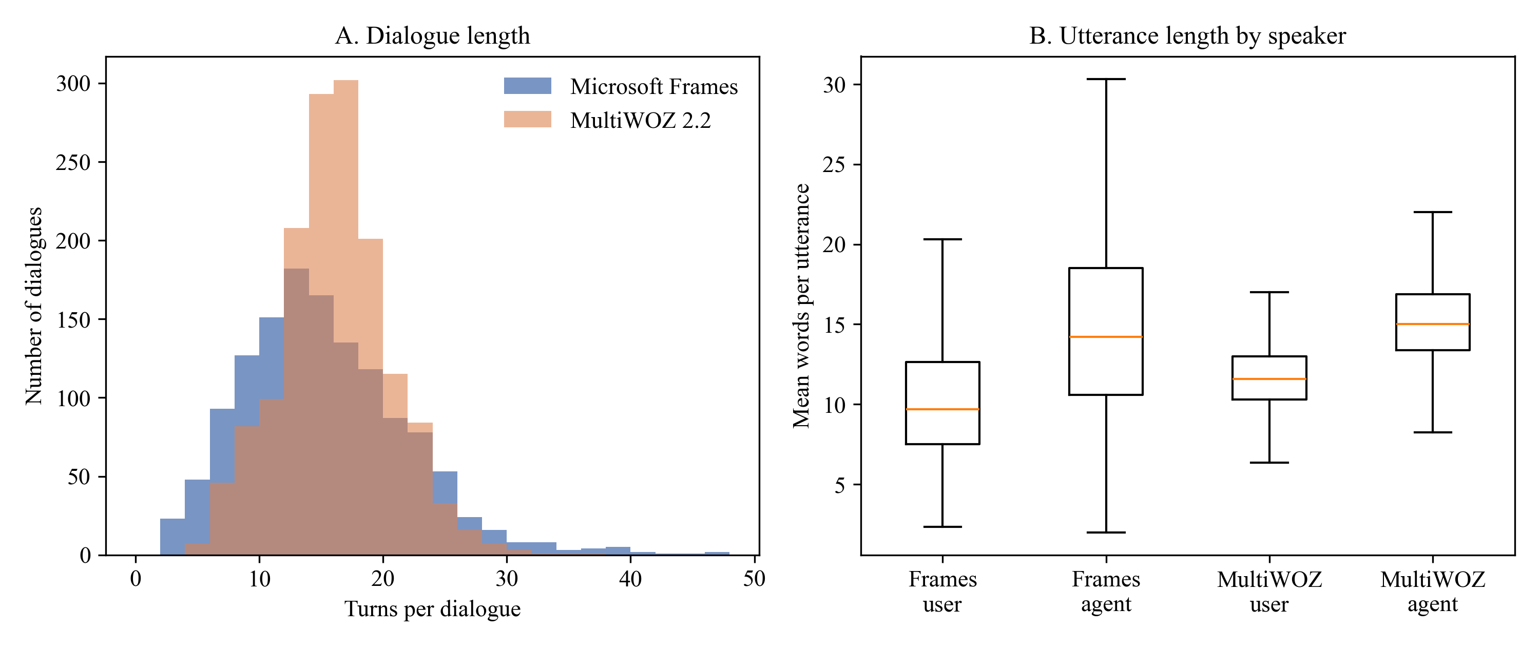
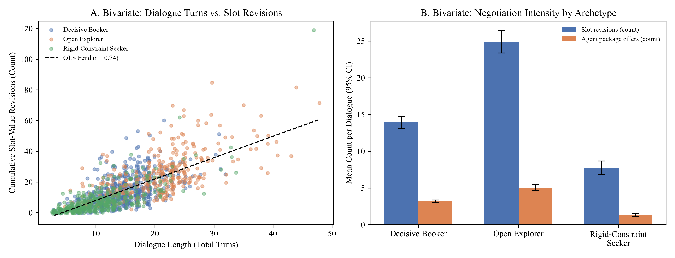
4. DATASET, HYGIENE & EXPLORATORY DATA ANALYSIS
Slide 9
Univariate and Bivariate Exploratory Data Analysis (Tables 6–7 & Figures 1–2)
Dialogue length is driven by slot revisions (r = .602) and package offers (r = .636), validating the negotiation constructs
Bivariate Variable Pair (Frames N = 1,334) | Pearson r (p) | Spearman ρ (p) | Analytical Interpretation
Dialogue Turns × Slot Revisions | .602 (< .001) | .582 (< .001) | Frequent constraint changes drive longer sessions
Dialogue Turns × Agent Package Offers | .636 (< .001) | .661 (< .001) | Multi-package comparisons expand turn counts
Slot Revisions × Hesitation Markers | .192 (< .001) | .206 (< .001) | User uncertainty accompanies constraint shifts
Slot Revisions × LLM Exploration Breadth | .554 (< .001) | .580 (< .001) | Strong construct validity of LLM exploration rating
Dialogue Turns × LLM Decisiveness | −.229 (< .001) | −.222 (< .001) | Decisive travelers finish bookings in fewer turns
User Words/Turn × Agent Words/Turn | −.026 (.341) | .014 (.618) | Utterance verbosity is independent across speakers
Figure 1: Univariate Turn Distributions (Frames M=14.90, SD=6.74 vs. MultiWOZ M=13.52, SD=4.46)
Key Takeaways from Univariate & Bivariate EDA
• Reporting Both Pearson r and Spearman ρ: Turn counts and revision counts are right-skewed; reporting linear Pearson r alongside rank-based Spearman ρ confirms correlations are not artifacts of tail outliers.
• Frames vs. MultiWOZ Dispersion: Frames has 51% wider turn dispersion (SD = 6.74 vs. 4.46, range 3–47 turns) because consultative vacation negotiation involves iterative trade-offs.
• Golden vs. Held-Out Balance: Golden (M = 14.94 turns) and Held-Out (M = 14.81 turns) partitions are statistically indistinguishable, confirming an unbiased split.
Figure 2: Bivariate Turns vs. Slot Revisions & Archetype Negotiation Intensity
Surnella Sandeep | QM640 Data Analytics Capstone | Cluster-Adaptive Prompting for Multi-Turn Travel Conversational Systems
Notes:
Explain Figure 1 (univariate turn distributions) and Figure 2 + Table 7 (bivariate Pearson and Spearman correlations).

Slide 10
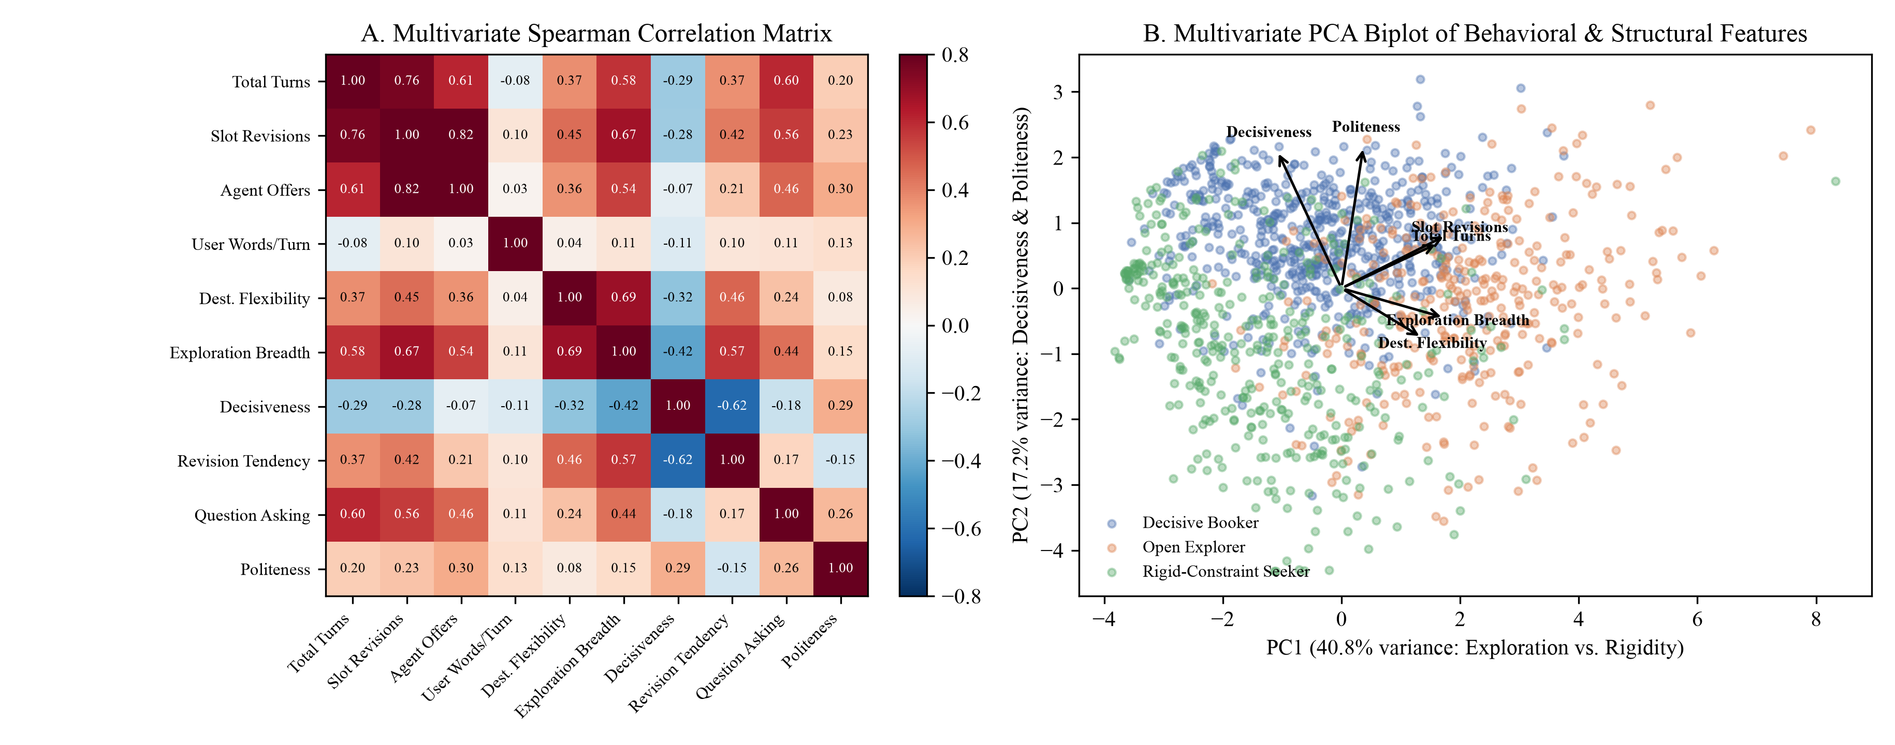
4. DATASET, HYGIENE & EXPLORATORY DATA ANALYSIS
Slide 10
Multivariate EDA: Correlation Structure & Principal Component Biplot (Figure 3)
Ten structural and behavioral variables span three orthogonal dimensions explaining 68.6% of total variance
Variable | PC1 (40.8%) | PC2 (17.2%) | PC3 (10.6%)
Total turns | +.390 | +.014 | −.267
User words / turn | −.123 | +.019 | +.893
Slot revisions | +.416 | +.087 | +.078
Agent package offers | +.357 | −.015 | −.229
Price sensitivity | +.174 | −.426 | −.122
Destination flexibility | +.304 | +.347 | +.116
Date flexibility | +.298 | +.345 | +.069
Exploration breadth | +.392 | +.060 | +.167
Decisiveness | −.162 | −.509 | +.039
Revision tendency | +.379 | +.127 | +.128
How to Read the 3 Principal Components
• PC1 (40.8% var.) — Exploration vs. Rigidity: Loaded on slot revisions (+.42), exploration breadth (+.39), and turns (+.39). Separates Open Explorers (right) from Rigid-Constraint Seekers (left).
• PC2 (17.2% var.) — Decisiveness & Price Focus: Loaded on decisiveness (−.51) and price sensitivity (−.43). Separates Decisive Bookers (bottom) from explorers.
• PC3 (10.6% var.) — User Verbosity: Isolates words per turn (+.89).
Figure 3: Multivariate Spearman Rank Correlation Matrix (Panel A) & PCA Biplot by Refined Archetype (Panel B)
Surnella Sandeep | QM640 Data Analytics Capstone | Cluster-Adaptive Prompting for Multi-Turn Travel Conversational Systems
Notes:
Explain Figure 3 (Panel A Spearman heatmap and Panel B PCA biplot) showing how travel behavior spans Exploration, Decisiveness, and Verbosity.

Slide 11
5. SAMPLE-SIZE ARCHITECTURE & RQ1 OPERATIONALIZATION
Slide 11
Sample-Size Derivation (α, β, f, λ, F_crit, N, n) & Operational Execution in RQ1
Exact noncentral-F sample-size parameters across RQ1–RQ4 and how the derived N = 159 (n = 53/alg) is operationalized in RQ1
A Priori Power Parameters (Cohen, 1988; Faul et al., 2007)
RQ & Story Stage | Experimental Design | df1, df2 (at N_min) | λ (at N_min) | F_crit (α=.05) | N_min (1−β=.80) | Final Buffered N & Cell Size n | Achieved Power
RQ1 (Identify) | One-Way ANOVA (k = 3 algs) | 2, 155 | 9.88 | 3.05 | 158 | N = 159 (n = 53 / alg) | .804
RQ2 (Personalize) | RM-ANOVA (m = 3, ρ = .50) | 2, 54 | 10.50 | 3.17 | 28 | N = 33 (99 LLM calls) | .865
RQ3 (Govern) | 2 × 2 Factorial (df1 = 1) | 1, 124 | 8.00 | 3.92 | 128 | N = 144 (n = 36 / cell) | .847
RQ4 (Optimize) | 2 × 3 Factorial (df1 = 2) | 2, 152 | 9.88 | 3.06 | 158 | N = 180 (n = 30 / cell) | .857
• Noncentral-F Power Criterion: 1 − β = 1 − F_{nc}(F_{crit} ; df₁, df₂, λ) ≥ .80
• Fixed Design Parameters Across All Four RQs:
▪ α = .05 (Type I error ceiling); β = .20 → Power (1 − β) = .80; F_{crit} = F_{1−α}(df₁, df₂).
▪ Target Effect Size: Medium Cohen's f = .25 (f² = 0.0625; equivalent to η² = f²/(1+f²) = .0588).
▪ Noncentrality Parameter (λ):
• Between-subjects (RQ1, RQ3, RQ4): λ = f² · N = 0.0625 · N (needs λ = 8.00 at df₁=1; λ = 9.88 at df₁=2).
• Repeated-measures (RQ2, m=3, ρ=.50, ε=1.0): λ = f² · N · m · ε / (1 − ρ) = 0.375 · N.
▪ Buffer Rule: N_{min} + ≥10% buffer rounded to exact cell multiples (n per group/cell).
Step 1: How N = 159 (n = 53/alg) Is Used in RQ1A
Step 2: Full D_gold (n = 933) Discovery in RQ1B
Step 3: How D_test (n = 401) Feeds RQ1C & RQ2–RQ4
• Why Subsampling Is Required for ANOVA:
▪ Running K-Means once on D_{gold} (n = 933) yields only 1 Silhouette score—impossible to compute within-group variance MS_{error}.
• Generating N = 159 Independent Replications:
▪ Solving λ = 9.88 / 0.0625 gives N_{min} = 158 → buffered to N = 159 (n = 53 runs × 3 algorithms).
▪ 53 deterministic seeds (`1000..1052`) draw 53 random 80% subsamples (746 dialogues each) from D_{gold} = 933.
▪ Each subsample is clustered by K-Means (n=53), Ward (n=53), and HDBSCAN (n=53) → produces 159 Silhouette & DB observations tested via One-Way ANOVA (F(2,156) = 91.33).
• Fitting the Operational Winner on All n = 933 Dialogues:
▪ Once the N = 159 benchmark proves K-Means (k = 3) is the operational winner (100% coverage vs. 39.1% HDBSCAN noise), K-Means is fitted on the full D_{gold} = 933 partition.
• Bootstrap Stability & Truncation Grid (`step2g`):
▪ 100 bootstrap resamples (80% draws) on D_{gold} = 933 evaluate prefix horizons M ∈ {3, 5, 7, 9, whole} across representations.
▪ At M = 9 user messages (`Blocks`), bootstrap stability reaches ARI = .89 (.87 ablation), and the 3 archetype centroids + L1/L2 prefix router + 3 FAISS sub-indices are frozen.
• Out-of-Sample Routing Audit on D_test (n = 401):
▪ The frozen `Blocks` router is evaluated across all n = 401 held-out dialogues, achieving κ = .535 (70.1% at M=5) and κ = .958 (97.3% at M=9).
• Stratified Sampling from D_test (n = 401) for RQ2–RQ4:
▪ • RQ2 (N = 33, n = 11/archetype): Tested across all 3 prompt modes = 99 paired LLM calls (RM-ANOVA df = 2, 64).
▪ • RQ3 (N = 144, n = 36/cell): 36 held-out seeds (12/archetype) × 4 cells (50% rule-violating, 50% compliant; df = 1, 140).
▪ • RQ4 (N = 180, n = 30/cell): 60 held-out seeds/archetype across 2 prompt modes × 3 archetypes (df = 2, 174).
Surnella Sandeep | QM640 Data Analytics Capstone | Cluster-Adaptive Prompting for Multi-Turn Travel Conversational Systems
Notes:
Retains all exact statistical parameters (alpha=.05, beta=.20, power=.80, f=.25, lambda, F_crit, N_min, N, n) while focusing on how the derived sample size is practically executed in RQ1 and flows into RQ2–RQ4.

Slide 12
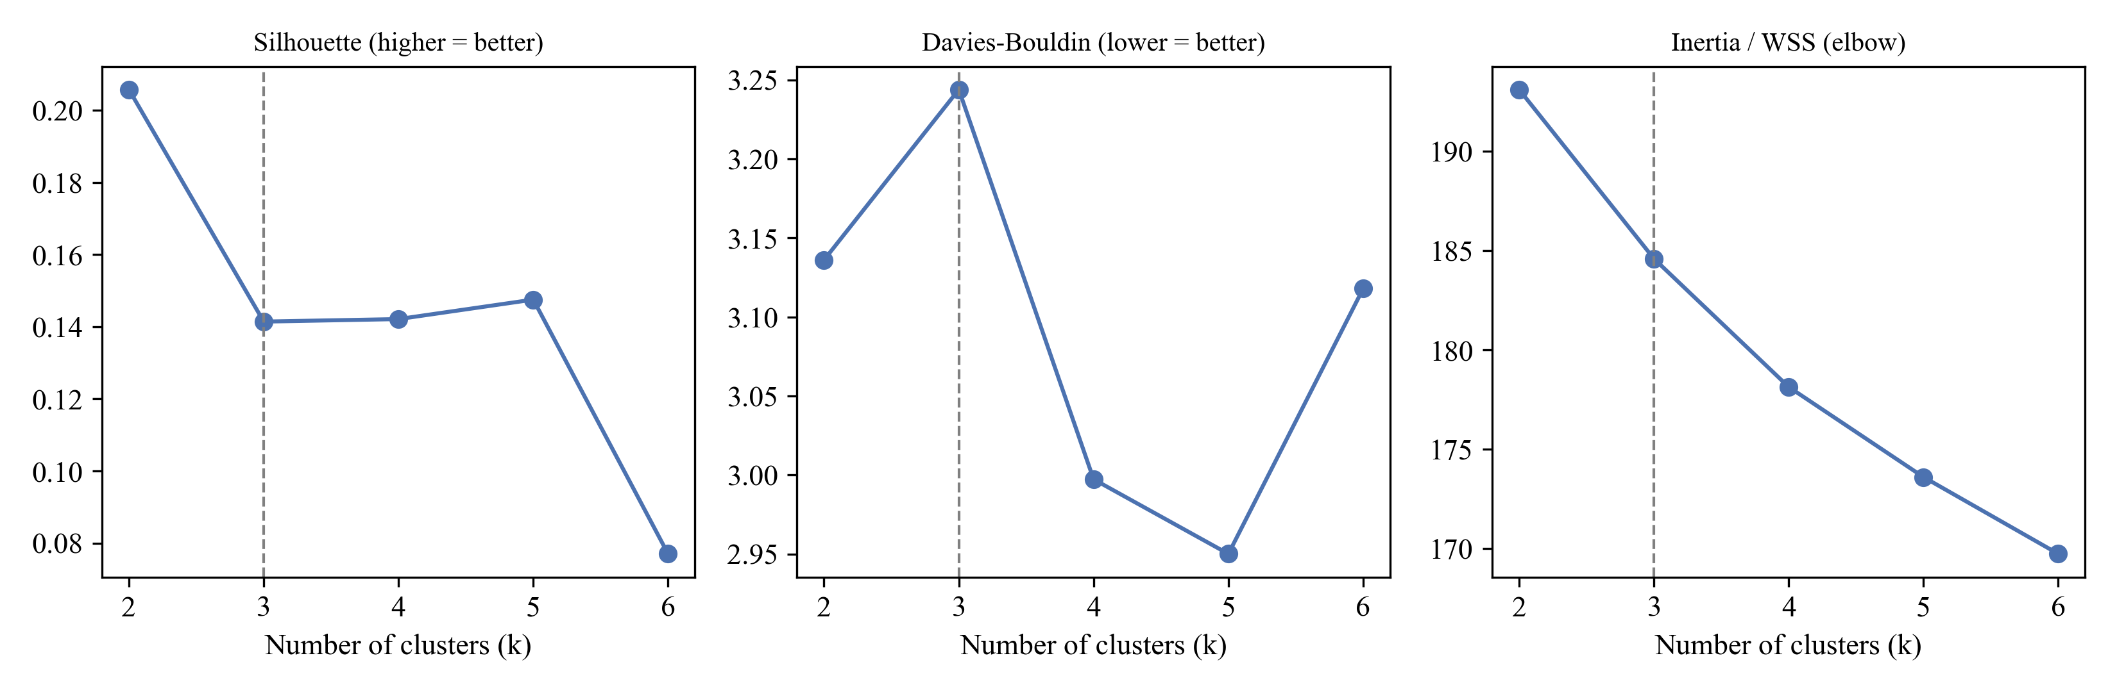
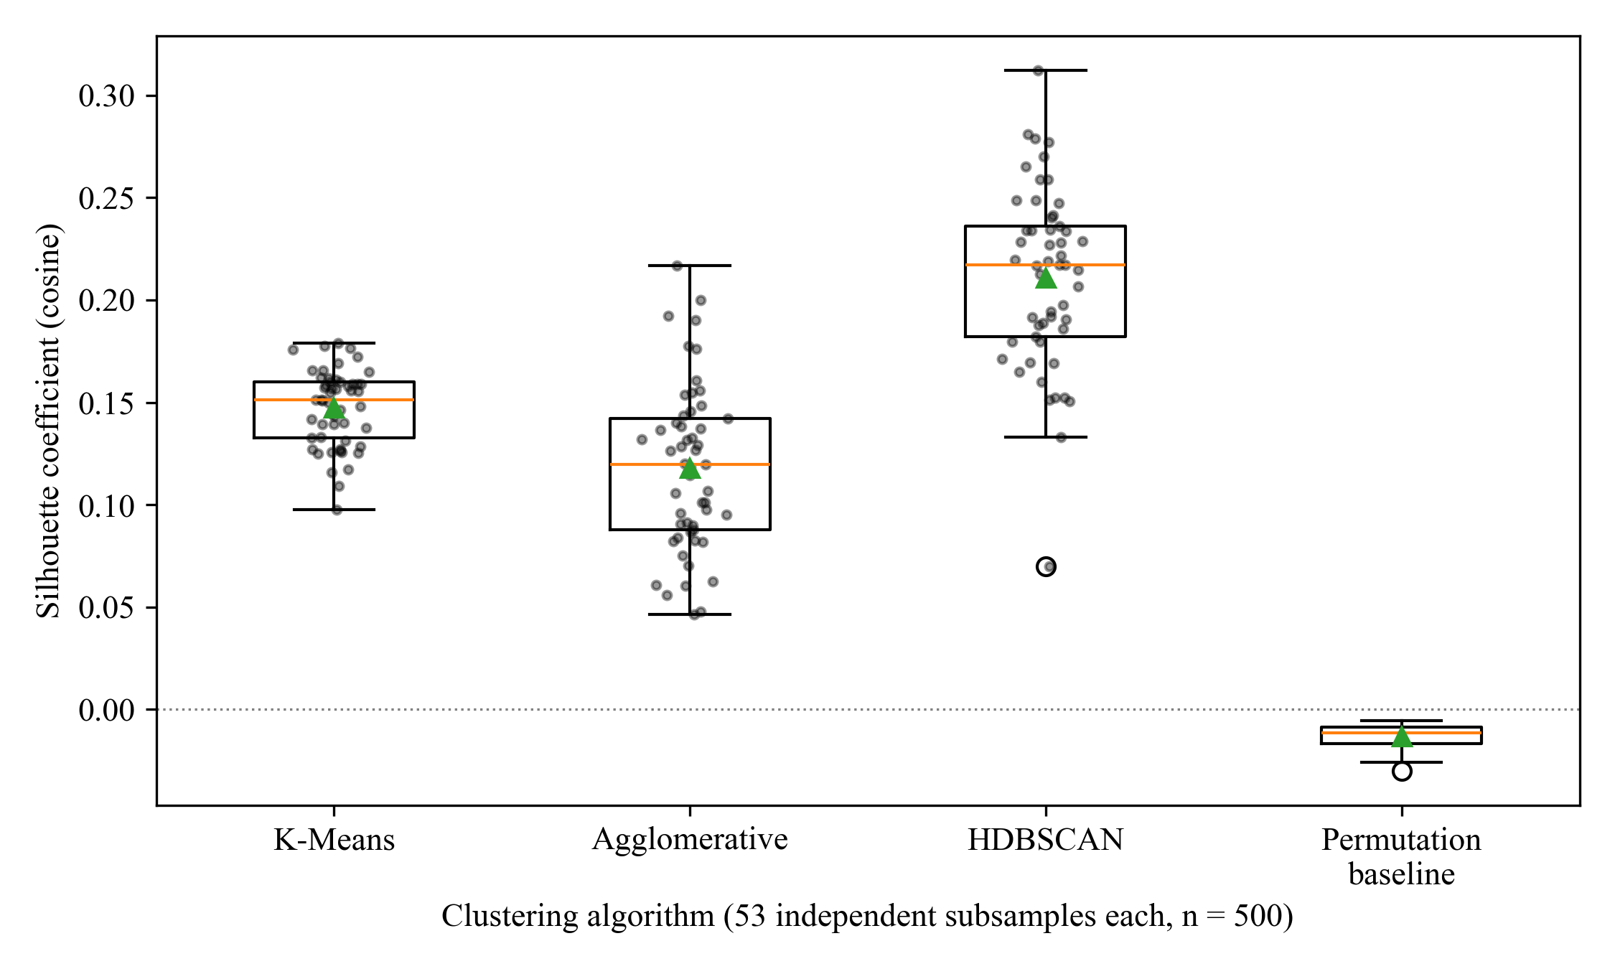
STAGE 1: IDENTIFY (RQ1 — DISCOVERY & ROUTING)
Slide 12
RQ1 (Part 1): Clustering Algorithm Benchmark Across N = 159 Subsample Runs
Table 12 & Figures D1–D2: Rejecting H01 (p < .001) across both MiniLM (384-d) and Gemini (3,072-d) spaces
Embedding Space & Algorithm | Runs (n) | Silhouette M (SD) | Davies–Bouldin | Omnibus ANOVA F (df = 2, 156) | Effect Size η²
1. MiniLM (384-d) — K-Means (k = 3) [Alg. Winner: 100% Cov.] | 53 | .147 (.019) | 3.129 (0.113) | F = 91.33 (p < .001) | .539
2. MiniLM (384-d) — Agglomerative (Ward, k = 3) | 53 | .118 (.040) | 3.550 (0.269) | Tukey KM > Ward: p < .001 | —
3. MiniLM (384-d) — HDBSCAN (Drops 39.1% as noise!) | 53 | .211 (.044)* | 2.657 (0.241)* | *Retains only 60.9% points | —
4. MiniLM (384-d) — Random Permutation Baseline | 53 | −.013 (.006) | — | Null chance reference | —
5. Gemini-001 (3,072-d Turn Pool) — KM / Ward / HDB* | 159 (53×3) | .158 / .150 / .289* | 35.8% HDB noise* | F = 77.09 (p < .001) | .497
6. Gemini-001 (3,072-d Document) [Best Space: KM=.161] | 159 (53×3) | .161 / .213 / .345* | 25.7% HDB noise* | F = 127.47 (p < .001) | .620
Figure D1: Cluster-Number Selection (k = 2..8) on Golden Partition (k = 3 balances Silhouette & size ≥ 20%)
How to Compare the 3 Highlighted Rows (Row 1 → Row 5 → Row 6)
• 1. Why Row 1 Is Highlighted (Winning Algorithm = K-Means, k = 3): Within MiniLM (Rows 1–4), HDBSCAN discards 39.1% of customers as noise, and K-Means (.147) beats Ward (.118, p < .001) with 100% routing coverage.
• 2. Why Row 6 Is the Best of the 3 Highlighted Rows (Row 1 < Row 5 < Row 6): Upgrading from `MiniLM 384-d` (Row 1, KM = .147) to `Gemini 3,072-d Turn-Pool` (Row 5, KM = .158) and `Gemini 3,072-d Document` (Row 6) yields the highest Silhouette (KM = .161, Ward = .213, HDB = .345) and largest effect size (F = 127.47, η² = .620) because full-document Gemini preserves cross-turn context without MiniLM's 256-token cutoff.
• 3. What Moves Forward: Algorithm Winner (`K-Means k=3`) + Embedding Winner (`Gemini-001 Document`, Row 6) are carried forward into the `46-d Blocks` model! (Welch & Kruskal–Wallis/Friedman checks also confirmed p < .001.)
Figure D2: Cosine Silhouette Across 159 Subsample Runs (53 per Algorithm) vs. Permutation Baseline
Surnella Sandeep | QM640 Data Analytics Capstone | Cluster-Adaptive Prompting for Multi-Turn Travel Conversational Systems
Notes:
Explain Table 12 and Figures D1-D2. Note that Welch's ANOVA and non-parametric Kruskal-Wallis / Friedman tests were also run and confirmed the exact same p < .001 result.

Slide 13
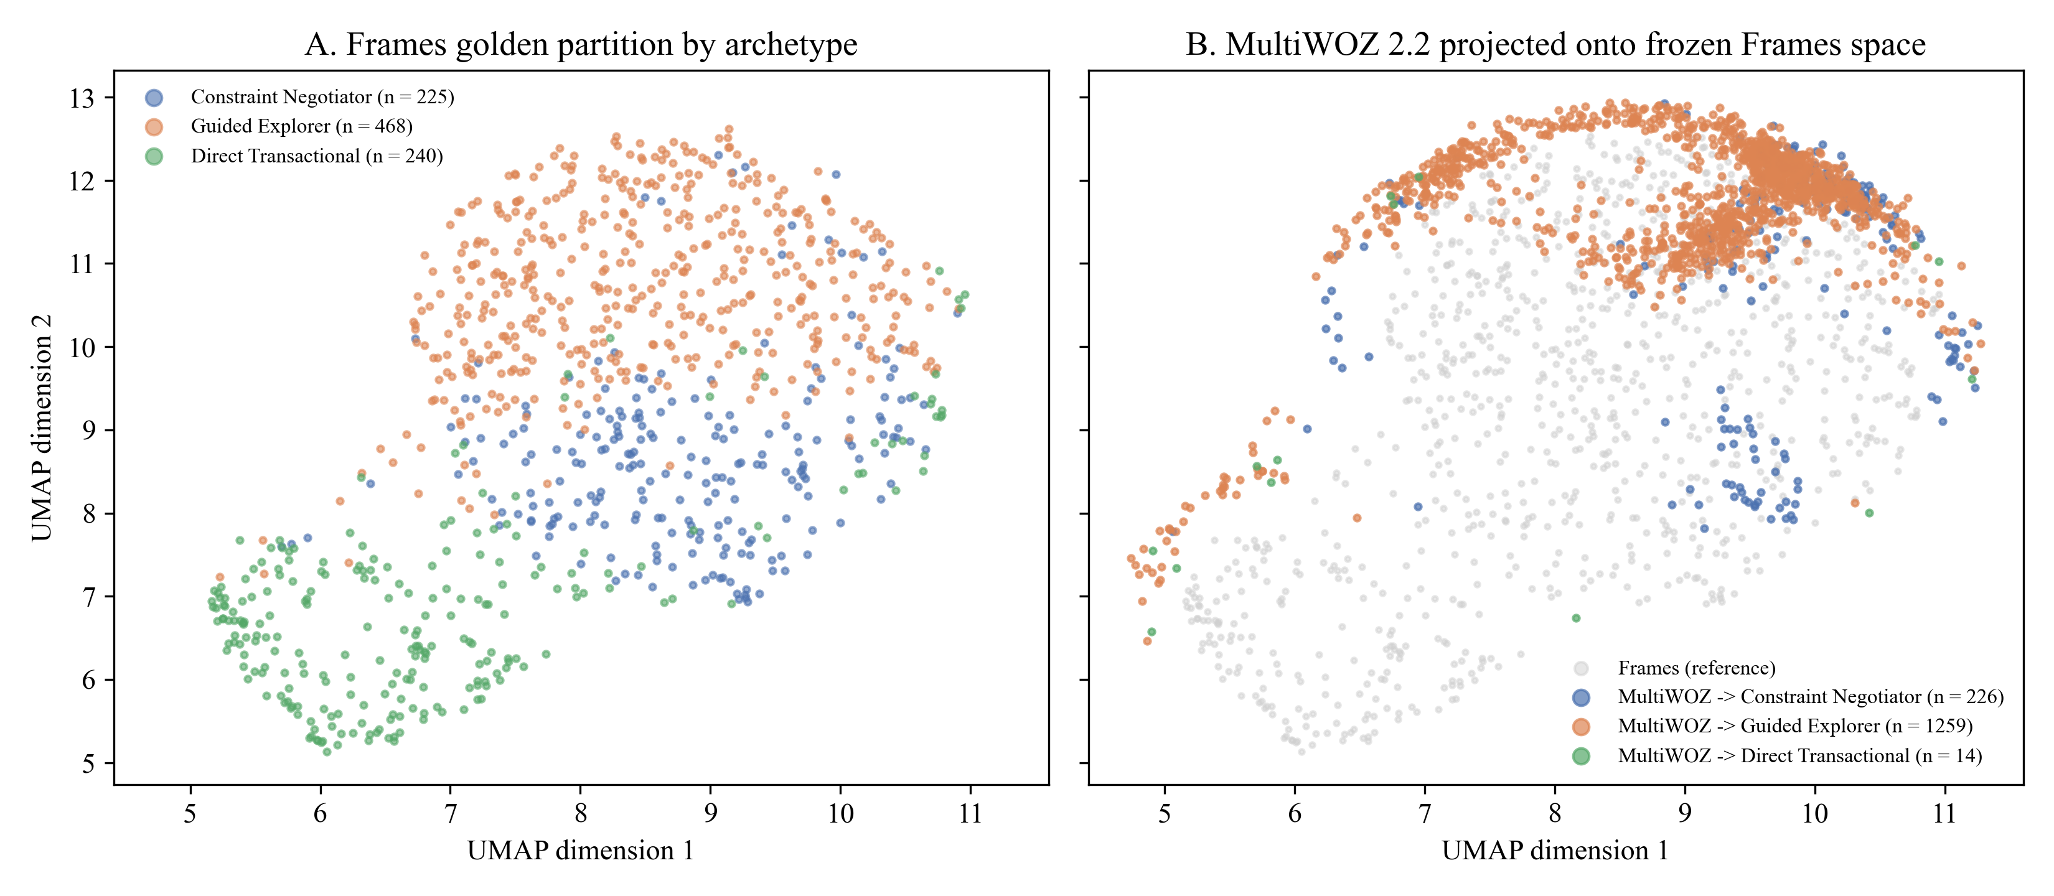
STAGE 1: IDENTIFY (RQ1 — DISCOVERY & ROUTING)
Slide 13
RQ1 (Part 2): Cross-Corpus Transfer & Why Whole-Dialogue Clustering Failed Early Routing
Figure D3 & Table D4: Diagnosing wizard confounding (V = .45) and outcome leakage (κ = .24) in full-transcript clusters
Partition / Corpus | N | Centroid Cosine M (SD) | Direct Trans. (%) | Constraint Neg. (%) | Guided Exp. (%)
Frames Golden (D_gold) | 933 | .466 (.116) | 42.3% | 37.6% | 20.0%
Frames Held-Out (D_test) | 401 | .467 (.116) | 42.6% | 37.7% | 19.7%
MultiWOZ 2.2 Sample | 1,499 | .269 (.115) | 71.4% | 28.6% | 0.1%
Three Diagnostic Findings That Motivated the Prefix `Blocks` Breakthrough
• 1. Internal Stability vs. Cross-Corpus Specificity (Table D4):
▪ Within Frames, Golden (.466) and Held-Out (.467) centroid similarity matched perfectly (t = −0.10, p = .923). Projecting MultiWOZ dropped similarity to .269 (t = 28.08, p < .001) with 0.1% Guided Explorers—confirming consultative travel archetypes are domain-specific.
• 2. Wizard Role-Player Confounding (Cramér's V = .45):
▪ Pooling both user and wizard turns caused clusters to reflect which human wizard handled the chat rather than the customer's own persona.
• 3. Weak Early-Turn Prefix Routing (κ = .24, 39.4% Accuracy):
▪ Predicting a whole-dialogue cluster from the first 5 turns achieved only κ = .24 because whole-dialogue clusters separated sessions by how they ended (Turn 15 booking vs. walk-away), which is unknown during opening turns!
Figure D3: UMAP Projection of Frames Golden/Test Archetypes (Panel A) vs. MultiWOZ 2.2 Projection (Panel B)
Surnella Sandeep | QM640 Data Analytics Capstone | Cluster-Adaptive Prompting for Multi-Turn Travel Conversational Systems
Notes:
Explain why clustering whole transcripts fails at runtime: at Turn 3, the end of the conversation hasn't happened yet!

Slide 14
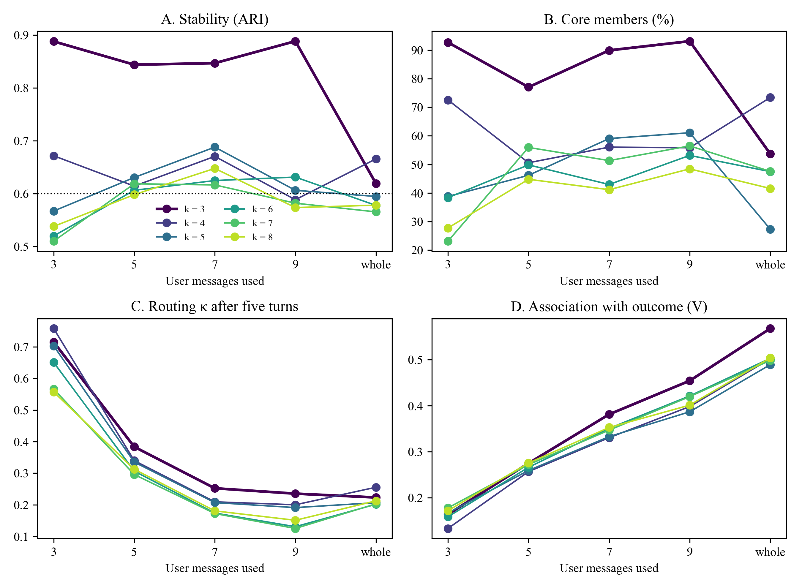
STAGE 1: IDENTIFY (RQ1 — DISCOVERY & ROUTING)
Slide 14
RQ1 (Part 3): The Representation × Truncation Breakthrough (`Blocks` at M = 9)
Figure D4 & Tables C2, D5–D6: Combining PCA-20 Gemini user prefixes + 16-field LLM behavioral profile on opening user messages
Prefix Horizon (m User Msgs / ≈T Turns) | Dialogues > m | Bootstrap ARI | Held-Out Routing p_o (κ) | p_o (<m / ≥m Msgs) | Outcome V
m = 3 user msgs (≈ 5 total turns) | 96.0% | .57 | 59.4% (κ = .359) | 87.5% / 58.2% | .14
m = 5 user msgs (≈ 9 turns — RQ2 Runtime) | 83.2% | .84 | 70.1% (κ = .535) | 81.8% / 67.8% | .17
m = 7 user msgs (≈ 13 total turns) | 59.9% | .85 | 82.0% (κ = .722) | 93.2% / 74.6% | .18
m = 9 user msgs (Adopted Golden Horizon) | 38.6% | .89 (.87 abl.) | 97.3% (κ = .958) | 96.0% / 99.3% | .20
Whole conversation (Un-truncated) | 0.0% | .62 | Confounded by outcome | — | .29
How the 46-d `Blocks` Representation Unlocks Early Routing
• 1. Three-Part Fix (`step2e` & `step2g`): (a) Extract user turns only (eliminates wizard confounding); (b) Truncate at first M = 9 user messages (cuts outcome association from V = .29 to .20); (c) Concatenate PCA-20 Gemini prefix embeddings + 26 encoded columns from the 16-field `UserBehaviour` codebook (Fields 1–13 clustered; Fields 14–16 held out for audit).
• 2. Codebook Reliability & Validity (Table C2): Test–retest reliability (n = 50) reached κ_w = .87 to .96 (mean .91), and ground-truth correlations with Frames acts reached Spearman ρ = .41 to .64 (p < .001).
• 3. Ablation Proof (Table D6): Text embeddings alone at M=9 achieve ARI = .39; combining PCA-20 Gemini + behavioral ratings (`Blocks`) jumps stability to ARI = .89 (.87 in ablation) and held-out routing from κ = .24 → .535 (M=5) → .958 (M=9)!
Figure D4: Bootstrap Stability (ARI), Core Membership, Early Routing, and Outcome Association Across M
Surnella Sandeep | QM640 Data Analytics Capstone | Cluster-Adaptive Prompting for Multi-Turn Travel Conversational Systems
Notes:
Explain how restricting to user turns only, truncating to the first M=9 user messages, and combining PCA-20 Gemini embeddings with the 16-field behavioral profile solved early routing.

Slide 15
STAGE 1: IDENTIFY (RQ1 — DISCOVERY & ROUTING)
Slide 15
RQ1 (Part 4): Behavioral Profile of the Three Refined User Archetypes (Table 13)
How the 16 schema fields differentiate Decisive Booker (45.0%), Open Explorer (25.5%), and Rigid-Constraint Seeker (29.5%)
Schema Field Group & Behavioral Attribute (All 16 Fields) | Archetype 1: Decisive Booker | Archetype 2: Open Explorer | Archetype 3: Rigid-Constraint Seeker | Downstream Prompting & Policy Action (RQ2–RQ4)
Golden (n=933) / Held-Out (n=401) Share | 420 (45.0%) / 165 (41.1%) | 238 (25.5%) / 140 (34.9%) | 275 (29.5%) / 96 (23.9%) | Balanced partition (smallest cluster = 25.5% > 20% rule)
Total Turns M (SD) / User Turns M | 14.96 (6.08) / 7.90 | 17.99 (6.65) / 9.48 | 10.64 (5.68) / 5.79 | Explorers converse 69% longer than Rigid-Constraint Seekers
Fields 1–2 (ORD): Dest. / Date Flexibility | 2.54 / 2.57 (Moderate) | 3.49 / 2.77 (Open dest./dates) | 2.20 / 2.18 (Fixed city & dates) | Offer multi-city alternatives only to Open Explorers
Fields 3–4 (ORD): Exploration / Decisiveness | 1.97 (Focused) / 3.97 (Decisive) | 2.96 (Broad) / 2.58 (Deliberative) | 1.59 (Narrow) / 3.23 (Firm) | Present 2–3 side-by-side options to Open Explorers
Fields 5–6 (ORD): Detail / Revision Tendency | 2.39 / 2.00 (Low revisions) | 2.87 / 3.03 (Frequent pivots) | 1.46 / 2.40 (Constraint-focused) | Proactive dual trade-off framing for Rigid-Constraint Seekers
Fields 7–8 (ORD): Question Asking / Politeness | 2.05 / 4.26 (Warm, direct) | 2.72 / 3.80 (Inquisitive) | 1.43 / 3.07 (Terse, direct) | Fast booking confirmation (~13w norm) for Decisive Bookers
Fields 9–10 (ORD): Price Sens. / Info Upfront | 3.20 / 2.18 (Stated early) | 3.18 / 1.82 (Gradual disclosure) | 3.12 / 2.16 (Hard ceiling) | Calibrate budget-ceiling and package-tier emphasis
Fields 11–13 (CAT Cluster): Goal / Sec. / Tone | 0.5% Exp, 99.3% Book | 52.4% Pos | 39.1% Exp, 50.8% Book | 69.3% Neut | 2.2% Exp, 89.8% Book | 7.6% Pos | One-hot / multi-hot encoded into 16 binary cols (10+16 = 26 cols)
Fields 14–16 (AUDIT Only): Outcome / Party / Flag | 90.5% Booked | 37.1% Solo/Cpl | 68.1% Booked | 44.5% Solo/Cpl | 28.0% Booked (68.0% None) | Excluded from clustering to guarantee zero outcome leakage!
Stage 1 (IDENTIFY) Handoff to Stage 2 (PERSONALIZE):
Unsupervised K-Means integer IDs (`0, 1, 2`) are deterministically mapped via golden centroid maxima (`idxmax(destination_flexibility)` → Open Explorer; `idxmax(decisiveness)` → Decisive Booker; remaining → Rigid-Constraint Seeker). The frozen `RefinedArchetypeRouter` predicts these personas on held-out test prefixes (`κ = .535` at M=5 for mid-dialogue RQ2 prompting; `κ = .958` at M=9 for RQ4 multi-turn policy selection).
Surnella Sandeep | QM640 Data Analytics Capstone | Cluster-Adaptive Prompting for Multi-Turn Travel Conversational Systems
Notes:
Walk through Table 13 showing how the three discovered archetypes differ across flexibility, exploration, decisiveness, revisions, and downstream prompting strategy.

Slide 16
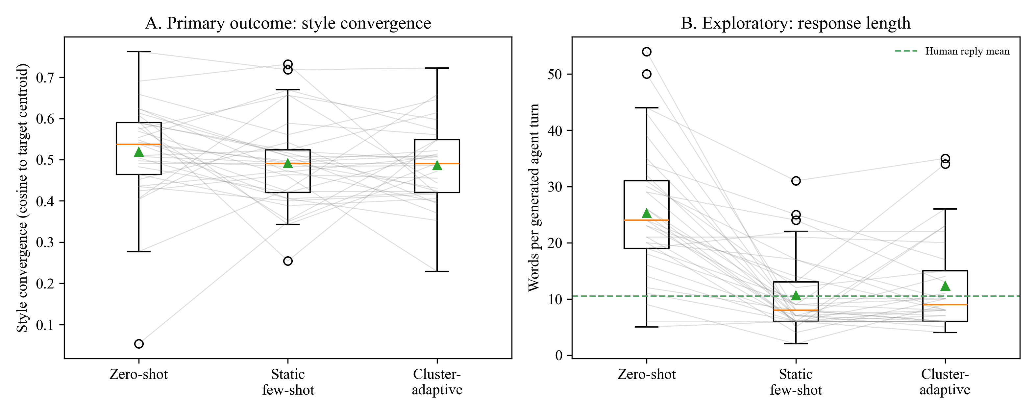
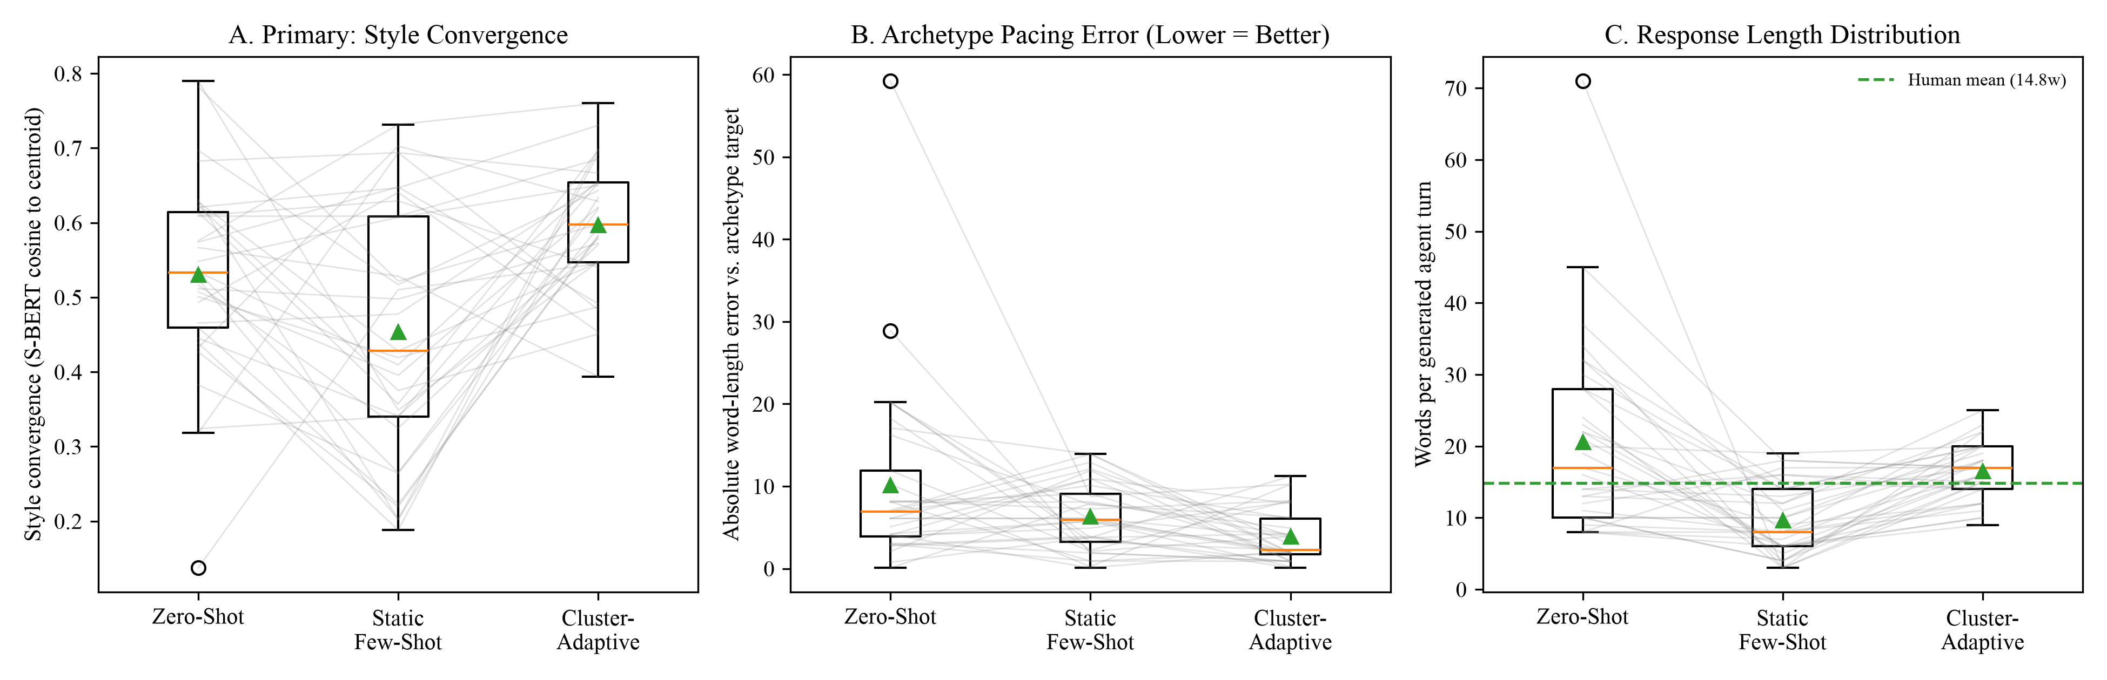
STAGE 2: PERSONALIZE (RQ2 — STYLE & PACING ADAPTATION)
Slide 16
RQ2 (Part 1): Causal Contrast Between Primary (p = .211) and Refined (p < .001) Archetypes
Figures E2 & 6: Proving that in-context style adaptation succeeds if and only if Stage 1 (Identify) routing is coherent
Figure E2 (Coarse Whole-Dialogue Routing, κ = .24): Style Cosine F = 1.61, p = .211 (Null)
Figure 6 (Refined `Blocks` Prefix Routing, κ = .535): Style Cosine F = 9.79, p < .001 (Reject H02!)
Why Primary RQ2 Yielded a Null Style Effect (p = .211)
Why Refined RQ2 Decisively Rejected H02 (p < .001)
• 1. Near-Chance Upstream Routing (39.4%, κ = .24): 60.6% of held-out dialogues were routed to the wrong primary cluster at Turn 3.
• 2. Conflated Exemplar Pools: Because primary clusters mixed user and wizard turns across whole sessions, retrieving from a cluster's FAISS pool fed mismatched examples into the prompt.
• 1. Accurate `Blocks` Prefix Routing (70.1%, κ = .535 at M = 5): Test dialogues were routed to their true behavioral archetype.
• 2. Coherent Sub-Indices & Pacing Directives: Retrieving k = 3 slot-masked exemplars from the matched refined archetype boosted style convergence (F = 9.79, p < .001) and cut pacing error to 3.87 words.
Surnella Sandeep | QM640 Data Analytics Capstone | Cluster-Adaptive Prompting for Multi-Turn Travel Conversational Systems
Notes:
Contrast Figure E2 (interim coarse routing kappa=.24) against Figure 6 (refined Blocks routing kappa=.535). This directly proves the causal link between RQ1 and RQ2.

Slide 17
STAGE 2: PERSONALIZE (RQ2 — STYLE & PACING ADAPTATION)
Slide 17
RQ2 (Part 2): Repeated-Measures Style Convergence & Pacing Calibration (Table 14)
Evaluating Zero-Shot, Static Few-Shot (k = 3), and Cluster-Adaptive Few-Shot (k = 3) across N = 33 dialogues (99 calls)
Experiment & Outcome Metric (N = 33 Dialogues) | Zero-Shot M (SD) | Static Few-Shot M (SD) | Cluster-Adaptive M (SD) | RM-ANOVA F (GG df) | p-value | Partial ηp²
Primary Archetypes (κ = .24) — Style Cosine | .603 (.161) | .650 (.165) | .642 (.125) | 1.61 (1.95, 62.45) | .211 | .048
Primary Archetypes — Response Length (words) | 27.58 (5.43) | 16.33 (4.73) | 15.06 (4.35) | 95.32 (1.82, 58.31) | < .001 | .749
Refined Archetypes (κ = .535) — SBERT Style Cosine (Primary DV) | .530 (.132) | .453 (.169) | .597 (.086) | 9.79 (1.88, 60.29) | < .001 | .234
Refined Archetypes — Gemini 3,072-d Topical Cosine | .787 (.052) | .775 (.055) | .796 (.042) | 1.66 (1.94, 62.22) | .200 | .049
Refined Archetypes — Token-Level BERTScore F1 | .849 (.020) | .844 (.023) | .852 (.019) | 1.45 (1.92, 61.51) | .243 | .043
Refined Archetypes — Pacing Calibration Error (words) | 10.12 (8.98) | 6.33 (3.55) | 3.87 (3.58) | 7.10 (1.30, 41.70) | .007 | .182
Refined Archetypes — Response Length (words) | 25.45 (9.17) | 14.48 (5.16) | 16.33 (3.52) | 31.92 (1.41, 45.24) | < .001 | .499
Pairwise Contrasts & Why SBERT Moves While BERTScore Stays Flat
Pacing Calibration & Distributional Robustness Check
• Holm Contrasts: `Cluster-Adaptive` beats `Static Few-Shot` by Δ = +.144 (+31.8%, t = 4.26, p_{Holm} < .001, d_{z} = 0.74) and `Zero-Shot` by Δ = +.067 (t = 2.37, p_{Holm} = .049, d_{z} = 0.41).
• Metric Specificity: Because all 3 prompts reply to the same travel scenario, broad 3,072-d topical cosine (.775–.796) and token-level `BERTScore F1` (.844–.852) stay invariant, whereas sentence-level discourse style (`SBERT`, F = 9.79) and pacing (F = 7.10) improve significantly.
• Pacing Error Reduction (10.12w → 3.87w): Human wizards average ~13w for Decisive Bookers, ~19w for Open Explorers, and ~15w for Rigid Seekers. `Cluster-Adaptive` calibrates verbosity to each persona (p_{Holm} ≤ .008).
• Variance & Non-Parametric Robustness: Greenhouse–Geisser sphericity corrections (ε = 0.65–0.94) and non-parametric Friedman rank tests (`χ² = 12.50, p = .002` for style; `χ² = 14.27, p < .001` for pacing) confirmed identical conclusions.
Surnella Sandeep | QM640 Data Analytics Capstone | Cluster-Adaptive Prompting for Multi-Turn Travel Conversational Systems
Notes:
Walk through Table 14. Mention concisely that Greenhouse-Geisser sphericity corrections and non-parametric Friedman rank tests confirmed the exact same outcomes.

Slide 18
STAGE 3: GOVERN (RQ3 — POLICY COMPLIANCE & LEAKAGE ELIMINATION)
Slide 18
RQ3 (Part 1): 2 × 2 Factorial Design, Declarative Rules & Dual-Judge Validation
Tables 9 & C3: Crossing Rules Mode (Off vs. Active) × Prompting Strategy (Zero-Shot vs. Cluster-Adaptive) across N = 144 units
Rule ID & Policy Name | Deterministic Trigger Condition | Action | Severity
RULE_VISA_LEAD_TIME: Visa Processing Lead Time | departure_lead_days < 15 on international destination | flag_warning | high
RULE_PASSPORT_VALIDITY: Passport 6-Month Validity | passport_expiry_months < 6 on international trip | block_booking | critical
RULE_PARTY_SIZE_LIMIT: Maximum FIT Adult Capacity | traveler_count_adults > 4 and package_type == 'FIT' | escalate_group_desk | medium
RULE_DISCOUNT_CAP: Promotional Discount Ceiling | discount_applied_percentage > 15.0% | cap_discount | high
RULE_MIN_BUDGET_INTL: Minimum International Budget | budget_amount < $500 per adult on international package | reject_and_reprompt | high
Cross-Model Dual-Judge Reliability (Table C3)
• Independent Verification Against Self-Preference Bias:
▪ Responses generated by `gemini-2.5-flash` were audited on a stratified 48-unit subsample by both `gemini-2.5-flash` (Judge 1) and the larger reasoning model `gemini-2.5-pro` (Judge 2).
• Validation Results (n = 48):
▪ Inter-Model Agreement: 95.8% (46 / 48 units identical; Cohen's κ = .917).
▪ Agreement with Deterministic Regex Verifier (N = 144): 93.1% raw agreement (κ = .861).
2 × 2 Experimental Protocol (N = 144, n = 36 per Cell, Seed = 42):
• 36 held-out test dialogues (12 per refined archetype) were paired with seeded Tier-2 policy states: 50% (18/cell) violated ≥ 1 YAML rule and 50% (18/cell) were 100% policy-compliant (verifying that the guardrail does not falsely block valid trips).
• In `Rules Off`, policies are stated only as text instructions and few-shot exemplars are unmasked. In `Rules Active`, `RuleEngine` injects deterministic pre-check directives, masks exemplar entities with `[SLOT]`, and runs post-generation entity leakage sanitization.
Surnella Sandeep | QM640 Data Analytics Capstone | Cluster-Adaptive Prompting for Multi-Turn Travel Conversational Systems
Notes:
Explain why Stage 2 (Personalize) needs Stage 3 (Govern): unmasked few-shot examples leak entities, and prompt-only rules are ignored 94.4% of the time.

Slide 19
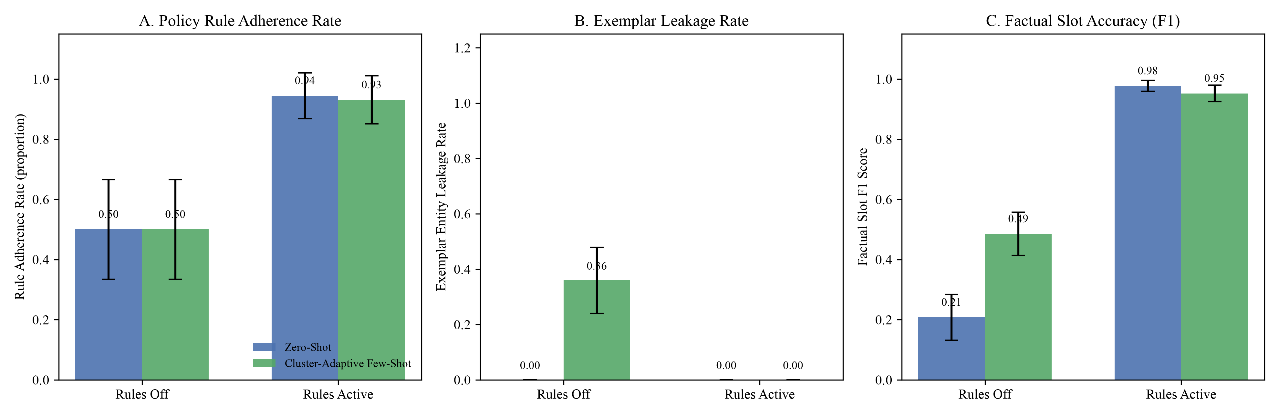
STAGE 3: GOVERN (RQ3 — POLICY COMPLIANCE & LEAKAGE ELIMINATION)
Slide 19
RQ3 (Part 2): 2 × 2 Factorial Interaction Profiles (Figure 7 Walkthrough)
Visualizing orthogonal main effects (Panels A, C, D) versus the protective interaction on Exemplar Leakage (Panel B)
How to Read the 4 Panels of Figure 7
• Panel A (Rule Adherence Rate):
▪ Lines are parallel: activating `RuleEngine` jumps overall adherence from .500 (5.6% violation sensitivity) to .938 (98.6% violation sensitivity), F = 43.92, p < .001.
▪ Prompting mode alone has zero effect (F = 0.01, p = .916) → prompt engineering alone cannot enforce numeric policies!
• Panel B (Exemplar Entity Leakage — Protective Interaction):
▪ Sharp non-parallel divergence (Interaction F = 34.82, p < .001)!
▪ Under `Rules Off`, switching to Cluster-Adaptive spikes entity leakage from .000 to .359 (55.6% incidence).
▪ Under `Rules Active`, `[SLOT]` masking + post-gen sanitization lock leakage at .000 (0.0%)!
• Panel C (Factual Slot Coverage F1) & Panel D (Style Cosine):
▪ `Rules Active` lifts Slot F1 from .208/.485 to .977/.952 (F = 489.52, p < .001), while `Cluster-Adaptive` lifts style alignment in both modes (F = 24.00, p < .001).
Figure 7: 2 × 2 Factorial Interaction Profiles Across N = 144 Units (n = 36/cell; 95% CIs)
Surnella Sandeep | QM640 Data Analytics Capstone | Cluster-Adaptive Prompting for Multi-Turn Travel Conversational Systems
Notes:
Walk through all 4 panels of Figure 7. Highlight Panel B's crossing lines showing how Rules Active eliminates the 35.9% entity leakage of Cluster-Adaptive prompting.

Slide 20
STAGE 3: GOVERN (RQ3 — POLICY COMPLIANCE & LEAKAGE ELIMINATION)
Slide 20
RQ3 (Part 3): Table 15 Factorial Results & Side-by-Side Output Proof
Proving that 'Rules Active × Cluster-Adaptive Few-Shot' (Cell 4) is the unique Pareto-optimal configuration (Reject H03, p < .001)
Experimental Cell or 2 × 2 ANOVA Effect | n or df | Rule Acc. | Viol. Sens. / Comp. Spec. | Exemplar Leakage M (SD) / Inc. % | Slot Coverage F1 M (SD) | Style Alignment M (SD)
Cell 1: Rules Off × Zero-Shot | 36 | .500 (.507) | 5.6% / 94.4% | .000 (.000) / 0.0% | .208 (.242) | .414 (.124)
Cell 2: Rules Off × Cluster-Adaptive (Unguarded) | 36 | .500 (.507) | 5.6% / 94.4% | .359 (.348) / 55.6% | .485 (.269) | .507 (.095)
Cell 3: Rules Active × Zero-Shot | 36 | .944 (.232) | 100.0% / 88.9% | .000 (.000) / 0.0% | .977 (.096) | .428 (.107)
Cell 4: Rules Active × Cluster-Adaptive [Pareto Optimal] | 36 | .931 (.244) | 97.2% / 88.9% | .000 (.000) / 0.0% | .952 (.124) | .506 (.086)
Main Effect: Rules Mode | 1, 140 | F = 43.92 (p < .001), ηp² = .239 | F = 34.82 (p < .001), ηp² = .199 | F = 489.52 (p < .001), ηp² = .778 | F = 3.68 (p = .057), ηp² = .026
Main Effect: Prompting Mode | 1, 140 | F = 0.01 (p = .916), ηp² = .000 | F = 34.82 (p < .001), ηp² = .199 | F = 20.46 (p < .001), ηp² = .128 | F = 24.00 (p < .001), ηp² = .146
Interaction: Rules × Prompting | 1, 140 | F = 0.01 (p = .916), ηp² = .000 | F = 34.82 (p < .001), ηp² = .199 | F = 29.32 (p < .001), ηp² = .173 | F = 8.95 (p = .003), ηp² = .060
Real Output Example: Rules Off × Cluster-Adaptive (Cell 2)
Real Output Example: Rules Active × Cluster-Adaptive (Cell 4)
• Active User State: Flying Dallas → Tokyo in 9 days (violates 15-day visa rule), 2 adults, budget $2,600.
• Generated Reply (Unguarded): 'I can book you into the Sapphire Bay Resort on SkyBridge Airways for $1,149 using code VIP25!'
• Failure: Leaked 4 stale exemplar entities (`ELR = .80`) AND missed the 9-day visa violation (`RAR = 0`)!
• Same User State: Dallas → Tokyo in 9 days, 2 adults, budget $2,600.
• Generated Reply (Governed): 'For your Dallas to Tokyo trip for 2 adults ($2,600 budget), please note that international departures within 15 days (9 days stated) require expedited visa verification before locking in your 9-night package.'
• Variance & Non-Parametric Check: Because zero-leakage cells have zero variance, `MacKinnon–White HC3` (`F = 42.71 & 33.85`) and non-parametric `Aligned Rank Transform (ART)` ANOVA (`p < .001`) were also run and confirmed identical outcomes.
Surnella Sandeep | QM640 Data Analytics Capstone | Cluster-Adaptive Prompting for Multi-Turn Travel Conversational Systems
Notes:
Show the streamlined Table 15 and the concrete Dallas-to-Tokyo output comparison. Mention that heteroscedasticity-robust HC3 and non-parametric ART ANOVA yielded the exact same results.

Slide 21
STAGE 4: OPTIMIZE (RQ4 — MULTI-TURN NEGOTIATION ECONOMY)
Slide 21
RQ4 (Part 1): 2 × 3 Multi-Turn Simulation Design & Persona Fidelity Validation
Testing Prompting Strategy (Zero-Shot vs. Cluster-Adaptive) × Refined Archetype across N = 180 closed-loop dialogues (n = 30/cell)
Closed-Loop Multi-Turn Simulation Protocol (N = 180, n = 30/cell)
Blind Persona Fidelity Audit by Gemini 2.5 Pro (Table C3)
• 1. Grounded Seed Trips: 60 unique held-out test dialogues per archetype (180 distinct trip goals across 3 archetypes × 2 prompting modes = 180 episodes; n = 30/cell).
• 2. Realistic 4-Option Travel Inventory per Dialogue:
▪ Option A (4-Star Exact Match): Exact destination & dates, 4-star hotel, priced at 88% of budget.
▪ Option B (3.5-Star Saver): Exact dates, boutique hotel, priced at 72% of budget.
▪ Option C (5-Star Exact Dates — Over Budget): 5-star luxury hotel on exact dates, priced at 118% of budget (creates realistic constraint conflict!).
▪ Option D (5-Star Shifted Dates — Within Budget): 5-star luxury hotel with dates shifted +3 days, priced at 94% of budget.
• 3. Stopping Criterion: Runs turn-by-turn until the user simulator issues `[ACCEPT_BOOKING]` on a valid package quotation.
• User Simulator Validation Protocol (n = 45 Transcripts):
▪ An independent `gemini-2.5-pro` judge read ONLY the customer utterances from 45 simulated dialogues (15 per archetype, blinded to condition and archetype label) and rated Decisiveness, Exploration Breadth, and Constraint Rigidity (1–5) plus predicted the archetype.
• Validation Results (Within-Simulation Fidelity):
▪ Blind Classification Accuracy: 95.6% (43 / 45 correct) vs. 33.3% chance (exact binomial p = 1.37 × 10⁻¹⁸ < .001, Cohen's κ = .933).
▪ Mean Behavioral Ratings (Decisiveness / Exploration / Rigidity):
• Decisive Booker: 5.00 / 1.00 / 2.27
• Open Explorer: 2.80 / 4.27 / 1.60
• Rigid-Constraint Seeker: 1.67 / 2.27 / 4.33
How Stage 4 (OPTIMIZE) Combines the Informed Slot Ledger with Archetype Package Policies:
• Zero-Shot Baseline: Uses a generic sequential policy—asks clarifying questions one by one and offers only Option A first, without a Verified Informed Slot Ledger.
• Governed Cluster-Adaptive Few-Shot (Routed via `Blocks` at M = 9, κ = .958): Combines the Verified Informed Slot Ledger (forbidding re-asking any stated slot) with archetype-specific action policies: (1) immediate Option A confirmation for Decisive Bookers; (2) side-by-side Option A vs. Option B/D comparison table for Open Explorers; and (3) proactive single-turn trade-off resolution (Option A [4-star exact date] vs. Option D [5-star flexible date]) for Rigid-Constraint Seekers.
Surnella Sandeep | QM640 Data Analytics Capstone | Cluster-Adaptive Prompting for Multi-Turn Travel Conversational Systems
Notes:
Explain how the closed-loop multi-turn simulation works, the 4-option package catalog, and the blind Gemini 2.5 Pro persona audit (95.6% accuracy, kappa = .933).

Slide 22
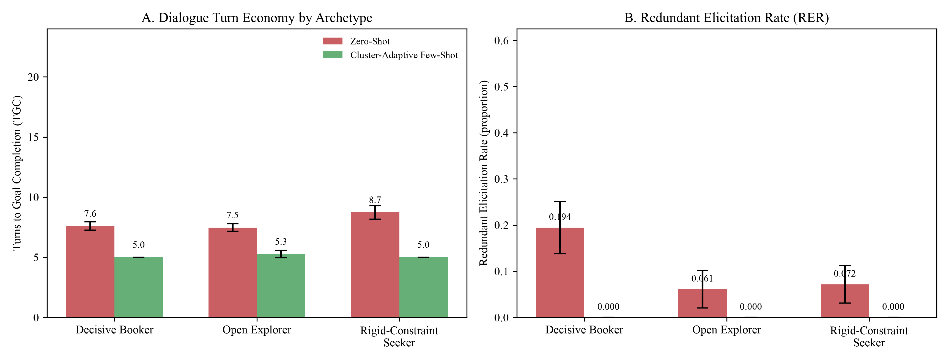
STAGE 4: OPTIMIZE (RQ4 — MULTI-TURN NEGOTIATION ECONOMY)
Slide 22
RQ4 (Part 2): Multi-Turn Turn Economy & Redundant Elicitation Profiles (Figure 8)
Rejecting H04 (p < .001): Massive main effect of prompting (F = 664.43) AND significant Prompt × Archetype interaction (F = 10.89)
Visual Walkthrough of Figure 8
• Panel A (Turns to Goal Completion):
▪ Under `Zero-Shot` (coral bars), Rigid-Constraint Seekers take the longest (8.73 turns) because they reject Option A when their 5-star request exceeds budget, triggering multi-turn pushback loops.
▪ Under `Cluster-Adaptive Few-Shot` (teal bars), turns drop dramatically across all three personas—and the drop is steepest for Rigid-Constraint Seekers (−3.73 turns, −42.7%, 8.73 → 5.00 turns)!
▪ This non-uniform compression produces the highly significant Prompt × Archetype interaction: F(2, 174) = 10.89, p < .001, ηp² = .111.
• Panel B (Redundant Elicitation Rate — RER):
▪ Under `Zero-Shot`, the bot re-asks already stated slots in 19.4% of turns for Decisive Bookers (who state many slots up front), 6.1% for Open Explorers, and 7.2% for Rigid Seekers.
▪ Under `Cluster-Adaptive Few-Shot` with the Verified Informed Slot Ledger, RER drops to 0.000 (0.0%) across all 90 dialogues (F = 63.02, p < .001)!
Figure 8: Mean Turns to Goal Completion (Panel A) & Redundant Elicitation Rate (Panel B) Across N = 180 Simulations
Surnella Sandeep | QM640 Data Analytics Capstone | Cluster-Adaptive Prompting for Multi-Turn Travel Conversational Systems
Notes:
Walk through Panels A and B of Figure 8. Highlight why the turn reduction is steepest (−42.7%) for Rigid-Constraint Seekers.

Slide 23
STAGE 4: OPTIMIZE (RQ4 — MULTI-TURN NEGOTIATION ECONOMY)
Slide 23
RQ4 (Part 3): Table 16 Turn Economy Breakdown by Archetype & Contrasts
Detailed cell means, log-turn ANOVA statistics, and simple within-archetype contrasts across N = 180 simulations
Archetype × Prompting Cell or 2 × 3 ANOVA Effect | Total Turns M (SD) | Log Turns ln(TGC) M (SD) | Redundant Elicitation (RER) | Turn Reduction Δ (%) | Simple Contrast (t_log / Cohen's d)
Decisive Booker — Zero-Shot (n = 30) | 7.60 (0.93) | 2.021 (0.119) | .194 (.166) | — | —
Decisive Booker — Cluster-Adaptive (n = 30) | 5.00 (0.00) | 1.609 (0.000) | .000 (.000) | −2.60 turns (−34.2%) | t = −18.92 (p < .001), d = −3.94
Open Explorer — Zero-Shot (n = 30) | 7.47 (1.01) | 2.002 (0.130) | .061 (.115) | — | —
Open Explorer — Cluster-Adaptive (n = 30) | 5.27 (0.69) | 1.654 (0.115) | .000 (.000) | −2.20 turns (−29.5%) | t = −10.97 (p < .001), d = −2.55
Rigid-Constraint Seeker — Zero-Shot (n = 30) | 8.73 (1.55) | 2.152 (0.175) | .072 (.119) | — | —
Rigid-Constraint Seeker — Cluster-Adaptive (n = 30) | 5.00 (0.00) | 1.609 (0.000) | .000 (.000) | −3.73 turns (−42.7%) | t = −17.02 (p < .001), d = −3.40
Main Effect: Prompting (df = 1, 174) | F = 457.74 (< .001), ηp² = .725 | F = 664.43 (< .001), ηp² = .793 | F = 63.02 (< .001), ηp² = .266 | Overall: 7.93 → 5.09 (−35.8%) | Rejects H04 (p < .001)
Main Effect: Archetype (df = 2, 174) | F = 7.77 (< .001), ηp² = .082 | F = 5.55 (.005), ηp² = .060 | F = 7.57 (< .001), ηp² = .080 | Explorers compare 3 options | Significant persona difference
Interaction: Prompting × Archetype (df = 2, 174) | F = 14.37 (< .001), ηp² = .142 | F = 10.89 (< .001), ηp² = .111 | F = 9.70 (< .001), ηp² = .100 | Steepest gain in Rigid (−42.7%) | Rejects H04 Interaction (< .001)
Protocol Floor (`5.00 Turns`) & Variance / Non-Parametric Robustness Check:
• Because each seed dialogue opens with 3/5 mandatory slots stated, the minimum trajectory to quotation agreement is 5 messages (`U1 → A1 [bundled intake] → U2 [remaining slots] → A2 [archetype-tailored package quote] → U3 [ACCEPT_BOOKING]`). `Cluster-Adaptive` reaches this 5.00-turn minimum for Decisive Bookers and Rigid-Constraint Seekers while giving Open Explorers a 3-option side-by-side comparison (5.27 turns).
• Variance & Non-Parametric Check: Testing unequal variances with `Welch's t` / `MacKinnon–White HC3` (`F_log = 681.53 & 8.58, p < .001`) and rank-based `ART ANOVA` / `Mann–Whitney U` (`p < .001`) confirmed that zero-variance floor cells do not alter any statistical conclusion (full derivations in Backup Deck).
Surnella Sandeep | QM640 Data Analytics Capstone | Cluster-Adaptive Prompting for Multi-Turn Travel Conversational Systems
Notes:
Walk through Table 16. Note concisely that heteroscedasticity-robust HC3, Aligned Rank Transform (ART), Welch t-tests, and Mann-Whitney U tests all confirmed the exact same p < .001 results.

Slide 24
EMPIRICAL SYNTHESIS ACROSS RQ1–RQ4
Slide 24
Consolidated Hypothesis Testing Scorecard (Table 11) & Operational ROI
All four null hypotheses (H01–H04) are rejected at p < .001 across Identify → Personalize → Govern → Optimize
Storyline Stage & RQ | Sample & Design | Baseline vs. Proposed Performance | Primary Parametric Test & Effect Size | Variance & Non-Parametric Check | Decision
1. IDENTIFY (RQ1): Algorithm Separation & Prefix Routing | N = 159 runs (D_gold=933, D_test=401) | Perm. Sil = −.013 vs. KM = .147, HDB = .211 (39.1% noise); Blocks ARI = .89 (.87 abl.); Routing κ = .535 (M=5) to .958 (M=9) | One-way F(2, 156) = 91.33, p < .001, η² = .539 Matched RM F(1.72, 89.30) = 83.04, ηp² = .615 | Welch & Kruskal–Wallis / Friedman confirmed identical outcome (p < .001) | Reject H01 (p < .001)
2. PERSONALIZE (RQ2): Style Convergence & Pacing Calibration | N = 33 dialogues × 3 conditions (99 calls) | Style Cos: Static = .453, Zero = .530 vs. Adaptive = .597 Pacing Error: Zero = 10.12w, Static = 6.33w vs. Adaptive = 3.87w | Style F(1.88, 60.29) = 9.79, p < .001, ηp² = .234 Pacing F(1.30, 41.70) = 7.10, p = .007, ηp² = .182 | GG sphericity & Friedman rank tests confirmed identical outcome (p ≤ .002) | Reject H02 (p < .001)
3. GOVERN (RQ3): Policy Adherence, Leakage & Slot F1 | N = 144 (2 × 2, n = 36/cell; κ_judge = .917) | Viol. Sens.: 5.6% (Off) → 98.6% (Active); Comp. Spec.: 94.4% vs 88.9% Few-Shot Leakage: .359 (55.6%) → .000 (0.0%); Slot F1: .485 → .952 | RAR Acc F(1, 140) = 43.92; Sens F = 498.78 ELR Int. F = 34.82, p < .001; Slot F1 F = 489.52 | HC3 robust SE & ART rank ANOVA confirmed identical outcome (p < .001) | Reject H03 (p < .001)
4. OPTIMIZE (RQ4): Multi-Turn Economy (Log Turns & RER) | N = 180 (2 × 3, n = 30/cell; κ_persona = .933) | Turns: −34.2% (DB), −29.5% (OE), −42.7% (RCS) Overall Turns: 7.93 → 5.09 (−35.8%); RER: .109 → .000 | Prompt F(1, 174) = 664.43, p < .001, ηp² = .793 Prompt × Arch Int. F(2, 174) = 10.89, p < .001 | HC3, Welch t, ART & Mann–Whitney U confirmed identical outcome (p < .001) | Reject H04 (p < .001)
Illustrative Operational Scenario (Hypothetical OTA Handling 1,000,000 Monthly Sessions)
• 1. Cloud Inference & Latency Savings (−35.8%): Compressing mean turns from 7.93 (`Zero-Shot`) to 5.09 (`Cluster-Adaptive`) corresponds to 2.84 fewer messages per session (≈ 2.84M fewer LLM calls/month) in simulation.
• 2. Zero Exemplar Leakage & Policy Enforcement: Eliminating exemplar entity leakage (55.6% incidence → 0.0%) and raising violation sensitivity from 5.6% to 98.6% (`F = 498.78, p < .001`) prevents hallucinated pricing and compliance breaches.
• 3. Rescuing Rigid-Constraint Shoppers: Proactive single-turn trade-off framing cuts simulated negotiation turns by 42.7% for the segment that experienced a 68.0% walk-away rate in historical human logs.
Surnella Sandeep | QM640 Data Analytics Capstone | Cluster-Adaptive Prompting for Multi-Turn Travel Conversational Systems
Notes:
Present Table 11 as the master executive scorecard across all four stages of the storyline.

Slide 25
6. CONCLUSIVE STORYLINE SYNTHESIS
Slide 25
Cumulative Decision & Data Flowchart: Identify (RQ1) → Personalize (RQ2) → Govern (RQ3) → Optimize (RQ4)
Showing how each RQ locks in key methodological decisions and carries forward the 46-d Blocks clusters & artifacts into the next stage
STAGE 1 (RQ1): IDENTIFY
STAGE 2 (RQ2): PERSONALIZE
STAGE 3 (RQ3): GOVERN
STAGE 4 (RQ4): OPTIMIZE
1. Foundation Input:
• 70/30 Split Firewall: D_{gold} = 933 (fit) & D_{test} = 401 (eval)
• N = 159 subsample runs (53 × 3 algs) + Prefix grid M ∈ {3,5,7,9}
1. Inherited from RQ1 (`46-d Blocks`):
• Sampled N = 33 D_{test} chats (11 per `46-d Blocks` archetype × 3 prompts = 99 calls)
• Uses RQ1's `RefinedArchetypeRouter` (M=5) & 3 46-d FAISS Sub-Indices
1. Inherited from RQ1 + RQ2:
• Sampled N = 144 D_{test} units (12 per `46-d Blocks` archetype × 3 = 36/cell; 2×2)
• Uses RQ1's `46-d Blocks` Router + RQ2's `Cluster-Adaptive` Prompting
1. Inherited from RQ1 + RQ2 + RQ3:
• Factor B IS the 3 `46-d Blocks` Archetypes (30 D_{test} trips/cell × 6 = 180 chats; simulator conditioned on RQ1 Table 13, κ=.933)
• Uses RQ1 Router (M=9, κ=.958) + RQ2 `[SLOT]` FAISS + RQ3 Active RuleEngine
2. Empirical Proof (Reject H₀₁, p < .001):
• RQ1A: F(2,156) = 91.33, η² = .539 (KM .147 vs. Ward .118; HDB drops 39.1% noise)
• RQ1B/C: `46-d Blocks` (`PCA-20 Gemini + 26 LLM cols` at M=9) lifts stability to ARI = .89 & routing from κ = .24 → .535 (M=5) → .958 (M=9)
2. Empirical Proof (Reject H₀₂, p < .001):
• Coarse clusters (κ=.24) failed: F = 1.61, p = .211 (Null)
• `46-d Blocks` clusters (κ=.535) succeeded: SBERT Style Cosine jumps .453 → .597 (+31.8%, F = 9.79, p < .001, ηp² = .234); Pacing Error drops 10.12w → 3.87w (p = .007)
2. Empirical Proof (Reject H₀₃, p < .001):
• Unguarded RQ2 prompt (`Rules Off`) leaks stale entities in 55.6% of replies (ELR = .359) & enforces only 5.6% of rules
• `Rules Active` cuts leakage to .000 (0.0%, Int. F = 34.82), lifts rule enforcement to 98.6% (F = 43.92) & Slot F1 to .952 (F = 489.52)
2. Empirical Proof (Reject H₀₄, p < .001):
• Cuts turns 7.93 → 5.09 (−35.8%, F = 664.43, ηp² = .793)
• Steepest gain in Rigid Seekers (−42.7%, 8.73→5.00t), Decisive (−34.2%), Explorer (−29.5%, Int. F = 10.89, p < .001)
• Redundant Asks (`RER`): .109 → .000 (F = 63.02)
46-d
Blocks
+
FAISS
Router
RQ1
Blocks
+
RQ2
Adaptive
Prompt
RQ1+2
+
Active
YAML
Rule
Engine
3. Key Decisions Locked In:
• ✓ Select: `K-Means (k=3)` (100% coverage) + `M=9 46-d Blocks` clusters (Decisive 45%, Explorer 25.5%, Rigid 29.5%)
• ✗ Drop: `HDBSCAN` (39.1% noise) & whole-chat vectors (κ=.24 outcome leakage)
3. Key Decisions Locked In:
• ✓ Select: `Cluster-Adaptive Few-Shot` (k=3 `46-d FAISS` exemplars + Persona Pacing Directives: 13w / 19w / 15w)
• ✗ Drop: `Static Few-Shot` (.453 cos) & coarse primary clusters (p=.211)
3. Key Decisions Locked In:
• ✓ Select: `Rules Active × Cluster-Adaptive` (Cell 4 Pareto Optimal: `[SLOT]` masking + `5 YAML rules` + post-gen sanitizer)
• ✗ Drop: Unmasked exemplars & prompt-only policy instructions
3. Key Decisions Locked In:
• ✓ Select: `Verified Informed Slot Ledger` (0% RER) + Persona Package Policies (1-Opt Confirm / 3-Opt Compare / Dual Trade-Off)
• ✗ Drop: Memoryless sequential 1-option policy
4. CARRIED FORWARD TO RQ2–RQ4 ➔
• `46-d Blocks` Cluster Labels on all 933 D_{gold} & 401 D_{test} chats
• Frozen `RefinedArchetypeRouter`
• 3 Partitioned 46-d FAISS Sub-Indices
4. CARRIED FORWARD TO RQ3–RQ4 ➔
• All RQ1 `46-d Blocks` Artifacts +
• Validated `Cluster-Adaptive` Prompting (k=3 46-d FAISS exemplars + `ARCHETYPE_DIRECTIVES`)
4. CARRIED FORWARD TO RQ4 ➔
• All RQ1 (`46-d Blocks`) + RQ2 (`FAISS ICL`) Artifacts +
• Mandatory `DeclarativeRuleEngine` (`Rules Active`) locked ON for RQ4
4. FINAL VALIDATED ARCHITECTURE ➔
• Complete 4-Stage Neuro-Symbolic Engine (`RQ1 + RQ2 + RQ3 + RQ4`)
• Seeds Doctoral Pillars 1–6 (Context×Behavior, Stages a–f, Turn-Q DB)
Cumulative Build Summary: Yes—the `46-d Blocks` clusters and `RefinedArchetypeRouter` created in RQ1 are the exact backbone carried forward into RQ2, RQ3, and RQ4: RQ1 locks in the 3 `46-d Blocks` clusters & FAISS sub-indices → RQ2 locks in `Cluster-Adaptive` prompting on those sub-indices → RQ3 locks in `[SLOT]` masking & the `YAML RuleEngine` to make that prompting safe → RQ4 deploys the combined `RQ1 + RQ2 + RQ3` stack with the `Slot Ledger` across all 3 `46-d Blocks` personas.
Surnella Sandeep | QM640 Data Analytics Capstone | Cluster-Adaptive Prompting for Multi-Turn Travel Conversational Systems
Notes:
Walk through this cumulative decision-and-data flowchart from left to right. Highlight how Each RQ (1) inherits validated data/models from the previous RQ, (2) runs a powered ANOVA experiment, (3) locks in key design decisions (dropping inferior alternatives), and (4) carries forward concrete artifacts—starting with the 46-d Blocks clusters and FAISS sub-indices from RQ1—into RQ2, RQ3, and RQ4.

Slide 26
7. FIRMING UP THE STORYLINE: CAPSTONE TO DOCTORAL ARCHITECTURE
Slide 26
Pictorial Roadmap: Completed Capstone Blocks (Teal) vs. Doctoral Extensions (Amber)
Condensing Slides 44, 45 & 47: How the 4-stage storyline is firmed up with Context × Behavior, Bayesian Drift, Call Stages (a–f) & 200-Package USP Narrowing
BUILT IN CAPSTONE (RQ1–RQ4)
Empirically Validated Modules & Parameters (p < .001)
TO BE DONE (DOCTORAL P1–P6)
Extensions Firming Up Live Enterprise Scale & Precision
TARGET ENTERPRISE SYSTEM
Human-Like Consultative Travel AI Architecture
[BUILT: RQ1] Identify 3 User Archetypes
[BUILT: RQ2] Personalize Style & Pacing
[BUILT: RQ3] Govern Policy & Zero Leakage
FIRMED-UP ENTERPRISE
CONVERSATIONAL AI
• Method: Opening prefix (`M=9`) `K-Means (k=3)` + `L2 Router` on `46-d Blocks`.
• Addressed Params: `PCA-20` Gemini prefix + `16` LLM behavioral fields (flexibility, decisiveness, exploration).
• Proven Result: `ARI = .89/.87`, `97.3%` prefix routing (`κ = .958`, `p < .001`).
RQ1 → RQ2
• Method: Archetype-Partitioned FAISS (`k=3`) + `[SLOT]` Masking + Pacing Directive.
• Addressed Params: Persona word norms (`12.9w` / `18.6w` / `14.8w`), discourse style.
• Proven Result: Style `.597` (`+31.8%`, `p < .001`) & `3.87w` pacing error (`p = .007`).
RQ2 → RQ3/4
• Method: Declarative `YAML` Rule Engine + Post-Gen Entity Sanitizer.
• Addressed Params: `visa ≥ 15d`, `passport ≥ 6m`, `FIT ≤ 4`, `discount ≤ 15%`, `budget ≥ $500`.
• Proven Result: `0.0%` leakage (`F = 34.82`) & `98.6%` rule enforcement (`κ = .917`).
RQ3 Output
1. Identify (RQ1 + P1–P2)
Tracks `C × K` regimes & live Bayesian persona drift.
3 Personas + Router (κ=.535→.958)
Style (.597) + [SLOT] Mask
0.0% Leak & 98.6% Guard
Firms Up: 1D k=3 → 2D Context×Behavior
Firms Up: Single-Stage → 6 Call Stages
Verified Slots Feed Turn Ledger
2. Personalize (RQ2 + P3)
Adapts style & pacing across call stages `a → f`.
[TO DO: P1] Hierarchical Clustering (C × K)
[TO DO: P3] Enterprise Call Stages (a–f)
[BUILT: RQ4] Optimize Turn Economy & Ledger
• Gap Addressed: Situational trip context shapes how personas behave.
• New Params (Tier 1 × Tier 2): `party_type` (solo/family/group), `budget_stakes` (economy/luxury), `lead_window` × `K=3` personas (`24–36` micro-clusters).
P1 Output
• Gap Addressed: Real sales calls progress across 6 stages (`3 × 6 = 18` FAISS cells).
• Stage Params: (a) Opening → (b) Mandatory Slots → (c) Positioning → (d) Negotiation → (e) Compliance → (f) Closure (`Hot/Warm/Cold` Lead).
P3 Output
• Method: Verified Informed Slot Ledger + Persona Package Trade-Off Framing.
• Addressed Params: `Informed` vs. `Missing` slots + `Option A/B/D` trade-off pitch.
• Proven Result: `−29.5%..−42.7%` turns (`F = 664.43`), `RER .109 → .000`.
RQ4 Output
3. Narrow (P4 USP Tree)
Narrows `200+` packages to `1–2` via USP info-gain.
C×K Regime + Stakes State
Stage (a–f) Gate + Lead Trigger
−30..43% Turns & .000 RER
Firms Up: Hard k-Means → Soft Drift
Firms Up: 4 Options → 200-Pkg USP Tree
Firms Up: Cosine → Turn-Q DB & RLHC
4. Govern (RQ3 Guard)
Enforces `0.0%` entity leakage & `98.6%` policy compliance.
[TO DO: P2] Soft-Mixture & Bayesian Drift
[TO DO: P4] 200-Package USP Catalog Tree
[TO DO: P5–6] Turn-Q DB, Ablation & RLHC
• Gap Addressed: `25.2%` boundary speakers (`s < .05`) & mid-call persona shifts after price shock.
• New Method: Turn-by-turn posterior `P(z_t | u_1..t)` & soft style blending weights (`w_1..w_K`).
P2 Output
• Gap Addressed: Mandatory slots still match `200+` regional packages.
• Narrowing Params: Info-Gain question tree over `seniors`, `children`, `breakfast`, `sightseeing tempo`, `occasion` matched to Package USPs.
P4 Output
• Gap Addressed: Backward cosine ignores remaining turns to quote; simulator vs. live humans.
• New Method: Historical Turn-Economy DB (`DTQ`) + `5-Arm (A–E)` prompt ablation + Constrained Offline RL (`CMDP`).
P5–6 Output
5. Optimize (RQ4 + P5–P6)
Combines Slot Ledger + `Turn-Q DB` + `Hot/Warm/Cold` lead.
Live Posterior P(z_t | u_1..t)
Top 1–2 USP Package Match
Min-DTQ Action + Lead Score
How the Storyline Is Firmed Up: The Teal Blocks (RQ1–RQ4) establish the proven 4-stage foundation (`Identify → Personalize → Govern → Optimize`, all p < .001), while the Amber Blocks (Pillars 1–6) show the exact architectural additions needed to scale from 4 simulated package options to 200+ live enterprise packages across call stages `a–f`.
Surnella Sandeep | QM640 Data Analytics Capstone | Cluster-Adaptive Prompting for Multi-Turn Travel Conversational Systems
Notes:
Condenses Slides 44, 45, and 47 into one cohesive pictorial block diagram using the exact color coding from Slide 47: Teal/Navy for completed and validated Capstone modules (RQ1–RQ4), Amber/Coral for the Doctoral Dissertation extensions that firm up the storyline for live enterprise scale, and Emerald Green for the target human-like AI outcome.

Slide 27
7. FIRMING UP THE STORYLINE: COSINE + TURN-ECONOMY DATA FLOW
Slide 27
Data Flow Diagram: Upgrading Cosine Retrieval (RQ2) with a Turn-Economy & USP Database
Pictorial block and data-flow architecture showing how an additional Turn-Economy Database (Turn-Q DB) & USP Index enhance cosine similarity
BUILT IN CAPSTONE (RQ1–RQ4)
Existing Prefix Router, FAISS Cosine Index, Rule Engine & Slot Ledger
NEW DATA STORE & SCORER
Historical Turn-Economy DB (Turn-Q DB), 200-Pkg USP Index & Composite Scorer
OPTIMIZED TURN OUTPUT
Minimum-Turn Package Quotation + Hot/Warm/Cold Lead Score
1. Why Pure Cosine Distance (RQ2) Needs an Additional Database
END-TO-END DATA FLOW DIAGRAM (DFD): COSINE FAISS INDEX + HISTORICAL TURN-ECONOMY & USP DATABASES
• What Capstone RQ2 Cosine Does Well:
▪ FAISS retrieves top-3 exemplars via context cosine similarity `cos(q_t, e_j)`—capturing how to phrase the reply (`.597` style cosine, `3.87w` pacing error).
• The Limitation of Cosine Alone:
▪ Cosine distance only looks backward at text similarity; it is blind to forward turn economy!
▪ Two past wizard replies may both have `cos = .82`, yet Action A took 9 more turns to reach a quote while Action B closed the quote in 1 turn.
[DATA STORE 1: BUILT RQ2] Partitioned FAISS Vector DB
[DATA STORE 2: NEW DB] Historical Turn-Economy DB
[DATA STORE 3: NEW DB] 200-Package USP Catalog DB
• Indexed By: Archetype `(k = 3)` → upgraded to `(C × K × Stage a–f)`.
• Query Signal: Cosine similarity `cos(q_t, e_j)` on prefix embeddings.
• Provides: Top `[SLOT]`-masked style templates (`HOW` to phrase).
• Indexed By: Symbolic State `S_t = (Cluster, Stage, Slot Bitmask, Conflict)`.
• Stored Metrics per Action `A_j`:
▪ Remaining turns `DTQ = E[T_quote − t]`
▪ Quote win rate `Q*(S_t, A_j)`
• Provides: Shortest path to quote!
• Indexed By: Destination, Window, Budget + Micro-Qualifiers (`Senior, Child, Breakfast, Tempo, Occasion`).
• Query Signal: Info-Gain `IG_USP(A_j)` (`Δ|P_t|` packages narrowed).
• Provides: Top 1–2 USP pitches.
cos(q_t, e_j)
Style Vectors
DTQ & Q*(S_t, A_j)
Turn Economy
IG_USP & Top Pkgs
Catalog Fit
[STEP 1: IDENTIFY] State & Cluster Router
[STEP 2: SCORE & RANK] Cosine + Turn-Q Scorer
[STEP 3: GOVERN] Rule & Style Synthesis
[STEP 4: OPTIMIZE] Quotation & Lead
2. The Upgrade: Composite Cosine + Turn-Economy Scoring
• Built (`RQ1 + RQ4`):
`Blocks` Router (`κ=.958`) + Verified Slot Ledger (`Known: 7/9`, `Missing: {Senior, Breakfast}`).
• Extended (`P1–P3`):
Assigns `(Family, Economy, Rigid)` + `Stage d` + `|P_t| = 38 pkgs`.
• Evaluates Candidate Actions:
▪ `A1 (Ask Sightseeing)`: `cos=.81`, `|P_t|: 38→31`, `DTQ = 5.4t` (Slow ✗)
▪ `A2 (Ask Senior Only)`: `cos=.82`, `|P_t|: 38→14`, `DTQ = 3.1t`
▪ `A3* (Bundle Ask Senior+Bkfst + Pitch 4★ vs 5★ +3d)`: `cos=.84`, `|P_t|: 38→2`, `Q*=.94`, `DTQ = 1.0t` (Selected ✓)
• WHAT to Execute:
Winning Action `A3*` (`DTQ = 1.0t`) + Package USPs.
• HOW to Phrase (`RQ2`):
Top-3 `[SLOT]`-masked exemplars (`14.8w` norm).
• Policy Guard (`RQ3/4`):
`0.0%` leakage, `5 YAML` rules, `0.0%` repeat asks.
• Catalog Narrowed:
`200 → Top 2` USP-fit packages in 1 turn.
• Stage (f) Closure:
Customer agrees to formal quotation.
• CRM Output:
Scored as `Hot / Warm / Cold` Lead.
• Augmenting FAISS with a Turn-Economy Database (`Turn-Q DB`):
▪ Every historical dialogue turn `(State S_t, Action A_j)` inside Cluster `(C × K)` is indexed with its empirical outcome metrics:
▪ • `DTQ(S_t, A_j)`: Expected remaining turns to quotation.
▪ • `Q*(S_t, A_j)`: Quotation agreement probability `[0, 1]`.
▪ • `IG_USP(A_j)`: Package catalog reduction (`200 → |P_t|`).
• Composite Retrieval & Action Score:
`Score = α·cos(q_t, e_j) + β·Q*(S_t, A_j) − γ·DTQ(S_t, A_j) + δ·IG_USP`
Data Flow Takeaway: In the firmed-up architecture, FAISS Cosine Similarity (`Data Store 1`, Teal) governs stylistic phrasing, while the Historical Turn-Economy Database (`Data Store 2`, Amber) and 200-Package USP Database (`Data Store 3`, Amber) govern next-action selection (`A3*`)—ensuring every agent turn simultaneously matches customer style and minimizes remaining turns to quotation.
Surnella Sandeep | QM640 Data Analytics Capstone | Cluster-Adaptive Prompting for Multi-Turn Travel Conversational Systems
Notes:
Presents the methodology from Slide 48 as a clean engineering Block and Data Flow Diagram (DFD) without chess analogies, using the same Teal (Built in Capstone) vs. Amber/Coral (New Database & Scorer Addition) vs. Emerald (Target Output) color coding.

Slide 28
8. CONCLUSION & DEFENSE OPEN FLOOR
Slide 28
Concluding Summary, Reproducibility Inventory & Open Floor
A complete, reproducible neuro-symbolic blueprint validated across Identify (RQ1) → Personalize (RQ2) → Govern (RQ3) → Optimize (RQ4)
Four-Stage Storyline Summary (All H01–H04 Rejected at p < .001)
Reproducibility & Companion Deep-Dive Backup Decks
• 1. IDENTIFY (RQ1 — Early Archetype Routing): Truncating to the first `M = 9` user messages and combining Gemini embeddings with 16 LLM behavioral ratings (`Blocks`) yields 3 stable archetypes (ARI = .89 / .87) and raises held-out prefix routing from κ = .24 to κ = .535 (M=5) and κ = .958 (M=9, 97.3%).
• 2. PERSONALIZE (RQ2 — Style & Pacing ICL): Contrasting Primary (p = .211) vs. Refined (F = 9.79, p < .001, ηp² = .234) archetypes proves that `[SLOT]`-masked FAISS retrieval + directives boost style convergence (+31.8% over static, d_{z} = 0.74) and cut pacing error to 3.87 words.
• 3. GOVERN (RQ3 — Symbolic Policy & Leakage Guard): Declarative `YAML` rule verification eliminates the 35.9% entity leakage of unguarded few-shot prompting down to 0.0% (Interaction F = 34.82, p < .001) while raising violation enforcement from 5.6% to 98.6% and Slot F1 to .952 (Dual-judge κ = .917).
• 4. OPTIMIZE (RQ4 — Multi-Turn Turn Economy): Governed cluster-adaptive prompting + Verified Informed Slot Ledger compress multi-turn sessions by 29.5% to 42.7% (F = 664.43, Interaction F = 10.89, p < .001) and eliminate redundant slot questions (RER .109 → .000; Persona κ = .933).
• GitHub Repository: https://github.com/surnella/QM640-Dialogue-Clustering-Capstone
• Complete Deliverable Suite (`final/`):
▪ 1. 15-Minute Executive Defense Deck (This Presentation — 28 Slides): Streamlined storyline (`Identify → Personalize → Govern → Optimize`) & DFD roadmap.
▪ 2. Comprehensive Defense Deck (`QM_640_Defense_Presentation_Sandeep_Surnella.pptx` — 48 Slides): Includes full ground-up primers, Welch/HC3/ART triangulation tables, counterfactual parameter proofs, and 11 prepared Defense Q&A slides.
▪ 3. Text-to-ANOVA Methodology Reference (`QM_640_RQ_Text_to_ANOVA_Methodology_Reference.pptx` — 19 Slides): Step-by-step mathematical derivations from raw text to F-ratios and noncentral-F power curves.
▪ 4. Final Report (`QM_640_Final_Report_Sandeep_Surnella.docx` & `.pdf`): Complete manuscript, 5 executed notebooks, and 100% cached JSONL outputs.
Thank You — Open Floor for Defense Committee Questions
Surnella Sandeep | Department of Data Analytics, Walsh College | QM640: Data Analytics Capstone | Mentor: Mr. Smitraj Raut
Surnella Sandeep | QM640 Data Analytics Capstone | Cluster-Adaptive Prompting for Multi-Turn Travel Conversational Systems
Notes:
Final summary slide to leave on screen during committee Q&A. Point to the 48-slide Full Defense Deck and 19-slide Methodology Reference Deck if deep mathematical or Q&A backup slides are requested.

