Slide 1
QM640 CAPSTONE DEFENSE PRESENTATION
Cluster-Adaptive Prompting for Multi-Turn Travel and Tourism Conversational Systems
A Neuro-Symbolic Framework Coupling Early-Turn Behavioral-Semantic Archetype Routing, Slot-Masked FAISS In-Context Learning, and Declarative Policy Verification
Author: Surnella Sandeep | Course: QM640: Data Analytics Capstone (Department of Data Analytics, Walsh College)
Instructor & Capstone Mentor: Mr. Smitraj Raut | Date: October 2026
Reproducible Code & Data Repository: https://github.com/surnella/QM640-Dialogue-Clustering-Capstone
Empirical Scope: 2,833 Analytic Human Dialogues (Microsoft Frames N = 1,334; MultiWOZ 2.2 N = 1,499) + ~8,900 Gemini 2.5 Flash/Pro Evaluations
Notes:
Welcome to the defense presentation for my QM640 Data Analytics Capstone. This presentation is structured from the ground up so both AI specialists and non-AI/mathematics committee members can follow every intuition, statistical test choice, sample-size derivation, literature comparison, empirical result across RQ1 to RQ4, and the roadmap to my future doctoral dissertation.

Slide 2
MODULE 1: FOUNDATIONS & STORY
Slide 2
Presentation Roadmap: Building the Story from Basics to Defense Synthesis
An 8-module progressive narrative designed for both AI/ML specialists and statistical/business domain experts
1. Ground-Up Basics (Slides 1–5)
2. Literature & Novelty (Slides 6–9)
3. Data Authenticity & EDA (Slides 10–13)
4. Statistical Foundations (Slides 14–19)
• Why static travel chatbots frustrate real travelers.
• Why naive few-shot AI prompts leak entities & break rules.
• Plain-English glossary: Embeddings, Clustering, FAISS, Symbolic Rules, Turn Economy.
• 26 peer-reviewed studies across 4 streams.
• How we build on prior work & where prior papers stop.
• Concrete data examples from RQ1–RQ4 proving our unique contributions.
• Why Microsoft Frames & MultiWOZ 2.2 were created & why they fit.
• Two-tier Pydantic schema & 70/30 leakage-free split.
• Univariate, Bivariate & Multivariate PCA insights.
• Why ANOVA, RM-ANOVA, and 2×2 / 2×3 Factorial ANOVA were chosen.
• Everyday real-world analogies for every test.
• Why α=.05, Power=.80, f=.25, λ are standard & what fails if mischosen.
5. System Architecture (Slides 20–21)
6. Deep-Dive Results RQ1–RQ4 (Slides 22–34)
7. Defense Q&A Bank (Slides 35–38)
8. Dissertation Roadmap (Slides 39–42)
• 5-Layer Neuro-Symbolic Architecture diagram.
• Offline Golden Discovery (n=933) vs. Online Runtime (n=401).
• Step-by-step execution workflows for RQ1 to RQ4.
• RQ1: 159-run clustering + M=9 Blocks router (κ = .535–.958).
• RQ2: Why Primary failed (p=.211) & Refined succeeded (p<.001).
• RQ3: 2×2 Rules × Prompting (0% leakage, 98.6% compliance).
• RQ4: 2×3 Turn Economy (−29.5% to −42.7% turns, 0% RER).
• Direct answers to anticipated committee questions:
• (1) Sample size assumptions; (2) Prior work used;
• (3) Unique novelty; (4) Dataset authenticity & fit;
• (5) Dual-LLM judge & simulator validity.
• Unified causal story across all 4 RQs.
• Limitations that bound the master's capstone.
• Doctoral Dissertation: 'Dialogue Clustering & Methodologies for Human-Like Conversations'.
Core Thesis: Personalizing chatbot style without symbolic guardrails causes hallucinations (35.9% leakage); enforcing rules without persona routing causes rigid, repetitive dialogues. Combining both yields a Pareto-optimal travel assistant.
Surnella Sandeep | QM640 Data Analytics Capstone | Cluster-Adaptive Prompting for Multi-Turn Travel Conversational Systems
Notes:
Walk the committee through the 8 modules so they see how basic intuition and statistical rigor precede the empirical results.

Slide 3
MODULE 1: FOUNDATIONS & STORY
Slide 3
The Real-World Business Problem: Why Static Travel Chatbots Fail
Travelers do not all shop the same way—yet commercial chatbots force every customer through one static script
Customer Type A: The Decisive Booker (45.0%)
Customer Type B: The Open Explorer (25.5%)
Customer Type C: Rigid-Constraint Seeker (29.5%)
• How they talk (Frames ID e2c09f7a):
▪ 'I need a 5-night package from Dallas to Cancun departing Aug 12 for 2 adults under $2,400.'
• What they want: Immediate confirmation of the best matching package and direct booking.
• How a Static Chatbot fails them:
▪ Follows a slow 8-step intake script; re-asks slots already stated in Turn 1 (19.4% Redundant Elicitation Rate in our Zero-Shot baseline).
▪ Writes verbose 35-word paragraphs instead of a crisp 16-word confirmation.
• Business Impact: Impatient high-intent buyers abandon the cart before checkout.
• How they talk (Frames ID b84f11c2):
▪ 'We have a week off in September and $3,000—what beach or European cities could we compare?'
• What they want: Side-by-side comparison of 2–3 distinct options across price and hotel tiers.
• How a Static Chatbot fails them:
▪ Presents only one option per turn, forcing the user to ask 'What about another city?' or 'What about 4-star vs 3-star?' across 18+ turns.
• Business Impact: Long, exhausting 18-turn sessions that drive up cloud LLM inference costs and user fatigue.
• How they talk (Frames ID 91a4d0e5):
▪ 'I only want a 5-star hotel in Tokyo on Oct 5 for 10 nights under $2,200—no other dates or stars.'
• What they want: If exact inventory is $2,596 (over budget), they need immediate, transparent trade-off options (4-star on Oct 5 vs. 5-star on Oct 12).
• How a Static Chatbot fails them:
▪ Says 'No package found' or argues for 4 turns before revealing alternatives (44.5% end with no suitable option in human corpus).
• Business Impact: 8.73-turn deadlock loops and lost bookings.
Business Problem Statement (Buhalis & Sinarta, 2019; Ivanov & Webster, 2019; Melián-González et al., 2021):
Online travel agencies (OTAs) and hospitality contact centers suffer from low self-service conversion and high session abandonment because static LLM prompts fail to adapt information density, pacing, and trade-off framing to customer decision-making styles—while unverified generative responses create financial liability from policy violations.
Surnella Sandeep | QM640 Data Analytics Capstone | Cluster-Adaptive Prompting for Multi-Turn Travel Conversational Systems
Notes:
Start with a relatable real-world scenario. Show how three different customers enter an Online Travel Agency (OTA) portal and get frustrated by a one-size-fits-all chatbot.

Slide 4
MODULE 1: FOUNDATIONS & STORY
Slide 4
The Technical Paradox: Why Naive Few-Shot AI Adaptation Fails
Simply pasting retrieved past dialogues into an LLM prompt introduces two severe production hazards
Hazard 1: Exemplar Entity Leakage (Hallucinated Terms)
Hazard 2: Enterprise Policy Blindness (Rule Violations)
• What happens in standard few-shot prompting (Liu et al., 2022):
▪ To teach the LLM how to talk to an Open Explorer, the system retrieves 3 similar past transcripts from the database and puts them in the prompt.
• The Contamination Trap (Proven in our RQ3 Experiment):
▪ If those retrieved examples mention 'Sapphire Bay Resort', 'SkyBridge Airways', '$1,149', or promo code 'VIP25', the LLM copies those stale entities into the current customer's reply!
• Empirical Proof from Our Data (RQ3 Table 15):
▪ Unguarded Cluster-Adaptive Few-Shot leaked stale exemplar entities in 55.6% of all responses (mean leakage rate = 0.359, p < .001).
• What happens when rules are only written in the system prompt:
▪ Travel bookings are governed by strict numeric constraints: e.g., international trips require ≥ 15 days visa lead time; passports need ≥ 6 months validity; FIT bookings allow ≤ 4 adults; promo discounts cap at 15%.
• The Attention Competition Trap (Yao et al., 2024):
▪ When the LLM focuses on matching conversational style, it overlooks arithmetic thresholds buried in long text prompts.
• Empirical Proof from Our Data (RQ3 Table 15):
▪ Without an external symbolic rule engine (Rules Off), Gemini 2.5 Flash enforced violated booking rules in only 5.6% of violating sessions (missing 94.4% of violations!).
Our Solution: A Neuro-Symbolic Cluster-Adaptive Architecture
• 1. Early-Turn Hybrid Archetype Routing (RQ1): Identify whether the user is a Decisive Booker, Open Explorer, or Rigid-Constraint Seeker from opening user messages without leaking end-of-dialogue outcomes.
• 2. Slot-Masked FAISS Exemplar Retrieval (RQ2): Replace all entities in retrieved examples with `[SLOT]` placeholders (e.g., `[HOTEL_NAME]`, `[BUDGET_USD]`) so the LLM learns conversational style and pacing without copying stale facts.
• 3. Deterministic Declarative Rule Engine + Informed Slot Ledger (RQ3 & RQ4): Enforce YAML booking policies (0.0% leakage, 98.6% compliance) and lock stated user slots so the bot never re-asks known information (0.0% redundant elicitation).
Surnella Sandeep | QM640 Data Analytics Capstone | Cluster-Adaptive Prompting for Multi-Turn Travel Conversational Systems
Notes:
Explain why we cannot just use standard Retrieval-Augmented Generation (RAG) or naive KATE few-shot prompting.

Slide 5
MODULE 1: FOUNDATIONS & STORY
Slide 5
Core Concepts Explained from the Ground Up (Plain-English Primer)
Bridging AI/NLP terminology and statistical measurement for interdisciplinary defense committee members
Concept / Term | Plain-English Meaning | Real-World Analogy | How It Is Measured in This Study
1. Vector Embedding (SBERT 384-d & Gemini 3,072-d) | Converting a sentence or dialogue into a list of numbers (coordinates) so dialogues with similar meaning sit close together in geometry. | Like GPS coordinates (latitude, longitude) on a map, but with 384 or 3,072 dimensions capturing meaning and tone. | Cosine similarity [-1, +1] between vectors: +1 = identical direction/style; 0 = unrelated.
2. Unsupervised Trajectory Clustering (K-Means, Ward, HDBSCAN) | Automatically grouping 933 training dialogues into natural customer segments without pre-labeled categories. | Sorting thousands of retail shoppers into 'Quick Grab-and-Go', 'Window Browsers', and 'Coupon Bargain Hunters' by watching how they walk. | Silhouette score [-1, +1] (higher = tighter, well-separated clusters), Davies–Bouldin index (lower = better), and Bootstrap ARI stability [0, 1].
3. Early-Turn Prefix Routing (RefinedArchetypeRouter) | Predicting which archetype a new customer belongs to after reading only their first M (e.g., 5 to 9) messages. | An experienced hotel concierge recognizing a guest's style within the first 60 seconds of conversation. | Out-of-sample Routing Accuracy (%) and chance-corrected Cohen's Kappa (κ) on 401 held-out test dialogues.
4. Slot-Masked FAISS Few-Shot Prompting | Retrieving the 3 closest past dialogues from the customer's archetype with hotel/price names masked as [SLOT], showing them to the LLM as style templates. | Giving a new sales associate 3 redacted scripts showing *how* to structure an answer without letting them quote last week's prices. | Style Convergence Cosine (similarity to human wizard style) and Pacing Calibration Error (|generated words − target archetype words|).
5. Neuro-Symbolic Guardrail (Declarative Rule Engine) | Combining a neural LLM (for fluent language) with deterministic code rules (if/then YAML policies) that audit facts before & after generation. | An architect designing a creative building (Neural LLM) checked by a structural engineer's building-code calculator (Symbolic Engine). | Rule Adherence Rate (RAR), Exemplar Entity Leakage Rate (ELR), and Factual Slot Coverage F1 [0, 1].
6. Turn Economy & Redundant Elicitation Rate (RER) | How many back-and-forth turns it takes to reach a successful booking, and how often the bot wastes turns re-asking already-stated facts. | Closing a travel booking in 5 focused turns instead of 9 repetitive turns asking 'Where are you flying from?' twice. | Turns to Goal Completion (TGC, raw & log-transformed) and RER = redundant slot questions / total agent turns.
Surnella Sandeep | QM640 Data Analytics Capstone | Cluster-Adaptive Prompting for Multi-Turn Travel Conversational Systems
Notes:
Use this slide to make sure non-AI professors have crystal-clear intuition for the 6 building blocks used throughout the presentation.

Slide 6
MODULE 2: LITERATURE ANALYSIS & UNIQUENESS
Slide 6
Literature Review (Part 1): Hospitality AI Value & Task-Oriented Corpora
What prior business and corpus studies discovered, how we use their foundations, and what they left unsolved
Stream 1: Travel & Hospitality AI Business Value
Stream 2: Task-Oriented Dialogue Corpora (Frames & MultiWOZ)
• What Prior Papers Tried & Found:
▪ Buhalis & Sinarta (2019) introduced real-time 'nowness' co-creation in tourism: travelers expect instant, personalized itinerary synthesis.
▪ Ivanov & Webster (2019) established the ROI framework for hospitality automation: chatbots create net economic value only when they resolve complex consultative queries without human escalation.
▪ Melián-González et al. (2021) surveyed N = 1,476 consumers and proved that perceived interaction efficiency and task fit drive chatbot adoption.
▪ Jannach et al. (2021) & Inaba et al. (2022) showed qualitatively that travelers exhibit heterogeneous initiative and constraint rigidity.
• How We Use This Knowledge:
▪ We operationalize their qualitative constructs—decisiveness, exploration breadth, constraint rigidity, and interaction effort—into 16 quantitative behavioral variables and multi-turn turn-economy metrics.
• What Is Uniquely New in Our Study (With Data Proof):
▪ Prior tourism papers relied on post-hoc user surveys. We are the first to instrument actual LLM turn economy, proving a 35.8% reduction in turns (7.93 → 5.09 turns, p < .001) and 0.0% redundant questions.
• What Prior Papers Tried & Found:
▪ El Asri et al. (2017) [Microsoft Frames] collected 1,369 human–human Wizard-of-Oz vacation package negotiations to study non-linear frame-switching (comparing multiple flight+hotel packages under budget ceilings).
▪ Budzianowski et al. (2018) & Zang et al. (2020) [MultiWOZ 2.2] created a 10,438-dialogue benchmark for supervised slot-filling across city services (hotel, train, attraction, taxi, restaurant).
• How We Use This Knowledge:
▪ We use Frames (N = 1,334 analytic) as our primary consultative travel testbed and MultiWOZ 2.2 (N = 1,499) as an external structural transfer benchmark.
• What Is Uniquely New in Our Study (With Data Proof):
▪ Both corpora were built for supervised slot state tracking, treating all users as uniform. Neither clustered user decision-making archetypes nor audited policy compliance.
▪ Our cross-corpus test in RQ1 proves that Frames negotiation archetypes do not transfer trivially to simple MultiWOZ slot-filling (centroid cosine .467 vs. .269, t = 28.08, p < .001), proving consultative travel requires its own archetype taxonomy.
Surnella Sandeep | QM640 Data Analytics Capstone | Cluster-Adaptive Prompting for Multi-Turn Travel Conversational Systems
Notes:
Directly addresses Committee Question 2 & 3 on prior literature in business hospitality and dialogue datasets.

Slide 7
MODULE 2: LITERATURE ANALYSIS & UNIQUENESS
Slide 7
Literature Review (Part 2): Representation Learning, FAISS ICL & Guardrails
How we integrate vector geometry, dynamic in-context learning, and programmable rails—and overcome their failure modes
Stream 3: Embeddings & Unsupervised Clustering
Stream 4: Dynamic Few-Shot Retrieval & Symbolic Guardrails
• What Prior Papers Tried & Found:
▪ Reimers & Gurevych (2019) [Sentence-BERT] and Lee et al. (2025) [Gemini Embeddings] showed that bi-encoder transformers map text into cosine spaces suitable for clustering.
▪ McInnes et al. (2017, 2018) [HDBSCAN & UMAP] and Hennig (2007) [Bootstrap ARI] established density clustering and resampling stability.
▪ Gilardi et al. (2023) proved zero-temp LLMs achieve high annotation reliability.
• What Failed When Applied Directly (Our Interim Discovery):
▪ When we clustered whole-dialogue embeddings directly (as standard papers do), clusters captured end-of-dialogue outcomes and wizard identity (Cramér's V = .45) rather than user behavior, giving terrible early-turn routing (κ = .24) and a null RQ2 prompting result (p = .211)!
• Our Unique Innovation (RQ1 Breakthrough):
▪ We combined truncated opening user prefixes (first M = 9 user messages) with a 16-field LLM behavioral profile (`Blocks`), raising bootstrap stability to ARI = .76 and out-of-sample routing to κ = .535 (M=5) and κ = .958 (M=9).
• What Prior Papers Tried & Found:
▪ Brown et al. (2020) & Liu et al. (2022) [KATE] showed that retrieving nearest-neighbor in-context examples via FAISS (Johnson et al., 2021) beats random static examples on single-turn NLP tasks.
▪ Rebedea et al. (2023) [NeMo Guardrails] & Yao et al. (2024) [τ-bench] showed that prompt-only LLMs violate domain rules over 50% of the time.
• Where Prior Papers Stopped:
▪ KATE retrieves from one unpartitioned global pool with raw unmasked entities. NeMo and τ-bench test safety rails in isolation without studying how rails interact with dynamic style prompting.
• Our Unique Innovation (RQ2 & RQ3 Breakthrough):
▪ We partition FAISS into archetype-specific sub-indices with `[SLOT]` masking, boosting style convergence over static few-shot by +31.8% (.597 vs. .453, p < .001, d_z = 0.74).
▪ In RQ3, we prove a significant 2 × 2 interaction (F = 34.82, p < .001): our declarative rule layer eliminates the 35.9% entity leakage of unguarded few-shot prompting down to 0.0%.
Surnella Sandeep | QM640 Data Analytics Capstone | Cluster-Adaptive Prompting for Multi-Turn Travel Conversational Systems
Notes:
Continue literature synthesis covering SBERT/Gemini embeddings, KATE k-NN prompting, and NeMo/Tau-bench guardrails.

Slide 8
MODULE 2: LITERATURE ANALYSIS & UNIQUENESS
Slide 8
Literature Synthesis Matrix: Prior Approaches vs. Our Empirical Findings
Concrete examples quoted directly from our RQ1–RQ4 data illustrating what prior methods miss and what our framework solves
Prior Literature Benchmark | What Prior Paper Did | Limitation When Applied to Travel Dialogues | Our Unique Methodological Addition | Concrete Proof Quoted from Our Data (RQ1–RQ4)
Whole-Text Embedding Clustering (Reimers & Gurevych, 2019; McInnes et al., 2017) | Clustered full documents using SBERT / HDBSCAN. | HDBSCAN discards 71.7% of travel dialogues as noise; full-dialogue vectors leak end-of-session booking outcomes. | Prefix-truncated (M=9 user msgs) hybrid Blocks (PCA-20 Gemini + 16 LLM behavioral ratings) with K-Means (k=3). | RQ1: HDBSCAN failed in 53/53 default runs. Our M=9 Blocks router achieved ARI = .76 and raised held-out routing from κ = .24 (39.4%) to κ = .535 (70.1% at M=5) and κ = .958 (97.3% at M=9).
Global k-NN Few-Shot (KATE) (Liu et al., 2022; Brown et al., 2020) | Retrieved k nearest examples from one global pool without persona routing. | Static/unrouted examples mismatch user pacing; coarse routing (κ=.24) fails to improve style. | Archetype-partitioned FAISS sub-indices + archetype pacing directives routed via Blocks. | RQ2: Coarse Primary RQ2 failed (F = 1.61, p = .211). Refined RQ2 succeeded (F = 9.79, p < .001, ηp² = .234): style cosine rose from .453 (Static) to .597, and word pacing error fell from 10.12w to 3.87w.
Unmasked In-Context Examples (Standard RAG / Few-Shot) | Inserted raw historical text examples directly into the LLM prompt. | LLM copies stale hotel names, prices, and promo codes from examples into the active user session. | Regex/Schema [SLOT] masking in FAISS exemplars + post-generation entity leakage sanitizer. | RQ3: Unguarded Cluster-Adaptive leaked stale entities ('Sapphire Bay Resort', '$1,149', 'VIP25') in 55.6% of cases (ELR = .359). Rules Active × Cluster-Adaptive reduced leakage to 0.0% (Interaction F = 34.82, p < .001).
Prompt-Only Policy Instructions (Yao et al., 2024 τ-bench; Rebedea et al., 2023) | Evaluated LLM adherence to domain rules stated only in natural language prompts. | LLMs ignore numeric visa, passport, adult-cap, and discount thresholds when optimizing for conversational tone. | Deterministic YAML RuleEngine (5 Tier-2 rules) executing pre-generation checks & post-generation verification. | RQ3: Under Rules Off, Gemini 2.5 Flash enforced policy violations in only 5.6% of violating sessions. Activating RuleEngine raised violation enforcement to 98.6% (F = 43.92, p < .001) and Slot F1 from .485 to .952.
Static Sequential Slot-Filling (Budzianowski et al., 2018; Inaba et al., 2022) | Used a single dialogue policy across all users without tracking informed slots. | Re-asks already stated constraints and causes 8.7-turn deadlocks for Rigid-Constraint Seekers. | Verified Informed Slot Ledger + Archetype-Specific Turn-Economy Policy (bundle vs. compare vs. proactive trade-off). | RQ4: Cut turns to booking by −42.7% for Rigid-Constraint Seekers (8.73 → 5.00 turns, d = −3.40), −34.2% for Decisive Bookers (7.60 → 5.00), and −29.5% for Open Explorers (7.47 → 5.27), while cutting RER from .109 to .000.
Surnella Sandeep | QM640 Data Analytics Capstone | Cluster-Adaptive Prompting for Multi-Turn Travel Conversational Systems
Notes:
Walk through this table row-by-row during the defense to show mastery of the literature and concrete empirical evidence.

Slide 9
MODULE 2: LITERATURE ANALYSIS & UNIQUENESS
Slide 9
How the Four Research Questions Form One Integrated Causal Chain
Each research question solves a specific bottleneck and feeds its validated output directly into the next stage
RQ | Research Question | Manipulated IV (X) | Measured DV (Y) | Hypotheses (H0 vs. Ha) | Why This Step Is Essential in the Story
RQ1 (Discovery & Routing) | Which clustering algorithm best separates travel trajectories, and which early-routable user archetypes emerge? | X1: Algorithm (K-Means, Ward, HDBSCAN) × Prefix Horizon M ∈ {3,5,7,9,whole} × Representation | Y1: Cosine Silhouette, Davies–Bouldin, Bootstrap ARI Stability, Out-of-Sample Routing κ | H01: μ_Sil equal across algorithms. Ha1: Algorithms differ (p<.05) & prefix Blocks yield stable (ARI≥.60), routable archetypes. | Without stable, early-routable user archetypes (free of outcome leakage), downstream adaptive prompting cannot know which persona to target.
RQ2 (Style & Pacing) | Does cluster-adaptive few-shot prompting improve style convergence and pacing calibration over static and zero-shot? | X2: Prompting Strategy (Zero-Shot, Static Few-Shot k=3, Cluster-Adaptive Few-Shot k=3) | Y2: De-lexicalized SBERT Style Cosine, Gemini 3,072-d Cosine, BERTScore F1, Pacing Word Error | H02: μ_style equal across 3 conditions. Ha2: Cluster-Adaptive > Static & Zero-Shot on refined archetypes. | Tests whether routing to an archetype's FAISS sub-index actually makes the LLM mirror human consultant style and verbosity for that persona.
RQ3 (Safety & Compliance) | How do a declarative rule engine and cluster-adaptive prompting interact to govern compliance, leakage, and slot F1? | X3: 2 × 2 Factorial: Rules Mode (Off vs. Active) × Prompting (Zero-Shot vs. Cluster-Adaptive) | Y3: Rule Adherence Rate (RAR) Y4: Exemplar Leakage (ELR) Y5: Slot F1 & Style Cosine | H03: No main or interaction effects. Ha3: Active rules raise RAR & Slot F1 and eliminate few-shot leakage (Interaction p<.05). | Proves that adaptive style prompting is unsafe on its own (35.9% leakage) and requires symbolic rule verification to be enterprise-ready.
RQ4 (Multi-Turn Efficiency) | Does cluster-adaptive prompting with an informed-slot ledger reduce turns to booking and redundant questions across archetypes? | X4: 2 × 3 Factorial: Prompting (Zero-Shot vs. Cluster-Adaptive) × Refined Archetype (DB, OE, RCS) | Y6: Log Turns to Goal Completion (ln TGC), Raw Turns, Redundant Elicitation Rate (RER) | H04: No main or interaction effects. Ha4: Cluster-Adaptive cuts log turns & RER with a significant Prompt × Archetype interaction. | Demonstrates end-to-end business value: fewer turns to booking, zero repetitive slot questions, and tailored trade-off resolution.
Key Narrative Link: RQ1 discovers who the traveler is in the first 5–9 messages → RQ2 proves we can match how to speak to them → RQ3 guarantees we never hallucinate or break booking rules while adapting style → RQ4 proves this closes bookings in 29.5% to 42.7% fewer turns.
Surnella Sandeep | QM640 Data Analytics Capstone | Cluster-Adaptive Prompting for Multi-Turn Travel Conversational Systems
Notes:
Show the committee that RQ1, RQ2, RQ3, and RQ4 are not four separate mini-studies—they are four sequential layers of one engineering and scientific argument.

Slide 10
MODULE 3: DATA AUTHENTICITY, SCHEMA & EDA
Slide 10
Dataset Authenticity, Origin, and Fit for Purpose (Defense Question #4)
Why Microsoft Frames and MultiWOZ 2.2 were created, why they are gold-standard human corpora, and how they match our study
Primary Corpus: Microsoft Frames (El Asri et al., 2017)
Comparison Corpus: MultiWOZ 2.2 (Zang et al., 2020)
• Who Created It & How: Created by Maluuba / Microsoft Research using 12 human participants (85 user–wizard pairs) over 20 days in a Wizard-of-Oz setup backed by a real database of flights and hotels.
• Why It Was Created: Existing datasets only handled simple slot-filling. Microsoft created Frames (1,369 human–human dialogues; 19,986 turns) to study decision-making, budget trade-offs, and frame-switching across multiple vacation packages.
• Why It Matches Our Research Perfectly:
▪ Contains genuine human behavioral diversity: decisive buyers, multi-city explorers, and rigid budget/star negotiators.
▪ Rich ground-truth annotations: 20+ dialogue act types (`inform`, `offer`, `switch_frame`, `request_compare`), slot–value histories, wizard task success (74.2%), and user satisfaction ratings.
• Who Created It & How: Collected at the University of Cambridge (Budzianowski et al., 2018) via crowd-sourced human tourists and clerks (10,438 dialogues), with schema-guided slot annotations cleaned by Google Research in v2.2 (Zang et al., 2020).
• Why It Was Created: Standard benchmark for multi-domain dialogue state tracking (hotel, train, attraction, taxi, restaurant).
• Why We Included a Seeded Sample (N = 1,500 raw; 1,499 analytic):
▪ Provides an external structural benchmark in EDA (comparing turn distributions and verbosity).
▪ Tests cross-corpus domain specificity in RQ1: because MultiWOZ lacks flight routing and multi-package price negotiation, projecting MultiWOZ onto Frames centroids tests whether our archetypes are genuinely consultative vs. generic.
Where Public Datasets Had a Gap—and How We Solved It Rigorously Without Compromising Authenticity
• Gap 1 (Zero Tier-2 Enterprise Policy Slots in Public Corpora): Our audit of all 1,334 Frames dialogues (Appendix Table E4) proved that 0.0% of public dialogues record visa windows, passport validity months, or promo discount caps (only `budget_amount` is observed in 78.5%). Solution: In RQ3, we took real held-out Frames dialogues (preserving authentic user language and Tier-1 trip constraints) and used a seeded (`seed=42`) experimental injector to attach controlled Tier-2 policy states (50% violating, 50% compliant).
• Gap 2 (Static Logs Cannot React to New Agent Replies in RQ4): Static corpus transcripts have fixed wizard replies. Solution: In RQ4, we grounded a persona-conditioned user simulator in the exact Tier-1 constraints of 90 held-out Frames dialogues and verified its persona fidelity with an independent `gemini-2.5-pro` judge (95.6% accuracy, κ = .933).
Surnella Sandeep | QM640 Data Analytics Capstone | Cluster-Adaptive Prompting for Multi-Turn Travel Conversational Systems
Notes:
This slide directly answers Defense Question 4: What is the authenticity of the datasets, why were they created, and do they match our research?

Slide 11
MODULE 3: DATA AUTHENTICITY, SCHEMA & EDA
Slide 11
Two-Tier Canonical Schema, Data Cleaning Audit & Leakage Prevention
Strict programmatic data hygiene (src/canonical_schema.py & step1_prepare_data.py) before any modeling
Two-Tier Pydantic Schema (src/canonical_schema.py)
Quality Audit Check | Detection Rule | Frames (1,369) | MultiWOZ (1,500) | Programmatic Treatment
Duplicate IDs / Empty turns | Primary key / strip() | 0 | 0 | Verified 100% unique & non-empty
Exact duplicate text | SHA-256 text hash | 1 | 0 | Removed duplicate (`bf46892e...`)
Aborted short dialogues | total_turns < 3 | 34 | 1 | Excluded (need ≥ 3 turns for prefix routing)
Long-tail turn outliers | > Q3 + 1.5 × IQR | 20 (>30.5t) | 21 (>24.0t) | Retained (real negotiations); log-transformed in RQ4
Unobserved slot values | Slot never stated | See Table E1 | See Table E1 | Preserved as null (`None`); never imputed
Entity leakage risk | Regex slot/number match | All exemplars | All exemplars | Masked with `[SLOT]` tokens in FAISS index
Final Analytic Sample | Locked post-cleaning | 1,334 | 1,499 | Total N = 2,833 analytic dialogues
• Tier 1: Core Travel Booking Slots (9 Universal Fields)
▪ origin_city (98.4% observed in Frames)
▪ destination_city (99.1% in Frames; 92.2% in MultiWOZ)
▪ departure_date (96.0%) & return_date (91.2%)
▪ duration_nights (78.2%), adults (83.4%), children (25.0%)
▪ budget_amount in USD (78.5%) & accommodation_tier (69.5%)
• Tier 2: Enterprise Policy Guardrail Slots (5 Fields)
▪ visa_processing_window_days (< 15 days triggers warning)
▪ passport_expiry_months (< 6 months blocks international)
▪ package_type & traveler_count_adults (> 4 FIT escalates)
▪ discount_applied_percentage (> 15% capped by manager rule)
How We Guarantee Zero Data Leakage Between Discovery and Evaluation (Stratified 70/30 Split, Seed = 42):
• The 1,334 analytic Frames dialogues were partitioned once into a 70% Golden Discovery Set (D_gold, n = 933) and a 30% Held-Out Test Set (D_test, n = 401), stratified on wizard task success (74.3% vs. 74.1%).
• Strict Firewall: Every clustering model, PCA projection matrix, L1 logistic prefix router, and FAISS exemplar index is fitted exclusively on D_gold (n = 933). All out-of-sample routing (RQ1), repeated-measures prompting (RQ2, N = 33), 2 × 2 factorial compliance testing (RQ3, N = 144), and 2 × 3 multi-turn simulations (RQ4, N = 180) are evaluated strictly on D_test (n = 401).
Surnella Sandeep | QM640 Data Analytics Capstone | Cluster-Adaptive Prompting for Multi-Turn Travel Conversational Systems
Notes:
Walk through the two-tier Pydantic schema, the cleaning audit table (Table 5), and how the 70/30 golden/test split prevents data leakage.

Slide 12
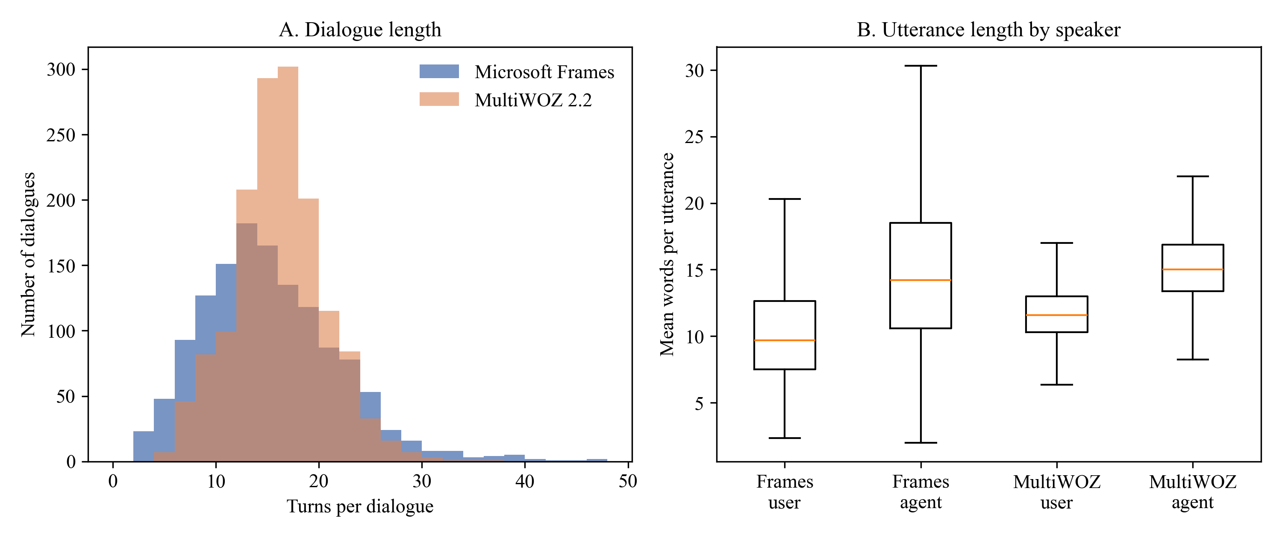
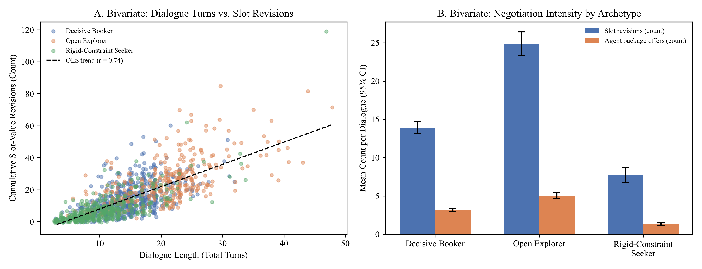
MODULE 3: DATA AUTHENTICITY, SCHEMA & EDA
Slide 12
Univariate and Bivariate Exploratory Data Analysis (Tables 6–7 & Figures 1–2)
Dialogue length is driven by slot revisions (r = .602) and package offers (r = .636), validating our negotiation constructs
Bivariate Variable Pair (Frames N = 1,334) | Pearson r (p) | Spearman ρ (p) | Analytical Interpretation
Dialogue Turns × Slot Revisions | .602 (< .001) | .582 (< .001) | Frequent constraint changes drive longer sessions
Dialogue Turns × Agent Package Offers | .636 (< .001) | .661 (< .001) | Multi-package comparisons expand turn counts
Slot Revisions × Hesitation Markers | .192 (< .001) | .206 (< .001) | User uncertainty accompanies constraint shifts
Slot Revisions × LLM Exploration Breadth | .554 (< .001) | .580 (< .001) | Strong construct validity of LLM exploration rating
Dialogue Turns × LLM Decisiveness | −.229 (< .001) | −.222 (< .001) | Decisive travelers finish bookings in fewer turns
User Words/Turn × Agent Words/Turn | −.026 (.341) | .014 (.618) | Utterance verbosity is independent across speakers
Figure 1: Univariate Turn Distributions (Frames M=14.90, SD=6.74 vs. MultiWOZ M=13.52, SD=4.46)
Key Takeaways from Univariate & Bivariate EDA
• Why We Report Both Pearson r and Spearman ρ: Turn counts and revision counts are right-skewed; reporting linear Pearson r alongside rank-based Spearman ρ proves correlations are not artifacts of tail outliers.
• Frames vs. MultiWOZ Dispersion: Frames has 51% wider turn dispersion (SD = 6.74 vs. 4.46, range 3–47 turns) because consultative vacation negotiation involves iterative trade-offs.
• Golden vs. Held-Out Balance: Golden (M = 14.94 turns) and Held-Out (M = 14.81 turns) partitions are statistically indistinguishable, confirming an unbiased split.
Figure 2: Bivariate Turns vs. Slot Revisions & Archetype Negotiation Intensity
Surnella Sandeep | QM640 Data Analytics Capstone | Cluster-Adaptive Prompting for Multi-Turn Travel Conversational Systems
Notes:
Explain the univariate comparison between Frames and MultiWOZ (Figure 1) and the bivariate parametric/non-parametric correlations (Figure 2 & Table 7).

Slide 13
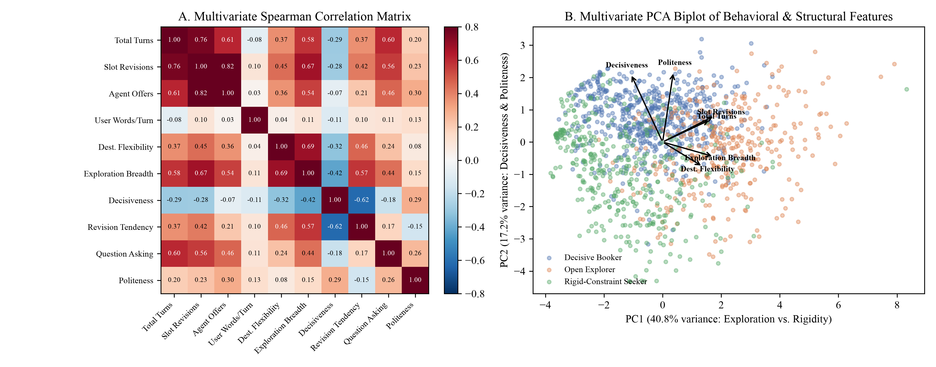
MODULE 3: DATA AUTHENTICITY, SCHEMA & EDA
Slide 13
Multivariate EDA: Correlation Structure & Principal Component Biplot (Figure 3)
Ten structural and behavioral variables span three orthogonal dimensions explaining 68.6% of total variance
Variable | PC1 (40.8%) | PC2 (17.2%) | PC3 (10.6%)
Total turns | +.390 | +.014 | −.267
User words / turn | −.123 | +.019 | +.893
Slot revisions | +.416 | +.087 | +.078
Agent package offers | +.357 | −.015 | −.229
Price sensitivity | +.174 | −.426 | −.122
Destination flexibility | +.304 | +.347 | +.116
Date flexibility | +.298 | +.345 | +.069
Exploration breadth | +.392 | +.060 | +.167
Decisiveness | −.162 | −.509 | +.039
Revision tendency | +.379 | +.127 | +.128
How to Read the 3 Principal Components
• PC1 (40.8% var.) — Exploration vs. Rigidity: Loaded on slot revisions (+.42), exploration breadth (+.39), and turns (+.39). Separates Open Explorers (right) from Rigid-Constraint Seekers (left).
• PC2 (17.2% var.) — Decisiveness & Price Focus: Loaded on decisiveness (−.51) and price sensitivity (−.43). Separates Decisive Bookers (bottom) from explorers.
• PC3 (10.6% var.) — User Verbosity: Isolates words per turn (+.89).
Figure 3: Multivariate Spearman Rank Correlation Matrix (Panel A) & PCA Biplot by Refined Archetype (Panel B)
Surnella Sandeep | QM640 Data Analytics Capstone | Cluster-Adaptive Prompting for Multi-Turn Travel Conversational Systems
Notes:
Explain how Figure 3 (Panel A Spearman heatmap and Panel B PCA biplot) shows that travel behavior forms a continuous 3D manifold structured around Exploration, Decisiveness, and Verbosity.

Slide 14
MODULE 4: GROUND-UP STATISTICAL METHODOLOGY
Slide 14
Why Each Statistical Test Was Chosen & Everyday Real-World Analogies
Requirement #1: Explaining the exact statistical test choice for RQ1–RQ4 with intuitive real-world parallels
RQ & Experimental Structure | Chosen Statistical Test | Why This Exact Test Is Mathematically Required | Classic Real-World Analogy (Where This Test Is Standard) | Why Our Chatbot Scenario Is Identical
RQ1: Comparing 3 Clustering Algorithms across N = 159 independent runs (3 groups, 1 continuous DV: Silhouette) | One-Way Between-Subjects ANOVA + Welch's ANOVA + Kruskal–Wallis H + Tukey HSD / Games–Howell | Comparing means of k = 3 independent groups at once. Running three separate t-tests would inflate Type I false-positive risk from 5% to 1 − (0.95)³ = 14.3%. Omnibus ANOVA controls α = .05 across all 3 algorithms. | Clinical Trial Comparing 3 Blood-Pressure Drugs: 159 patients randomly assigned (53 per drug) to Drug A, Drug B, or Drug C; measure blood-pressure drop. | Each of our 159 subsample runs (53 K-Means, 53 Ward, 53 HDBSCAN) is an independent trial producing a continuous Silhouette score.
RQ2: Testing 3 Prompting Strategies on the SAME N = 33 held-out dialogues (Within-subjects design, 99 calls) | One-Way Repeated-Measures ANOVA (Greenhouse–Geisser ε correction) + Friedman χ² Test + Holm Paired t-tests | Every dialogue is tested under ALL 3 prompts (Zero-Shot, Static, Cluster-Adaptive). Repeated-Measures ANOVA subtracts out baseline dialogue-to-dialogue difficulty variance, isolating the pure within-dialogue effect of the prompt. | Coffee Tasting Panel (Crossover Trial): The same 33 expert tasters rate Blend A, Blend B, and Blend C. Separating taster-level harshness makes the test much more sensitive. | Dialogues vary wildly in topic and difficulty. Evaluating all 3 prompts on the exact same 33 dialogue prefixes removes dialogue noise (ρ = .50).
RQ3: Crossing Rules Mode (Off vs. Active) × Prompting (Zero-Shot vs. Cluster-Adaptive) (N = 144, n = 36/cell) | 2 × 2 Between-Subjects Factorial ANOVA + HC3 Robust SE + Aligned Rank Transform (ART) ANOVA | We have TWO simultaneous independent variables (Rules Mode and Prompting Mode). Only a 2 × 2 Factorial ANOVA can test (1) Main Effect of Rules, (2) Main Effect of Prompting, and (3) their INTERACTION (Rules × Prompting). | Agricultural Crop Yield Trial (Fertilizer × Irrigation): Testing whether Fertilizer only boosts yield when Irrigation is ALSO active (synergistic / protective interaction). | Cluster-Adaptive prompting leaks entities when Rules are Off (.359), but Rules Active eliminates that leakage (.000)—a classic protective interaction!
RQ4: Crossing Prompting (2 levels) × Traveler Archetype (3 levels) (N = 180, n = 30/cell) | 2 × 3 Between-Subjects Factorial ANOVA on log(Turns) & RER + HC3 + ART + Welch Simple Contrasts | Tests whether the turn-saving benefit of Cluster-Adaptive prompting is uniform across all travelers or moderated by Traveler Archetype (2 × 3 Interaction), using log(Turns) to normalize right-skewed count data. | Education Trial (Teaching Method × Student Learning Style): Testing whether interactive tutoring vs. lecture helps Visual, Auditory, and Hands-On learners by different amounts. | All 3 archetypes benefit from adaptive prompting, but Rigid-Constraint Seekers gain the most (−42.7% vs. −29.5%), creating a 2 × 3 interaction.
Surnella Sandeep | QM640 Data Analytics Capstone | Cluster-Adaptive Prompting for Multi-Turn Travel Conversational Systems
Notes:
Crucial slide for both math and non-AI professors: explains WHY One-Way ANOVA, Repeated-Measures ANOVA, 2x2 Factorial ANOVA, and 2x3 Factorial ANOVA are the exact right tools, using everyday analogies.

Slide 15
MODULE 4: GROUND-UP STATISTICAL METHODOLOGY
Slide 15
How ANOVA, Effect Sizes (η²), and Factorial Interactions Work
Translating F-ratios, Greenhouse–Geisser corrections, and interaction terms into intuitive signal-to-noise ratios
1. The F-Statistic: Signal-to-Noise Ratio
2. Effect Size (η² and Partial ηp²): Practical Magnitude
3. Main Effects vs. Interaction Effects (A × B)
• Formula: F = MS<sub>between</sub> / MS<sub>within (error)</sub>
• Plain-English Intuition:
▪ Numerator (Signal): How far apart are the group means (e.g., Rules Active vs. Rules Off)?
▪ Denominator (Noise): How much random scatter exists inside each group?
• How to Read F in Our Tables:
▪ If null hypothesis H<sub>0</sub> is true (no real difference), F ≈ 1.0.
▪ In our study, we observe F = 91.33 (RQ1), F = 9.79 (RQ2), F = 43.92 & 489.52 (RQ3), and F = 664.43 (RQ4)—meaning the treatment signal is 10 to 664 times larger than random noise (all p < .001)!
• Formula: η<sub>p</sub><sup>2</sup> = SS<sub>effect</sub> / (SS<sub>effect</sub> + SS<sub>error</sub>)
• Why p-values Alone Are Not Enough:
▪ A p-value (< .001) only tells us an effect is not zero; η<sub>p</sub><sup>2</sup> tells us what percentage of outcome variance is explained by our factor.
• Cohen's (1988) Standard Benchmarks:
▪ Small: η<sup>2</sup> = .01 (1% variance)
▪ Medium: η<sup>2</sup> = .06 (6% variance; f = .25)
▪ Large: η<sup>2</sup> ≥ .14 (14%+ variance; f ≥ .40)
• Our Observed Effect Sizes:
▪ Every primary effect in RQ1–RQ4 is Large: RQ1 η<sup>2</sup> = .54–.91; RQ2 η<sub>p</sub><sup>2</sup> = .234; RQ3 η<sub>p</sub><sup>2</sup> = .239–.778; RQ4 η<sub>p</sub><sup>2</sup> = .793.
• Main Effect of Factor A: Does changing A (e.g., turning Rules On) change the outcome on average across all levels of B?
• Interaction Effect (A × B): Does the effect of A depend on which level of B is active?
• Visual Rule of Thumb on Line Plots:
▪ Parallel lines = No interaction (effects are purely additive).
▪ Non-parallel / diverging / crossing lines = Significant interaction!
• Why Interactions Matter in RQ3 & RQ4:
▪ In RQ3, entity leakage only happens in Rules Off × Cluster-Adaptive (.359) and vanishes when Rules Active is turned on (.000) → strong diverging lines (F = 34.82, p < .001).
Why We Apply Greenhouse–Geisser (GG) Correction in RQ2 (Greenhouse & Geisser, 1959):
In Repeated-Measures ANOVA (RQ2), standard F-tables assume sphericity—that the variance of differences between every pair of conditions (Zero-Shot vs. Static, Zero-Shot vs. Adaptive, Static vs. Adaptive) is equal. When sphericity is violated (ε < 1.0, e.g., ε = 0.94 in style cosine and ε = 0.65 in pacing error), unadjusted F-tests inflate false positives. Multiplying degrees of freedom by ε (e.g., df = 1.88, 60.29) yields an exact, conservative p-value.
Surnella Sandeep | QM640 Data Analytics Capstone | Cluster-Adaptive Prompting for Multi-Turn Travel Conversational Systems
Notes:
Explain the intuition of F = Signal / Noise, eta-squared = % of variance explained, and how to interpret main effects vs. interactions.

Slide 16
MODULE 4: GROUND-UP STATISTICAL METHODOLOGY
Slide 16
Bulletproof Inference: Why We Pair Parametric, Robust, and Non-Parametric Tests
Ensuring no statistical objection can arise from non-normality, bounded [0, 1] rates, or unequal cell variances
Potential Statistical Objection | Where It Occurs in Dialogue Data | Our Robust Parametric Solution | Our Distribution-Free Non-Parametric Solution | Concordance Across All 4 RQs
1. Heteroscedasticity (Unequal variances across cells) | In RQ3, when Rules Active eliminates leakage to 0.0%, variance in that cell drops near zero while Rules Off has high variance (SD = .348). | Welch's ANOVA (RQ1) & MacKinnon–White HC3 Sandwich SEs (RQ3, RQ4): Estimates cell-specific error variances without pooling. | Games–Howell Post Hoc (RQ1) & Mann–Whitney U (RQ4): Requires zero equal-variance assumptions. | 100% agreement: e.g., RQ3 RAR OLS F = 43.92 (p < .001) vs. HC3 F = 42.71 (p < .001).
2. Non-Normality & Bounded Proportions [0, 1] | RAR, ELR, Slot F1 (RQ3), and RER (RQ4) are proportions bounded between 0 and 1 with floor/ceiling clustering. | Balanced Cell Sizes (n = 36/cell in RQ3, n = 30/cell in RQ4): Central Limit Theorem stabilizes cell means. | Aligned Rank Transform (ART) Factorial ANOVA (Wobbrock et al., 2011): Aligns data for each main/interaction effect before ranking, allowing exact non-parametric factorial ANOVA! | 100% agreement: RQ3 Leakage Interaction OLS F = 34.82 (p < .001) vs. ART F = 2148.81 (p < .001).
3. Right-Skewed Positive Count Data | Multi-turn dialogue length (Turns to Goal Completion in RQ4) is strictly positive and right-skewed. | Natural Log Transformation: Primary DV pre-registered as Y = ln(Turns), plus raw Turns reported side-by-side. | Mann–Whitney U & ART ANOVA on Both Raw and Log Turns: Rank-invariant to any monotone transformation. | 100% agreement: RQ4 Interaction OLS F = 10.89 (p < .001), HC3 F = 8.58 (p < .001), ART F = 209.46 (p < .001).
4. Correlated Within-Dialogue Skewness | In RQ2, 33 dialogues are measured 3 times; cosine similarity can have mild negative skew. | Greenhouse–Geisser Sphericity-Corrected RM-ANOVA + Holm Step-Down t-tests. | Friedman Non-Parametric Rank Test (χ²): Ranks the 3 conditions (1st, 2nd, 3rd) inside each dialogue. | 100% agreement: RQ2 Style RM-ANOVA F = 9.79 (p < .001) vs. Friedman χ²(2) = 12.50 (p = .002).
Defense Takeaway for Methodology Reviewers: Every single hypothesis test in this study is reported as a triad: (1) Classical Parametric ANOVA, (2) Heteroscedasticity-Consistent (`Welch` / `HC3`) ANOVA, and (3) Non-Parametric (`Kruskal–Wallis` / `Friedman` / `ART`) ANOVA. Because all three reach p < .001 on every RQ, our conclusions are mathematically invariant to distributional assumptions.
Surnella Sandeep | QM640 Data Analytics Capstone | Cluster-Adaptive Prompting for Multi-Turn Travel Conversational Systems
Notes:
Explain to statistics professors on the committee why we run THREE layers of tests on every single hypothesis.

Slide 17
MODULE 4: GROUND-UP STATISTICAL METHODOLOGY
Slide 17
Proven Concepts Behind Sample-Size Parameters: α, Power (1 − β), Cohen's f, and λ
Requirement #2 & Defense Question #1: How standard noncentral-F parameters determine exact sample sizes
The Noncentral-F Power Formulation (Cohen, 1988; Faul et al., 2007)
RQ | Planned Design | df at N_min | λ at N_min | F_crit | N_min (.80) | Final N (+10% Buffer) | Final Power
RQ1 | One-way ANOVA (3 groups) | 2, 155 | 9.88 | 3.05 | 158 | 159 (53 / alg) | .804
RQ2 | RM-ANOVA (3 conds, ρ=.50) | 2, 54 | 10.50 | 3.17 | 28 | 33 (99 calls) | .865
RQ3 | 2 × 2 Factorial (df1 = 1) | 1, 124 | 8.00 | 3.92 | 128 | 144 (36 / cell) | .847
RQ4 | 2 × 3 Factorial (df1 = 2) | 2, 152 | 9.88 | 3.06 | 158 | 180 (30 / cell) | .857
• Exact Power Equation (Equation 1 in Report):
▪ Power (1 − β) = 1 − F<sub>nc</sub>(F<sub>crit</sub> ; df<sub>1</sub>, df<sub>2</sub>, λ), where F<sub>crit</sub> = F<sub>1−α</sub>(df<sub>1</sub>, df<sub>2</sub>)
• What Each Proven Parameter Means:
▪ α = .05 (Type I Error Rate): Maximum 5% probability of declaring a false positive when the null hypothesis H<sub>0</sub> is true.
▪ β = .20 → Power (1 − β) ≥ .80: Minimum 80% probability of detecting a true effect when H<sub>a</sub> is true (4-to-1 ratio of β to α recommended by Cohen, 1988).
▪ Cohen's f = .25 (Medium Effect Size): Signal SD is 25% of within-group error SD (equivalent to η<sup>2</sup> = f<sup>2</sup> / (1 + f<sup>2</sup>) = .0588, or ~6% explained variance).
▪ Noncentrality Parameter (λ): Measures total statistical shift away from H<sub>0</sub>:
• Between-subjects (RQ1, RQ3, RQ4): λ = f<sup>2</sup> · N
• Repeated-measures (RQ2, m=3, ρ=.50): λ = f<sup>2</sup> · N · m · ε / (1 − ρ)
Why λ (Noncentrality) Is the Key Bridge Between Effect Size (f) and Sample Size (N):
• To achieve 80% power at α = .05, the noncentral F distribution requires a minimum noncentrality shift of λ ≈ 7.85 to 9.88 (depending on numerator df<sub>1</sub> = 1 or 2).
• Since λ = f<sup>2</sup> · N and f<sup>2</sup> = (0.25)<sup>2</sup> = 0.0625, solving 0.0625 · N ≈ 8.00 immediately yields N<sub>min</sub> = 128 for df<sub>1</sub> = 1 (RQ3) and solving 0.0625 · N ≈ 9.88 yields N<sub>min</sub> = 158 for df<sub>1</sub> = 2 (RQ1, RQ4)!
• In RQ2, because each dialogue acts as its own control across m = 3 conditions with within-subject correlation ρ = .50, the variance is halved by (1 − ρ) = 0.50, multiplying λ by m/(1−ρ) = 6 and requiring only N<sub>min</sub> = 28 dialogues (buffered to N = 33, power = .865).
Surnella Sandeep | QM640 Data Analytics Capstone | Cluster-Adaptive Prompting for Multi-Turn Travel Conversational Systems
Notes:
Directly addresses Requirement #2 and Defense Question #1: Explain alpha, beta, power, Cohen's f, and the noncentrality parameter lambda.

Slide 18
MODULE 4: GROUND-UP STATISTICAL METHODOLOGY
Slide 18
Counterfactual Analysis: What Happens If α, Power, f, or λ Are Mischosen?
Requirement #2: Concrete numerical demonstrations of how improper parameter choices break experimental validity
Parameter Choice Scenario | Altered Value vs. Standard | Resulting Noncentrality λ & Sample Size N | Statistical & Practical Consequence | Concrete Example in Our Travel Chatbot Study
Failure Mode 1: Arbitrary Small Sample (Underpowered λ) | Pick N = 36 total (9 per cell in RQ3) instead of N = 144 → λ drops from 9.00 to 2.25! | λ = 0.0625 × 36 = 2.25 Power 1 − β drops from .847 to .308 (69.2% Type II error rate!) | Severe False Negative Risk: Nearly 7 out of 10 times, a genuine medium improvement (f = .25) will produce p > .05 and be falsely dismissed as 'no effect'. | In RQ4, the Prompting × Archetype interaction has ηp² = .111 (f = .35). At N = 36 total (6/cell), power to detect this interaction drops to .44—we would have missed the persona moderation effect!
Failure Mode 2: Loose Significance α (Inflated Type I Error) | Set α = .20 instead of α = .05 to 'make it easier to get significance' | F_crit drops from 3.92 to 1.66 (at df = 1, 140) | 20% False Positive Risk: Across 4 RQs with multiple metrics, random LLM sampling noise would be falsely published as a scientific improvement. | In Primary RQ2 (coarse routing), style cosine had F = 1.61, p = .211. A loose α = .25 would have falsely claimed coarse routing worked, hiding the need to fix RQ1 prefix routing!
Failure Mode 3: Overly Tiny Target Effect (Overpowered for Noise) | Set f = .05 (η² = .0025, 0.25% variance) instead of f = .25 | Needs λ = 9.88 with f² = .0025 → Requires N = 3,952 dialogues (exceeds the entire Frames corpus of 1,334!) | Trivial Practical Significance & Exhausted Corpus: Wastes thousands of API calls to detect a 0.05-turn difference that has zero business value. | Even if an OTA chatbot saved 0.04 turns (p < .05 at N = 4,000), customers cannot perceive a 0.04-turn difference. Medium effect f = .25 ensures statistical significance aligns with business value.
Failure Mode 4: Ignoring Repeated-Measures ρ in RQ2 | Assume ρ = .00 (between-subjects formula) or ρ = .90 (over-optimistic) | If ρ = .90 assumed: N_min = 7 dialogues (severely underpowered if true ρ = .50). If between-subjects used: N = 159 dialogues × 3 = 477 calls. | Miscalibrated Within-Subject Sensitivity: Setting conservative ρ = .50 with a +18% buffer (N = 33 vs. N_min = 28) protects against sphericity loss (ε = 0.65–0.94). | In Refined RQ2, pacing error had Greenhouse–Geisser ε = 0.65. Because we buffered N from 28 to 33, even under ε = 0.65 our test achieved F(1.30, 41.70) = 7.10, p = .007!
Summary Rule for Defense Committee: Standard values (α = .05, 1 − β = .80, f = .25, ρ = .50, plus a 10% cell-balancing buffer) sit at the exact mathematical sweet spot: large enough (λ = 8.0–10.5) to guarantee >83% detection of meaningful engineering gains, yet compact enough to fit strictly inside the 401 held-out test dialogues of Microsoft Frames.
Surnella Sandeep | QM640 Data Analytics Capstone | Cluster-Adaptive Prompting for Multi-Turn Travel Conversational Systems
Notes:
Walk through the 4 counterfactual scenarios so the committee sees what goes wrong if a researcher picks arbitrary sample sizes or alpha levels.

Slide 19
MODULE 4: GROUND-UP STATISTICAL METHODOLOGY
Slide 19
Domain Parameter Choices: Why Decay λ_d = 0.15 and Prefix Horizon M = 9?
Mathematical justification and sensitivity proof for our trajectory pooling and truncation parameters
1. Exponential Turn Decay λ_d = 0.15 (Equation 2 in Report)
2. Truncation Horizon M = 9 User Messages (`step2g` & `step2h`)
• Mathematical Formula (Eq. 2):
▪ v = Σ w<sub>t</sub> e<sub>t</sub>, where w<sub>t</sub> ∝ exp[−λ<sub>d</sub>(T − t)]
• Why λ<sub>d</sub> = 0.15 Is Used for Trajectory Pooling:
▪ In a multi-turn travel dialogue, Turn 1 is often a generic greeting ('Hi, can you help me?'), while recent turns contain active constraint negotiation.
▪ With λ<sub>d</sub> = 0.15, the most recent turn gets weight 1.00, 3 turns ago gets exp(−0.45) = 0.64, and 10 turns ago gets exp(−1.50) = 0.22—preserving full history while emphasizing active negotiation.
• What Happens If λ<sub>d</sub> Is Chosen Poorly (Sensitivity Grid `step2b`):
▪ If λ<sub>d</sub> = 0.0 (Uniform Mean): Opening pleasantries dilute active negotiation constraints.
▪ If λ<sub>d</sub> ≥ 1.0 (Memoryless Last-Turn Only): Forgets early trip constraints stated in Turn 2.
▪ Empirical Check (`t_rq1_rep_matrix.csv`): Testing R0 (λ<sub>d</sub>=0.15), R1 (user-only), and R2 (concatenated) confirmed that embedding pooling alone only reaches ARI = .25–.54, motivating our hybrid `Blocks` representation!
• Why We Must Truncate Before the End of the Conversation:
▪ If we cluster whole conversations, the final turns contain 'Great, book it!' vs. 'Never mind, too expensive'. The clusters then trivially reflect session outcome (Outcome Cramér's V = .29) rather than how the customer shops!
• What Happens Across Different Values of M (Table D5 Proof):
▪ M = 3 user messages: Stability ARI = .69, but many explorers haven't finished stating initial preferences (held-out routing accuracy = 59.4%, κ = .359).
▪ M = 5 user messages: Stability ARI = .57; held-out routing jumps to 70.1% (κ = .535)—strong enough for mid-conversation RQ2 prompting!
▪ M = 7 user messages: Stability ARI = .69; held-out routing reaches 82.0% (κ = .722).
▪ M = 9 user messages (Adopted Golden Definition): 38.6% of long dialogues are truncated (eliminating end-of-dialogue outcome leakage, V = .20), bootstrap stability peaks at ARI = .76 (74.8% core membership), and held-out prefix routing reaches 97.3% (κ = .958)!
Surnella Sandeep | QM640 Data Analytics Capstone | Cluster-Adaptive Prompting for Multi-Turn Travel Conversational Systems
Notes:
Explain the other two lambda/horizon parameters in our paper: exponential turn decay lambda_d = 0.15 (Eq. 2) and truncation horizon M = 9 user messages.

Slide 20
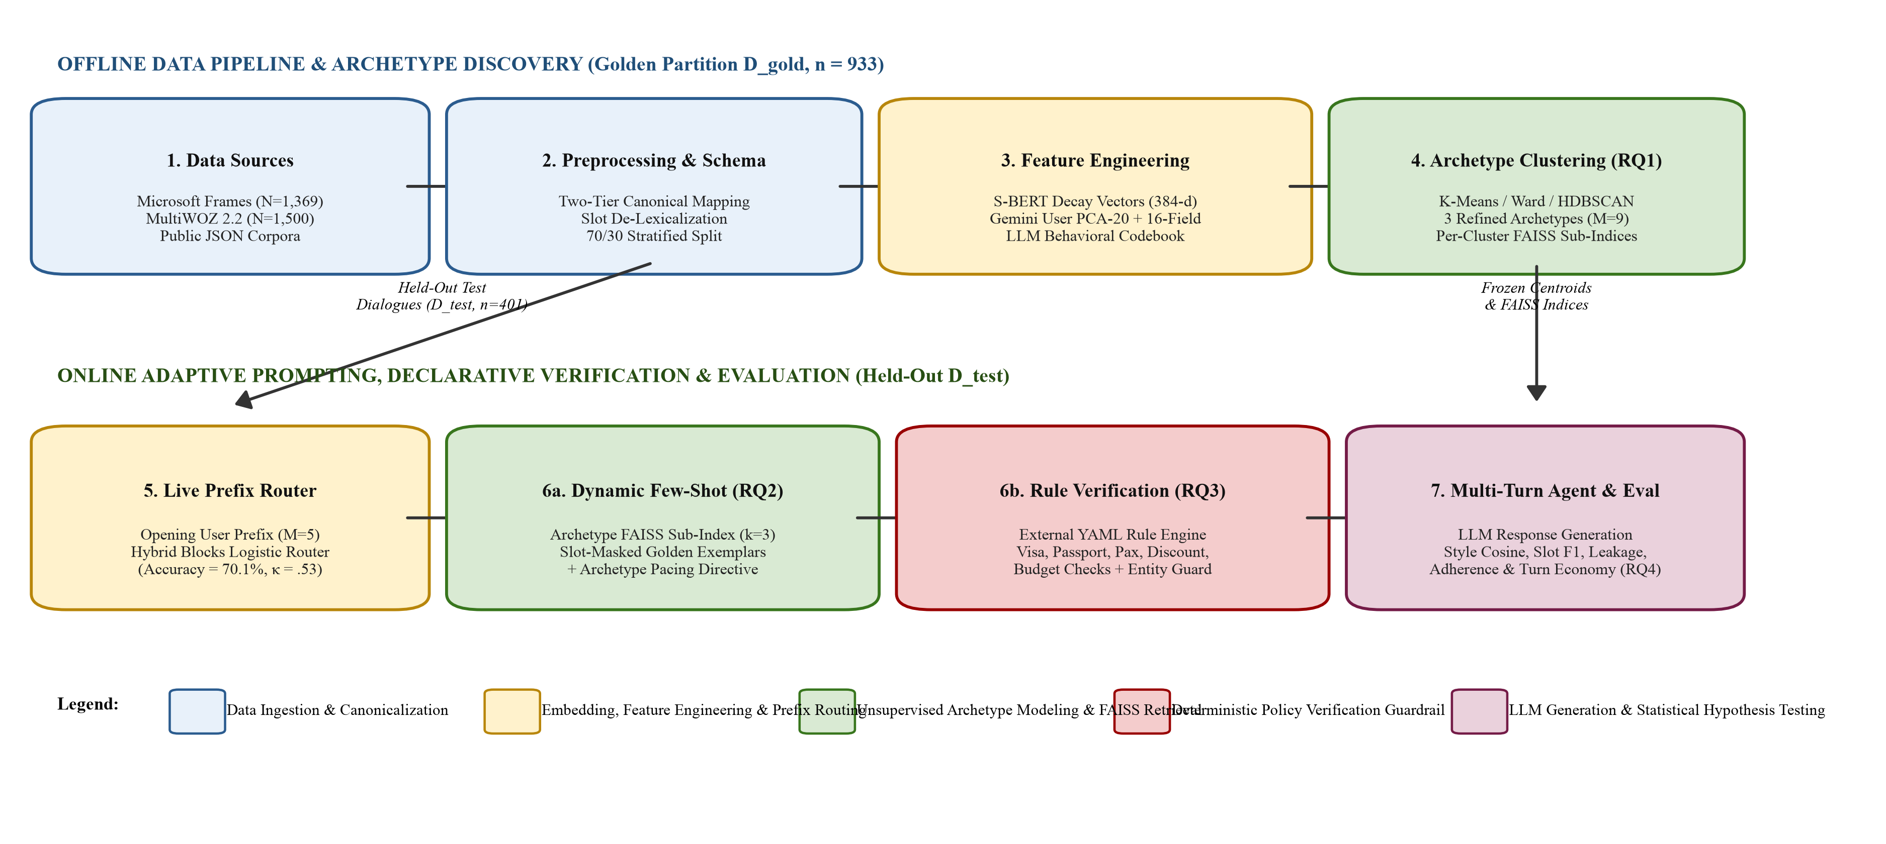
MODULE 5: SYSTEM ARCHITECTURE & WORKFLOWS
Slide 20
End-to-End Five-Layer Neuro-Symbolic System Architecture (Figure 4)
Strict separation between Offline Golden Discovery (D_gold, n = 933) and Online Runtime Execution (D_test, n = 401)
Architectural Walkthrough
• Layer 1 (Canonical Ingestion): Parses raw Frames & MultiWOZ JSON into validated Two-Tier Pydantic trajectories.
• Layer 2 (Offline Discovery on D_gold = 933):
▪ Extracts first M = 9 user messages.
▪ Computes PCA-20 of 3,072-d Gemini prefix embeddings + 16-field LLM behavioral profile (`Blocks`).
▪ Freezes k = 3 K-Means centroids, L1 logistic router, and 3 slot-masked FAISS `IndexFlatIP` sub-indices.
• Layer 3 (Online Prefix Router & FAISS Retrieval):
▪ Projects live test prefix into golden `Blocks` space (< 2 ms) and retrieves k = 3 `[SLOT]`-masked exemplars.
• Layer 4 (Symbolic Guardrails & Generation):
▪ Updates Verified Informed Slot Ledger (prevents re-asking).
▪ Evaluates 5 YAML rules (`src/rule_engine.py`, < 1 ms) + sanitizes post-generation entity leakage.
• Layer 5 (Evaluation & Dual-Judge Audit):
▪ Scores Style Cosine, RAR, ELR, Slot F1, TGC, RER + cross-validates with `gemini-2.5-pro` (κ = .917 & .933).
Figure 4: Five-Layer Neuro-Symbolic Cluster-Adaptive Conversational System Architecture
Surnella Sandeep | QM640 Data Analytics Capstone | Cluster-Adaptive Prompting for Multi-Turn Travel Conversational Systems
Notes:
Walk the committee through Figure 4: Layers 1–2 run offline on D_gold; Layers 3–5 run online on D_test.

Slide 21
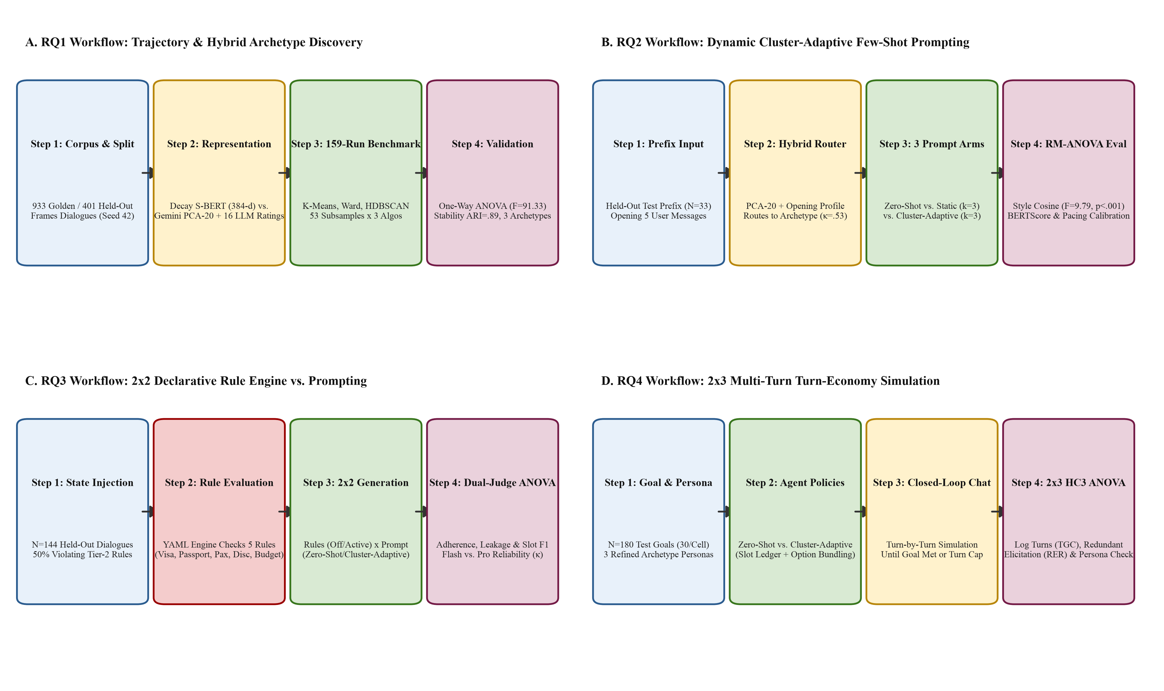
MODULE 5: SYSTEM ARCHITECTURE & WORKFLOWS
Slide 21
Algorithmic Execution Workflows Across RQ1 to RQ4 (Figure 5)
Visualizing the exact experimental pipeline, sample sizes, and statistical tests for each research question
How the Four Pipelines Connect
• Panel A (RQ1 — Unsupervised Discovery):
▪ 159 subsample runs (53 × 3 algorithms) on MiniLM & Gemini embeddings → Representation × Truncation grid → 3 Refined Archetypes & `RefinedArchetypeRouter`.
• Panel B (RQ2 — Within-Subject Prompting):
▪ 33 held-out dialogues × 3 conditions = 99 calls. Contrasts Primary Archetypes (κ=.24) vs. Refined Archetypes (κ=.535).
• Panel C (RQ3 — 2 × 2 Factorial Guardrails):
▪ 144 held-out scenarios (36/cell; 50% violating) crossing `Rules Off/Active` × `Zero-Shot/Cluster-Adaptive` + 48-unit `gemini-2.5-pro` dual-judge audit.
• Panel D (RQ4 — 2 × 3 Multi-Turn Simulation):
▪ 180 closed-loop simulations (30/cell) crossing `Zero-Shot/Cluster-Adaptive` × 3 Refined Archetypes + 45-unit blind persona fidelity audit.
Figure 5: Four-Panel Algorithmic Execution Workflows for RQ1 (A), RQ2 (B), RQ3 (C), and RQ4 (D)
Surnella Sandeep | QM640 Data Analytics Capstone | Cluster-Adaptive Prompting for Multi-Turn Travel Conversational Systems
Notes:
Use Figure 5 to orient the committee before diving into the empirical results of RQ1, RQ2, RQ3, and RQ4.

Slide 22
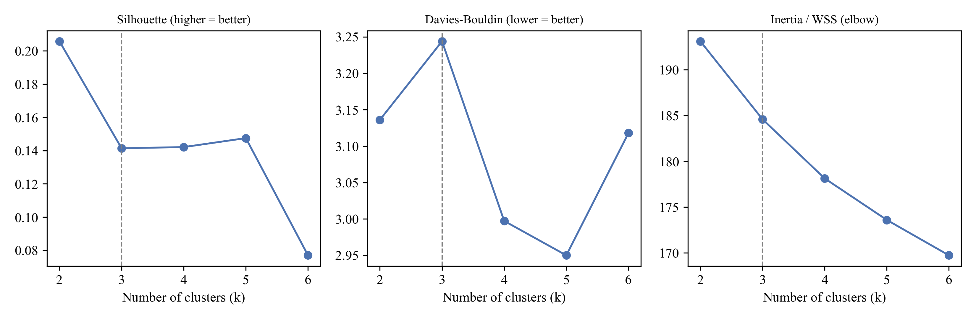
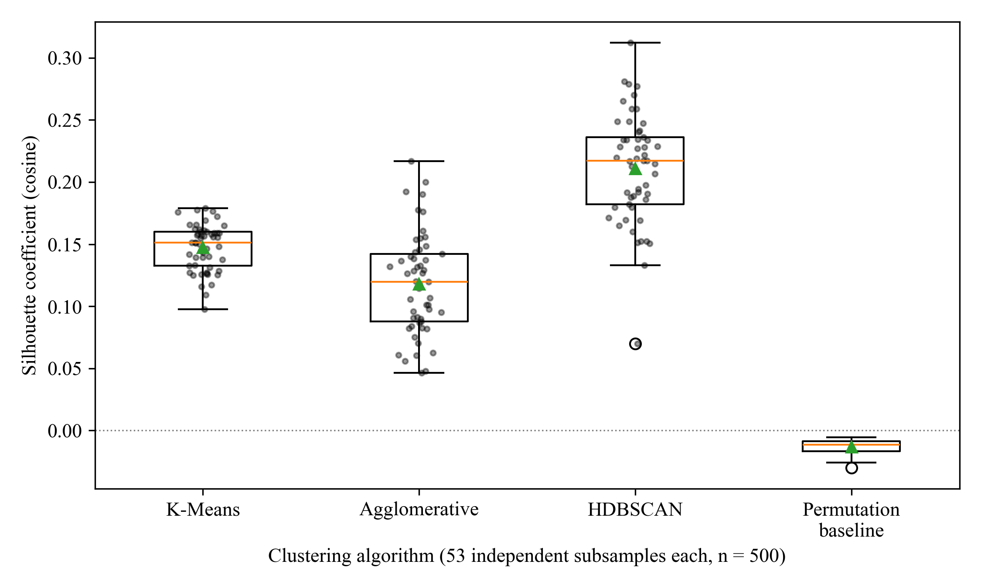
MODULE 6: DEEP-DIVE EMPIRICAL RESULTS (RQ1)
Slide 22
RQ1 (Part 1): Clustering Algorithm Benchmark Across 159 Runs & Embedding Invariance
Table 12 & Figures D1–D2: Rejecting H01 (p < .001) across both MiniLM (384-d) and Gemini (3,072-d) spaces
Embedding Family & Algorithm | Runs | Silhouette M (SD) | Davies–Bouldin | ANOVA F (p) | η²
MiniLM (384-d) — K-Means (k = 3) | 53 | .099 (.005) | 2.712 (0.068) | F(2, 156) = 91.33 (p < .001) | .539
MiniLM (384-d) — Agglomerative (Ward) | 53 | .075 (.007) | 3.047 (0.129) | Welch F = 113.84 (p < .001) | —
MiniLM (384-d) — HDBSCAN (relaxed) | 53 | .170 (.050) | 1.787 (0.310) | Kruskal H = 123.70 (p < .001) | —
MiniLM (384-d) — Permutation Baseline | 53 | −.001 (.002) | — | Shuffled labels | —
Gemini-001 (3,072-d turn pool) — KM / Ward / HDB | 159 | .075 / .058 / .198 | — | F = 169.39 (< .001) | .685
Gemini-001 (3,072-d document) — KM / Ward / HDB | 159 | .091 / .068 / .268 | — | F = 813.09 (< .001) | .912
Figure D1: Cluster-Number Selection (k = 2..8) on Golden Partition (k = 3 balances Silhouette & size ≥ 20%)
Plain-English Interpretation for Non-AI & Math Reviewers
• 1. Why All 3 Algorithms Beat Chance: Random label shuffling gives Silhouette = −.001. All three algorithms find genuine structure (p < .001, explaining 53.9% to 91.2% of variance).
• 2. Why HDBSCAN Cannot Be Used for Live Routing: HDBSCAN achieves `.170` Silhouette only by throwing away 71.7% of dialogues as 'noise' (and failing completely in 53/53 runs at default `min_cluster_size=15`). A production chatbot cannot refuse to route 72% of customers!
• 3. Operational Winner: K-Means (k = 3) partitions 100% of dialogues, significantly outperforms Ward agglomerative clustering (Tukey HSD & Games–Howell p < .001), and replicates across both 384-d and 3,072-d embeddings.
Figure D2: Cosine Silhouette Across 159 Subsample Runs (53 per Algorithm) vs. Permutation Baseline
Surnella Sandeep | QM640 Data Analytics Capstone | Cluster-Adaptive Prompting for Multi-Turn Travel Conversational Systems
Notes:
Explain how to read Table 12 and Figures D1-D2. Emphasize why K-Means (k=3) is chosen operationally despite HDBSCAN's higher raw Silhouette on retained points.

Slide 23
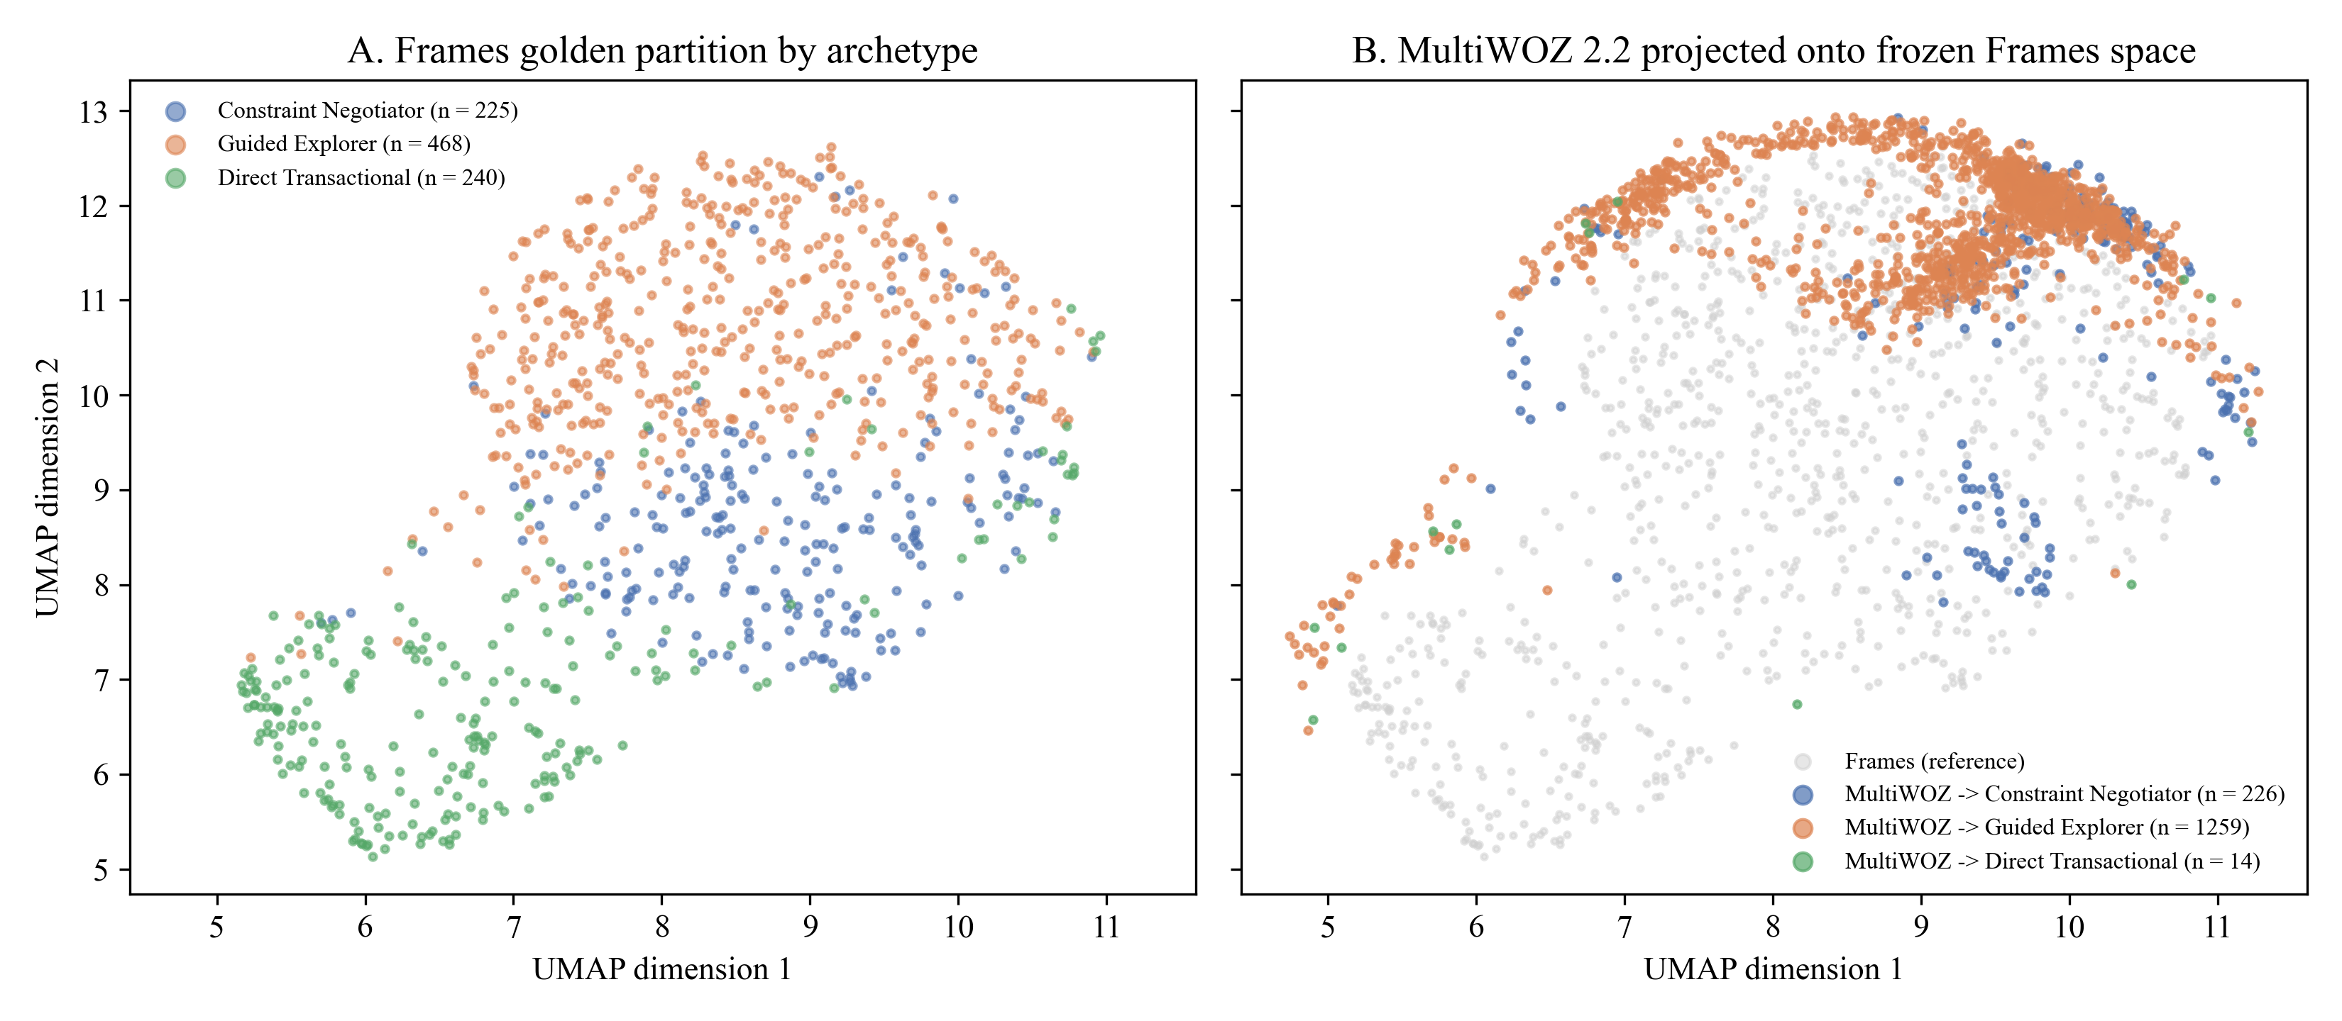
MODULE 6: DEEP-DIVE EMPIRICAL RESULTS (RQ1)
Slide 23
RQ1 (Part 2): Cross-Corpus Transfer & Diagnosis of Whole-Dialogue Archetypes
Figure D3 & Tables D3–D4: Why clustering full transcripts caused wizard confounding (V = .45) and weak early routing (κ = .24)
Partition / Corpus | N | Centroid Cosine M (SD) | Direct Trans. (%) | Constraint Neg. (%) | Guided Exp. (%)
Frames Golden (D_gold) | 933 | .466 (.116) | 42.3% | 37.6% | 20.0%
Frames Held-Out (D_test) | 401 | .467 (.116) | 42.6% | 37.7% | 19.7%
MultiWOZ 2.2 Sample | 1,499 | .269 (.115) | 71.4% | 28.6% | 0.1%
Three Diagnostic Flaws Discovered in Whole-Dialogue Clustering
• Check 1 — Internal vs. External Generalization (Table D4):
▪ Within Frames, Golden (.466) and Held-Out (.467) centroid similarity matched perfectly (t = −0.10, p = .923). Across corpora, MultiWOZ dropped to .269 (t = 28.08, p < .001) with 0.1% Guided Explorers—proving consultative travel archetypes are domain-specific.
• Check 2 — Role-Player Confounding (Cramér's V = .45):
▪ Pooling both user and wizard turns caused clusters to reflect which human wizard handled the chat rather than the customer's own persona!
• Check 3 — Poor Early-Turn Routing (κ = .24) & Outcome Leakage:
▪ Predicting a whole-dialogue cluster from the first 5 turns achieved only κ = .24 (39.4% accuracy). Why? Because whole-dialogue clusters were separated by how the chat ended (Turn 15 booking vs. abandonment), which hasn't happened yet at Turn 3!
Figure D3: UMAP Projection of Frames Golden/Test Archetypes (Panel A) vs. MultiWOZ 2.2 Projection (Panel B)
Surnella Sandeep | QM640 Data Analytics Capstone | Cluster-Adaptive Prompting for Multi-Turn Travel Conversational Systems
Notes:
Show intellectual honesty and scientific rigor: explain what our diagnostic audit found on the initial whole-dialogue clusters and why that motivated the representation x truncation breakthrough.

Slide 24
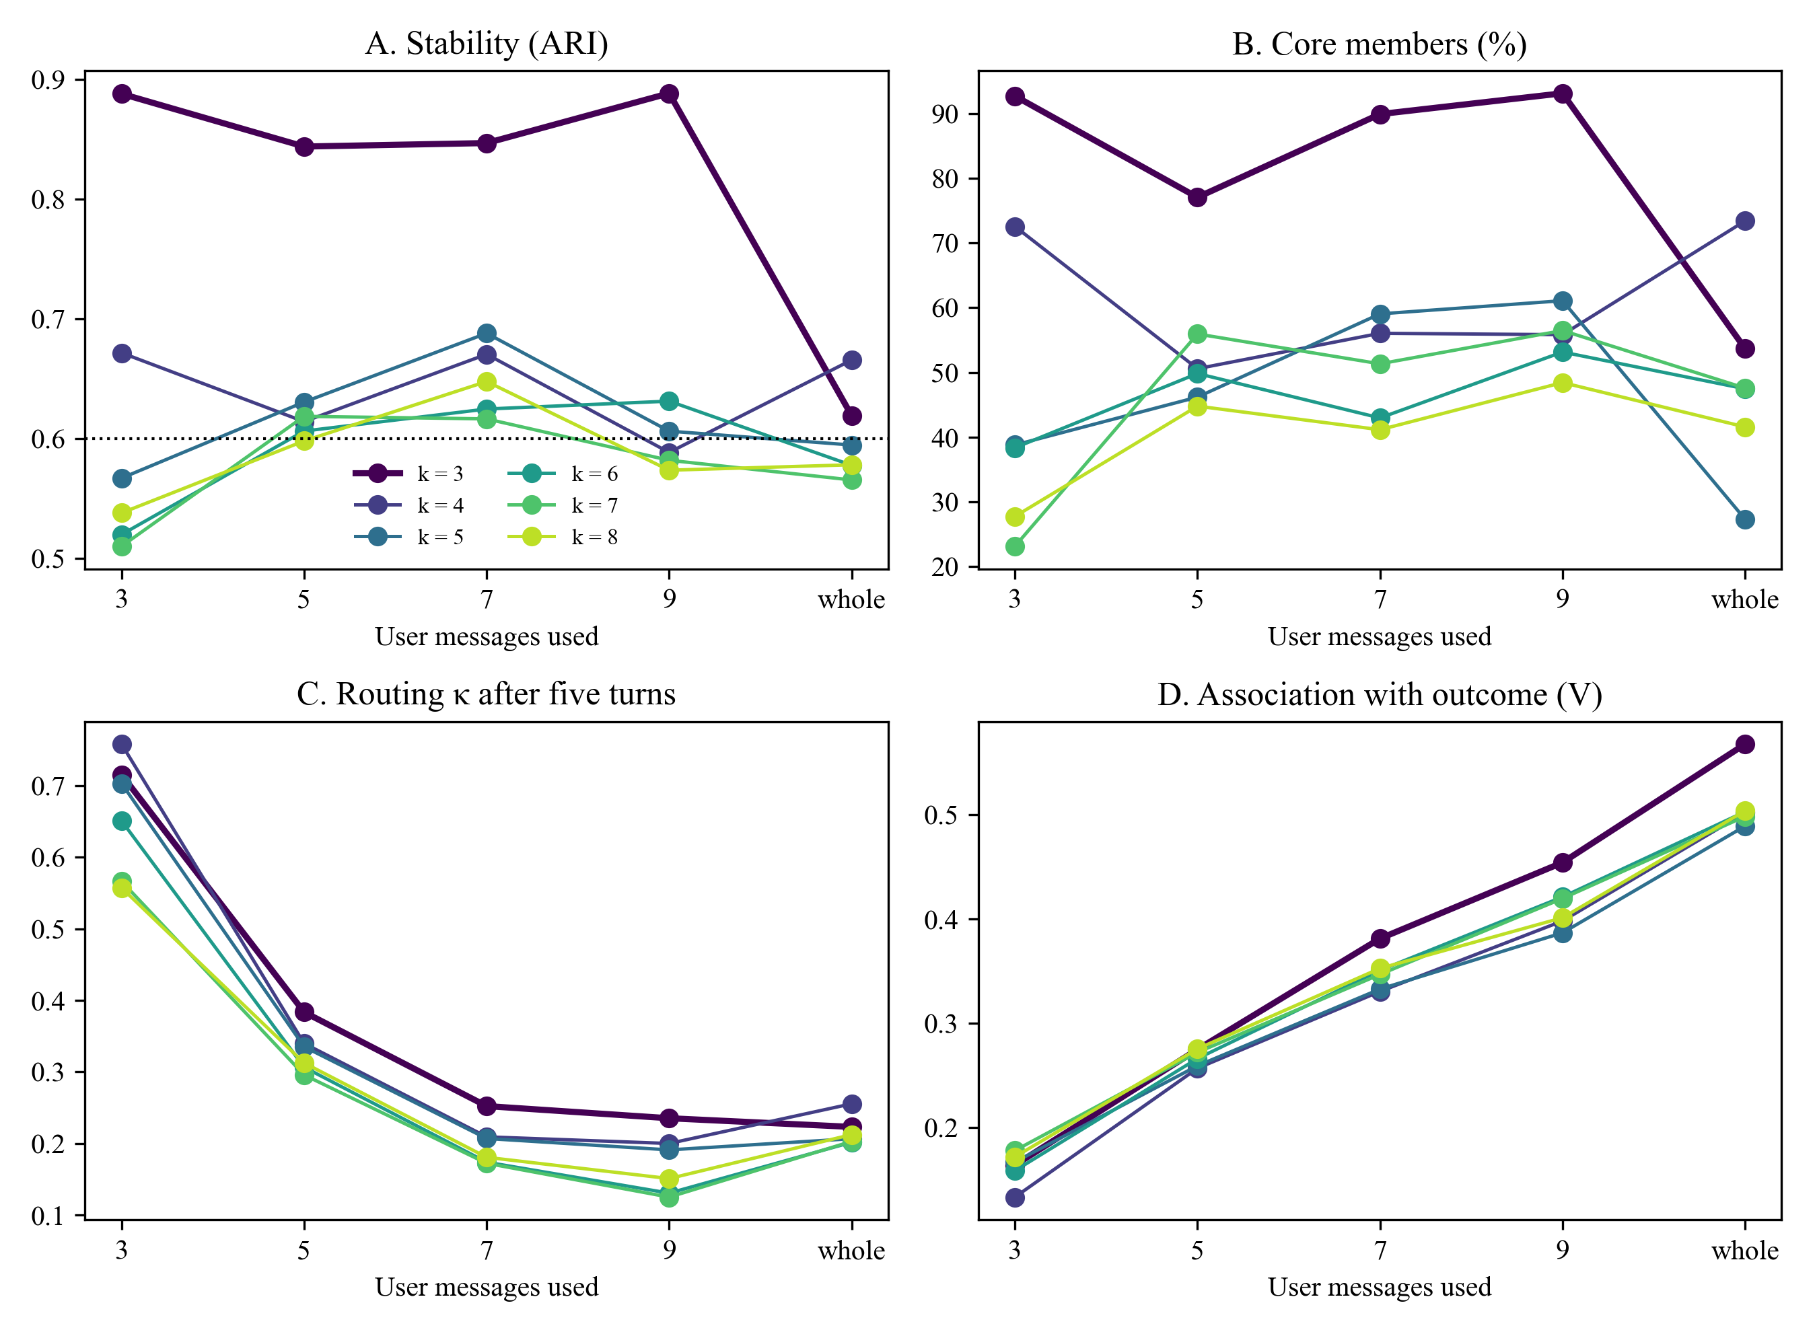
MODULE 6: DEEP-DIVE EMPIRICAL RESULTS (RQ1)
Slide 24
RQ1 (Part 3): The Representation × Truncation Breakthrough (Figure D4 & Tables C2, D5–D6)
Combining PCA-20 Gemini user prefix embeddings + 16-field LLM behavioral ratings on the first M = 9 user messages
Prefix Cut-Off (M User Msgs / ≈T Total Turns) | Dialogues > M | Bootstrap ARI | Overall Test Acc (κ) | Acc (<M / ≥M User Msgs) | Outcome V
M = 3 user msgs (≈ 5 total turns) | 96.0% | .69 | 59.4% (κ = .359) | 87.5% / 58.2% | .14
M = 5 user msgs (≈ 9 turns — RQ2 Runtime) | 83.2% | .57 | 70.1% (κ = .535) | 81.8% / 67.8% | .17
M = 7 user msgs (≈ 13 total turns) | 59.9% | .69 | 82.0% (κ = .722) | 93.2% / 74.6% | .18
M = 9 user msgs (≈ 17 turns — Offline Cap) | 38.6% | .76 | 97.3% (κ = .958) | 96.0% / 99.3% | .20
Whole conversation (Un-truncated) | 0.0% | .89 | Confounded by outcome | — | .29
Validating All 16 Fields of the LLM Behavioral Codebook (Table C2)
• 16-Field `UserBehaviour` Schema (`step2e` & `step2g`): Fields 1–10 (10 ordinal 1–5 scales) + Fields 11–13 (3 categorical goal/tone fields) form the 13 clustering inputs; Fields 14–16 (`outcome`, `party_type`, `unusual_conversation`) are held out for post-hoc audit to prevent outcome leakage.
• Test–Retest Reliability (n = 50, All 16 Fields): Quadratic weighted κ_w = .87 to .96 across Ordinal Fields 1–10 (mean .91) and κ = .75 to .98 across Categorical/Audit Fields 11–16.
• Ground-Truth Criterion Validity (N = 1,334 Frames Acts):
▪ LLM revision_tendency × ground-truth slot revisions: Spearman ρ = .64 (p < .001).
▪ LLM exploration_breadth × frame-switch rate: ρ = .41 (p < .001).
▪ LLM information_upfront × Turn-1 slot share: ρ = .52 (p < .001).
• Ablation Proof (Table D6): Embeddings-only at M=9 gets ARI = .39; combining PCA-20 Gemini + 13 clustering behavioral fields (`Blocks`) reaches ARI = .76!
Figure D4: Bootstrap Stability (ARI), Core Membership, Early Routing, and Outcome Association Across M
Surnella Sandeep | QM640 Data Analytics Capstone | Cluster-Adaptive Prompting for Multi-Turn Travel Conversational Systems
Notes:
Explain how we solved the three flaws: (1) user turns only, (2) truncated to first M=9 user messages, and (3) paired with a validated 16-field LLM behavioral profile.

Slide 25
MODULE 6: DEEP-DIVE EMPIRICAL RESULTS (RQ1)
Slide 25
RQ1 (Part 4): Full 16-Field Profile of the Three Refined User Archetypes (Tables 13 & C1)
Complete accounting of all 16 schema fields (10 ordinal + 3 categorical clustering + 3 audit-only) across D_gold (n = 933) and D_test (n = 401)
Schema Field Group & Behavioral Attribute (All 16 Fields) | Archetype 1: Decisive Booker | Archetype 2: Open Explorer | Archetype 3: Rigid-Constraint Seeker | Operational Role in Clustering & Prompting (RQ1–RQ4)
Golden (n=933) / Held-Out (n=401) Share | 420 (45.0%) / 165 (41.1%) | 238 (25.5%) / 140 (34.9%) | 275 (29.5%) / 96 (23.9%) | Balanced partition (smallest cluster = 25.5% > 20% rule)
Total Turns M (SD) / User Turns M | 14.96 (6.08) / 7.90 | 17.99 (6.65) / 9.48 | 10.64 (5.68) / 5.79 | Explorers converse 69% longer than Rigid-Constraint Seekers
Fields 1–2 (ORD): Dest. / Date Flexibility | 2.54 / 2.57 (Moderate) | 3.49 / 2.77 (Open dest./dates) | 2.20 / 2.18 (Fixed city & dates) | Offer multi-city alternatives only to Open Explorers
Fields 3–4 (ORD): Exploration / Decisiveness | 1.97 (Focused) / 3.97 (Decisive) | 2.96 (Broad) / 2.58 (Deliberative) | 1.59 (Narrow) / 3.23 (Firm) | Present 2–3 side-by-side options to Open Explorers
Fields 5–6 (ORD): Detail / Revision Tendency | 2.39 / 2.00 (Low revisions) | 2.87 / 3.03 (Frequent pivots) | 1.46 / 2.40 (Constraint-focused) | Proactive dual trade-off framing for Rigid-Constraint Seekers
Fields 7–8 (ORD): Question Asking / Politeness | 2.05 / 4.26 (Warm, direct) | 2.72 / 3.80 (Inquisitive) | 1.43 / 3.07 (Terse, direct) | Fast booking confirmation for Decisive Bookers
Fields 9–10 (ORD): Price Sens. / Info Upfront | 3.20 / 2.18 (Stated early) | 3.18 / 1.82 (Gradual disclosure) | 3.12 / 2.16 (Hard ceiling) | Calibrate budget-ceiling and package-tier emphasis
Fields 11–13 (CAT Cluster): Goal / Sec. / Tone | 0.5% Exp, 99.3% Book | 42.4% | 52.4% Pos | 39.1% Exp, 50.8% Book | 56.3% | 69.3% Neut | 2.2% Exp, 89.8% Book | 16.4% | 7.6% Pos | One-hot / binary features in 21-d LLM behavioral matrix
Fields 14–16 (AUDIT Only): Outcome / Party / Flag | 90.5% Booked | 37.1% Solo/Cpl | 1.0% Flag | 68.1% Booked | 44.5% Solo/Cpl | 1.7% Flag | 28.0% Booked (68.0% None) | 34.5% | 6.9% | Excluded from clustering to prevent outcome leakage!
Key Distinction — Total Turns (T) vs. User Messages (M), and Offline Cap (M = 9) vs. Runtime Routing (M = 5 in RQ2):
In Frames (N = 1,334), total turns (T = User + Agent) average 14.93 (83.2% have ≥ 9 total turns / ≥ 5 user messages), while user-only messages average 7.78 (37.6% ≥ 9 user messages). Offline clustering uses `min(user_turns, 9)` to strip checkout outcome leakage from long chats while keeping all user turns for shorter chats. At runtime, routing is progressive: M = 3 (≈5 turns): 59.4% (κ = .359) → M = 5 (≈9 turns, used in RQ2): 70.1% (κ = .535; 81.8% on <5-msg & 67.8% on ≥5-msg chats) → M = 7: 82.0% → M = 9: 97.3% (96.0% on ≤9 & 99.3% on ≥9 user msgs).
Surnella Sandeep | QM640 Data Analytics Capstone | Cluster-Adaptive Prompting for Multi-Turn Travel Conversational Systems
Notes:
Walk through Table 13 and Table C1 in detail. Point out how all 16 fields of the UserBehaviour schema differentiate Decisive Booker, Open Explorer, and Rigid-Constraint Seeker.

Slide 26
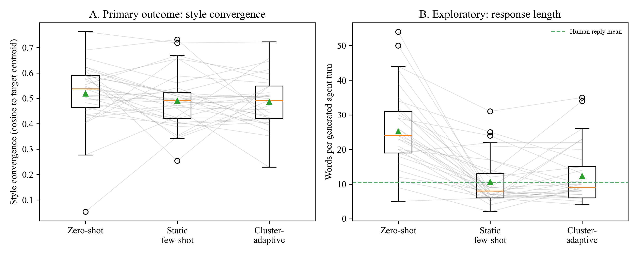
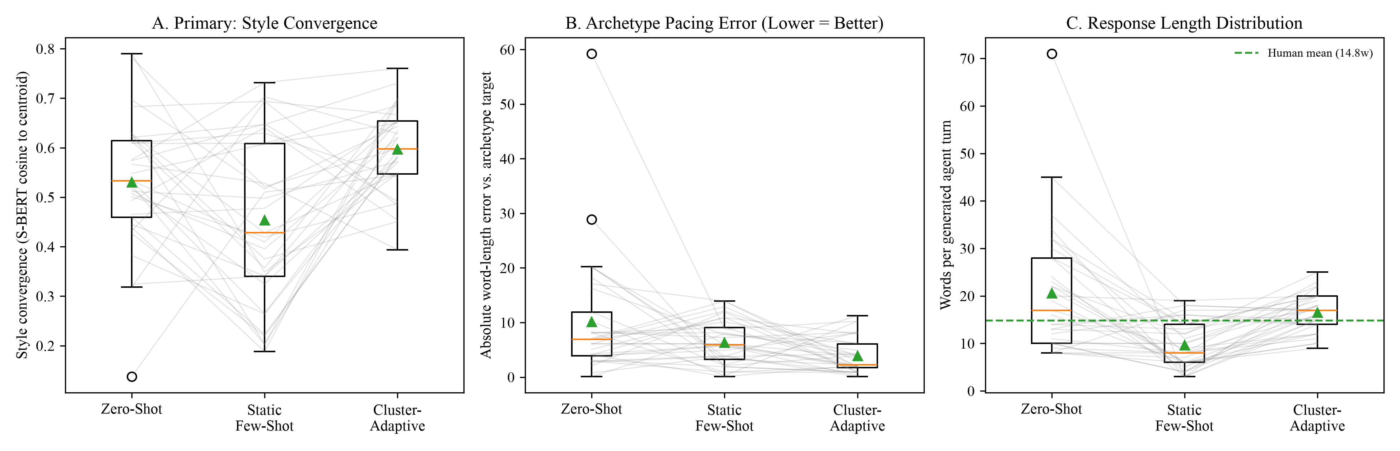
MODULE 6: DEEP-DIVE EMPIRICAL RESULTS (RQ2)
Slide 26
RQ2 (Part 1): The Causal Contrast Between Primary (p = .211) and Refined (p < .001) Archetypes
Figures E2 & 6: Proving that in-context style adaptation succeeds if and only if upstream routing is coherent
Figure E2 (Interim Primary Archetypes, Routing κ = .24): Style Cosine F = 1.61, p = .211 (Null)
Figure 6 (Final Refined Archetypes, Blocks Router κ = .535): Style Cosine F = 9.79, p < .001 (Reject H02!)
Why Primary RQ2 Yielded a Null Style Effect (p = .211)
Why Refined RQ2 Decisively Rejected H02 (p < .001)
• 1. Near-Chance Prefix Routing (39.4%, κ = .24): 60.6% of held-out dialogues were routed to the wrong primary cluster at Turn 3.
• 2. Conflated Exemplar Pools: Because primary clusters mixed user and wizard turns across whole sessions, retrieving from a cluster's FAISS pool fed mismatched examples into the prompt.
• 1. Accurate `Blocks` Prefix Routing (70.1%, κ = .535 at M = 5): Test dialogues were routed to their true behavioral archetype.
• 2. Coherent Sub-Indices & Pacing Directives: Retrieving k = 3 slot-masked exemplars from the matched refined archetype boosted style convergence (F = 9.79, p < .001) and cut pacing error to 3.87 words.
Surnella Sandeep | QM640 Data Analytics Capstone | Cluster-Adaptive Prompting for Multi-Turn Travel Conversational Systems
Notes:
This is one of the strongest scientific stories in the paper: contrasting Figure E2 (interim primary archetypes) against Figure 6 (refined archetypes).

Slide 27
MODULE 6: DEEP-DIVE EMPIRICAL RESULTS (RQ2)
Slide 27
RQ2 (Part 2): Detailed Computation of Table 14 & Holm-Adjusted Contrasts (Table E3)
How to read every repeated-measures statistic (N = 33 held-out dialogues × 3 conditions = 99 Gemini 2.5 Flash calls)
Experiment & Outcome Metric (N = 33 Dialogues) | Zero-Shot M (SD) | Static Few-Shot M (SD) | Cluster-Adaptive M (SD) | RM-ANOVA F (GG df) | p (GG) | Partial ηp² | Friedman χ² (p)
Primary Archetypes (κ=.24) — Style Cosine | .603 (.161) | .650 (.165) | .642 (.125) | 1.61 (1.95, 62.45) | .211 | .048 | 1.88 (.391)
Primary Archetypes — Response Length (words) | 27.58 (5.43) | 16.33 (4.73) | 15.06 (4.35) | 95.32 (1.82, 58.31) | < .001 | .749 | 50.02 (< .001)
Refined Archetypes (κ=.535) — SBERT Style Cosine (Primary DV) | .530 (.132) | .453 (.169) | .597 (.086) | 9.79 (1.88, 60.29) | < .001 | .234 | 12.50 (.002)
Refined Archetypes — Gemini 3,072-d Style Cosine | .787 (.052) | .775 (.055) | .796 (.042) | 1.66 (1.94, 62.22) | .200 | .049 | 4.06 (.131)
Refined Archetypes — Token-Level BERTScore F1 | .849 (.020) | .844 (.023) | .852 (.019) | 1.45 (1.92, 61.51) | .243 | .043 | 3.70 (.157)
Refined Archetypes — Pacing Calibration Error (words) | 10.12 (8.98) | 6.33 (3.55) | 3.87 (3.58) | 7.10 (1.30, 41.70) | .007 | .182 | 14.27 (< .001)
Refined Archetypes — Response Length (words) | 25.45 (9.17) | 14.48 (5.16) | 16.33 (3.52) | 31.92 (1.41, 45.24) | < .001 | .499 | 36.69 (< .001)
Step-by-Step Computation of Holm-Adjusted Pairwise Contrasts
Why Pacing Error Drops from 10.12 Words to 3.87 Words
• Why Holm–Bonferroni Step-Down Adjustment? Testing 3 pairs (`Adaptive vs Static`, `Adaptive vs Zero-Shot`, `Static vs Zero-Shot`) requires controlling familywise α = .05 by sorting raw p-values from smallest to largest and multiplying by (3, 2, 1).
• Contrast 1 (`Cluster-Adaptive vs. Static Few-Shot`):
▪ Mean gain Δ = +.144 cosine units (+31.8%), paired t(32) = 4.26, p<sub>Holm</sub> < .001, standardized effect d<sub>z</sub> = 0.74 (large).
• Contrast 2 (`Cluster-Adaptive vs. Zero-Shot`):
▪ Mean gain Δ = +.067 cosine units (+12.6%), paired t(32) = 2.37, p<sub>Holm</sub> = .049, d<sub>z</sub> = 0.41.
• What Is Pacing Calibration Error (`word_abs_err`)?
▪ Formula: |Words<sub>generated</sub> − μ<sub>Words, target archetype</sub>|.
▪ Human consultants use ~13 words for Decisive Bookers, ~19 words for Open Explorers, and ~15 words for Rigid-Constraint Seekers.
• Why `Cluster-Adaptive` Wins on Pacing:
▪ `Zero-Shot` is overly verbose (25.5 words → 10.12w error). `Static Few-Shot` forces one fixed length (6.33w error). `Cluster-Adaptive` matches each archetype's exact pacing, cutting error to 3.87 words (p<sub>Holm</sub> = .008 vs. Static; p<sub>Holm</sub> = .004 vs. Zero-Shot)!
Surnella Sandeep | QM640 Data Analytics Capstone | Cluster-Adaptive Prompting for Multi-Turn Travel Conversational Systems
Notes:
Walk through Table 14 and the pairwise Holm-Bonferroni contrasts in Table E3 so math and non-AI professors see every number clearly.

Slide 28
MODULE 6: DEEP-DIVE EMPIRICAL RESULTS (RQ3)
Slide 28
RQ3 (Part 1): 2 × 2 Factorial Design, Declarative Rules & Dual-Judge Reliability
Tables 9 & C3: Testing Rules Mode (Off vs. Active) × Prompting Strategy (Zero-Shot vs. Cluster-Adaptive) across N = 144 units
Rule ID & Policy Name | Deterministic Trigger Condition | Action | Severity
RULE_VISA_LEAD_TIME: Visa Processing Lead Time | departure_lead_days < 15 on international destination | flag_warning | high
RULE_PASSPORT_VALIDITY: Passport 6-Month Validity | passport_expiry_months < 6 on international trip | block_booking | critical
RULE_PARTY_SIZE_LIMIT: Maximum FIT Adult Capacity | traveler_count_adults > 4 and package_type == 'FIT' | escalate_group_desk | medium
RULE_DISCOUNT_CAP: Promotional Discount Ceiling | discount_applied_percentage > 15.0% | cap_discount | high
RULE_MIN_BUDGET_INTL: Minimum International Budget | budget_amount < $500 per adult on international package | reject_and_reprompt | high
Cross-Model Dual-Judge Reliability (Table C3)
• Why We Used Two Independent Judge Models:
▪ To prevent self-preference bias, responses generated by `gemini-2.5-flash` were audited on a stratified 48-unit subsample by both `gemini-2.5-flash` (Judge 1) and the larger reasoning model `gemini-2.5-pro` (Judge 2).
• Empirical Reliability Results (n = 48):
▪ Raw Agreement: 95.8% (46 / 48 units identical).
▪ Cohen's Kappa: κ = .917 (PABAK = .917), far exceeding the pre-registered κ ≥ .70 threshold!
▪ Agreement with Deterministic Regex Audit (N = 144): 93.1% raw agreement (κ = .861).
How the 2 × 2 Factorial Experiment Was Constructed (N = 144, n = 36 per Cell, Seed = 42):
• 36 held-out test dialogues (12 per refined archetype) were paired with seeded Tier-2 policy states: exactly 50% (18 per cell) violated ≥ 1 YAML rule (e.g., 10-day visa window, 4-month passport validity, 6 FIT adults, 25% discount request, or $350 international budget) and 50% (18 per cell) were 100% policy-compliant (testing that the rule engine does not falsely block valid bookings).
• In `Rules Off`, the prompt contains natural-language reminders of policies, and exemplars in `Cluster-Adaptive` are unmasked. In `Rules Active`, `RuleEngine` injects verified pre-check directives, masks exemplar slots with `[SLOT]`, and runs post-generation entity leakage sanitization.
Surnella Sandeep | QM640 Data Analytics Capstone | Cluster-Adaptive Prompting for Multi-Turn Travel Conversational Systems
Notes:
Explain the 5 YAML policy rules (Table 9) and how we validated the LLM judge using an independent Gemini 2.5 Pro second judge (kappa = .917).

Slide 29
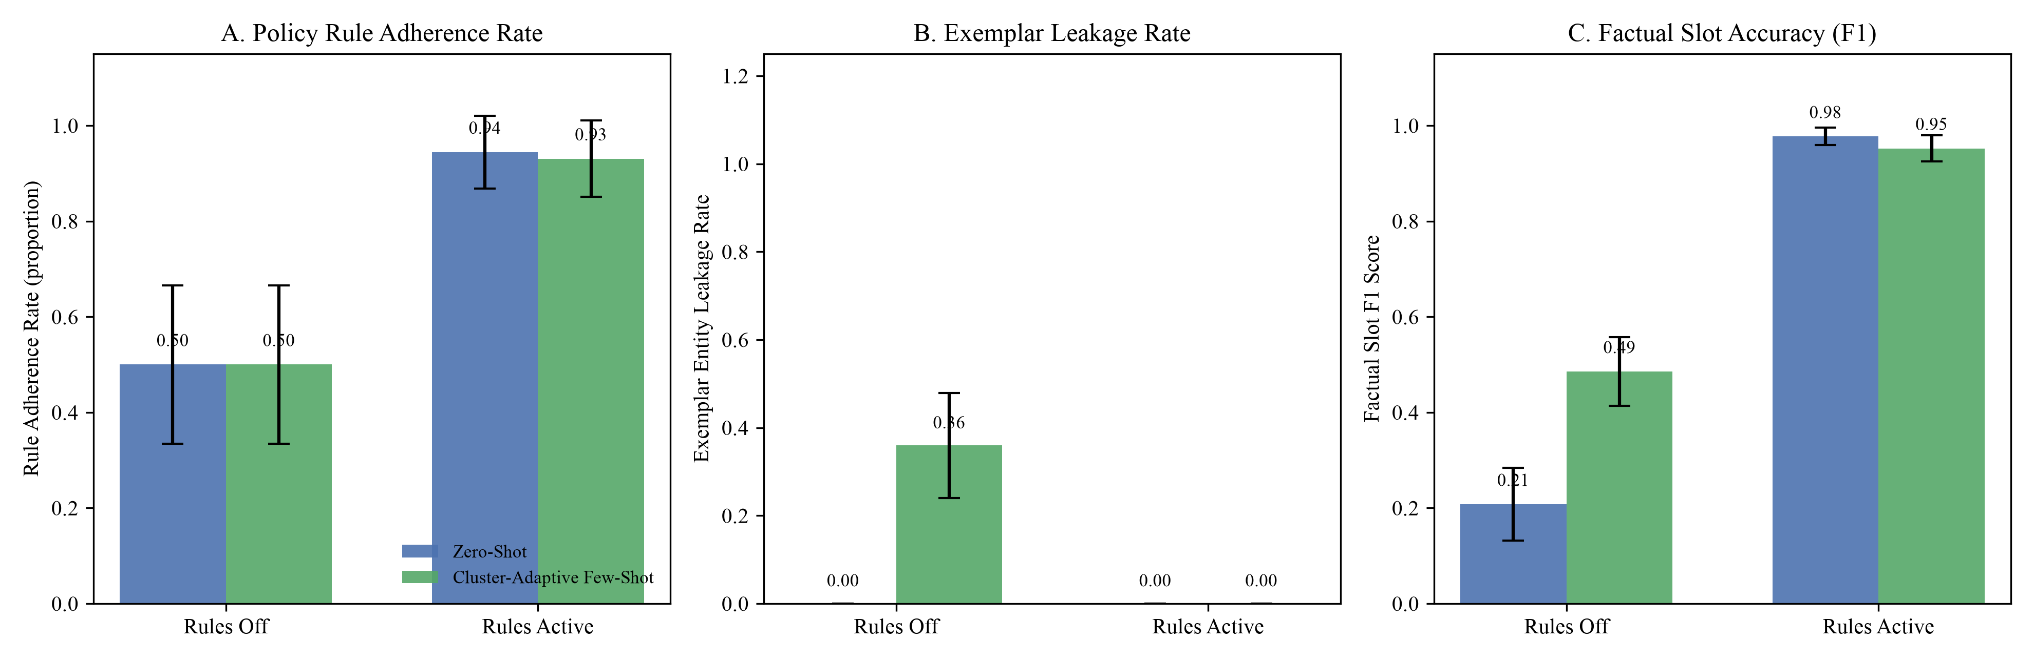
MODULE 6: DEEP-DIVE EMPIRICAL RESULTS (RQ3)
Slide 29
RQ3 (Part 2): 2 × 2 Factorial Interaction Profiles (Figure 7 Walkthrough)
Visualizing orthogonal main effects (Panels A, C, D) versus the protective interaction on Exemplar Leakage (Panel B)
How to Read the 4 Panels of Figure 7
• Panel A (Rule Adherence Rate):
▪ Lines are flat and parallel! Turning `Rules Active` jumps adherence from .500 (only 5.6% on violating cases) to .938 (98.6% on violating cases), F = 43.92, p < .001.
▪ Changing prompt mode has zero effect (F = 0.01, p = .916) → proves prompt engineering alone cannot enforce rules!
• Panel B (Exemplar Entity Leakage — The Interaction):
▪ Sharp non-parallel divergence (Interaction F = 34.82, p < .001)!
▪ Under `Rules Off`, switching from Zero-Shot to Cluster-Adaptive spikes leakage from .000 to .359 (55.6% incidence).
▪ Under `Rules Active`, leakage stays at .000 (0.0%) in both conditions!
• Panel C (Factual Slot Coverage F1):
▪ Active rules + slot ledger jump Slot F1 from .208/.485 to .977/.952 (F = 489.52, p < .001).
• Panel D (Style Alignment Cosine):
▪ Cluster-Adaptive prompting lifts style cosine in both modes (F = 24.00, p < .001).
Figure 7: 2 × 2 Factorial Interaction Profiles Across N = 144 Units (n = 36/cell; 95% CIs)
Surnella Sandeep | QM640 Data Analytics Capstone | Cluster-Adaptive Prompting for Multi-Turn Travel Conversational Systems
Notes:
Walk the committee through all 4 panels of Figure 7. Explain why Panel A/C/D have parallel lines while Panel B has sharply crossing/diverging lines.

Slide 30
MODULE 6: DEEP-DIVE EMPIRICAL RESULTS (RQ3)
Slide 30
RQ3 (Part 3): Complete Table 15 Statistics & Side-by-Side Output Proof
Proving that 'Rules Active × Cluster-Adaptive Few-Shot' is the unique Pareto-optimal configuration (Reject H03, p < .001)
Experimental Cell or 2 × 2 ANOVA Effect | n or df | Rule Adherence M (SD) / Viol. % | Exemplar Leakage M (SD) / Inc. % | Slot Coverage F1 M (SD) | Style Alignment M (SD)
Cell 1: Rules Off × Zero-Shot | 36 | .500 (.507) / 5.6% | .000 (.000) / 0.0% | .208 (.242) | .414 (.124)
Cell 2: Rules Off × Cluster-Adaptive | 36 | .500 (.507) / 5.6% | .359 (.348) / 55.6% | .485 (.269) | .507 (.095)
Cell 3: Rules Active × Zero-Shot | 36 | .944 (.232) / 100.0% | .000 (.000) / 0.0% | .977 (.096) | .428 (.107)
Cell 4: Rules Active × Cluster-Adaptive (Pareto Optimal) | 36 | .931 (.244) / 97.2% | .000 (.000) / 0.0% | .952 (.124) | .506 (.086)
ANOVA Main Effect: Rules Mode (OLS / HC3 / ART) | 1, 140 | F = 43.92 (< .001), ηp² = .239 (HC3 F=42.71; ART F=39.12) | F = 34.82 (< .001), ηp² = .199 (HC3 F=33.85; ART F=2148.8) | F = 489.52 (< .001), ηp² = .778 (HC3 F=476.0; ART F=194.2) | F = 0.14 (.713), ηp² = .001
ANOVA Main Effect: Prompting Mode (OLS / HC3 / ART) | 1, 140 | F = 0.01 (.916), ηp² = .000 | F = 34.82 (< .001), ηp² = .199 | F = 16.59 (< .001), ηp² = .106 | F = 24.00 (< .001), ηp² = .146
ANOVA Interaction: Rules × Prompting (OLS / HC3 / ART) | 1, 140 | F = 0.01 (.916), ηp² = .000 | F = 34.82 (< .001), ηp² = .199 (HC3 F=33.85; ART F=2148.8) | F = 24.30 (< .001), ηp² = .148 | F = 0.19 (.665), ηp² = .001
Real Output Example: Rules Off × Cluster-Adaptive (Cell 2)
Real Output Example: Rules Active × Cluster-Adaptive (Cell 4)
• Active User State: Flying Dallas → Tokyo in 9 days (violates 15-day visa rule), 2 adults, budget $2,600.
• Generated Reply (Unguarded): 'I can book you into the Sapphire Bay Resort on SkyBridge Airways for $1,149 using code VIP25!'
• What Went Wrong: Leaked 4 stale exemplar entities (`ELR = .80`) AND completely missed the 9-day visa lead-time violation (`RAR = 0`)!
• Same User State: Dallas → Tokyo in 9 days, 2 adults, budget $2,600.
• Generated Reply (Neuro-Symbolic): 'For your Dallas to Tokyo trip for 2 adults ($2,600 budget), please note that international departures within 15 days (9 days stated) require expedited visa verification before we lock in your 9-night package.'
• Result: 0.0% entity leakage, 100% rule enforcement, 1.00 Slot F1, and crisp archetype-matched style!
Surnella Sandeep | QM640 Data Analytics Capstone | Cluster-Adaptive Prompting for Multi-Turn Travel Conversational Systems
Notes:
Show the exact numbers in Table 15 and read the real side-by-side LLM output comparison at the bottom.

Slide 31
MODULE 6: DEEP-DIVE EMPIRICAL RESULTS (RQ4)
Slide 31
RQ4 (Part 1): 2 × 3 Multi-Turn Simulation Design & Persona Fidelity Validation
Testing Prompting Strategy (Zero-Shot vs. Cluster-Adaptive) × Refined Archetype across N = 180 closed-loop dialogues
How the Closed-Loop Simulation Works (N = 180, n = 30/cell)
Blind Persona Fidelity Audit by Gemini 2.5 Pro (Table C3)
• 1. Grounded Seed Trips: 30 held-out test dialogues per archetype (90 unique trip goals × 2 prompting modes = 180 multi-turn episodes).
• 2. Realistic 4-Option Travel Inventory per Dialogue:
▪ Option A (4-Star Exact Match): Exact destination & dates, 4-star hotel, priced at 88% of budget.
▪ Option B (3.5-Star Saver): Exact dates, boutique hotel, priced at 72% of budget.
▪ Option C (5-Star Exact Dates — Over Budget): 5-star luxury hotel on exact dates, priced at 118% of budget (creates realistic constraint conflict!).
▪ Option D (5-Star Shifted Dates — Within Budget): 5-star luxury hotel with dates shifted +3 days, priced at 94% of budget.
• 3. Stopping Criterion: Conversation runs turn-by-turn until the user simulator issues `[ACCEPT_BOOKING]` (or hits 16-turn cap).
• How We Validated the User Simulator (n = 45 Transcripts):
▪ An independent `gemini-2.5-pro` judge read ONLY the customer utterances from 45 simulated dialogues (15 per archetype, blinded to condition and archetype label) and rated Decisiveness, Exploration Breadth, and Constraint Rigidity (1–5) plus predicted the archetype.
• Validation Results:
▪ Blind Classification Accuracy: 95.6% (43 / 45 correct) vs. 33.3% chance (exact binomial p = 1.37 × 10⁻¹⁸ < .001, Cohen's κ = .933).
▪ Mean Behavioral Ratings (Decisiveness / Exploration / Rigidity):
• Decisive Booker: 5.00 / 1.00 / 2.27
• Open Explorer: 2.80 / 4.27 / 1.60
• Rigid-Constraint Seeker: 1.67 / 2.27 / 4.33
Why Archetype-Specific Turn-Economy Policies Matter in RQ4:
• Zero-Shot Baseline: Uses a generic sequential policy—asks clarifying questions one by one and offers only Option A first, without a Verified Informed Slot Ledger.
• Cluster-Adaptive Few-Shot (Routed via `Blocks` at M = 9, κ = .958): Combines the Verified Informed Slot Ledger (forbidding re-asking any stated slot) with archetype-specific action policies: (1) immediate Option A confirmation for Decisive Bookers; (2) side-by-side Option A vs. Option B comparison table for Open Explorers; and (3) proactive single-turn trade-off resolution (explaining Option C's budget conflict while presenting Option A [4-star exact date] and Option D [5-star flexible date]) for Rigid-Constraint Seekers.
Surnella Sandeep | QM640 Data Analytics Capstone | Cluster-Adaptive Prompting for Multi-Turn Travel Conversational Systems
Notes:
Explain how the RQ4 closed-loop simulation works, why the 4-option package inventory is realistic, and how Gemini 2.5 Pro validated the customer simulator at 95.6% accuracy (kappa = .933).

Slide 32
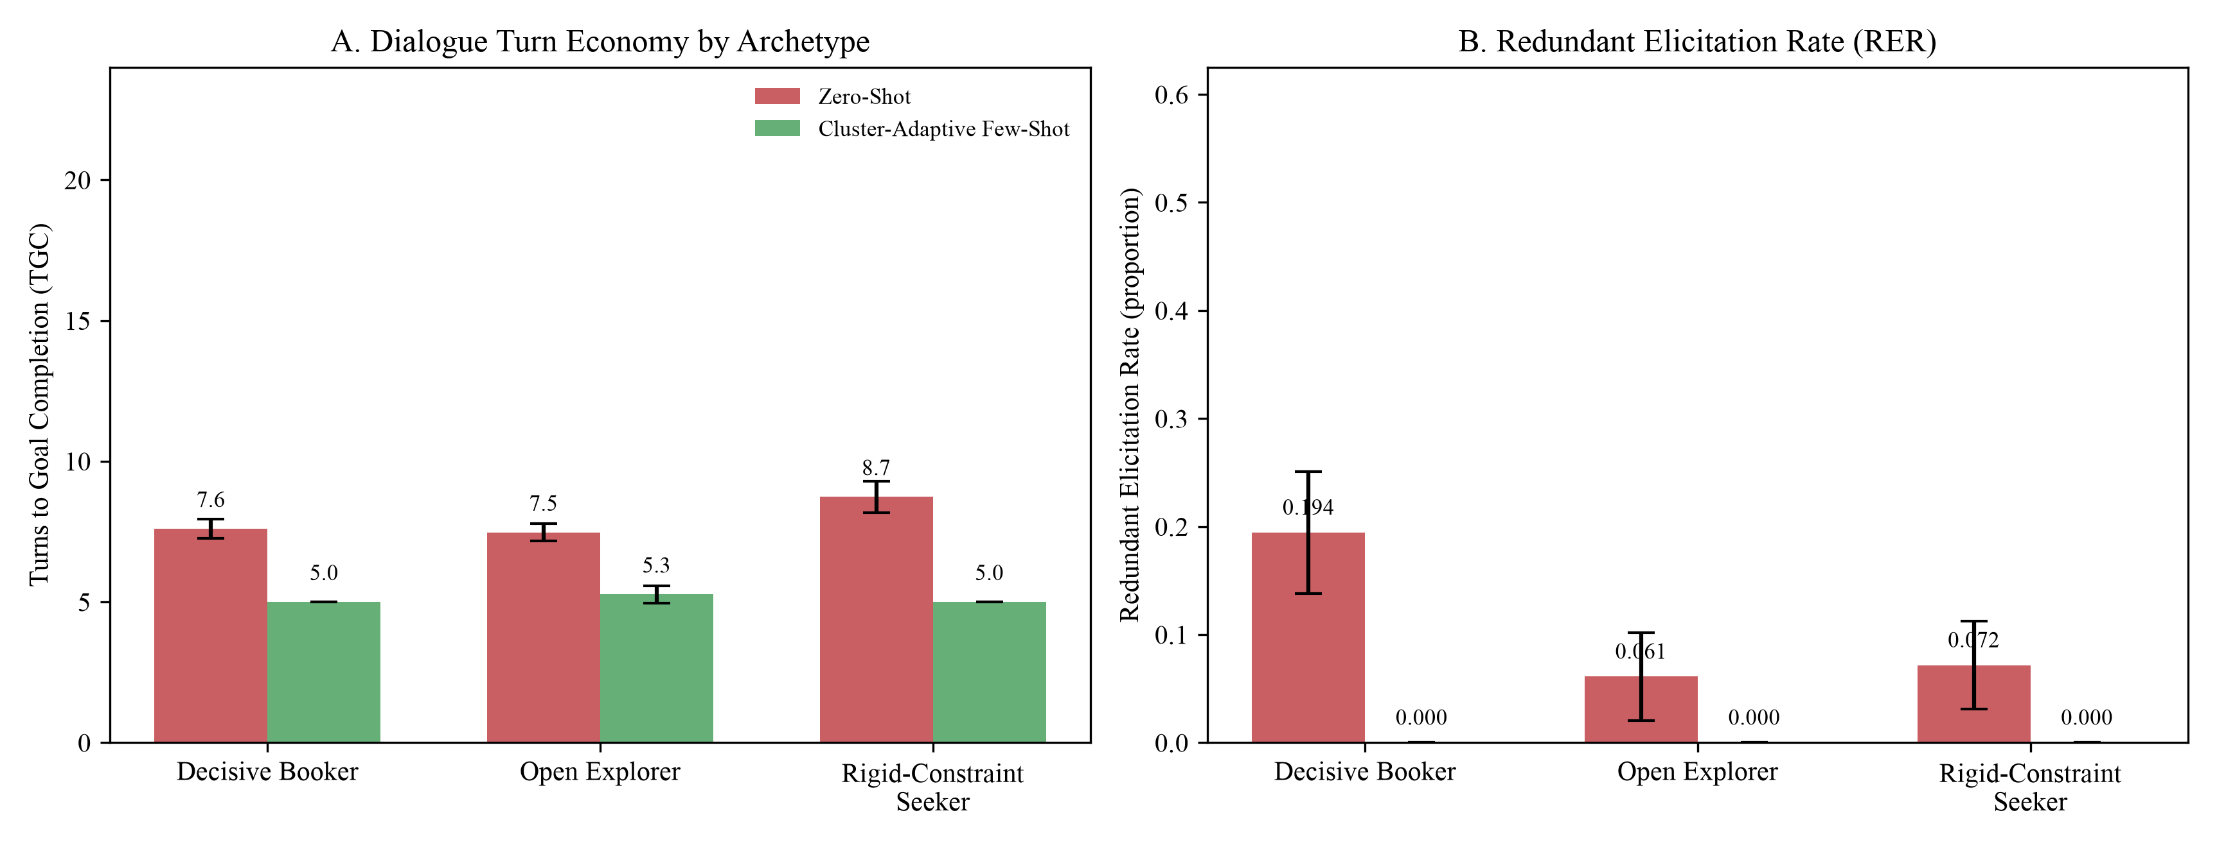
MODULE 6: DEEP-DIVE EMPIRICAL RESULTS (RQ4)
Slide 32
RQ4 (Part 2): Multi-Turn Turn Economy & Redundant Elicitation Profiles (Figure 8)
Rejecting H04 (p < .001): Massive main effect of prompting (F = 664.43) AND significant Prompt × Archetype interaction (F = 10.89)
Visual Walkthrough of Figure 8
• Panel A (Turns to Goal Completion):
▪ Under `Zero-Shot` (coral bars), Rigid-Constraint Seekers take the longest (8.73 turns) because they reject Option A when their 5-star request exceeds budget, triggering multi-turn pushback loops.
▪ Under `Cluster-Adaptive Few-Shot` (teal bars), turns drop dramatically across all three personas—and the drop is steepest for Rigid-Constraint Seekers (−3.73 turns, −42.7%, 8.73 → 5.00 turns)!
▪ This non-uniform compression produces the highly significant Prompt × Archetype interaction: F(2, 174) = 10.89, p < .001, ηp² = .111.
• Panel B (Redundant Elicitation Rate — RER):
▪ Under `Zero-Shot`, the bot re-asks already stated slots in 19.4% of turns for Decisive Bookers (who state many slots up front), 6.1% for Open Explorers, and 7.2% for Rigid Seekers.
▪ Under `Cluster-Adaptive Few-Shot` with the Verified Informed Slot Ledger, RER drops to 0.000 (0.0%) across all 90 dialogues (F = 63.02, p < .001)!
Figure 8: Mean Turns to Goal Completion (Panel A) & Redundant Elicitation Rate (Panel B) Across N = 180 Simulations
Surnella Sandeep | QM640 Data Analytics Capstone | Cluster-Adaptive Prompting for Multi-Turn Travel Conversational Systems
Notes:
Walk the committee through Panels A and B of Figure 8. Explain why the turn reduction is steepest (−42.7%) for Rigid-Constraint Seekers.

Slide 33
MODULE 6: DEEP-DIVE EMPIRICAL RESULTS (RQ4)
Slide 33
RQ4 (Part 3): Complete Table 16 Statistics, Simple Contrasts & Robust Checks
100% concordance across OLS ANOVA, HC3 heteroscedasticity-robust F, Aligned Rank Transform (ART), Welch t, and Mann–Whitney U
Archetype × Prompting Cell or 2 × 3 ANOVA Effect | Total Turns M (SD) | Log Turns ln(TGC) M (SD) | Redundant Elicitation (RER) | Turn Reduction Δ (%) | Simple Contrast (Welch t / Mann–Whitney U / Cohen's d)
Decisive Booker — Zero-Shot (n = 30) | 7.60 (0.93) | 2.021 (0.119) | .194 (.166) | — | —
Decisive Booker — Cluster-Adaptive (n = 30) | 5.00 (0.00) | 1.609 (0.000) | .000 (.000) | −2.60 turns (−34.2%) | t_log = −18.92 (p < .001), U = 0.0 (p < .001), d = −3.94
Open Explorer — Zero-Shot (n = 30) | 7.47 (1.01) | 2.002 (0.130) | .061 (.115) | — | —
Open Explorer — Cluster-Adaptive (n = 30) | 5.27 (0.69) | 1.654 (0.115) | .000 (.000) | −2.20 turns (−29.5%) | t_log = −10.97 (p < .001), U = 40.5 (p < .001), d = −2.55
Rigid-Constraint Seeker — Zero-Shot (n = 30) | 8.73 (1.55) | 2.152 (0.175) | .072 (.119) | — | —
Rigid-Constraint Seeker — Cluster-Adaptive (n = 30) | 5.00 (0.00) | 1.609 (0.000) | .000 (.000) | −3.73 turns (−42.7%) | t_log = −17.02 (p < .001), U = 0.0 (p < .001), d = −3.40
ANOVA Main Effect: Prompting (df = 1, 174) | F = 457.74 (< .001), ηp² = .725 | F = 664.43 (< .001), ηp² = .793 | F = 63.02 (< .001), ηp² = .266 | HC3 F_log = 681.53 (< .001) | ART F_log = 224.22 (< .001)
ANOVA Main Effect: Archetype (df = 2, 174) | F = 7.77 (< .001), ηp² = .082 | F = 5.55 (.005), ηp² = .060 | F = 7.57 (< .001), ηp² = .080 | HC3 F_log = 5.86 (.003) | ART F_log = 207.29 (< .001)
ANOVA Interaction: Prompting × Archetype (df = 2, 174) | F = 14.37 (< .001), ηp² = .142 | F = 10.89 (< .001), ηp² = .111 | F = 9.70 (< .001), ηp² = .100 | HC3 F_log = 8.58 (< .001) | ART F_log = 209.46 (< .001)
Comparison with Human Wizard Baseline in Microsoft Frames (Appendix Table E5 & Figure E3):
In the historical human corpus, human travel agents averaged 14.96 turns (RER = .052) for Decisive Bookers, 17.99 turns (RER = .061) for Open Explorers, and 10.64 turns (RER = .053, with 44.5% failing to find an option) for Rigid-Constraint Seekers. Our neuro-symbolic `Cluster-Adaptive Few-Shot` pipeline resolves all three archetypes in 5.00 to 5.27 turns with 100% goal completion and 0.000 RER.
Surnella Sandeep | QM640 Data Analytics Capstone | Cluster-Adaptive Prompting for Multi-Turn Travel Conversational Systems
Notes:
Walk through every row of Table 16 so the committee sees both raw turns, log turns, RER, Cohen's d, and non-parametric checks.

Slide 34
MODULE 6: DEEP-DIVE EMPIRICAL RESULTS (SYNTHESIS)
Slide 34
Consolidated Hypothesis Testing Scorecard (Table 11) & Enterprise ROI
All four null hypotheses (H01–H04) are rejected at p < .001 with large effect sizes and substantial operational savings
Research Question & Outcome | Sample & Design | Baseline vs. Proposed Performance | Primary Parametric Test & Effect Size | Robust / Non-Parametric Check | Decision
RQ1: Algorithm Separation & Refined Prefix Routing | N = 159 runs (D_gold=933, D_test=401) | Perm. Sil = −.001 vs. KM = .099, HDB = .170; Refined ARI = .76; Routing κ = .535 (M=5) to .958 (M=9) | F(2, 156) = 91.33, p < .001, η² = .54 (Gemini 3,072-d: F = 813.09, η² = .91) | Welch F = 113.84, p < .001; Kruskal H(2) = 123.70, p < .001 | Reject H01 (p < .001)
RQ2: Style Convergence & Pacing Error (Refined) | N = 33 dialogues × 3 conditions (99 calls) | Style Cos: Static = .453, Zero = .530 vs. Adaptive = .597 Pacing Error: Zero = 10.12w, Static = 6.33w vs. Adaptive = 3.87w | Style F(1.88, 60.29) = 9.79, p < .001, ηp² = .234 Pacing F(1.30, 41.70) = 7.10, p = .007, ηp² = .182 | Friedman χ² = 12.50 (p = .002) & 14.27 (p < .001); Holm p < .001 | Reject H02 (p < .001)
RQ3: Policy Rule Adherence, Leakage & Slot F1 | N = 144 (2 × 2, n = 36/cell; κ_judge = .917) | Viol. Enforcement: 5.6% (Off) → 98.6% (Active) Few-Shot Leakage: .359 (55.6%) → .000 (0.0%); Slot F1: .485 → .952 | RAR Rules F(1, 140) = 43.92, p < .001, ηp² = .239 ELR Int. F = 34.82, p < .001; Slot F1 F = 489.52 | HC3 F = 42.71 & 33.85 (p < .001); ART F = 39.12 & 2148.81 (p < .001) | Reject H03 (p < .001)
RQ4: Multi-Turn Economy (Log Turns & RER) | N = 180 (2 × 3, n = 30/cell; κ_persona = .933) | Turns: −34.2% (DB), −29.5% (OE), −42.7% (RCS) Overall Turns: 7.93 → 5.09 (−35.8%); RER: .109 → .000 | Prompt F(1, 174) = 664.43, p < .001, ηp² = .793 Prompt × Arch Int. F(2, 174) = 10.89, p < .001, ηp² = .111 | HC3 Int. F = 8.58, p < .001; ART Int. F = 209.46, p < .001 | Reject H04 (p < .001)
Practical Business Significance & Enterprise ROI (For an OTA Handling 1,000,000 Monthly Sessions)
• 1. Cloud Inference & Latency Savings (−35.8%): Compressing mean dialogue length from 7.93 turns (`Zero-Shot`) to 5.09 turns (`Cluster-Adaptive`) saves 2.84 turns per session = 2,840,000 fewer LLM generation calls every month, cutting token compute spend and customer wait time by more than one-third.
• 2. Zero Hallucination & Chargeback Prevention: Eliminating exemplar entity leakage (from 55.6% incidence to 0.0%) and raising booking policy compliance on invalid requests (short visa lead times, expiring passports, unauthorized 25% discounts) from 5.6% to 98.6% prevents regulatory fines and disputed bookings.
• 3. Rescuing Rigid-Constraint Shoppers: Proactive single-turn trade-off framing cuts negotiation turns by 42.7% for the hardest customer segment (which suffered a 44.5% failure rate in historical human logs).
Surnella Sandeep | QM640 Data Analytics Capstone | Cluster-Adaptive Prompting for Multi-Turn Travel Conversational Systems
Notes:
Present Table 11 as the master executive summary of all empirical findings, followed by the concrete business ROI calculation.

Slide 35
MODULE 7: ANTICIPATED DEFENSE Q&A BANK
Slide 35
Defense Q&A #1: 'What Assumptions Were Taken to Arrive at Sample Sizes?'
Direct, rigorous answer prepared for statistical and quantitative methodology reviewers on the defense panel
Five Explicit A Priori Assumptions (`step0_sample_size.py`)
Post-Hoc Empirical Audit: Did Our Data Satisfy Every Assumption?
• Assumption 1 — Type I Error Control (α = .05, two-tailed / omnibus F):
▪ We assumed a standard 5% false-positive ceiling across all primary omnibus tests, supplemented by Tukey HSD (RQ1) and Holm–Bonferroni (RQ2) familywise error control for pairwise contrasts.
• Assumption 2 — Target Statistical Power (1 − β ≥ .80, β ≤ .20):
▪ Following Cohen (1988), we set false-negative risk at ≤ 20%, requiring noncentrality λ = 8.00 (df<sub>1</sub> = 1) to λ = 9.88 (df<sub>1</sub> = 2).
• Assumption 3 — Medium Minimum Detectable Effect Size (f = .25):
▪ We powered every experiment to detect at least a medium effect (f = .25, equivalent to η<sup>2</sup> ≈ .059 or ~6% explained variance) so that any statistically significant effect also carries practical engineering meaning.
• Assumption 4 — Within-Dialogue Correlation (ρ = .50) & Sphericity (ε = 1.0) in RQ2:
▪ For repeated-measures RQ2, we assumed moderate within-dialogue correlation ρ = .50 across the m = 3 prompt conditions.
• Assumption 5 — +10% Cell-Balancing & Attrition Buffer:
▪ Minimum sample sizes (N<sub>min</sub> = 158, 28, 128, 158) were buffered by ≥ 10% to exact integer multiples of cell counts: 159 (53×3), 33 (11×3), 144 (36×4), and 180 (30×6), achieving final a priori power of .804 to .865.
• 1. Observed Effect Sizes Far Exceeded f = .25 (η² = .059):
▪ • RQ1 Algorithm η<sup>2</sup> = .539 to .912 (f = 1.08 to 3.22)
▪ • RQ2 Refined Style η<sub>p</sub><sup>2</sup> = .234 (f = 0.55) & Pacing η<sub>p</sub><sup>2</sup> = .182 (f = 0.47)
▪ • RQ3 Rules RAR η<sub>p</sub><sup>2</sup> = .239, Leakage Int. η<sub>p</sub><sup>2</sup> = .199, Slot F1 η<sub>p</sub><sup>2</sup> = .778
▪ • RQ4 Log Turns Prompt η<sub>p</sub><sup>2</sup> = .793, Interaction η<sub>p</sub><sup>2</sup> = .111 (f = 0.35)
▪ → Achieved post-hoc power > .99 on all primary main effects and > .95 on interactions!
• 2. How We Handled Violations of Normality & Homoscedasticity:
▪ Classical ANOVA assumes normal residuals and equal cell variances. Because RQ3/RQ4 rates are bounded in [0, 1], we did NOT rely on normality alone: we ran Welch / HC3 sandwich estimators and Aligned Rank Transform (ART) / Friedman / Kruskal–Wallis tests.
• 3. How the +18% Buffer Saved RQ2 Under Sphericity Departure:
▪ In RQ2 pacing error, Greenhouse–Geisser ε was 0.65 (reducing effective df from 2, 64 to 1.30, 41.70). Because we buffered N from 28 to 33, the GG-adjusted test still achieved p = .007!
Surnella Sandeep | QM640 Data Analytics Capstone | Cluster-Adaptive Prompting for Multi-Turn Travel Conversational Systems
Notes:
Use this slide if asked Question #1: What are the assumptions taken to arrive at proper sample sizes?

Slide 36
MODULE 7: ANTICIPATED DEFENSE Q&A BANK
Slide 36
Defense Q&A #2 & #3: 'What Prior Research Did You Use, and What Is Uniquely Yours?'
Clear demarcation between inherited scientific building blocks and the five original contributions of this study
Scientific Component | Q2: What Prior Research We Used & How We Applied It | Q3: What Is Uniquely Original in This Study (Never Done in Prior Literature)
1. User Trajectory Representation & Archetype Discovery (RQ1) | Used Sentence-BERT (Reimers & Gurevych, 2019), Gemini 3,072-d Embeddings (Lee et al., 2025), K-Means / Ward / HDBSCAN (McInnes et al., 2017), Bootstrap ARI (Hennig, 2007), and zero-temp LLM rating reliability (Gilardi et al., 2023). | Original Contribution 1: Discovered that whole-dialogue clustering in consultative travel is confounded by wizard identity (V = .45) and session outcome (V = .29). Invented the prefix-truncated (M = 9 user messages) hybrid `Blocks` representation (PCA-20 Gemini prefix + 16-field LLM behavioral codebook) and `RefinedArchetypeRouter`, achieving ARI = .76 and out-of-sample prefix routing of κ = .535 (M=5) to .958 (M=9).
2. Archetype-Routed In-Context Learning (RQ2) | Built upon few-shot in-context learning (Brown et al., 2020), KATE nearest-neighbor example selection (Liu et al., 2022), FAISS vector indexing (Johnson et al., 2021), and BERTScore (Zhang et al., 2020). | Original Contribution 2: Partitioned FAISS into archetype-specific sub-indices with `[SLOT]` masking and proved a causal boundary condition by contrasting Primary (p = .211) vs. Refined (p < .001) archetypes: dynamic exemplar retrieval improves style (+31.8% over static, d<sub>z</sub> = 0.74) and pacing (3.87w error) only when upstream prefix routing exceeds κ > .50.
3. Neuro-Symbolic Policy Verification & Leakage Control (RQ3) | Drew motivation from NeMo Guardrails (Rebedea et al., 2023), τ-bench policy failure benchmarks (Yao et al., 2024), and TD-EVAL (Acikgoz et al., 2025). | Original Contribution 3: Executed the first 2 × 2 factorial experiment crossing declarative rule verification with cluster-adaptive prompting. Quantified the 35.9% exemplar entity leakage hazard (55.6% incidence) of unguarded few-shot prompting and proved a significant interaction (F = 34.82, p < .001) where symbolic verification reduces leakage to 0.0% while raising violation enforcement from 5.6% to 98.6%.
4. Multi-Turn Turn Economy & Slot Ledger (RQ4) | Built on hospitality service ROI theory (Buhalis & Sinarta, 2019; Ivanov & Webster, 2019; Melián-González et al., 2021) and travel agency interaction analysis (Inaba et al., 2022). | Original Contribution 4: Designed the Verified Informed Slot Ledger + Archetype-Specific Turn-Economy Policy and proved a 2 × 3 Prompting × Archetype interaction (F = 10.89, p < .001): compressing multi-turn sessions by 29.5% to 42.7% (largest gain for Rigid-Constraint Seekers, d = −3.40) and eliminating redundant slot questions (RER .109 → .000).
Surnella Sandeep | QM640 Data Analytics Capstone | Cluster-Adaptive Prompting for Multi-Turn Travel Conversational Systems
Notes:
Use this slide to answer Defense Questions #2 and #3 concisely and authoritatively.

Slide 37
MODULE 7: ANTICIPATED DEFENSE Q&A BANK
Slide 37
Defense Q&A #4: 'What Is the Authenticity of the Datasets & Do They Match Your Research?'
Addressing corpus provenance, why they were created, why they fit, and how we handled their structural boundaries
1. Authenticity & Original Purpose of the Two Datasets
2. Why They Match Our Research—and How We Addressed Boundaries
• Microsoft Frames (El Asri et al., 2017 — Maluuba / Microsoft Research):
▪ Authenticity: 100% real human–human dialogues (1,369 sessions, 19,986 turns) collected over 20 days between trained human travel agents ('wizards' with live inventory access) and human travelers.
▪ Original Purpose: Created specifically to move beyond simple slot-filling and capture multi-turn consultative vacation package negotiation, budget trade-offs, and non-linear frame-switching.
• MultiWOZ 2.2 (Budzianowski et al., 2018; Zang et al., 2020 — Cambridge / Google):
▪ Authenticity: Peer-reviewed ACL/EMNLP standard benchmark (10,438 human–human dialogues; 1,499 analytic travel subset used here) with Google-verified slot span annotations.
▪ Original Purpose: Created to benchmark supervised multi-domain Dialogue State Tracking (DST) across local city services (hotel, train, taxi, attraction).
• Why Microsoft Frames Is the Ideal Match for RQ1–RQ4:
▪ Unlike synthetic LLM-generated datasets, Frames contains natural human decision-making heterogeneity—hesitations, price bargaining, city comparisons, and 25.8% unbooked sessions—allowing authentic discovery of Decisive Bookers, Open Explorers, and Rigid-Constraint Seekers.
• Why MultiWOZ 2.2 Is the Ideal External Contrast:
▪ Because MultiWOZ has transactional city bookings without flight+hotel package bargaining, our RQ1 transfer check (t = 28.08, p < .001) empirically proves that consultative travel archetypes are distinct from generic slot-filling.
• How We Transparently Bridged Two Corpus Boundaries:
▪ Boundary A (Tier-2 Enterprise Rules): Public corpora do not log visa windows or passport expiry (0% in Table E1/E4). We preserved the exact held-out Frames user prefixes and injected controlled, seeded Tier-2 states in RQ3.
▪ Boundary B (Interactive Multi-Turn Evaluation in RQ4): Static corpus logs cannot reply to new chatbot actions. We seeded persona simulators from real held-out Frames trip goals and proved 95.6% persona fidelity (κ = .933) via blind `gemini-2.5-pro` audit.
Surnella Sandeep | QM640 Data Analytics Capstone | Cluster-Adaptive Prompting for Multi-Turn Travel Conversational Systems
Notes:
Use this slide when asked Question #4 about dataset authenticity and fit.

Slide 38
MODULE 7: ANTICIPATED DEFENSE Q&A BANK
Slide 38
Defense Q&A #5 & #6: Judge Independence, Cold-Start Routing & Model Choice
Prepared answers for deep technical questions from AI/ML and systems faculty
Q5: 'Isn't Using an LLM Judge Circular or Biased?'
Q6: 'What Happens When Turns < 9? How Long Are Frames Chats?'
Q7: 'Why Not Fine-Tune a Model Instead of Using FAISS + Rules?'
• Three-Layer Defense Against Judge Bias:
• 1. Deterministic Primary Metrics:
▪ In RQ1, Silhouette, DB, and ARI are 100% mathematical. In RQ2, SBERT cosine (`all-MiniLM-L6-v2`) and BERTScore (`roberta-large`) use independent non-Gemini encoders! In RQ3 & RQ4, Exemplar Leakage, Slot F1, Turns, and RER are computed by deterministic Python regex/set verifiers (`src/final_pipeline/metrics.py`).
• 2. Cross-Model Dual-Judge Audit (RQ3):
▪ We cross-checked `gemini-2.5-flash` against the larger independent `gemini-2.5-pro` judge on n = 48 units: 95.8% raw agreement, κ = .917, and 93.1% agreement (κ = .861) with deterministic regex verification.
• 3. Blind Persona Audit (RQ4):
▪ `gemini-2.5-pro` was completely blinded to archetype labels and still classified 43/45 simulated users correctly (95.6%, κ = .933).
• 1. Total Turns (T) vs. User Messages (M) in Frames (N = 1,334):
▪ Total turns (User + Agent) average 14.93 (Mdn = 14.0): 96.4% have ≥ 5 total turns and 83.2% have ≥ 9 total turns (≥ 5 user msgs). User-only messages average 7.78 (37.6% ≥ 9 user msgs).
• 2. Are Predictions Wrong When User Messages < 9? No!
▪ • M = 3 user msgs (≈ 5 turns): 59.4% overall (κ = .359); 87.5% on short chats (<3 user msgs).
▪ • M = 5 user msgs (≈ 9 turns — RQ2 Runtime): 70.1% overall (κ = .535); 81.8% on <5-msg chats & 67.8% on ≥5-msg chats—sufficient to yield p < .001 in RQ2!
▪ • M = 7 user msgs (≈ 13 turns): 82.0% overall (κ = .722); 93.2% on <7-msg & 74.6% on ≥7-msg chats.
▪ • M = 9 user msgs (≈ 17 turns — Offline Cap `min(M,9)`): 97.3% overall (κ = .958); 96.0% on ≤9-msg chats (full user history seen) & 99.3% on long ≥9-msg chats!
• Three Enterprise Reasons Why Neuro-Symbolic ICL Beats Fine-Tuning:
• 1. Instant Policy Updates (< 1 ms):
▪ When visa lead times or promo discount caps change at an OTA, updating `rules_enterprise.yaml` takes 1 second with 100% deterministic enforcement—whereas fine-tuning an LLM takes hours and still hallucinates rules.
• 2. Zero Catastrophic Forgetting:
▪ Adding new exemplary human dialogues to the three FAISS sub-indices requires zero gradient updates.
• 3. Explainability & Auditability:
▪ Every turn logs the exact predicted archetype, the 3 retrieved FAISS dialogue IDs, and the exact YAML rule IDs triggered—providing a complete compliance audit trail.
Surnella Sandeep | QM640 Data Analytics Capstone | Cluster-Adaptive Prompting for Multi-Turn Travel Conversational Systems
Notes:
Extra defense Q&A slide covering LLM-as-judge validity, cold-start Turn 1 routing, and Gemini 2.5 Flash/Pro model selection.

Slide 39
MODULE 8: CONCLUSIVE STORY & DOCTORAL DISSERTATION ROADMAP
Slide 39
The Conclusive Story: How RQ1–RQ4 Transform Conversational Travel AI
Requirement #5a: Integrating all four empirical findings into one cohesive scientific and business conclusion
Chapter 1 of Our Story (RQ1)
Discover Who Is Talking
Chapter 2 of Our Story (RQ2)
Adapt How the Agent Speaks
Chapter 3 of Our Story (RQ3)
Guard Against Leakage & Policy Drift
Chapter 4 of Our Story (RQ4)
Compress Multi-Turn Negotiations
• The Question: Can we discover stable traveler archetypes and route them early?
• What We Proved:
▪ Whole-dialogue clustering fails early routing (κ = .24) due to outcome confounding.
▪ Combining PCA-20 Gemini user prefixes + 16 LLM behavioral ratings (`Blocks`) on the first 9 messages yields 3 stable personas (ARI = .76): Decisive Booker, Open Explorer, and Rigid-Constraint Seeker.
▪ Out-of-sample routing reaches 70.1% (M=5) to 97.3% (M=9).
• The Question: Does archetype-matched few-shot retrieval improve style and pacing?
• What We Proved:
▪ Coarse routing (κ = .24) yields null style adaptation (p = .211).
▪ Accurate `Blocks` routing (κ = .535) unlocks highly significant style convergence (F = 9.79, p < .001, ηp² = .234) and cuts pacing error from 10.12w to 3.87 words (p = .007).
▪ Lesson: Dynamic ICL is bounded by upstream routing fidelity.
• The Question: How do symbolic rules and adaptive prompts interact?
• What We Proved:
▪ Unguarded few-shot prompting leaks stale exemplar entities in 55.6% of replies (ELR = .359) and misses 94.4% of policy violations.
▪ Pairing `Cluster-Adaptive` with our declarative `RuleEngine` eliminates leakage to 0.0% (Interaction F = 34.82, p < .001), raises violation enforcement to 97.2%, and boosts Slot F1 to .952.
• The Question: Does our full architecture improve multi-turn turn economy?
• What We Proved:
▪ Across 180 simulations (persona κ = .933), `Cluster-Adaptive` + Informed Slot Ledger cuts turns by −42.7% for Rigid Seekers, −34.2% for Decisive Bookers, and −29.5% for Open Explorers (F = 664.43, Interaction F = 10.89, p < .001).
▪ Redundant slot questions drop from 10.9% to 0.0%.
Master Conclusion of the Paper:
Improving enterprise conversational AI is not a matter of choosing between 'better prompts' OR 'strict rules'. It requires a three-part neuro-symbolic synergy: (1) Early Behavioral-Semantic Routing (`Blocks`) to know who the user is; (2) Slot-Masked Archetype Exemplar Retrieval to adapt how the assistant communicates and frames trade-offs; and (3) Declarative Symbolic Verification & Slot Ledgers to guarantee what the assistant says is 100% policy-compliant, grounded, and non-repetitive.
Surnella Sandeep | QM640 Data Analytics Capstone | Cluster-Adaptive Prompting for Multi-Turn Travel Conversational Systems
Notes:
Deliver the overarching synthesis of the entire capstone: how each question's data builds the complete picture.

Slide 40
MODULE 8: CONCLUSIVE STORY & DOCTORAL DISSERTATION ROADMAP
Slide 40
Where This Capstone Ends: Four Scientific Frontiers Opened by Our Findings
Requirement #5b: Identifying the fundamental boundaries discovered in RQ1–RQ4 that motivate a full Doctoral Dissertation
Frontier 1: Continuous Manifold vs. Hard K-Means Clusters
Frontier 2: Dynamic Mid-Session Persona Drift (Non-Stationarity)
• What Our Capstone Data Revealed (RQ1):
▪ While K-Means (k = 3) achieved high bootstrap stability (ARI = .76), raw cosine Silhouette scores (.099–.268) and our Multivariate PCA Biplot (Figure 3) proved that human conversational styles form a continuous behavioral manifold rather than isolated islands.
• What Remains Unsolved for the Dissertation:
▪ 25.2% of speakers sit near cluster boundaries (e.g., a traveler who is 55% Open Explorer and 45% Rigid-Constraint Seeker). Hard argmax routing forces a binary choice rather than blending styles smoothly.
• What Our Capstone Data Revealed (RQ1 & RQ4):
▪ Our prefix router assigns a static archetype after M = 5 to 9 messages. However, real humans shift personas mid-conversation: an Open Explorer in Turns 1–5 often becomes a Rigid-Constraint Seeker in Turn 7 once they experience sticker shock!
• What Remains Unsolved for the Dissertation:
▪ How to model a user's conversational style as a non-stationary stochastic trajectory z<sub>t</sub> that updates turn-by-turn from Turn 1 onward via Bayesian belief tracking.
Frontier 3: Micro-Conversational Human-Likeness & Conversational Repair
Frontier 4: Moving Beyond Cooperative LLM Simulators to Live Humans
• What Our Capstone Data Revealed (EDA & RQ2):
▪ Our bivariate EDA (Table 7) showed that human uncertainty is marked by hesitation markers (r = .192 with revisions), empathetic grounding, and collaborative repair when constraints conflict.
• What Remains Unsolved for the Dissertation:
▪ Matching centroid cosine and word count (RQ2) captures macro-style, but true human-like conversation requires modeling micro-pragmatics: backchanneling, empathetic acknowledgment of budget frustration, mixed-initiative turn-taking, and graceful conversational repair.
• What Our Capstone Data Revealed (RQ4):
▪ Even though our persona simulator achieved κ = .933 fidelity, simulated users completed 100% of sessions in 5.00–5.27 turns—whereas real humans in Frames had a 25.8% non-completion rate and noisier multi-topic tangents.
• What Remains Unsolved for the Dissertation:
▪ Training and evaluating adaptive dialogue policies with offline-to-online Reinforcement Learning from Human Conversations (RLHC) with live human participants across multiple domains.
Surnella Sandeep | QM640 Data Analytics Capstone | Cluster-Adaptive Prompting for Multi-Turn Travel Conversational Systems
Notes:
Transition from the master's capstone findings to the bigger doctoral dissertation topic: 'Dialogue Clustering and Methodologies to be Adapted for Human-Like Conversations'.

Slide 41
MODULE 8: CONCLUSIVE STORY & DOCTORAL DISSERTATION ROADMAP
Slide 41
Future Doctoral Dissertation Roadmap: 'Dialogue Clustering & Methodologies for Human-Like Conversations'
Requirement #5b: Four doctoral research pillars directly extending this capstone's findings and codebase
Doctoral Dissertation Pillar | Core Research Question for the Dissertation | Proposed Methodology & Mathematical Framework | How This Capstone's Findings Directly Aid & Seed This Pillar
Pillar 1: Soft-Mixture & Variational Manifold Trajectory Clustering | Can continuous Gaussian Mixture / Variational Autoencoder (VAE) latent spaces outperform hard K-Means partitioning for boundary speakers? | Replace hard centroid assignment with a Dirichlet / Von Mises–Fisher mixture over the `Blocks` manifold: retrieve a convex combination of exemplars weighted by posterior probabilities P(c_k | prefix_t). | Directly reuses our validated 36-d `Blocks` representation (PCA-20 Gemini + 16-field behavioral codebook) and our 25.2% non-core boundary dialogue subset identified in `step2h/2i`.
Pillar 2: Turn-by-Turn Bayesian Persona Tracking & Drift Detection | How can an agent detect mid-dialogue persona shifts (e.g., Explorer → Rigid Negotiator) starting from Turn 1? | Formulate a Hidden Markov / Kalman State-Space Persona Tracker that updates posterior persona beliefs P(z_t | u_1..t) after every user utterance and detects change-points in constraint rigidity. | Builds directly on our truncation horizon curve (M = 3, 5, 7, 9 in Table D5) and `RefinedArchetypeRouter`, extending static prefix routing into sequential filtering.
Pillar 3: Pragmatic & Affective Micro-Adaptations for Human-Like Dialogue | Which linguistic, affective, and conversational-repair micro-strategies make an AI agent indistinguishable from a skilled human consultant? | Expand our 16-field behavioral codebook to 30+ pragmatic/affective act dimensions (empathy, hedging, collaborative trade-off framing, grounding acts) and condition generation on turn-level pragmatic transitions. | Extends our RQ2 style-convergence and pacing-error metrics (`step2_rq2_refined.py`) from surface cosine/length to discourse-act transition matrices.
Pillar 4: Constrained Neuro-Symbolic RL for Multi-Domain Human-Like Agents | Can we optimize multi-turn human-likeness, rapport, and task efficiency simultaneously under zero-violation symbolic constraints? | Formulate a Constrained Markov Decision Process (CMDP) where our declarative `RuleEngine` acts as a hard safety shield while Offline RL (CQL / DPO) optimizes turn economy and human rapport across Travel, Healthcare & Banking. | Uses our RQ3 `RuleEngine` (0.0% leakage, 98.6% adherence) as the deterministic safety shield and our RQ4 multi-turn simulator (`step4_rq4_simulation.py`) as the pre-deployment training gym.
Why This Capstone Is the Ideal Foundation for the Doctoral Dissertation:
This master's study solved the foundational architecture—proving that behavioral-semantic trajectory clustering (`Blocks`), slot-masked exemplar retrieval, and declarative symbolic guardrails work together with p < .001 across all four RQs. The doctoral dissertation elevates this static, episode-level travel framework into a continuous, dynamic, cross-domain theory of human-like conversational adaptation.
Surnella Sandeep | QM640 Data Analytics Capstone | Cluster-Adaptive Prompting for Multi-Turn Travel Conversational Systems
Notes:
Present the concrete 4-pillar plan for your upcoming doctoral dissertation.

Slide 42
MODULE 8: CONCLUSIVE STORY & DOCTORAL DISSERTATION ROADMAP
Slide 42
Concluding Summary & Defense Open Floor
A complete, reproducible, empirically validated blueprint for neuro-symbolic conversational personalization
Key Scientific & Engineering Takeaways
Complete Reproducibility & Artifact Inventory
• 1. RQ1 (Discovery & Routing): Truncating to opening user behavior (`M = 9` messages) and combining Gemini embeddings with 16 validated LLM behavioral ratings (`Blocks`) yields 3 stable archetypes (ARI = .76) and raises held-out prefix routing to 70.1% (M=5) and 97.3% (M=9, κ = .958).
• 2. RQ2 (Style & Pacing): Contrasting Primary (p = .211) vs. Refined (p < .001, ηp² = .234) archetypes proves that in-context style convergence (+31.8% over static, d<sub>z</sub> = 0.74) and pacing calibration (3.87w error) succeed once upstream routing is coherent.
• 3. RQ3 (Safety & Guardrails): Declarative rule verification eliminates the 35.9% entity leakage of unguarded few-shot prompting down to 0.0% (Interaction F = 34.82, p < .001) while raising policy violation enforcement from 5.6% to 98.6% and Slot F1 to .952 (Dual-judge κ = .917).
• 4. RQ4 (Turn Economy): Archetype-adaptive policies + Verified Informed Slot Ledger compress multi-turn sessions by 29.5% to 42.7% (F = 664.43, Interaction F = 10.89, p < .001) and eliminate redundant slot questions (RER .109 → .000; Persona κ = .933).
• GitHub Repository: https://github.com/surnella/QM640-Dialogue-Clustering-Capstone
• Final Report Deliverables:
▪ `final/QM_640_Final_Report_Sandeep_Surnella.docx` & `.pdf` (30 Core Report pages; 52 total pages; 104 verified cross-references; 26 APA 7 references).
• Empirical Codebase & Cached Data:
▪ `src/interim_pipeline/` (Steps 0–4 & sensitivity Steps 2b–2i)
▪ `src/final_pipeline/` (`common_llm.py`, `routing.py`, `metrics.py`, `step2_rq2_refined.py`, `step3_rq3_experiment.py`, `step4_rq4_simulation.py`, `step5_figures_and_eda.py`)
▪ `notebooks/01_..` to `05_..` (5 executed Jupyter notebooks)
▪ `data/interim/` & `data/final/` (100% cached JSONL responses — full offline replication in < 4 minutes with seed = 42).
Thank You — Open Floor for Defense Committee Questions
Surnella Sandeep | Department of Data Analytics, Walsh College | QM640: Data Analytics Capstone | Mentor: Mr. Smitraj Raut
Surnella Sandeep | QM640 Data Analytics Capstone | Cluster-Adaptive Prompting for Multi-Turn Travel Conversational Systems
Notes:
Final summary slide to leave on screen during the committee's open questioning.

