Slide 1

Lumo AI
COMPANY PRESENTATION
Your AI. Your device. No internet needed.
Varvara Surnova
Notes:
Good morning, everyone! My name is Varvara, and today I want to present my company. It is called Lumo AI. And this is not only an idea: I really built this product.

Slide 2




Most AI assistants send your data to the cloud
THE PROBLEM
Your messages
leave your computer
No internet?
No assistant
Monthly
subscriptions
Notes:
Let’s start with a problem. Popular AI assistants work in the cloud. This means your messages go to a big server far away. Without the internet, they don’t work at all. And very often you need to pay every month.

Slide 3

Smart AI that lives on your laptop
OUR SOLUTION
Works offline · Keeps your data private
Notes:
Our solution is Lumo. It is a smart AI assistant that lives on your own laptop. It works without the internet, and your data never leaves your device.

Slide 4



One app, three skills
WHAT LUMO DOES
Chat
Write
Translate
Ask anything
Emails, posts, essays
Russian ↔ English
Notes:
Lumo can do three things. First, you can chat with it and ask questions. Second, it helps you write texts: emails, posts and essays. Third, it translates between Russian and English. And it remembers all your chats.

Slide 5
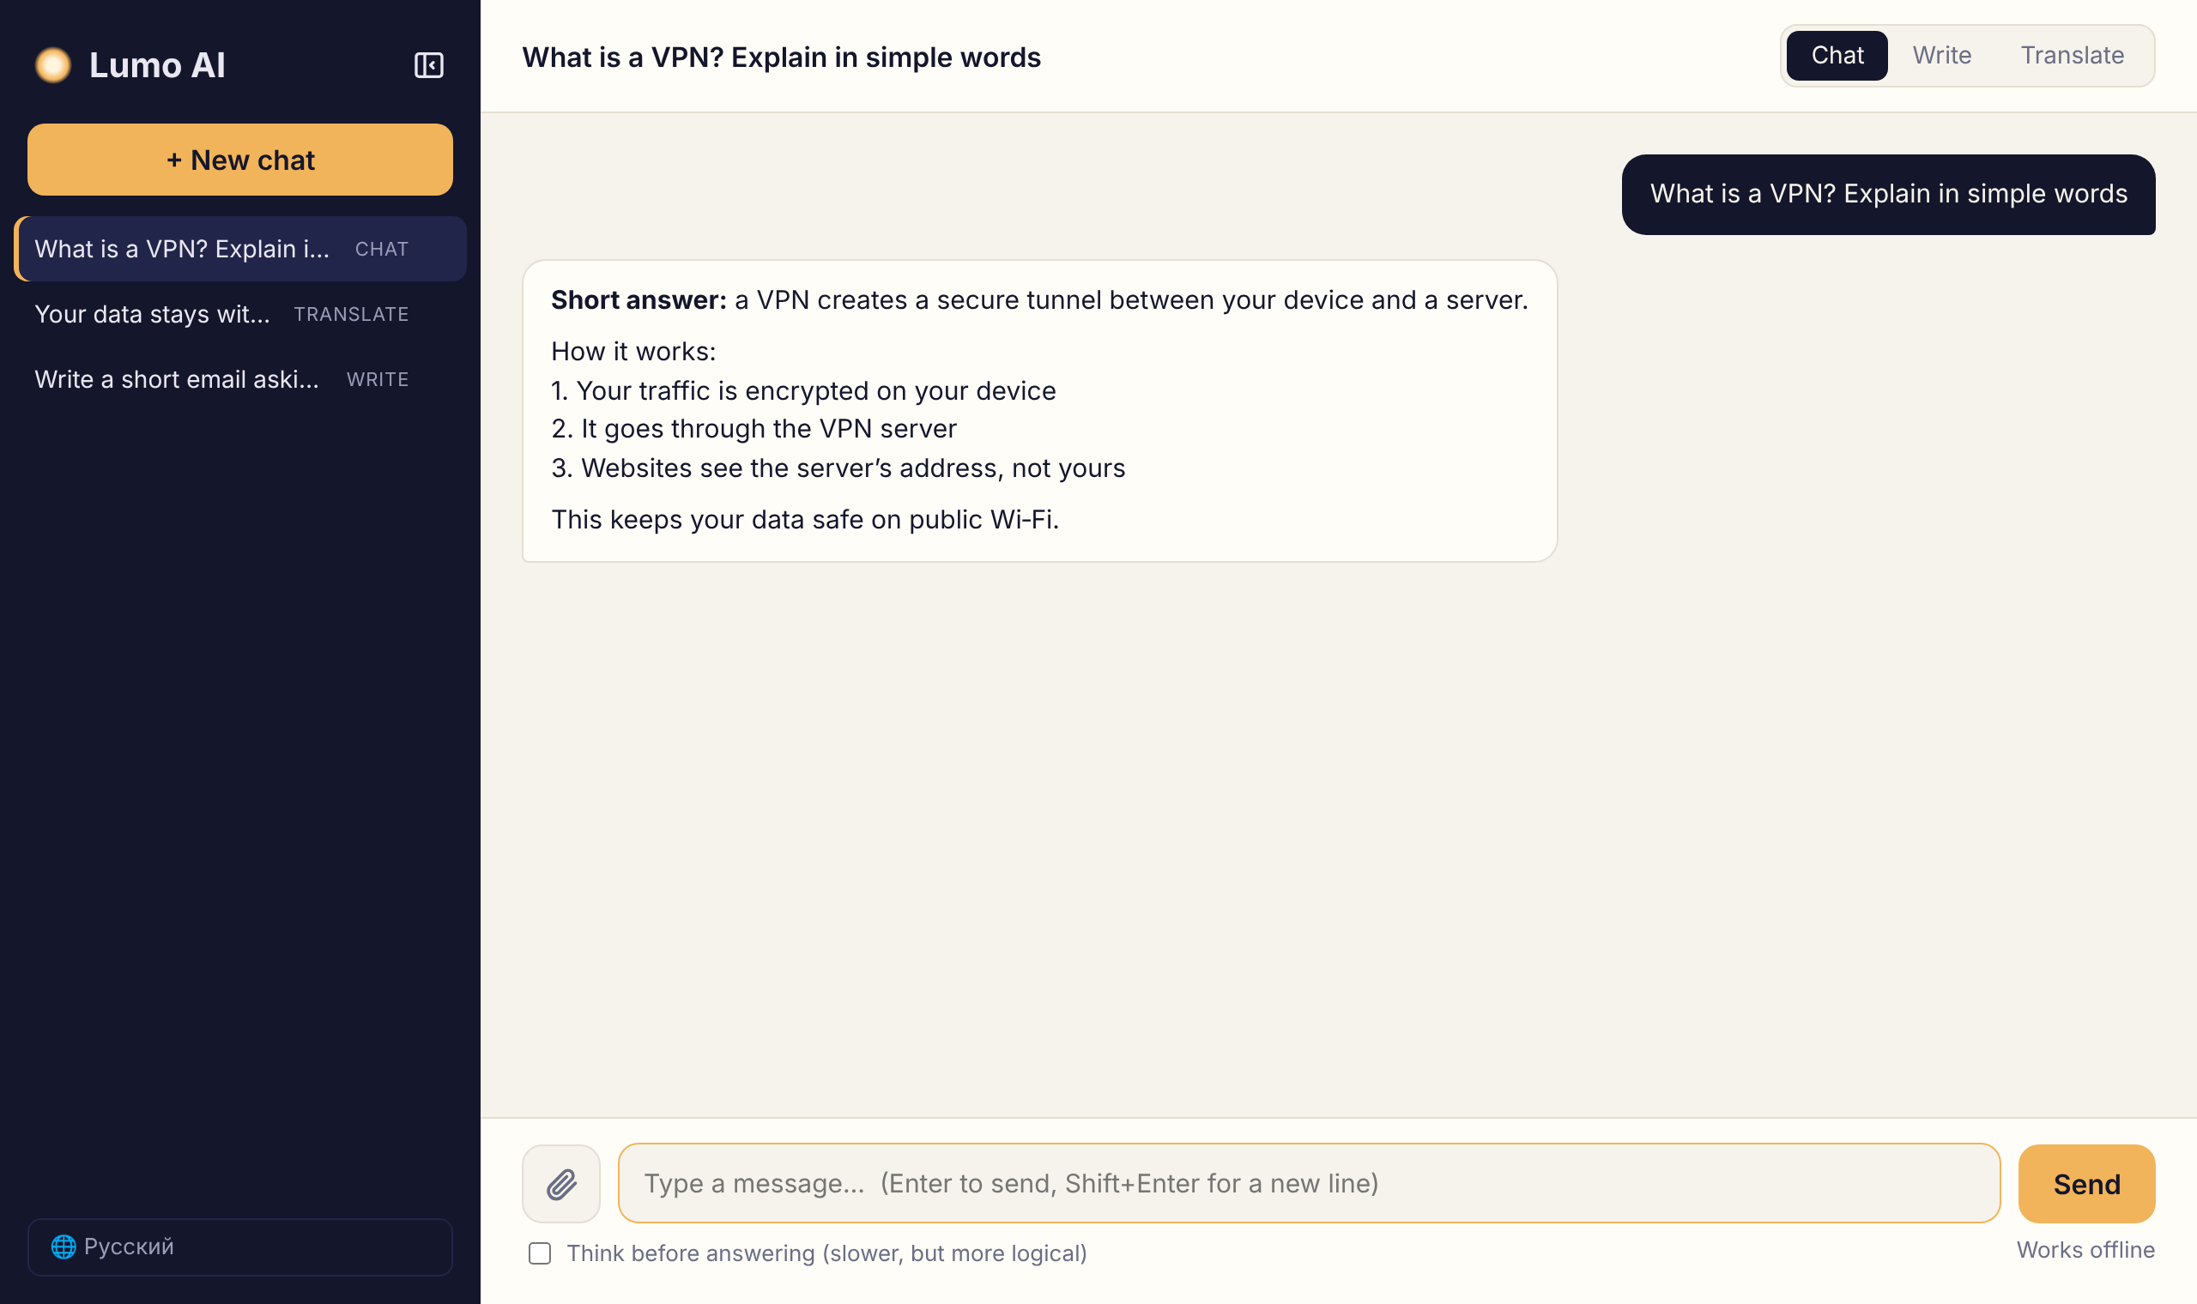
Simple and clean
LUMO IN ACTION
Notes:
This is how Lumo looks. On the left you can see all your chats. On the right is the conversation. At the top you choose the mode: chat, write or translate. It is simple and easy to use.

Slide 6



Made for people on the move
OUR CUSTOMERS
Students
Travellers
Small firms
Notes:
Who are our customers? Students use Lumo to study and to write essays. Travellers use it on planes and in the mountains, where there is no internet. And small companies use it because they want to keep their business data private.

Slide 7



Three reasons to choose us
WHY LUMO
Works offline
Private by design
Remembers your chats
Notes:
So why should you choose Lumo? First, it works offline, anywhere in the world. Second, it is private: nobody can read your messages, not even us. And third, it remembers your chats, so you can continue a conversation later.

Slide 8



What comes next
OUR PLANS
Desktop app
Read your files
Voice
Step 1
Step 2
Step 3
Notes:
What are our plans? First, we want to make a real desktop app for Windows, Mac and Linux. Next, Lumo will read your own files, like PDF and Word documents, and answer questions about them. And finally, we want to add voice, so you can just talk to it.

Slide 9
Thank you for your attention!
Any questions?
Notes:
That’s all about my company. Thank you for your attention! Do you have any questions?

