Slide 1

Lumelle AI
COMPANY PRESENTATION
Your AI. Your device. No internet needed.
Varvara Surnova
Notes:
Good morning, everyone! My name is Varvara, and today I want to present my company. It is called Lumelle AI. And this is not only an idea: I really built this product.

Slide 2




Most AI assistants send your data to the cloud
THE PROBLEM
Your messages
leave your computer
No internet?
No assistant
Monthly
subscriptions
Notes:
Let’s start with a problem. Popular AI assistants work in the cloud. This means your messages go to a big server far away. Without the internet, they don’t work at all. And very often you need to pay every month.

Slide 3

Smart AI that lives on your laptop
OUR SOLUTION
Works offline · Keeps your data private
Notes:
Our solution is Lumelle. It is a smart AI assistant that lives on your own laptop. It works without the internet, and your data never leaves your device.

Slide 4





One app, five skills
WHAT LUMELLE DOES
Chat
Write
Translate
Slides
Learn
Ask anything
Emails, posts, essays
Any language
Ready PowerPoint
Language tutor
Notes:
Lumelle can do five things. You can chat with it and ask questions. It helps you write texts: emails, posts and essays. It translates between languages. It makes presentations: you give a topic and get a ready PowerPoint file. And it can be your language tutor. It understands any language and remembers all your chats.

Slide 5
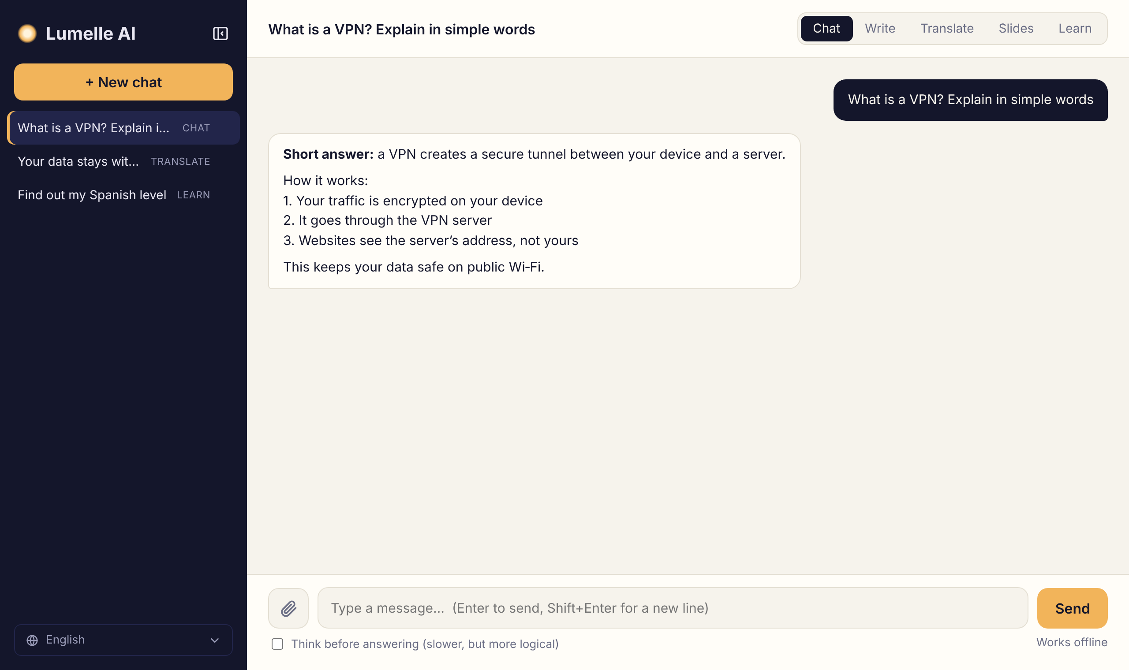
Simple and clean
LUMELLE IN ACTION
Notes:
This is how Lumelle looks. On the left you can see all your chats. On the right is the conversation. At the top you choose the mode. The interface speaks five languages: English, Russian, Chinese, French and German.

Slide 6



Made for people on the move
OUR CUSTOMERS
Students
Travellers
Small firms
Notes:
Who are our customers? Students use Lumelle to study, to learn languages and to write essays. Travellers use it on planes and in the mountains, where there is no internet. And small companies use it because they want to keep their business data private.

Slide 7



Three reasons to choose us
WHY LUMELLE
Works offline
Private by design
Remembers your chats
Notes:
So why should you choose Lumelle? First, it works offline, anywhere in the world. Second, it is private: nobody can read your messages, not even us. And third, it remembers your chats, so you can continue a conversation later.

Slide 8



What comes next
OUR PLANS
Desktop app
Read your files
Voice
Step 1
Step 2
Step 3
Notes:
What are our plans? First, we want to make a real desktop app for Windows, Mac and Linux. Next, Lumelle will read your own files, like PDF and Word documents, and answer questions about them. And finally, we want to add voice, so you can just talk to it.

Slide 9
Thank you for your attention!
Any questions?
Notes:
That’s all about my company. Thank you for your attention! Do you have any questions?

