Slide 1
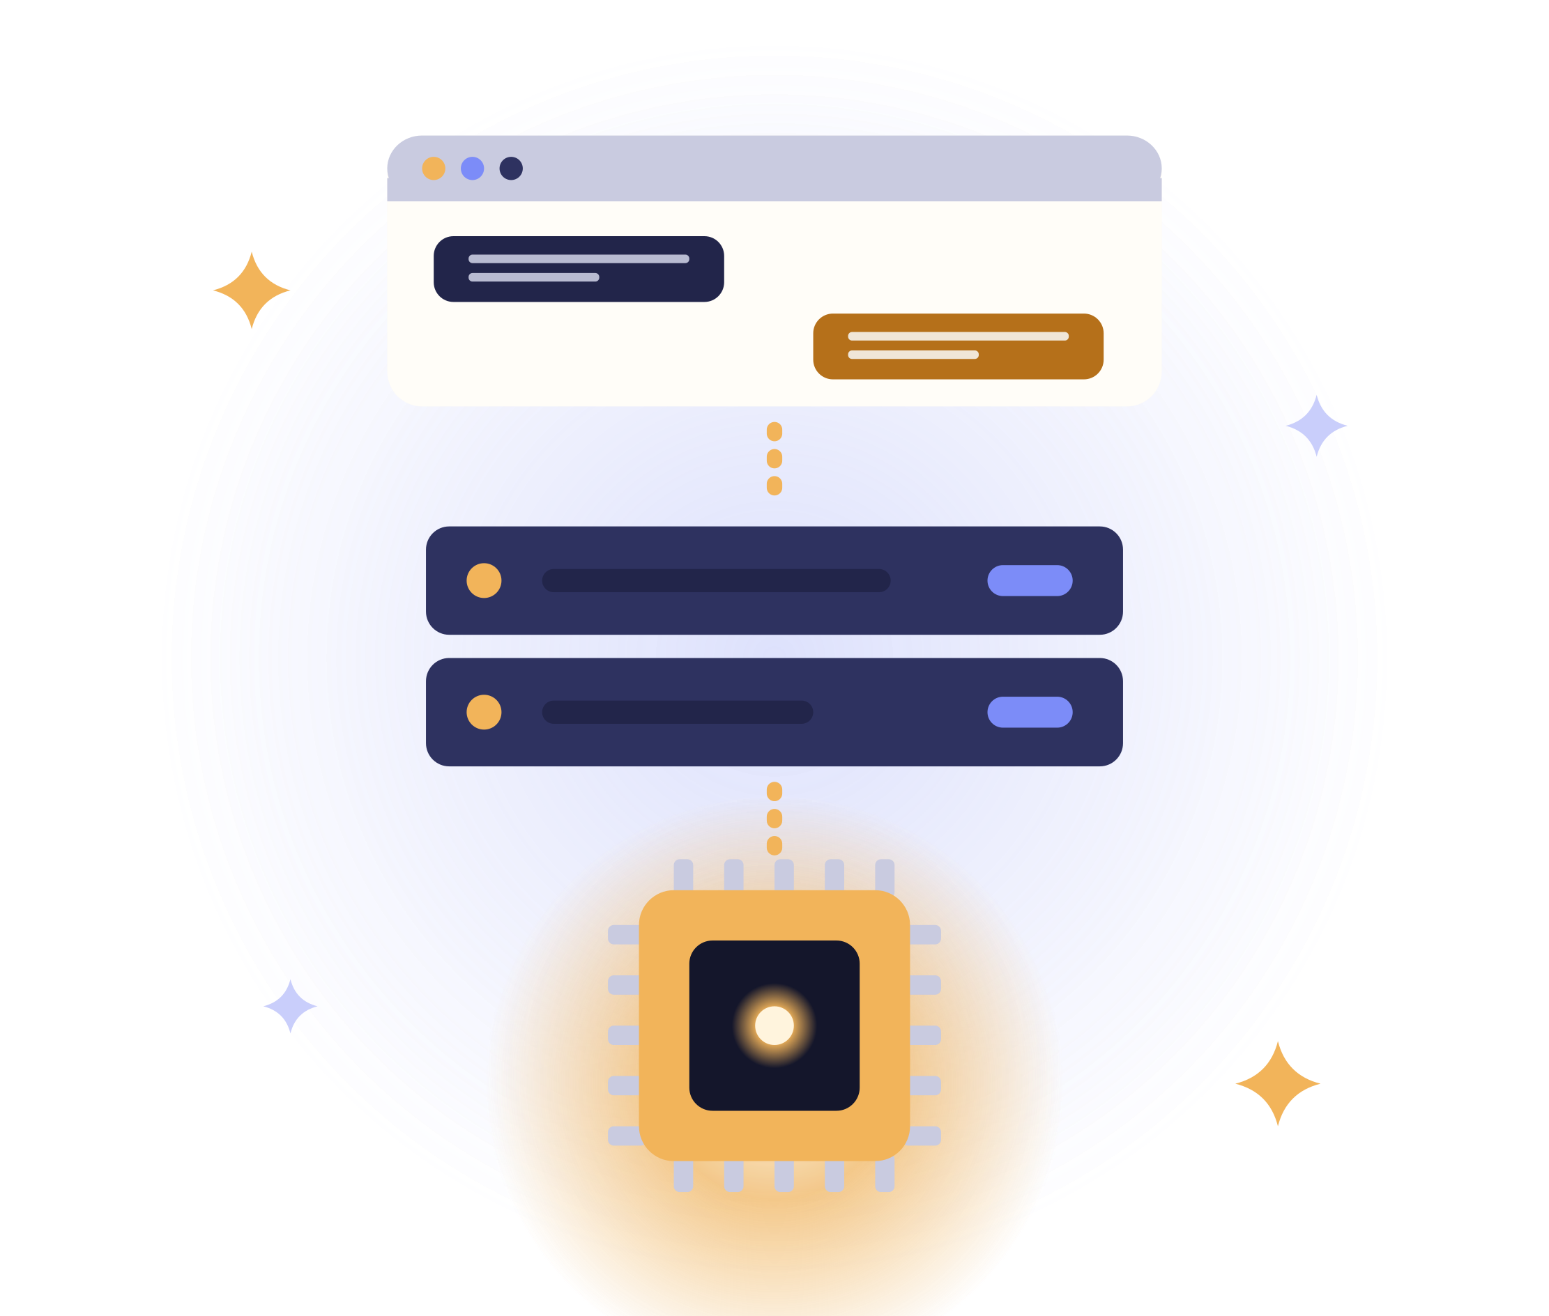
Lumelle AI
TECHNICAL PRESENTATION
Local AI, no internet
Varvara Surnova
Notes:
Hello! I’m Varvara, and I’ll show you how Lumelle AI works inside. It is a local AI assistant that works without the internet. I built it as a portfolio project, from the idea to a working app.

Slide 2



An assistant without the cloud
THE TASK
PROBLEM
GOAL
RESULT
Data in the cloud
AI on the laptop
Works offline
Notes:
Cloud assistants are convenient, but they have three problems: your data goes to someone else’s servers, they don’t work offline, and you need a subscription. My goal was to run a language model right on the laptop. The result is a web app that runs fully offline on Windows, macOS and Linux.

Slide 3








What Lumelle can do
FEATURES
Chat
Write
Translate
Slides
Learn
Images
History
5 languages
Notes:
Lumelle has five modes: chat, writing, translation, slides and language learning. In Slides mode it makes a ready PowerPoint file. You can attach an image to a message. Chats are saved, and the model remembers the context. The interface works in five languages, and the model answers in any language.

Slide 4





Three layers, one computer
ARCHITECTURE
Browser
Backend
Ollama
HTML · CSS · JS
FastAPI
qwen3 · qwen3-vl
All local
SQLite
Notes:
The system has three layers, all on one computer. The browser shows the interface and sends requests to the backend. The FastAPI backend keeps chats in SQLite and calls Ollama. Ollama runs two models: one for text and one for images. Not a single request leaves the laptop.

Slide 5





Technologies
STACK
Qwen3 8B
Qwen3-VL 8B
Ollama
text
images
model runtime
FastAPI
SQLite
HTML · CSS · JS
backend · python-pptx
history
interface
Notes:
For text I chose Qwen3 8B: it knows more than a hundred languages and fits into 16 GB of memory. For images I use Qwen3-VL. The backend is Python with FastAPI, python-pptx builds the slides, and the data lives in SQLite. The interface uses no frameworks and no external libraries, so everything works offline.

Slide 6




The path of one message
REQUEST FLOW
1
2
3
4
5
Question
Context
Mode
Model
Answer
last 20 messages · mode prompt · qwen3 or qwen3-vl
Notes:
Here is what happens to one message. The interface sends the text and images. The backend loads the last 20 messages, adds the mode’s instructions and picks the model. The model writes the answer, the backend saves it, and the interface shows it with formatting.

Slide 7
Temperature by mode
MODEL SETTINGS
Chat
Write
Translate
Slides
Learn
0.4
0.7
0.1
0.5
0.4
precise
lively
exact
structured
balanced
think — reason before answering
Notes:
Each mode has its own system prompt and temperature. Translation uses 0.1, because it needs precision. Writing uses 0.7, because it needs a livelier style. In Slides mode the model returns a JSON outline that follows a schema, and the backend turns it into a PowerPoint file. The think parameter makes the model reason before answering; it is off by default to keep answers fast.

Slide 8
Two tables in SQLite
DATA STORAGE
chats
messages
1 : N
id
title
mode
created_at
id
chat_id → chats
role
content
images
created_at
Notes:
The database has two tables, chats and messages, with a one-to-many relation. Images are stored inside the message. Older databases are upgraded automatically, so no chat history is lost.

Slide 9

8 endpoints
REST API
POST
/ask
POST
/chats/{id}/ask
POST
/chats
PATCH
/chats/{id}
GET
/chats
DELETE
/chats/{id}
GET
/chats/{id}
GET
/decks/{file}
/docs
Notes:
The backend is a REST API with eight endpoints: create a chat, list chats, get the history, send a message, change the mode, delete a chat, a quick one-off question and downloading a presentation made in Slides mode. FastAPI generates the documentation, so every request can be tested in the browser.

Slide 10
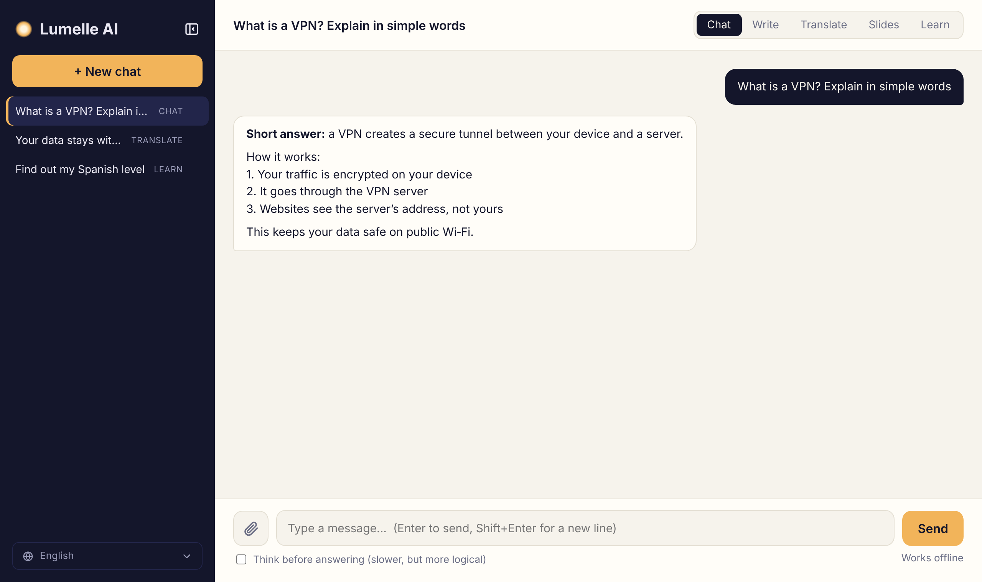
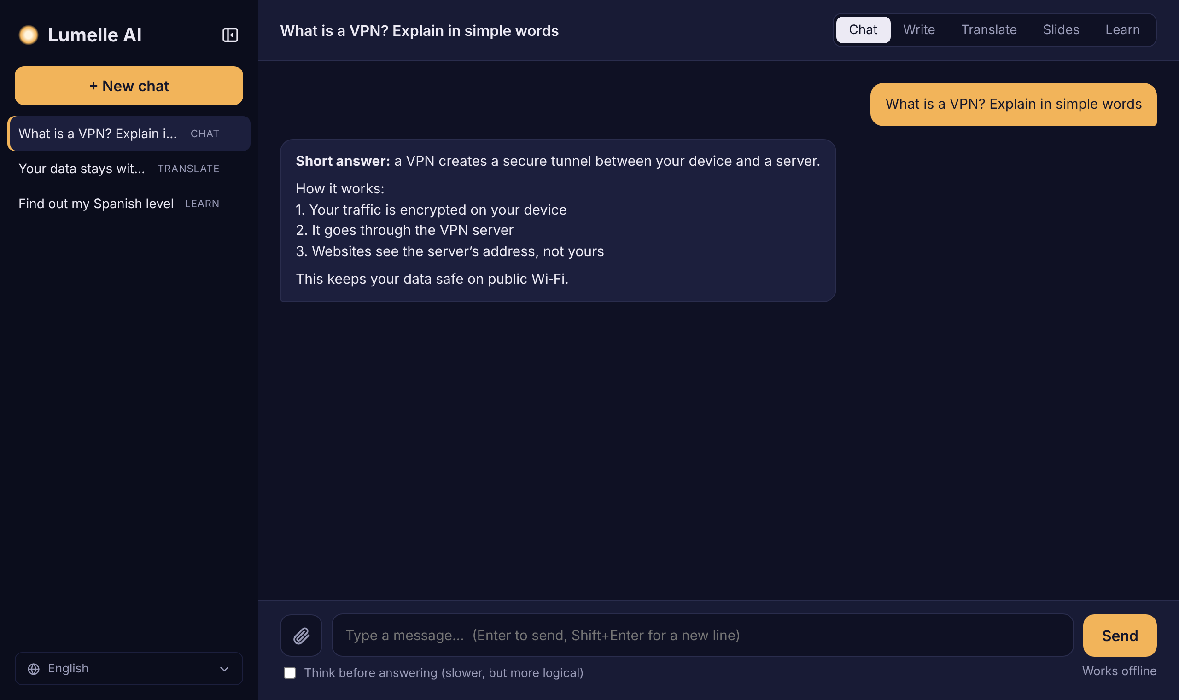
Light and dark theme
INTERFACE
Notes:
The interface looks like a familiar messenger: chats on the left, the conversation on the right. It has a dark theme, a mobile layout, five interface languages and a built-in presentation viewer.

Slide 11
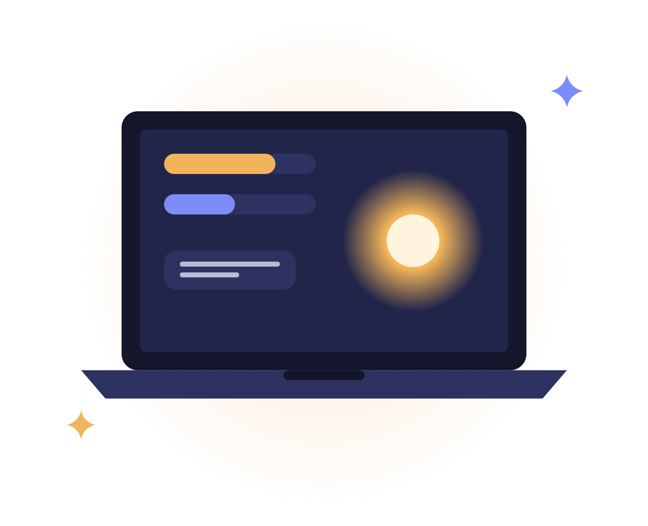
What it runs on
REQUIREMENTS
16 GB
11 GB
0
RAM
on disk
network requests
Windows · macOS · Linux
Notes:
Lumelle runs on Windows, macOS and Linux and starts with a double-click. A laptop with 16 GB of memory is enough. The models take about 11 GB on disk. You only need the internet once, to install everything.

Slide 12




Plans
ROADMAP
Streaming
Desktop app
Your documents
Password
Notes:
The next step is streaming answers, so the text appears word by word. After that: a desktop app, search over your own documents, and a password for access from other devices.

Slide 13

Thank you for your attention!
Any questions?
Notes:
Thank you for your attention! I’m happy to show Lumelle live and answer your questions.

