Slide 1
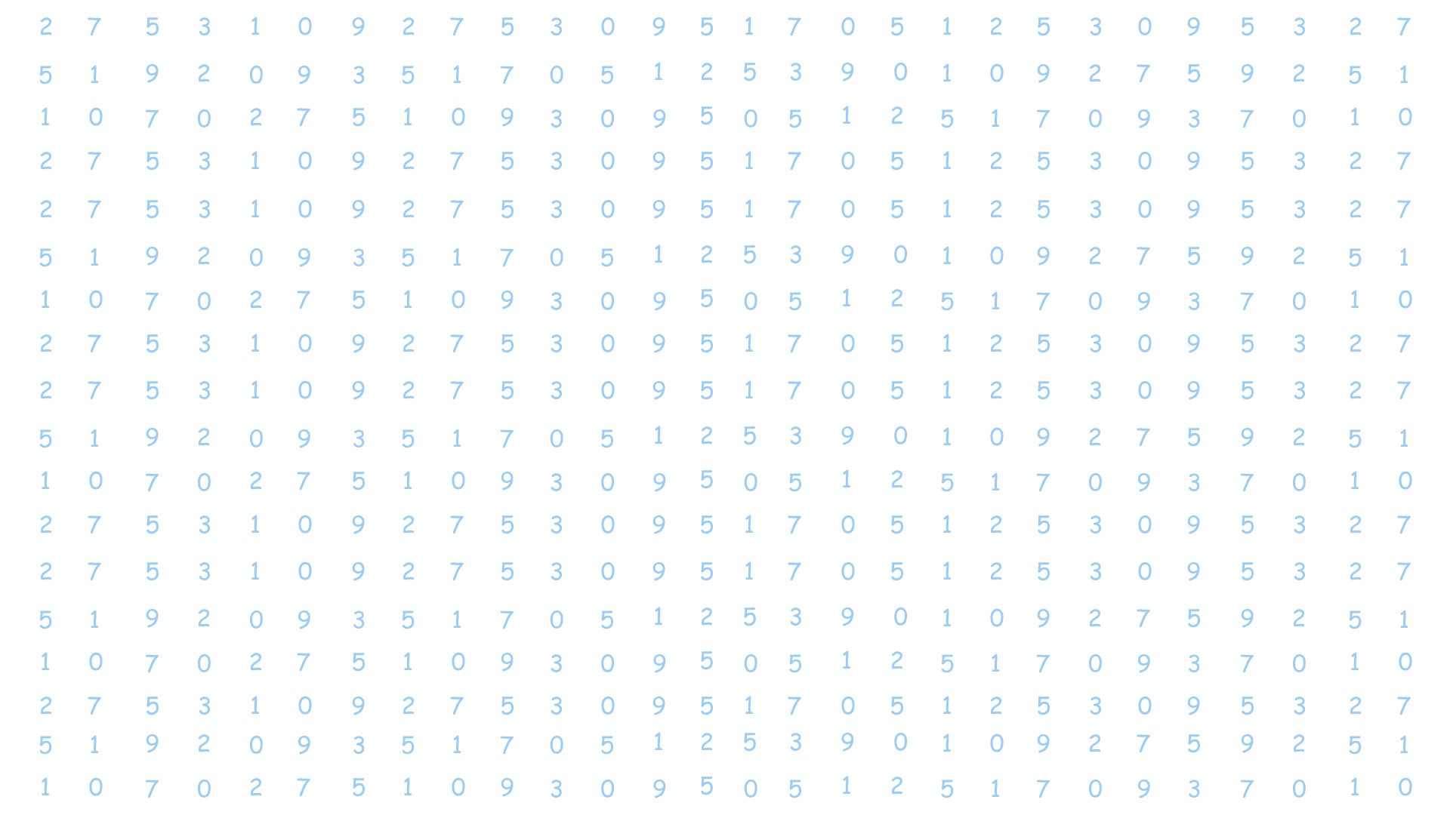
TYPES
OF
FRACTIONS
Notes:
@@SLIDE@@
1
@@TNOTES@@
Learning Objectives:
This session maps the following learning objectives.
LO1: Define proper and improper & mixed fractions.
Background Knowledge:
LO1: Identify fraction as part of a whole
LO2: Identify fraction as division

Slide 2

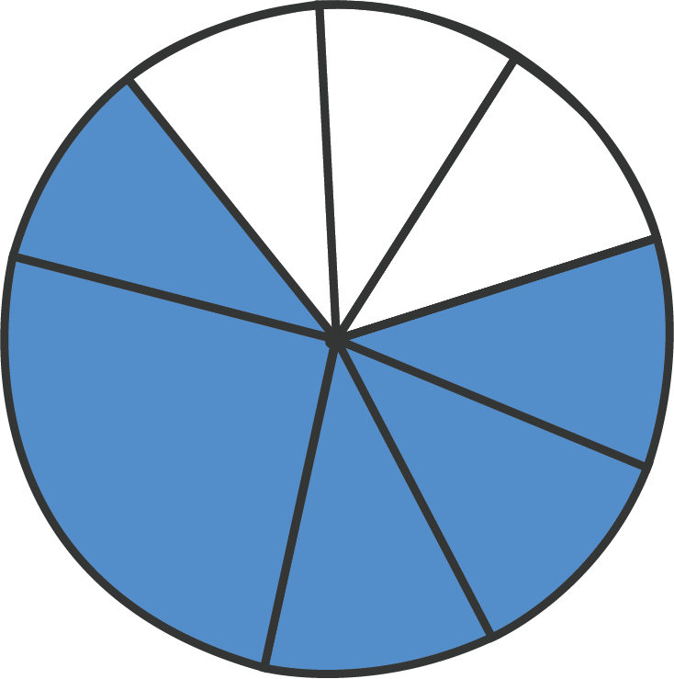
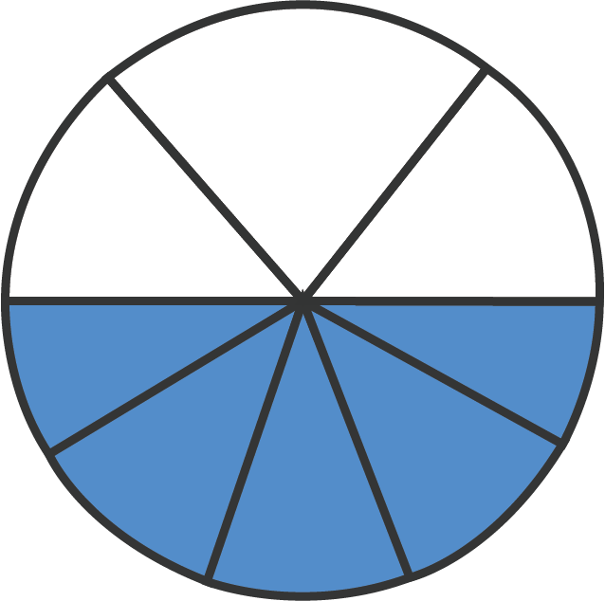
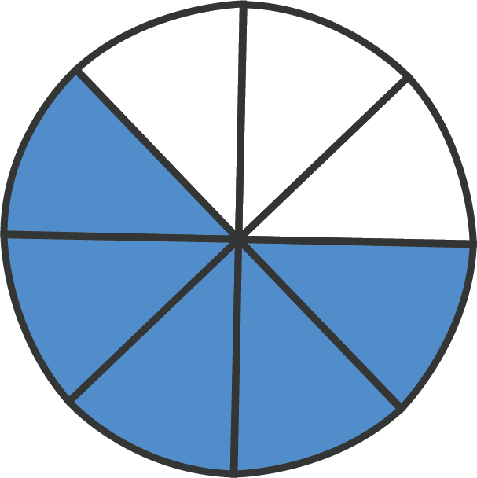
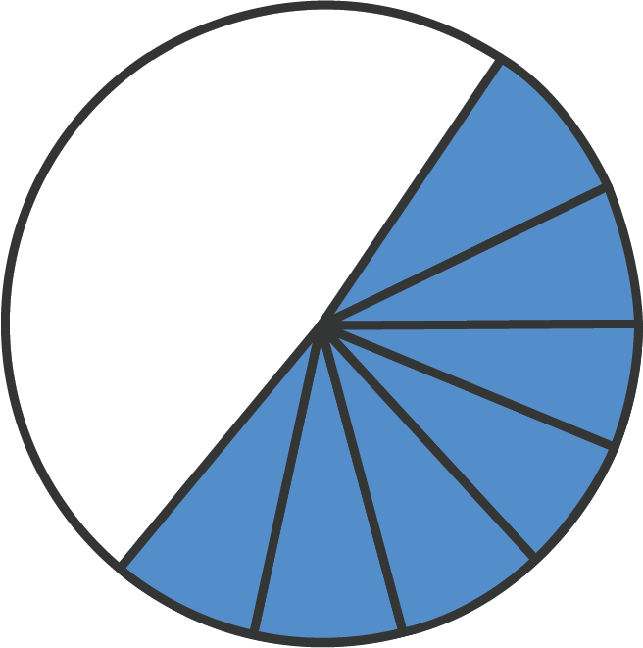
Identify Fractions
5
?
Which choice best represents
8
A
B
C
D
Notes:
@@SLIDE@@
2
@@TNOTES@@
Tell: Hi everyone! Before we start todays lesson, lets revise fractions.
<Student name> Which of these images represents 5/8? Give reasons for your answer.
Note to Tutor: Ask one student to tell you the answer; ask the student to explain why their answer is correct. Ask others if they agree or disagree. Ask students if anyone has a different answer;
discuss their answer with them, explaining why it is correct or incorrect. Then, show the answer on the next slide.
==QUIZ==
::Q1:: 1+1=2 {T}
::Q2:: What's between orange and green in the spectrum? { =yellow # right; good! ~red # wrong, it'syellow ~blue # wrong, it's yellow }
::Q3:: Two plus {=two =2} equals four.

Slide 3
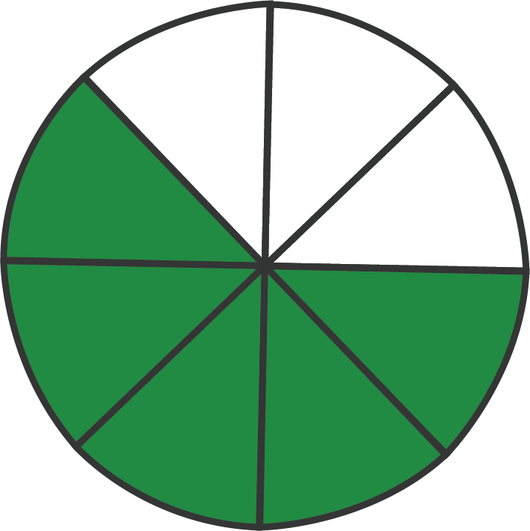
Identify Fractions
5
?
Which choice best represents
8
A
B
C
D
Notes:
@@SLIDE@@
3
@@VIMEO@@
https://vimeo.com/322453850

Slide 4
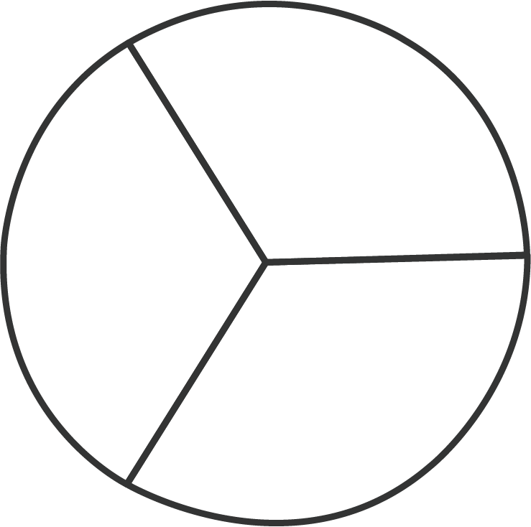
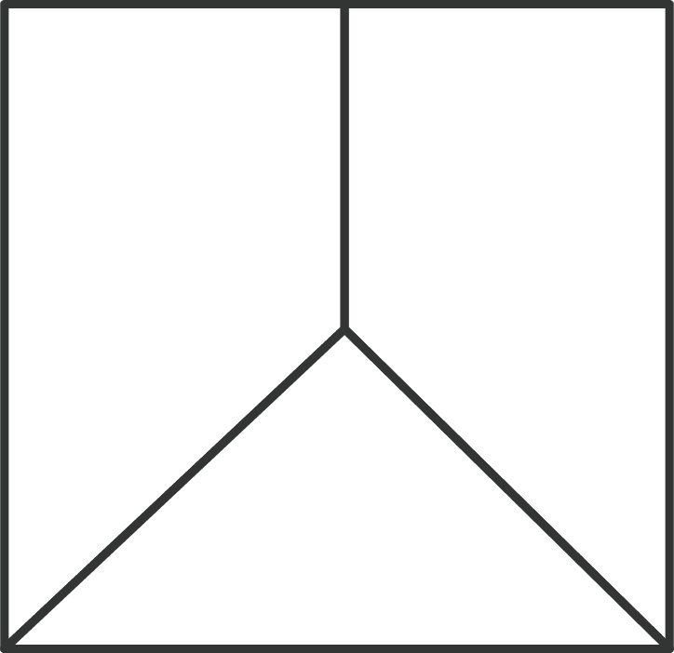

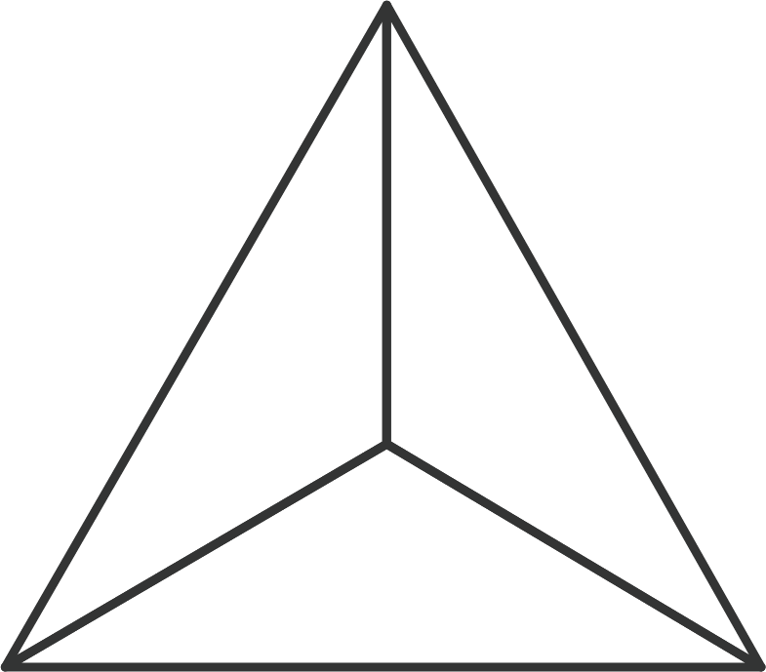
Identify Fractions
1
?
Which of these cannot be used to show
3
A
B
C
D
Notes:
@@SLIDE@@
4
@@TNOTES@@
Tell: Let’s try one more.
<Student name> Which of these images cannot be used to represent 1/3? Give reasons for your answer.
Note to Tutor: Ask one student to tell you the answer; ask the student to explain why their answer is correct. Ask others if they agree or disagree. Ask students if anyone has a different answer; discuss their answer with them, explaining why it is correct or incorrect. Then, show the answer on the next slide.
@@QUIZ@@
::Q1:: 1+1=2 {T}
::Q2:: What's between orange and green in the spectrum? { =yellow # right; good! ~red # wrong, it's yellow ~blue # wrong, it's yellow }
::Q3:: Two plus {=two =2} equals four. // matching

Slide 5
Identify Fractions
1
?
Which of these cannot be used to show
3
A
B
C
D
Notes:
@@SLIDE@@
5
@@TNOTES@@
Tell: To show any fraction, I need a figure that is divided into 3 EQUAL parts. B is not divided into equal parts. So we cannot use that.
Now that we know what fractions are, lets learn something new about fractions.

