Slide 1


RoboTester Autonomous Execution Utility
October 2019

Slide 2
Index
NOW to NEXT using HOW
Teck Stack
Demo – Use Cases
Benefits and Future Enhancements

Slide 3
Problem Statement -- NOW
1. Lack of AI/ML capabilities in current Automation frameworks.
2. Reskilling/Upskilling required for majority of Functional QA to work in Automation.
3. Time consuming to build and maintain Automation scripts.
Solution -- NEXT
Advanced AI/ML capabilities in Automation
Utility to read manual test cases and automatically execute them with minimal human intervention.
Ability to integrate with existing Automation framework (Selenium/Python)
Functional QA to have ability to execute and debug.

Slide 4
HOW - RoboTester
User enters testcase in Natural Language
NLP reads the manual test case.
Machine Learning classifies the action to be performed
Py4j call to java gateway for extent report generation
Webdriver performs the action according to the label
Classifier labels the testcase

Slide 5
Teck Stack
Technology | Libraries Used | Purpose
Python | NLTK | To filter stopwords from the text to be preprocessed , lemmatization of text .
 | Sklearn | Logistical regression for classifying testcases into pre-specified labels.
 | Webdriver Selenium | Perform various actions for testing.
 | Re (regex library) | Data pre-processing.
Java | Py4j | Python-Java bridge for testing framework integration.
 | Extent Reports | Generating HTML reports.

Slide 6
Demo - Use Cases
Scenario - I
Scenario - II
Verify Registration for Shareholder
User navigates to Registration page.
User clicks on Shareholder
User fills the requires details and a weak strength password
User clicks on Continue button
Verify Registration for Financial Advisor US
User navigates to Registration page.
User clicks on Investment Professional -> US -> Financial Advisor
User accepts T&C by clicking on I Agree
User fills the requires details and a weak strength password
User clicks on Complete button

Slide 7
Demo - Use Cases (Cont.)
Scenario - III
Scenario - IV
Check Q&A page display in Tax Centre
User navigates to Tax Centre
User clicks on Cost-Basis Reporting
User traverses to Q&A under resources
User clicks on MFS logo to go back to Homepage
Test WebService Math.api (free,opensource)
Hit API with get request
Pass necessary parameters
Validate response status code and response value

Slide 8
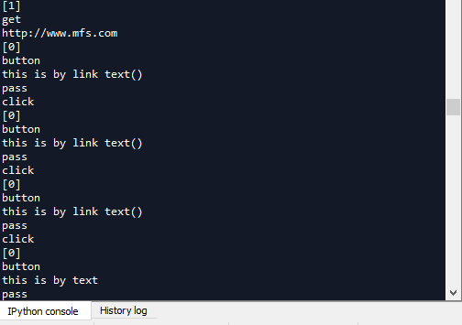
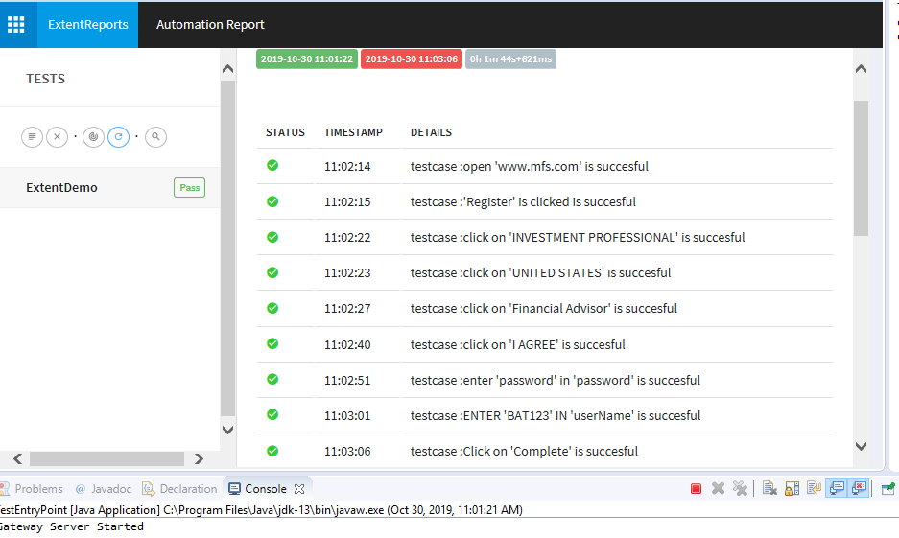
MFS
Console Output
Extent Report

Slide 9
Benefits
AI/ML capabilities in Automation with reduced Manual efforts.
Ease of use and provide reporting capabilities.
Integration with existing Automation frameworks.

Slide 10
Future Enhacements
JIRA/ATM Integration
WebServices Automation
Generate run time JAVA code

