Slide 1
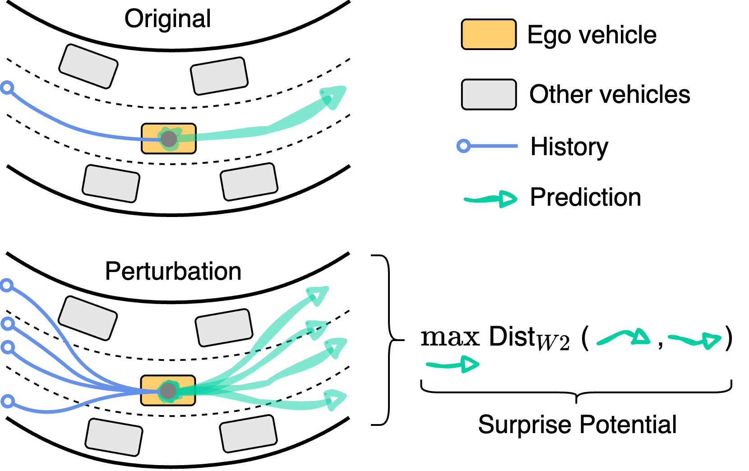
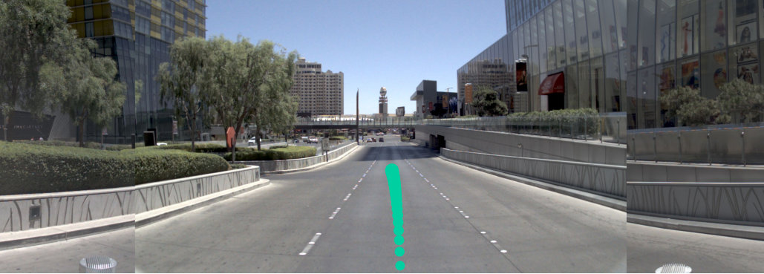
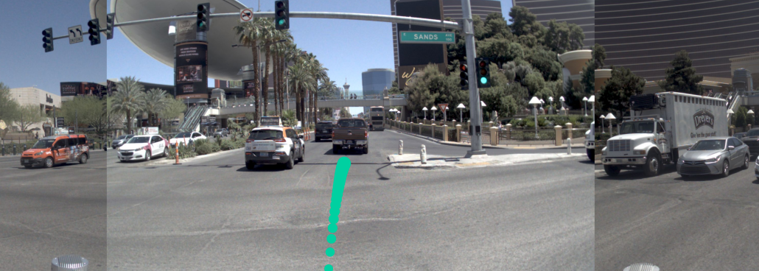
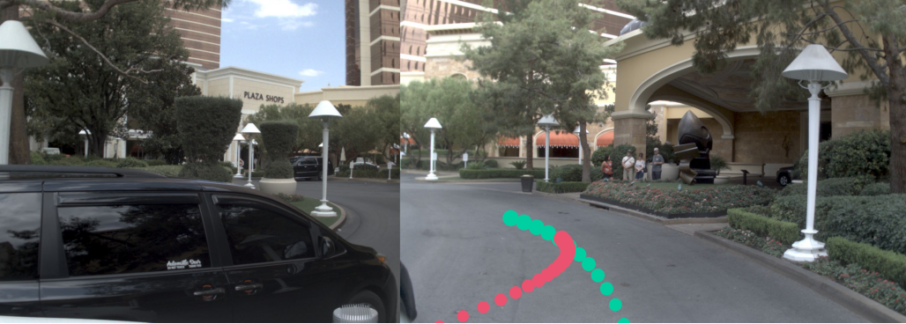
Straight lane-keeping
Crossing intersection
Cutting in
Number of sample
No interaction
Weak interaction
Strong interaction
90% of data
9% of data
1% of data

