Slide 1
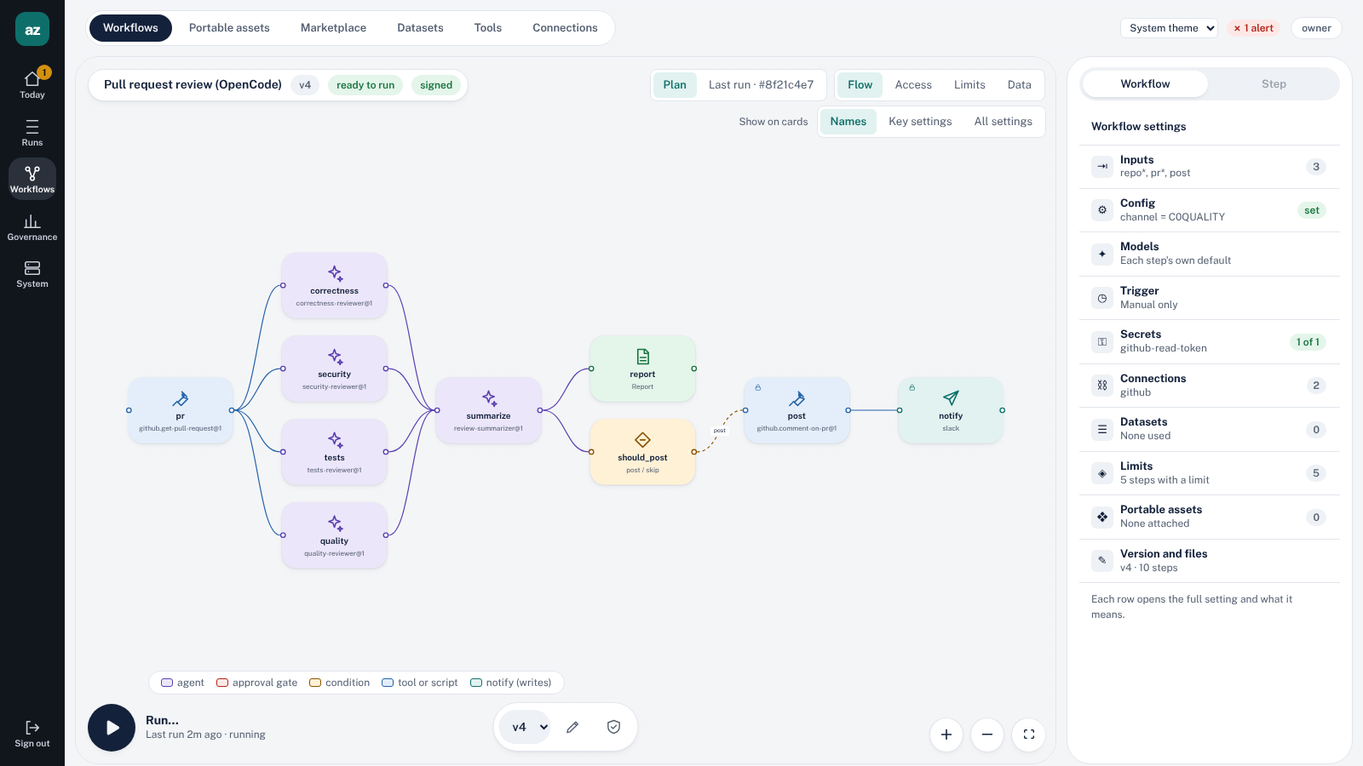
Azhi Flow
az
Governed, durable agent workflows that say plainly what they can and cannot guarantee.
Self-hosted · Open source · Apache-2.0
https://github.com/comcast-enterprise/azhi-flow
Notes:
Azhi Flow is a self-hosted runtime for AI workflows. The picture is the real web app, on sample data.

Slide 2




Agents in production fail in familiar ways
Runs die halfway
Retries write twice
No one can say what happened
Untrusted text steers writes
A crash, restart or timeout, and the work is redone or lost.
The retried agent posts to Slack or GitHub a second time.
What did it see, what was it allowed to do, and what did it cost?
A pull request or ticket can talk an agent into a write it should never make.
Azhi starts from the workflow, not the agent.
Notes:
Four failure modes. Azhi answers all four by treating the agent as one node in a durable, governed workflow.

Slide 3
A workflow of nodes, and an agent is just one of them
Script
Tool
Retrieve
Agent
Condition
Parallel
Loop
Subworkflow
Approval
Report
Notify
Eleven node types in one YAML definition (schema 2.0), checked by a compiler before anything runs.
Steps that need no model run as plain code and cost no tokens
The agent step is bounded: budget, tools, output schema
Durable on Temporal: retries, waits, schedules, cancellation
The pull request review workflow: 12 steps, 5 of them call a model.
Notes:
pr-review: pr, four reviewer agents, summarize, report, slack_message, two conditions, post, notify. Five agent steps.

Slide 4
A model is called only where judgment is needed
1
Steps that need no model never call one
2
Tool output is projected: agents get the fields they need
5 of 12
3
retrieve returns top-k cited passages, not a corpus
steps in the PR review
4
Per-step budgets: tool calls, output tokens, dollars
5
Heavy harness and checkout only where a step needs one
6
Prompt caching, with cache tokens counted
Mechanisms, not benchmarks. The count is from the example workflow; your savings depend on your workflow, and Azhi reports your measured cost.
Notes:
No savings percentage is claimed. The 5 of 12 comes from the example pr-review workflow.

Slide 5
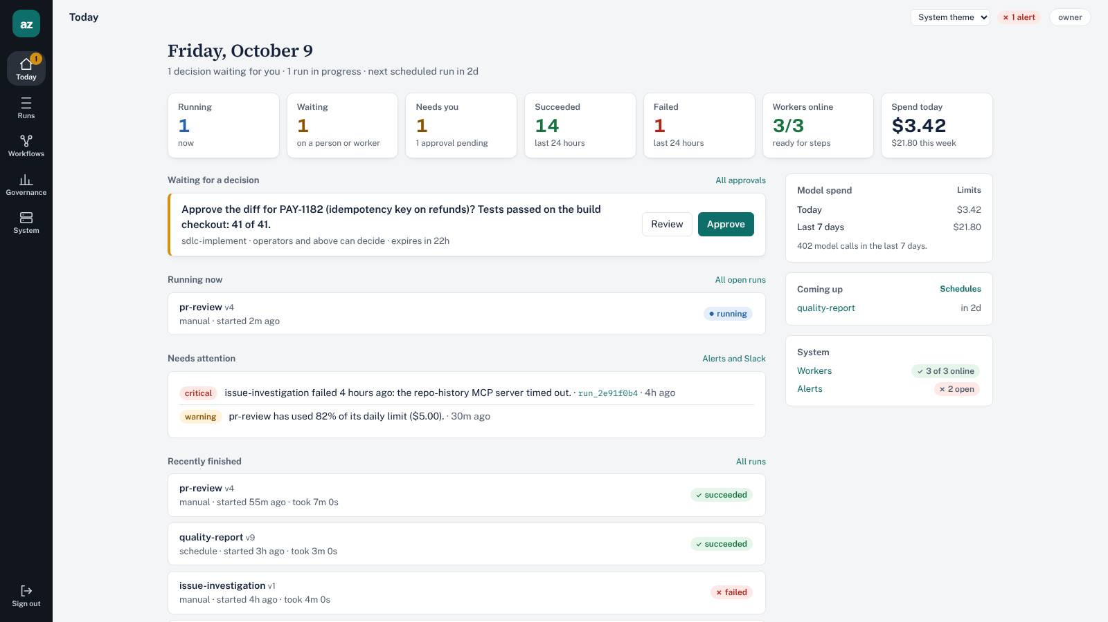
Mission Control: one screen for what needs you
What is running, waiting and failing
Approvals waiting on a person, with the payload
Alerts, schedules and worker health
Model spend today and this week
Every action goes through the same API and role checks as the CLI
Notes:
Secrets are write-only in the UI. Unknown cost shows as unknown.

Slide 6
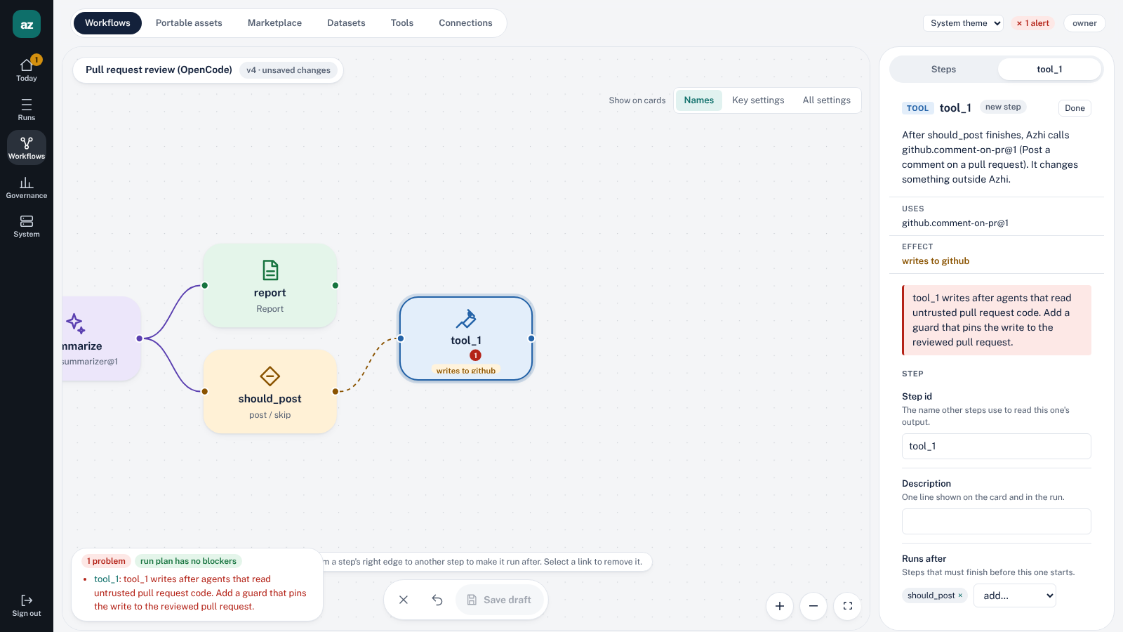
Build the harness on the canvas, checked as you type
Per-agent harness: executor, prompt, skills, read-only tools, MCP servers, budget
Add tools from the catalog; each new step runs after the selected one
The server compiles and plans every change
Taint rule: a write after an agent that read untrusted code fails to compile. A guard fixes it
Notes:
In the screenshot the new comment-on-pr step is flagged because it writes after agents that read untrusted pull request code.

Slide 7
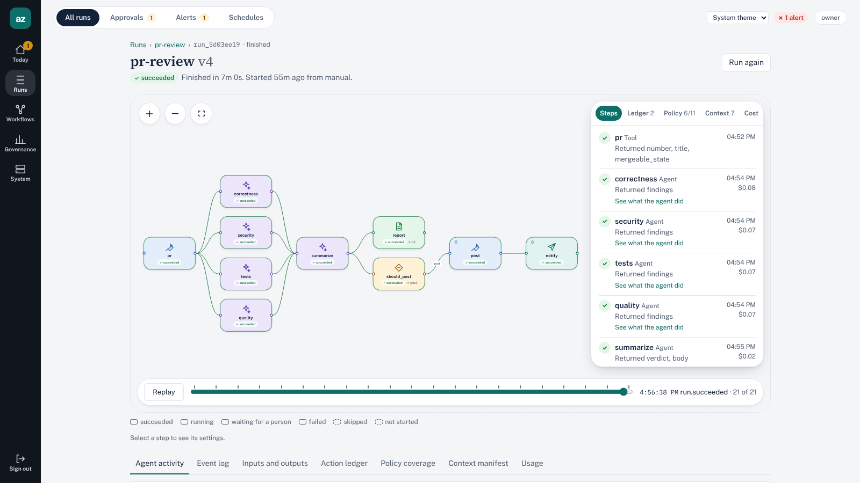




Every run is evidence, not a log to dig through
Action ledger
Every external write, with receipts. Exactly once.
Policy coverage
Enforced by Azhi, by the harness, or unobservable.
Context manifest
Every source the model saw, with hashes.
Cost per step
Usage per turn; unknown stays unknown.
Notes:
Replay scrubs through the run events. The ledger uses fencing so a crash mid-post still yields one message.

Slide 8





Trust you can check before and after a run
Run plan
Taint gate
Exactly-once writes
Each requirement marked native, bridged, unsupported or unverified. Blockers refuse the run before anything executes.
An ungated write after an agent that read untrusted data fails to compile.
Gateway and ledger with fencing. Kill it mid-post: one Slack message.
Context manifest
Signed packages
Human approvals
What the model saw on every turn, and what is unobservable said out loud.
Per-publisher keys certified by the workspace; workers enforce a trust policy.
Gates on risky steps, decided in the web app or Slack, kept in the ledger.
Notes:
Policy coverage labels each rule enforced, harness-enforced or unobservable, per executor.

Slide 9
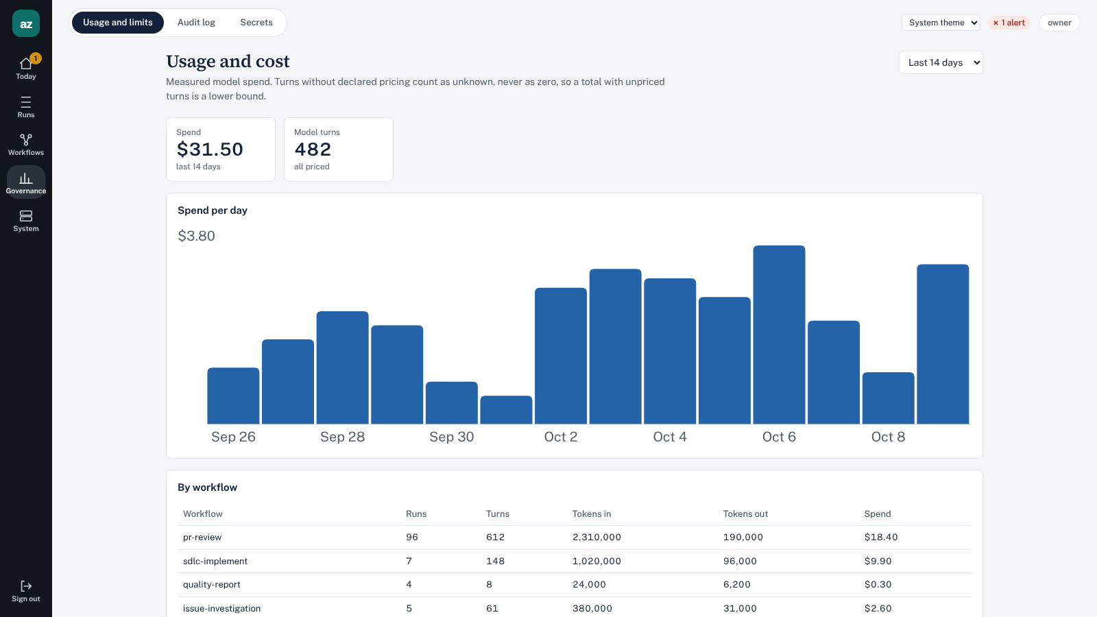
Spend you can see, cap and trust
Tokens in, tokens out and dollars, per day and per workflow
Per-step budgets: max tool calls, output tokens and cost
Spend limits per workflow or workspace, per day or month. At the limit, new runs are refused
Alerts at 80% and 100%
Cost comes from declared pricing; unpriced turns show as unknown, never zero
Figures on the screenshot are sample data.
Notes:
Copilot steps are counted in AI credits against the monthly pool.

Slide 10
Where Azhi fits next to the tools you already use
 | Azhi Flow | OpenCode | VS Code agent mode | n8n-style | LangGraph-style
Durable runs, retries, schedules | Yes | No | No | Yes | Checkpoints
Plan of what is enforced, before the run | Yes | No | No | No | No
Exactly-once writes ledger | Yes | No | No | No | No
Compile-time taint check | Yes | No | No | No | No
Per-turn context manifest | Yes | No | No | No | No
Per-step budgets and spend limits | Yes | Usage shown | Plan-level | Varies | Separate tools
Human approval gates | Yes | Per tool | Per tool | Yes | Yes
As of 6 October 2026, from each product’s public descriptions; these tools change quickly. OpenCode and the Claude Agent SDK also run inside Azhi as executors.
Notes:
Azhi is not a replacement for an in-editor assistant. Several of these tools can run inside Azhi.

Slide 11
Bring your harness. Start from a working example
Pluggable executors
Examples that ship with it
Built-in model agent
Weekly quality report
Anthropic or OpenAI, gateway-only tools, validated output
CI metrics analysed by a model, posted to Slack with numbered citations.
Pull request review
OpenCode
Parallel OpenCode reviewers in isolated checkouts; an approval gates the comment.
Fresh repository checkout, skills, read-only tools, MCP; Anthropic or GitHub Copilot models
Feature delivery
Jira or GitHub issue to requirements, design, build, tests and a reviewed pull request.
Claude Agent SDK
Anthropic, with declared capabilities checked by the run plan
Issue root cause
Investigator agent returns a 5-whys chain with file and line evidence.
Notes:
Examples install with azhi example install, or from the marketplace page in Mission Control.

Slide 12
Honest status: what is built, and what is vision
Built
Partly built
Vision
Eleven node types, YAML schema 2.0, compiler
Durable runs on Temporal
Gateway, action ledger, run plan, taint gate
Model agent, OpenCode, Claude Agent SDK
Datasets with hybrid retrieval and citations
Mission Control, CLI and REST API
Provider choice per profile, not by capability
MCP over stdio; streamable HTTP pending
Token optimization by design, not automatic
Worker checkouts; no hosted sandbox yet
Capability-based model routing
Result caching across runs
Savings reports against a baseline
Capability resolution, then a capability graph
Workflows exposed as MCP tools
Alpha, version 0.1.0. Server and workers on Linux (Windows through WSL2); local mode runs everything in one process.
Notes:
Claim the roadmap only as each piece ships. Source: docs/positioning.md.

Slide 13
Try it
git clone https://github.com/comcast-enterprise/azhi-flow
cd azhi-flow && npm ci
npx azhi up
Repository
github.com/comcast-enterprise/azhi-flow
Demo video
docs/demo/out/azhi-flow-demo.mp4
Prints the web link. Or run deploy/install.sh for the Docker stack with PostgreSQL, Temporal and the server.
Documentation
README, docs/positioning.md, docs/install.md
Governed, durable agent workflows that say plainly what they can and cannot guarantee.
Notes:
Alpha release. Linux workers; Windows through WSL2.

