Slide 1
Algorithmic Subdivisions of Gamespaces
Victor Matheke

Slide 2
Problem Statement
Mental Models of Game Logic often depends on relative („semantic“) positions rather than absolute, continuous coordinate representations
Semantic positioning must be derived from underlying continuous space
Requires work to map volumes of the gamespace to their semantic meaning
We attempt to automate this work as much as possible by designing and implementing an algorithm

Slide 3
Existing Work
„Location“ / „Space-Foundation“ Papers by Daniel
Previous Bachelor Thesis by Kerstin

Slide 4
Requirements / Evaluation
Does the proposed algorithm create the results which the designers would expect?
How much time is actually saved versus doing all the work manually?
How performant is the algorithm?
How erroneous is the output?

Slide 5
General Approach (As explained last time, so very short)
Create Clipping Planes based on Level Geometry (e.g. by marking Game Objects with a „Delimiter“ component)
Create Anchors in a similar manner
Algorithm finds the nearest clipping planes around an anchor point, which in turn create the volume around this anchor

Slide 6
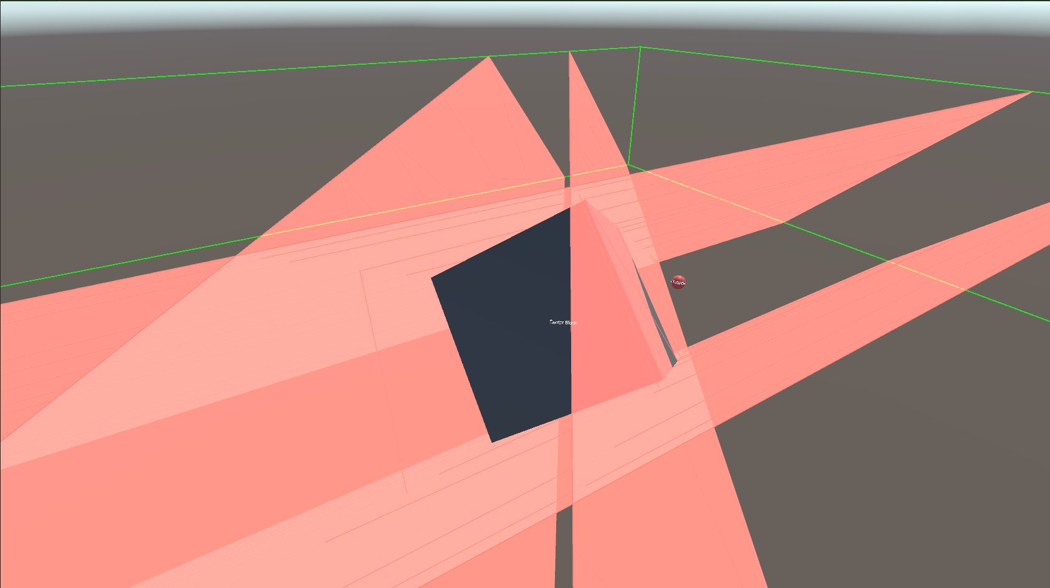
Visualization

Slide 7
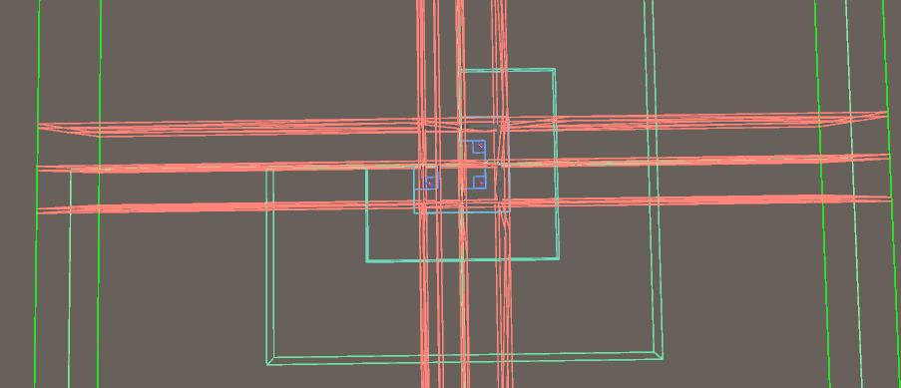
Visualization, The Second

Slide 8
(Viewer Demo)

