Slide 1
Algorithmic Subdivision of Gamespaces Into Semantic Volumes Using Anchors and Delimiters
Victor Matheke
München, 24. Oktober 2024
Final: B.Sc: Informatik: Games Engineering
Supervisor: Prof. Dr. rer. nat. David Plecher

Slide 2

Problem Statement
Games are often played in continuous space, but require rule evaluation in semantic space
If ball inside goal => Update score
If player starts shooting => Activate all enemies inside the room
Game requires mapping from continuous space $\left(\begin{aligned}x \\ y \\ z\end{aligned}\right)$into semantic space (integer ID)
Creation of mapping is work-intensive and error prone
Can this creation be automated?

Slide 3
Overview
Three-dimensional world containing anchors and delimiters
Anchor represented by a point in space
Delimiter represented by a triangulated plane
Algorithm calculates one volume for each anchor
Volume is a coherent semantic subspace in the world, characterized by the anchor
Volume grows outward from anchor until it is stopped by delimiters
Volumes are enclosed, concave triangulated meshes

Slide 4
Goals
Mapping should have lowest possible error
Error: Discrepancy between the ideal, expected result and the calculated output
The generated mapping must be predictable for practicality
Querying of the mapping must be possible in real-time for games

Slide 5
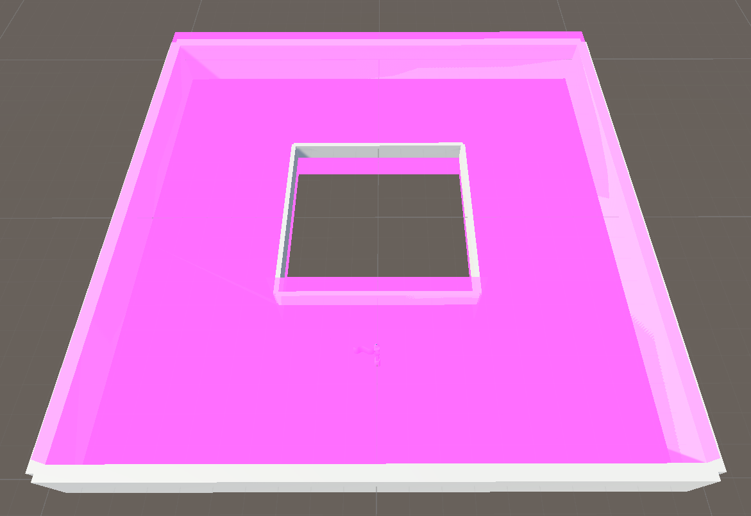
Desired Output I

Slide 6
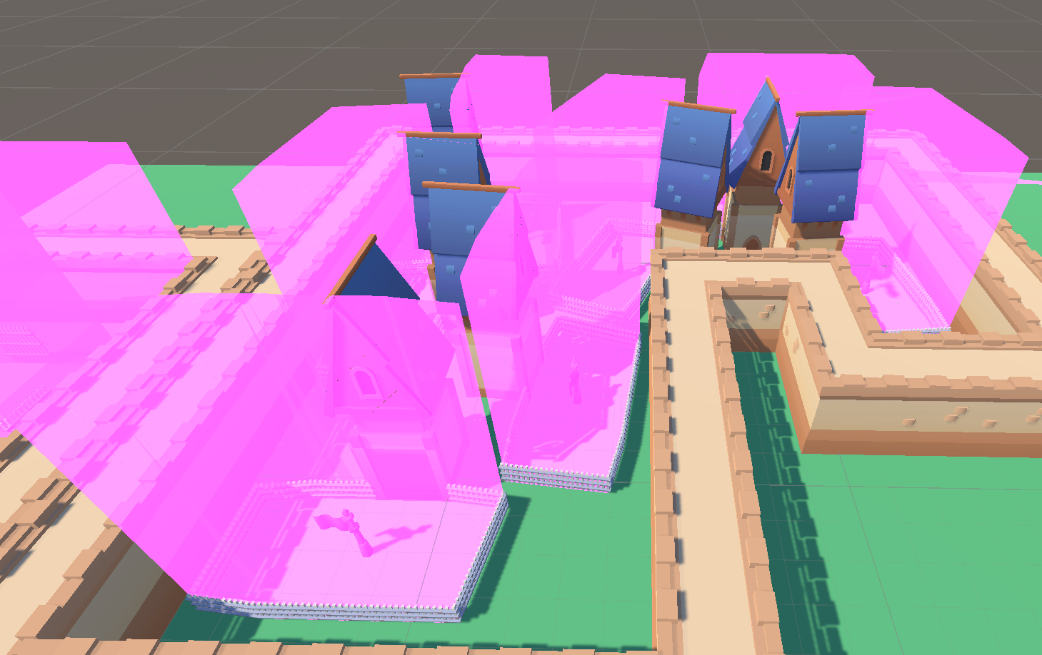
Desired Output II

Slide 7
Approach
Solution consists of two major phases:
Build-Up: Processing the input, calculating the volumes.
Calculated volumes can be serialized
Only needs to be done once by the developer for quick loading times
Generation takes around 36s
build_world_from_current_unity_scene()
Runtime: Querying of the generated mapping
Determines which semantic location a point belongs to
Used for evaluating game logic during runtime
Point query takes around ~0.1ms
If semantic_location(player.position) == semantic_location(enemy.position) then attack_player()

Slide 8
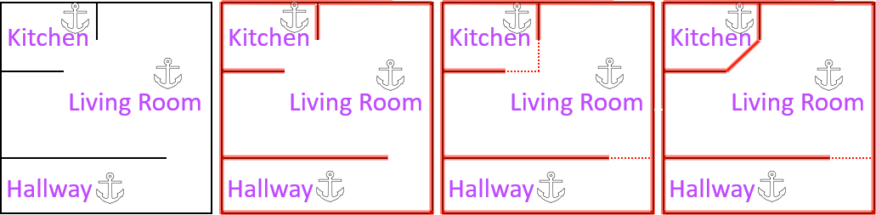
Build-Up: Clipping Delimiters
Enable „Virtual Extension“ of delimiter planes => Grow them automatically to fit into a shape
Preprocess the input by clipping delimiter planes against each other
Reduces the overhead for setting up the input by the user of the solution

Slide 9
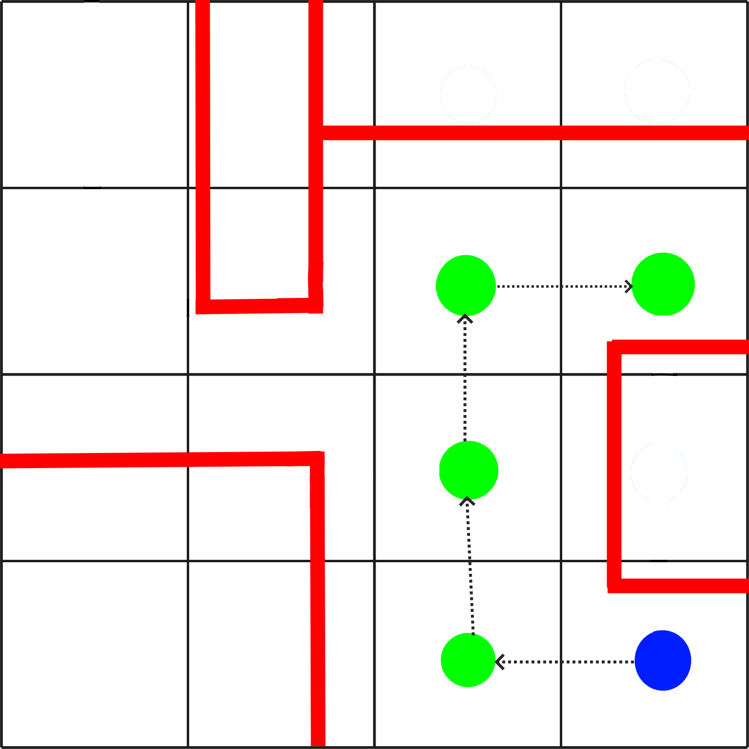
Build-Up: Calculating Volumes
For each Anchor:
Create a floodfilled grid around the world to calculate the outline of the volume
Floodfilling condition: No delimiter plane between source and destination cell center
Required for bending volumes around corners
Find all delimiters that “border” this outline
Build a triangle representation for this outline from the bordering delimiters

Slide 10
Runtime: Point Queries
Find the volume containing the point of interest:
Iterate over all anchors in the world
If the anchor‘s volume encloses the point => return the anchor‘s ID

Slide 11
Assessment
In Theory: All requirements fulfilled
Solution is deterministic
Fast enough for real-time queries
Every anchor owns a volume that extends as far as possible and is fully enclosed
In Practice: Implementation supplied is incomplete
Instability due to Floating Point Imprecision (Gaps in volumes)
Handling of invalid input

Slide 12
Comparison
Thesis by Kerstin Pfaffinger on the same topic
Pfaffinger’s Approach: Use Marching Cubes (on Voronoi Diagram)
Marching Cubes has much higher error (depending on cell size)
Voronoi Diagram has better resolution of underspecification (here: Anchors cannot grow into each other. They can do that in my approach)
Marching Cubes is much faster
Better approach depends on use case
Highly dynamic and/or low-poly games may use Marching Cubes
Static games and/or high precision software my prefer my approach

Slide 13
Future Work
Serialization of calculated volumes
Optimization of generated meshes (for delimiters and volumes)
Spatial relations between volumes (neighbor graph for pathfinding, spatial analysis…)
Partial rebuilds of dynamic worlds (?)

Slide 14
Conclusion
Proposed solution works in theory
Supplied implementation is not numerically stable enough for larger worlds
Tradeoff:
Higher accuracy using this approach
Better performance using Pfaffinger’s Approach (Marching Cubes)
Practicality in real world must be determined with a user study
Enough customizability with anchors and delimiters?
Overhead of setting up the input worth it?
Does the output match the expectations?

