Slide 1
CITI-BRIDGE PROGRAM

Slide 2
Clearing Feed Generation
Group No: 1
Group members:
Prerana Bavaskar
Mohini Khare
Vaishnavi Khare
Gayatri Surse
Vaishnavi Zope

Slide 3
OUTLINE
Project Objective
Clearing Feed Cycle
Software Development Life Cycle
Dynamic View of Project Using UML Diagrams
Demonstration
Technology Stack
Future Scope
Conclusion

Slide 4
PROJECT OBJECTIVE
Objective
Generate the feed file towards clearing system in a specific format based on the input transactions to the system.
Overview :
Poll local folder
Upload feed file
Validate feeds
Generate feed files

Slide 5
Assumptions :
A valid file format is a .txt file
User can select only one file at a time.
No discrepancy in system date.
Transaction file management is not in scope

Slide 6
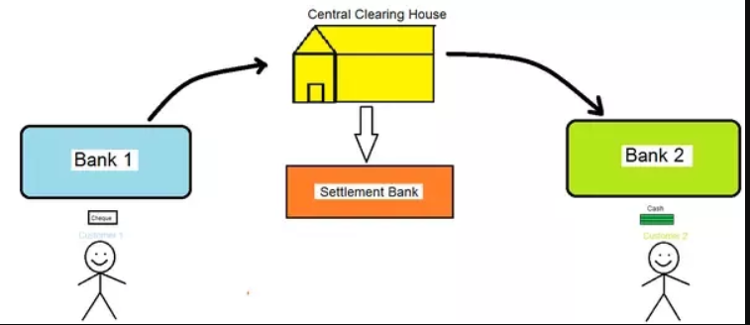
CLEARING FEED GENERATION

Slide 7
Software Development Life Cycle WATERFALL MODEL

Slide 8
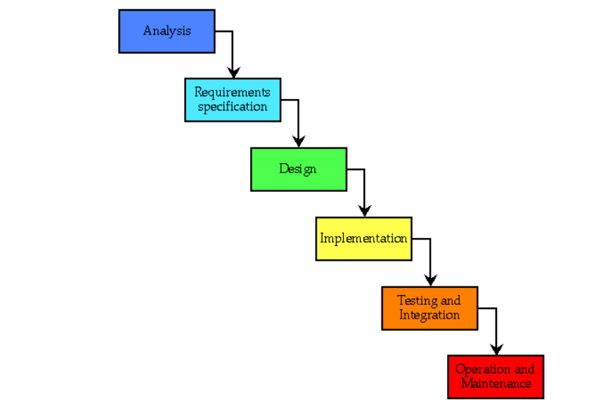
Notes:
Frequent meetings
Division of work as front end ,backend teams
Regular updates to all about work progress

Slide 9
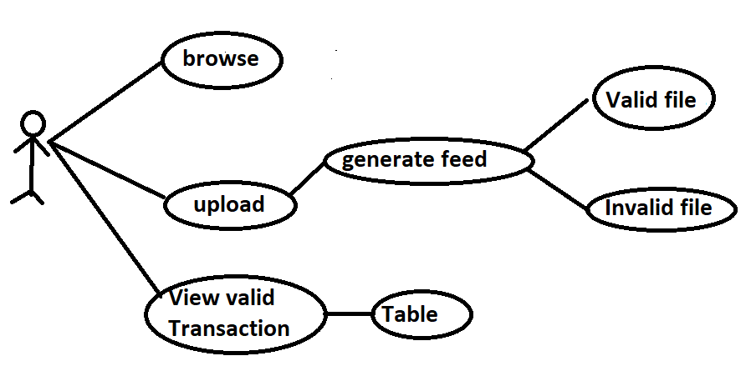
USE-CASE DIAGRAM

Slide 10

SEQUENCE DIAGRAM
: UI
: Client-Side
:Server-Side
User
browseFile
fileSelected
Upload File
checkFeed
return feedStatus
validateFeed()

Slide 11
Flowchart
Start
Upload File
Read the file contents
Validate feed
Is feedStatus valid ?
No
Store in invalid feed file
Yes
Store in valid feed file
Display status
End

Slide 12
TECHNOLOGY STACK
Back-end
-Java
Front - end
-HTML
Server side
-Java Server page
-Tomcat

Slide 13
DEMONSTRATION

Slide 14
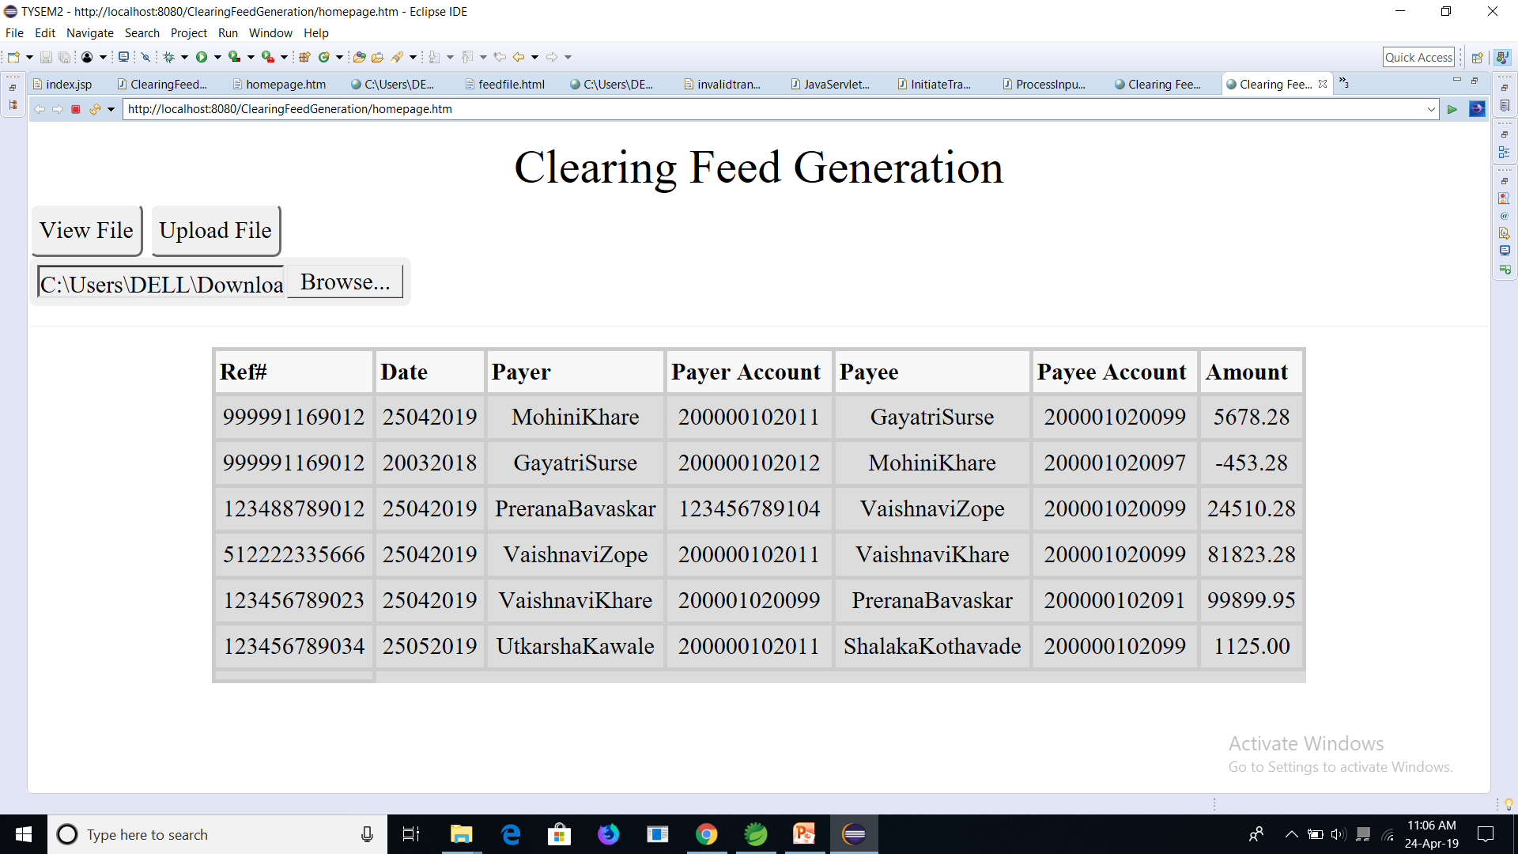
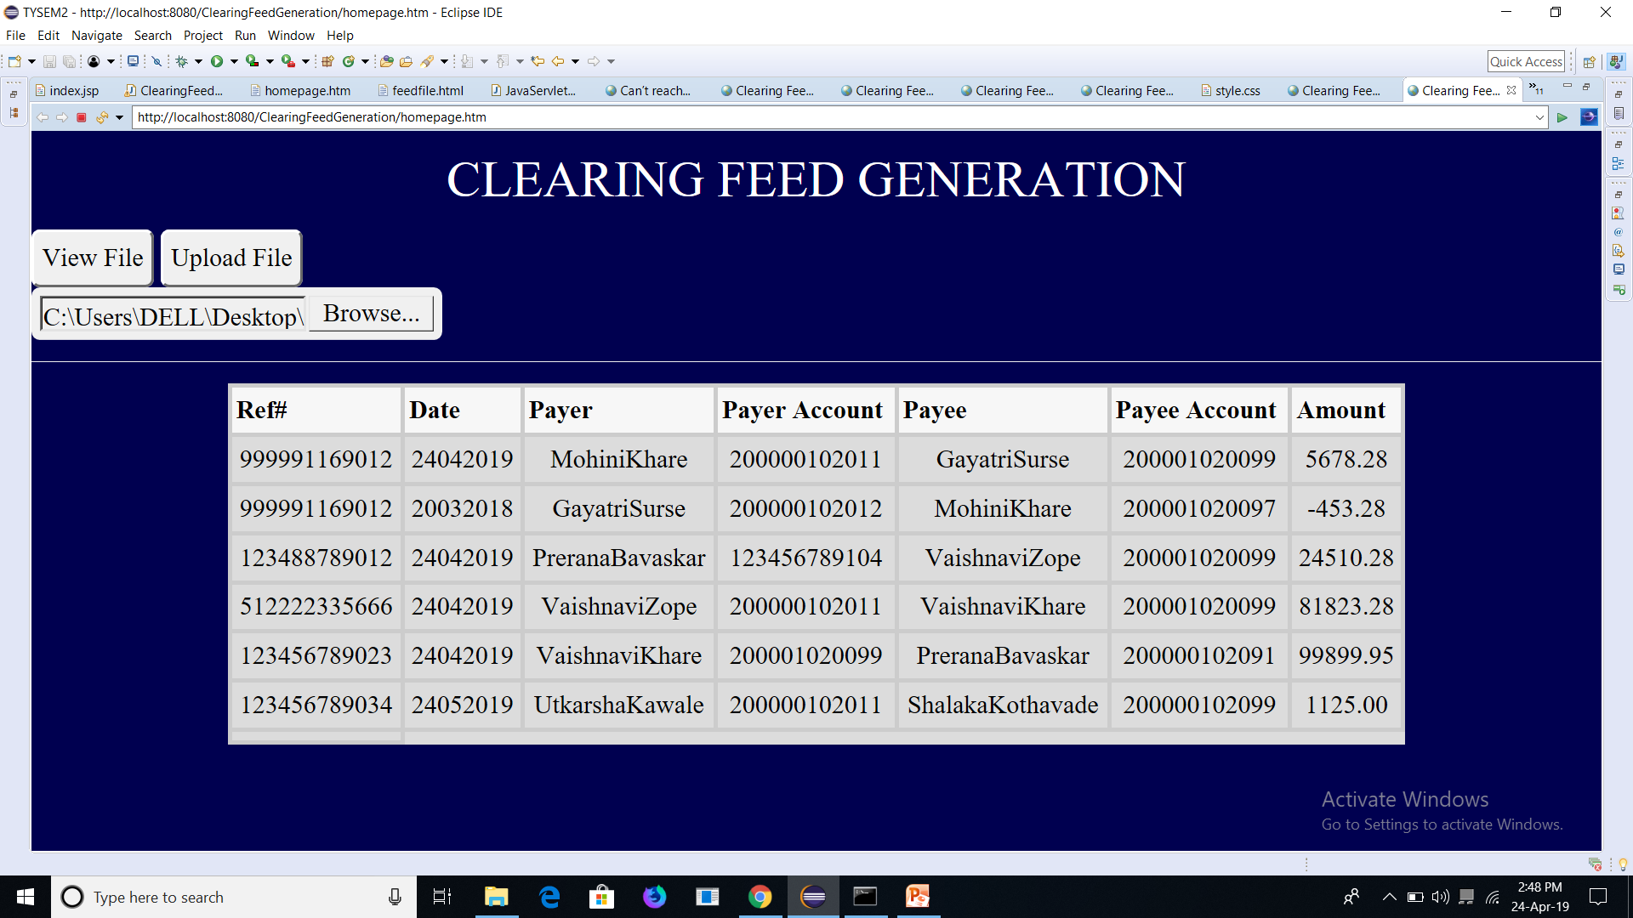
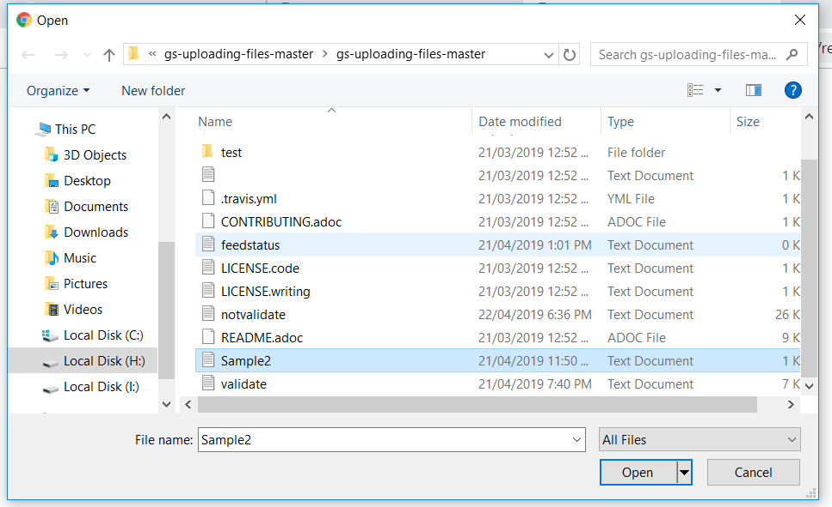

Slide 15
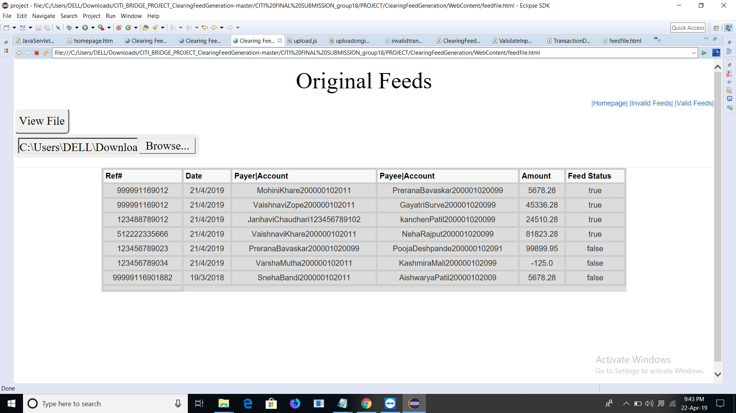
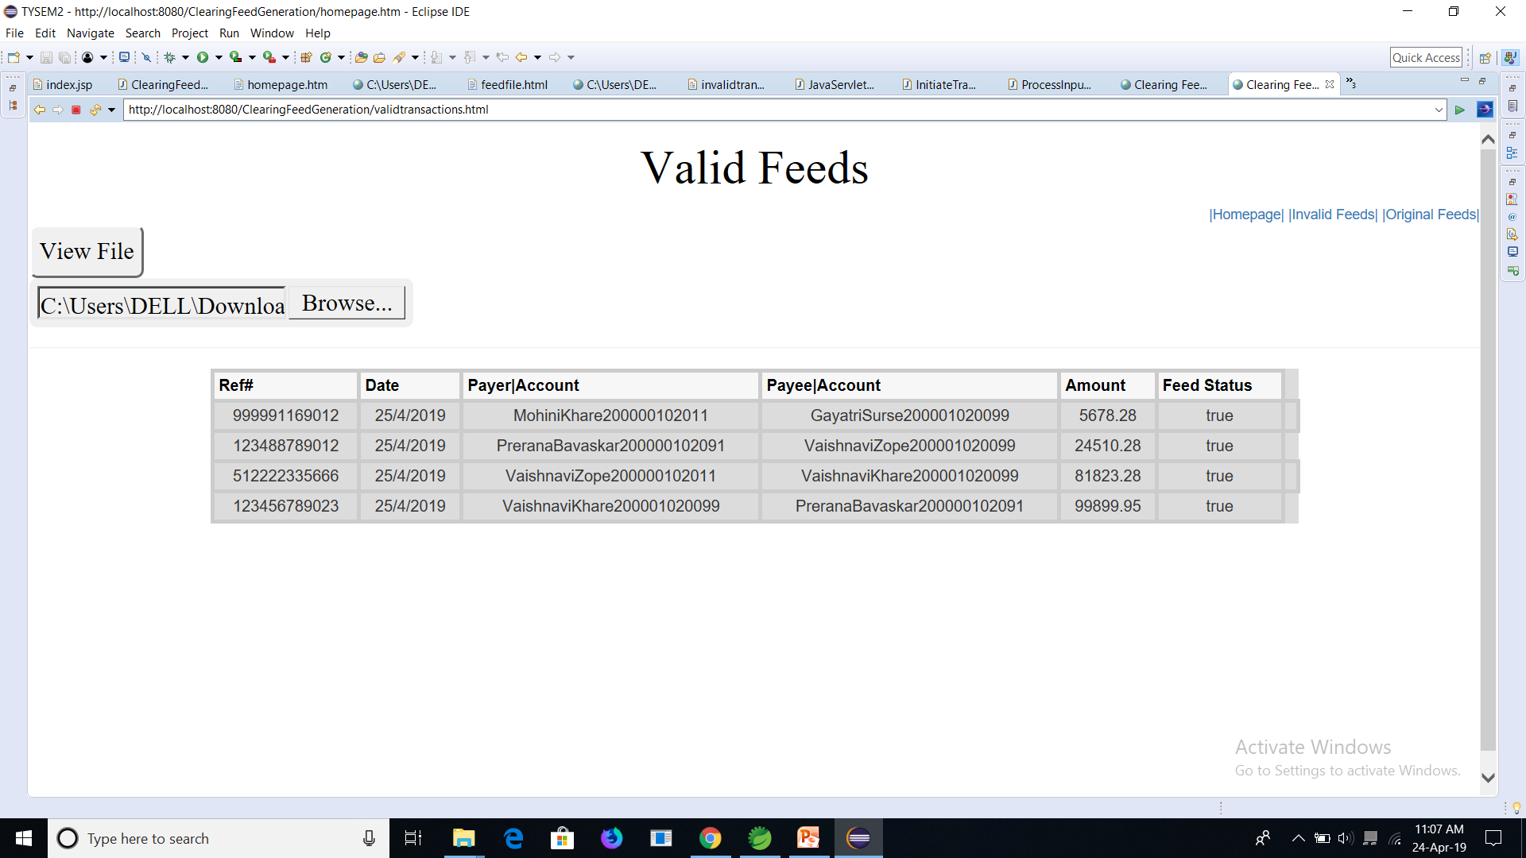
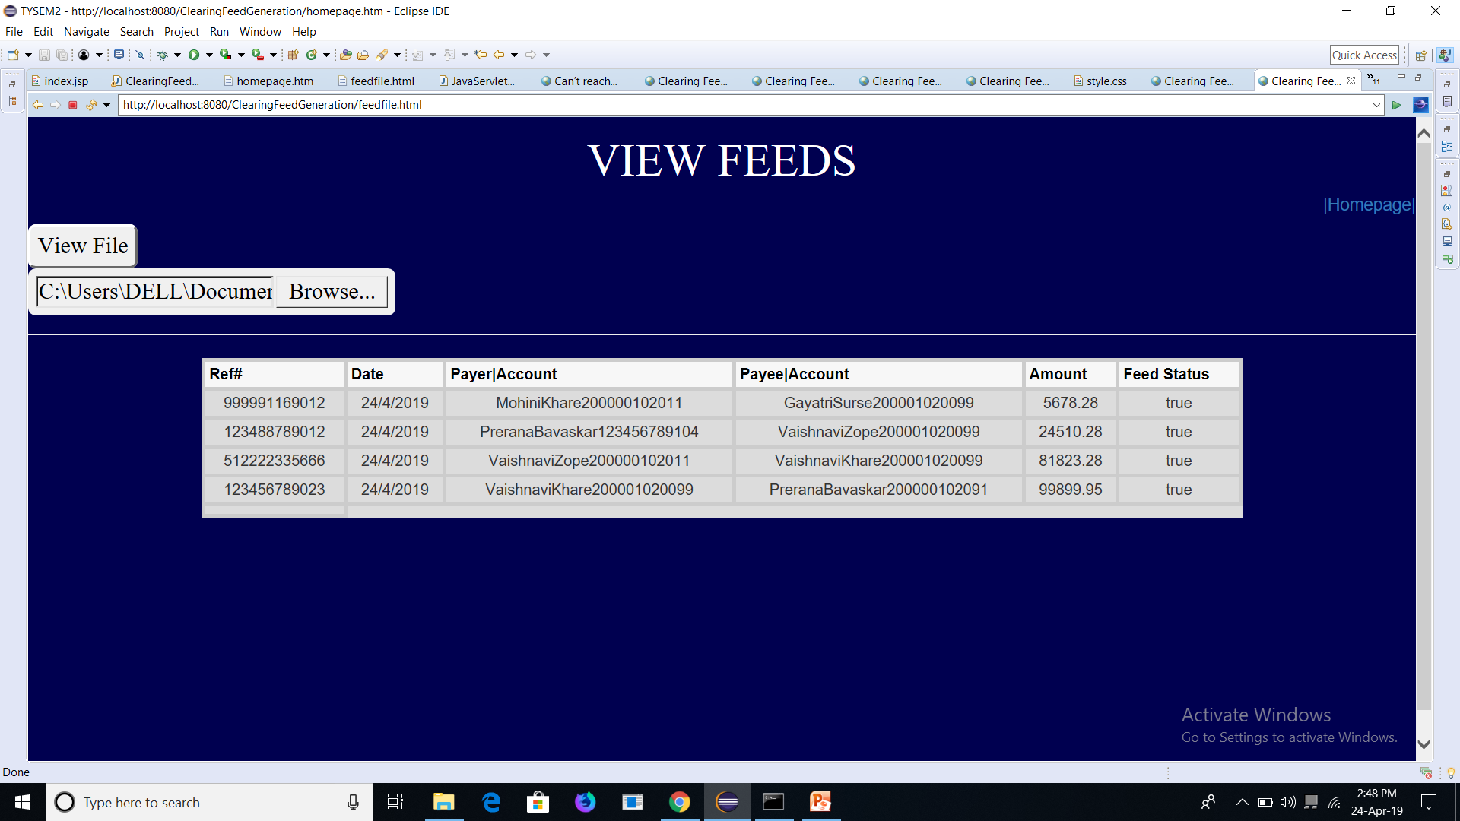
CONCLUSION
If your submitted data for the transactions is as per the norms of both the involved clients, only then will your transaction be considered successful.
Clearing feed acts as a mediator in validating transactions.
After clearing feed , the validFeed.txt file is generated which will have valid transactions.

Slide 16
FUTURE SCOPE
The overall transactions of a day can be uploaded on cloud and shown on a graph with a successful and failed rate of transactions.
All the transactions can be stored using database and can be analysed on weekly or monthly basis.

Slide 17
Thank You

