Slide 1
Using Progress To Update
Excel Spreadsheets
A Case Study

Slide 2
Who Am I?
Craig Pollatz
MIS Programmer/Manufacturing Systems Manager
Help desk
Customize ERP system reports
Programming for over 25 years
Progress for over 10 years

Slide 3

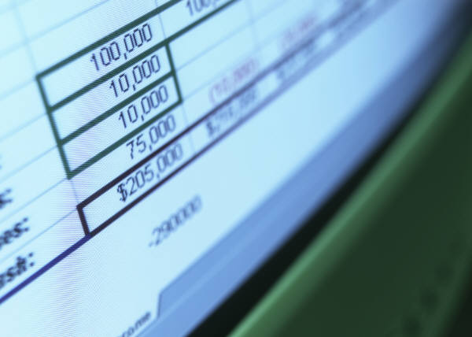
How many departments use spreadsheets for data reporting and storage???

Slide 4
User Requests
New report
New graph
Ever spend lots of time creating and formatting a report only to have the user print it and retype the numbers into a spreadsheet?

Slide 5
Problem
No single report had all the data needed for a weekly summary
Solution: Create a spreadsheet
It took several hours to update
Solution: Delegate it to a programmer

Slide 6
Requirements
5 Spreadsheets updated weekly
Input for 3 divisions from 3 spreadsheets, 2 QAD reports, 5 CorVu reports.
1-2 hours just to run reports
4-6 hours to manually input data

Slide 7
Intermediate Solutions
Have IT run reports
IT automates running of reports
Have IT input data
IT automates data input
Current process takes 15-30 minutes

Slide 8


Main Parts
Initialization
Open Spreadsheet
Update Spreadsheet
Close Spreadsheet
Release resources

Slide 9
Initialize
DEFINE VARIABLE chExcel AS COM-HANDLE NO-UNDO.
DEFINE VARIABLE chWorksheet AS COM-HANDLE NO-UNDO.
DEFINE VARIABLE chWorkbook AS COM-HANDLE NO-UNDO.
CREATE "excel.application" chExcel.

Slide 10
Open Spreadsheet
/* Open an Excel document */
chExcel:Workbooks:Open("h:\excel\test1.xls").
chExcel:visible = true.
/* Select a workbook */
chWorkbook = chExcel:Workbooks(1).
/* Select a worksheet */
chWorkbook:Worksheets(1):Activate.
chWorksheet = chWorkbook:Worksheets(1).

Slide 11
Update Spreadsheet
/* Add data */
ASSIGN
chWorksheet:Range("B1"):VALUE = "Value"
chWorksheet:Range("B2"):VALUE = 255
chWorksheet:Range("B3"):VALUE = 100
chWorksheet:Range("B4"):VALUE = 250
chWorksheet:Range("B5"):VALUE = 400
chWorksheet:Range("B6"):VALUE = 100
chWorksheet:Range("B7"):VALUE = 600.

Slide 12
Update Spreadsheet
/* Change the cell's format */
ASSIGN
chWorksheet:Columns("A:A"):Font:ColorIndex = 2
chWorksheet:Columns("A:A"):Font:Name = "Courrier New"
chWorksheet:Columns("A:A"):Font:Bold = TRUE
chWorksheet:Columns("A:A"):Font:Italic = TRUE.
/* Set underline: StyleSingle = 2 */
chWorksheet:Columns("A:A"):FONT:UNDERLINE = 2 .

Slide 13
Update Spreadsheet
/* Add a Formula */
chWorksheet:Range("A8"):VALUE = "Total:".
chWorksheet:Range("B8"):Formula = "=SUM(B2:B7)“.
/* Set Cell's format to Number */
chWorksheet:Range("B8"):NumberFormat = 0.
/* Set horizontal alignment
Right Alignment: -4152 / Left Alignment :-4131 */
chWorksheet:Range("B:B"):HorizontalAlignment = -4152.
/* Freeze Pane */
chWorksheet:Range("A2"):SELECT.
chExcel:ActiveWindow:FreezePanes = TRUE.

Slide 14
Update Spreadsheet
/* Rename the worksheet */
chWorkSheet:NAME = "test".
/* Modify the cell's format to Text */
chWorksheet:Cells:NumberFormat = "@".
/* Change the cell's color */
chWorksheet:Columns("A:A"):Interior:ColorIndex = 5.

Slide 15
Other Commands
/* Add a new worksheet as the last sheet */
chWorksheet = chWorkbook:Worksheets(5).
chWorkbook:Worksheets:add(, chWorksheet).
/* Rename the worksheet */
chWorkSheet:NAME = "test".
/* Modify the cell's format to Text */
chWorksheet:Cells:NumberFormat = "@".
/* Change the cell's color */
chWorksheet:Columns("A:A"):Interior:ColorIndex = 5.

Slide 16
Calculating a Cell Reference
/* column dependant on week */
ndx = SUBSTRING("LMNOP",week,1) + "86".
chWorksheet:Range(ndx):VALUE = days_WIP_oh.
/* row dependant on iteration */
ndx = "B" + STRING(43 + cnt, ">9").
chWorksheet:Range(ndx):VALUE = tcust.

Slide 17
Save and Close Spreadsheet
/* Save the new workbook without displaying alerts */
chExcel:DisplayAlerts = FALSE.
chWorkbook:Save().
chWorkbook:SaveAs("h:\excel\test2.xls",43,,,,,).
/* Quit Excel */
chExcel:quit().

Slide 18
Release Resources
/* Release Com-handles */
RELEASE OBJECT chWorksheet.
RELEASE OBJECT chWorkbook.
RELEASE OBJECT chExcel.

Slide 19
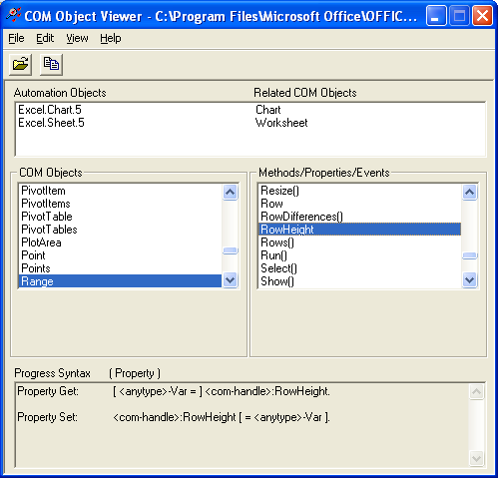
Find Command Syntax
Open Excel
Record Macro
Open Progress client
Tools >> PRO*Tools
Com Viewer
File >> Open >> c:/Program Files/
Microsoft Office/
Office11/xl5en32.olb

Slide 20
Let the User Choose the Spreadsheet
DEFINE VARIABLE sourcefile AS CHARACTER FORMAT "x(70)" NO-UNDO.
DEFINE VARIABLE labelfile AS CHARACTER FORMAT "x(70)" NO-UNDO.
DEFINE VARIABLE targetfile AS CHARACTER FORMAT "x(20)" VIEW-AS FILL-IN.
DEFINE VARIABLE OKpressed AS LOGICAL INITIAL TRUE.
DEFINE VARIABLE vahrfile AS CHARACTER FORMAT "x(70)" NO-UNDO.
Main:
REPEAT:
SYSTEM-DIALOG GET-FILE vahrfile
TITLE "Choose the VAHR file"
MUST-EXIST
USE-FILENAME
UPDATE OKpressed.
LEAVE Main.
END.

Slide 21
Demonstration/Examples
Weekly Reports
Hold Tags
Process Change Notices
Scrap Report by Reason
Weekly Report by Machine

Slide 22
Send File Via Email
Set objMessage = CreateObject("CDO.Message") 'Create the email object...
'Specify the email attributes...
objMessage.Subject = "Scrap Report"
objMessage.From = "cpollatz@cascade-cdc.com"
objMessage.To = "cpollatz@cascade-cdc.com; khysell@cascade-cdc.com"
objMessage.TextBody = "Automated Scrap Report"
objMessage.AddAttachment "c:\program files\eb2srv\batch\chart for phil.xls"
'Needed to send via a remote server...
objMessage.Configuration.Fields.Item("http://schemas.microsoft.com/cdo/configuration/sendusing") =2
objMessage.Configuration.Fields.Item("http://schemas.microsoft.com/cdo/configuration/smtpserer") = "exchange”
objMessage.Cnfiguration.Fields.Item("http://schemas.microsoft.com/cdo/configuration/smtpserverport") = 25
objMessage.Configuration.Fields.Update
'Sends the message...
objMessage.Send

Slide 23
Scheduled Batch Job
"C:\Program Files\DLC91\bin\_progres.exe"
-p "C:\Program Files\eb2srv\batch\excel-min2.p"
-pf "c:\Program Files\eb2srv\eb2ms.pf"
-c 500 -s 63 -D 50 -TM 31 -TB 31 -B 1000
-yy 1920 -d mdy
"C:\Program Files\eb2srv\batch\mail-scrap.vbs"

Slide 24
Contact Information
Craig Pollatz
MIS Programmer/
Manufacturing Systems Manager
Cascade Die Casting Group, Inc.
Group Services Office
7441 South Division Suite 1A
Grand Rapids, MI 49548
cpollatz@cascade-cdc.com
Ph: (616) 281-1660 x110

