Slide 1
PDFinclude
Progress® Open Source
Adobe® PDF Development

Slide 2
Contents
Creator
Contributors
Problems
Some Solutions
Best Solution
PDFinclude Overview (3)
Benefits
Drawbacks
Future
Contains
Document Elements
Text Elements
Graphic Elements
External Elements
Planes – Defined
PDFgrid.w (2)
Sample Code (3)
Gallery (4)
Links

Slide 3
Creator
Gordon Campbell of PRO-SYS Consultants Ltd.
Over 13 Years of Progress Experience utilizing Progress V6-V9, WebSpeed, Appserver, WebClient, and Roundtable in CHUI, GUI, Net-UI and N-Tier environments.
Currently resides in Edmonton, Alberta, Canada
Still consumes Alberta Beef
www.epro-sys.com

Slide 4
Contributors
Julian Lyndon-Smith of DotR (www.dotr.com)
Peter Kiss of Paradyme N.V
Herbert Bayer of B&R Innovative DV-Lösungen GmbH (www.bundrinno.de)
Steven Jellin of ELCB (www.elcb.co.za)
Steve Southwell of Bravepoint (www.bravepoint.com)
John Stonecipher of Indiana Packers (www.inpac.com)
Paul Keary of Coe Press Equipment (www.cpec.com)
plus many others … (apologies to those not listed)

Slide 5
Problem
Reports and text output, in general, is boring
Many use pre-printed forms as solution
  Expensive
  Inflexible
  One printer, one type of form
Have to line-up text to fit in pre-printed boxes
Miss many opportunities since you can’t print barcodes on forms
Barcode fonts and cartridges are printer-specific

Slide 6
Some Solutions
Barcode cartridges (for printers)
Send printer-specific Control Codes from 4GL
Use plain text, one font only
Create templates to be stored in printer’s memory and called via escape codes in 4GL

Slide 7
Best Solution
Create your own forms from 4GL
Print on any printer, view on any computer
Not a printer specific solution
Use Barcodes at will
Use Graphics (images and logos) anywhere
Change font sizes, colours, orientation
Print on plain paper
Easily distributable content
Best Solution = PDFinclude

Slide 8
PDFinclude Overview (1)
Free Product (monetary donations gladly accepted)
Dynamically create PDF documents using predefined Progress functions and procedures
Available for Progress Version 9 and 10 (diluted versions are available for V7 and v8)
Originated from a need for distributed Reporting – HTML couldn’t handle the complexity and not everyone uses MS Word … but (almost) everyone has Adobe Reader®
Download at http://pdfinclude.epro-sys.com

Slide 9
PDFinclude Overview (2)
PDFinclude has been deployed by companies in the following
countries:
Canada
USA
Britain
Belgium
The Netherlands
Sweden
Australia
Argentina
Singapore
South Africa
Hong Kong
Portugal
France
Romania
Hungary
Norway
Plus many more

Slide 10
PDFinclude Overview (3)
PDFinclude has been deployed in the following:
Industries
  Manufacturing
  Mining
  ERP Software
  Retail
  Forestry
  Healthcare
  Service
  ….
Operating Systems
  Windows NT,XP,2000
  Linux
  HP-UX
  AIX
  Solaris
  SCO
  …
Usage
  Print/E-Mail PDF from MFG/PRO
  Internal Report Generator
  Outside Communication Forms
  General Reporting and Storage
  Product Catalogues
  E-Mail Distribution
  Quotations
  Stock Reports
  Therapist Schedules
  ….

Slide 11
Technical Benefits
Free … did I say that already?
Full Source code, documentation and samples
Seamless integration to Progress 4GL
Single Source for multiple platforms
Simple to implement
Additional feature for end users
Can run as SUPER procedure
Can be implemented in an AppServer Architecture

Slide 12
Practical Benefits
Eliminate pre-printed forms (cost savings)
Make reports and print-outs more visually appealing
Include logos, graphics, and fonts
Print Bar Codes
  Lower Date-Entry Error Rates
  Reduce Labour Costs
  Achieve vendor and customer full-packaging-list acceptance

Slide 13
Job Benefits
Boss can brag about cost savings
You will be super-cool programmer
Add another utility to your list of tools

Slide 14
Drawbacks
No GUI Design Tool (but you can now import pages from pre-existing PDF documents. So you can create your template using MS Word then run it through Adobe Distiller then ‘use it’ in PDFinclude)
Depending on situation .. could be a little slow
Pentium 90 - 2+ minutes
Pentium 4 2.4Ghz – too fast to time

Slide 15
Future
The following offerings have been identified as outstanding issues or
nice-to-have Features. These items are listed in no particular order and will be
addressed – time permitting.
GUI Report Designer (integrate directly within Progress environment)
Expand encryption offering to include 128-Bit Encryption
Performance Improvements

Slide 16
PDFinclude Contains
Set Typeface, font size, bold/italic/underline, orientation
Predefined or Custom Page Sizes
Graphic Elements (rectangles, circles, lines, colors etc)
Page Header/Footer capability
Add Bookmarks, Hyperlinks
Ability to include images and logos (JPEG only today)
Ability to embed True Type Fonts (including BarCoding fonts)
Compression (via Zlib)
Encryption (v9.1A forward – currently only 40-Bit)
Stream Merging Capability
Seamlessly Handles European Numeric Format
Some rudimentary XML handling

Slide 17
Document Elements
Allows for control of the total document appearance plus allows you to interactively determine some of the documents attribute
Procedures
  pdf_new
  pdf_close
  pdf_new_page
  pdf_set_info
  pdf_set_PageWidth
  pdf_set_PageHeight
  pdf_set_PageRotate
  pdf_set_orientation
  pdf_set_verticalspace
  pdf_set_leftMargin
  pdf_set_TopMargin
  pdf_set_BottomMargin
  pdf_set_PaperType
  pdf_merge_stream
  pdf_bookmark
Functions
  pdf_page
  pdf_orientation
  pdf_PaperType
  pdf_PageHeader
  pdf_PageFooter
  pdf_LastProcedure
  pdf_get_info
  pdf_TotalPages

Slide 18
Text Elements
Allows for the positioning and formatting of textual content
Output
  pdf_text
  pdf_text_at
  pdf_text_to
  pdf_text_center
  pdf_text_align
  pdf_text_xy
  pdf_text_boxed_xy
  pdf_skip
  pdf_skipn
  pdf_textY
  pdf_textX
  pdf_text_char
  Pdf_text_charxy
  pdf_wrap_text
  pdf_watermark
Control
  pdf_set_font
  pdf_text_color
  pdf_text_width
  pdf_set_textRed
  pdf_set_textGreen
  pdf_set_textBlue
  pdf_text_render
  pdf_text_rotate
  pdf_get_numfittingchars
  pdf_PointSize
  pdf_TextRed
  pdf_TextGreen
  pdf_TextBlue
  pdf_rgb

Slide 19
Graphic Elements
Allows for the positioning and formatting of graphical content
Procedures
  pdf_set_fillRed
  pdf_set_fillGreen
  pdf_set_fillBlue
  pdf_move_to
  pdf_rect
  pdf_circle
  pdf_curve
  pdf_line
  pdf_stroke_color
  pdf_stroke_fill
  pdf_set_linejoin
  pdf_set_dash
  pdf_link
Functions
  pdf_fillRed
  pdf_fillGreen
  pdf_fillBlue
  pdf_GraphicX
  pdf_GraphicY

Slide 20
External Elements
Allows for the inclusion of external elements into the PDF document.
The External Fonts are used by Text Elements to vary the appearance of textual content. That is, you could use an external Code39 True Type Font to display an Invoice Number.
External Images or PDF Pages need only be defined once, but can be used multiple times.
Procedures
  pdf_load_font
  pdf_font_diff
  pdf_load_image
  pdf_place_image
  pdf_open_pdf (new)
  pdf_use_pdf_page (new)
  pdf_load_xml (new)
Functions
  pdf_Font
  pdf_FontType
  pdf_ImageDim
  GetXMLNodeValue (new)

Slide 21
14 Predefined Fonts
Courier (Oblique, Bold, BoldOblique)
Helvetica (Oblique, Bold, BoldOblique)
Times-Roman
Times (Italic, Bold, BoldItalic)
Symbol
ZapfDingbats
Plus use True Type Fonts with a little up front work. You will need to create Adobe Font Metrics (AFM) using a utility program (called ttfpt1.exe .. included in download).

Slide 22
Planes – Defined (1)
Planes are used to define how elements are added to the PDF document. Textual Content works top-down from upper-left hand corner while Graphic Content work bottom-up from lower left hand corner.
0,0
80
792
Textual Content
is measured in
Rows and Cols.
Eg: Portrait Page
Is 80 Cols by 65
Rows
Graphic Content
is measured in
Points.
Eg: Portrait Page
is 612 by 792
65
0,0
612

Slide 23
Planes –Defined (2)
Of course, there are always some stipulations:
If you use pdf_text_xy or or pdf_text_align then they use the Graphic Plane
For Textual content, the number of columns and rows will vary depending on the size of the font you use and whether you use a fixed or proportional font.
So how can you effectively determine placement without a GUI Report Designer?

Slide 24
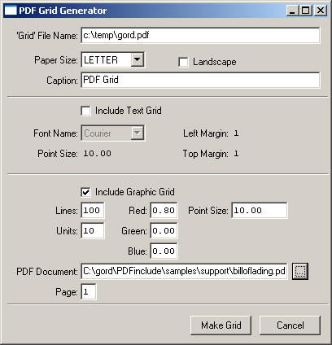
PDFgrid.w (1)
This utility (included in the download) allows you to define some document
elements and will produce a Layout Grid.
You can define Page Size and Orientation
Can display Text or Graphic Grid
For Text Grid, you can control Font Name, Font Size, and Margins
For Graphic Grid, you can control grid placements, grid colour, and Point Size.
You can include an external PDF Page (new)

Slide 25
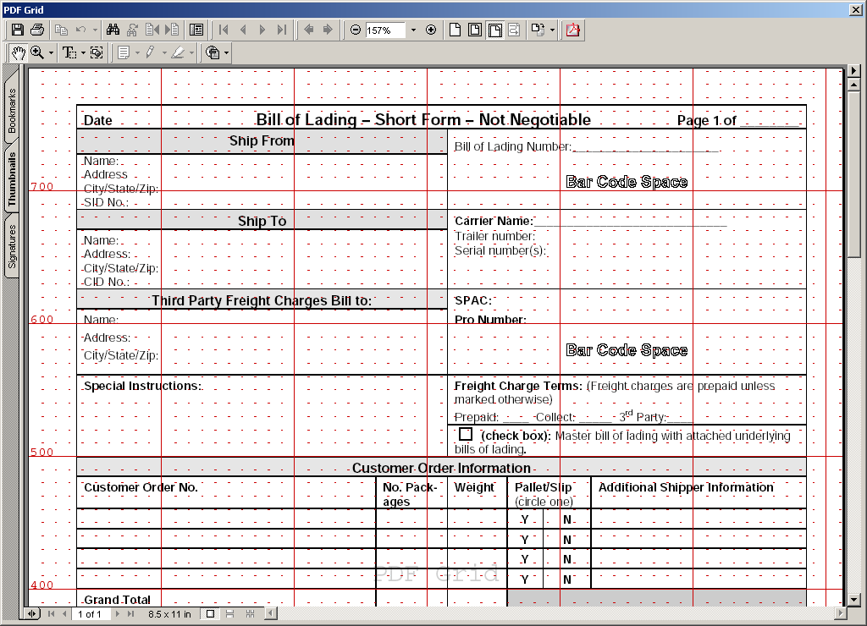
PDFgrid.w (2)
Upon selection of the ‘Make Grid’ button, a PDF document similar to the
following will be produced. This will aid you in the design of PDF documents.

Slide 26
Sample Code (1a)
This sample illustrates the standard ‘Hello World’ example. It also illustrates
the minimum statements required for generating a PDF document (see next
page for output produced)
{ pdf_inc.i}
RUN pdf_new ("Spdf","\temp\hello.pdf").
RUN pdf_new_page("Spdf").
RUN pdf_text ("Spdf", "Hello World!").
RUN pdf_close("Spdf").

Slide 27
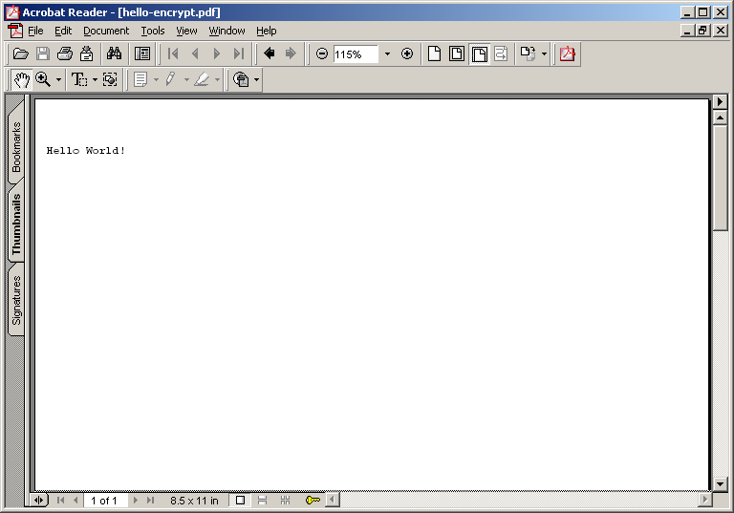
Sample Code (1b)

Slide 28
Sample Code (2a)
This sample illustrates how to convert an existing text document to a PDF
document.
DEFINE INPUT PARAMETER p_TextFile AS CHARACTER NO-UNDO.
DEFINE INPUT PARAMETER p_PDFFile AS CHARACTER NO-UNDO.
DEFINE VARIABLE v_line AS CHARACTER NO-UNDO.
{ pdf_inc.i}
RUN pdf_new ("Spdf",p_PDFFile).
RUN pdf_set_BottomMargin("Spdf",50).
RUN pdf_new_page("Spdf"). /* Instantiate a new page */
INPUT FROM VALUE(p_TextFile) NO-ECHO.
REPEAT:
IMPORT UNFORMATTED v_Line.
RUN pdf_text_color ("Spdf",0.0,.0,.0).
RUN pdf_text ("Spdf", v_Line).
RUN pdf_skip ("Spdf").
IF INDEX(v_Line,CHR(12)) > 0 THEN
RUN pdf_new_page("Spdf").
END.
INPUT CLOSE.
RUN pdf_close("Spdf").

Slide 29
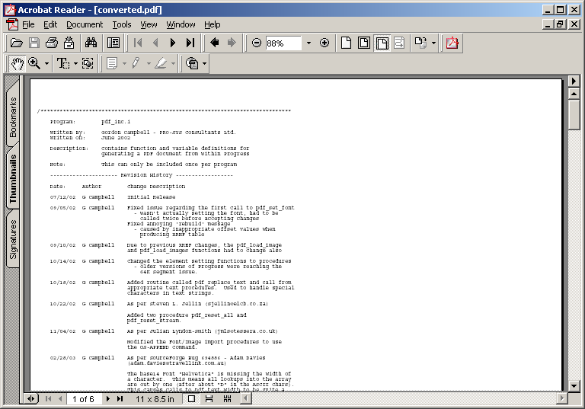
Sample Code (2b)

Slide 30
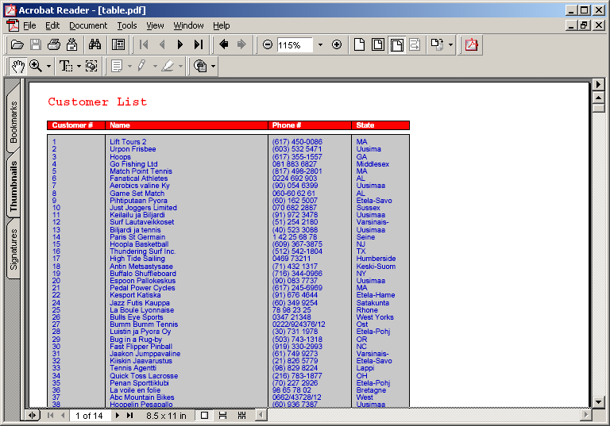
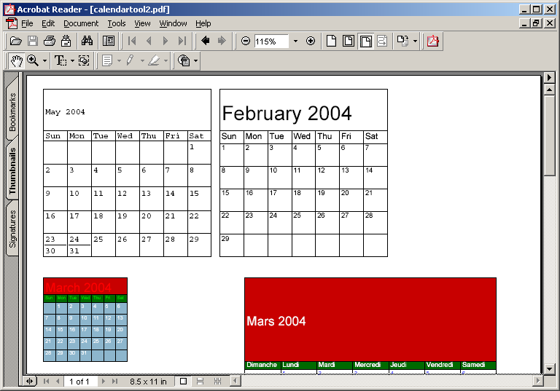
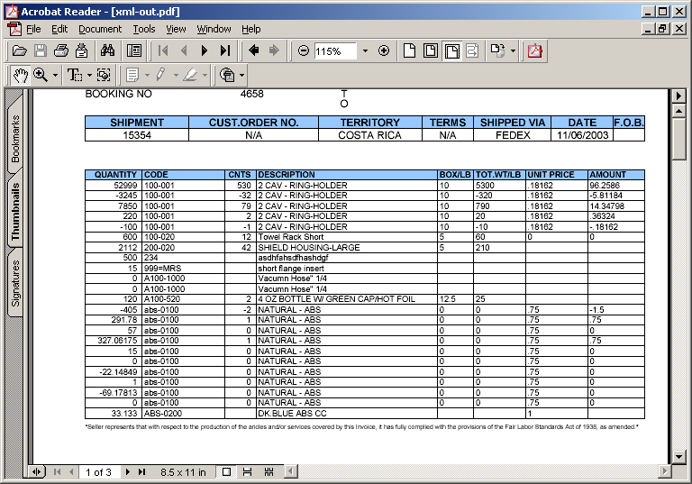
Tools
PDFinclude currently comes with 3 tools which allow you to easily create PDF
content.
1. Table
2. Calendar
3. Matrix

Slide 31
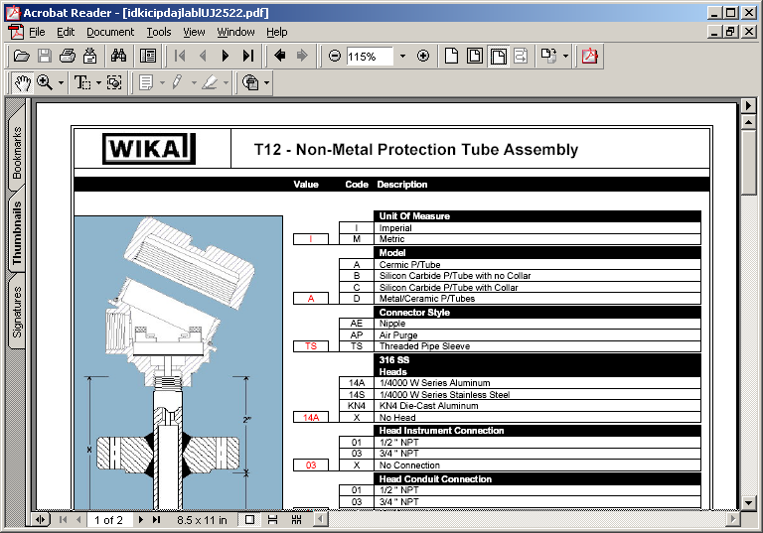
Gallery (1)
Fonts
Rectangles
Logo
Image
DB
Content

Slide 32
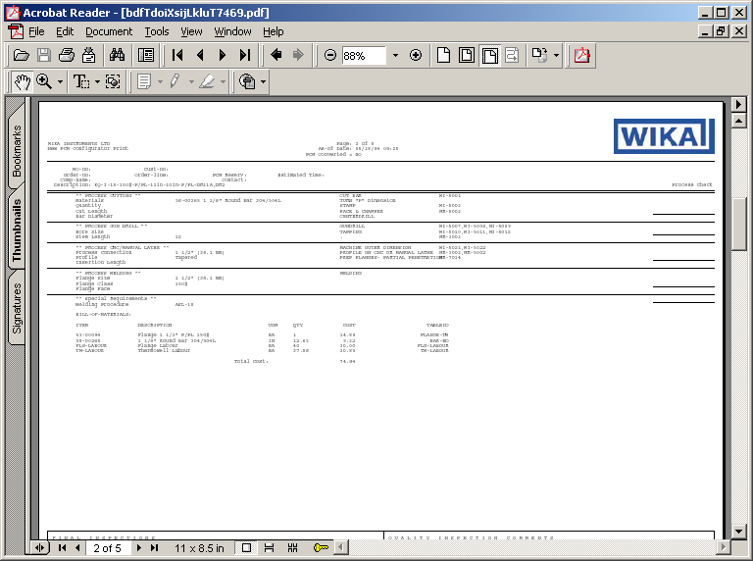
Gallery (2)
Logo
Lines
DB
Content

Slide 33
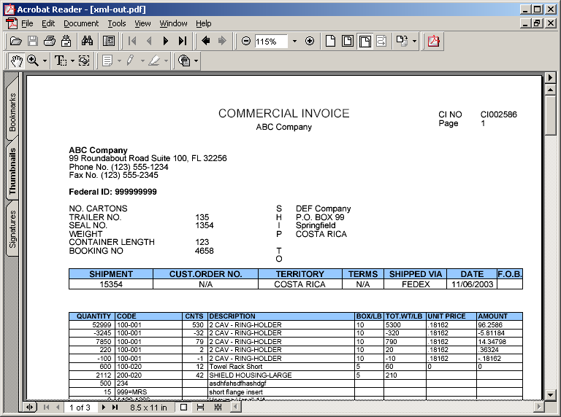
Gallery (3)
XML
Content
Matrix
Tool

Slide 34
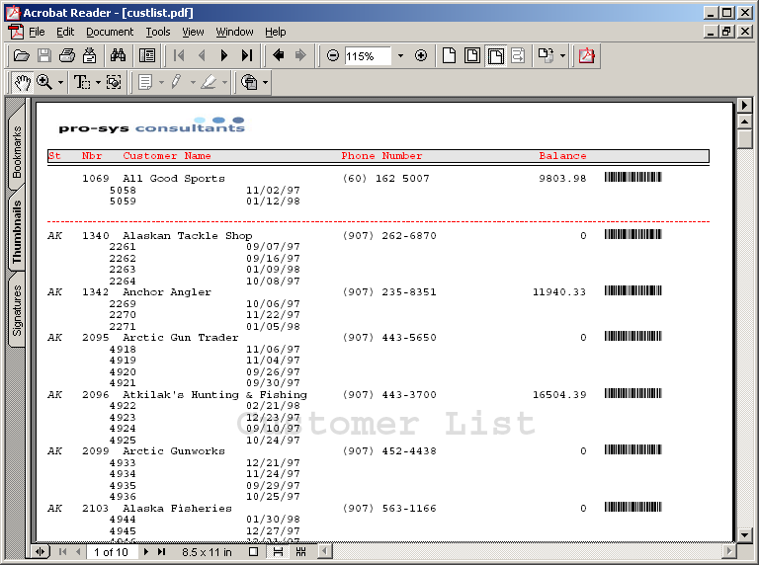
Gallery (4)
Logo
Barcode
Font
Watermark

Slide 35
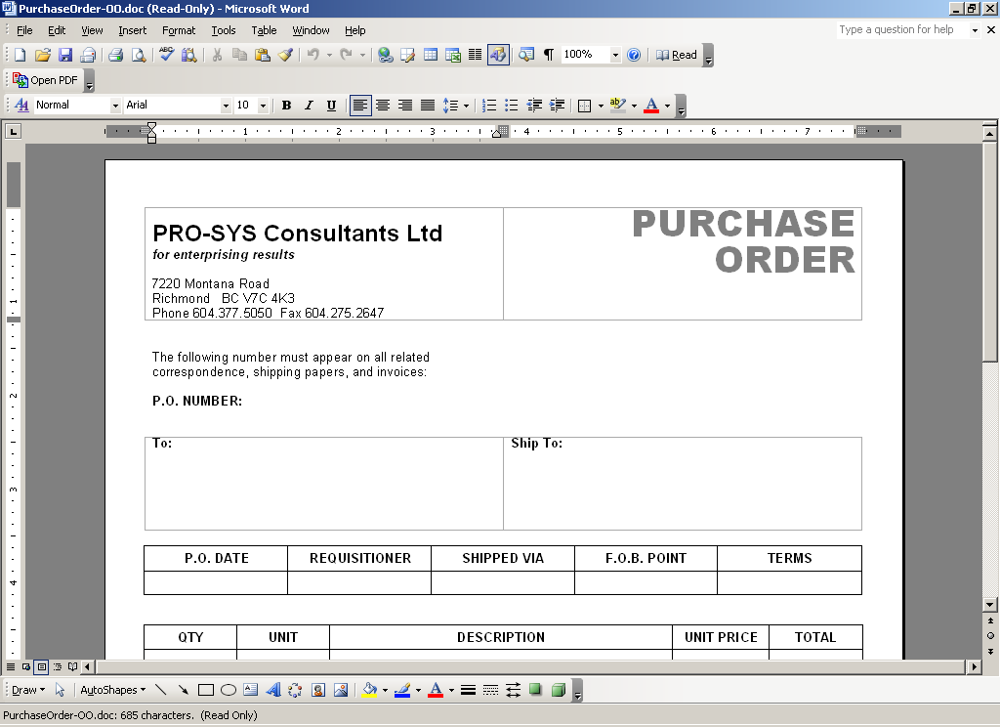
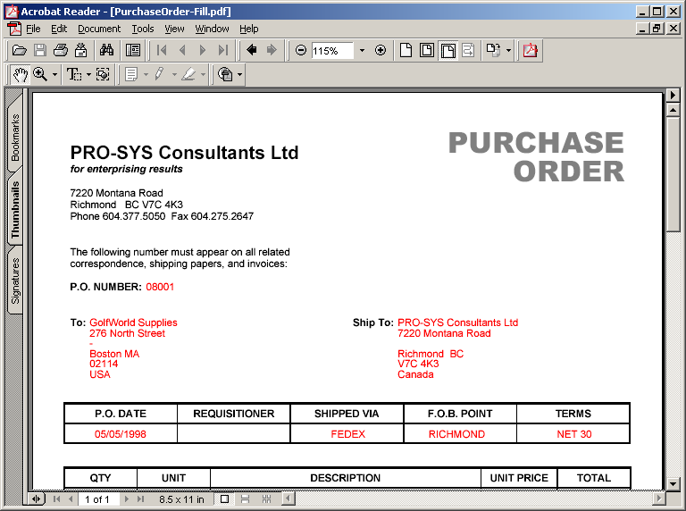
Using an External PDF Page (1)
Create form in MS Word
Print through
Adobe Distiller
to generate blank PDF.
Use in PDFinclude
And overlay with DB content

Slide 36
Using an External PDF Page (2)
Sample Code:
{ pdf_inc.i "THIS-PROCEDURE"}
DEFINE VARIABLE i_Counter AS INTEGER NO-UNDO.
RUN pdf_new ("Spdf","\gord\PDFinclude\samples\super\openpdf.pdf").
RUN pdf_set_parameter("Spdf","Compress","TRUE").
RUN pdf_open_PDF("Spdf","c:\gord\pdfinclude\samples\support\Invoice.pdf","Inv").
RUN DoNewPage.
RUN DoInvoiceInfo.
RUN pdf_close("Spdf").
/* ------------------- INTERNAL PROCEDURES ------------------------- */
PROCEDURE DoNewPage:
RUN pdf_new_page("Spdf").
RUN pdf_use_PDF_page("Spdf","Inv",1).
END.
PROCEDURE DoInvoiceInfo:
RUN pdf_set_font("Spdf","Helvetica",8).
RUN pdf_text_color("Spdf",1.0,0.0,0.0).
/* This procedure overlays the DB info on the external PDF form */
RUN pdf_text_xy ("Spdf",STRING(Invoice.InvoiceNum,"99999"),350,557).
RUN pdf_text_xy ("Spdf",STRING(Invoice.InvoiceDate,"99.99.9999"),350,546).
RUN pdf_text_xy ("Spdf",STRING(Invoice.CustNum,"99999"),350,535).
END.

Slide 37
?
The following were some of the questions that were asked at
the Michigan PUG held on January 21, 2004.
What is the significance of “Spdf"?
It's totally arbitrary, but something is required to differentiate each stream. That’s right, you
can have more than one PDF stream per procedure (it’s actually unlimited … unlike Progress
streams).
What version of Acrobat is required?
Does not require Acrobat at all, pdf-inc implements PDF format natively. You do require a PDF
viewer but these are typically free.
How do you print pdf's on Unix platform?
Use ghostscript to convert pdf to required format. Ghostscript has a utility called pdf2ps that
converts the PDF output to Postscript which can then be printed on any Postscript printer.
Ghostscript is also a free utility (GPL) available at www.ghostscript.com.
There is a sample program called WinpdfPrint.p available at www.epro-sys.com that illustrates
how to silently print a PDF on Windows.
How do you direct the pdf streams to different destinations such as email, fax, printer, etc?
You don't direct the streams at all, they are used to create a PDF file that can be sent via
whatever means you like.

Slide 38
Links
https://sourceforge.net/projects/pdf-inc (for Download, Sample, Documentation, Bug Reporting, Feature Request, and Donation)
http://www.epro-sys.com (for Creator contact)
http://www.zlib.org (for compression library)
http://partners.adobe.com/asn/acrobat/docs/File_Format_Specifications/PDFReference.pdf (for Adobe PDF spec)

