Slide 1
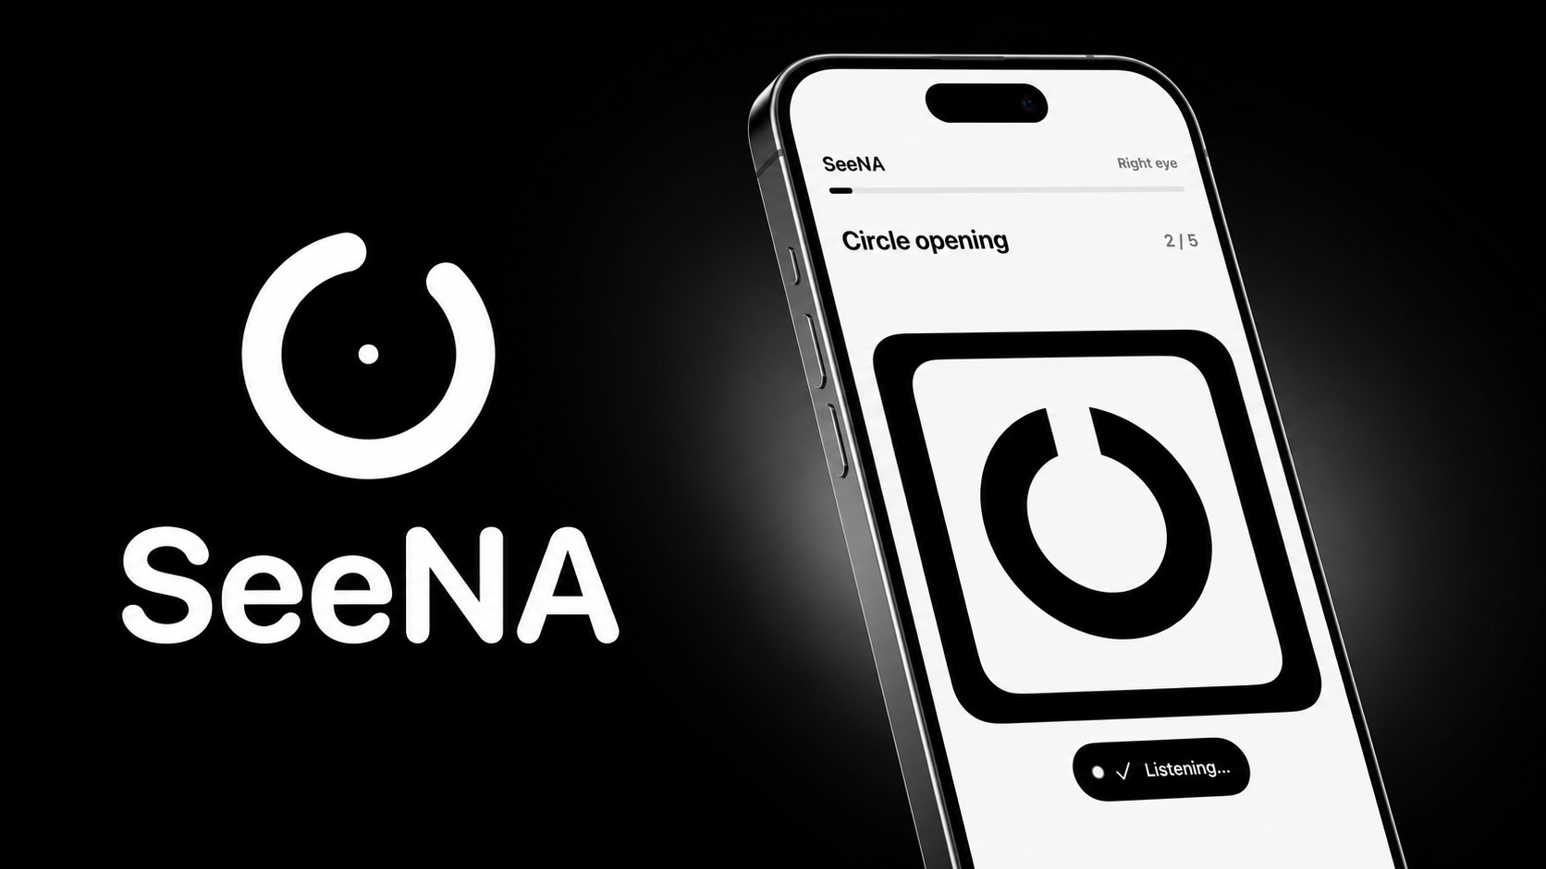
SYNCS HACKATHON 2026
See now.
Always.
A voice-guided vision screening companion.
SeeNA | See Now and Always
Notes:
TIMING: 0:00 to 0:12 Most eye checks begin with a clinic appointment. SeeNA begins with the iPhone already in your hand, making the first step simple, independent and understandable.

Slide 2
THE MISSING FIRST STEP
For many people, the first eye check is already out of reach.
A simple need becomes a chain of barriers.
01
02
03
DISTANCE
DEPENDENCE
DELAY
The nearest check may be far away.
Travel and unfamiliar tools can require help.
Without a first signal, action is postponed.
02
Notes:
TIMING: 0:12 to 0:32 For older adults and remote communities, distance, transport and dependence can turn a simple check into a chain of barriers. People delay action not because vision does not matter, but because the first step is hard to reach. SeeNA reconnects that missing block without pretending to replace an optometrist.

Slide 3
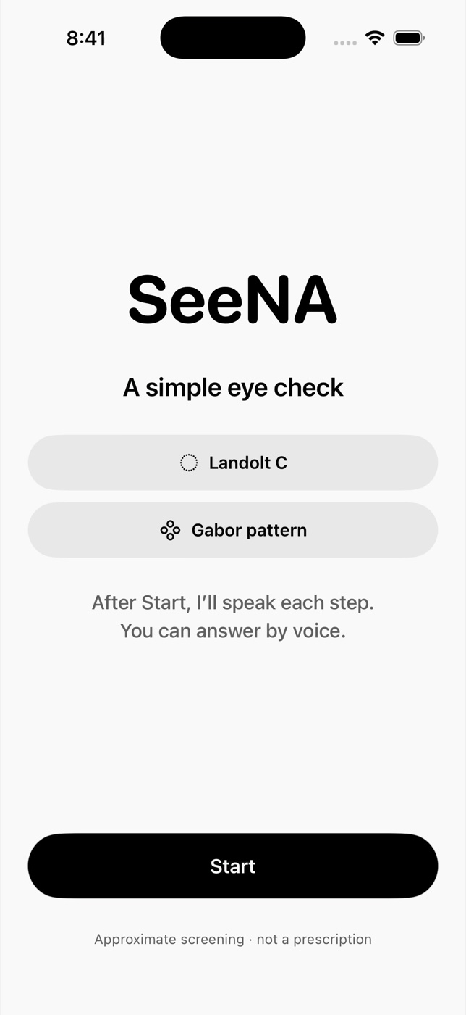
THE PRODUCT
Press Start.
SeeNA guides the rest.
No charts. No typing. No technical setup.
01
Listen
02
Look
03
Answer
VOICE STARTS AFTER TAP
03
Notes:
TIMING: 0:32 to 0:45 One tap starts the experience. SeeNA speaks every instruction, guides positioning, shows one large target at a time and waits for a natural voice answer. No chart, typing or technical setup.

Slide 4

1:28 PRODUCT WALKTHROUGH
The complete
SeeNA journey.
01
Guided positioning
02
Voice-led screening
03
Result and answer review
Click the video frame to play with sound. 1:28.
04
Notes:
TIMING: 0:45 to 2:13 Presenter pauses. Play the embedded 1 minute 28.44 second walkthrough with sound. Do not add narration over the video.

Slide 5
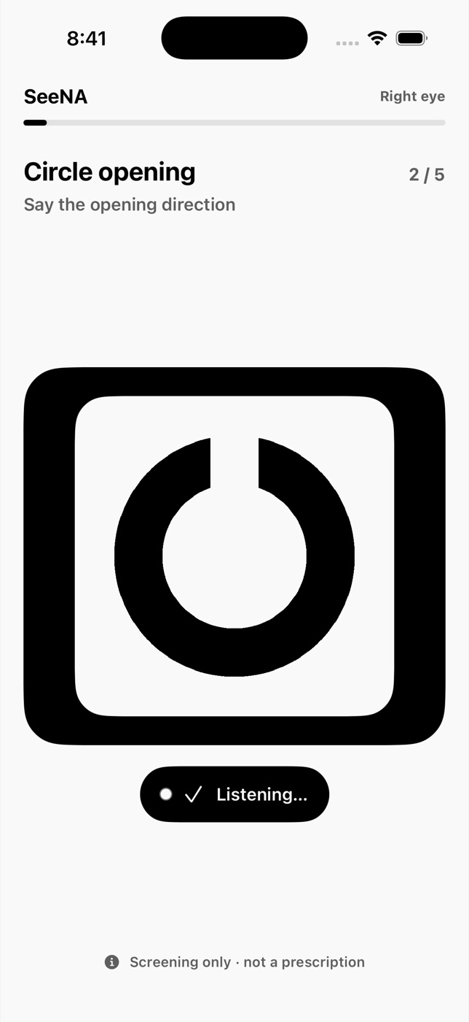
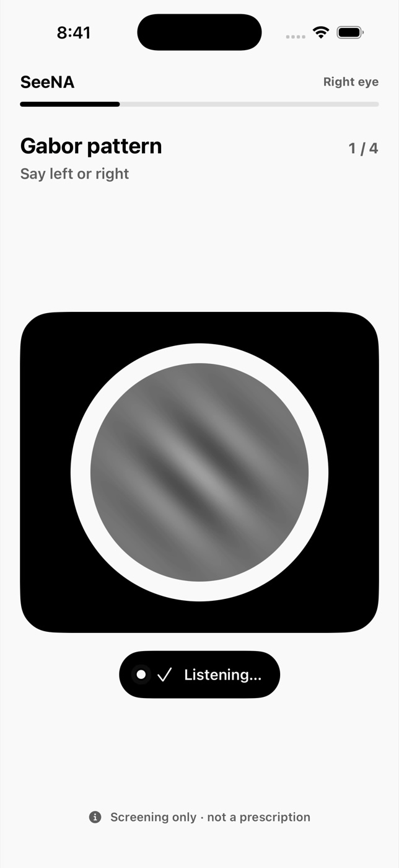
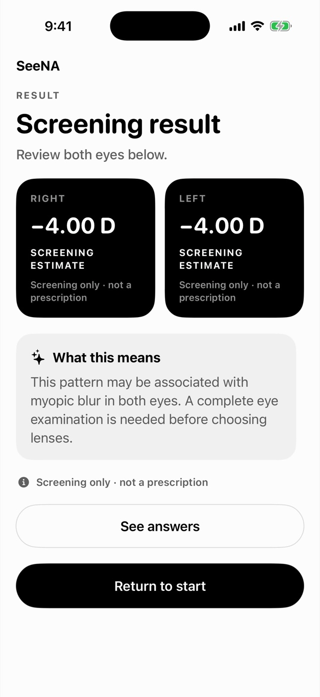
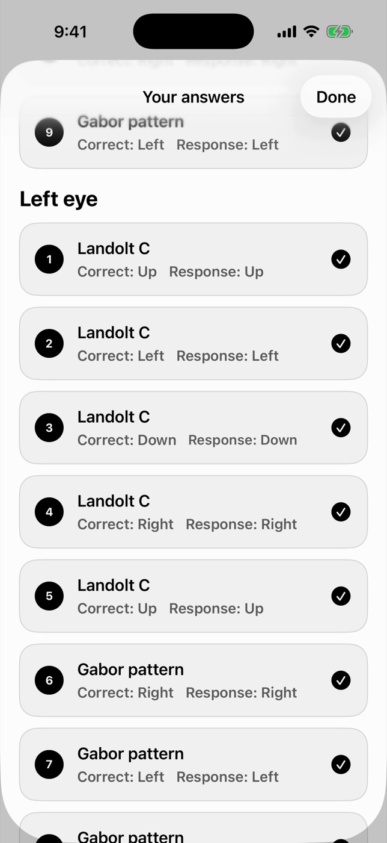
DESIGNED FOR INDEPENDENCE
One target. One answer. Full transparency.
01
Circle
02
Pattern
03
Result
04
Review
05
Notes:
TIMING: 2:13 to 2:38 What you saw is deliberate. Landolt C asks where the circle opens. Gabor asks which way the pattern tilts. Each eye is screened separately, the target waits for every answer, and ‘I cannot see it’ counts as evidence. The user receives an estimate and can review every prompt, correct answer and response.

Slide 6
BUILT FOR TRUST
The result comes from the test.
Not the model.
01
Scored on the iPhone
Landolt C and Gabor responses determine the estimate.
02
AI explains only
Plain-language meaning, never a model-generated number.
03
Private by design
No raw camera frames or face mesh sent to OpenAI.
06
Notes:
TIMING: 2:38 to 3:13 The architecture separates screening from explanation. TrueDepth, motion, lighting, gaze and stillness checks run on the device to protect result quality. Landolt C and Gabor responses are scored deterministically on the iPhone. OpenAI transcription turns speech into text, and GPT-5.6 Luna explains the finished result in plain language. AI never creates or changes the numeric estimate, and raw camera frames and face-mesh data are not sent to OpenAI.

Slide 7
WHY IT MATTERS
START
RESULT
Access starts with the phone already there.
SeeNA turns one tap into an independent first step.
AT HOME
VOICE GUIDED
REVIEWABLE
One guided screening
07
Notes:
TIMING: 3:13 to 3:37 SeeNA supports the moment before access: an older adult at home, a family helping someone they love, or a remote community looking for a first signal. The phone already there becomes a guided, reviewable first step. When concern appears, SeeNA makes the next action clear: arrange a complete eye examination.

Slide 8
SYNCS HACKATHON 2026
A first step toward clarity.
For anyone, anywhere.
SeeNA
Because everyone deserves to see their world, now and always.
See Now and Always
Karthik Ramesh
Kishore Srinivasan
Suryateja Challa
Sujan Ramesh
Notes:
TIMING: 3:37 to 4:00 Our world is built from people, communities, and access. But when eye care becomes a missing block, distance and age can leave someone behind. SeeNA reconnects that block, turning the phone already in their hand into a first step toward clarity. Because everyone deserves to see their world, now and always.

