Slide 1
Rna- sequencing technologies is a technique for characterizing RNA transcripts and comparative analysis of their abundancies.
The count for a given gene or region quantifies the expression of the gene or region. There are several emerging tools within the Bioconductor that have been developed for differential analysis of the count data including DeSeq, DeSeq2, edgeR, baySeq, limma, Rsubread and SVA.

Slide 2
Normalization
Normalization is a process designed to identify and remove systematic technical difficulties between samples that occur in data to ensure that technical differences between samples that occur in data to ensure that technical bias has minimum impact on the results.
The overall strategy is to choose an appropriate baseline and express sample counts relative to that base line.

Slide 3
Different methods for Normalization:
Total Count
Upper Quartile
Median
DeSeq
Trimmed means of M-value (TMM)
Reads per Kilobase per Million (RPKM)

Slide 4
DESeq2
The package DESeq2 provides methods to test for differential expression by use of negative binomial generalized linear models; the estimates of dispersion and logarithmic fold changes incorporate data-driven prior distributions.
Here the input data must be the count data as obtained from RNA-seq or any sequencing experiment in the form of a matrix of interger values.
The DESeq2 model internally corrects for the library size, so transformed or normalized values such as counts scaled by library size should not be used as input.

Slide 5
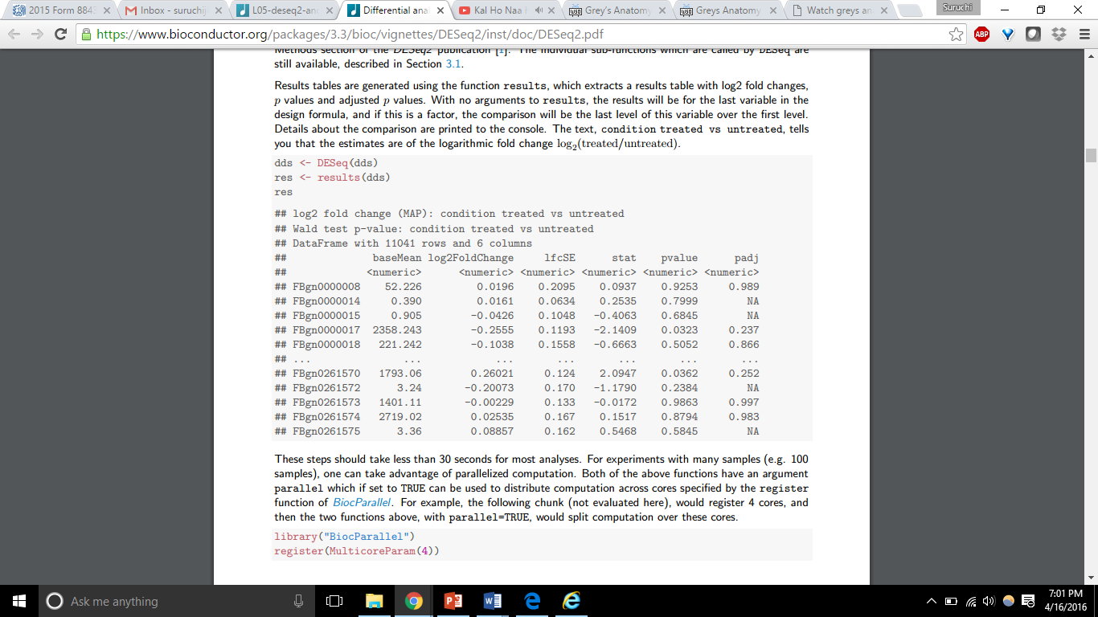
Differential Expression Analysis
The standard differential expression analysis steps are wrapped into a single function, DESeq

Slide 6
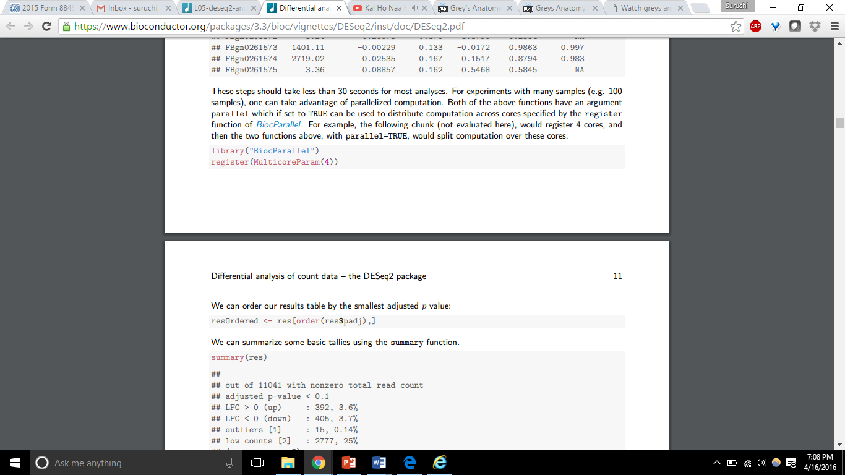
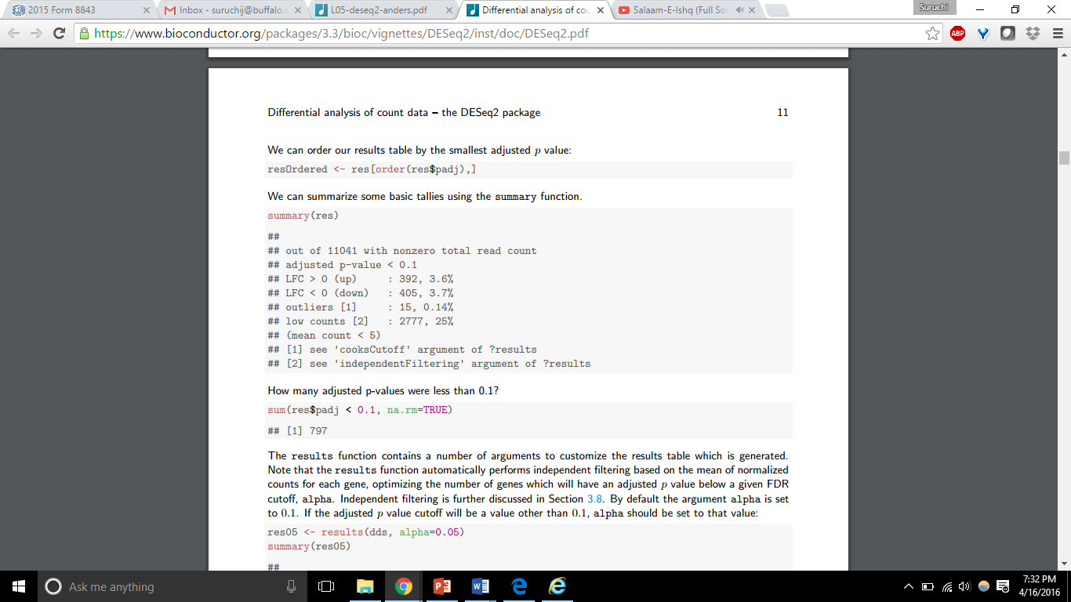
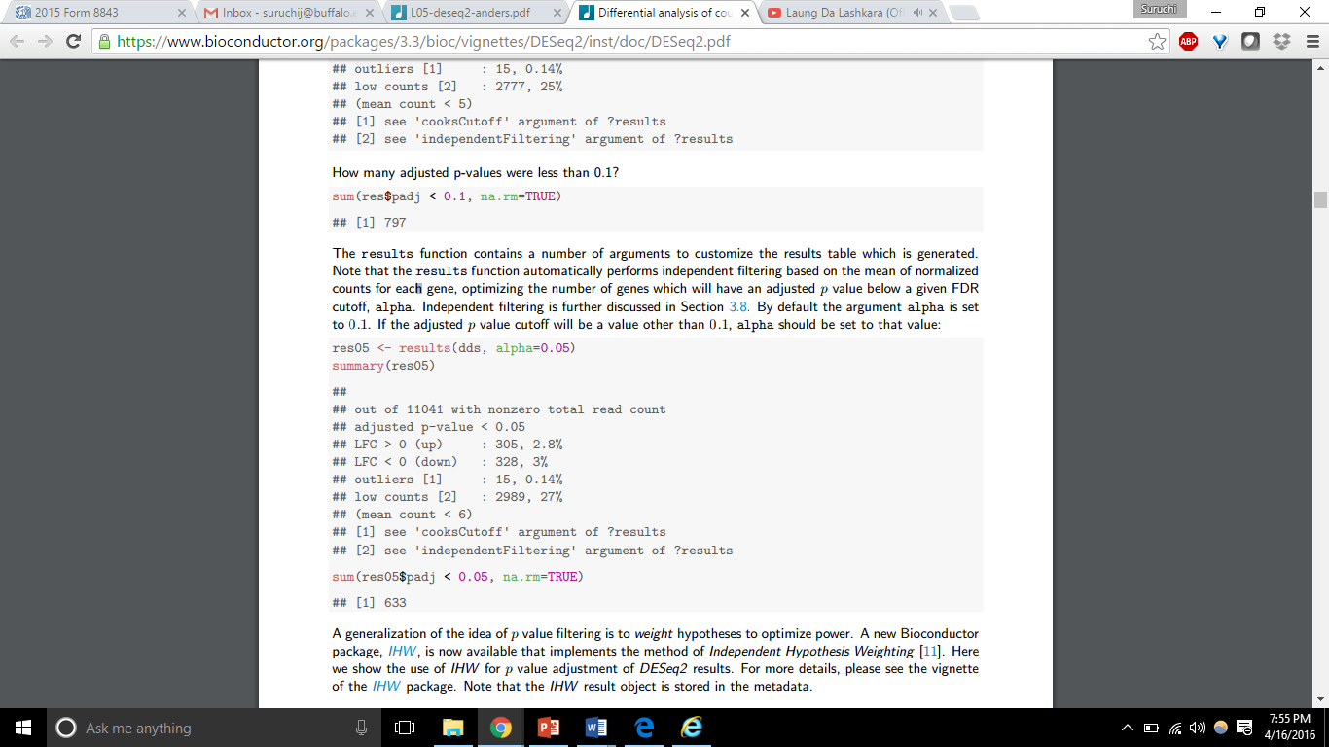
For experiments with many samples, set parallel = TRUE, which distributes computation across cores specified by register function of Bioparallel.
The results can be ordered by the smallest adjusted p-value.
The results function contains a number of arguments to customize the results table which is generated.
The results function automatically performs independent filtering based on the mean of normalized counts for each gene, optimizing the number of genes which will have an adjusted p value below a given FDR cutoff, alpha.
By default the argument alpha is set to 0.1. If the adjusted p value cutoff will be a value other than 0.1, alpha should be set to that value.
A generalization of the idea of p value filtering is to weight hypotheses to optimize power

Slide 7
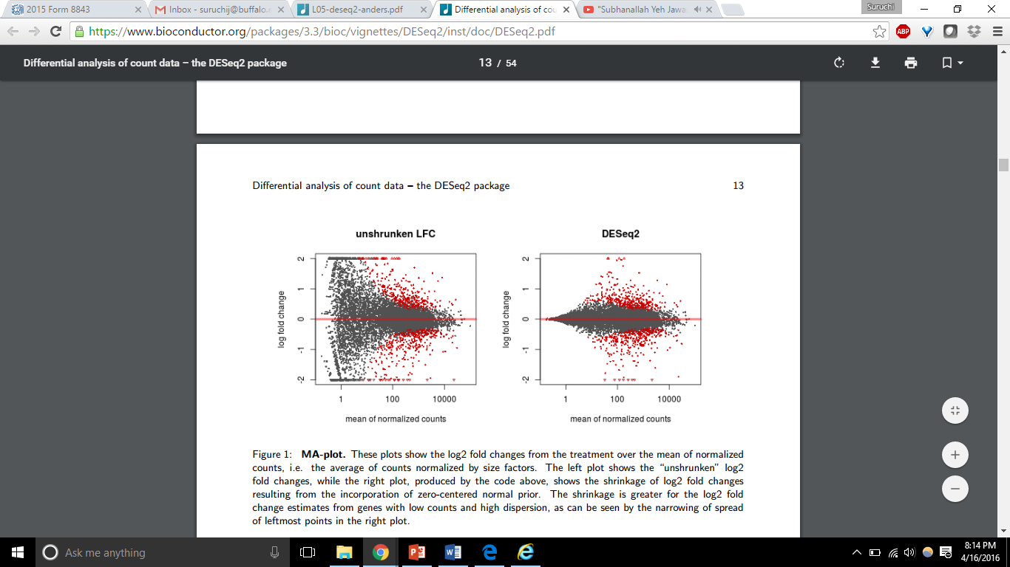
MA - Plot
In DESeq2, the function plotMA shows the log2 fold changes attributable to a given variable over the mean of normalized counts. Points will be colored red if the adjusted p value is less than 0.1. Points which fall out of the window are plotted as open triangles pointing either up or down.
The MA-plot of log2 fold changes returned by DESeq2 allows us to see how the shrinkage of fold changes works for genes with low counts

Slide 8
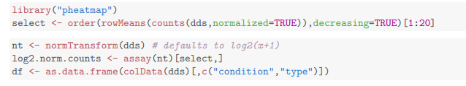
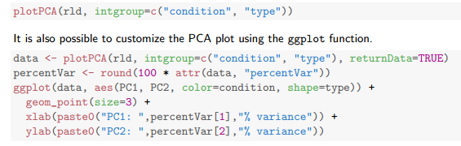
Heat maps can be used to explore a count matrix.
A heat map of the sample to sample distance matrix gives us an overview over similarities and dissimilarities between samples
Principal component analysis can also be performes.

Slide 9
Limma package
Limma is an R package for the analysis of gene expression microarray data, especially the use of linear models for analysing designed experiments and the assessment of differential expression.
Limma provides the ability to analyze comparisons between many RNA targets simultaneously in arbitrary complicated designed experiments. Empirical Bayesian methods are used to provide stable results even when the number of arrays is small. The normalization and data analysis functions are for two-color spotted microarrays. The linear model and differential expression functions apply to all microarray technologies including Affymetrix and other single-channel oligonucleotide platforms.

Slide 10
SVA Package
The sva package contains functions for removing batch effects and other unwanted variation in high throughput experiments.
The sva package contains functions for identifying and building surrogate variables for high-dimensional data sets. Surrogate variables are covariates constructed directly from high-dimensional data (like gene expression/RNA sequencing/methylation/brain imaging data) that can be used in subsequent analyses to adjust for unknown, unmodeled, or latent sources of noise.
The sva package can be used to remove artifacts in two ways:
identifying and estimating surrogate variables for unknown sources of variation in high-throughput experiments and
directly removing known batch effects using ComBat .

Slide 11
Data in the sva package
The first step in using the sva package is to properly format the data and create appropriate model matrices. The data should be a matrix with features (genes, transcripts, voxels) in the rows and samples in the columns. This is the typical genes by samples matrix found in gene expression analyses.
The sva package assumes there are two types of variables that are being considered:
adjustment variables
variables of interest

Slide 12
Differential Expression Analysis
The limma package is one of the most commonly used packages for differential expression analysis. The sva package can easily be used in conjunction with the limma package to perform adjusted differential expression analysis.
The first step in this process is to fit the linear model with the surrogate variables included.
> fit = lmFit(edata,modSv)
The limma functions are used to perform the usual analyses.
As an example, suppose we wanted to calculate differential expression with respect to cancer. To do that we first compute the contrasts between the pairs of cancer/normal terms. We do not include the surrogate variables in the contrasts, since they are only being used to adjust the analysis.
> contrast.matrix <- cbind("C1"=c(-1,1,0,rep(0,svobj$n.sv)),
"C2"=c(0,-1,1,rep(0,svobj$n.sv)),"C3"=c(-1,0,1,rep(0,svobj$n.sv)))
> fitContrasts = contrasts.fit(fit,contrast.matrix)

Slide 13
The ComBat function adjusts for known batches using an empirical Bayesian framework .
To use this function, you must have a known batch variable in your dataset. The SVA package for removing batch effects and other unwanted variation in high-throughput experiments
> batch = pheno$batch
Direct adjustment for batch effects can also be performed using the f.pvalue function.

Slide 14
The goal of the sva is to remove all unwanted sources of variation while protecting the contrasts due to the primary variables included in mod. This leads to the identification of features that are consistently different between groups, removing all common sources of latent variation.
When the number of features is very large (m > 100, 000) both the num.sv and sva functions may be slow, since multiple singular value decompositions of the entire data matrix must be computed. Both functions include a variance filtering term, vfilter, which may be used to speed up the calculation. vfilter must be an integer between 100 and the total number of features m.

