Slide 1
ADLogger: Behavior Modification for ADL Time Management
WellComp suke B4 Mentor: shiba
Notes:
評価項目
問題意識
タイトル：システム解説
文字が多い
4p
あるなし色分け
逆算？
認識のずれ
時間がわかれば見込みが頑張れる
今後の展望

Slide 2
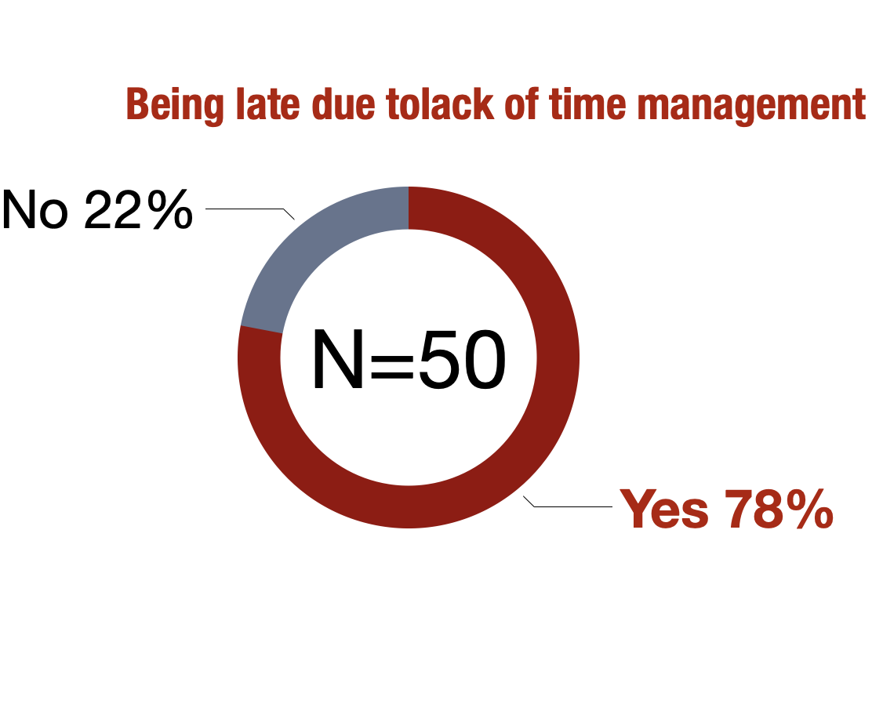

1. Background
Some people have problems with time management
Lack of time management cause problems

Slide 3
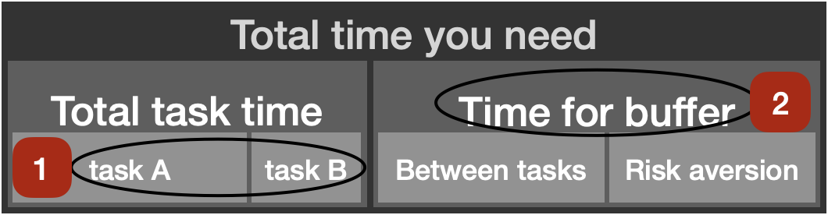
2. Problem
Time management needs 2 factors
Expect time for tasks correctly
Make time for buffer

Slide 4
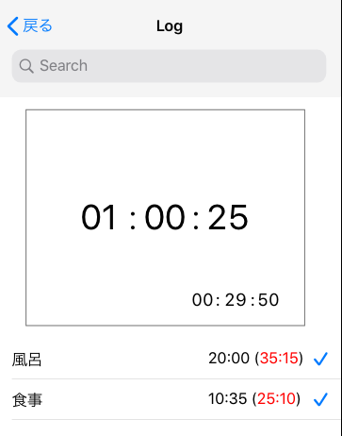

3. Motivation & Approach
Definition of margin time for buffer
$$T_{υ}=\overline{T}+σ\left(T\right) × N$$
$T_{sum}= \sum_{i=1}^{n}{(T_{vi})}$ + a
Visualization using iOS app
Improving time management

Slide 5
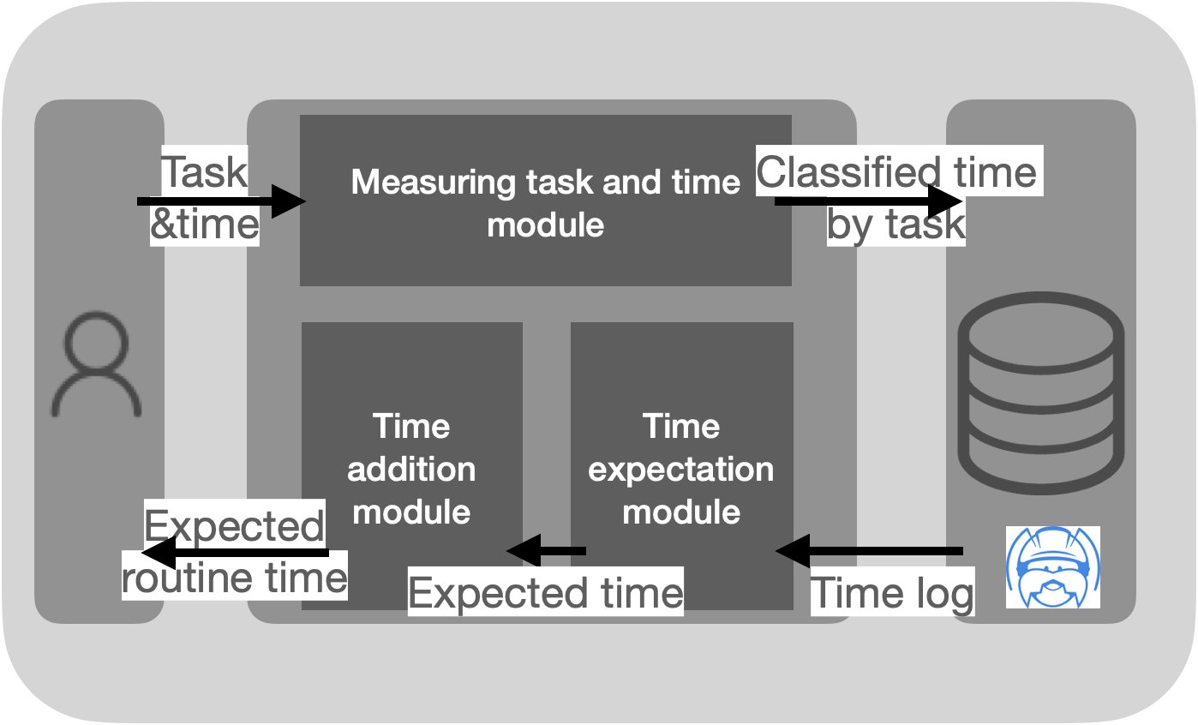
4. System

Slide 6
5. Experiment
20 subjects
Measure time using the app
Compare predicted time and measured time of tasks and buffer

Slide 7
6. Evaluation
Compare how the subjects’ behavior changed because of using visualization
Interview about the app
Now: analyzing the data

Slide 8
6. Why I start the research
I’m not good at time management
Medical Adherence → Self Management → Time Management
→Realize what I want & I can do in 4 years
Chart
4 years are really short
for research
Goal
ability
Music
Healthcare Knowledge
want
English
Art/Design
Communication
Time Management
Fitness
Analysis
Programming

