Slide 1
ADLogger: Behavior Modification for ADL Time Management
WellComp suke B4 Mentor: shiba
Notes:
評価項目
問題意識
タイトル：システム解説
文字が多い
4p
あるなし色分け
逆算？
認識のずれ
時間がわかれば見込みが頑張れる
今後の展望

Slide 2
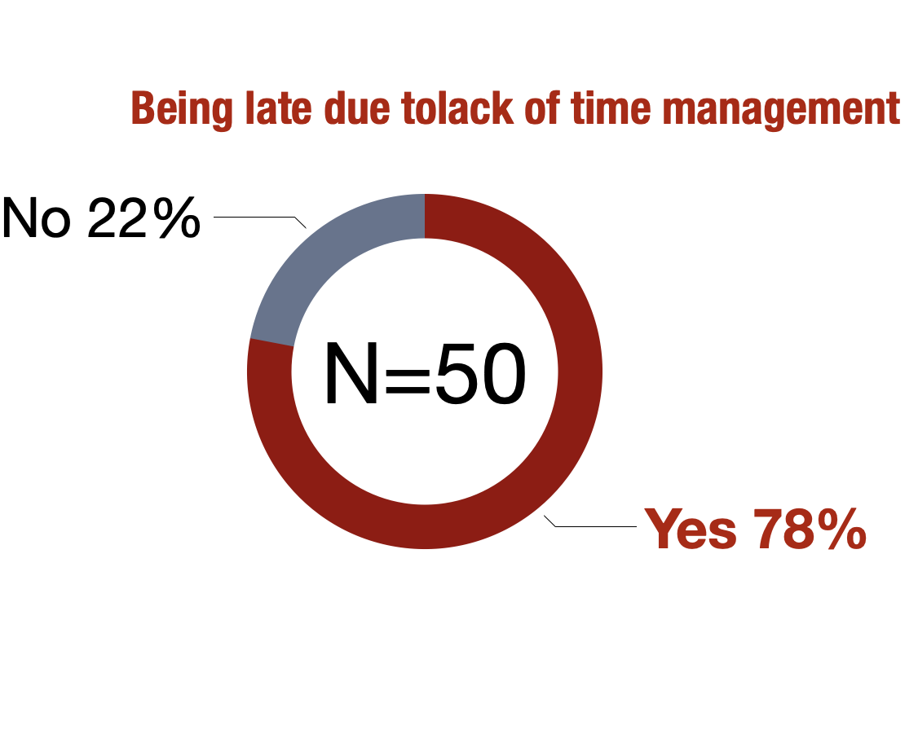

1. Background
Some people have problems with time management
Lack of time management cause problems

Slide 3
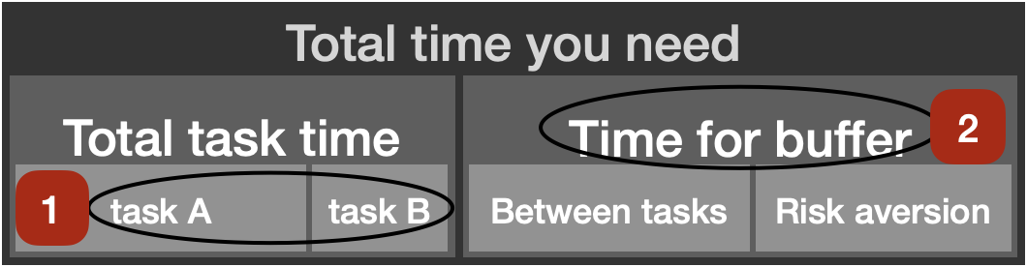
2. Problem
Time management needs 2 factors
Expect time for tasks correctly
Make time for buffer

Slide 4
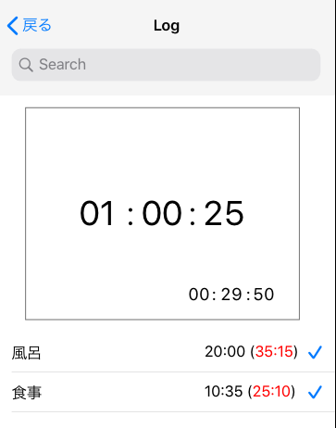

3. Motivation & Approach
Definition of margin time for buffer
$\sum_{i=1}^{n}{(x_{i}−y_{i})}$ +a
$𝓃$=number of tasks $𝓍$=extended time $𝓎$=average time a= buffer
Visualization using iOS app
Improving time management

Slide 5
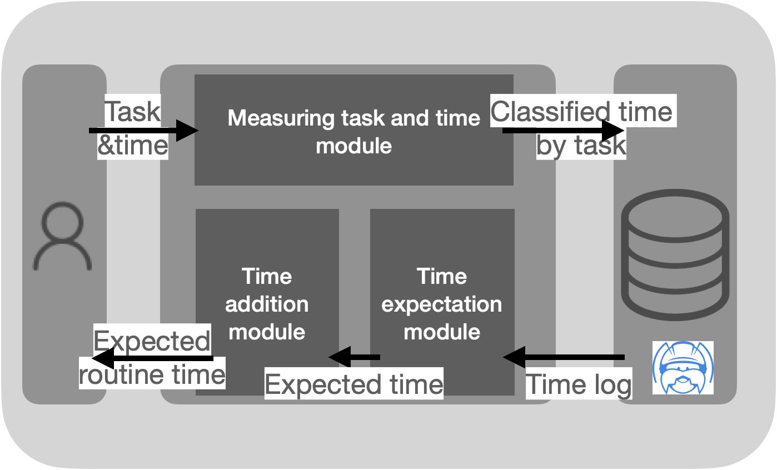
4. System

Slide 6
5. Experiment
10 subjects
Measure time using the app
Compare predicted time and measured time of tasks and buffer

Slide 7
6. Evaluation
Classification using cluster analysis
Compare how the subjects’ behavior changed because of using visualization
Interview about the app

