Slide 1
Introduction to Programming with Python

Slide 2
Recap

Slide 3
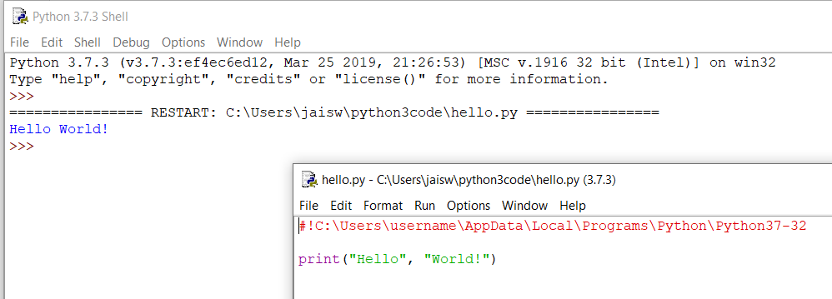

Programming basics
code or source code: The sequence of instructions in a program.
syntax: The set of legal structures and commands that can be used in a particular programming language.
output: The messages printed to the user by a program.
console: The text box onto which output is printed.
  Some source code editors pop up the console as an external window, and others contain their own console window.

Slide 4



Compiling and interpreting
Many languages require you to compile (translate) your program into a form that the machine understands.
Python is instead directly interpreted into machine instructions.
compile
execute
source code
Hello.java
byte code
Hello.class
output
interpret
source code
Hello.py
output

Slide 5
Expressions
expression: A data value or set of operations to compute a value.
  Examples: 1 + 4 * 3
  42
Arithmetic operators we will use:
  + - * / addition, subtraction/negation, multiplication, division
  % modulus, a.k.a. remainder
  ** exponentiation
precedence: Order in which operations are computed.
  * / % ** have a higher precedence than + -
  1 + 3 * 4 is 13
  Parentheses can be used to force a certain order of evaluation.
  (1 + 3) * 4 is 16

Slide 6
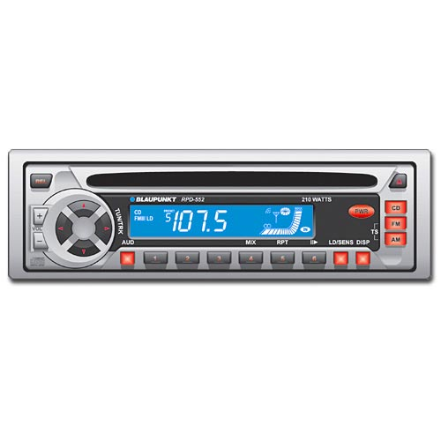
Variables
variable: A named piece of memory that can store a value.
  Usage:
    Compute an expression's result,
    store that result into a variable,
    and use that variable later in the program.
assignment statement: Stores a value into a variable.
  Syntax:
  name = value
  Examples: x = 5
  gpa = 3.14
  x 5 gpa 3.14
  A variable that has been given a value can be used in expressions.
  x + 4 is 9
Exercise: Evaluate the quadratic equation for a given a, b, and c.

Slide 7
print
print : Produces text output on the console.
Syntax:
  print "Message"
  print Expression
  Prints the given text message or expression value on the console, and moves the cursor down to the next line.
  print Item1, Item2, ..., ItemN
  Prints several messages and/or expressions on the same line.
Examples:
  print("Hello, world!“)
  age = 45
  print("You have", 65 - age, "years until retirement“)
  Output:
  Hello, world!
  You have 20 years until retirement

Slide 8
input
input : Reads a number from user input.
  You can assign (store) the result of input into a variable.
  Example:
  age = input("How old are you? ")
  print("Your age is", age)
  print("You have", 65 – int(age), "years until retirement“)
  Output:
  How old are you? 53
  Your age is 53
  You have 12 years until retirement
Exercise: Write a Python program that prompts the user for his/her amount of money, then reports how many Xbox the person can afford, and how much more money he/she will need to afford an additional Xbox. Assume latest xBox one price $ 450

Slide 9
99 Bottles
99 bottles of beer on the wall!
99 bottles of beer!
Take one down
And pass it around
98 bottles of beer on the wall!
98 bottles of beer on the wall!
98 bottles of beer!
Take one down
And pass it around
97 bottles of beer on the wall!
....
1 bottle of beer on the wall!
1 bottle of beer!
Take it down
And pass it around
No more bottles of beer on the wall!

Slide 10
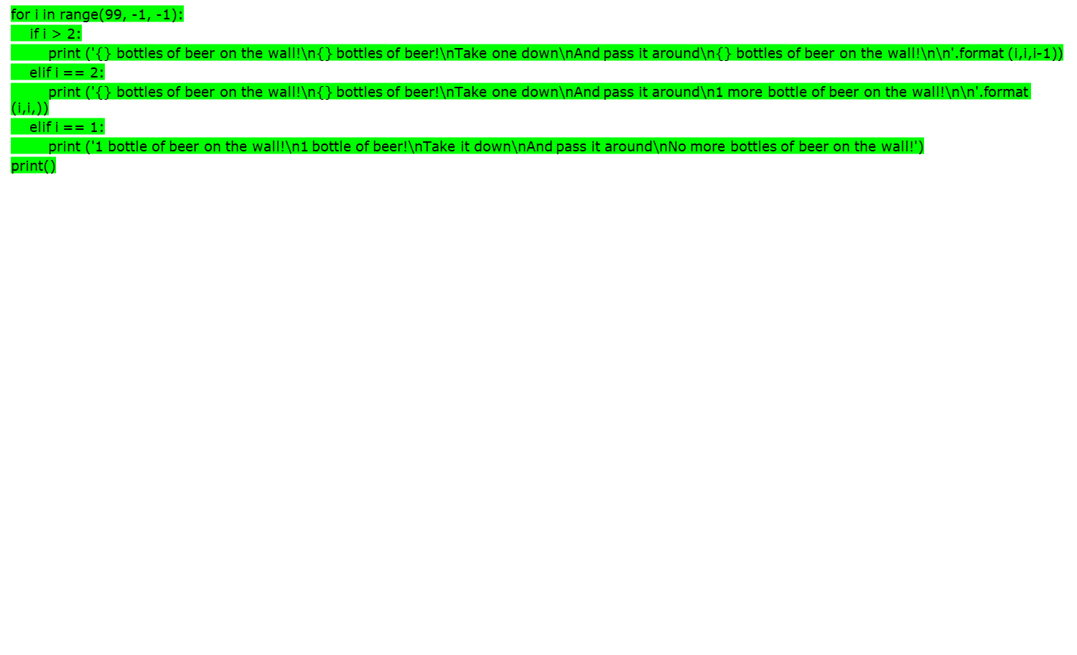
99 Bottles

Slide 11
UI

Slide 12
What is a Module?
Consider a module to be the same as a code library.
A file containing a set of functions you want to include in your application.
Example- How to create module
Save this code in a file named
  File :mymodule.py
  def greeting(name):
  print("Hello, " + name)
Example- How to use module
File : usemymodule.py
import mymodule as mm
mm.greeting("Jonathan")

Slide 13
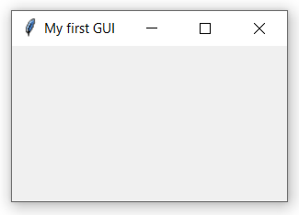
tkinter module ?
Tkinter is the standard GUI library for Python. Python when combined with Tkinter provides a fast and easy way to create GUI applications. Tkinter provides a powerful object-oriented interface to the Tk GUI toolkit.
File :createwindow.py
  import tkinter as tk
  window = tk.Tk()
  window.title("My first GUI")
  window.geometry("800x600")
  window.mainloop()

Slide 14
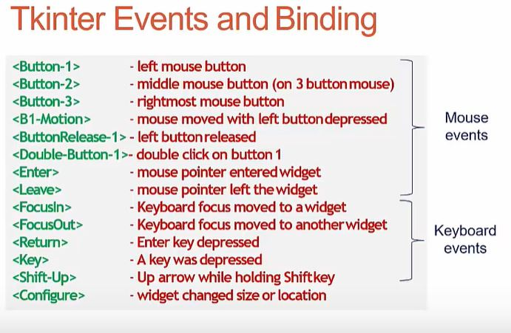
tkinter events ?

Slide 15
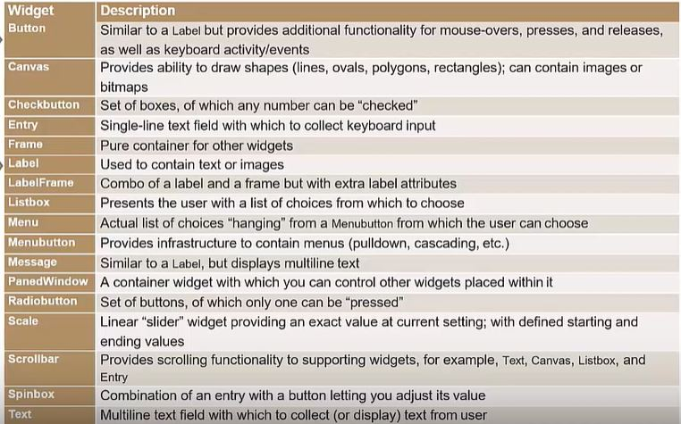
tkinter widgets ?

Slide 16
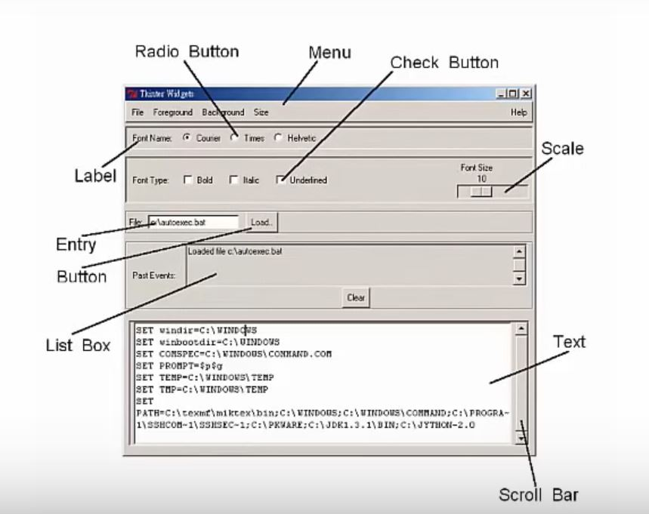
tkinter widgets ?

Slide 17
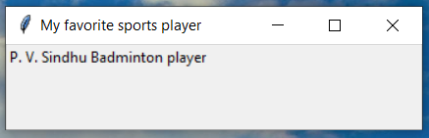
tkinter module-label ?
Label
A label is a class in Tkinter which is used to display text or image. It is a widget that the user just views but does not interact with.
File :label.py
  import tkinter as tk
  window=tk.Tk()
  window.title("My favorite sports player")
  window.geometry("300x200")
  mylabel=tk.Label(text="P. V. Sindhu Badminton player")
  mylabel.grid(column=0,row=0)
  window.mainloop()

Slide 18
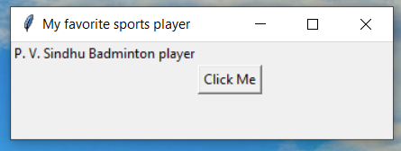
tkinter module -buttons?
Buttons
The Button widget is used to display the buttons in your application.
File :button.py
  import tkinter as tk
  window=tk.Tk()
  window.title("My favorite sports player")
  window.geometry("300x200")
  mylabel=tk.Label(text="P. V. Sindhu Badminton player")
  mylabel.grid(column=0,row=0)
  button_name = tk.Button(window, text = "Click Me")
  button_name.grid(column=3,row=3)
  window.mainloop()

Slide 19
App1-You rang the doorbell

Slide 20
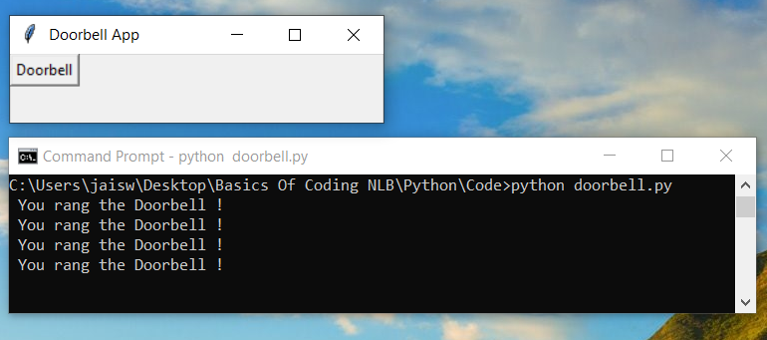
You rang the doorbell
Let’s try an example to see how we can do these. We will create a doorbell app. When you click the button, it will print ‘You rang the doorbell’ on the window
parameter <Button-1> is the left
click short key of the mouse.
File :doorbell.py
  import tkinter as tk
  def doorbell(event):
  print(" You rang the Doorbell !")
  window = tk.Tk()
  window.title(" Doorbell App")
  window.geometry("300x200")
  mybutton = tk.Button(window, text = "Doorbell")
  mybutton.grid(column=1,row=0)
  mybutton.bind("<Button-1>",doorbell)
  window.mainloop()

Slide 21
App2-Regisration Form

Slide 22
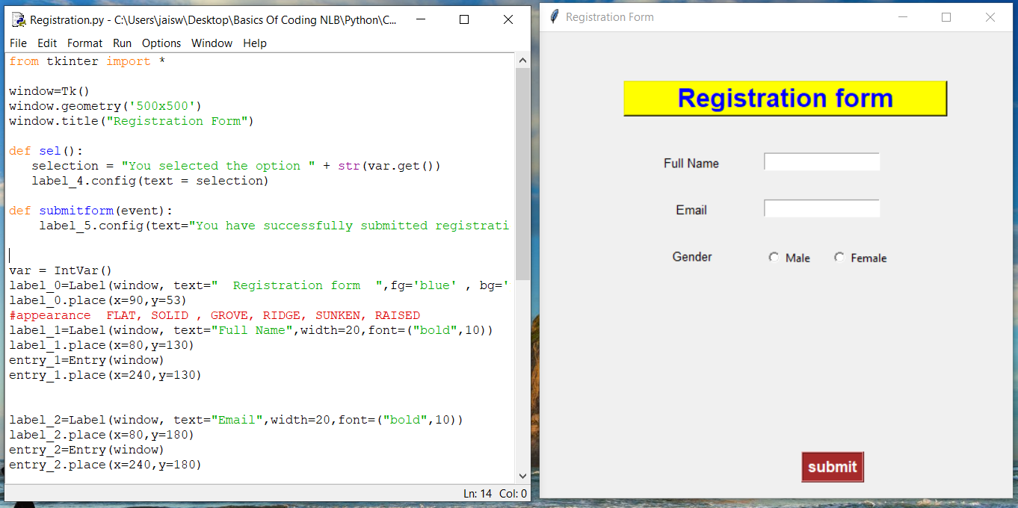
Registration Form

Slide 23
Registration Form
  from tkinter import *
  window=Tk()
  window.geometry('500x500')
  window.title("Registration Form")
  def sel():
  selection = "You selected the option " + str(var.get())
  label_4.config(text = selection)
  def submitform(event):
  label_5.config(text="You have successfully submitted registration form")
  var = IntVar()
  label_0=Label(window, text=" Registration form ",fg='blue' , bg='yellow', relief=RAISED, width=20,font=("arial",20,"bold"))
  label_0.place(x=90,y=53)
  #appearance FLAT, SOLID , GROVE, RIDGE, SUNKEN, RAISED
  label_1=Label(window, text="Full Name",width=20,font=("bold",10))
  label_1.place(x=80,y=130)
  entry_1=Entry(window)
  entry_1.place(x=240,y=130)
  label_2=Label(window, text="Email",width=20,font=("bold",10))
  label_2.place(x=80,y=180)
  entry_2=Entry(window)
  entry_2.place(x=240,y=180)

Slide 24
Registration Form
  label_3=Label(window, text="Gender",width=20,font=("bold",10))
  label_3.place(x=80,y=230)
  r1=Radiobutton(window, text="Male", variable=var, value=1,command=sel)
  r1.place(x=240,y=230)
  r2=Radiobutton(window, text="Female", variable=var, value=2,command=sel)
  r2.place(x=310,y=230)
  label_4 = Label(window)
  label_4.place(x=250,y=260)
  label_5 = Label(window)
  label_5.place(x=100,y=360)
  button_1=Button(window, text="submit", fg='white',bg='brown', relief=RIDGE, font=("arial",12,"bold"))
  button_1.place(x=280, y=450)
  button_1.bind("<Button-1>",submitform)
  ##GROVE, RIDGE, SUNKEN, RAISED
  window.mainloop()

Slide 25
App3-My Social Media

Slide 26
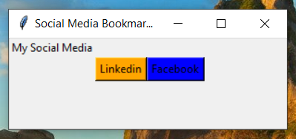
My Social Media

Slide 27
My Social Media
  import tkinter as tk
  import webbrowser
  def linkedin(event):
  webbrowser.open_new_tab('https://www.linkedin.com/in/linkedinuserid/')
  def facebook(event):
  webbrowser.open_new_tab('https://www.facebook.com/facebookuserid')
  window=tk.Tk()
  window.geometry("300x200")
  window.title("Social Media Bookmark App")
  label1=tk.Label(text="My Social Media")
  label1.grid(column=0,row=0)
  button1=tk.Button(window,text="Linkedin",bg="orange")
  button1.grid(column=1,row=1)
  button2=tk.Button(window,text="Facebook",bg="blue")
  button2.grid(column=3,row=1)
  button1.bind("<Button-1>",linkedin)
  button2.bind("<Button-1>",facebook)
  window.mainloop()

Slide 28
Repetition (loops) and Selection (if/else)

Slide 29
The for loop
for loop: Repeats a set of statements over a group of values.
  Syntax:
  for variableName in groupOfValues:
  statements
    We indent the statements to be repeated with tabs or spaces.
    variableName gives a name to each value, so you can refer to it in the statements.
    groupOfValues can be a range of integers, specified with the range function.
  Example:
  for x in range(1, 6):
  print(x, "squared is", x * x)
  Output:
  1 squared is 1
  2 squared is 4
  3 squared is 9
  4 squared is 16
  5 squared is 25

Slide 30
range
The range function specifies a range of integers:
    range(start, stop) - the integers between start (inclusive)
    and stop (exclusive)
  It can also accept a third value specifying the change between values.
    range(start, stop, step) - the integers between start (inclusive)
    and stop (exclusive) by step
  Example:
  for x in range(5, 0, -1):
  print x
  print "Blastoff!"
  Output:
  5
  4
  3
  2
  1
  Blastoff!
  Exercise: How would we print the "99 Bottles of Beer" song?

Slide 31
Cumulative loops
Some loops incrementally compute a value that is initialized outside the loop. This is sometimes called a cumulative sum.
  sum = 0
  for i in range(1, 11):
  sum = sum + (i * i)
  print("sum of first 10 squares is", sum)
  Output:
  sum of first 10 squares is 385
Exercise: Write a Python program that computes the factorial of an integer.

Slide 32

if
if statement: Executes a group of statements only if a certain condition is true. Otherwise, the statements are skipped.
  Syntax:
  if condition:
  statements
Example:
  gpa = 3.4
  if gpa > 2.0:
  print "Your application is accepted."

Slide 33
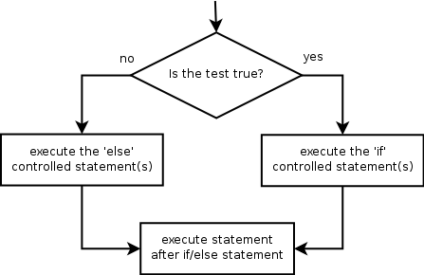

if/else
if/else statement: Executes one block of statements if a certain condition is True, and a second block of statements if it is False.
  Syntax:
  if condition:
  statements
  else:
  statements
Example:
  gpa = 1.4
  if gpa > 2.0:
  print "Welcome to Mars University!"
  else:
  print "Your application is denied."
Multiple conditions can be chained with elif ("else if"):
  if condition:
  statements
  elif condition:
  statements
  else:
  statements

Slide 34
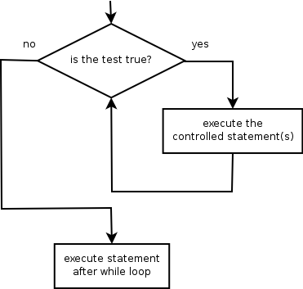
while
while loop: Executes a group of statements as long as a condition is True.
  good for indefinite loops (repeat an unknown number of times)
Syntax:
  while condition:
  statements
Example:
  number = 1
  while number < 200:
  print number,
  number = number * 2
  Output:
  1 2 4 8 16 32 64 128

Slide 35
Logic
Many logical expressions use relational operators:
Logical expressions can be combined with logical operators:
Exercise: Write code to display and count the factors of a number.
Operator | Meaning | Example | Result
== | equals | 1 + 1 == 2 | True
!= | does not equal | 3.2 != 2.5 | True
< | less than | 10 < 5 | False
> | greater than | 10 > 5 | True
<= | less than or equal to | 126 <= 100 | False
>= | greater than or equal to | 5.0 >= 5.0 | True
Operator | Example | Result
and | 9 != 6 and 2 < 3 | True
or | 2 == 3 or -1 < 5 | True
not | not 7 > 0 | False

Slide 36
Text and File Processing

Slide 37
Strings
string: A sequence of text characters in a program.
  Strings start and end with quotation mark " or apostrophe ' characters.
  Examples:
  "hello"
  "This is a string"
  "This, too, is a string. It can be very long!"
A string may not span across multiple lines or contain a " character.
"This is not
a legal String."
"This is not a "legal" String either."
A string can represent characters by preceding them with a backslash.
  \t tab character
  \n new line character
  \" quotation mark character
  \\ backslash character
  Example: "Hello\tthere\nHow are you?"

Slide 38
Indexes
Characters in a string are numbered with indexes starting at 0:
  Example:
  name = "P. Diddy"
Accessing an individual character of a string:
  variableName [ index ]
  Example:
  print name, "starts with", name[0]
  Output:
  P. Diddy starts with P
index | 0 | 1 | 2 | 3 | 4 | 5 | 6 | 7
character | P | . |  | D | i | d | d | y

Slide 39
String properties
len(string) - number of characters in a string
(including spaces)
str.lower(string) - lowercase version of a string
str.upper(string) - uppercase version of a string
Example:
name = "Martin Douglas Stepp"
length = len(name)
big_name = str.upper(name)
print big_name, "has", length, "characters"
Output:
MARTIN DOUGLAS STEPP has 20 characters

Slide 40
raw_input
raw_input : Reads a string of text from user input.
  Example:
  name = raw_input("Howdy, pardner. What's yer name? ")
  print name, "... what a silly name!"
  Output:
  Howdy, pardner. What's yer name? Paris Hilton
  Paris Hilton ... what a silly name!

Slide 41
Text processing
text processing: Examining, editing, formatting text.
  often uses loops that examine the characters of a string one by one
A for loop can examine each character in a string in sequence.
  Example:
  for c in "booyah":
  print c
  Output:
  b
  o
  o
  y
  a
  h

Slide 42
Strings and numbers
ord(text) - converts a string into a number.
  Example: ord("a") is 97, ord("b") is 98, ...
  Characters map to numbers using standardized mappings such as ASCII and Unicode.
chr(number) - converts a number into a string.
  Example: chr(99) is "c"
Exercise: Write a program that performs a rotation cypher.
  e.g. "Attack" when rotated by 1 becomes "buubdl"

Slide 43
File processing
Many programs handle data, which often comes from files.
Reading the entire contents of a file:
  variableName = open("filename").read()
  Example:
  file_text = open("bankaccount.txt").read()

Slide 44
Line-by-line processing
Reading a file line-by-line:
  for line in open("filename").readlines():
  statements
  Example:
  count = 0
  for line in open("bankaccount.txt").readlines():
  count = count + 1
  print "The file contains", count, "lines."
Exercise: Write a program to process a file of DNA text, such as:
  ATGCAATTGCTCGATTAG
  Count the percent of C+G present in the DNA.

Slide 45
Graphics

Slide 46
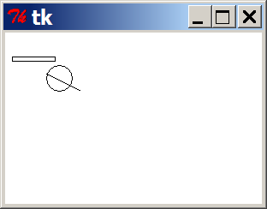
DrawingPanel
To create a window, create a drawingpanel and its graphical pen, which we'll call g :
  from drawingpanel import *
  panel = drawingpanel(width, height)
  g = panel.get_graphics()
  ... (draw shapes here) ...
  panel.mainloop()
The window has nothing on it, but we can draw shapes and
lines on it by sending commands to g .
  Example:
  g.create_rectangle(10, 30, 60, 35)
  g.create_oval(80, 40, 50, 70)
  g.create_line(50, 50, 90, 70)

Slide 47
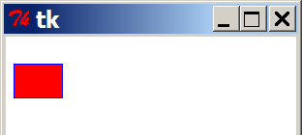
Graphical commands
Command | Description
g.create_line(x1, y1, x2, y2) | a line between (x1, y1), (x2, y2)
g.create_oval(x1, y1, x2, y2) | the largest oval that fits in a box with top-left corner at (x1, y1) and bottom-left corner at (x2, y2)
g.create_rectangle(x1, y1, x2, y2) | the rectangle with top-left corner at (x1, y1), bottom-left at (x2, y2)
g.create_text(x, y, text="text") | the given text at (x, y)
The above commands can accept optional outline and fill colors.
  g.create_rectangle(10, 40, 22, 65, fill="red", outline="blue")
The coordinate system is y-inverted:
  (0, 0)
  (200, 100)

Slide 48
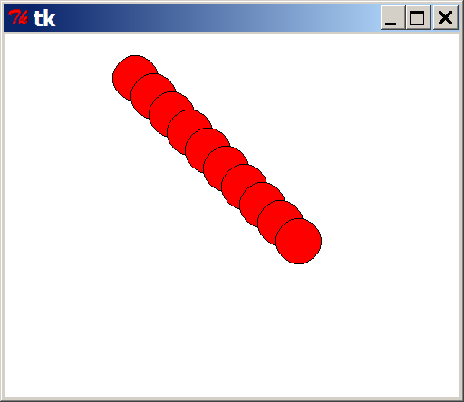
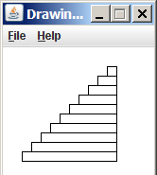
Drawing with loops
We can draw many repetitions of the same item at different x/y positions with for loops.
  The x or y assignment expression contains the loop counter, i, so that in each pass of the loop, when i changes, so does x or y.
  from drawingpanel import *
  window = drawingpanel(500, 400)
  g = window.get_graphics()
  for i in range(1, 11):
  x = 100 + 20 * i
  y = 5 + 20 * i
  g.create_oval(x, y, x + 50, y + 50, fill="red")
  window.mainloop()
Exercise: Draw the figure at right.

Slide 49
What's Next?

