Slide 1
Name: R.SURUTHI
NM id: au730321104056
Reg. No: 730321104056
Year: III
Department: BE/COMPUTER SCIENCE AND ENGINEERING
College Name: BUILDERS ENGINEERING COLLEGE
3/21/2024
Annual Review
1

Slide 2
PROJECT TITLE
DRONE-DETECTION
3/21/2024
Annual Review
2

Slide 3

Types of Drones
Potential Risks Posed by Drones
Drone Detection Technologies
Regulatory Landscape
Challenges and Limitations
Case Studies
Countermeasures and Response Strategies
Future Trends
Q&A and Discussion
AGENDA
3/21/2024
Annual Review
3

Slide 4

PROBLEM STATEMENT
Despite the increasing prevalence of drones across various sectors, there exists a critical need for effective drone detection systems to mitigate the potential risks they pose.
The lack of robust detection technologies and comprehensive regulatory frameworks has resulted in challenges such as privacy violations, security breaches, and safety concerns.
Addressing these challenges requires a multifaceted approach that encompasses advancements in detection technologies, regulatory measures, and response strategies.
3/21/2024
Annual Review
4

Slide 5

PROJECT OVERVIEW
Object
Develop and deploy effective drone detection systems to mitigate risks associated with the proliferation of drones.
Scope
Evaluate existing drone detection technologies and regulatory frameworks to identify gaps and opportunities.
Develop and test innovative detection solutions tailored to specific environments and threats.
Collaborate with stakeholders to implement and optimize drone detection systems for real-world applications.
Expected Outcomes:
Enhanced situational awareness and security against unauthorized drone activities.
Improved regulatory compliance and public safety in areas vulnerable to drone-related risks.
Establishment of a scalable and adaptable framework for ongoing drone detection efforts.
3/21/2024
Annual Review
5

Slide 6

WHO ARE THE END USERS?
Law Enforcement Agencies
Military and Defense
Critical Infrastructure Operators
Event Organizers and Venue Operators
3/21/2024
Annual Review
6

Slide 7

SOLUTION AND ITS VALUE PROPOSITION
Solution:
Advanced drone detection technology offers real-time monitoring and threat identification, enhancing security and safety for diverse environments.
Value Proposition:
The implementation of drone detection systems provides proactive defense against unauthorized drone activities, ensuring protection for critical assets and public gatherings.
3/21/2024
Annual Review
7

Slide 8

THE WOW IN SOLUTION
Cutting-edge AI Algorithms for Swift and Accurate Drone Identification
Integration of Multi-Sensor Fusion Technology
Seamless Interoperability and Rapid Deployment Capabilities
Autonomous Countermeasure Capabilities
Continuous Innovation and Adaptation
3/21/2024
Annual Review
8

Slide 9
MODELLING
Relationships:
Sensor Technology Integration: Examining how various sensor technologies, such as radar, acoustic, and optical sensors, can be integrated to provide comprehensive coverage and accurate detection of drones.
Data Fusion Techniques: Modeling how data fusion techniques can be employed to combine information from different sensors to improve detection accuracy and minimize false alarms.
AI and Machine Learning Algorithms: Investigating the use of AI and machine learning algorithms for drone detection, including training models on large datasets to enhance the system's ability to identify drones amidst complex environments.
3/21/2024
Annual Review
9

Slide 10
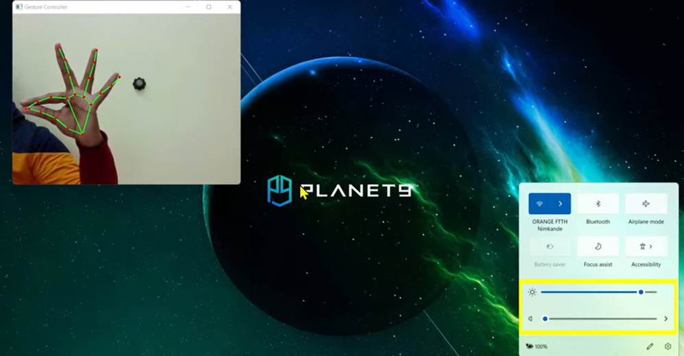
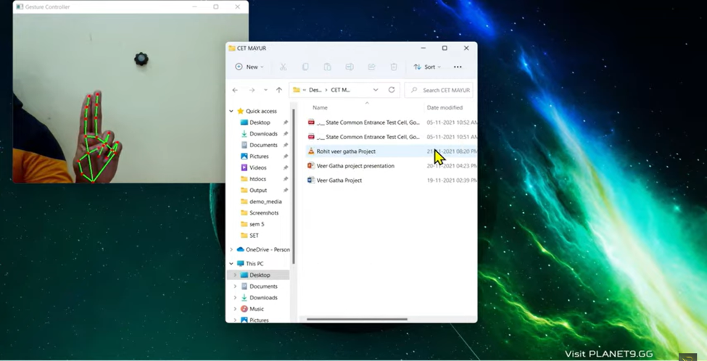
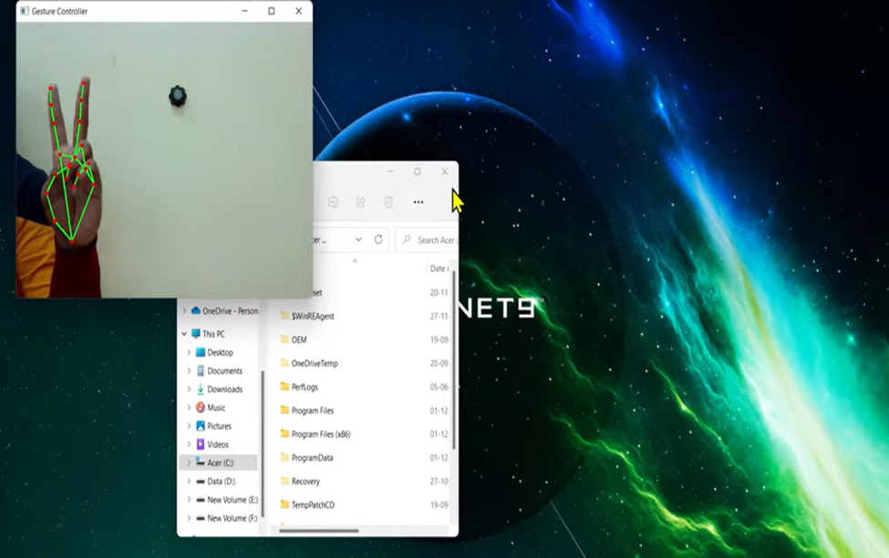
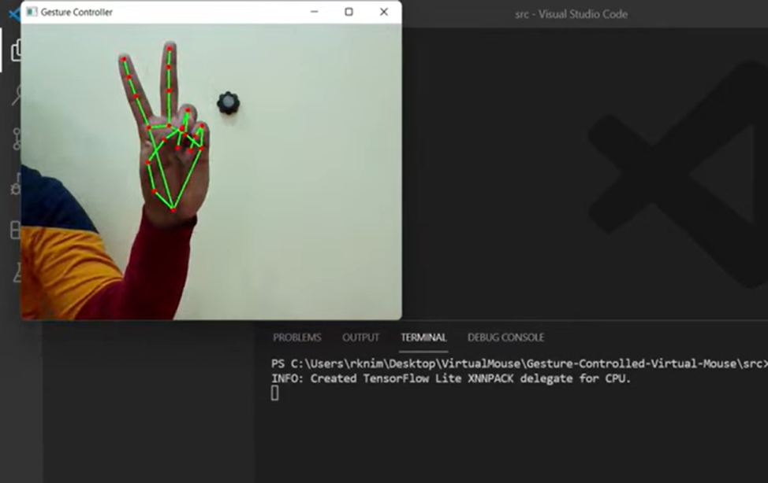
RESULTS
https://colab.research.google.com/drive/1jzrh-ftlXzI-8ips_sNFHjwz-42C64XF#scrollTo=w66R4goW4Bl1&line=346&uniqifier=1
3/21/2024
Annual Review

