Slide 1

EDUCATION
SUNDHARAVADIVU

Slide 2
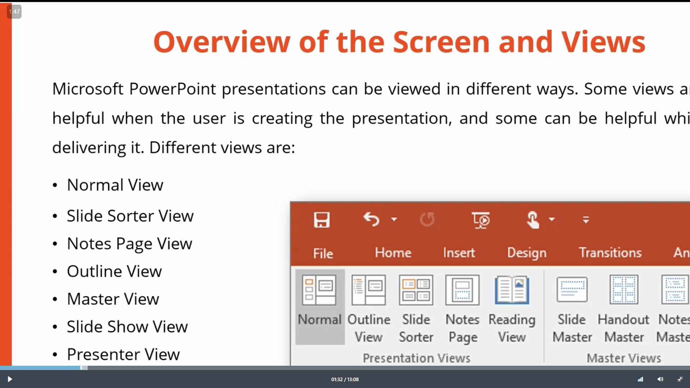

Table
 | Category 1 | Category 2 | Category 3 | Category 4
Item 1 | 4.5 | 2.3 | 1.7 | 5
Item 2 | 3.2 | 5.1 | 4.4 | 3
Item 3 | 2.1 | 1.7 | 2.5 | 2.8
Item 4 | 4.5 | 2.2 | 1.7 | 7

Slide 3

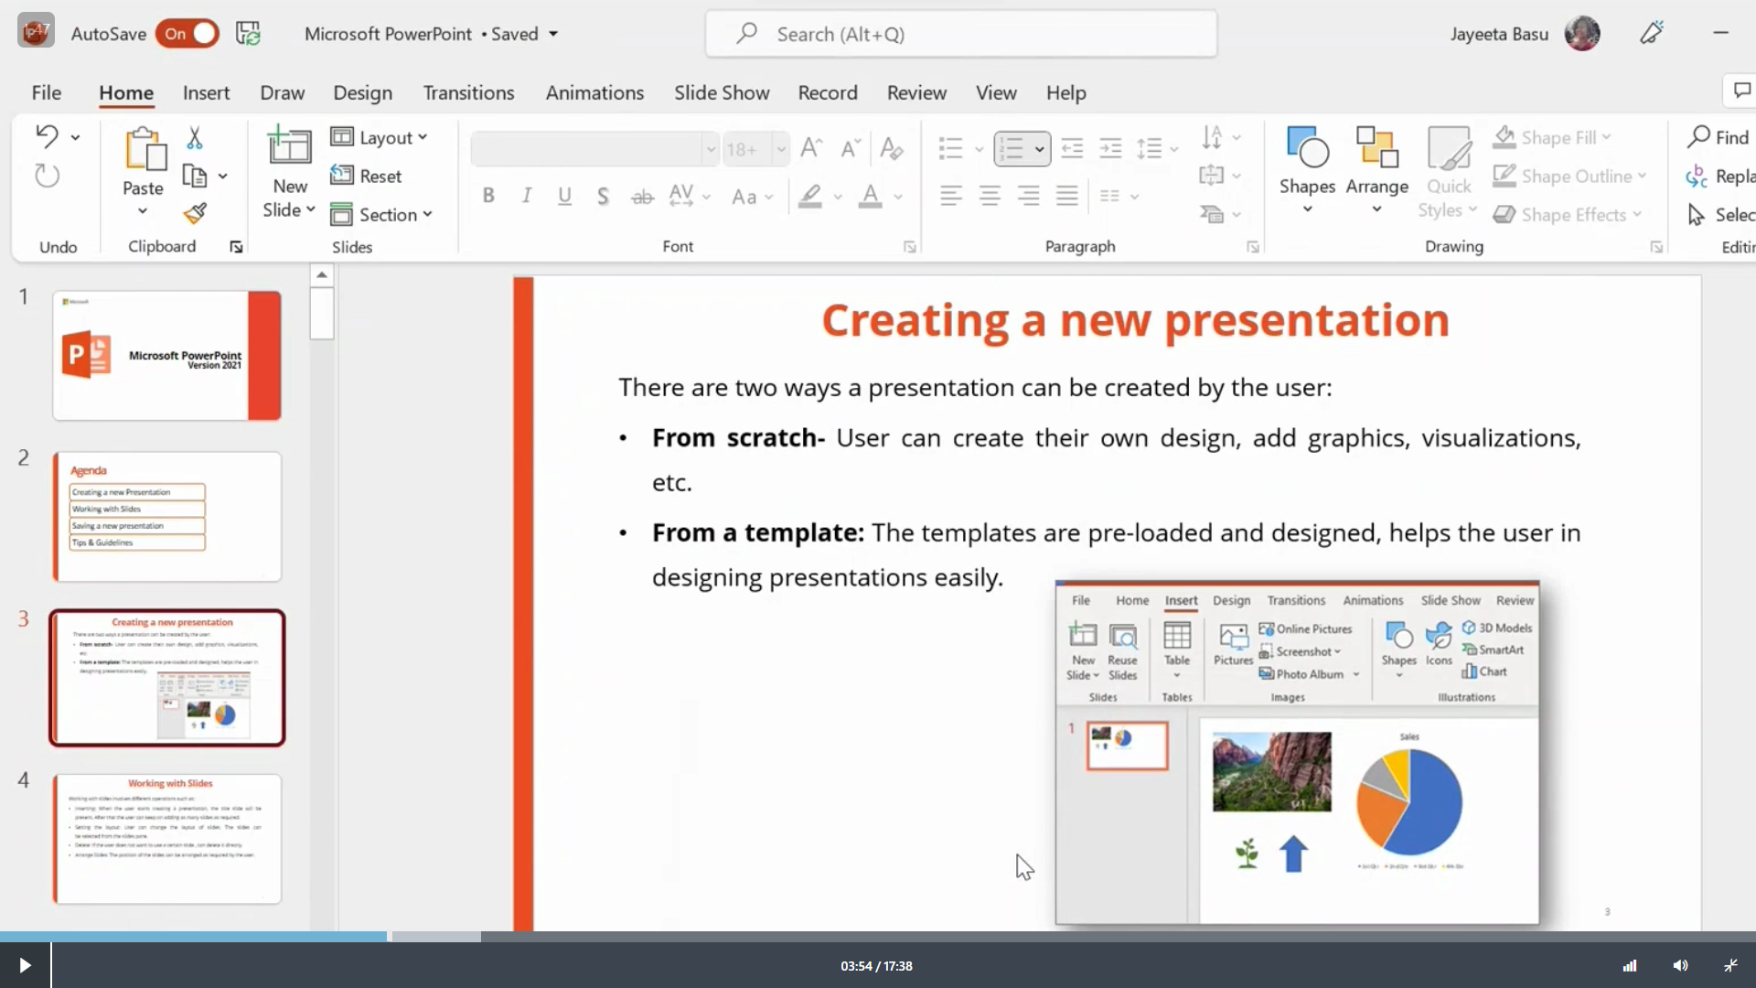
The way to get started is to quit talking and begin doing.
Walt Disney

Slide 4
Creating a new presentation
From a template

Slide 5
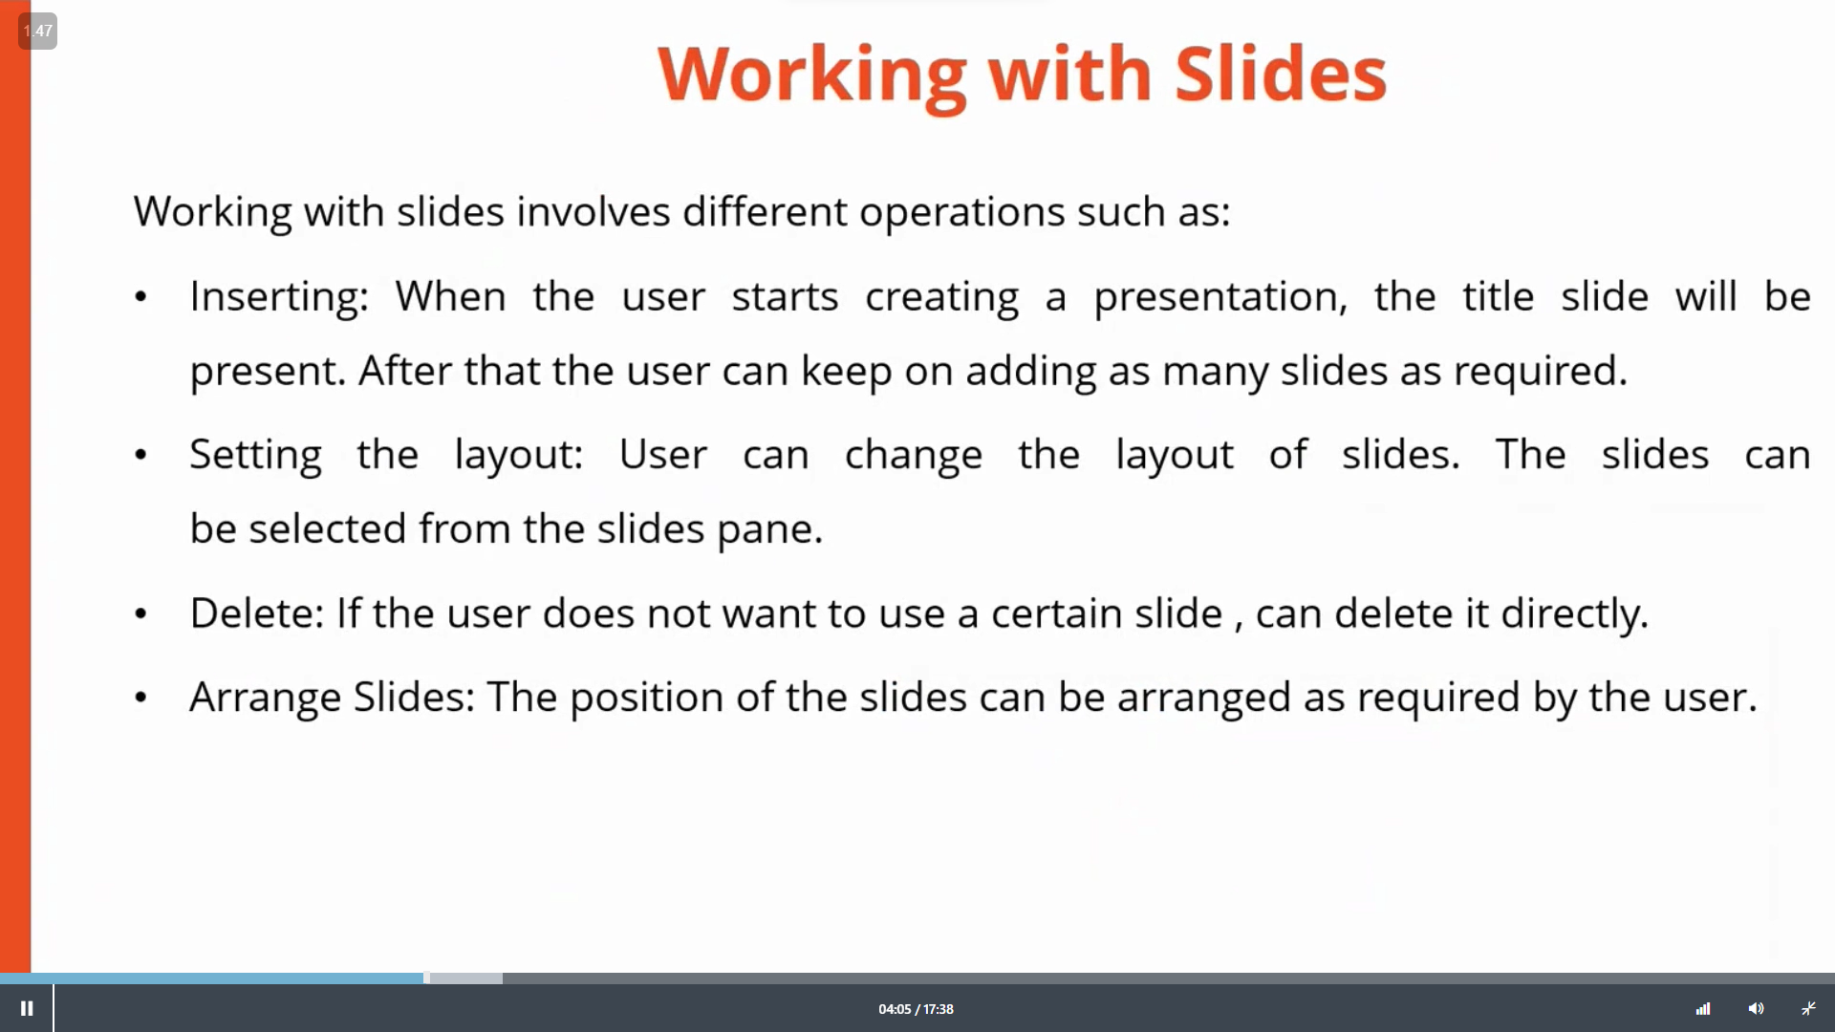
Team
Name Title
Name Title
Name Title
Name Title

Slide 6
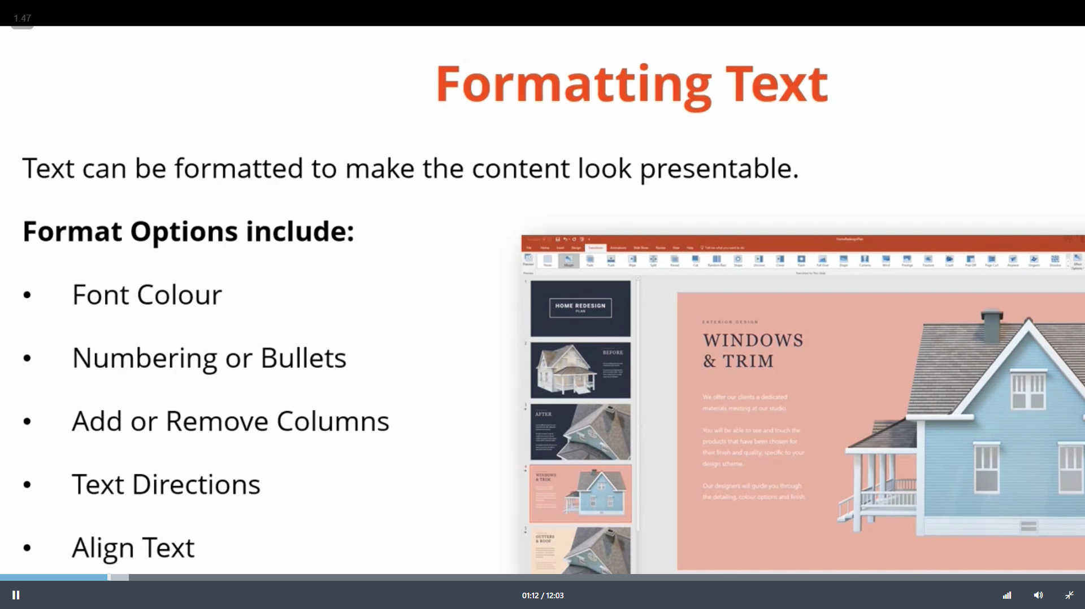
Timeline
Title
To start a presentation, go to the Slide Show tab, and select From Beginning.
Title
To display Presenter view, in Slide Show view, on the control bar at the bottom left select the three dots, and then Show Presenter View.
Title
During your presentation, the speaker notes are visible on your monitor, but aren't visible to the audience.
Title
Title
The Notes pane is a box that appears below each slide. Tap it to add notes.
If you don’t see the Notes pane or it is completely minimized, click Notes on the task bar across the bottom of the PowerPoint window.

