Slide 1
ECG Image Digitization
Group 2/B: Bohan Chen, Ansh Goyal, Mateo Gurria, Suruthikha Vijay

Slide 2
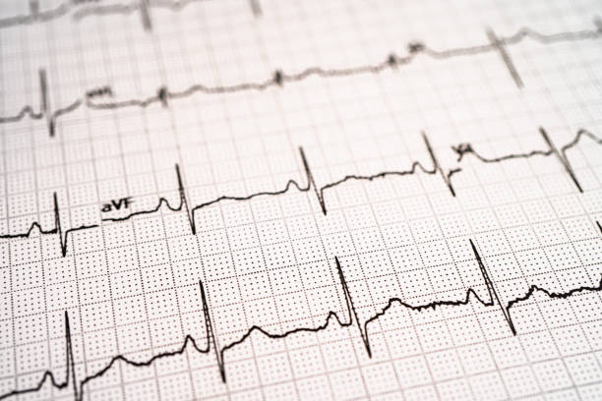
Background
ECGs are often printed on ECG thermal paper
  Reliable, Standardized, Widely Used
Increased need for digitalization
  Digital/Electronic health records & storage
  Potential support for AI/ML analysis
Task: Reconstruct a true 12-lead ECG signal from an image of a paper/scanned/photographed ECG
  Baseline: Replicating the image-processing pipeline from Baydoun et al. (2019)
  Benchmarks: SignalSavants (1st place, SNR 12.15) and WAVIE (3rd place, SNR 5.469)
Today: Formalizing our evaluation metric, digging into a real distortion dataset, and laying out a subgroup analysis plan
Notes:
ECGs are still commonly printed on thermal paper, and that isn’t going away anytime soon.
It’s reliable, standardized, and clinicians are trained to read it directly off the page.
That creates a real problem for digital health records and for any AI or ML analysis, since most computerized tools need a time series signal, not a picture of one.
Our task is to take an image of a paper, scanned, or photographed ECG and reconstruct the actual 12-lead signal behind it.
For our baseline, we’re replicating the pipeline from Baydoun et al. from 2019.
We’re benchmarking ourselves against two PhysioNet Challenge 2024 winners, SignalSavants at SNR 12.15 for first place, and WAVIE at 5.469 for third.
Today we’re formalizing how we’ll measure our own performance, digging into a real distortion dataset instead of only synthetic data, and laying out our subgroup analysis plan.

Slide 3
Comparison of Approaches
Baydoun et al. (2019)
Five Stage MATLAB Pipeline:
  ROI detection
  Otsu thresholding
  Connected-component labeling
  Hough-based trace reconstruction
  Post-processing
Evaluated via Pearson correlation (0.952 avg. across 30 ECGs)
SignalSavants (Oxford)
Three Stage Python Pipeline:
  Hough Transform rotation
  nnU-Net segmentation
  column-wise vectorization
Classical CV for rotation, deep learning only for segmentation
Evaluated by signal to noise ratio
SNR 12.15, 1st place in Physionet Challenge
WAVIE (Auckland)
Four Stage Python Pipeline
  Learned rotation correction
  nnU-Net segmentation
  YOLOv5s lead localization
  OpenCV digitization
Modular, 4 trained models
Evaluated by signal to noise ratio
SNR 5.469, 3rd place in Physionet Challenge
Notes:
This slide puts all three methods side by side so we can talk about them as one family of approaches.
Baydoun’s baseline is a five stage MATLAB pipeline: detect regions of interest, threshold with Otsu’s method, label connected components, reconstruct the trace with the Hough transform, then post-process.
It’s evaluated with Pearson correlation, averaging 0.952 across thirty ECGs in the original paper.
SignalSavants compresses that down to three stages in Python: rotate with the Hough transform, segment with nnU-Net, then vectorize column by column.
They deliberately kept it a hybrid, classical computer vision for rotation, deep learning only where it’s actually needed for segmentation.
WAVIE goes the other direction, four fully modular stages, each one its own trained model: learned rotation correction, nnU-Net segmentation, YOLOv5s lead localization, then OpenCV digitization.
Both challenge methods are scored with signal to noise ratio rather than Pearson correlation, which is why we need two separate evaluation metrics.
More stages didn’t translate to a better score, SignalSavants’ simpler three stage approach beat WAVIE’s four stage approach.
That suggests every extra stage is another place for error to compound, not another opportunity to improve accuracy.

Slide 4
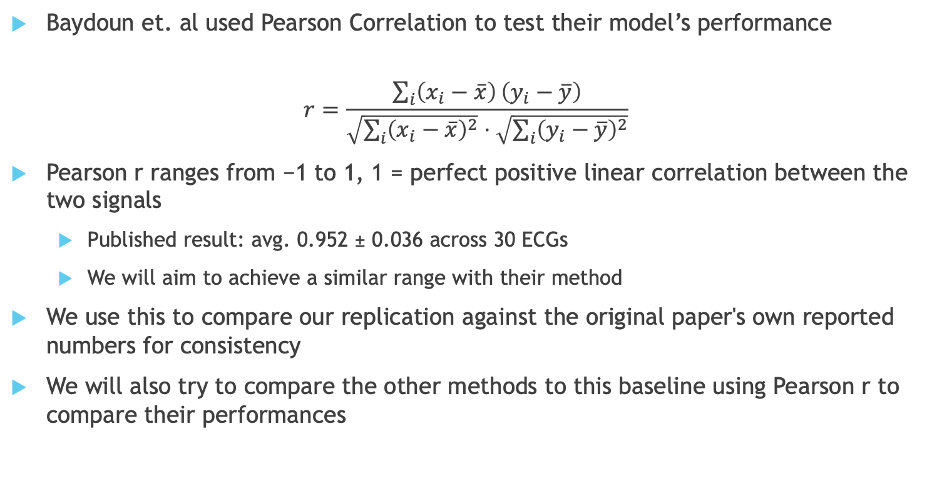
Evaluation Metric 1 – Pearson Correlation
Baydoun et. al used Pearson Correlation to test their model’s performance
$$r=\frac{\sum_{i}{\left(x_{i}−\overline{x}\right)}\left(y_{i}−\overline{y}\right)}{\sqrt{\sum_{i}{{\left(x_{i}−\overline{x}\right)}^{2}}}⋅\sqrt{\sum_{i}{{\left(y_{i}−\overline{y}\right)}^{2}}}}$$
Pearson r ranges from −1 to 1, 1 = perfect positive linear correlation between the two signals
  Published result: avg. 0.952 ± 0.036 across 30 ECGs
  We will aim to achieve a similar range with their method
We use this to compare our replication against the original paper's own reported numbers for consistency
We will also try to compare the other methods to this baseline using Pearson r to compare their performances
Notes:
This is the metric Baydoun et al. used to score their own pipeline, so we’re adopting it to keep our replication directly comparable to their published numbers.
The formula is the standard Pearson correlation coefficient, computed between the reference signal and our digitized signal.
It ranges from negative one to one, where one means a perfect positive linear correlation.
Their published result averaged 0.952 with a standard deviation of 0.036 across thirty ECGs.
We’re aiming for a similar range, but treating it as a sanity check rather than a hard target, since our images and implementation won’t be identical to theirs.
We’re also planning to see whether we can apply this same metric to evaluate SignalSavants and WAVIE against our baseline, for one consistent comparison scale across all three.

Slide 5
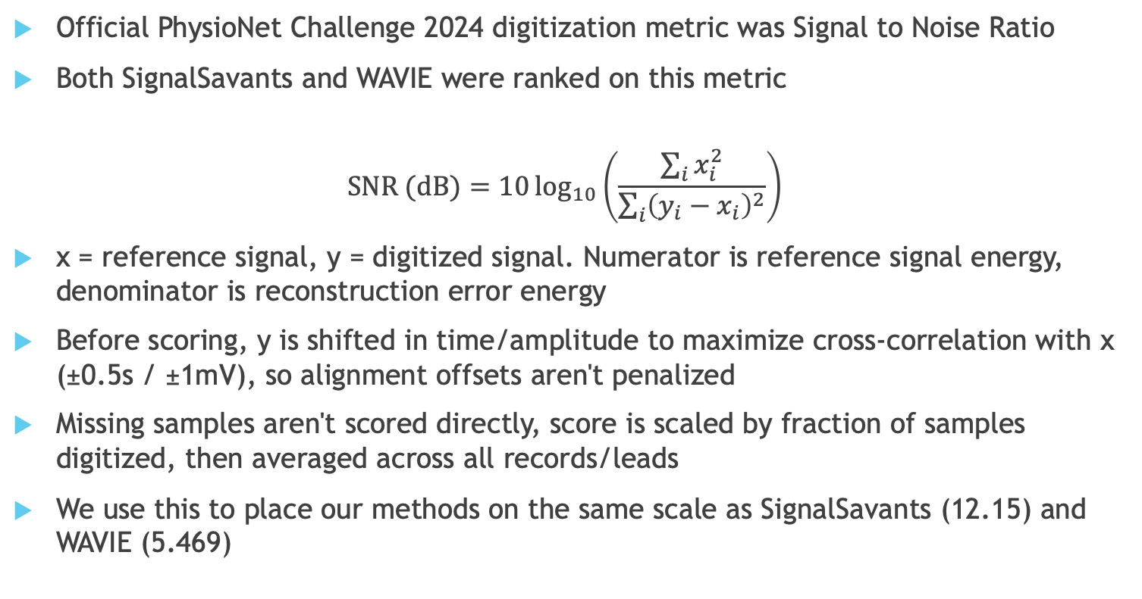
Evaluation Metric 2 – Signal to Noise Ratio
Official PhysioNet Challenge 2024 digitization metric was Signal to Noise Ratio
Both SignalSavants and WAVIE were ranked on this metric
$$\text{SNR (dB)}=10\log_{10}\left(\frac{\sum_{i}{x_{i}^{2}}}{\sum_{i}{{\left(y_{i}−x_{i}\right)}^{2}}}\right)$$
x = reference signal, y = digitized signal. Numerator is reference signal energy, denominator is reconstruction error energy
Before scoring, y is shifted in time/amplitude to maximize cross-correlation with x (±0.5s / ±1mV), so alignment offsets aren't penalized
Missing samples aren't scored directly, score is scaled by fraction of samples digitized, then averaged across all records/leads
We use this to place our methods on the same scale as SignalSavants (12.15) and WAVIE (5.469)
Notes:
SNR is the metric the PhysioNet Challenge actually used to rank teams in 2024, so both SignalSavants and WAVIE were scored on this.
The formula puts reference signal energy in the numerator and reconstruction error energy in the denominator, so a higher SNR means less error relative to the signal.
Before scoring, the digitized signal gets shifted in time and amplitude to maximize its correlation with the reference, within half a second and one millivolt, so small alignment issues don’t unfairly hurt the score.
Samples that never got digitized aren’t scored directly, the final score is instead scaled down by the fraction of samples actually recovered.
Everything is then averaged across all records and all leads.
We’re adopting this specifically so we can place our own baseline on the same scale as SignalSavants at 12.15 and WAVIE at 5.469.

Slide 6
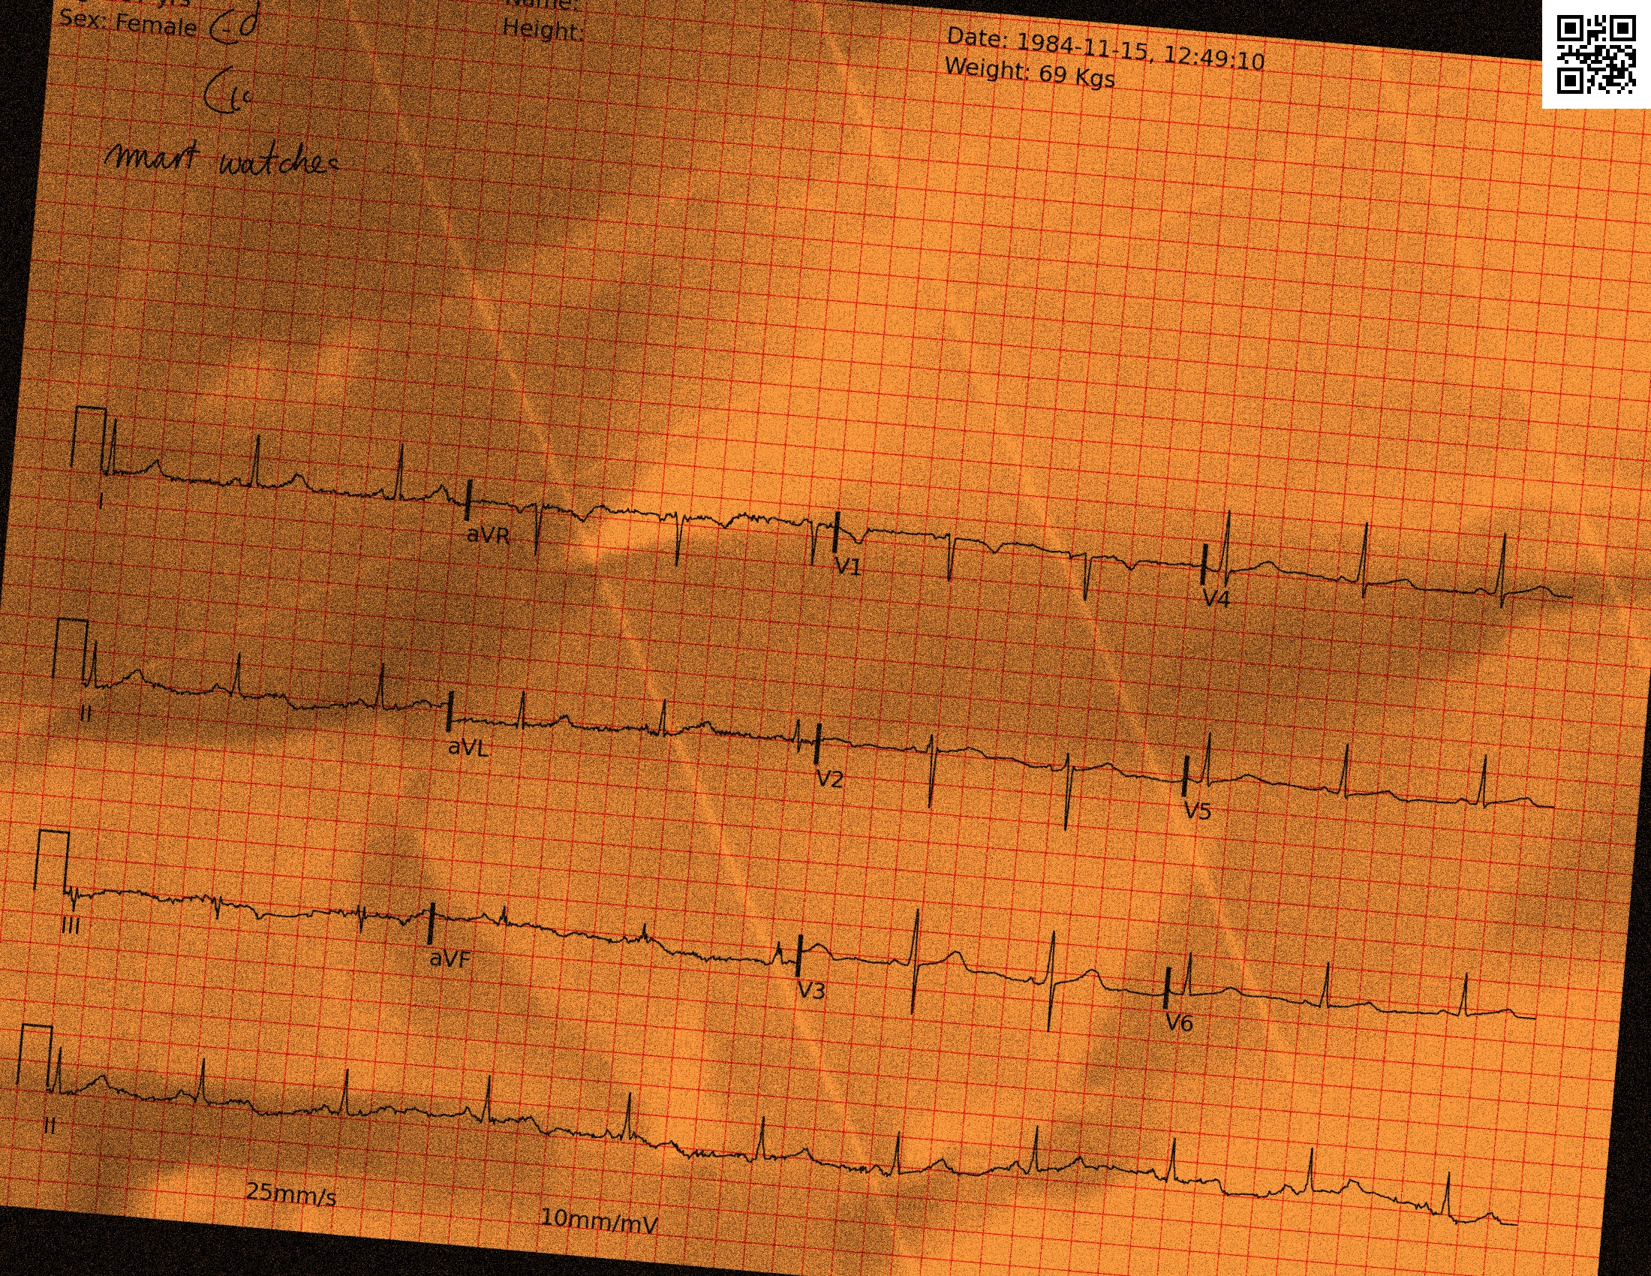
Creating Distorted Data
ECG-Image-Kit can digitally recreate thermal paper ECG:
  Plot the signal
  Add grid lines, header (date, sex, age) and labels
  Apply distortions:
    Wrinkles and Creases
    Handwritten Notes and Noise
    Rotation, Crop, Color Temperature
Limitations:
  Wrinkle patterns limited to a fixed set of 20 quilted maps, limited camera perspectives
  No water damage/blurring ink
We plan to test our own image creation to better understand the process and its limits
Notes:
ECG-Image-Kit lets us digitally recreate what a thermal paper ECG looks like.
It starts by plotting the actual signal, adding grid lines and a header with date, sex, and age, and labels.
Then it layers on distortions: wrinkles and creases, handwritten notes and noise, rotation, cropping, and color temperature shifts.
It has real limitations though, the wrinkle patterns come from a fixed set of only twenty quilted maps, so they’re not infinitely varied.
Camera perspective is limited too, and there’s no way to simulate actual water damage or blurred ink.
We’re planning to generate our own batches with this tool so we understand exactly what it can and can’t produce.

Slide 7
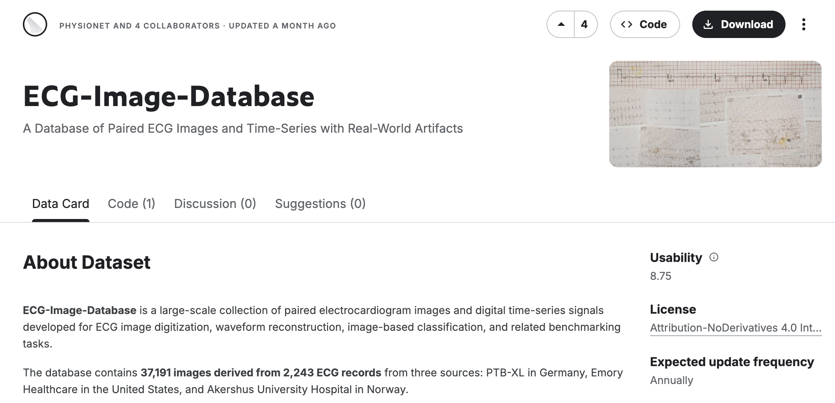
PhysioNet Challenge Dataset
37,191 images total, generated from 2,243 unique 12-lead ECG records – 37 GB
  PTB-XL (Germany) — 977 records
  Emory Healthcare (USA) — 1,000 records
  Akershus University Hospital (Norway) — 266 records
PTB-XL and Emory records were rendered via ECG-Image-Kit, then printed and distorted manually
  Physical scans, phone photos, monitor photos, water/coffee/sauce staining, heat damage, mold
Akershus images are originally paper scans with archived digital counterparts
Each image has a corresponding WFDB format digital signal as ground truth
Notes:
This dataset has 37,191 images generated from 2,243 unique ECG records.
It actually comes from three different sources, not two like we initially thought: PTB-XL out of Germany with 977 records, Emory Healthcare in the US with 1,000, and Akershus University Hospital in Norway with 266.
PTB-XL and Emory images were rendered digitally through ECG-Image-Kit and then physically printed and distorted by hand.
Those start as synthetic images that get artificially aged, things like real scans, phone photos, monitor photos, staining, heat damage, and even mold.
Akershus is different, those are images of paper scans that were already real to begin with, with archived digital signals paired to them after the fact.
That subset gives us a genuine real versus synthetic comparison point, not just synthetic images with varying degrees of simulated wear.
Every image in the dataset has a corresponding WFDB format digital signal as ground truth.
That’s what makes this usable for direct, quantitative evaluation rather than just visual inspection.

Slide 8
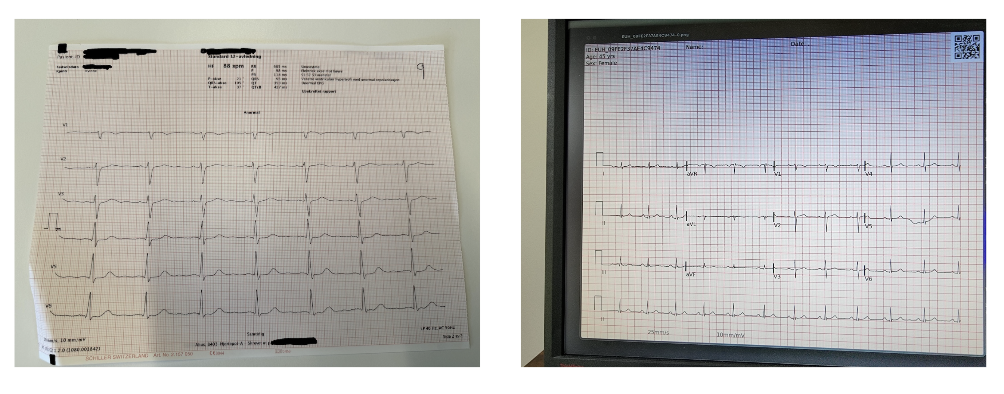
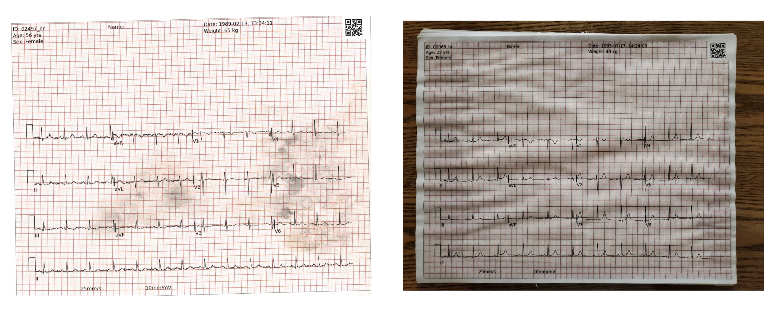
Subgroup Analysis – Distortion Type
28 image variants across capture method
PTB-XL/Emory (synthetic origin) distortions
  Programmatic: rotation, geometric transforms, wrinkles, creases, grid color, handwritten text
  Physical: color/grayscale scans, phone photos, monitor photos, water/coffee/sauce staining, heat damage, mold
Akershus’ real distortions
  Natural wear from routine clinical handling (bending, handwritten annotations)
  Captured via flatbed scanner, iPhone 16 Pro Max, OnePlus Nord CE2
Plan: score SNR separately per category
  Test performance on synthetic + physical distortions vs true clinical handling distortions
  Find failure modes for each model type
Notes:
There are 28 documented image variants across the different capture methods in this dataset, and we’re planning to use that structure directly.
For PTB-XL and Emory, distortions split into two families: programmatic ones like rotation, geometric transforms, wrinkles, creases, grid color changes, and handwritten text, and physical ones like real scans, phone photos, monitor photos, staining, and heat damage.
Akershus is different again, its only distortions are natural wear from routine clinical handling, things like bending and occasional handwritten annotations.
Those images were captured with a flatbed scanner, an iPhone 16 Pro Max, and a OnePlus Nord CE2.
Our plan is to score SNR separately for each category instead of only looking at one aggregate number.
That lets us directly test whether our model handles synthetic plus physical distortions differently than it handles true clinical handling distortions from Akershus.
More generally, it lets us find where each type of model actually tends to fail.

Slide 9
Subgroup Analysis – Diagnosis Type
PTB-XL has diagnostic superclasses;
  Normal
  Myocardial Infarction
  ST/T Change
  Conduction Disturbance
  Hypertrophy
The other two datasets do not specify diagnostic subgroups, will need to double check once we have data access
Plan: compute SNR separately per diagnostic class
  Accurate on normal rhythm but degraded on abnormal morphology is problematic
Notes:
PTB-XL comes with diagnostic superclasses built in: normal, myocardial infarction, ST or T wave change, conduction disturbance, and hypertrophy.
We already have a clean axis to break results down by diagnosis for that subset.
We haven’t confirmed yet whether Emory or Akershus have the same kind of diagnostic labeling available.
That’s something we need to check once we actually have access to the data itself, not just the documentation.
The plan is the same as the distortion breakdown, compute SNR separately per diagnostic class rather than only in aggregate.
The real risk here is clinical, not just statistical.
A model that’s accurate on normal rhythm but quietly degrades on abnormal morphology is a much worse tool than its overall SNR would suggest.
Those abnormal cases are exactly the ones where getting the digitization right actually matters.

Slide 10
Next Steps
Finish baseline replication, get first Pearson/SNR numbers
Test ECG-Image-Kit for custom dataset creation
Once cluster access is available:
  Run full subgroup breakdown (distortion type × diagnostic class) on ECG-Image-Database
  Replicate and test SignalSavants/WAVIE’s public code against our subgroup splits
Notes:
Our immediate priority is finishing the baseline replication so we have an initial step to work off of.
In parallel, we want to test ECG-Image-Kit ourselves to build some of our own custom data, rather than relying only on existing datasets.
Once we get cluster access, the plan is to run the full subgroup breakdown, distortion type crossed with diagnostic class, on the real PhysioNet dataset.
We also want to replicate and test SignalSavants and WAVIE’s own public code against those same subgroup splits.
That lets us see whether their reported strengths and failure modes actually hold up under a more granular, controlled breakdown, rather than just taking their aggregate numbers at face value.

Slide 11
Thank you for listening
Any Questions?

Slide 12
References
[1] Baydoun, M., Safatly, L., Abou Hassan, O. K., Ghaziri, H., El Hajj, A., & Isma’eel, H. (2019). High Precision Digitization of Paper-Based ECG Records: A Step Toward Machine Learning. IEEE Journal of Translational Engineering in Health and Medicine, 7, 1900808. DOI: 10.1109/JTEHM.2019.2949784
[2] Krones, J. S., Walker, W., Lyons, T., & Mahdi, A. (2024). Combining Hough Transform and Deep Learning Approaches to Reconstruct ECG Signals From Printouts. arXiv:2410.14185.
[3] Verlyck, M. A., Dillon, J. R., Creamer, S. A., & Zhao, D. (2024). WAVIE: A Modular and Open-Source Python Implementation for Fully Automated Digitisation of Paper Electrocardiograms. Computing in Cardiology, 51. DOI: 10.22489/CinC.2024.229
[4] Reyna, M. A., et al. (2026). ECG-Image-Database: Large-Scale Paired ECG Images and Time-Series With Real-World Artifacts; A Foundation for Computerized ECG Digitization and Analysis. Physiological Measurement, 47(7), 075015. DOI: 10.1088/1361-6579/ae85b2
[5] Wagner, P., Strodthoff, N., Bousseljot, R.-D., Kreiseler, D., Lunze, F. I., Samek, W., & Schaeffter, T. (2020). PTB-XL, a Large Publicly Available Electrocardiography Dataset. Scientific Data, 7(1). DOI: 10.1038/s41597-020-0495-6
[6] Stenhede, E., Bjørnstad, A. M., & Ranjbar, A. (2026). Digitizing Paper ECGs at Scale: An Open-Source Algorithm for Clinical Research. npj Digital Medicine, 9(1). DOI: 10.1038/s41746-025-02327-1 (this is the Akershus/AHUS dataset paper)

Slide 13
Baseline Algorithm Replication
Replicating image processing and digitization pipeline from Baydoun et al. (2019)
Detect Regions of Interest (ROI)
Threshold Utilizing Otsu's Technique
Identify & Label Connected Pixels
Trace Detection & Waveform Reconstruction
Post-Processing
Scan image for pixel variation
Detect peaks
Create bounding boxes around each peak
Crop & invert each ROI
Apply Ostu's Technique to get a back & foreground
Binarize Image
Find connected pixel groups
Label separate image objects
Remove noise components
Line detection using Hough Transform
Estimate ECG signal centerline
Iteratively include adjacent pixels to trace signal
Linear interpolation to estimate missing values
Smooth digitized waveform
Preserve major ECG peaks
Notes:
For our baseline, we're replicating the image-processing and digitization pipeline developed by Baydoun and colleagues in 2019.
The first step is identifying the regions of interest, or ROIs. Rather than trying to extract every waveform from the entire ECG image at once, the algorithm first identifies the separate signal regions. It moves a small mask across the image and measures variation in pixel intensity. Areas containing both the dark ECG trace and the lighter background have a relatively high standard deviation. The resulting variation profile is then searched for peaks, which are used to estimate the centers of the individual ECG regions and construct bounding boxes around them.”
“This is important because once those regions are separated, the actual waveform-extraction procedure can be applied independently to each lead region rather than trying to interpret the entire multi-lead image simultaneously.”
“Next, each region is cropped and its colors are inverted. Otsu's automatic thresholding technique is then applied to separate the foreground from the background and produce a binary image. In the original implementation, the authors multiplied the automatically calculated Otsu threshold by 1.2 based on empirical testing.”
“Once the image is binary, connected-pixel algorithms are used to identify and label the different objects within the image. Small connected components are assumed to be noise and removed, which leaves the larger structures that are more likely to represent the actual ECG trace.”
“The next stage is the main waveform-reconstruction step. Because portions of an ECG waveform run approximately horizontally, the algorithm uses the Hough Transform to identify nearly horizontal lines. The median position of those detected lines is used to estimate the centerline of the ECG signal.”
“The algorithm then tries to construct a path from the left side of the image to the right side, selecting approximately one signal point per column. It begins with pixels near the estimated centerline and then iteratively adds connected adjacent pixels. This allows it to follow the waveform even when the ECG moves above or below that original centerline.”
“Finally, if some columns still don't contain a detected point, linear interpolation is used to estimate those missing values. The resulting digitized signal is then smoothed using averaging over a small span, while very large values are excluded from the averaging step so that important ECG peaks are preserved.”
“So at the end of the pipeline, the goal is to go from an ECG that exists only as pixels in an image to an actual numerical waveform that can be analyzed computationally.”

Slide 14
SignalSavants – University of Oxford
PhysioNet Challenge 2024 • Digitization task: SNR 12.15, 1st place of 16 teams
Three-stage pipeline of rotations, segmentation, and vectorization
Rotate
OpenCV Hough Transform detects line angles
Straightens the image
99.7% accurate
Segment
nnU-Net predicts a per-pixel mask
One mask per signal trace
Vectorize
Average mask pixel position per column
Rescale using grid calibration
Training images were self-generated from PTB-XL via ECG-Image-Kit, with 4+ augmented variants per signal
Their winning model used only 20k images and simpler masks. Larger, more complex models overfit
Notes:
This next method comes from the team that actually won the PhysioNet Challenge in 2024, SignalSavants out of Oxford, with an SNR of 12.15, first place out of sixteen teams. The thing that stands out about their approach is that it's not one single end-to-end deep learning model. Instead they broke the problem into three separate stages, rotate, segment, and then vectorize.
The first stage handles rotation using a classical computer vision technique called the Hough Transform, which detects straight lines in the image and figures out how much the whole thing is tilted, then corrects it. That detection step alone is 99.7 percent accurate, which is a strong result, though it's worth noting that getting the rotation right doesn't automatically mean the rest of the signal extraction will be accurate too.
Once the image is straightened, the second stage uses a model called nnU-Net to do segmentation. This produces a per-pixel mask that tells you which pixels in the image actually belong to a given signal trace, essentially separating the ECG line from the background and the grid.
The third stage is vectorization, where they take that mask and, for every column of the image, average the pixel positions to get one y value, then rescale those pixel coordinates into real time and voltage using the grid calibration printed on the paper. For training, they generated their own images from PTB-XL using a tool called ECG-Image-Kit, with at least four augmented variants per signal. One thing worth pointing out here is that their winning model actually used a smaller dataset, only twenty thousand images, and simpler masks. When they tried scaling up to larger and more complex models, performance actually got worse, which tells us overfitting is a real risk in this setup.

Slide 15
WAVIE Method – University of Auckland
PhysioNet Challenge 2024 • Digitization task: SNR 5.469, 3rd place of 16 teams
Separate modules for rotation correction, signal segmentation, lead detection, and signal digitization.
Rotation Correction
Signal Segmentation
Lead Localization
Signal Digitization
Deep Image Orientation Angle Detection
Predict rotation angle θ
Train with θ ~ N(0, 25.2²), emphasizing realistic small rotations
Apply inverse angle −θ
Output: standardized image orientation
2D nnU-Net
Input: corrected ECG image
Output: binary mask of all lead signals
250 epochs; initial LR = 0.01 with polyLR
Augmentations: rotation, downsampling, mirroring
YOLOv5s
Detect signal bounding boxes and lead-name boxes
Pretrained weights; trained 300 epochs
Post-process to retain 13 boxes: 12 leads + 1 rhythm lead
OpenCV + signal processing
Crop mask using YOLO boxes
Extract contours
Column-wise median; one y-position per x
Pixel → time/voltage (0.04 s / 0.1 mV)
Sliding-window baseline estimate
Training images were self-generated from PTB-XL via ECG-Image-Kit, different configurations were made
Five generation configurations were used for training and ten for the held-out data
6 of 10 held-out generation configurations were unseen during training
Notes:
The next method we looked at is WAVIE, out of the University of Auckland, which placed third overall with an SNR of 5.469. Where SignalSavants used three stages, WAVIE splits the problem into four, rotation correction, signal segmentation, lead localization, and signal digitization, with each one trained as its own separate model.
Rotation correction here is learned rather than classical. They train a model to predict a rotation angle theta directly, and during training that angle is sampled from a normal distribution centered at zero with a standard deviation around 25 degrees, which emphasizes realistic small rotations rather than extreme ones. Once predicted, the inverse angle is applied to straighten the image.
Segmentation uses 2D nnU-Net, which is conceptually similar to what SignalSavants did. The part that's genuinely different is lead localization. They run a model called YOLOv5s to detect bounding boxes around each of the twelve individual leads plus the rhythm strip, so thirteen boxes in total. This means they're explicitly handling the full multi-lead layout of a standard ECG printout, rather than assuming there's just one fixed trace to extract.
From there, digitization crops the image using those YOLO boxes, extracts contours, takes a column-wise median to get one y position per x position, and converts those pixel coordinates into real time and voltage values, with a sliding window step to correct for baseline drift. Their training data also comes from PTB-XL through ECG-Image-Kit, but they pushed harder on testing generalization, using five generation configurations for training and ten for the held-out set, six of which were completely unseen during training.

