Slide 1

Notes:
Good morning, Professor. We are Group 2/B, and our project is ECG Image Digitization. Before I explain this week's proposed method, I will briefly recap the problem and the approaches we have investigated. The overall goal is to recover digital ECG waveforms from images of ECG printouts. We are not trying to classify diseases from an image at this stage; we are trying to reconstruct the underlying numerical signal so it can be stored, measured, and analyzed computationally. After this short recap, I will focus on my assigned part of the proposal: how we plan to implement and validate the digitization pipeline.

Slide 2
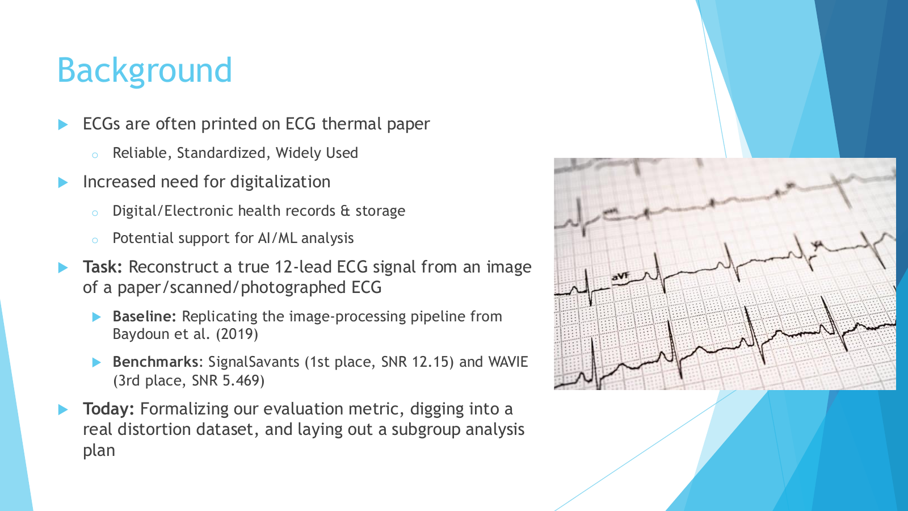
Notes:
ECGs are often printed on thermal paper, and historical clinical records may survive only as scanned or photographed images. Such images contain valuable waveform information, but they are not directly usable as numerical time-series data. The goal is to reconstruct a true 12-lead ECG signal from these images. That means preserving the shape, timing, and scale of the waveform, not merely producing a similar-looking picture. We selected Baydoun 2019 as our classical image-processing baseline and SignalSavants and WAVIE as learning-based benchmarks from the 2024 PhysioNet Challenge. The numbers on this slide are published benchmark scores, not our group's own results. The original slide's final 'Today' bullet describes the focus of the previous presentation; today I will extend that work into a concrete implementation plan.

Slide 3
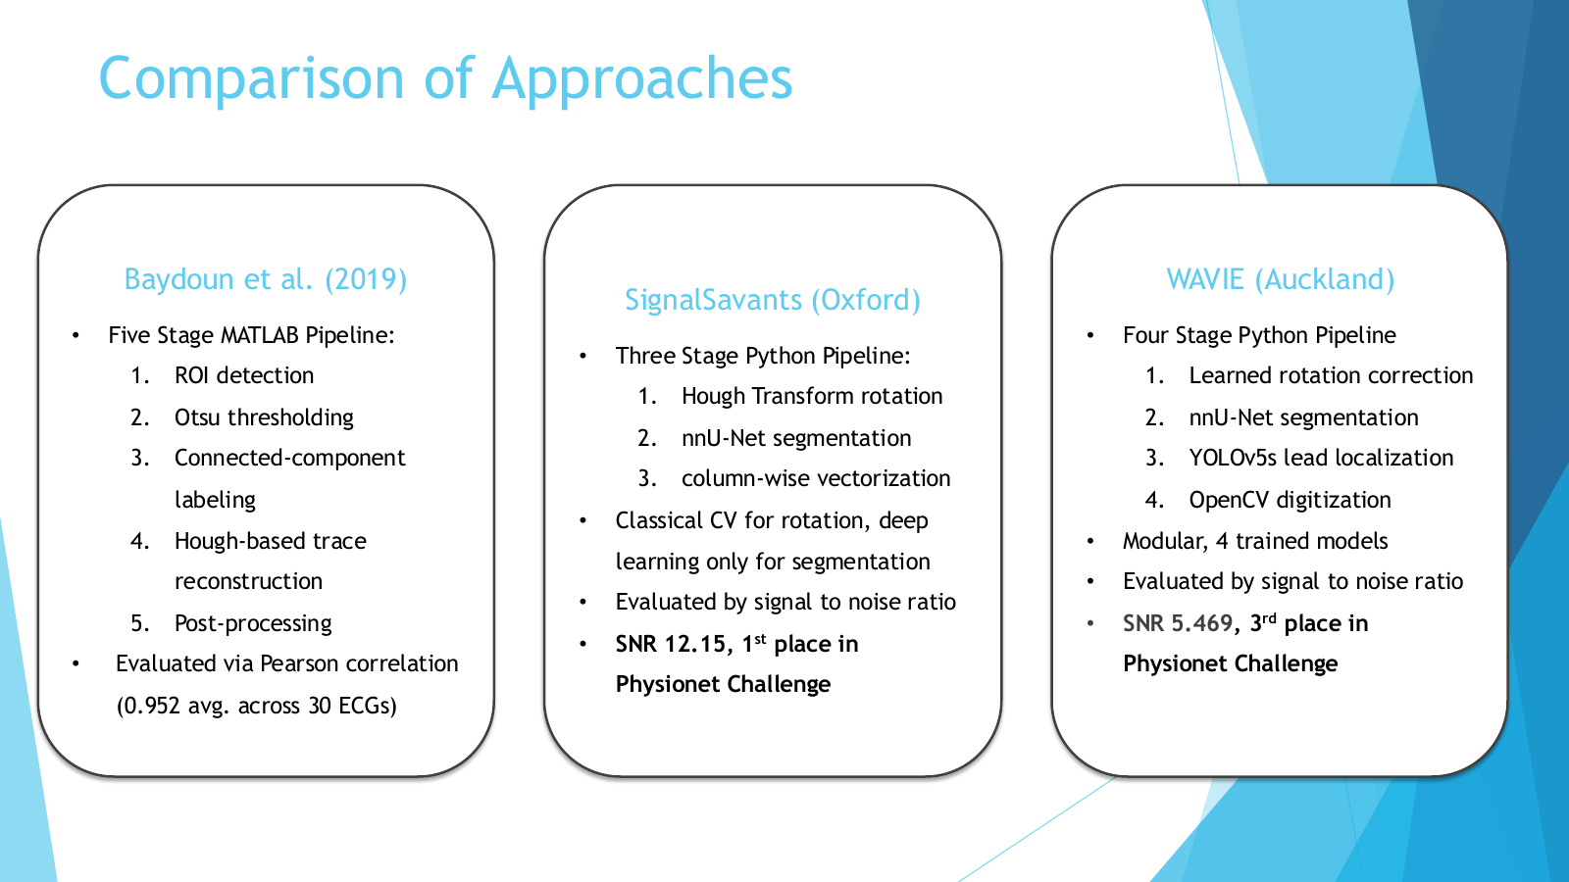
Notes:
This slide briefly compares the three approaches we have studied. Baydoun is a five-stage MATLAB image-processing pipeline: find regions of interest, threshold the image using Otsu's method, remove small connected noise components, trace the waveform using a Hough-assisted reference, and interpolate or smooth the result. It does not need a trained segmentation network. SignalSavants uses Hough-based rotation correction, nnU-Net segmentation, and column-wise vectorization. WAVIE uses learned rotation correction, nnU-Net segmentation, YOLOv5s for lead localization, and OpenCV-based signal digitization. They differ in their internal steps, but all ultimately seek the same output: a numerical ECG waveform. This distinction motivates my proposed method: we need to standardize their outputs and compare them against the same paired digital references. The published Pearson and SNR numbers shown here come from different evaluation settings and should not be treated as a direct head-to-head comparison.

Slide 4

JOHNS HOPKINS UNIVERSITY | ECG DIGITIZATION
Proposed Method: From Image to Digital ECG
One reproducible pipeline connects paired data, reconstruction and validation.
01
02
03
04
PAIRED DATA
→
RECONSTRUCTION
→
CALIBRATION
→
VALIDATION
ECG image + reference
• Lead identity
• Sample rate
• Baydoun pixel tracing
• Learned segmentation
• Inspect masks
• Pixels → time & mV
• Grid calibration
• Preserve peaks
• Same reference ECG
• Pearson & SNR
• Distortion tests
Same underlying ECG
TARGET OUTPUT
12-lead waveform with correct lead IDs,
time axis and calibrated voltage.
Visual similarity alone is not enough.
Biomedical Data Design | Proposed Method
4
Notes:
Now I will focus specifically on my part of the group proposal: the proposed method. The earlier slides tell us what the task is and which algorithms exist. My question is how we will put them together into one reproducible study. The workflow begins with an ECG image paired with its original digital recording. That reference is essential: without it, a reconstruction can look plausible while still being numerically wrong. Next, we process each image with the Baydoun baseline and, when compatible public implementations are available, the SignalSavants and WAVIE methods. The output of an image-based algorithm may initially be a pixel path or segmentation mask, not a physical ECG. We must convert pixel coordinates into time and voltage using the image's calibration. Finally, we compare the reconstructed signal with the original digital signal under a common scoring procedure. We are proposing a workflow here, not presenting new performance results. The important methodological principle is to keep the input records and evaluation rules consistent so that differences in scores are more interpretable.

Slide 5
JOHNS HOPKINS UNIVERSITY | ECG DIGITIZATION
Step 1: Build Reliable Image–Signal Pairs
Synthetic images solve the ground-truth problem; real scans test generalization.
1
Synthetic training / controlled tests
2
Realistic held-out evaluation
• Start with measured 12-lead ECG (PTB-XL)
• Render paper-style images (ECG-Image-Kit)
• Add noise, rotation, creases and wrinkles
• Keep source waveform and lead metadata
• Test clean images before harder distortions
• Evaluate paired ECG-Image-Database records
• Include scans, photos and damaged paper
• Test artifacts absent from synthetic images
• Compare synthetic vs. physical distortions
• Hold out original ECG records
Critical split rule
Split by original ECG record, not image variant. Keep every version of a waveform in one subset to prevent data leakage.
Biomedical Data Design | Proposed Method
5
Notes:
Our first practical step is constructing reliable input-reference pairs. We start from a real measured digital ECG, for example a 12-lead record from PTB-XL. ECG-Image-Kit can draw that waveform as a paper-style image, add a grid and labels, and apply controlled artifacts. The paper appearance is generated, but the physiological waveform is not invented; it remains the measured reference. This solves the supervision and evaluation problem because we know exactly what numerical signal the image should represent. We should begin with clean renderings. If our code fails on a clean image, introducing wrinkles or staining makes debugging much harder. After verifying the pipeline, we can systematically vary one image condition at a time. However, software-generated wrinkles and noise do not capture every feature of a real photograph or physically damaged page. The ECG-Image-Database discussed last week offers paired images with physical scans, photographs, and real-world damage. We can use those as a more realistic test of generalization. One important design choice is to split at the underlying ECG record level if training or tuning models. Otherwise, a clean image of a waveform could appear in training while a wrinkled version of the same waveform appears in testing, producing misleadingly optimistic results. The previous presentation identified this dataset; my method slide now explains how we will use it.

Slide 6
JOHNS HOPKINS UNIVERSITY | ECG DIGITIZATION
Step 2: Replicate and Verify Baydoun Baseline
Inspect intermediate outputs to locate errors, rather than only scoring the final signal.
ROI
→
OTSU
→
CC
→
HOUGH
→
FILL
Locate each
lead region
Separate trace
from background
Group pixels;
remove artifacts
Estimate baseline;
trace waveform
Fill gaps;
smooth trace
Implementation checkpoints
Signal-level verification
• Check lead-region crops
• Save binary masks and components
• Overlay traced pixels on source image
• Inspect broken traces and grid crossings
• Debug using clean development images
• Convert pixels into seconds and mV
• Align sample times with ground truth
• Inspect R peaks, baseline and gaps
• Score clean images before distortions
• Log failures for later comparisons
First milestone: reconstruct one calibrated ECG, inspect intermediate outputs, and compute reference-based metrics.
Biomedical Data Design | Proposed Method
6
Notes:
Our first algorithm is Baydoun's classical image-processing pipeline, which the group reviewed previously. Instead of repeating all five steps as literature review, this slide explains how we will implement and verify them. First, ROI detection locates individual lead regions. That matters because a full 12-lead report has multiple traces and text, and treating it as one continuous waveform would be incorrect. Second, Otsu thresholding chooses an intensity threshold to separate candidate foreground pixels from background; connected-component processing removes small isolated noise groups. Otsu is not a magical ECG detector. It operates on intensity, so grid lines and annotations may also survive. Third, Hough-based line detection helps establish a reference centerline, while the tracing procedure follows connected pixels to recover the curve. Hough itself does not directly output the full ECG time series. Fourth, interpolation fills columns with missing detected pixels; without it, we may have gaps in the reconstructed sequence. It must be used carefully because interpolation across a missing sharp QRS complex could flatten that feature. Our proposed implementation will save and inspect intermediate outputs: the ROI crops, binary masks, traced paths overlaid on the original image, and the final numerical waveform. This is essential for debugging. If a reconstructed signal is wrong, we want to know whether the error arose during lead localization, thresholding, tracing, or calibration. We will first confirm that the implementation behaves sensibly on clean paired images before testing difficult distortions. We are not claiming that the Baydoun replication is complete yet.

Slide 7
JOHNS HOPKINS UNIVERSITY | ECG DIGITIZATION
Step 3: Standardize Outputs Across Methods
Different algorithms create different intermediate representations — but the target is identical.
Baydoun
SignalSavants
WAVIE
• ROI and threshold mask
• Connected-pixel tracing
• Interpolation / smoothing
• Hough rotation correction
• nnU-Net segmentation
• Column-wise extraction
• Learned rotation correction
• nnU-Net and YOLO lead boxes
• OpenCV signal extraction
↓
↓
↓
COMMON OUTPUT: correct lead ID | time axis (s) | voltage (mV)
Use identical held-out ECGs, alignment rules, missing-sample handling and scoring code.
Biomedical Data Design | Proposed Method
7
Notes:
A challenge in comparing the three approaches is that they do not produce identical intermediate representations. Baydoun traces foreground pixels using image-processing rules. SignalSavants uses nnU-Net to identify pixels belonging to ECG traces and then vectorizes them. WAVIE additionally uses a lead-localization detector before converting masks to signals. But our actual target is the same: a numerical waveform for the correct lead, in units of time and voltage. Therefore, we need a common output interface. For every test record, we should verify the lead identity, the covered time interval, the pixel-to-time conversion, and the pixel-to-voltage conversion. We also need consistent handling of gaps, missing values, and alignment. Otherwise, one algorithm could look worse merely because its output was sampled or aligned differently. This slide does not propose training a new network. It proposes running available implementations where feasible, converting their outputs into a comparable representation, and then evaluating them fairly. This also gives us a way to study error propagation. For example, if WAVIE's lead detector chooses the wrong bounding box, even a good segmentation model can yield the wrong signal. By inspecting intermediate results, we can distinguish a localization failure from a tracing failure.

Slide 8
JOHNS HOPKINS UNIVERSITY | ECG DIGITIZATION
Step 4: Validate Reconstruction and Robustness
A common scoring protocol connects method development to reliable comparison.
1
Numerical reconstruction quality
2
Progressive stress testing
• Pearson: waveform-shape similarity
• SNR: error relative to reference energy
• Align time and calibrate voltage
• Use the same records and scoring code
• Inspect aggregate scores and failures
• Debug extraction on clean ECGs
• Increase synthetic distortion strength
• Test physical scans and phone photos
• Compare distortion and diagnosis groups
• Trace failures to processing stages
Proposed test sequence
A
Clean paired ECG
Debug pipeline
B
Synthetic artifacts
Test robustness
C
Physical images
Test generalization
→
→
Biomedical Data Design | Proposed Method
8
Notes:
The final step of my proposed method is to validate each reconstructed signal against its paired digital reference. We will use Pearson correlation and SNR, both already introduced in last week's presentation, but here the focus is on how to use them in a reproducible workflow. Pearson correlation tells us whether two waveforms vary together, but it does not guarantee correct amplitude: a signal scaled by a constant can still have correlation one. SNR measures reconstruction error relative to reference signal energy, so it provides a complementary view. We need to apply the same temporal and amplitude alignment and missing-sample scoring conventions to every method, ideally using the official PhysioNet scoring implementation where applicable. The sequence of testing is important. First, evaluate clean images to establish whether the basic pipeline works. Next, introduce controlled changes such as rotation or noise to isolate which conditions degrade performance. Then use physical scans and photographs to test whether performance transfers beyond synthetic rendering. The wider group may later report distortion and diagnosis subgroup results; my responsibility in this presentation is to define the procedure that produces reliable reconstructed signals and comparable scores. A concrete near-term milestone is to take one paired ECG image, recover its calibrated waveform end-to-end, and calculate its comparison metrics. Once that works, the process can scale to more records and methods. This is a proposed milestone, not a result we have already achieved.

