Slide 1
ROBOTICS
TeleRobotics
Presentation by
Suruthi Raman(11012454)
Under guidance of prof Dr .Achim Gottscheber

Slide 2
Overview
Introduction
General Structure of Telerobotics System
Control architecture
Emerging Application of Telerobotics.
Applications
Conclusions
References

Slide 3
Introduction
Telerobotics is one of the oldest term and technology used in the history of robotics. The word “tele” is derived from a Greek word which means distant
The term telerobot means accessing the hazardous or remote locations by allowing the robot to work in such an environment.
The human operator controls the telerobot for doing complex and dangerous task to attain a great result
The human system interfaces have two main functionality.
Initially using the field devices such as sensors and actuators, it senses the parameters and transfer the information the to the human operator through the Human Machine Interface system .
Secondly telerobotic perform the task given by the human operator as commend and inputs to the sensors as force, motion and voice. These inputs will be processed using Human system Interface.

Slide 4
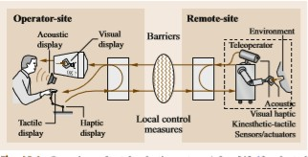
Sensors play an imported role in collecting the data from the remote location to the operator and displayed in the multi-modal human system interface.
For better performance of the telerobotics , one should take in account of telepresence. Telepresence is a display which is used to display the information or data from the remote location, which gives the exact information of the remote location

Slide 5
General Structure of Telerobotics System
A telerobotic framework is involved two fundamental parts: the administrator condition and the remote condition.
The administrator condition is comprised of a multi- modular human framework interface, which the administrator utilizes as a part of request to control the remote gadgets
The remote condition comprises of teleoperated gadgets, sensors and articles that partake in the teleoperation task
Each condition contains preparing modules which have twofold capacities:
first, to change information transmitted by the correspondences station and second, to execute the relating nearby control circles

Slide 6
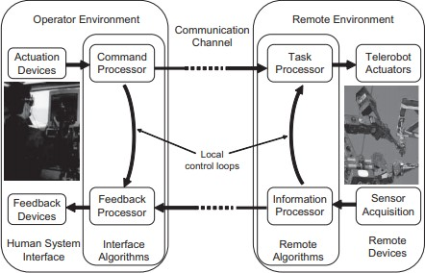

Slide 7
Operator Environment
The human framework interface assumes a vital part in a telerobotic framework.
It gives input gadgets that are utilized to produce administrator orders and show gadgets that are utilized to screen the connection between remote robot and condition.
Telerobot orders are produced by input gadgets that recognize the administrator actions.
According to the control mode, charges must be prepared to a more noteworthy or lesser degree before they are transmitted to the remote condition

Slide 8
Remote Environment
At the point when the administrator charges achieve the remote condition, the errand processor changes them into activities.
By and by, the multifaceted nature of information preparing relies upon the sort of order and the level of coupling.
Complex information handling is required when the administrator and the telerobot are feebly coupled

Slide 9
Control Architecture
Telerobotics system passes the information to the human operator, where the other robot system just executes the commend from the operator without any feedback to the operator about the current data of the remote location.
Following is the three main categories of the control architecture of the telerobotics.
Direct control
Shared control
Supervisory control

Slide 10
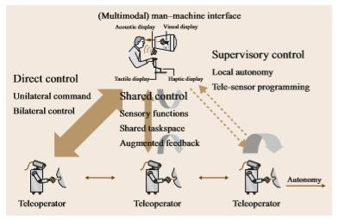
Coordinate control suggests no insight or self-governance in the framework, with the goal that all slave movement is straightforwardly controlled by the client through the ace interface

Slide 11
Clutching and Offsets
The robots are not coupled always. The robot has to be configured as master and slave before switching ON the robot and also coupling to each other. For coupling the system we have three process
Keep the robot in a fixed position/place by moving them
The operator has to relocate the slave robot to the master robot ie. Both the robot has to place in same location
The offset has to be decided and configured with the two robot

Slide 12
Supervisory Control
Supervisory control, presented by Ferell and Sheridan in 1967 is gotten from the simple of regulating a human subordinate staff part
Sheridan portrays this approach in correlation with manual and programmed robot control
By and large, supervisory control strategies will permit increasingly self- governance and knowledge to move to the robot framework
The administrator manages the telerobotic framework nearly and chooses precisely the proper behavior and what to do

Slide 13
Telesensor Programming
Produced for space applications with vast correspondence delays, the telesensor programming (TSP) approach has been portrayed as an assignment level-situated programming system and sensor-based educating by demonstrating.
Fundamentally, administrators associate with a perplexing reproduction of the robot and remote environment, in which they can test and change tasks.
This demonstrates the structure of a TSP execution, comprising of two control circles working in parallel. One circle controls the genuine (remote) framework, which contains inward input for nearby self-governance
builds up a reproduction situation which is fundamentally equal to the genuine framework, with a couple of exemptions
.

Slide 14
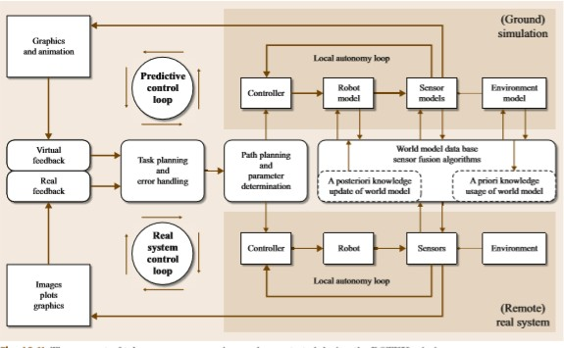

Slide 15
Emerging Applications of Telerobotics
Historically,telerobotics research has focused on a conventional setup with two ﬁxed-based automated controllers filling in as the ace and slave gadgets.
As of late, there have been considerable endeavors to expand the telerobotic theories and frameworks to more unconventional situations
The rundown is in no way, shape or form thorough and, to be predictable with the part, centers around controls angles and giving a stable respective UI.

Slide 16
Telerobotics for Mobile Robots
Versatile robots are valuable slave gadgets if the assignment covers a substantial spatial territory. Flying robots, specifically, can work in three- dimensional space without being bound to the ground
For versatile robot teleoperation, constrain input possibly used to pass on expert insightful data of the slave robot (e.g., speed), or haptic criticism of virtual (or genuine) protests in the remote condition
The ace position and the slave speed have diverse relative degrees as for the torque. One approach to bypass this difﬁculty is to use supposed r variable

Slide 17
Multilateral Telerobotics
Numerous reasonable telerobotic assignments require able, convoluted, and vast level of-opportunity movements, e.g., in careful preparing, restoration, or investigation
Single-master multiple-slave (SMMS) systems
Multiple-master multiple-slave (MMMS) systems
Multiple-master single-slave (MMSS) systems
4. Single-master single-slave (SMSS) systems

Slide 18
APPLICATIONS
Telerobots in Surgery: performs procedures through small incisions, this reduces the incidence of the trauma in the patient and this is too effective than conventional surgery
Telerobots in Nuclear or Chemical
Industry: Performs protective role, Service maintenance and repairing operations without human interruption and putting down explosives is another important task
Space Robotics: Example Expedition into mars
Orbital Robotics: It had components like the torque sensors and stero video cameras and this helps in communication between space station and the operator station at DLR

Slide 19
CONCLUSIONS
In spite of its age, telerobotics remains an energizing and dynamic are an of mechanical technology. Inmanyways,it shapes a stage which can use the advances in mechanical innovations while at the same time utilizing the demonstrated abilities and capacities of human clients.
In numerous ongoing advances, including techniques, trials, applications, and improvements, are gathered. Past this, in the zones of respective and shared control, and also to comprehend the different applications
we note specifically Presence: Teleoperators and Virtual Environments, distributed by the MIT Press. Joined with virtual reality applications, it centers around advances with a human administrator.

Slide 20
REFERENCES
M. Buss, G. Schmidt: Control problems in multimodaltelepresencesystems.In:AdvancesinControl, ed. by P.M. Frank (Springer, London 1999)
W.R. Ferell, T.B. Sheridan: Supervisory control of remote manipulation, IEEE Spectrum 4
R.C. Goertz: Fundamentals of general-purpose remote manipulators, Nucleonics 10(11)
R.C. Goertz: Mechanical master–slave manipulator, Nucleonics 12(11), 45–46 (1954) 43.5 R.C. Goertz, F. Bevilacqua: A force-reflecting positionalservomechanism,Nucleonics10(11),43–45 (1952)
W.R.Ferell:Remotemanipulation with transmission delay, IEEE Trans. Hum. Factors Electron. 6, 24–32 (1965)
R.J. Anderson, M.W. Spong: Asymptotic stability for force reflecting teleoperators with time delay, Int. J. Robotics Res. 11(2), 135–149 (1992)

Slide 21
THANK YOU

