Slide 1
INSIDE THE MIND OF THE MASTER PROCRASTINATOR
TIM URBAN

Slide 2
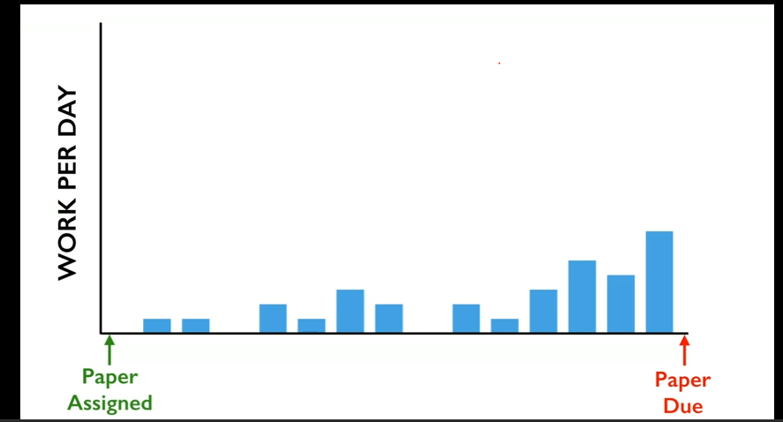
Introduction
Method A:
Divide the work through out the period

Slide 3
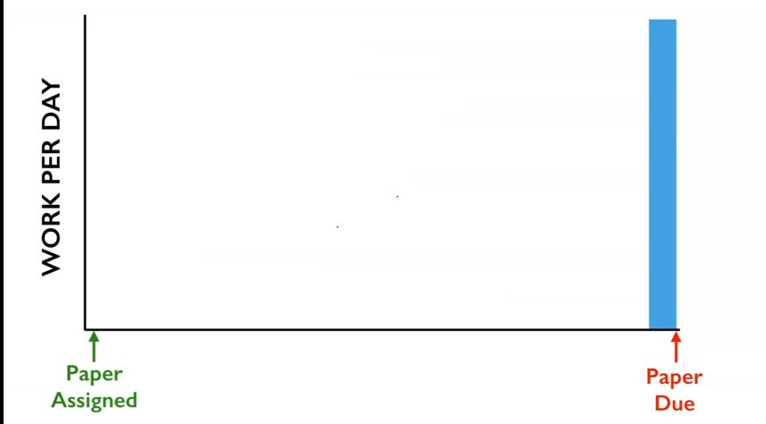

Slide 4
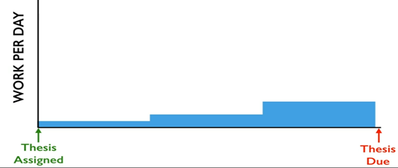
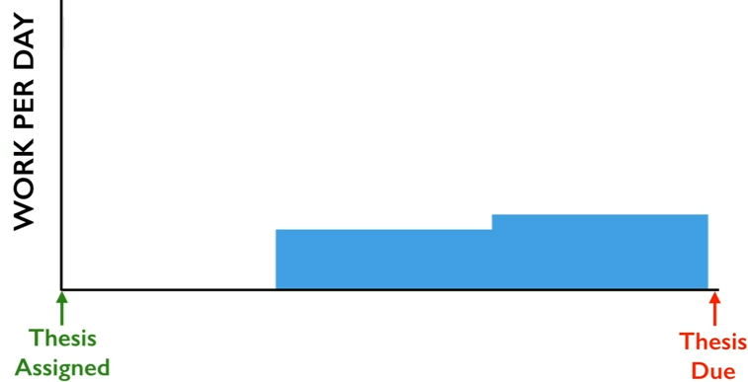
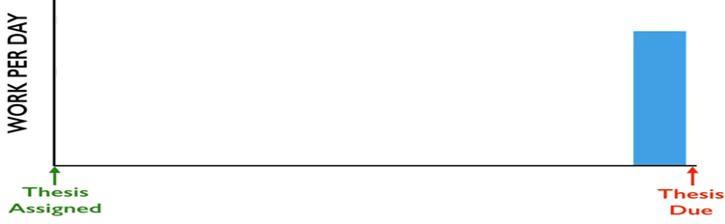
Method B:

Slide 5
Brains of a procrastinator and nonprocrastinator
Procrastinator:
Thinks about the present.
Easy and fun
Non Procrastinator:
Rational thinking
Visualise the future

Slide 6
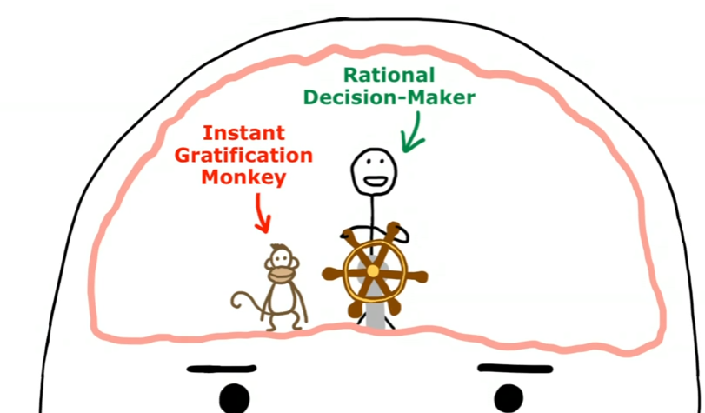
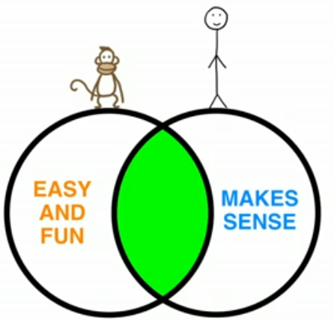

Slide 7
Panic Master
Dead Lines
Career disaster
Types of procrastination:
With deadlines
Without deadlines

Slide 8
THANK YOU

