Slide 1
SPRING
iNautix Learning & Development
01 Feb 2016

Slide 2
Spring Overview
Spring is an open source layered java/J2EE application framework
A popular and stable java application framework for enterprise development
Ubiquitous for java development
Well established in enterprise java apps
Time tested and proven reliable
“Lightweight container”
Very loosely coupled
Components widely reusable and separately packaged
The spring framework is licensed under the terms of the apache license, latest version can be downloaded at:
Http://www.Springframework.Org/download
A software framework is a re-usable design for a software system.

Slide 3
Spring Overview (Contd.)
A primary purpose is to reduce dependencies and even introduce negative dependencies
Different from almost every other framework out there
Part of the reason it has been adopted so quickly
Considered an alternative / replacement for the enterprise javabean (EJB) model
Flexible
Programmers decide how to program
Not exclusive to java solutions to typical coding busywork
Jdbc
Ldap
Web services

Slide 4
Spring Mission Statement
J2EE should be easier to use
It's best to program to interfaces, rather than classes. Spring reduces the complexity cost of using interfaces to zero.
JavaBeans offer a great way of configuring applications
OO design is more important than any implementation technology, such as j2ee
Checked exceptions are overused in java. A framework shouldn't force you to catch exceptions you're unlikely to be able to recover from.
Testability is essential, and a framework such as spring should help make your code easier to test
Spring should be a pleasure to use
Your application code should not depend on spring APIs
Spring should not compete with good existing solutions, but should foster integration. (For example, JDO and hibernate are great O/R mapping solutions. Don't need to develop another one).

Slide 5
Why Use Spring?
Wiring of components (dependency injection)
Promotes/simplifies decoupling, design to interfaces, TDD
Declarative programming without J2EE
Easily configured aspects, esp. Transaction support
Simplify use of popular technologies
Abstractions insulate application from specifics, eliminate redundant code, and handle common error conditions
Underlying technology specifics still accessible (closures)
Conversion of checked exceptions to unchecked
(Or is this a reason not to use it?)
Not an all-or-nothing solution
Extremely modular and flexible
Well designed
Easy to extend
Many reusable classes

Slide 6
Spring Details
Spring allows to decouple software layers by injecting a component’s dependencies at runtime rather than having them declared at compile time via importing and instantiating classes.
Spring provides integration for j2ee services such as ejb, jdbc, jndi, jms, jta. It also integrates several popular ORM toolkits such as hibernate and JDO and assorted other services as well.
One of the highly touted features is declarative transactions, which allows the developer to write transaction-unaware code and configure transactions in spring config files.
Spring is built on the principle of unchecked exception handling. This also reduces code dependencies between layers. Spring provides a granular exception hierarchy for data access operations and maps JDBC, EJB, and ORM exceptions to spring exceptions so that applications can get better information about the error condition.
With highly decoupled software layers and programming to interfaces, each layer is easier to test. Mock objects is a testing pattern that is very useful in this regard.

Slide 7
What are lightweight frameworks?
Non-intrusive
No container requirements
Simplify application development
Remove re-occurring pattern code
Productivity friendly
Unit test friendly
Very pluggable
Usually open source
Examples:
Spring, pico, hivemind
Hibernate, ibatis, castor
Webwork
Quartz
Sitemesh

Slide 8
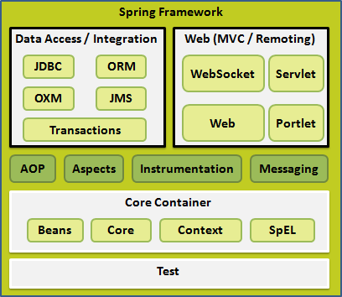
What does spring offer?
Dependency injection
Also known as IOC
(inversion of control)
Aspect oriented programming
Runtime injection-based
Portable service abstractions
The rest of spring
ORM, DAO, web MVC, web, etc.
Allows access to these without knowing how they actually work

Slide 9
Modules of the spring framework
The spring framework can be considered as a collection of frameworks-in-the-framework:
Core - inversion of control (ioc) and dependency injection
AOP - aspect-oriented programming
DAO - data access object support, transaction management, jdbc-abstraction
ORM - object relational mapping data access, integration layers for JPA, JDO, hibernate, and ibatis
MVC - model-view-controller implementation for web-applications
Remote access, authentication and authorization, remote management, messaging framework, web services, email, testing, …

Slide 10
Spring solutions
Solutions address major J2EE problem areas:
Web application development (MVC)
Enterprise java beans (EJB, JNDI)
Database access (JDBC, ibatis, ORM)
Transaction management (JTA, hibernate, JDBC)
Remote access (web services, RMI)
Each solution builds on the core architecture
Solutions foster integration, they do not re-invent the wheel

Slide 11
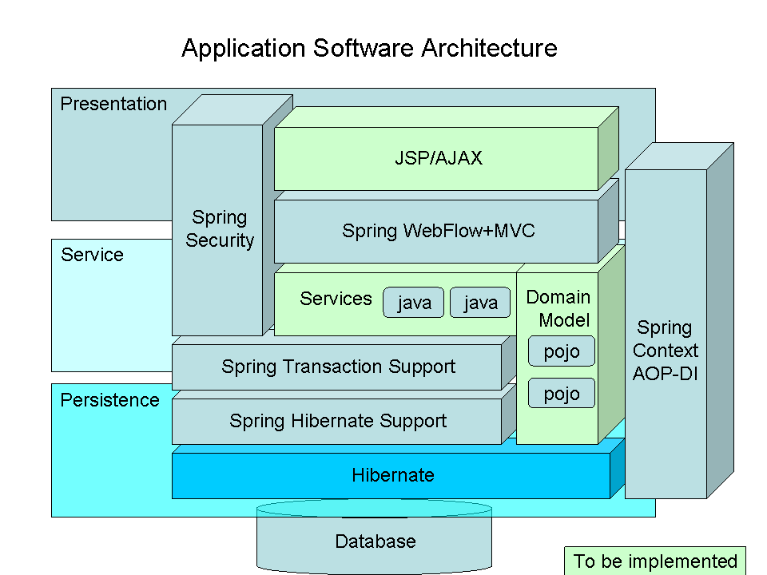
Spring Application

Slide 12
Advantages of spring architecture
Enable you to write powerful, scalable applications using pojos
Lifecycle – responsible for managing all your application components, particularly those in the middle tier container sees components through well-defined lifecycle: init(), destroy()
Dependencies - spring handles injecting dependent components without a component knowing where they came from (ioc)
Configuration information - spring provides one consistent way of configuring everything, separate configuration from application logic, varying configuration
In J2EE (e.g. EJB) it is easy to become dependent on container and deployment environment, proliferation of pointless classes (locators/delegates); spring eliminates them
Cross-cutting behavior (resource management is cross-cutting concern, easy to copy-and-paste everywhere)
Portable (can use server-side in web/ejb app, client-side in swing app, business logic is completely portable)

Slide 13
Inversion of control (IOC)
Central in the spring is its inversion of control container
Based on “inversion of control containers and the dependency injection pattern” (martin fowler)
Provides centralized, automated configuration, managing and wiring of application java objects
Container responsibilities:
Creating objects,
Configuring objects,
Calling initialization methods
Passing objects to registered callback objects
etc
All together form the object lifecycle which is one of the most important features

Slide 14
Ioc basics
Basic javabean pattern:
Include a “getter” and “setter” method for each field:
Rather than locating needed resources, application components provide setters through which resources are passed in during initialization
In spring framework, this pattern is used extensively, and initialization is usually done through configuration file rather than application code
Class MyBean {
private int counter;
public int getCounter()
{ return counter; }
public void setCounter(int counter)
{ this.Counter = counter; }
}

Slide 15
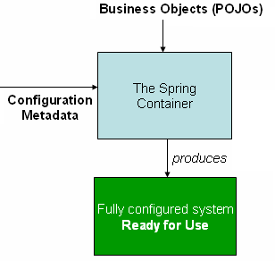
Dependency injection - ioc
Beans define their dependencies through constructor arguments or properties
Container resolves (injects) dependencies of components by setting implementation object during runtime
BeanFactory interface - the core that
loads bean definitions and manages beans
Most commonly used implementation
is the XmlBeanFactory class
Allows to express the objects that compose
application, and the interdependencies
between such objects, in terms of xml
The XmlBeanFactory takes this xml
configuration metadata and uses it to create a fully configured system

Slide 16
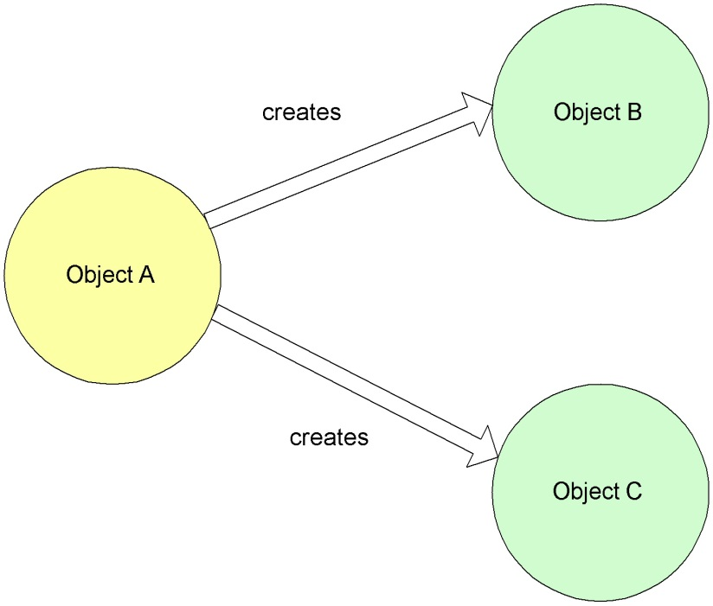
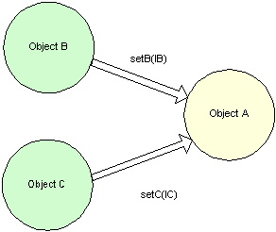
Non-IOC versus IOC
Non Inversion of Control approach
Inversion of Control approach

Slide 17
configuration metadata
spring configuration xml consists of at least one bean definition that the container must manage, but typically there will be more than one bean definition
<?xml version="1.0" encoding="utf-8"?>
<beans xmlns="http://www.springframework.org/schema/beans"
xmlns:xsi="http://www.w3.org/2001/xmlschema-instance" xsi:schemalocation="http://www.springframework.org/schema/beans http://www.springframework.org/schema/beans/spring-beans-4.0.xsd">
<bean id=“student"
class="com.college.Student"/>
<bean id=“teacher" class="com.college.Teacher"/>
<bean id=“dept" class="com.college.Dept">
<property name=“student" ref=“student"/>
<property name=“teacher" ref=“teacher"/>
</bean>
</beans>

Slide 18
Instantiating a container
Instantiating a spring ioc container is easy. Place config xml in classpath and from your code call:
Resource resource = new FileSystemResource("beans.xml");
BeanFactory factory = new XmlBeanFactory(resource);
Or
ClassPathResource resource = new ClassPathResource("beans.xml");
BeanFactory factory = new XmlBeanFactory(resource);
Or
ApplicationContext context =
new ClassPathXmlApplicationContext("applicationcontext.xml");
The applicationcontext interface builds on top of the
Beanfactory (it is a sub-interface) and adds other functionality

Slide 19
Using the container
The beanfactory interface has only six methods for client code to call:
boolean containsBean(string): returns true if the beanFactory contains a bean definition or bean instance that matches the given name.
Object getBean(string): returns an instance of the bean registered under the given name.
Object getBean(string, class): returns a bean, registered under the given name. The bean returned will be cast to the given class.
Class getType(string name): returns the class of the bean with the given name.
boolean isSingleton(string): determines if the bean under the given name is a singleton.
String[] getAliases(string): return the aliases for the given bean name, if any were defined in the bean definition.

Slide 20
What is a bean?
Java objects that are managed by the spring ioc container are referred to as beans
Typical java bean with a unique id
In spring there are basically two types
Singleton
One instance of the bean created and referenced each time it is requested
Prototype (non-singleton)
New bean created each time
Same as new classname()
Beans are normally created by spring as late as possible

Slide 21
What is a bean definition?
Defines a bean for spring to manage
Key attributes
class (required): fully qualified java class name
id: the unique identifier for this bean
configuration: (singleton, init-method, etc.)
constructor-arg: arguments to pass to the constructor at creation time
property: arguments to pass to the bean setters at creation time
collaborators: other beans needed in this bean (a.K.A dependencies), specified in property or constructor-arg
Typically defined in an XML file

Slide 22
Sample bean definition
<bean id="exampleBean" class=”org.example.ExampleBean">
<property name="beanOne"><ref bean="anotherExampleBean"/></property>
<property name="beanTwo"><ref bean="yetAnotherBean"/></property>
<property name="integerProperty"><value>1</value></property>
</bean>
public class ExampleBean {
private AnotherBean beanOne;
private YetAnotherBean beanTwo;
private int i;
public void setBeanOne(AnotherBean beanOne) {
this.beanOne = beanOne; }
public void setBeanTwo(YetAnotherBean beanTwo) {
this.beanTwo = beanTwo; }
public void setIntegerProperty(int i) {
this.i = i; }
…
}

Slide 23
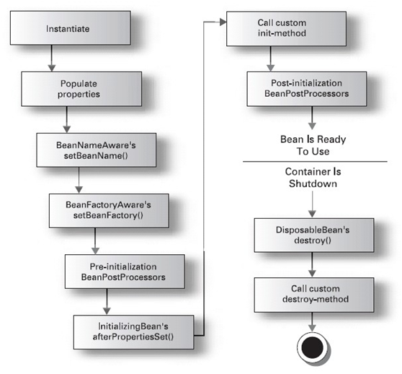
Bean Lifecycle

Slide 24
How are beans created?
Beans are created in order based on the dependency graph
Often they are created when the factory loads the definitions
Can override this behavior in bean
<bean class=“classname” lazy-init=“true” />
You can also override this in the factory or context but this is not recommended
Spring will instantiate beans in the order required by their dependencies
App scope singleton - eagerly instantiated at container startup
Lazy dependency - created when dependent bean created
VERY lazy dependency - created when accessed in code

Slide 25
What is a bean factory?
Often seen as an applicationcontext
Beanfactory is not used directly often
Applicationcontext is a complete superset of bean factory methods
Same interface implemented
Offers a richer set of features
Spring uses a beanfactory to create, manage and locate “beans” which are basically instances of a class
Typical usage is an XML bean factory which allows configuration via XML files

Slide 26
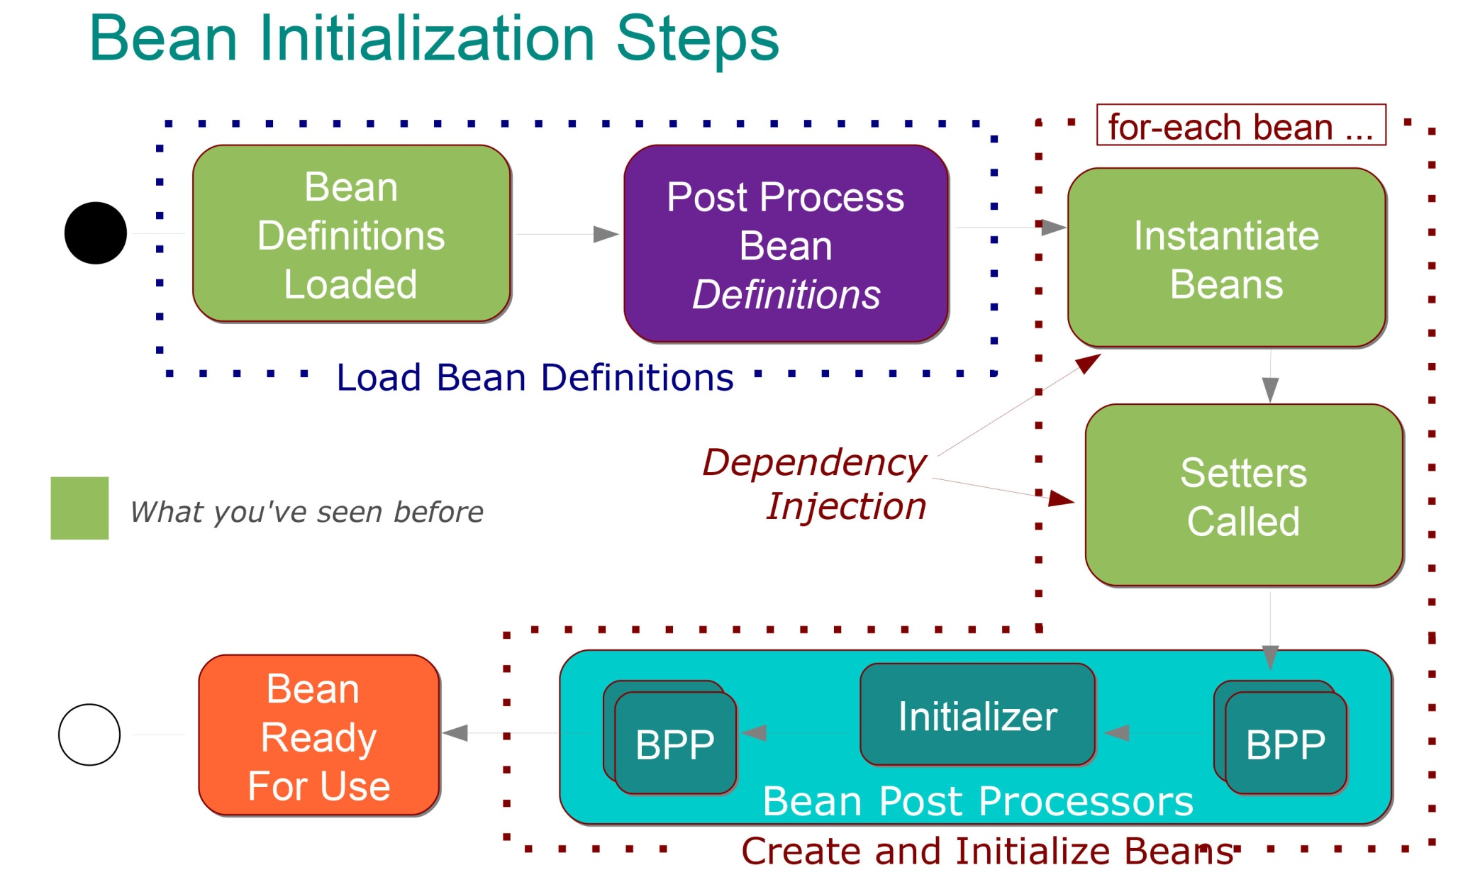

Slide 27
How are beans injected?
A dependency graph is constructed based on the various bean definitions
Beans are created using constructors (mostly no-arg) or factory methods
Dependencies that were not injected via constructor are then injected using setters
Any dependency that has not been created is created as needed

Slide 28
Spring bean definition
The bean class is the actual implementation of the bean being described by the beanfactory
Spring config contains implementation classes while your code should program to interfaces
Bean behaviors include:
Singleton or prototype
Autowiring
Initialization and destruction methods
Beans can be configured to have property values set
Can read simple values, collections, maps, references to other beans, etc

Slide 29
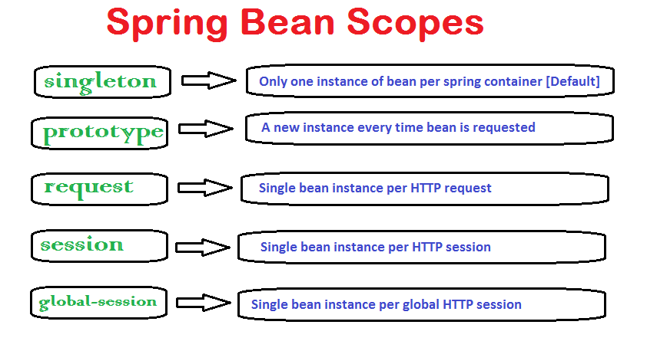

Slide 30
Setter/constructor injection
Dependency injection exists in two major variants:
<Bean id="examplebean" class="examples.Examplebean">
<!-- Setter injection using the nested <ref/> element -->
<property name="beanone"><ref bean="anotherexamplebean"/></property>
<!-- Setter injection using the neater 'ref' attribute -->
<property name="beantwo" ref="yetanotherbean"/>
<property name="integerproperty" value="1"/>
</bean>
<Bean id="anotherexamplebean" class="examples.Anotherbean"/>
<bean id="yetanotherbean" class="examples.Yetanotherbean"/>
Setter
Injection:
<Bean id="examplebean" class="examples.Examplebean">
<!-- Constructor injection using the nested <ref/> element -->
<constructor-arg><ref bean="anotherexamplebean"/></constructor-arg>
<!-- constructor injection using the neater 'ref' attribute -->
<constructor-arg ref="yetanotherbean"/>
<constructor-arg type="int" value="1"/>
</bean>
<Bean id="anotherexamplebean" class="examples.Anotherbean"/>
<bean id="yetanotherbean" class="examples.Yetanotherbean"/>
Constructor
injection:

Slide 31
Bean properties?
The primary method of dependency injection
Can be another bean, value, collection, etc.
<Bean id="examplebean" class="org.example.Examplebean">
<property name="anotherbean">
<Ref bean="someotherbean" />
</property>
</bean>
This can be written in shorthand as follows
<Bean id="examplebean" class="org.example.Examplebean">
<property name="anotherbean" ref="someotherbean" />
</bean>

Slide 32
Anonymous vs ID
Beans that do not need to be referenced elsewhere can be defined anonymously
This bean is identified (has an id) and can be accessed to inject it into another bean
<bean id="examplebean" class="org.example.Examplebean">
<property name="anotherbean" ref="someotherbean" />
</bean>
This bean is anonymous (no id)
<bean class="org.example.Examplebean">
<property name="anotherbean" ref="someotherbean" />
</bean>

Slide 33
What is an inner bean?
<bean id="outer" class="org.example.Somebean">
<property name="person">
<bean class="org.example.Personimpl">
<property name="name"><value>Arun</value></property>
<property name="age"><value>21</value></property>
</bean>
</property>
</bean>
It is a way to define a bean needed by another bean in a shorthand way
Always anonymous (id is ignored)
Always prototype (non-singleton)

Slide 34
Bean init-method
The init method runs AFTER all bean dependencies are loaded
Constructor loads when the bean is first instantiated
Allows the programmer to execute code once all dependencies are present
<bean id="examplebean“ class=”org.example.Examplebean"
init-method=”init” />
public class Examplebean {
public void init() {
// do something
}
}

Slide 35
Bean values
Spring can inject more than just other beans
Values on beans can be of a few types
Direct value (string, int, etc.)
Collection (list, set, map, props)
Bean
Compound property
Example of injecting a string value
<bean class="org.example.Examplebean">
<property name="email">
<Value>aarun@inautix.co.in</value>
</property>
</bean>

Slide 36
Abstract (parent) beans
Allows definition of part of a bean which can be reused many times in other bean definitions
The parent bean defines 2 values (name, age)
The child bean uses the parent age value (31)
The child bean overrides the parent name value (from parent-az to child-az)
Parent bean could not be injected, child could
<bean id="abstractbean" abstract="true"
class="org.example.Parentbean">
<property name="name" value="parent-az"/>
<property name="age" value="31"/>
</bean>
<bean id="childbean"
class="org.example.Childbean"
parent="abstractbean" init-method="init">
<property name="name" value="child-az"/>
</bean>

Slide 37
Autowiring mode
It is possible to automatically let spring resolve collaborators (other beans) for your bean by inspecting the contents of the beanfactory.
Mode | Explanation
no | No autowiring at all.
byName | Autowiring by property name. Will inspect the container and look for a bean named exactly the same as the property which needs to be autowired.
byType | Allows a property to be autowired if there is exactly one bean of the property type in the container.
constructor | This is analogous to byType, but applies to constructor arguments.
autodetect | Chooses constructor or byType through introspection of the bean class.

Slide 38
Dependency checking mode
This feature is sometimes useful when you want to ensure that all properties are set on a bean.
Mode | Explanation
none | No dependency checking. Properties of the bean which have no value specified for them are simply not set.
simple | Dependency checking is performed for primitive types and collections (everything except collaborators).
object | Dependency checking is performed for collaborators only.
all | Dependency checking is done for collaborators, primitive types and collections.

Slide 39
Lazy-initialization mode
The default behavior for applicationcontext implementations is to eagerly pre-instantiate all singleton beans at startup
If you do not want such a behavior, you can selectively control this by marking a bean definition as lazy-initialized
It is also possible to control lazy-initialization at the container level by using the 'default-lazy-init' attribute on the <beans/> element:
If lazy bean is the dependency of a not lazy singleton bean – don't be confused if the ioc container creates it!
<Bean id="lazy" class="com.Foo.Expensivetocreatebean" lazy-init="true"/>
<bean name="not.Lazy" class="com.Foo.Anotherbean"/>
<Beans default-lazy-init="true">
<!-- No beans will be pre-instantiated... -->
</Beans>

Slide 40
Init/destroy methods
Two ways to implement initialization/destruction callbacks:
Implementing initializingbean interface
Using the 'init-method' attribute
<Bean id="exampleinitbean" class="examples.Anotherexamplebean"/>
Public class anotherexamplebean implements initializingbean {
public void afterpropertiesset() {
// do some initialization work
}
}
<Bean id="exampleinitbean" class="examples.Examplebean" init-method="init"/>
Public class examplebean {
public void init() {
// do some initialization work
}
}

Slide 41
XmlBeanFactory example
Property and Constructor based IOC
<bean id="examplebean" class="examples.Examplebean">
<property name="beanone"><ref bean="anotherexamplebean"/></property>
<property name="beantwo"><ref bean="yetanotherbean"/></property>
<property name="integerproperty">1</property>
</bean>
<bean id="anotherexamplebean" class="examples.Anotherbean"/>
<bean id="yetanotherbean" class="examples.Yetanotherbean"/>
<bean id="examplebean" class="examples.Examplebean">
<constructor-arg><ref bean="anotherexamplebean"/></constructor-arg>
<constructor-arg><ref bean="yetanotherbean"/></constructor-arg>
<constructor-arg><value>1</value></constructor-arg>
</bean>
<bean id="anotherexamplebean" class="examples.Anotherbean"/>
<bean id="yetanotherbean" class="examples.Yetanotherbean"/>

Slide 42
Autowiring properties
Beans may be auto-wired (rather than using <ref>)
Per-bean attribute autowire
Explicit settings override
Autowire=“name”
Bean identifier matches property name
Autowire=“type”
Type matches other defined bean
Autowire=”constructor”
Match constructor argument types
Autowire=”autodetect”
Attempt by constructor, otherwise “type”

Slide 43
Dependency checking
Ensures properties are defined
Per-bean attribute dependency-check
None required by default
Verifies autowiring succeeded
“Simple”
All but collaborators
“Object”
Collaborators only
“All”
Collaborators, primitive types, and collections

Slide 44
Lifecycle customization
Can define init method called after properties set
Init-method=”<method-name>”
Can define destroy method as shutdown hook
Destroy-method=”<method-name>”
May alternatively implement initializingbean and/or disposablebean
At cost of spring dependency

Slide 45
BeanFactory miscellany
BeanFactoryAware interface provides BeanFactory for bean
setBeanFactory(beanfactory)
BeanNameAware interface provides bean name
setBeanName(string)
Factorybean for beans which are themselves factories
Object getObject()
boolean isSingleton()
Class getObjectType()

Slide 46
BeanFactory Usage
InputStream is = new FileInputStream("beans.xml");
XmlBeanFactory factory = new XmlBeanFactory(is);
MyBeanClass bean = (MyBeanClass)factory.getBean(“myBean”);
OR
ApplicationContext ctx = new ClassPathXmlApplicationContext("beans.xml");
MyBeanClass bean = (MyBeanClass)ctx.getBean(“myBean”);

Slide 47
ApplicationContext
Extends functionality of BeanFactory
Pre-instantiates singleton beans
Detects and registers BeanPostProcessors and BeanFactoryPostProcessors
Supports nesting of contexts
ApplicationListener and ApplicationEvents
Initialized and closed predefined
Custom may be created
MessageSource provides i18n messaging
<bean id=”messagesource” class=”...Resourcebundlemessagesource”/>
Contains list of bundle base names

Slide 48
ApplicationContext Example
<bean id="propertyConfigurer"
class="org.springframework.beans.factory.config.PropertyPlaceholderConfigurer">
<property name="location"><value>database.properties</value></property>
</bean>
<bean id="dataSource"
class="org.springframework.jdbc.datasource.DriverManagerDataSource">
<property name="driverClassName">
<value>${database.connection.driver_class}</value>
</property>
<property name="url">
<value>${database.connection.url}</value>
</property>
</bean>

Slide 49
Web Framework

Slide 50
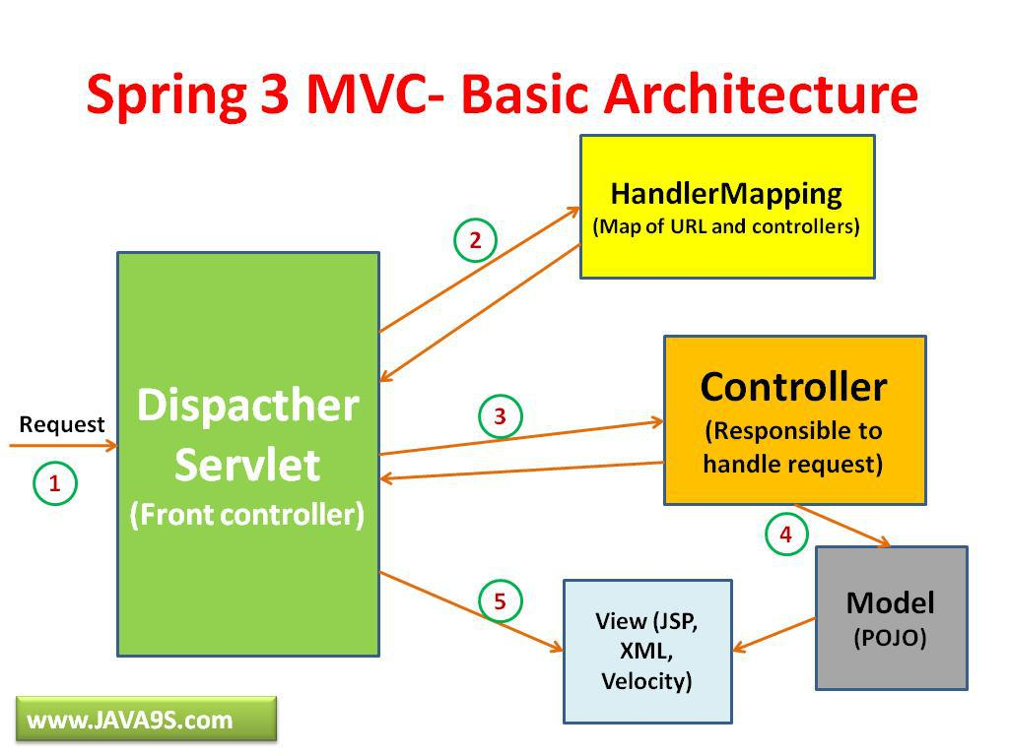

Slide 51
Web initialization
Web applications may use contextloaderlistener to initialize spring
web.xml
<listener>
<listener-class>org.springframework.web.context.contextloaderlistener</listener-class>
</listener>
Dispatcher Servlet
The dispatcherservlet is the spring front controller
Initializes webapplicationcontext
Uses /WEB-INF/[servlet-name]-servlet.Xml by default
Webapplicationcontext is bound into servletcontext

Slide 52
DispatcherServlet configuration
HandlerMapping
Routing of requests to handlers
HandlerAdapter
Adapts to handler interface. Default utilizes controllers
HandlerExceptionResolver
Maps exceptions to error pages
Similar to standard servlet, but more flexible
ViewResolver
Maps symbolic name to view
MultipartResolver
Handling of file upload
LocaleResolver
Default uses HTTP accept header, cookie, or session

Slide 53
Spring AOP

Slide 54
Spring AOP
Generally, applies aspects to beans using BeanFactory
Uses dynamic proxies if interface available otherwise CGLIB
CGLIB creates derived class which proxies requests
Bean class may not be final
Less capable than AspectJ
Does not have field interception
Only runtime weaving solution is available
Closer integration with AspectJ anticipated

Slide 55
AOP fundamentals
Aspect-oriented programming (AOP) provides for simplified application of cross-cutting concerns
Transaction management
Security
Logging
Auditing
Locking
AOP sometimes (partially) achieved via decorators or proxies
CORBA portable interceptors
Servlet filters

Slide 56
AOP fundamentals
Aspect - implementation of a cross-cutting concern.
Spring advisors or interceptors
Joinpoint - execution point to target
Typically, methods
Advice - action taken at a particular joinpoint.
Pointcut - a set of joinpoints specifying where advice should be applied (e.G. Regular expression)
Introduction/mixin - adding methods or fields to an advised class.
Weaving - assembling aspects into advised objects.

Slide 57
Aspect oriented programming defined
Attempts to separate concerns, increase modularity, and decrease redundancy
Separation of concerns (soc)
Break up features to minimize overlap
Don’t repeat yourself (DRY)
Minimize code duplication
Cross-cutting concerns
Program aspects that affect many others (e.G. Logging)
AspectJ is the top AOP package
Java like syntax, IDE integration

Slide 58
AOP in Spring
Provides way to create declarative services and custom aspects
Transaction management is the most common aspect (or concern)
Spring handles AOP via advisors or interceptors
Interception point is a joinpoint
A set of joinpoints are called a pointcut
Pointcuts are key to spring AOP, they allow intercepts without explicit knowledge of the OO hierarchy
Action taken by an interceptor is called advice

Slide 59
AOP Advice types
Around
Most common and powerful
Execute code before and after joinpoint
Before
Executes before joinpoint, cannot stop execution
Throws
Executes code if exception is thrown
After return
Executes code after normal joinpoint execution

Slide 60
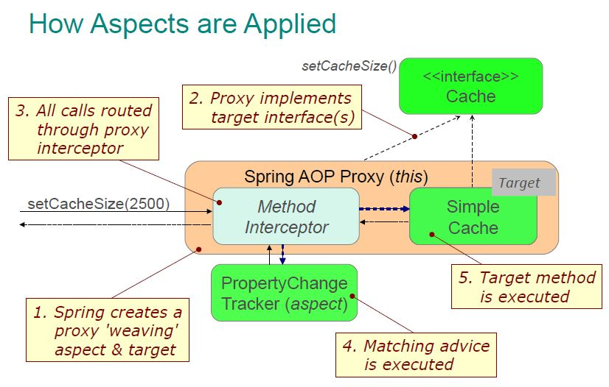

Slide 61
Spring pointcuts
Pointcut applicability to a class may be evaluated statically or dynamically
Spring only creates proxies where necessary
public interface Pointcut {
classfilter getClassFilter();
Methodmatcher getMethodMatcher();
}
public interface ClassFilter {
boolean matches(class clazz);
}

Slide 62
Pointcuts (cont'd)
Pointcut may be statically or dynamically evaluated based on isruntime()
Abstract class staticmethodmatcherpointcut requires override of 1st method only
public interface MethodMatcher {
boolean matches(Method m, Class targetClass);
boolean isRuntime();
boolean matches(Method m, Class targetClass, Object[] args);
}
Only called if isruntime() == true

Slide 63
Pointcuts (cont'd)
Spring predefined pointcuts
In org.Springframework.Aop.Support package
Regexpmethodpointcut
Union of multiple regular expressions
Uses jakarta ORO package
Controlflowpointcut
Similar to aspectj cflow
Applied if call stack includes specific class and, optionally, method
Unionpointcut
Merges pointcuts

Slide 64
Spring advice
Can have per-class or per-instance advice
Spring provides several advice types
Around advice
AOP alliance compliant
Must call invocation.Proceed() to call target
public class MyAdvice implements AroundAdvice {
Object invoke(MethodInvocation invocation) {
// change arguments, start transaction, lock, etc.
invocation.proceed();
// change return value, stop transaction, unlock,etc.
}
}

Slide 65
Spring advice
Methodbeforeadvice
void before(method m, object[] args, object target)
Cannot alter return type
Throwsadvice
Marker interface
Implementors define methods of form:
afterThrowing([method], [args], [target], subclassofthrowable)
Afterreturningadvice
void afterReturning(object returnvalue, method, m, object[] args, object target)
Cannot modify return value

Slide 66
Spring advice
Introductioninterceptor provides ability to define mixins
public class RollbackAdvice extends DelegatingIntroductionInterceptor
implements RollbackSupport {
Map map = new HashMap();
void rollback(Date date) {
// rollback to state at given time
}
public Object invoke(MethodInvocation invocation) {
// record change and time of change
}
}

Slide 67
Injecting Advice
<bean id=“meetingTarget" class=“ex.DefaultMeeting“
singleton=“false”>
<property name=“topic">Spring</property>
</bean>
<bean id="myAdvisor" class=“ex.RollbackAdvice"
singleton=”false”>
</bean>
<bean id="debugInterceptor"
class="org.springframework.aop.interceptor.DebugInterceptor">
</bean>

Slide 68
Injecting Advice (cont'd)
<bean id=“meeting"
class="org.springframework.aop.framework.ProxyFactoryBean">
<property name="proxyInterfaces">
<value>ex.Meeting</value>
</property>
<property name="target"><ref local=“meetingTarget"/></property>
<property name="interceptorNames">
<list>
<value>myAdvisor</value>
<value>debugInterceptor</value>
</list>
</property>
</bean>
All methods
using CGLib
if none defined
Advisors applied in order

Slide 69
Portable Service Abstractions defined
Services that easily move between systems without heavy reworking
Ideally easy to run on any system
Abstraction without exposing service dependencies
LDAP access without knowing what LDAP is
Database access without typical JDBC hoops
Basically everything in spring that is not IOC or AOP

Slide 70
Spring AOP key points
Pure java implementation
Allows method interception
No field or property intercepts yet
AOP advice is specified using typical bean definitions
Closely integrates with spring ioc
Proxy based AOP
J2SE dynamic proxies or CGLIB proxies
Not a replacement for AspectJ

Slide 71
Recommended URLs
Spring overview , Modules & Injection and AOP
Spring Core basics
Spring Core Tchnologies in Depth , Data Access , MVC Framework
Other References:
Reference 1: Quick Start guide
WikiPedia Overview - Spring

