Slide 1
ASSIGNMENT 3
UNIVERSITY MODEL

Slide 2
PROBLEM
TO MEASURE
QUALITY OF EDUCATION
OF THE UNIVERSITIES
AND RANK ACCORDINGLY

Slide 3
THE APPROACH IS TO LOOK INTO, HOW COURSES, FACULY AND EMPLOYERS HELP IN THE PROFESSIONAL GROWTH.
APPROACH

Slide 4
SOLUTION
The purpose is to store the feedback provided by the employer or alumni and use it to analyse the data.
Based on the feedback, the rank for courses will be calculated.
The courses which are helpful for professional growth will be ranked higher than other courses.
The growth of the student is tracked based on the data collected.

Slide 5
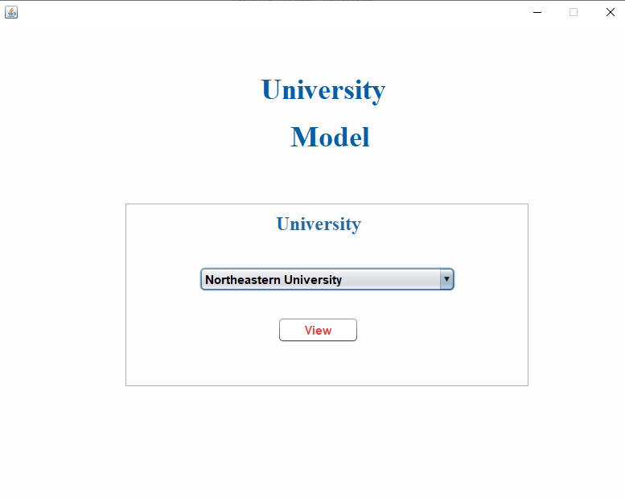
UI DESIGN

Slide 6
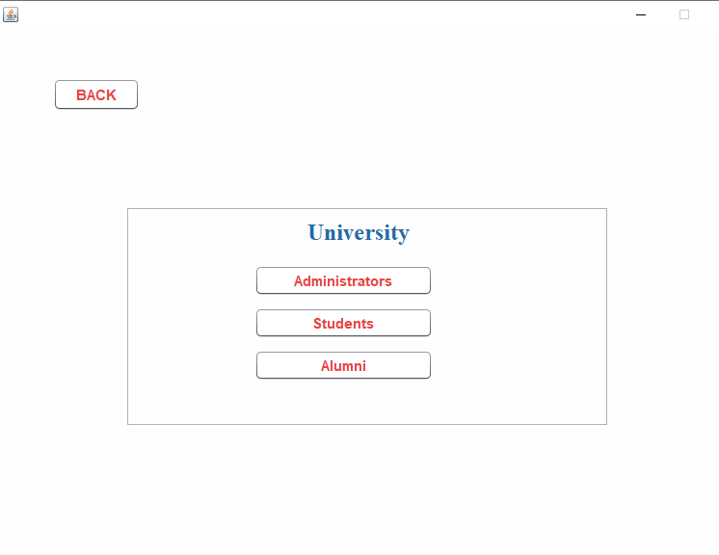
DIFERENT VIEWS

Slide 7
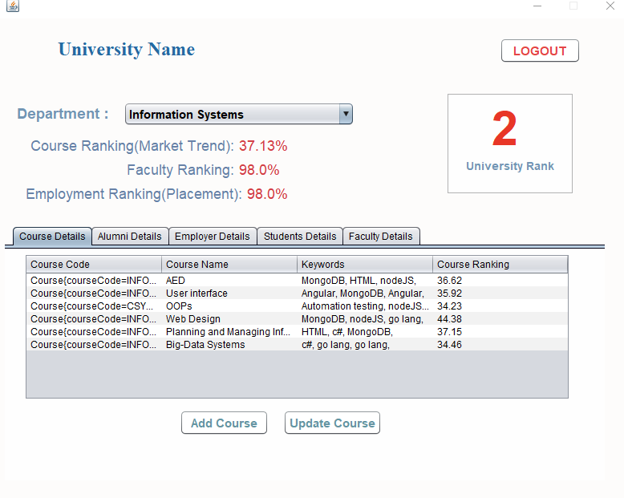
COURSE RANKING
Course RATING is calculated based on feedback by alumni and employer

Slide 8
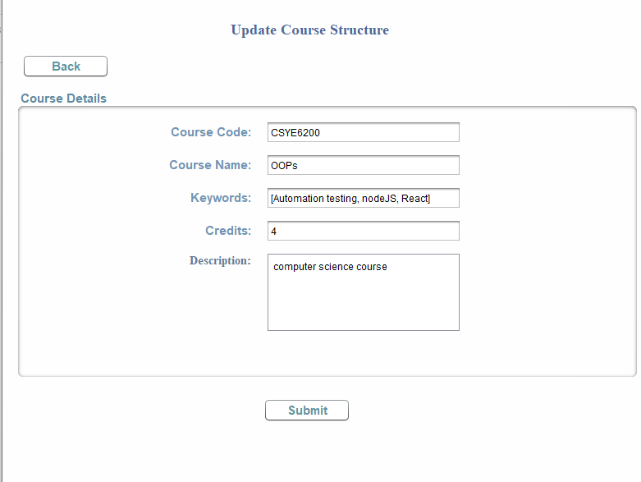
UPDATE COURSES

Slide 9
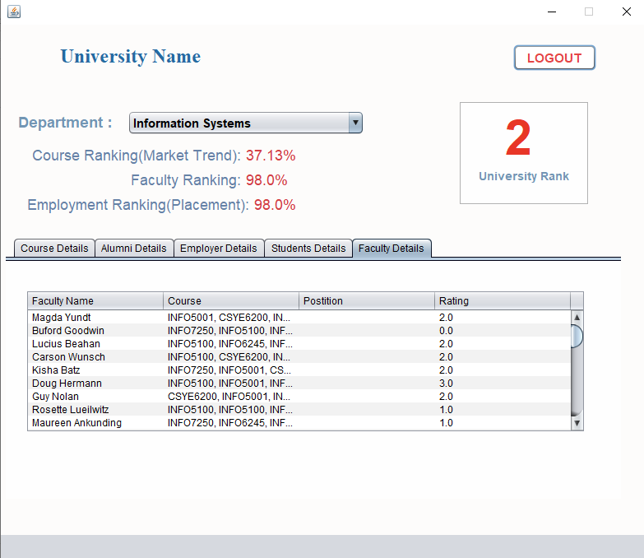
FACULTY RATING

Slide 10
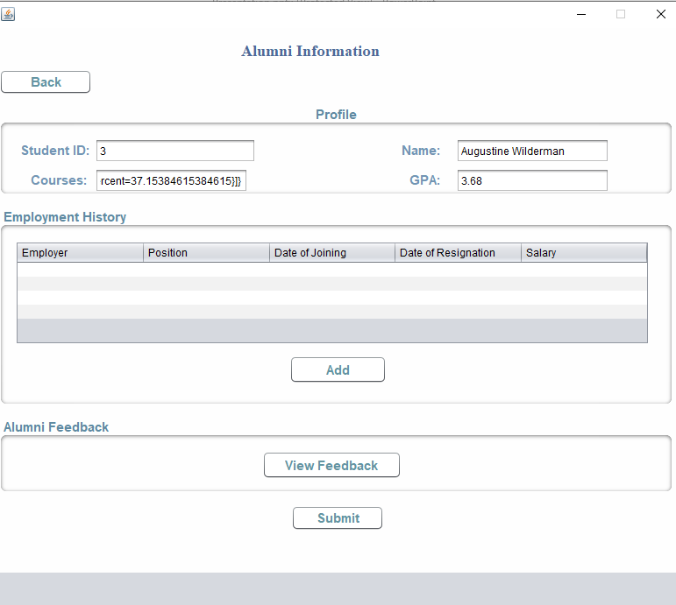
ALUMNI INFORMATION
Here all the information about the alumni
Is retrieved
Employment history about the alumni is maintained here

Slide 11
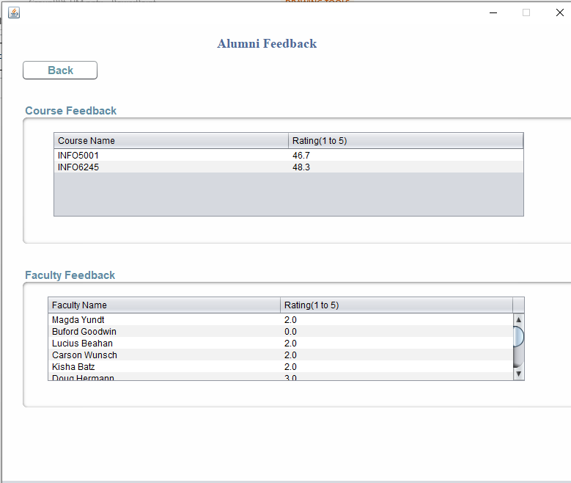
ALUMNI FEEDBACK
ALUMNI GIVES FEEDBACK ABOUT THE COURSE AND FACULTY

Slide 12
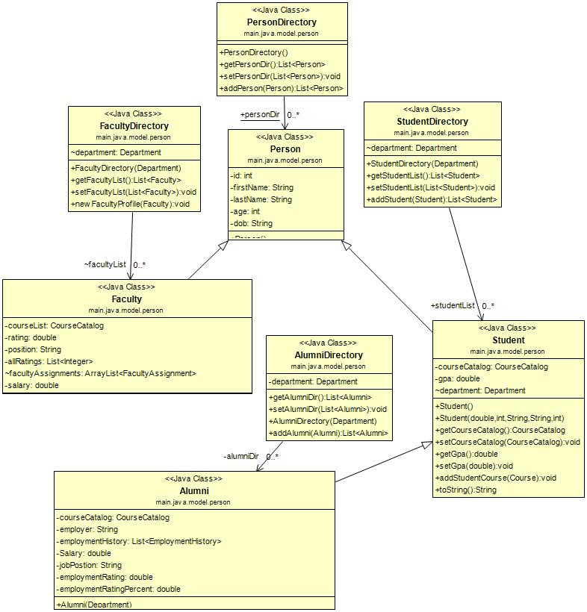
HIERARCHY FOR DIFFERENT PEOPLE

Slide 13
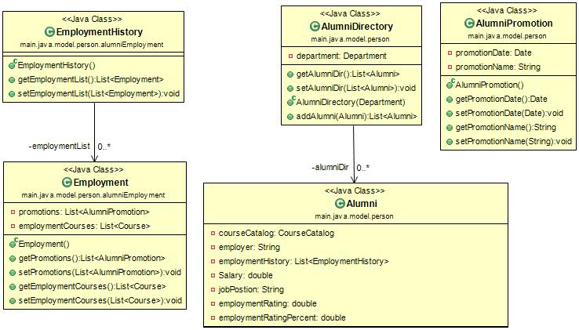
ALUMNI AND EMPLOYMENT

Slide 14
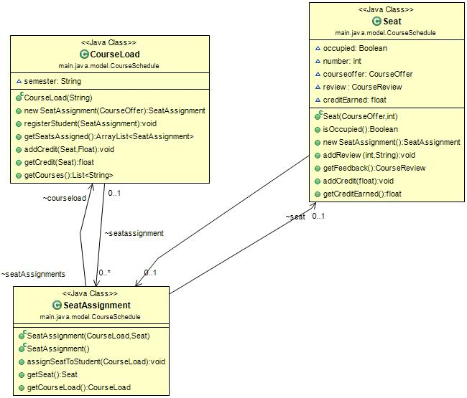
SEAT ASSIGNMENT

Slide 15
COURSE RANKING BY ALUMNI
ALUMNI
DEPARTMENT
COURSECATALOG
getCourseList()
getDepartments()
IF ALUMNI COURSE LIST CONTAINS DESIRED COURSE
UNIVERSITY
YES
NO
setCourseRating()
ALUMNI GIVES RATING FOR THE COURSE
END

Slide 16
COURSE RANKING BY EMPLOYER
If CourseList contains DemandCOURSES
EMPLOYER DIRECTORY
getEmployerList()
EMPLOYER
getinDemandCourses()
NO
COURSE
getCourseList()
YES
setCourseRating()
GIVE RATE
END

Slide 17
CUMULATIVE DEPARTMENT RANKING
getCourseList()
CALCULATE COURSERANKINg SUM
DEPARTMENT
COURSE CATALOG
CALCULATE CUMULATIVE RANKING

Slide 18
EMPLOYMENT RATING
Alumni Salary is fetched and
Based on the amount of the
Salary – JobPosition is calculated
And employment rating is calculated
getJobPosition()
ALUMNI
getSalary()
HIGHER THE POSITION – HIGHER THE REMPLOYMENT RATING FOR THAT PARTICULAR ALUMNI
getEmploymentRating()

Slide 19
FAKER PACKGE
WE USED THE FAKER PACKAGE TO GENERATE DATA.
WE HAVE GENEARTED DATA FOR DIFFERENT DEPARTMENTS IN THE UNIVERSITY AND ALSO MULTIPLE COURSES ARE ASSIGNED TO DEPARTMENTS.
DATA FOR STUDENTS, FACULTY AND EMPLOYER IS ALSO GENERATED.

