Slide 1
ASSIGNMENT 3
UNIVERSITY MODEL

Slide 2
PROBLEM
TO MEASURE
QUALITY OF EDUCATION
OF THE UNIVERSITIES
AND RANK ACCORDINGLY

Slide 3
THE APPROACH IS TO LOOK INTO, HOW COURSES, FACULY AND EMPLOYERS HELP IN THE PROFESSIONAL GROWTH.
APPROACH

Slide 4
SOLUTION
The purpose is to store the feedback provided by the employer or alumni and use it to analyse the data.
Based on the feedback, the rank for courses will be calculated.
The courses which are helpful for professional growth will be ranked higher than other courses.
The growth of the student is tracked based on the data collected.

Slide 5
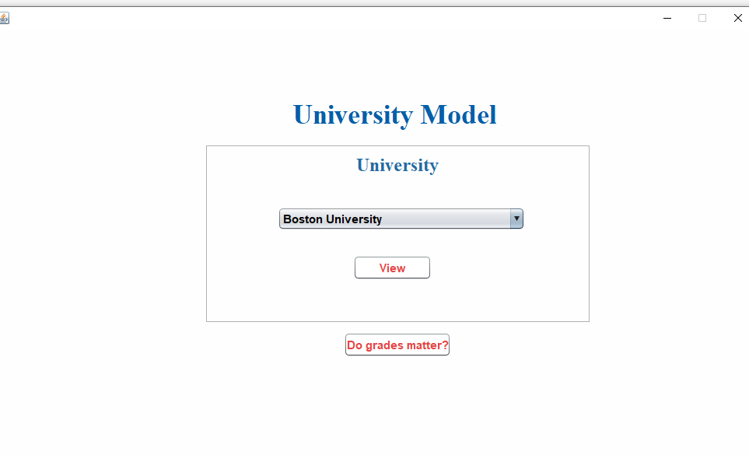
UI DESIGN

Slide 6
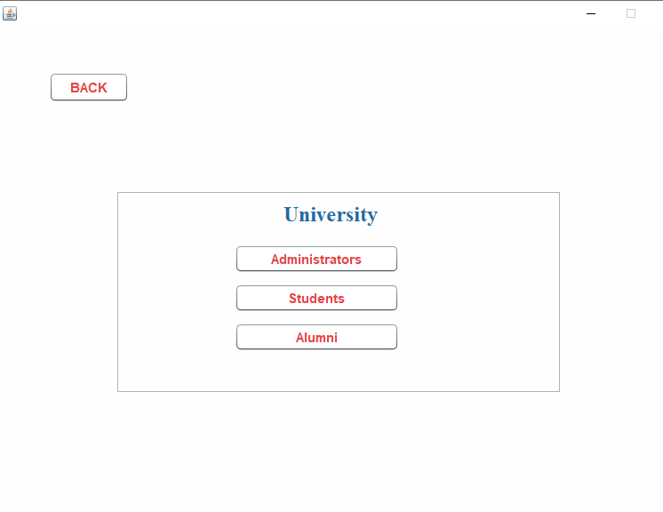
DIFERENT VIEWS

Slide 7
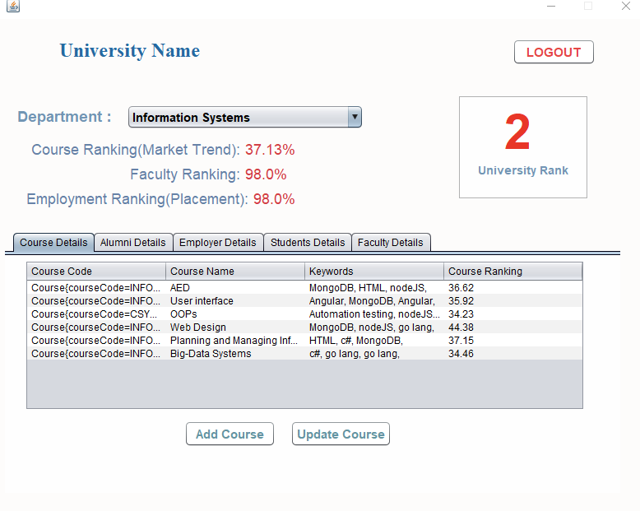
COURSE RANKING
Course RATING is calculated based on feedback by alumni and employer

Slide 8
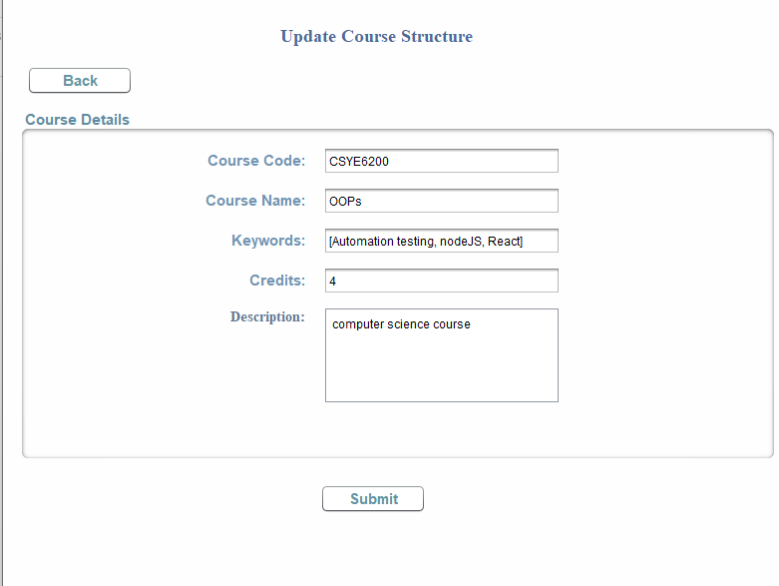
UPDATE COURSES

Slide 9
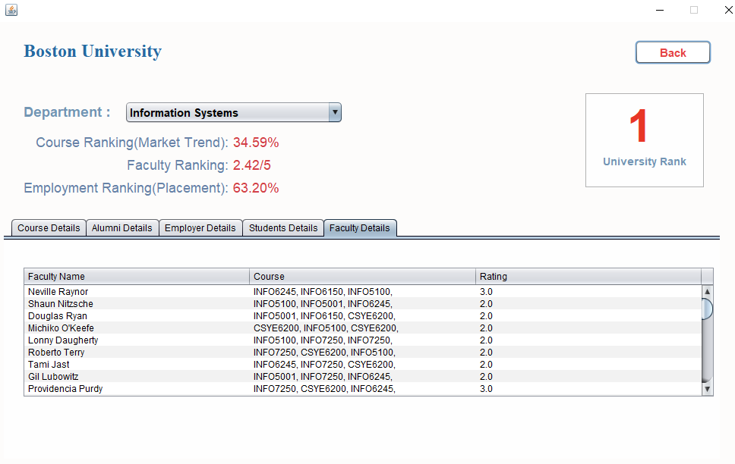
FACULTY RATING

Slide 10
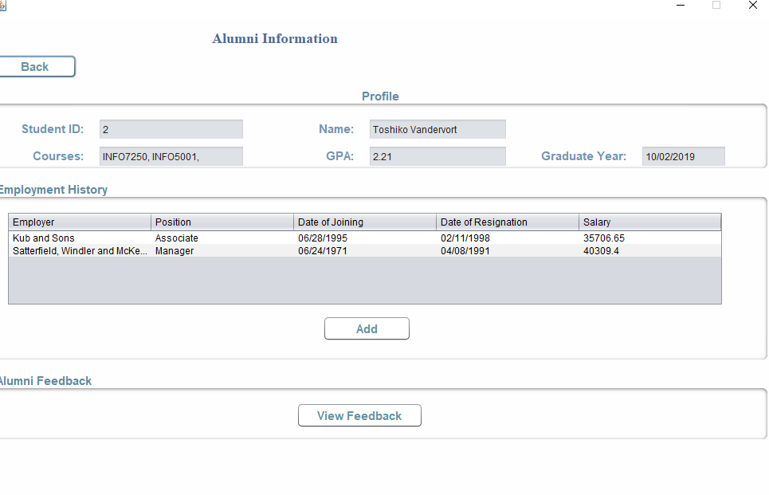
ALUMNI INFORMATION
Here all the information about the alumni
Is retrieved
Employment history about the alumni is maintained here

Slide 11
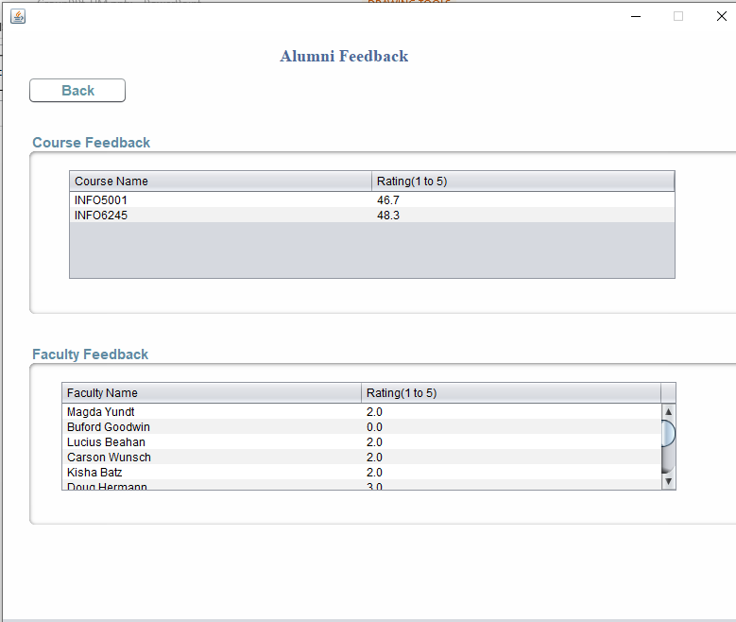
ALUMNI FEEDBACK
ALUMNI GIVES FEEDBACK ABOUT THE COURSE AND FACULTY

Slide 12
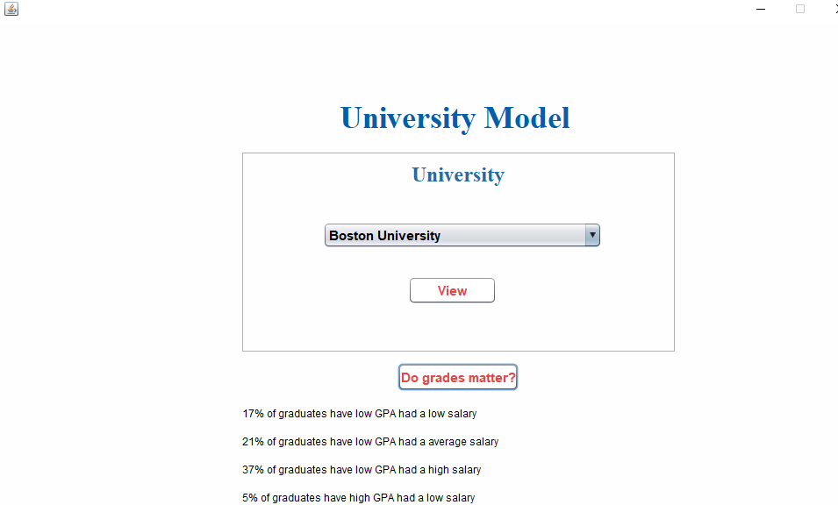
DO GRADES MATTER?

Slide 13
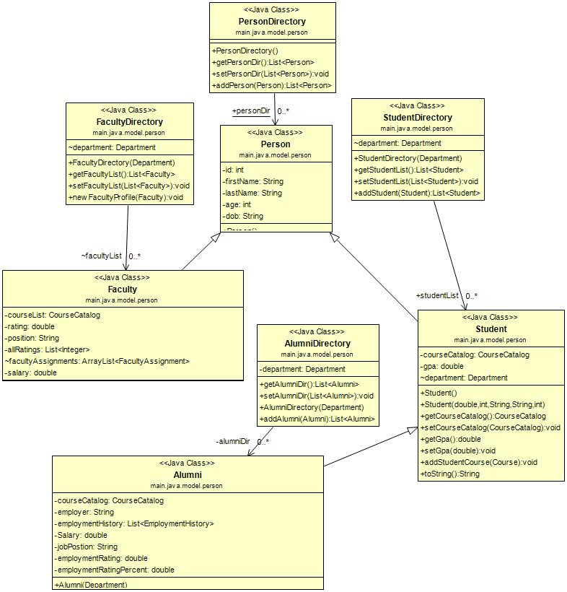
HIERARCHY FOR DIFFERENT PEOPLE

Slide 14
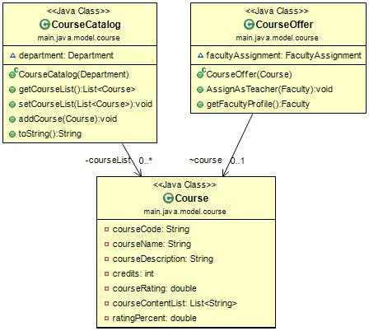
COURSES MODEL

Slide 15
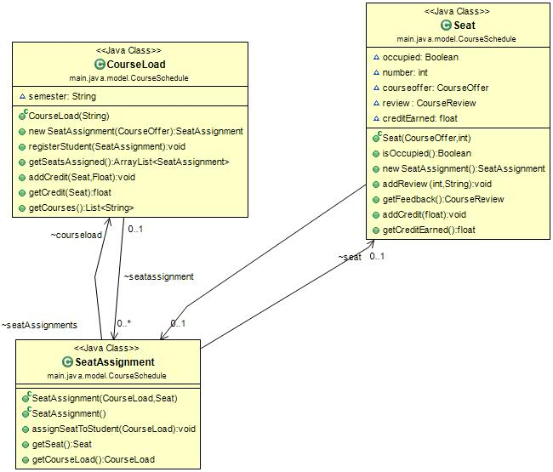
SEAT ASSIGNMENT

Slide 16
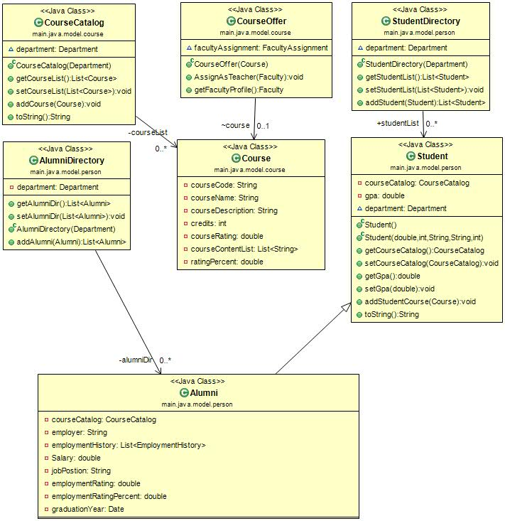
COURSE STUDENT ALUMNI

Slide 17
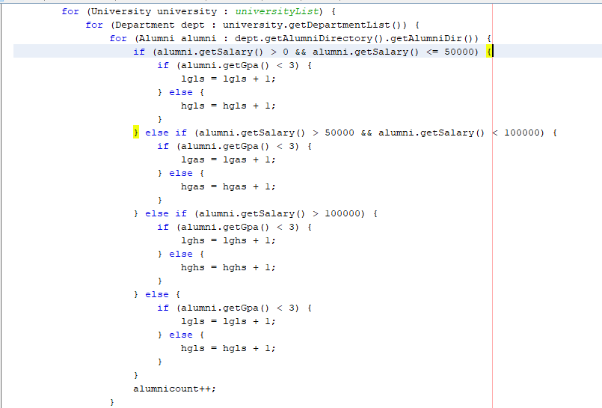
DO GRADES MATTER?
UNIVERSITY
DEPARTMENT
getSalary()
If GPA < 3
ALUMNI
CHECK SALARY OF STUDENTS HAVING GPA < 3

Slide 18
COURSE RANKING BY ALUMNI
ALUMNI
DEPARTMENT
COURSECATALOG
getCourseList()
getDepartments()
IF ALUMNI COURSE LIST CONTAINS DESIRED COURSE
UNIVERSITY
YES
NO
setCourseRating()
ALUMNI GIVES RATING FOR THE COURSE
END

Slide 19
COURSE RANKING BY EMPLOYER
If CourseList contains DemandCOURSES
EMPLOYER DIRECTORY
getEmployerList()
EMPLOYER
getinDemandCourses()
NO
COURSE
getCourseList()
YES
setCourseRating()
GIVE RATE
END

Slide 20
CUMULATIVE DEPARTMENT RANKING
getCourseList()
CALCULATE COURSERANKING SUM
DEPARTMENT
COURSE CATALOG
CALCULATE CUMULATIVE RANKING

Slide 21
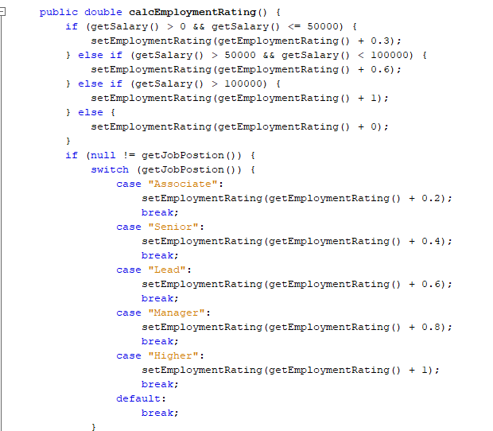
EMPLOYMENT RATING
getJobPosition()
ALUMNI
getSalary()
Alumni Salary is fetched and
Based on the amount of the
Salary – JobPosition is calculated
And employment rating is calculated
getEmploymentRating()
HIGHER THE POSITION – HIGHER THE EMPLOYMENT RATING FOR THAT PARTICULAR ALUMNI

Slide 22
FAKER PACKGE
WE USED THE FAKER PACKAGE TO GENERATE DATA.
WE HAVE GENEARTED DATA FOR DIFFERENT DEPARTMENTS IN THE UNIVERSITY AND ALSO MULTIPLE COURSES ARE ASSIGNED TO DEPARTMENTS.
DATA FOR STUDENTS, FACULTY AND EMPLOYER IS ALSO GENERATED.

