Slide 1



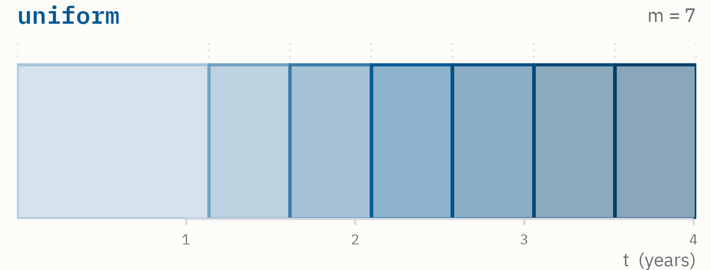
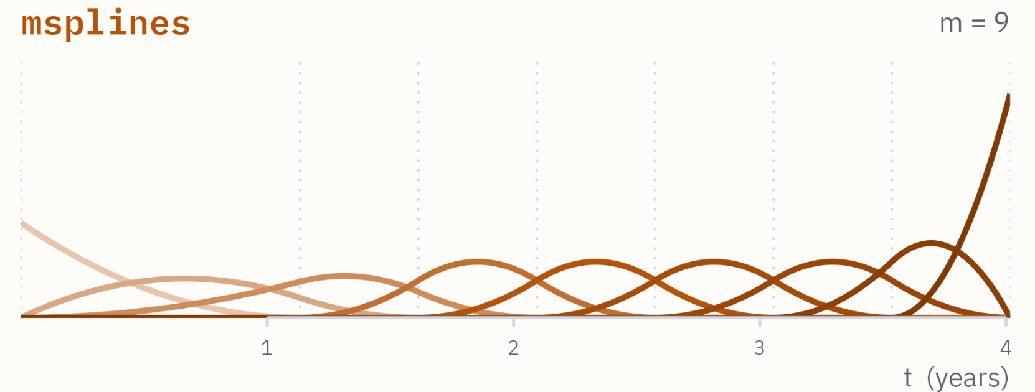
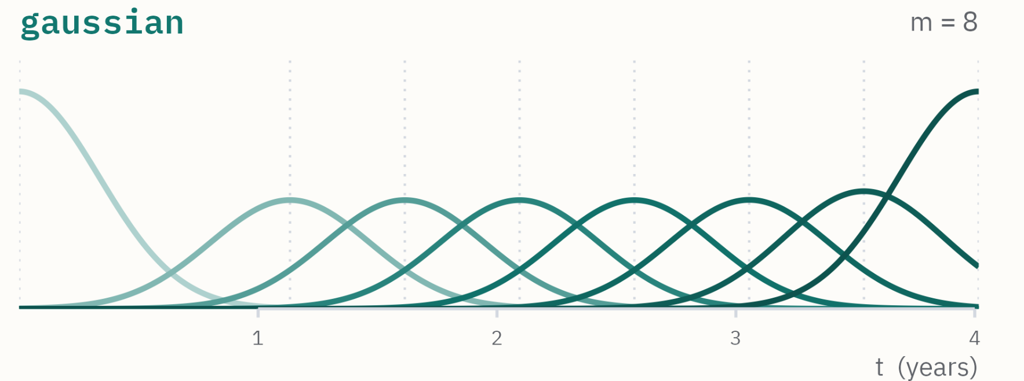
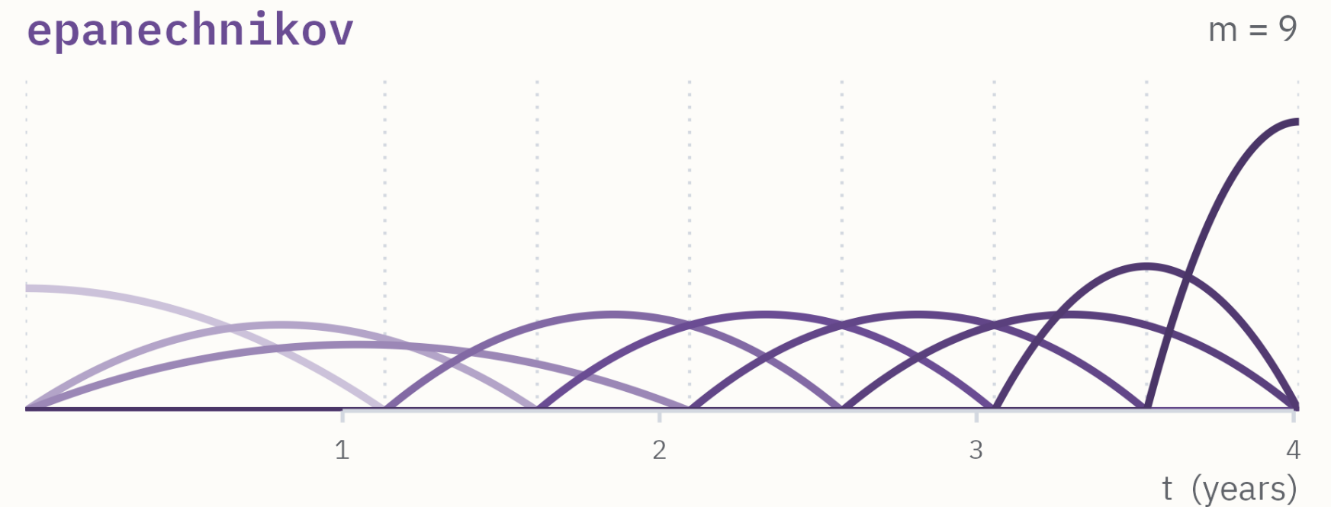
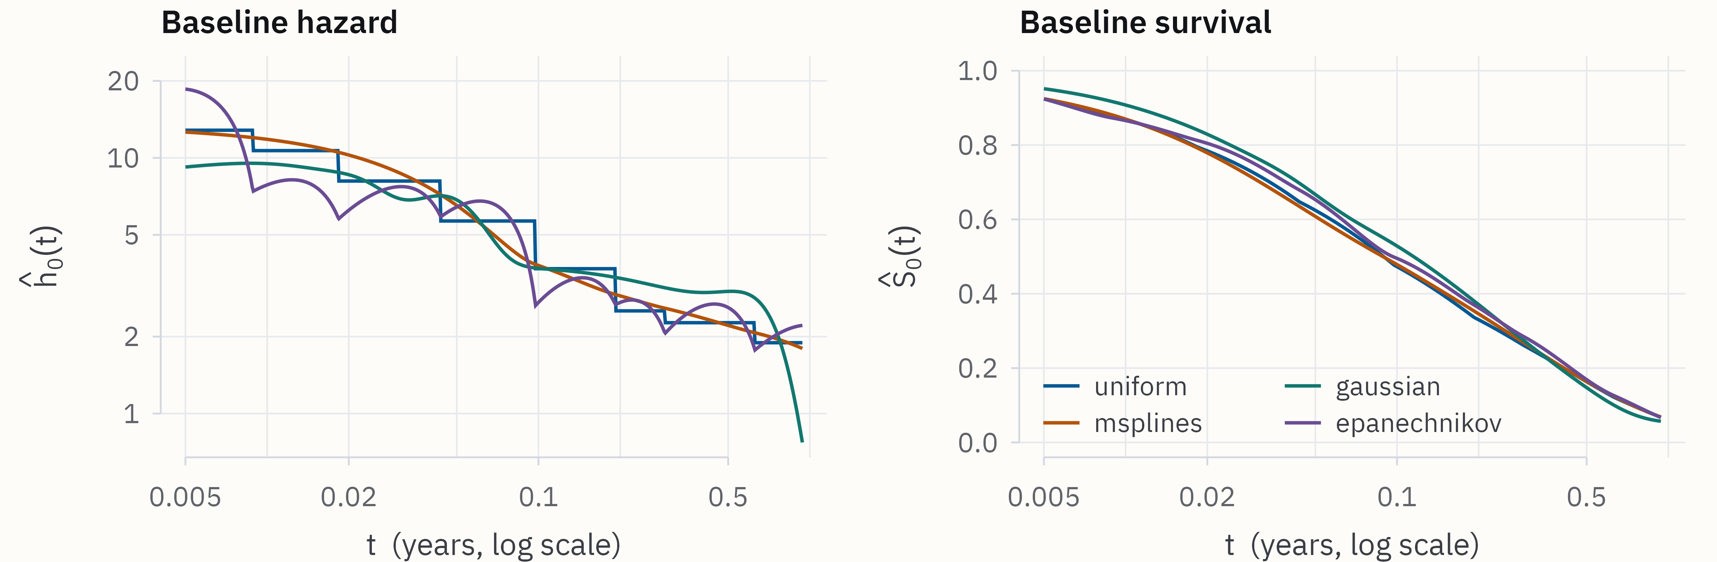

Penalised Maximum Likelihood
for Interval-Censored Survival Data
The survivalMPL R package
`
N. Mozgunov¹, D.-L. Couturier¹, S. Lo², J. Ma³
Download this poster
¹ MRC Biostatistics Unit, University of Cambridge · ²Melanoma Institute Australia · ³ Macquarie University
THE PROBLEM
OBSERVATION SCHEMES SUPPORTED
Trials observe visits, not events. The event time is known only to lie between two assessments.
under observation
event lies in here
assessment visit
exact event time
Exact event
Most survival software handles this by discarding the interval or collapsing it to a single imputed time. survivalMPL fits a Cox model to exact, right-, left- and interval-censored data in one likelihood, with optional delayed entry, and returns a smooth estimate of the baseline hazard rather than a step function.
event time recorded
Right censored
last contact
Left censored
Where an interval is replaced by a single imputed time, that imputation is then treated as if it had been observed, so standard errors are understated and bias increases with the width of the interval. Maximum penalised likelihood instead considers each interval as recorded and estimates the baseline hazard jointly with the regression coefficients.
first assessment
Interval censored
visit k
visit k+1
Left truncated
delayed entry
4
5
6
7
basis families for the baseline hazard
observation schemes, one likelihood
S3 methods for fitted objects
worked tutorials on the docs site
ARCHITECTURE
BASELINE HAZARD BASES
Four separated stages, one stable user-facing API.
The baseline hazard is defined as a non-negative mixture of basis functions.
Model specification
uniform
formula · Surv(type = "interval2") · entry=
Piecewise-constant function. The package default, and the only basis that supports delayed entry.
Estimation
coefficients via penalised likelihood with non-negativity constraints
msplines
Inference
Cubic M-splines, the usual recommendation.
standard errors, confidence intervals for coefficients,
confidence bounds for hazard-related functions
gaussian
Post-processing
Truncated Gaussian kernels.
print · summary · predict · residuals · plot
epanechnikov
A WORKED EXAMPLE
bcos2: breast cosmesis after radiotherapy
Compact parabolic kernels.
1 THE CALL
library(survivalMPL)
fit <- coxph_mpl(Surv(left, right, type = "interval2") ~ treatment,
data = bcos2, basis = "msplines")
SMOOTHING & METHODS
2 WHAT IT RETURNS
λ, the penalisation parameter, is selected automatically by marginal likelihood or held fixed at a value user supplies.
Non-negativity of θ, the baseline hazard estimates, is a constraint inside the optimiser, not a correction applied afterwards.
> summary(fit)$Beta
Estimate Std. Error z-value Pr(>|z|)
treatmentRadChem 0.89355 0.29414 3.03787 0.00238
HR 2.5% 97.5%
treatmentRadChem 2.44 1.37 4.35
> predict(fit, type = "survival", i = 47, time = c(24, 36))
time survival se low high
24 0.4499 0.0574 0.3351 0.5648
36 0.2273 0.0461 0.1351 0.3194
coef()
summary()
predict()
residuals()
plot()
print()
3 WHAT IT MEANS
Adding chemotherapy raises the instantaneous rate of breast retraction by a factor of 2.44 (95% CI 1.37 to 4.35) compared to the radiotherapy-only group. For a woman given both, the fitted probability of remaining free of deterioration is 45% (34 to 56) at two years and 23% (14 to 32) at three.
DOCUMENTATION & REPRODUCIBILITY
IN PRACTICE
A pkgdown site with worked examples.
By combining our rigorous penalised likelihood framework with an extensible and openly documented implementation, survivalMPL brings exact, right-, left- and interval-censored observations, and delayed entry, into a single analysis rather than a collection of workarounds.
The worked examples and reference documentation lower the barrier for clinicians, trialists and applied statisticians, and reduce reliance on ad hoc approaches that discard or misrepresent the censoring the trial actually observed.
Getting-started vignette
Right, left, interval censoring
Left truncation, profile likelihood
Bases and control parameters
coxph() vs coxph_mpl()
Searchable, cross-linked reference
Ma, Jun, Couturier, Dominique-Laurent, Heritier, Stephane and Marschner, Ian C.. "Penalized likelihood estimation of the proportional hazards model for survival data with interval censoring" The International Journal of Biostatistics, vol. 18, no. 2, 2022, pp. 553-575. https://doi.org/10.1515/ijb-2020-0104
Ma J., Webb A., Hudson H. M. (2024). Likelihood Methods in Survival Analysis: With R Examples. Chapman and Hall/CRC, Boca Raton.
Full documentation https://tinyurl.com/survivalMPL
Bhaskaran A., Liquet B., Ma J. Maximum profile likelihood for Cox models under left truncation and right censoring. Macquarie University.
nikita.mozgunov@mrc-bsu.cam.ac.uk
ICTMC 2026 · Birmingham
Notes:
Single-slide version of the A0 poster: the problem, the four-stage architecture, the four basis families, the documentation site, and the adoption argument.

