Slide 1
HDSC WINTER ‘22
Topic: Online Job Posting
Jobs and career
Project code: PP22/J609

Slide 2
Team Members
Joseph Ologunja
Evans Olonde
Omoh Joseph
Elishama Yomi-Agbajor
Pelumi Ogunlusi
Nitika Yadav
Daniel Olatunji
Victor Anoke
Ugochukwu Umeh
Emoghena Itakepe
Ogwang Tonny
Ayoyomide Akin-Ojo
Damilola Omolusi
Ibrahim Aderinto
Egbine Oghenero
Ekhoegbe Christian

Slide 3
Presentation Flow
Introduction
Objectives
Dataset
Methodology
Data Cleaning
Exploratory Data Analysis
Conclusion and findings
Recommendations

Slide 4
Introduction
The demand for jobs in the labor market is continuously evolving with the use of technology to advertise job openings, hence, the need to understand the demand for certain job titles and professions. There is also a need to identify skills that are most frequently required by employers, how the distribution of necessary skills changes over time and making recommendations to job seekers and employers.
The online job market is a good indicator of overall demand for labor in the local economy. In addition, online job postings data are easier and quicker to collect and they can be richer source of information than more traditional job postings, such as those found in printed newspapers.

Slide 5
Objectives
The project’s main objectives are;
The demands for certain professions and job titles
Identify skills that are most frequently required by employers
Distribution of necessary skills changes over time
Make recommendations to job seekers and employers

Slide 6
Dataset
The data used in this project was extracted from https://www.kaggle.com/madhab/jobposts
The dataset consists of 19,000 job postings that were posted through the Armenian Human Resource Portal Career Center. The dataset representation is tabular, but many of the columns are textual/unstructured in nature. There are 24 columns in the dataset to describe various job posts. The column jobpost is an amalgamation of these various textual columns. The data also consists of job posts from 2004-2015.

Slide 7
Methodology
The following steps were taken during the process of analysis of the data:
Data understanding
Data cleaning
Data exploration
Data analysis
Visualizations
Recommendation

Slide 8
Data Cleaning
Columns in the dataset were renamed for easy identification.
All duplicated rows in the jobpost column were removed using the drop_duplicates() function.
Null values in Title column was dropped as it would have no significant effect on the data set.
The next action carried out was the creation of a new dataframe (job_demand) containing a subset of the data with only the columns required to answer each of the objectives.

Slide 9
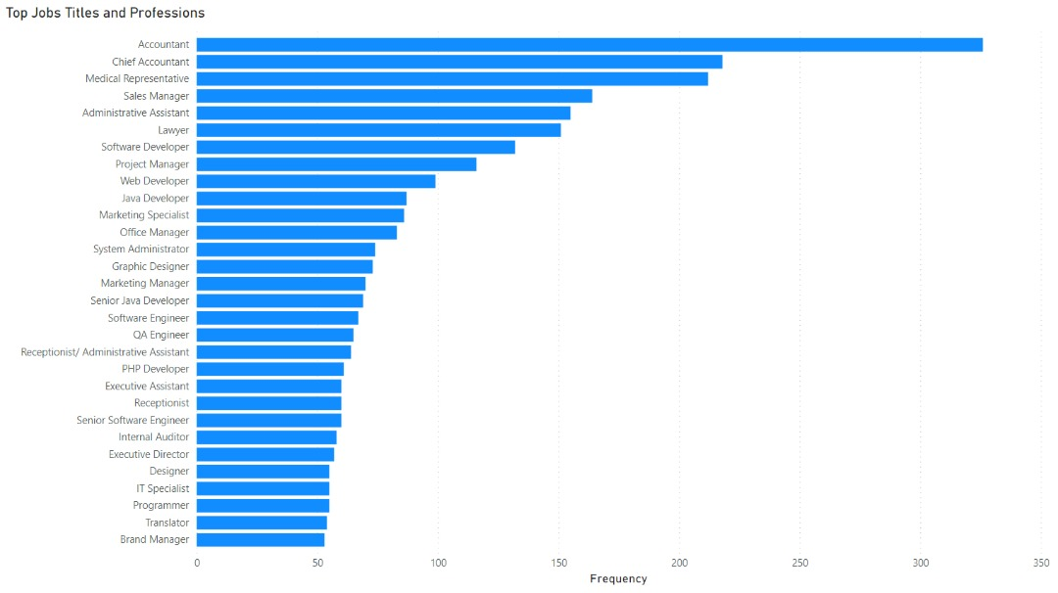
Data Analysis

Slide 10
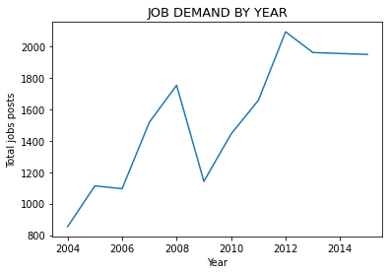
Data Analysis

Slide 11
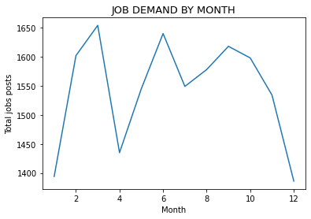
Data Analysis

Slide 12
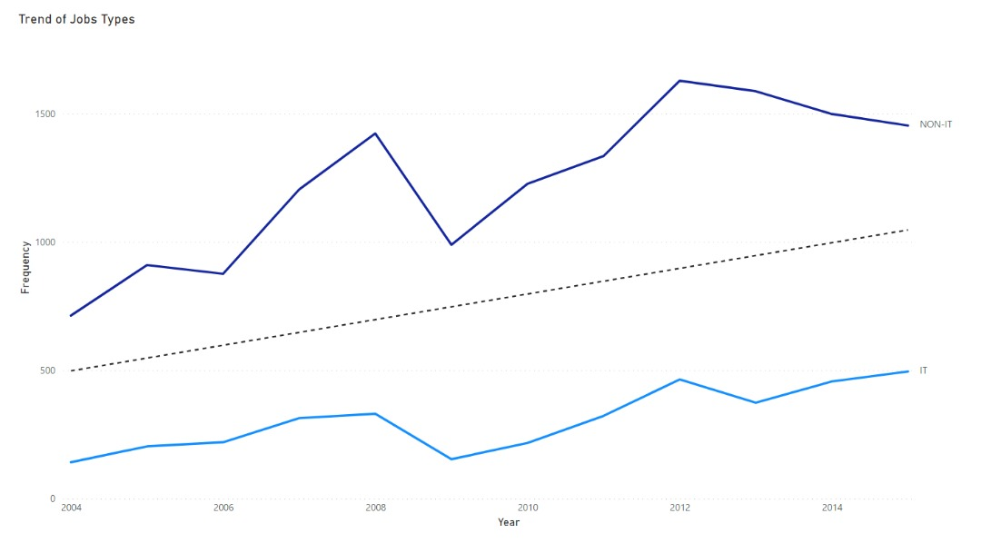
Data Analysis

Slide 13
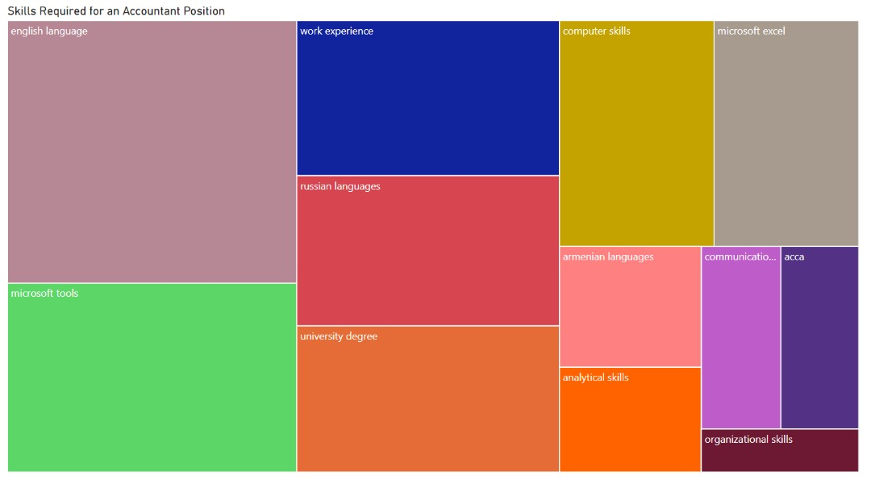
Data Analysis

Slide 14
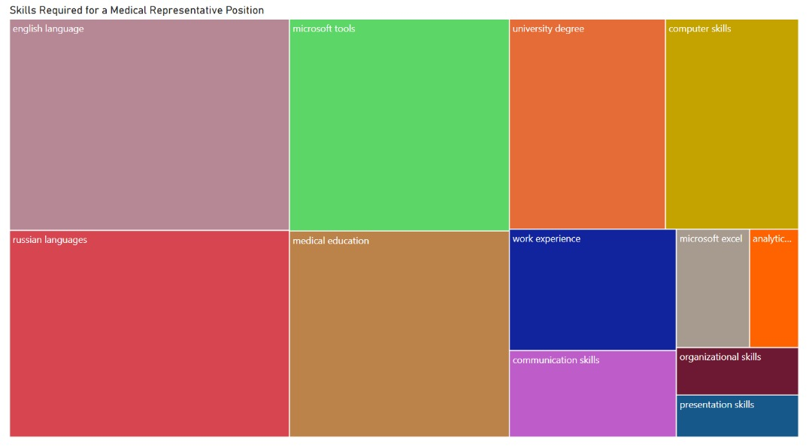
Data Analysis

Slide 15
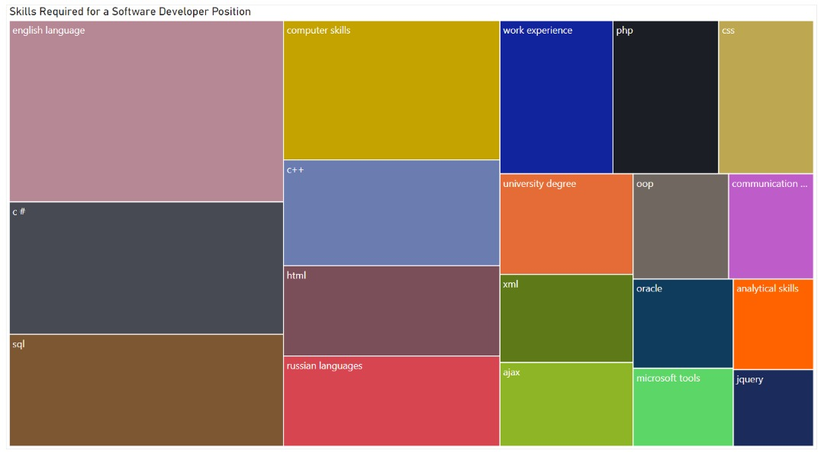
Data Analysis

Slide 16
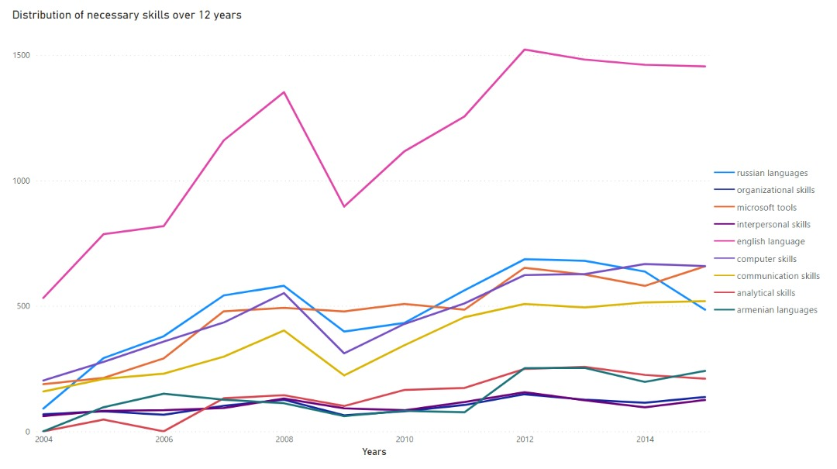
Data Analysis

Slide 17
Conclusion and Findings
From the analysis above, it was deduced that;
Accountant positions were highly demanded in the years between 2004 and 2015.
The year 2012 had the highest demand for jobs.
The skills required by most companies between 2004 to 2015 were mostly language skills, with very few analytical or technical skills in demand.
Just as well, there has been no sudden jump in IT skills which goes in line with the total number of IT job postings, being considerably lesser than that of NON-IT jobs.

Slide 18
Recommendations
Based on the findings from our analysis, we can make the following recommendations:
There are more or greater opportunities in IT related jobs as the current data shows more people are likely employed in NON-IT jobs.
Job seekers looking to change careers should be more inclined towards the IT sector of the economy.
The decrease in job postings during the ‘EMBER’ months should be taken into consideration for job seekers as stifler/tougher competition during this period could lead to difficulty in securing jobs.

