Slide 1
Healthcare Patient Analytics Pipeline
TEAM MEMBERS
Surya
Sai kiran
K Gayatri
Raghava reddy

Slide 2
Tabel of context
Projective Overview and Objective
Technical Specifications
Design solutions with HLD and LLD
Development of Lakehouse in Databricks
Testing the ELT pipelines in AWS AND Data Bricks
Business outcomes

Slide 3



Project Overview & Objectives
The project is a Healthcare Patient Analytics Pipeline that ingests patient and hospital records from AWS S3, processes them in Databricks using the Bronze-Silver-Gold architecture, and ensures data quality with Delta Live Tables. It provides reliable, automated, and scalable data processing for healthcare analytics.
Primary Goals
Ingest and store raw patient & hospital records securely.
Clean, transform, and validate data for accuracy.
Automate workflows with Databricks & AWS integration.
Deliver analytics-ready data for risk scoring and trend dashboards.

Slide 4
Business / Technical Specifications
Build ETL pipelines using AWS & Databricks with healthcare datasets (Patient & Hospital records).
Implement Lakehouse Architecture (Bronze → Silver → Gold) for structured and scalable data management.
Establish Raw Data Store in Bronze layer with Unity Catalog for schema governance and traceability.
Perform Data Cleansing, Validation, and Quality Checks using Delta Live Tables in the Silver layer.
Derive Risk Score Analytics, Trend Reports, and Forecast Features from Gold layer datasets.
Automate Workflows & Scheduling using Databricks Workflows and AWS services (GitHub).
Optimize storage and performance using Partitioning and Vacuum in Delta Lake.
Enable Visualization Dashboards for patient insights, anomalies, and healthcare trends.
Implement Testing & Validation with PyTest for data accuracy, transformations, and performance.

Slide 5
Design Solutions for building pipelines
High level design
Low level design

Slide 6
high level design

Slide 7
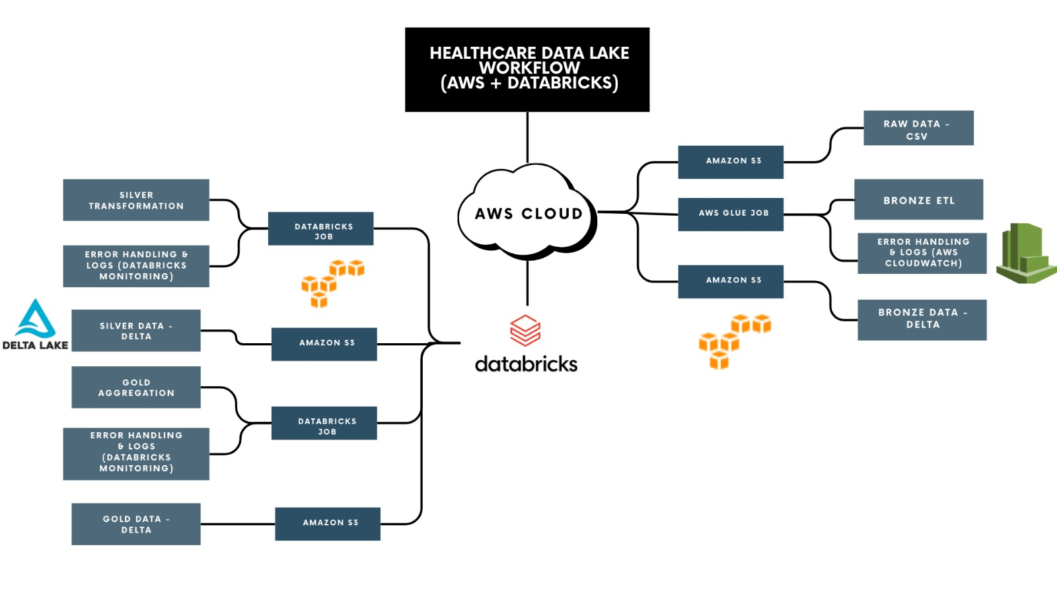
high level design
Introduction
Requirements
Specifications
Workflow
Problem statement
SDLC life cycle
Database Schema
Core features
Reporting & analytics
Testing & Validation
Conclusion

Slide 8
low level design

Slide 9
Building ETL Pipelines in AWS and Databricks
Pipeline Orchestration in AWS AND DATABRICKS
Error Handling mechanisms in AWS AND DATABRICKS
Data Quality checks using DLT expectations and other approaches
Building ALERTS , Audit and error logs in Databricks
Data Visualisation for better analysis
Git Integration

Slide 10
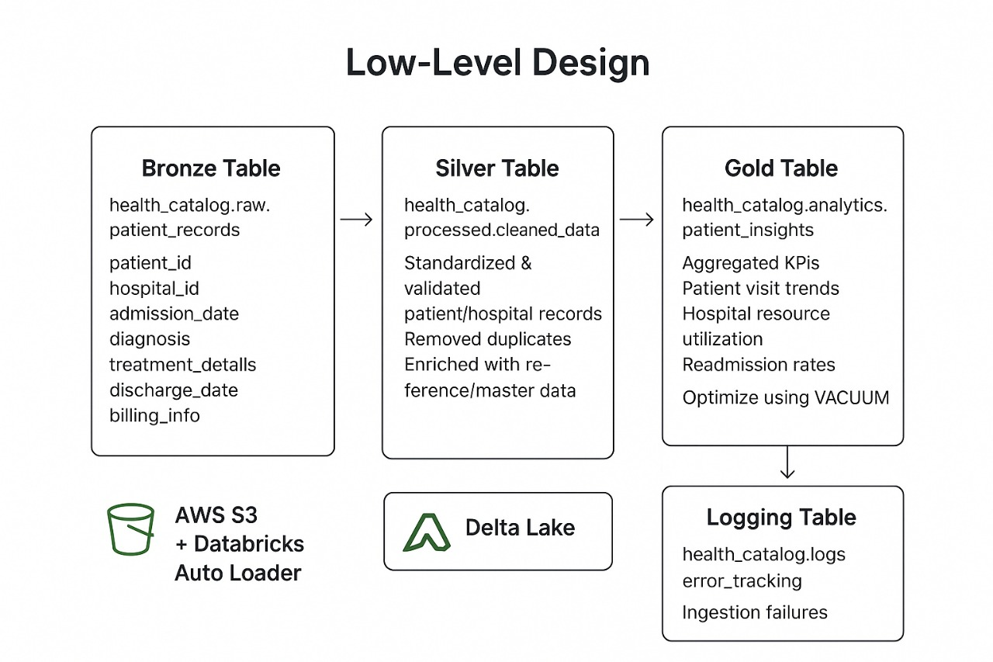

Slide 11
error handling & quality checks
Schema Validation – Enforce defined schema in Bronze layer (column names, data types, mandatory fields) to prevent malformed patient records.
Deduplication & Integrity Checks – Remove duplicate patient entries and validate unique identifiers (e.g., patient_id, record_id) in Silver layer.
Null & Outlier Handling – Apply imputation or rejection rules for missing/invalid health metrics (e.g., negative age, impossible values like BP = 0).
Error Logging – Capture failed/invalid patient records into a dedicated error log table in Databricks with timestamp, error reason, and source file.
Delta Live Tables (DLT) Expectations – Used for enforcing data quality checks continuously in pipeline execution.

Slide 12
Pipeline orchestration
Workflow Orchestration – Use AWS Glue Workflows (AWS setup) or Databricks Workflows (Databricks setup) to chain ETL jobs in sequence (Bronze → Silver → Gold).
Job Scheduling – Configure daily batch runs at 2 AM UTC using Event Bridge (AWS) or built-in scheduler (Databricks).
Dependency Management – Ensure downstream jobs (Silver/Gold) run only after upstream tasks (Bronze/Silver) succeed.
Monitoring & Logging – Track job execution with Databricks Job Runs UI, storing logs for audits.
Failure Handling & Alerts – On job failure, send alerts via email and rerun failed tasks without reprocessing entire pipeline.

Slide 13
Alerts/Monitoring/Logging
Pipeline Monitoring – Track ETL job runs in Databricks Workflows (status: success, failed, duration, resource usage).
Data Quality Alerts – Raise alerts if patient data has schema mismatches, duplicate patient IDs, or missing critical health fields (e.g., date of birth, diagnosis code).
Error Logging – Store failed patient records and schema errors into a dedicated error table/logs (healthcare_logs.etl_errors) with timestamps and reason.
Notifications – Use AWS SNS or Databricks alerting (emails) to notify data engineers and analysts on pipeline failures or anomalies.
Performance & Cost Tracking – Monitor pipeline runtime, cluster utilization, and storage growth in Databricks to optimize healthcare data processing.

Slide 14
Development of lakehouse
Build ETL Pipelines in AWS & Databricks as per requirements
Ingest raw healthcare data into AWS Data Lake (S3)
Create catalogs and load data into Bronze Layer (raw storage with Unity Catalog)
Process and cleanse data, feed curated tables into Silver Layer
Aggregate, derive risk scores & analytics, feed results into Gold Layer

Slide 15
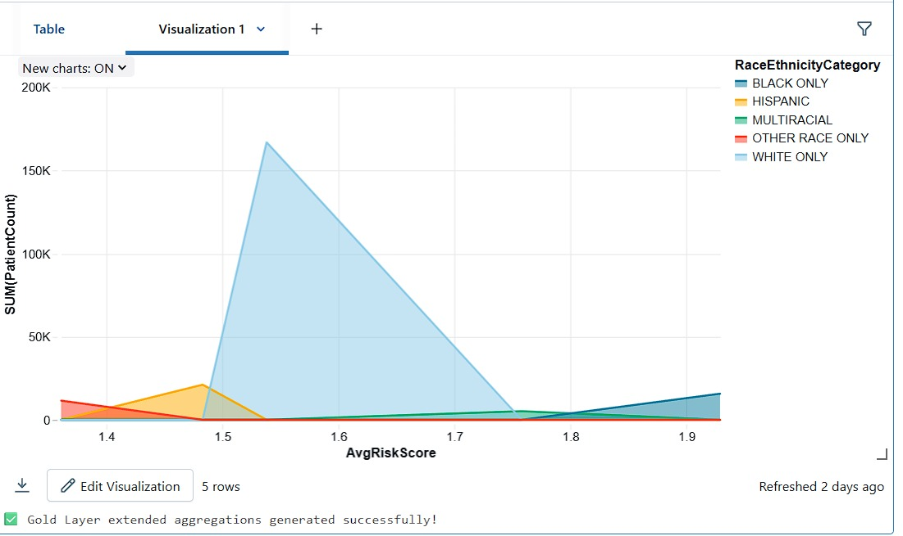
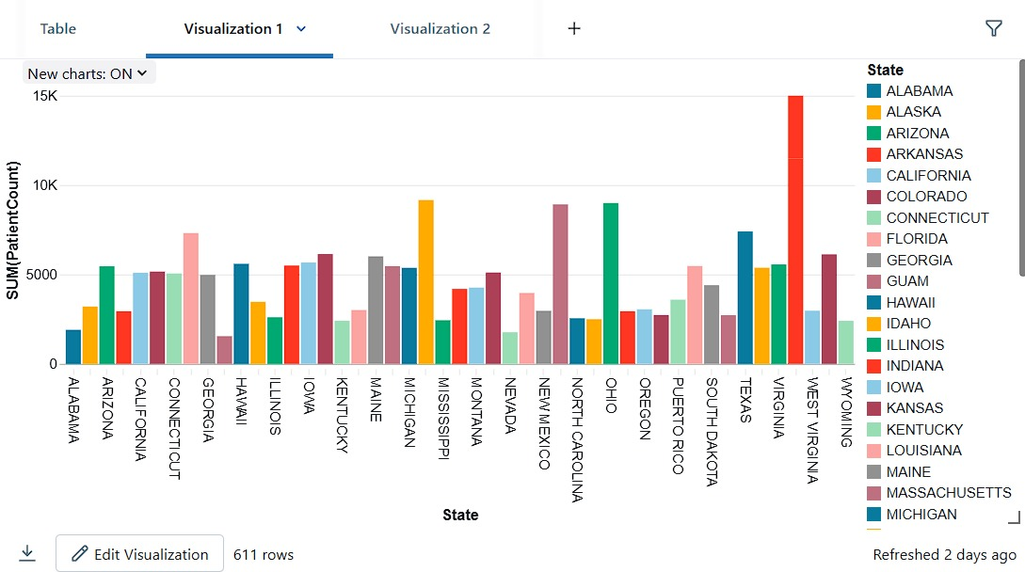
visualization
This chart shows how patient counts vary across different ethnic groups based on their average health risk score. It helps in understanding which communities have higher patient volumes in certain risk ranges.
This bar chart displays the number of patients across different U.S. states. It shows where most patients are concentrated, helping in regional healthcare analysis.

Slide 16
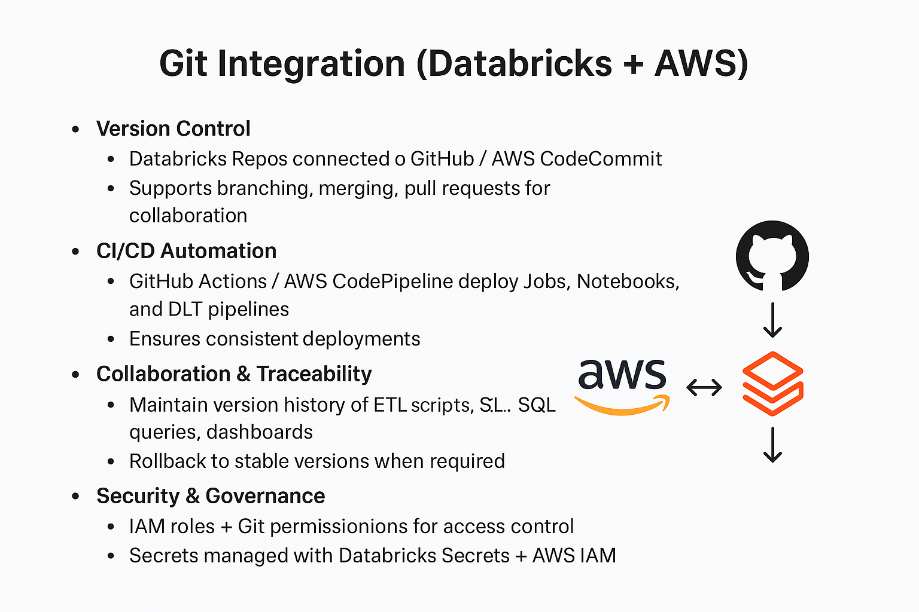
Git integration

Slide 17
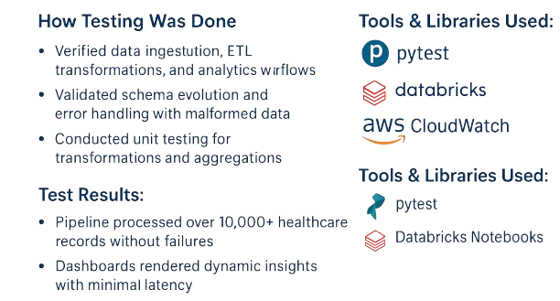
🧪 TESTING & VALIDATION

Slide 18
Business Impact & Outcomes
Improved patient data quality with accurate, clean, and reliable records.
Faster data access & insights through Lakehouse architecture.
Enhanced decision-making with advanced analytics and dashboards.
Increased efficiency by automating ETL pipelines and reducing manual effort.
Strong compliance & security with error handling, logging, and audits.
Better healthcare outcomes by enabling risk analysis and patient monitoring

Slide 19
Thank you

