Slide 1

Crew Ops Advisor
Multi-agent decision support for airline crew operations
Evidence from MCP. Independent fact checks. Final legal review.
Team Name - Dooms Day
Shahid Musabbar – musabbarshahid@gmail.com
Surya D – surya.vit25@gmail.com
Premchandar K – premsankan@gmail.com
Multi Agent + OpenAI + MCP + operational rules
01

Slide 2

Problem and solution
Crew disruptions demand fast, defensible decisions
The operating picture is split across flight schedules, pairings, rosters, reserve availability, duty clocks, certifications, rules, and costs.
Manual review can miss a rest limit, an expired certificate, an aircraft rating, or a reserve window. Any missed condition can turn a recovery plan into a delay or cancellation.
One question
One evidence trail
The advisor retrieves the relevant records, produces a proposed answer, checks the facts independently, and tests impacted actions against every operating rule.
One checked answer
02

Slide 3
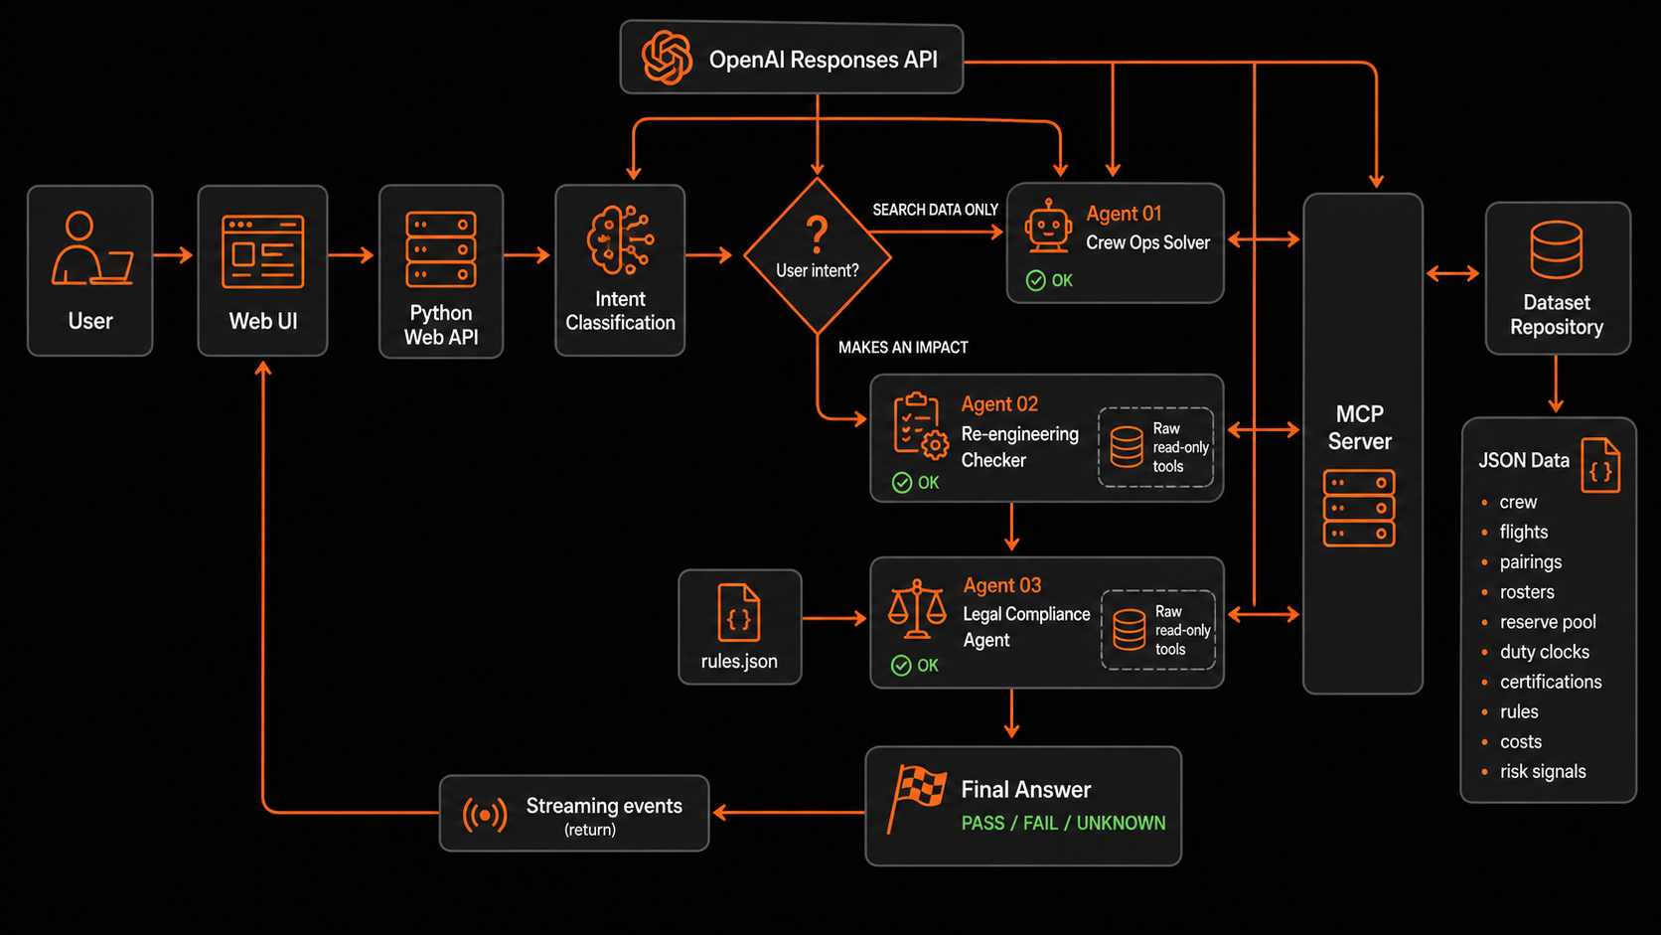
Multi-agent architecture
03

Slide 4

From question to verified action
“Draft the callout notification to C-3310 for covering P-2291.”
01
Intent classification
Recognizes that the request can change an operational assignment.
02
Agent 01: Crew Ops Solver
Retrieves the crew, pairing, roster, reserve, and certification records through MCP.
Agent 02: Re-engineering Checker
03
Checks the important claims against raw read-only records.
Every tool call and result streams to the web interface.
Agent 03: Legal Compliance Agent
04
Applies every rule and returns PASS, FAIL, NOT APPLICABLE, or UNKNOWN.
04

Slide 5

Operational value and next steps
Every impacted action receives a final rule check
Operational value
Next steps
Faster disruption decisions
Evidence attached to each recommendation
Clear reasons for exclusions and failed rules
Consistent policy application
A visible audit trail for reviewers
Connect live airline systems
Require human approval before callout execution
Send approved notifications through crew channels
Optimize delay, cancellation, and positioning costs
Store complete decision and compliance logs
The legal agent reduces avoidable errors. Human operations teams retain final authority.
05

