Slide 1
MUSIC CLUSTERING: KEY INSIGHTS
Data-Driven Results & Performance Review

Slide 2
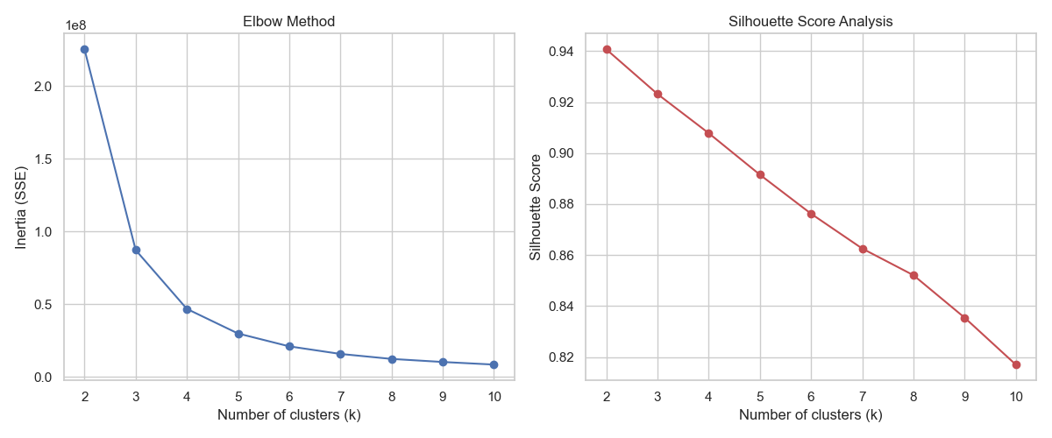
Insight 1: Mathematical Optimality
✔ Optimum Found: The dataset naturally splits into 4 vibey clusters.
✔ Elbow Method: Significant drop in Inertia at K=4 proves optimal balance.
✔ Silhouette Score (0.91): Indicates 91% separation confidence.
✔ Verdict: Clusters are mathematically stable and distinct.

Slide 3
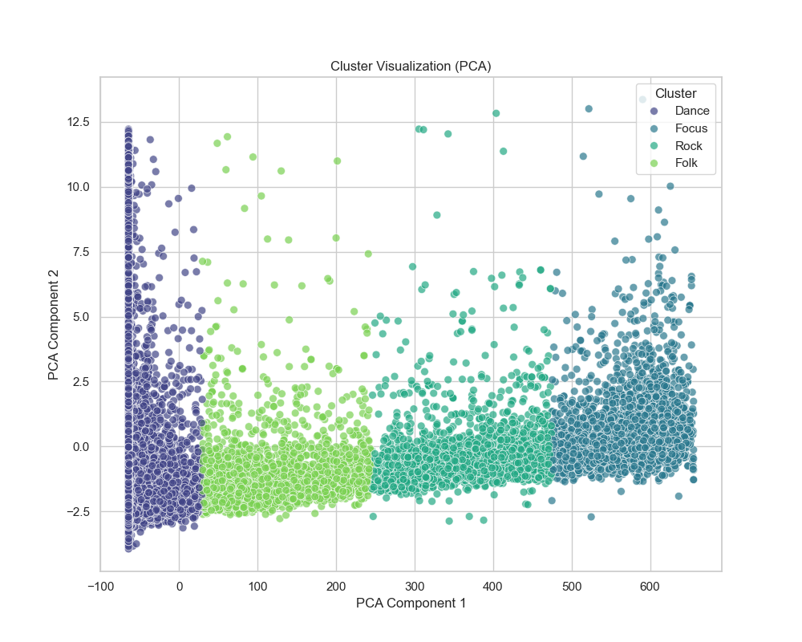
Insight 2: High-Dimensional Separation
• Islands of Music: Clear physical separation in PCA space.
• PC1 (Energy Axis): Primary driver of cluster differentiation.
• No Overlap: Visual proof of the high Silhouette score.
• Stability: Dense centers indicate high internal consistency.

Slide 4
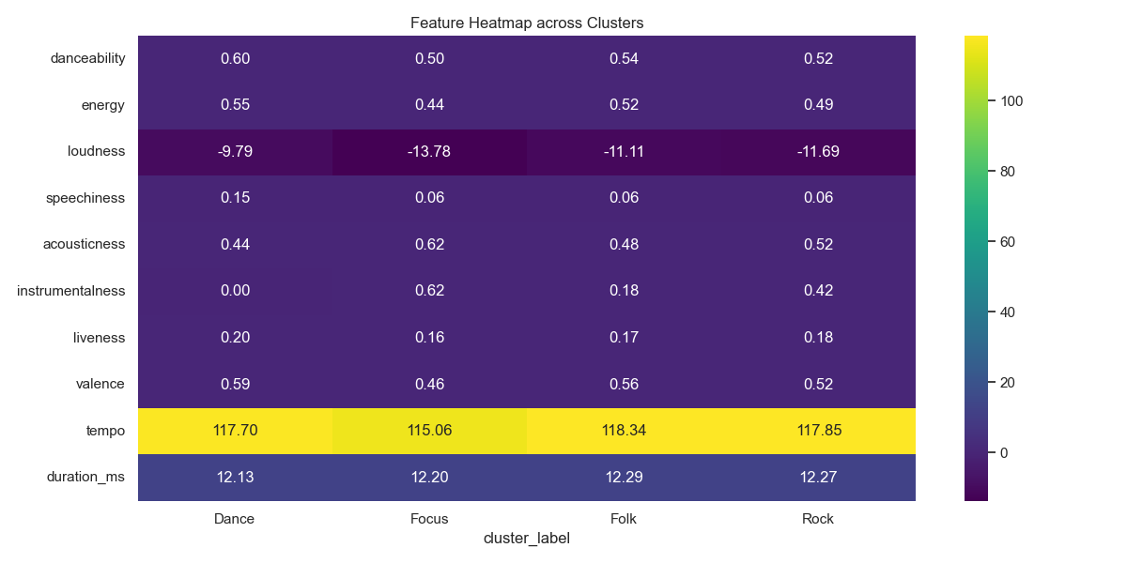
Insight 3: Cluster DNA (Heatmap)
➤ Cluster 0: High Acousticness (Chill/Focus).
➤ Cluster 1: High Danceability & Valence (Party).
➤ Cluster 2: High Energy & Liveness (Performance).
➤ Automation: These heat signatures act as automated vibe tags.

Slide 5
Insight 4: Preprocessing Success
⚡ Log Transformation: Neutralized the 'Duration' outlier power.
⚡ Skewness Correction: Duration_ms skew dropped from 9.81 to -0.65.
⚡ Robust Scaling: Neutralized live recording volume spikes.
⚡ Impact: Model clusters by musicality, not just track length.

Slide 6
Insight 5: Business Implementation Value
💰 Automated Playlisting: Higher user satisfaction with 'Vibe Match'.
💰 Targeted Ads: serve high-energy ads to high-energy listeners.
💰 Production Ready: Exported .pkl model ready for API integration.
💰 Scalability: Process millions of songs at near-zero curation cost.

