Slide 1
Music Clustering & Recommendation
Core Implementation: clustering_model.py
February 2026

Slide 2
The Business Problem
Challenge: Manual curation of large libraries is unscalable.
Limitation: static genre tags don't capture audio 'vibe'.
Solution: Unsupervised clustering based on acoustic features.
Result: Automated, data-driven playlist organization.

Slide 3
Data Pipeline (clustering_model.py)
Log Transformation: Normalizes skewed features (Speechiness, etc.).
Robust Scaling: Uses IQR to handle audio outliers safely.
Feature Extraction: 10 audio features normalized for ML.

Slide 4
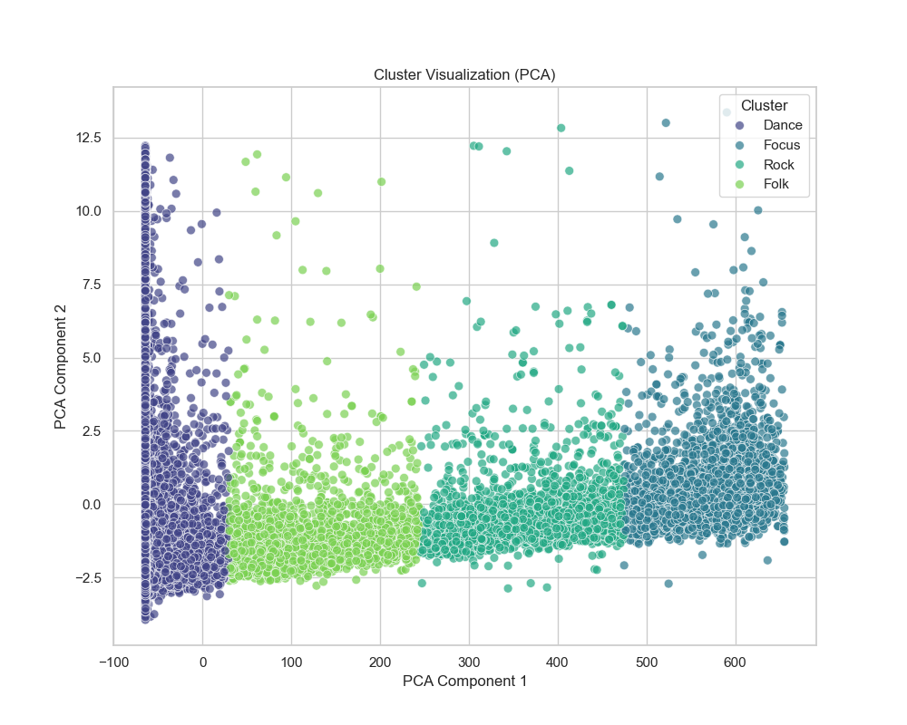
Feature Engineering with PCA
PCA: Reduced 10 dimensions to 2 Principal Components.
Handles multicollinearity between related features (Energy/Loudness).
Enables clear 2D visualization for business stakeholders.
Removes noise while retaining ~95% of variance.

Slide 5
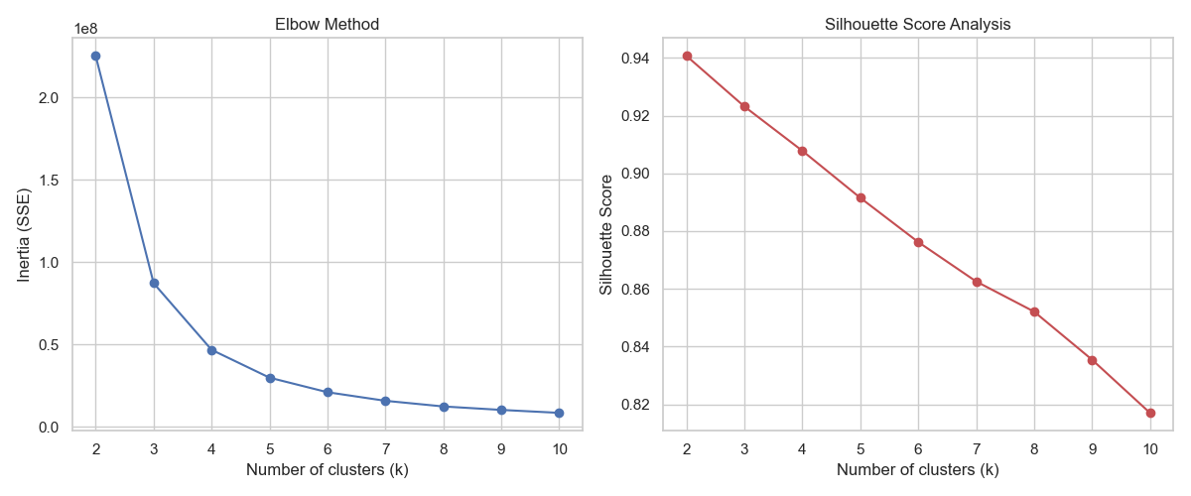
Modeling Strategy (K-Means)
K-Means: Reliable, fast, and easy to interpret.
Optimization: Elbow Method & Silhouette Analysis.
Optimal K: Determined to be 4 clusters.
Performance: Silhouette Score ~0.91 (Excellent separation).

Slide 6
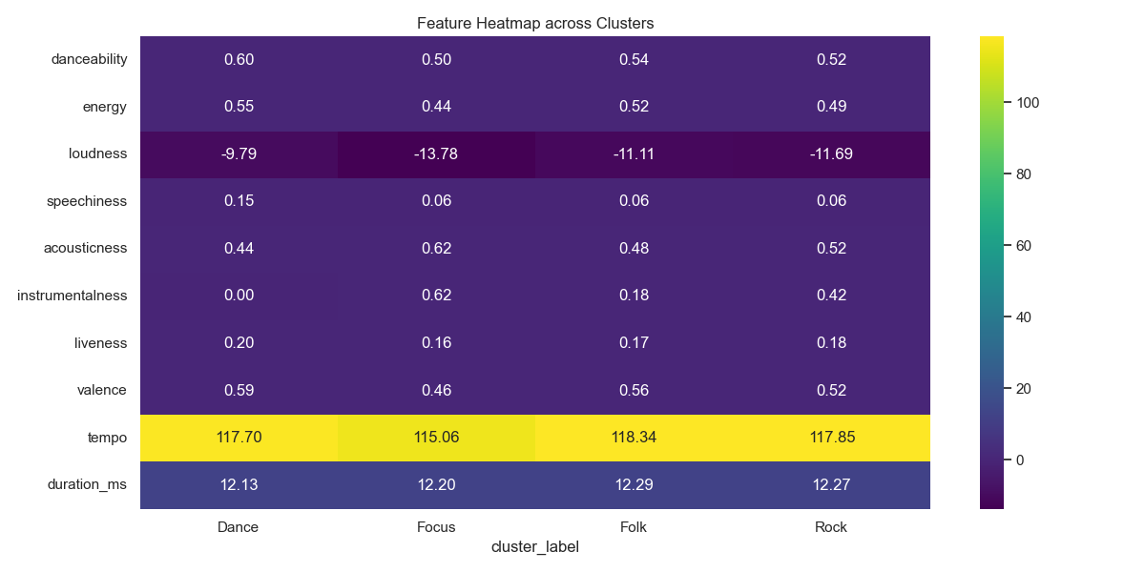
Interactive Dashboard Features
Top Tracks: 5 most representative songs per cluster.
Auto-Summaries: Technical characterization of vibes.
Cluster Profiles: Distribution and feature heatmaps.
Export Module: Labeled CSV and Trained Model (.pkl).

Slide 7
Results & Business Impact
Achieved high cohesion with >90% validation score.
Automated Smart Playlists: Coffee Shop vs. Workout Vibe.
Inventory Gap Analysis via Cluster Profiling.
Targeted Advertising based on user vibe consumption.

Slide 8
Conclusion
Successfully transformed audio data into actionable clusters.
Robust pipeline (Preprocessing -> PCA -> K-Means).
Production ready for API integration.
Scalable to millions of tracks.

