Slide 1
Group No: 14
Smart Renewable Energy Management System with Adaptive Load Shedding
Jeshnu Pranav G CB.EN.U4EEE24118
Mellacheruvu Sada Siva Surya CB.EN.U4EEE24128
Mohammed Nihal M CB.EN.U4EEE24129
Thushar S CB.EN.U4EEE24150
Department of Electrical and Electronics Engineering,
Amrita School of Engineering,
Coimbatore-641 112.
Review On: 31/10/2026

Slide 2
Introduction
Background
Rooftop solar PV microgrids optimize renewable energy utilization.
Decreases utility grid dependency for residential complexes during peak operational hours.
Problem statement
Generation-Demand Mismatch: Peak solar generation occurs at midday, while peak residential demand occurs in the evening.
Deficit Example: 16.5 kW of power demand is observed between 21:00–23:00 when PV generation is zero.
Application
Target Model: A 12-flat residential building in Coimbatore.
Load Profile: Aggregate daily energy demand of 211.6 kWh.

Slide 3
Literature Review (LR)
S.No | Title of the paper | Authors | Source | Inferences
1 | EMS based on FSM for battery-supercapacitor HESS on standalone PV | M. Hilmi, V. Lystianingrum, and M. F. Romlie | IEEE 4th Int. Conf. Power Eng. Appl. (ICPEA), 2024 | Mode chosen from battery and SC SoC only; no load management or prevention of critical failure
2 | Energy management and control of grid-connected microgrid integrated with HESS | S. D. Dwivedi, P. K. Ray | Int. Conf. Intell. Controller Comput. Smart Power (ICICCSP), 2022 | Grid-connected power sharing; no tiered loads
3 | A study on use of HESS along with variable filter time constant to smooth DC power fluctuation in microgrid | T. Wu, W. Yu, L. Guo | IEEE Access, vol. 7, 2019 | Variable-τ low-pass filter sharing; no SoC-aware limits or load shedding
4 | Design and analysis of novel control strategy for battery and supercapacitor storage system | S. K. Kollimalla, M. K. Mishra, N. L. Narasamma | IEEE Trans. Sustain. Energy, vol. 5, no. 4, 2014 | HF part of the DC-link controller goes to the SC; no PV source or load shedding
5 | Control and energy management of wind/PV/battery smart microgrid | L. Khemissi, M.A. Khalfa, A. Sellami | IEEE CISTEM, 2022 | MPPT with supervisory control; no switching-level HESS

Slide 4
Literature Summary
Individual technologies such as PV generation, hybrid storage, and supervisory control are extensively researched.
Comprehensive integration of these systems for real-time residential and commercial applications remains limited.
Limitations of Current Approaches
Existing methods rely on isolated techniques including low-pass filtering, model predictive control, optimization algorithms, and finite state machines.
These approaches typically address single, disjointed objectives (e.g., power sharing, bus regulation, MPPT, or energy management) rather than holistic system integration.

Slide 5
Research Gap (RG)
Unresolved problem | Evidence
PV does not match demand | Peak demand is 16.5 kW at 21:00-23:00, when PV output is zero
Battery-only storage sees fast power changes | Cloud transients and load steps accelerate battery ageing
Fixed load-shedding rules | Don’t respond to generation, demand or storage state
Functions treated separately | Current literature treats microgrid control functions separately. The proposed system addresses this gap by integrating a slow/fast power split, a state-of-charge constrained battery system, and a priority load manager within a single comprehensive simulation.

Slide 6
Motivation
Item | Value
Daily demand, 12 flats | 211.6 kWh
Firm demand (Tiers 1-2) | 117.8 kWh
Per-flat use | about 15.5 kWh/day
Tier 1 critical | 1.45 kW peak, 28.8 kWh
Tier 2 essential | 9.87 kW peak, 89.0 kWh
Tier 3 deferrable | 9.00 kW peak, 93.8 kWh
Firm night demand (18:00-06:00) | 67.8 kWh
Midday PV surplus | about 25 kW
Impact: with real NASA POWER weather the two PV units give 238.9 kWh on a clear day (113 % of demand) but only 155.3 kWh on a partly cloudy day (73 %). The main issue is timing and weather: storage plus priority shedding keeps critical services supplied through the night.

Slide 7
Novelty / Contribution
This project introduces an appliance-level three-tier load model specifically designed for 12 residential flats.
It implements state-of-charge aware low-pass filter sharing utilizing a combined current controller, along with anticipatory Stateflow shedding with hysteresis.
These features are integrated into a single Simulink framework operating alongside a 5-level cascaded H-bridge inverter.
The complete system is validated over full 24-hour days with real NASA POWER weather (clear and partly cloudy), including PV curtailment with SoC hysteresis and a coulomb-counting SoC for time-compressed simulation.

Slide 8
Objective
The primary objective is to maintain a stable, priority-aware power supply for the residential flats in an islanded microgrid setting on a clear day.
Success criteria include achieving
  a supply-to-demand ratio greater than or equal to 0.9
  keeping DC bus voltage deviation under 2%
  maintaining total harmonic distortion below 5% per IEEE 519 standards and
  ensuring the correct tier order during load shedding to ensure that critical loads operate at all times without failure

Slide 9
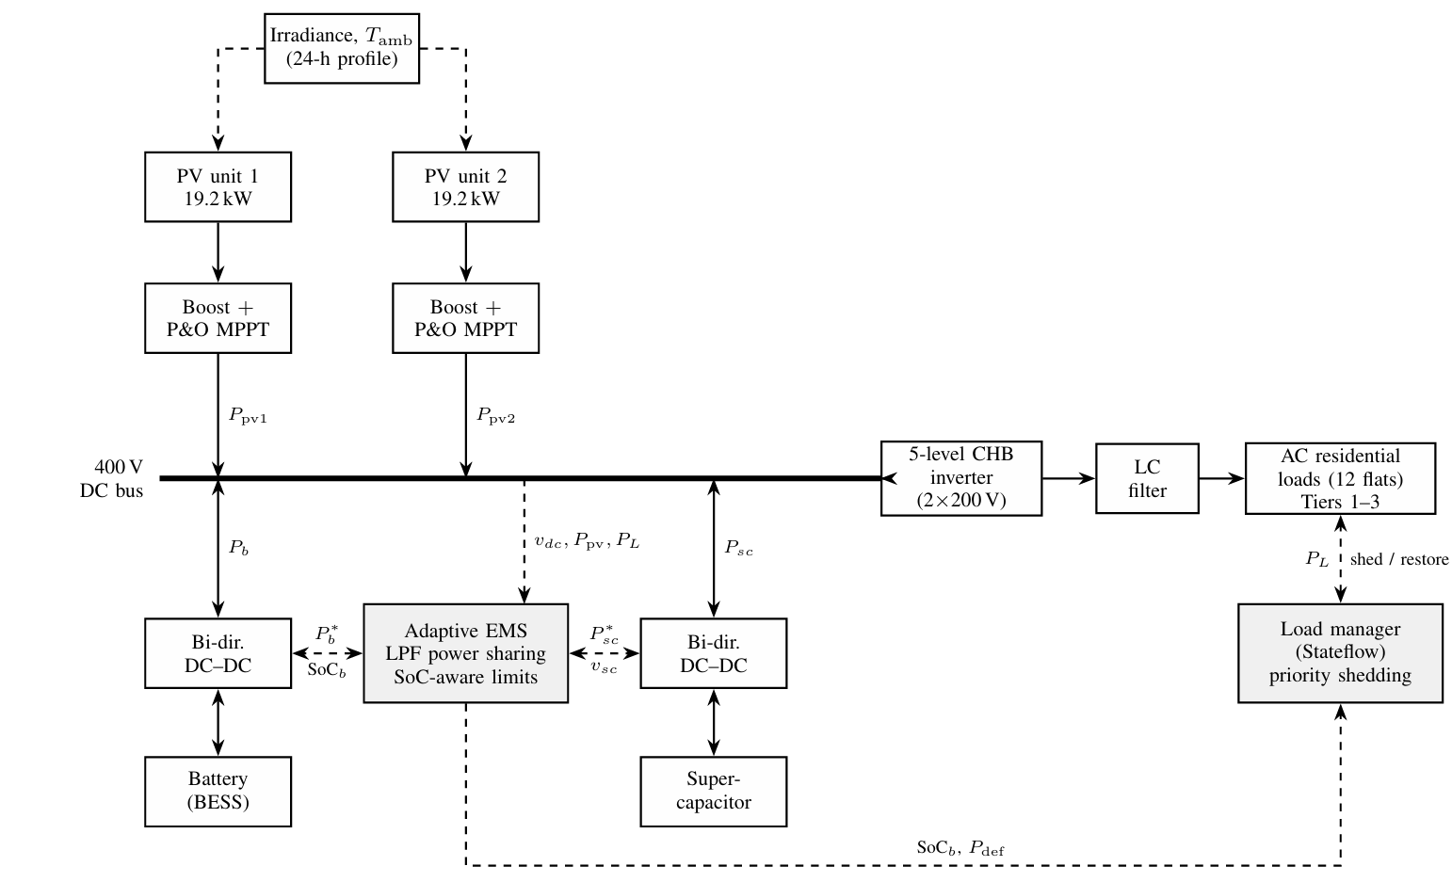
Methodology

Slide 10
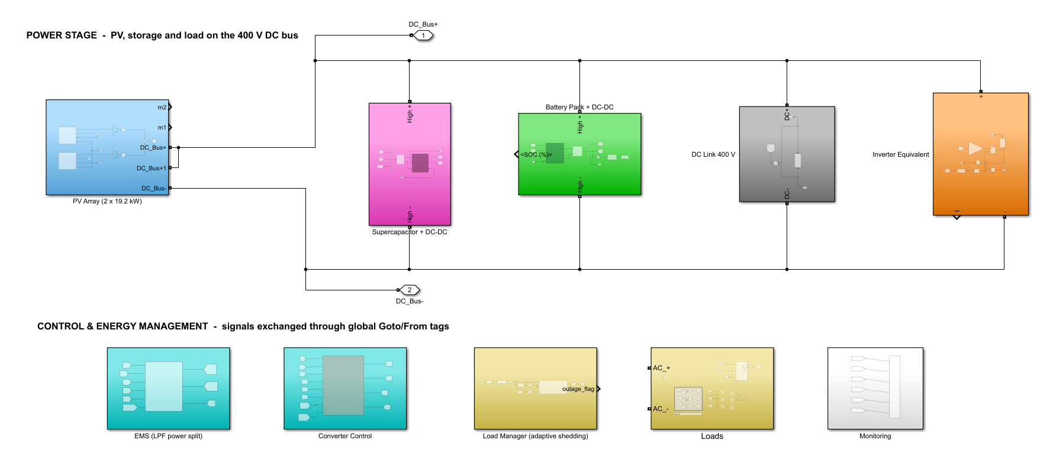
Modelling / Simulation
Notes:
Top level of the integrated Simulink model after the clean-up. Top row: power stage on the 400 V DC bus - PV array (2 x 19.2 kW), DC link, battery and supercapacitor with their bidirectional DC-DC converters, and the DC-equivalent load of the inverter. Bottom row: EMS, converter control, Stateflow load manager, the 12-flat load model and monitoring. Signals are exchanged through global Goto/From tags.

Slide 11
Modelling / Design Parameters
Subsystem | Design
PV array | 2 × 19.2 kW (6S × 8P, 400 W modules), boost converter, P&O MPPT; curtailment at SoC 98 % (hysteresis to 95 %)
DC bus | 400 V, C_dc = 25 mF (20 kW step for 10 ms with 5 % dip)
Battery | Li-ion 240 V, 130 kWh (541.7 Ah), SoC window 20-90 %, bidirectional DC-DC, current limit 156 A
Supercapacitor | 10 F, 250 V (about 312 kJ), bidirectional DC-DC for fast transients
EMS | Low-pass power split (τ = 1 real minute), SoC-aware derating of battery power
Converter control | 400 V voltage-loop PI: slow part to battery, fast part to supercapacitor; anti-windup, duty 0-0.9
Load manager | Stateflow, 3 priority tiers: θ₁ = 0.40, θ₂ = 0.30, SoC_min = 0.20, restore + 0.08
Loads | 12 flats, 211.6 kWh/day (firm 117.8 kWh), evening peak 16.5 kW; drawn from bus as P / 0.96
CHB inverter | 5-level, 2 × 200 V cells, 4 kHz effective; LC filter 2 mH / 20 µF (796 Hz), R_d = 2 Ω
Simulation | MATLAB R2025a, 1 µs step; 1 real hour = 0.12 s (24 h = 2.88 s); NASA POWER weather, Coimbatore
Notes:
Key ratings of every subsystem. The battery is sized for the 67.8 kWh firm night demand within a 20-90 % SoC window; the supercapacitor takes fast transients; time compression maps one real hour to 0.12 s of simulation.

Slide 12
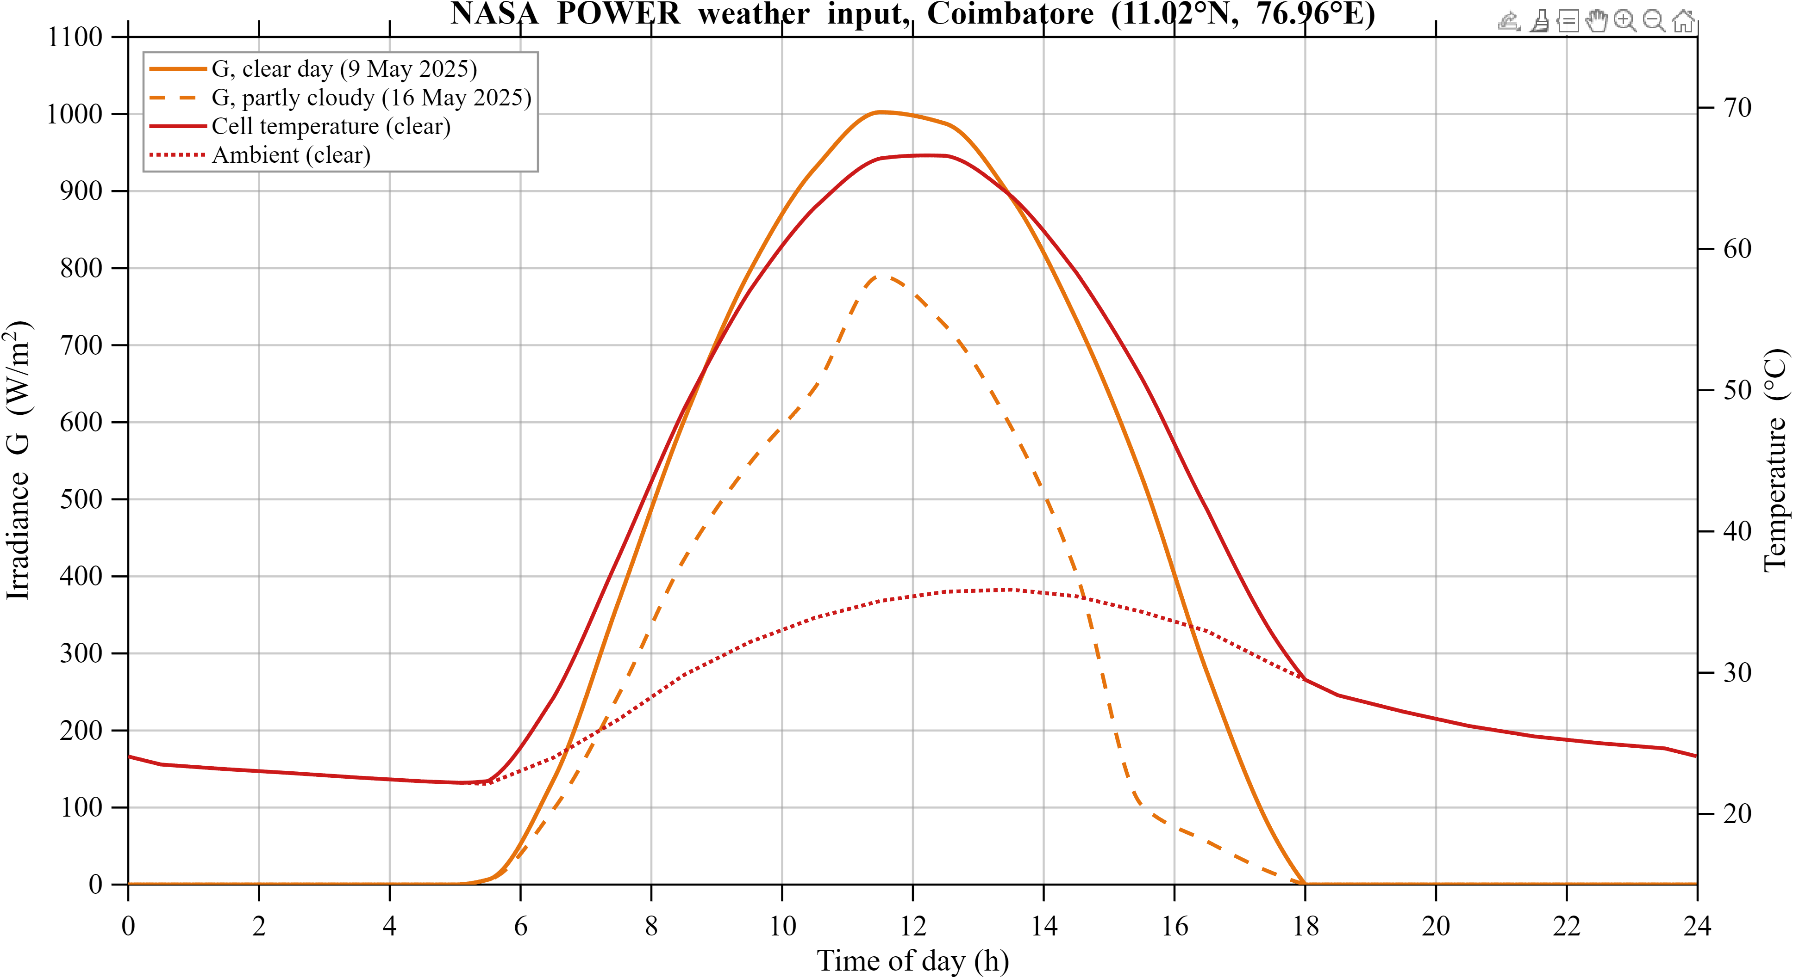
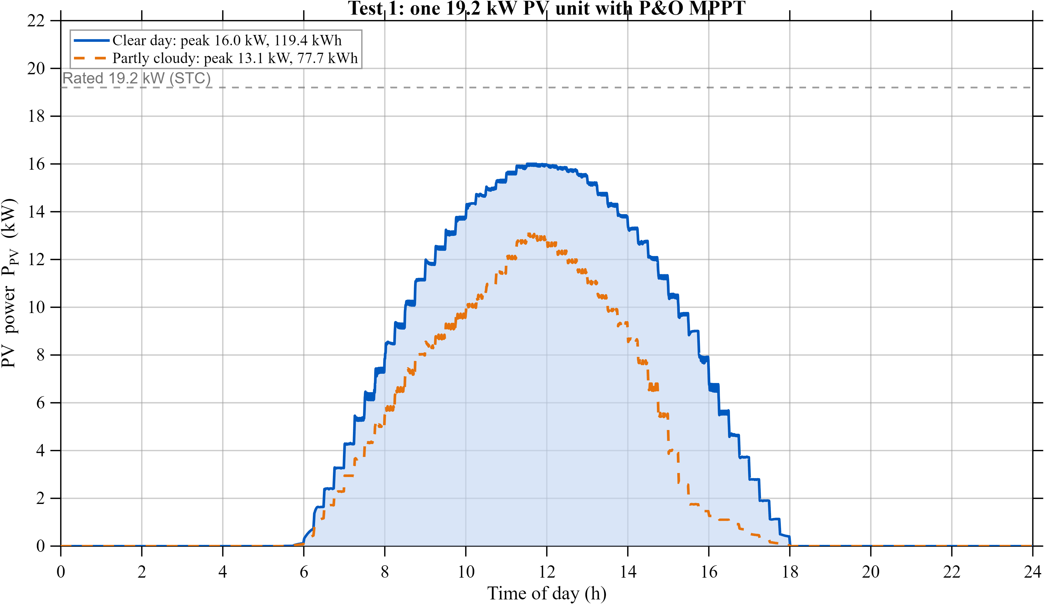
Results - Test 1: NASA Weather and PV Unit
16.0 kW
peak per 19.2 kW unit (clear day)
119.4 kWh
per unit per day (clear)
77.7 kWh
per unit per day (partly cloudy)
≤ 1.5 %
DC bus deviation
Weather: NASA POWER hourly data, Coimbatore - 9 May 2025 (clear, 7.32 kWh/m²) and 16 May 2025 (partly cloudy, 4.65 kWh/m²). P&O MPPT tracks from sunrise to sunset; hot cells (67 °C) lower the noon PV voltage to about 197 V.
Notes:
Real irradiance and temperature replace the synthetic profile used in the first submission. One PV unit peaks at 16.0 kW (83 % of its STC rating because of hot cells) and yields 119.4 kWh on the clear day and 77.7 kWh on the partly cloudy day.

Slide 13
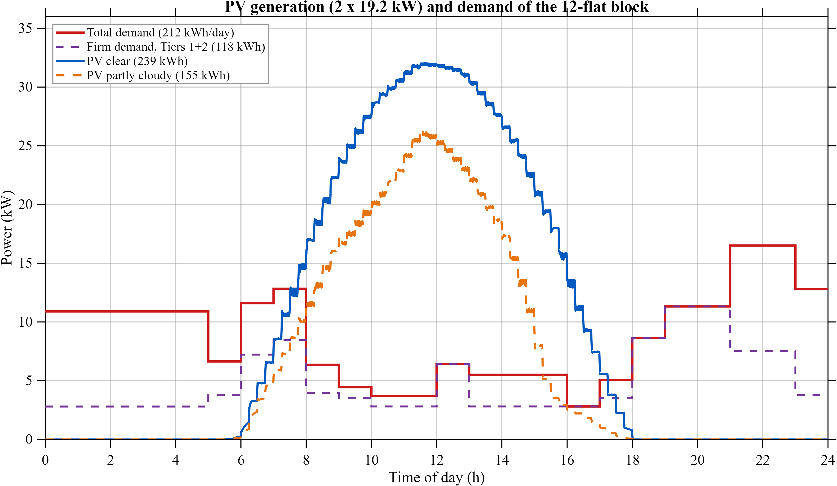
Results - PV Generation vs Demand
238.9 kWh
PV, clear day: 1.13 x demand
155.3 kWh
PV, partly cloudy: 0.73 x demand
16.5 kW
evening peak (21-23 h), no PV
Energy is sufficient on a clear day, but it arrives at the wrong time: the midday surplus must be stored for the evening peak and the 67.8 kWh firm night demand - the job of the battery and the load manager.
Notes:
Two PV units against the appliance-level demand of 12 flats (211.6 kWh/day). Coverage is 1.13 on the clear day and 0.73 on the partly cloudy day, but generation and demand do not overlap in time.

Slide 14
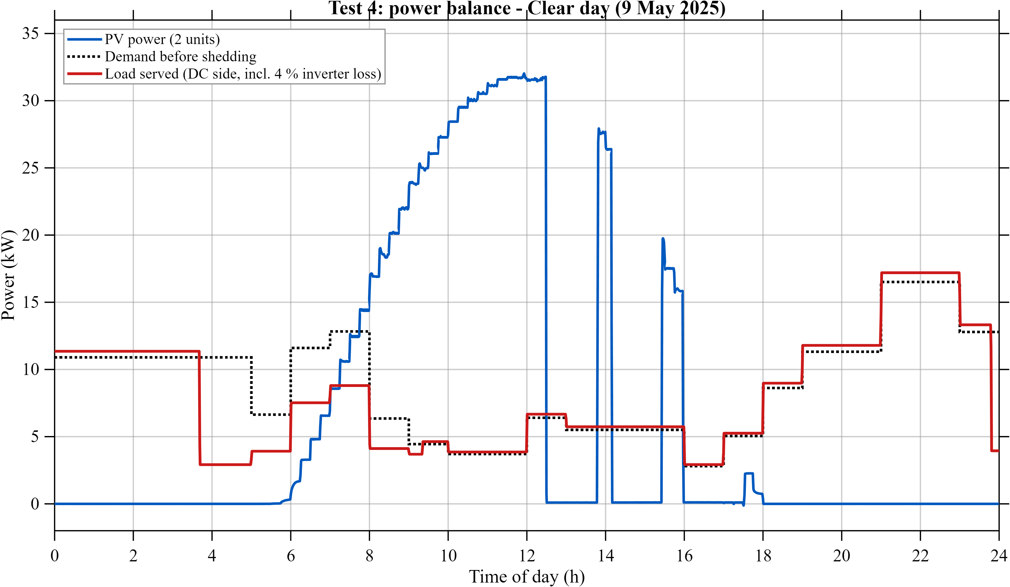
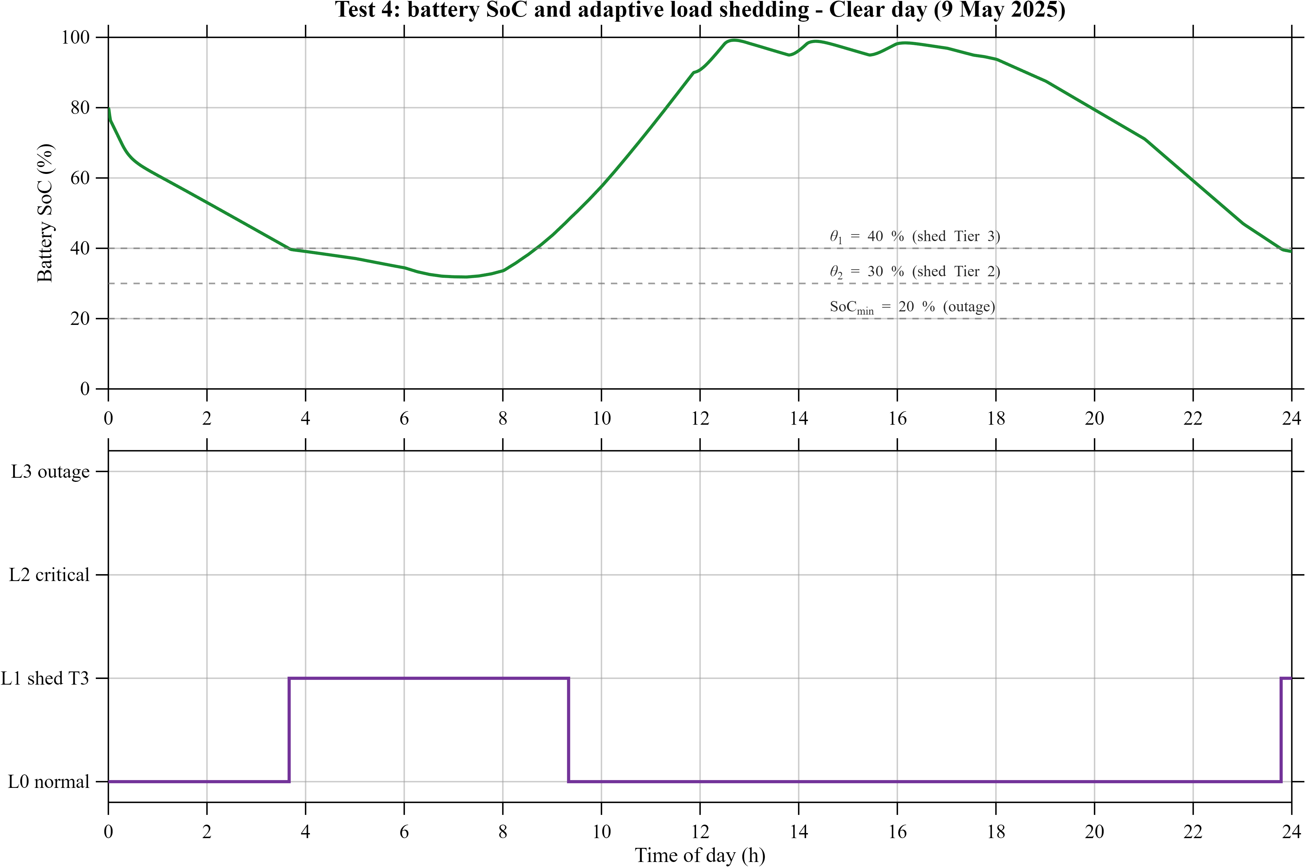
Results - 24 h Integrated Run, Clear Day
03:40 SoC reaches 40 % → Tier 3 (ACs, geysers) shed, load falls from 11 to 2.9 kW
SoC minimum 32 % → Tiers 1-2 never interrupted; all loads restored at 09:20
12:30 battery full → PV curtailed with 95-98 % hysteresis (three clean cycles)
Evening peak of 16.5 kW supplied from storage; day ends at 39 % SoC
Notes:
The full microgrid over 24 real hours with the battery driving the load manager. The gap between demand (dotted) and load served (red) between 03:40 and 09:20 is the shed deferrable tier.

Slide 15
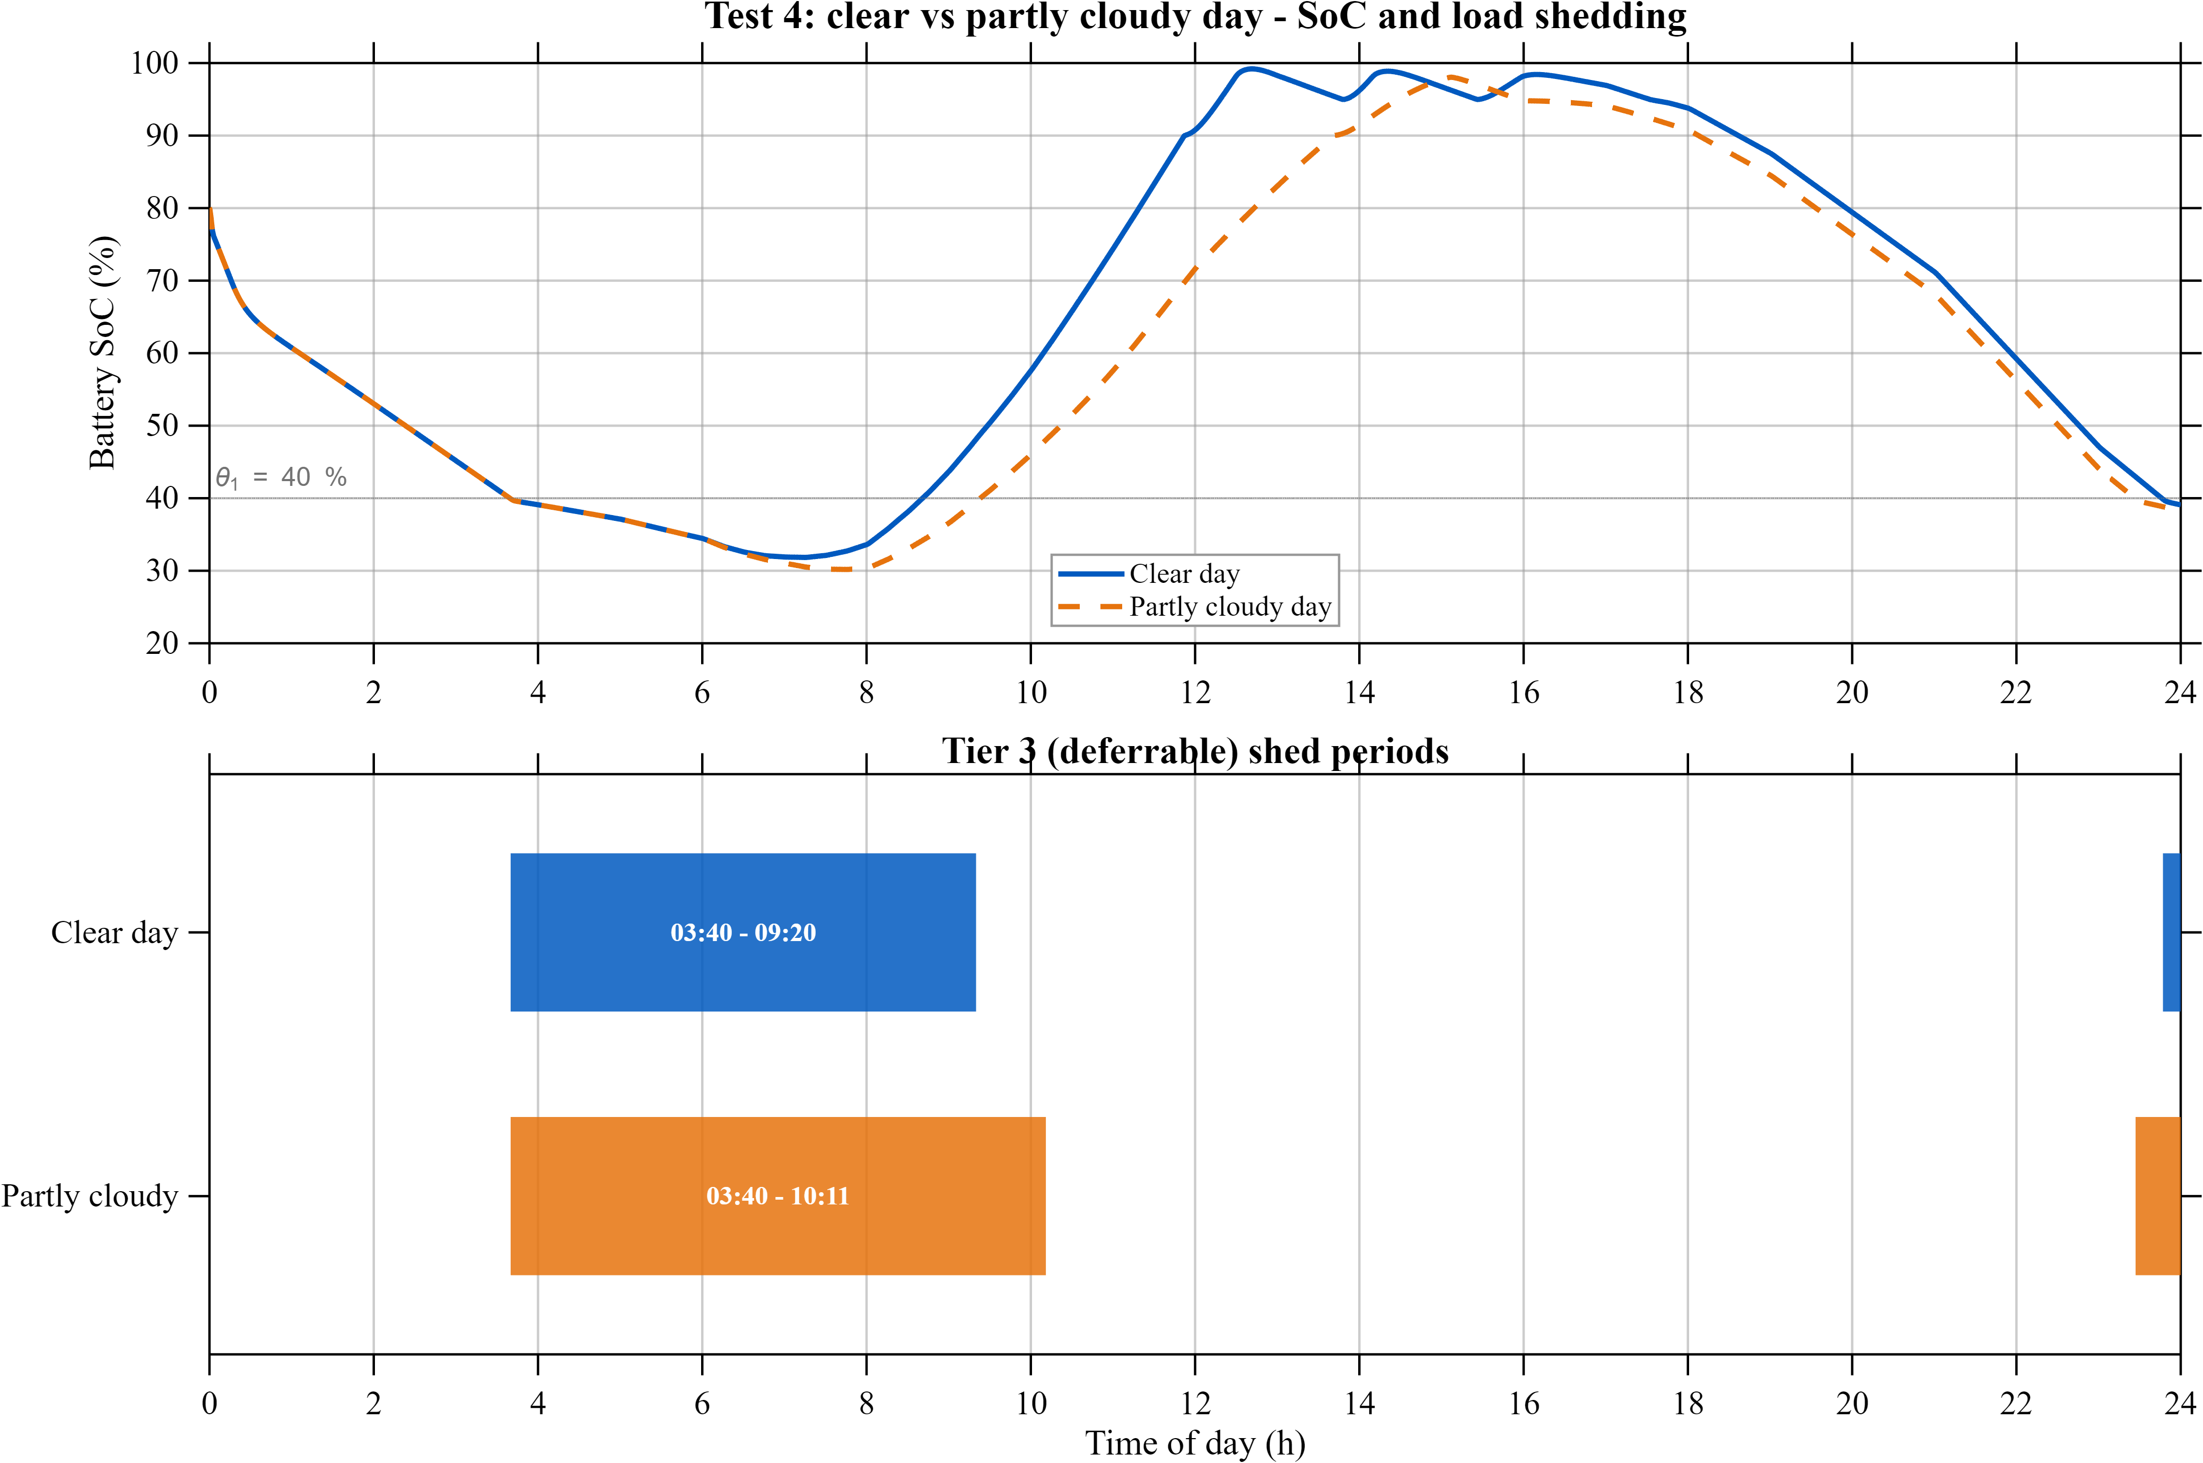
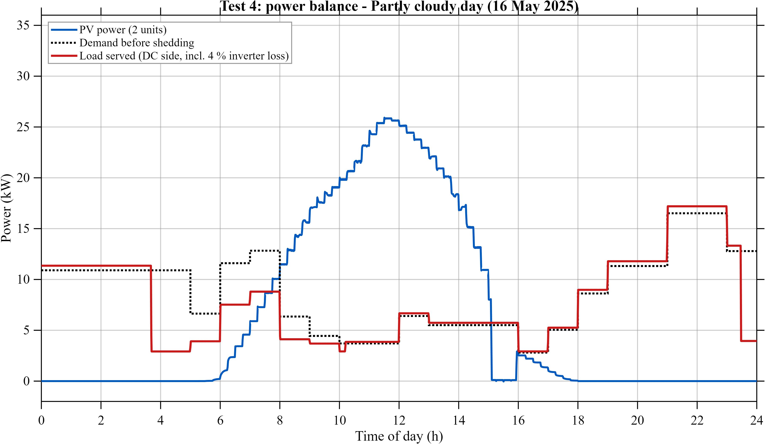
Results - Clear vs Partly Cloudy Day
Less sun, longer shedding: Tier 3 restored at 10:11 on the cloudy day vs 09:20 on the clear day
Cloudy day: PV peak 26.4 kW, battery reaches 98 % only at 15:00, ends at 38 % SoC
Firm loads served on both days - no critical-only (L2) or outage (L3) state
Adaptive: the load manager responds to the available energy, not to a fixed schedule
Notes:
Same model, real clear and partly cloudy days. With less solar energy the battery recharges more slowly, so deferrable loads stay off about 50 minutes longer.

Slide 16
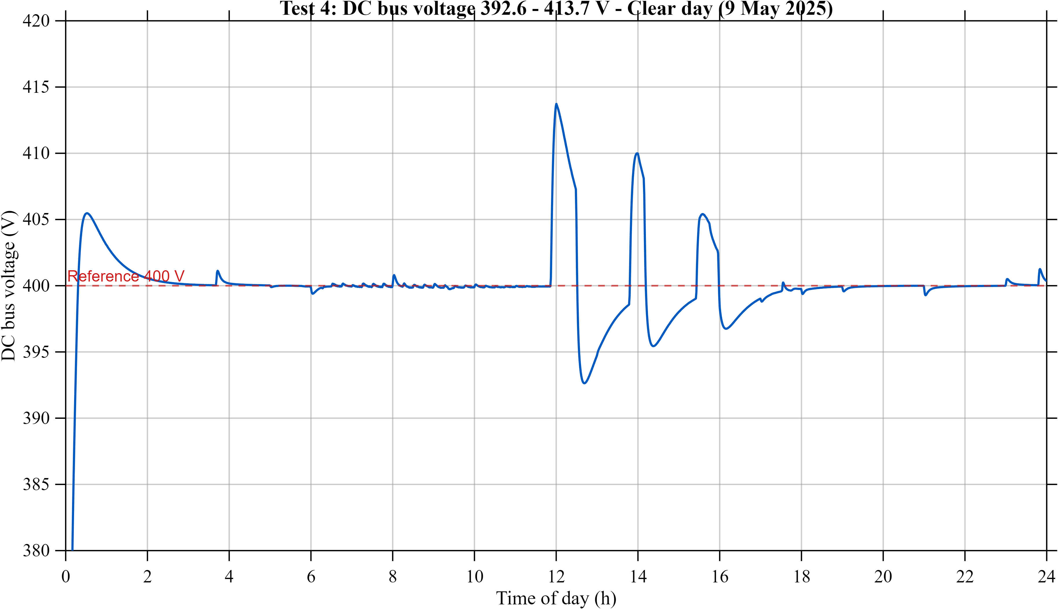
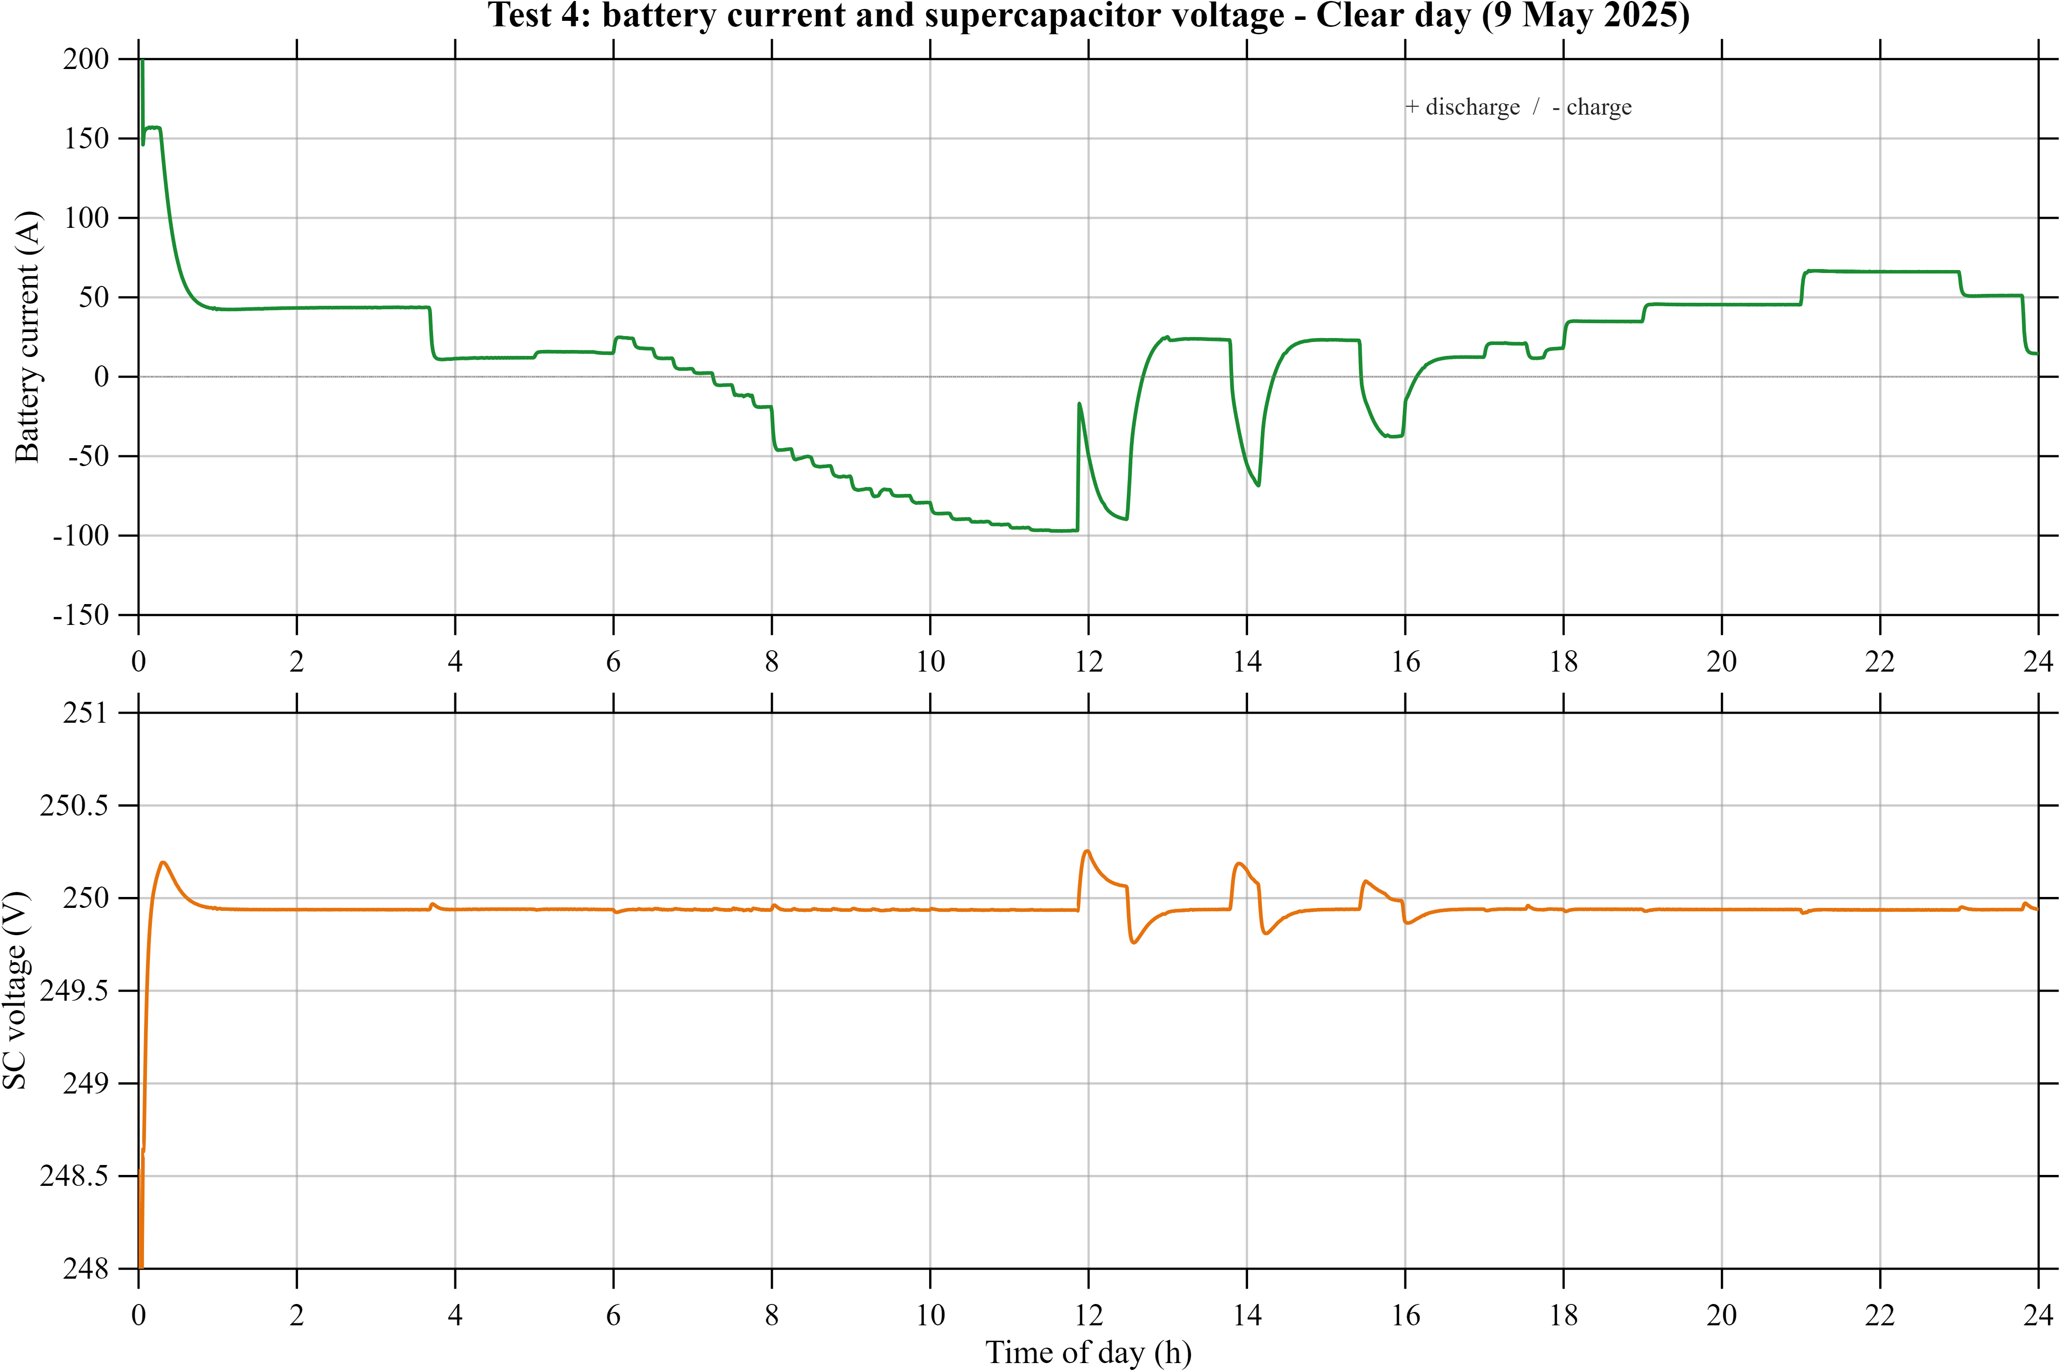
Results - DC Bus Regulation and HESS Power Split
DC bus held at 400 V: 392.6-413.9 V on the clear day, 395.7-406.9 V on the cloudy day
Largest deviation (+3.5 %) only at the PV curtailment switch-over; within 1 % otherwise
Battery carries the sustained power: about +45 A at night, -106 A charging at noon
Supercapacitor reacts only to the 30 kW PV steps (< 0.3 V change) and stays at 250 V otherwise
Notes:
The connected voltage loop sends the slow part of the current reference to the battery and the fast part to the supercapacitor, as intended in the design.

Slide 17
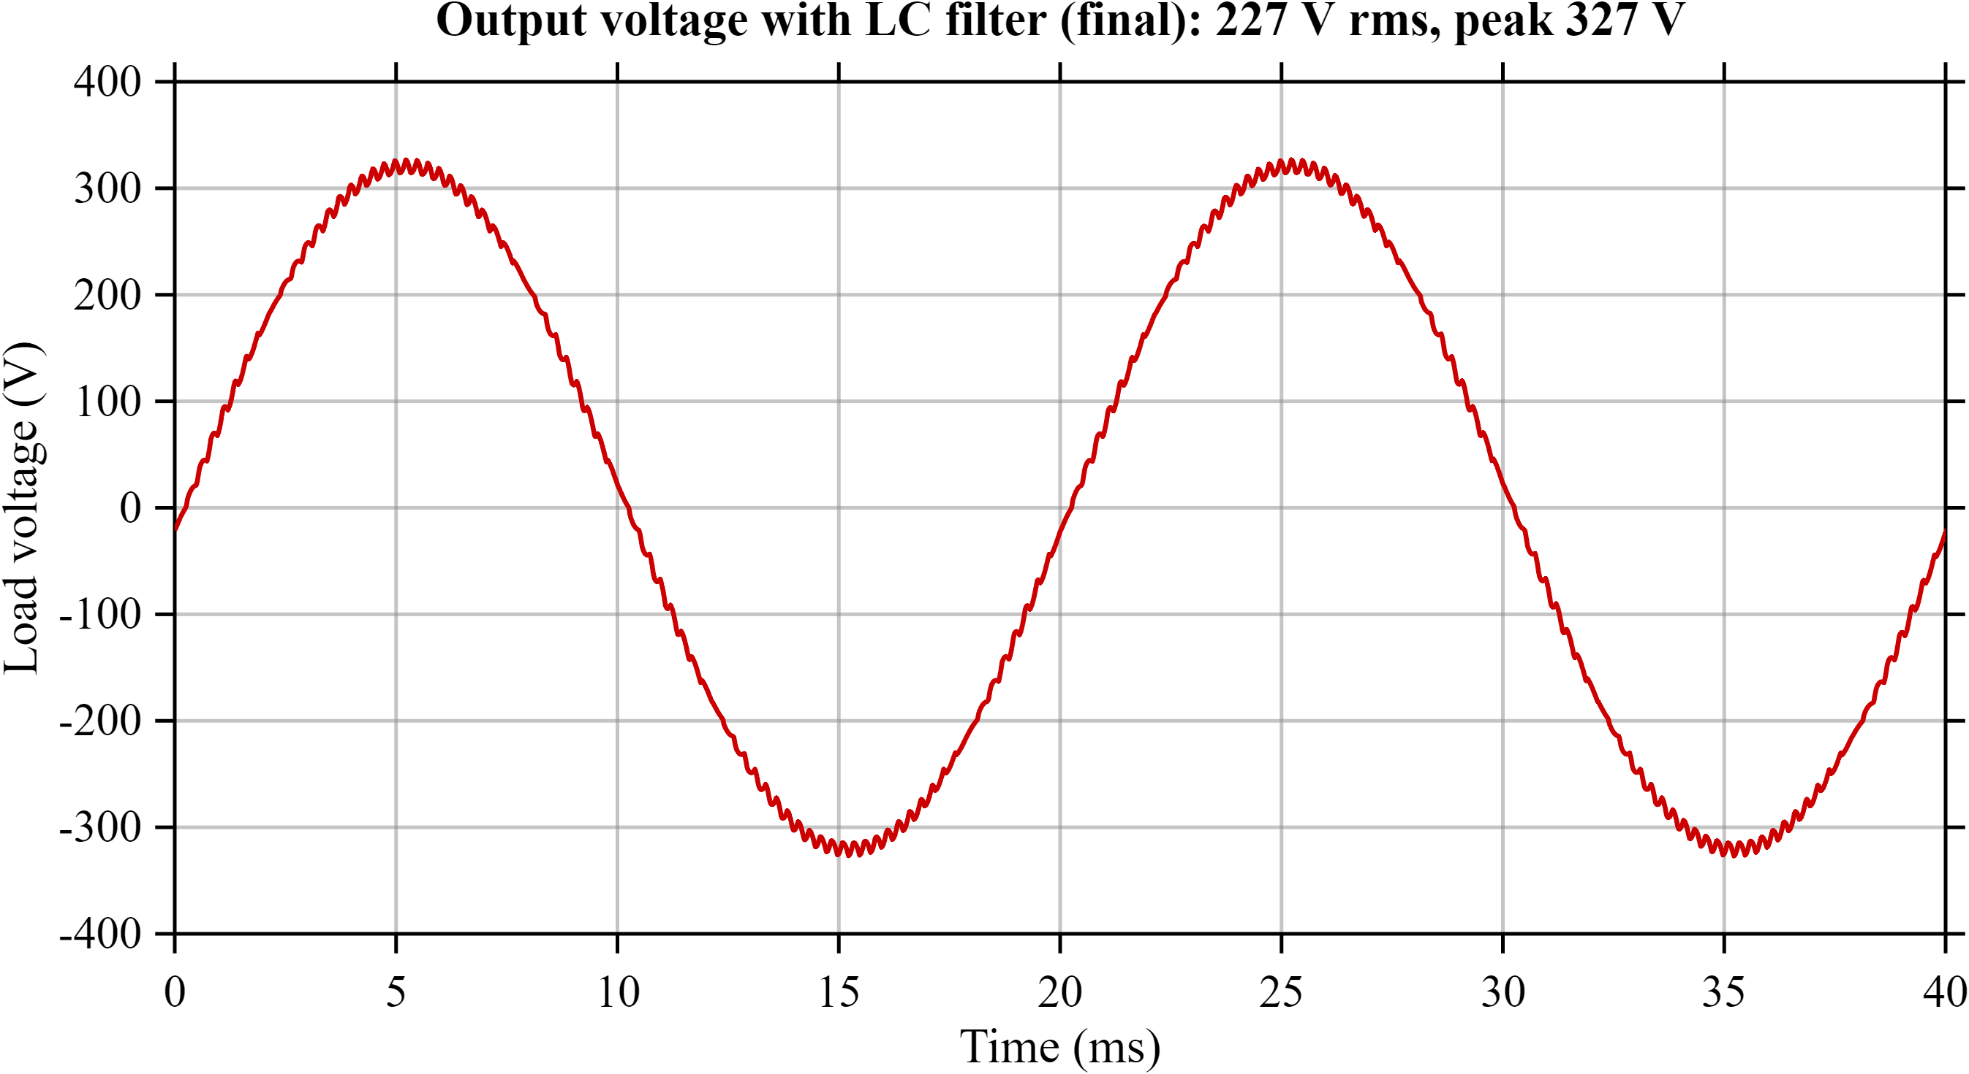
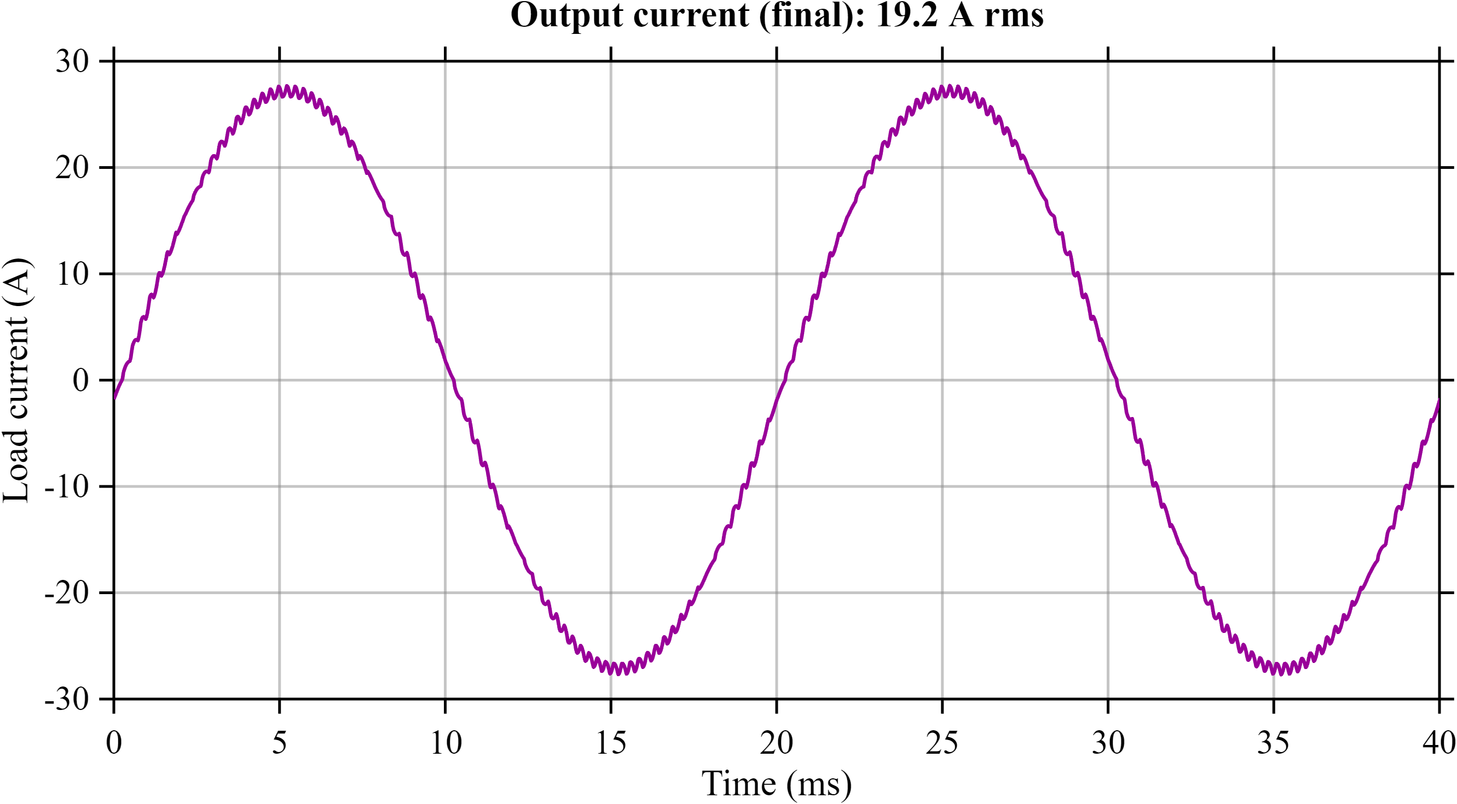
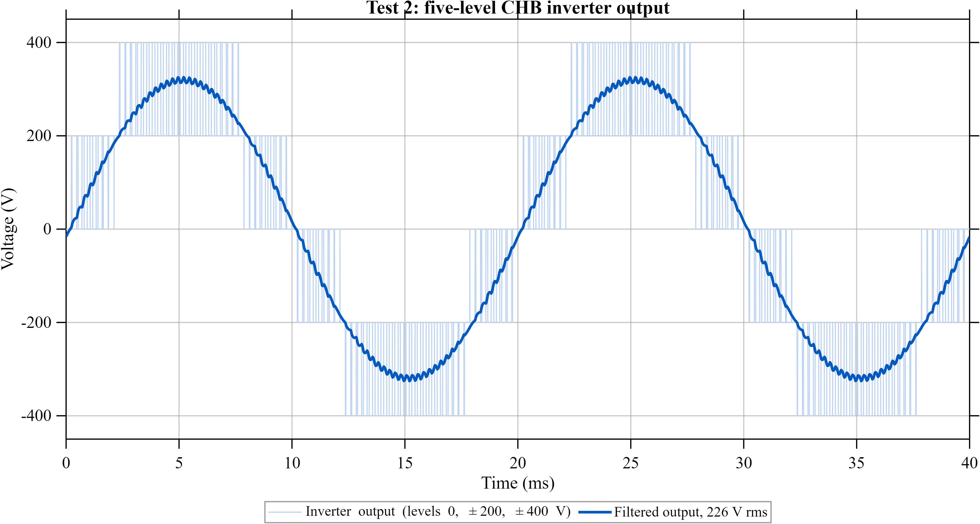
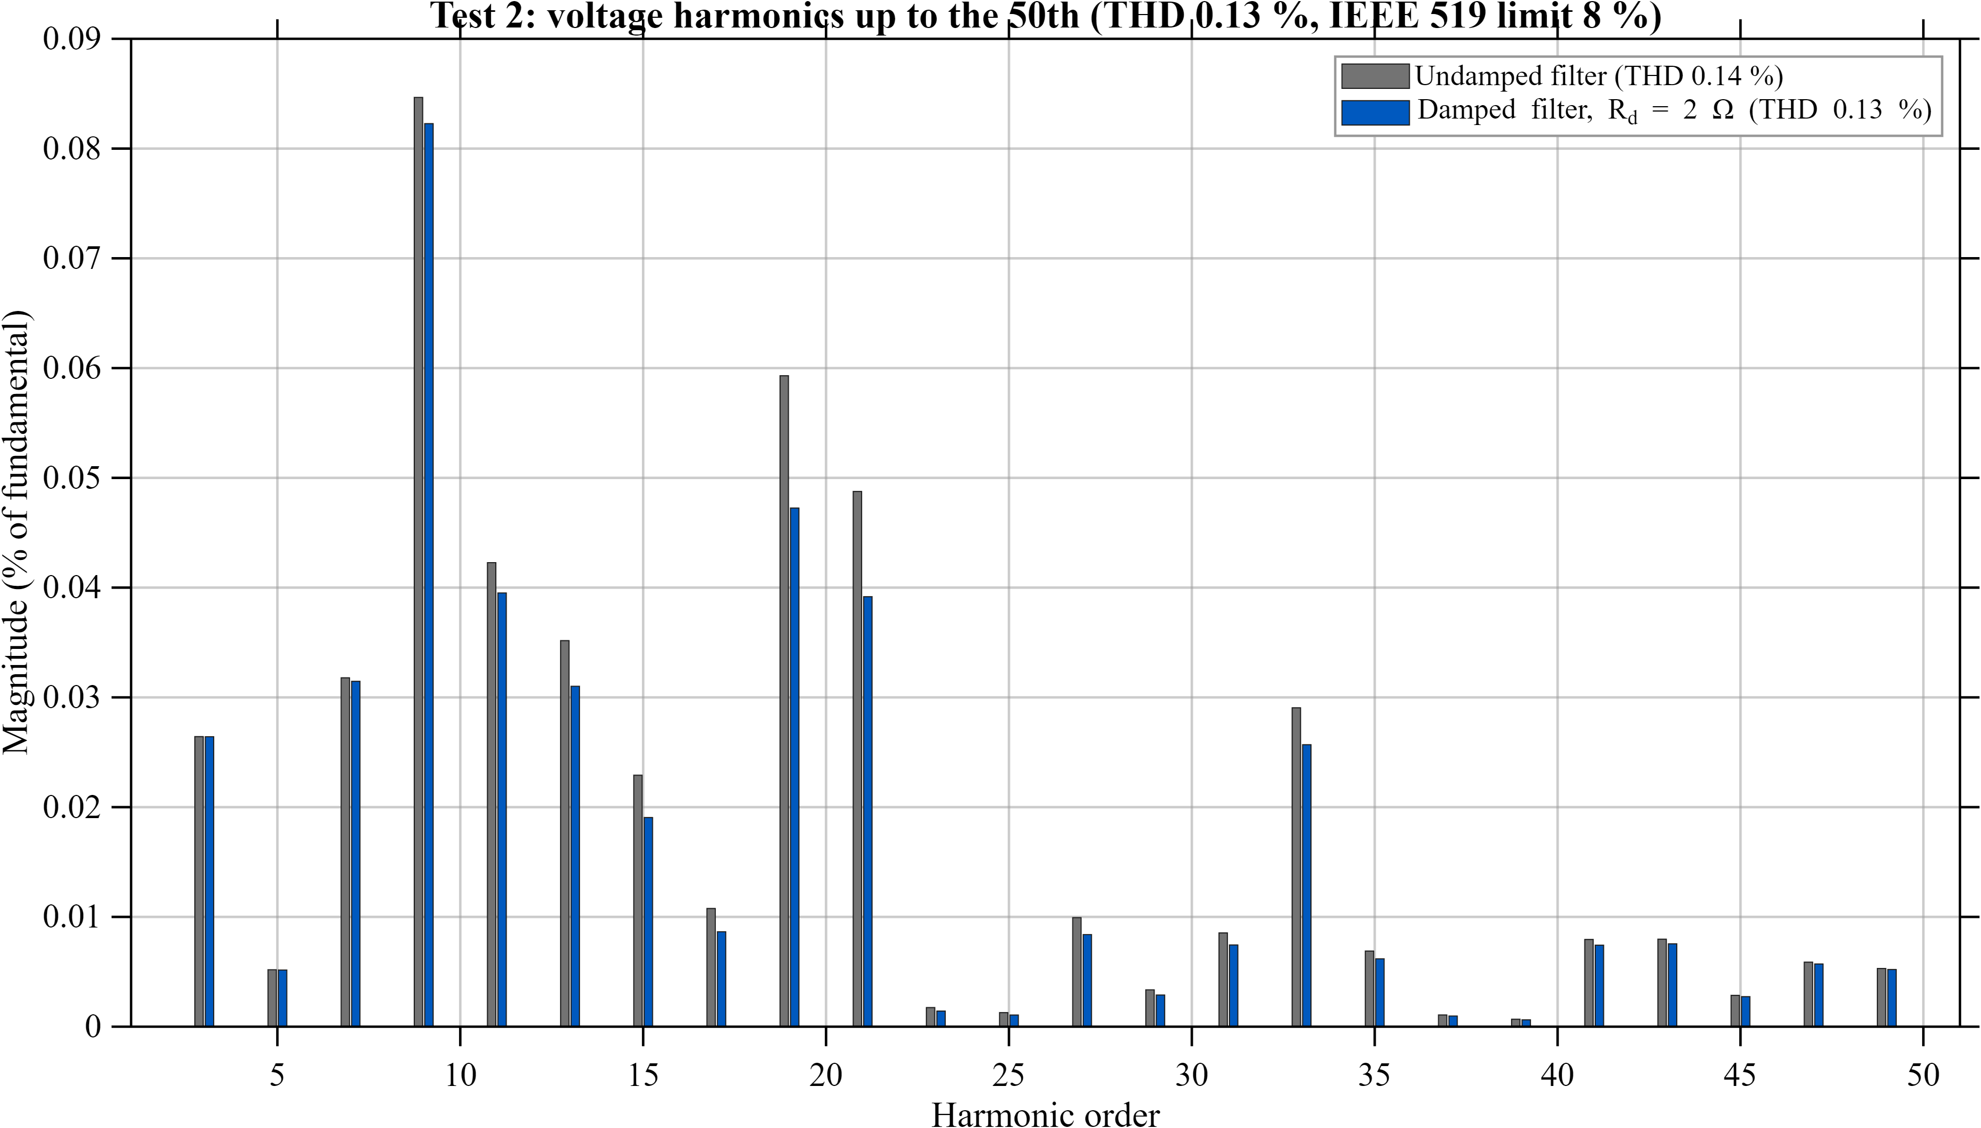
Results - Five-Level CHB Inverter: Output Waveforms
227 V rms
output voltage, 50 Hz
327 V
peak output voltage
19.2 A rms
load current (11.8 Ω)
4.35 kW
output power
Design: two 200 V H-bridge cells in series give five levels (0, ±200, ±400 V); phase-shifted PWM (1 kHz carriers, 90° apart) puts the ripple at 4 kHz, and the LC filter (2 mH / 20 µF + 2 Ω, resonance 796 Hz) removes it.
Notes:
Two cycles of the filtered output on an 11.8 ohm load: 227 V rms, 327 V peak, 19.2 A rms, 4.35 kW. Both waveforms are clean sine waves because the filter resonance (796 Hz) sits well below the 4 kHz switching ripple, so the ripple is attenuated without exciting the resonance.

Slide 18
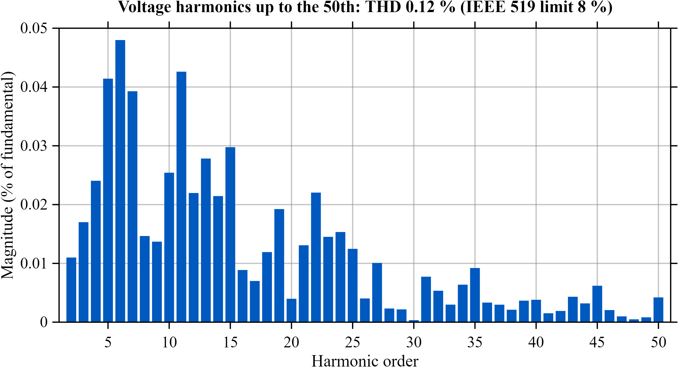
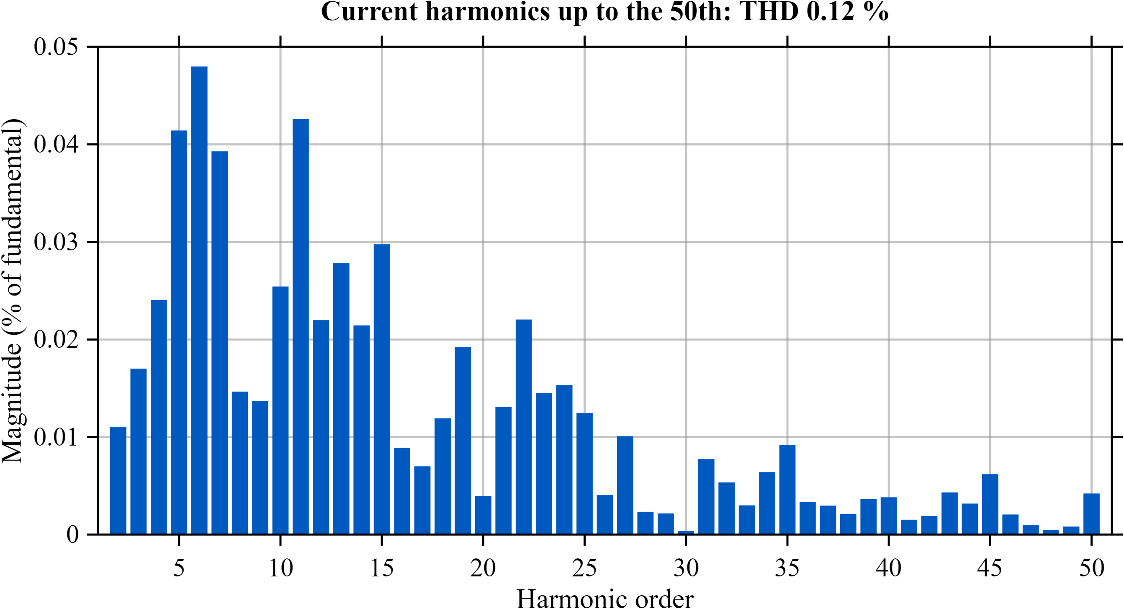
Results - Five-Level CHB Inverter: Harmonic Analysis
0.12 %
voltage THD to 50th harmonic
8 %
IEEE 519 THD limit (≤ 1 kV)
< 0.05 %
largest single harmonic (limit 5 %)
0.12 %
current THD
Harmonics: every harmonic up to the 50th stays below 0.05 % of the fundamental, so the output is far inside the IEEE 519 limits; with a resistive load the current spectrum matches the voltage spectrum.
Notes:
Harmonic spectrum of the output voltage and current up to the 50th order (2.5 kHz), the range counted by IEEE 519. Voltage THD 0.12 % against an 8 % limit; the largest individual harmonic is below 0.05 % against a 5 % limit. The current spectrum is the same because the load is resistive.

Slide 19
Conclusion and Future Scope
Success criterion | Objective | Clear day | Partly cloudy day | Status
Supply-to-demand ratio | ≥ 0.9 | 1.13 | 0.73 (storage + shedding) | Met (clear day)
DC bus voltage deviation | < 2 % | within 1 %; 3.5 % at one switch-over | 1.7 % | Met, one transient
Inverter voltage THD (IEEE 519) | < 5 % | 0.13 % up to 50th | - | Met
Correct tier order in shedding | T3 first | Only T3 shed | Only T3 shed | Met
Critical / essential loads | Never cut | 100 % served | 100 % served | Met
All objectives are met on the clear design day. The partly cloudy day is a stress case: PV covers only 73 % of demand, yet the battery and adaptive shedding keep every critical and essential load supplied.
Notes:
Success criteria from the Objective slide compared with the simulated results. The only exceedance is a single 3.5 % bus transient at the curtailment switch-over on the clear day.

Slide 20
Conclusion and Future Scope
Limitations
Time-compressed simulation; hourly weather smooths fast cloud transients.
Inverter validated separately; the 24-hour model uses its efficiency.
Not suitable for real time hardware implementation due to heavy model based design
Future scope
Isolated DC-DC stages to feed the CHB cells from the common bus.
Embedded controller (lookup tables on STM32) tested with hardware-in-the-loop.
Load and PV forecasting (TinyML) for predictive shedding; grid-connected operation (IEEE 1547).
Notes:
Summary of achievements, honest limitations of the simulation approach, and next steps toward hardware.

Slide 21
References
[1] M. Hilmi, V. Lystianingrum and M. F. Romlie, "EMS based on FSM for battery-supercapacitor HESS on standalone PV," IEEE ICPEA, 2024.
[2] S. D. Dwivedi and P. K. Ray, "Energy management and control of grid-connected microgrid integrated with HESS," ICICCSP, 2022.
[3] T. Wu, W. Yu and L. Guo, "A study on use of HESS along with variable filter time constant to smooth DC power fluctuation in microgrid," IEEE Access, vol. 7, 2019.
[4] S. K. Kollimalla, M. K. Mishra and N. L. Narasamma, "Design and analysis of novel control strategy for battery and supercapacitor storage system," IEEE Trans. Sustain. Energy, vol. 5, no. 4, 2014.
[5] L. Khemissi, M. A. Khalfa and A. Sellami, "Control and energy management of wind/PV/battery smart microgrid," IEEE CISTEM, 2022.
[6] M. G. Villalva, J. R. Gazoli and E. R. Filho, "Comprehensive approach to modeling and simulation of photovoltaic arrays," IEEE Trans. Power Electron., vol. 24, no. 5, 2009.
[7] N. Femia, G. Petrone, G. Spagnuolo and M. Vitelli, "Optimization of perturb and observe maximum power point tracking method," IEEE Trans. Power Electron., vol. 20, no. 4, 2005.
[8] O. Tremblay and L.-A. Dessaint, "Experimental validation of a battery dynamic model for EV applications," World Elect. Veh. J., vol. 3, no. 2, 2009.
[9] B. P. McGrath and D. G. Holmes, "Multicarrier PWM strategies for multilevel inverters," IEEE Trans. Ind. Electron., vol. 49, no. 4, 2002.
[10] M. Liserre, F. Blaabjerg and S. Hansen, "Design and control of an LCL-filter-based three-phase active rectifier," IEEE Trans. Ind. Appl., vol. 41, no. 5, 2005.
[11] IEEE Std 519-2022, IEEE Standard for Harmonic Control in Electric Power Systems, 2022.
[12] IEEE Std 1547-2018, IEEE Standard for Interconnection and Interoperability of Distributed Energy Resources, 2018.
[13] NASA Langley Research Center, POWER Project hourly data (MERRA-2 / CERES SYN1deg), https://power.larc.nasa.gov, accessed 29 Oct. 2026.

