Slide 1
Monocular Visual Odometry for Trajectory Estimation Using a Mobile Robot
CS 5733 Final Project Presentation
Group 07: Soumith Reddy Asani, Seri Sai Venkat Reddy,
Surya Prabhav Gurram

Slide 2
Introduction and Motivation
What is this project about?
Estimating camera trajectory using only a monocular RGB camera
Applied to real data collected from the ARCPro mobile robot
No depth sensors, no GPS, no ground truth
Why this problem/topic is important?
Monocular cameras are cheap, lightweight, and widely available
Visual Odometry (VO) is a core component of robotics and autonomous navigation
Useful in indoor and GPS-denied environments

Slide 3
Previous Work & Limitations
Previous Work
Feature-based VO and SLAM methods (e.g., ORB-SLAM, classical VO)
Stereo and RGB-D systems provide scale but require extra hardware
Most existing systems rely on stereo or RGB-D cameras to recover scale directly.
Limitations
Monocular VO suffers from:
Scale ambiguity
Drift accumulation
Loop closure and global consistency are challenging without additional sensors
Motivation for Our Work
Focus on a clean, robust monocular VO pipeline
Emphasize real robot data and honest evaluation

Slide 4
Project Contribution
Our Contributions
Implemented a monocular visual odometry pipeline
Evaluated on real ARCPro robot camera data
Provided:
Quantitative tracking statistics
Qualitative feature matching visualizations
Trajectory estimation
Sparse 3D reconstruction (optional)
Key Focus
Robust feature tracking
Stable pose estimation
Honest discussion of success and failure cases

Slide 5
Methodology Overview
Pipeline Overview
Feature detection and description
Detect salient key points in each frame
Feature matching between consecutive frames
Establish pixel correspondences for motion estimation
Essential matrix estimation (RANSAC)
Enforce epi-polar geometry and reject outliers
Relative pose recovery
Estimate camera rotation and translation
Trajectory integration over time
Accumulate relative poses to form a global path

Slide 6
Algorithm Details
Key Techniques Used
Feature detection and matching
Essential matrix estimation
RANSAC-based outlier rejection
Pose recovery using epipolar geometry
Incremental trajectory accumulation
RANSAC helps handle mismatches caused by dynamic objects and repetitive textures.
Pose estimates are relative between frames, not absolute.

Slide 7
Experiment Setup
Data Collection
RGB camera data from ARCPro mobile robot
Data was collected in an indoor MiniCity environment with realistic lighting variations.
Offline processing allowed us to focus on correctness rather than real-time constraints.
Implementation
OpenCV used for feature detection, matching, and pose estimation.
Custom monocular visual odometry pipeline implemented from scratch.
No ground-truth trajectory used
Hardware
RGB monocular camera mounted on the ARCPro mobile robot.
All computation performed offline on a standard laptop.

Slide 8
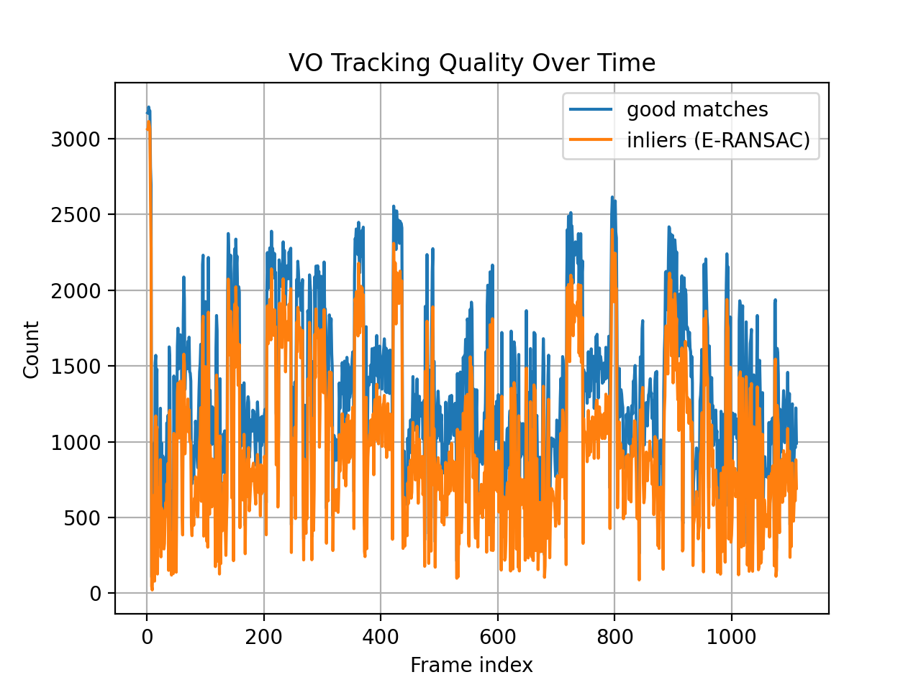
Results: Tracking Quality
Tracking Statistics
Number of feature matches per frame
Number of inliers after E-RANSAC
Statistics computed across the full image sequence
Observations
Consistent separation between matches and inliers indicates effective outlier rejection
Stable inlier counts across most frames
No long-term tracking collapse observed
Temporary drops correspond to low-texture regions or rapid motion

Slide 9
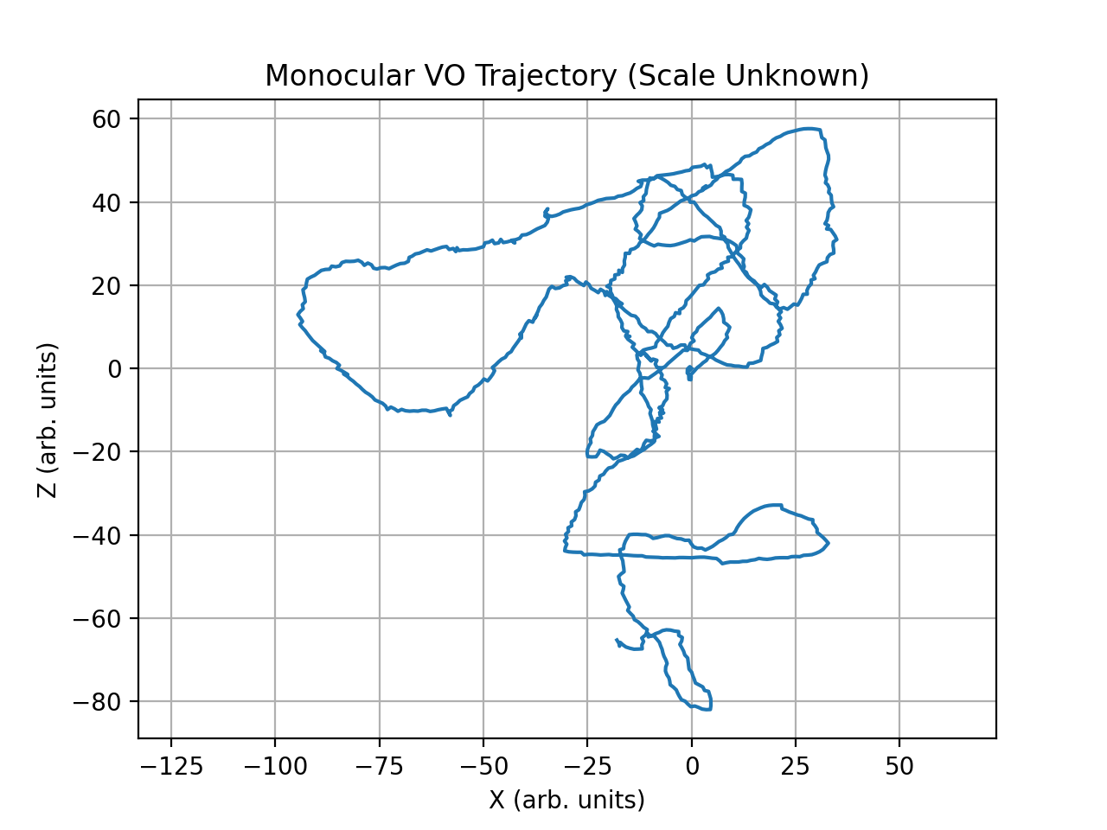
Results: Trajectory Estimation
Monocular VO Trajectory
Trajectory estimated by chaining relative frame-to-frame poses
Smooth and continuous motion over the sequence
Drift accumulates over time, which is expected for monocular VO
Absolute scale is not observable with a single camera
Takeaway
Relative motion is estimated reliably
Drift highlights the need for loop closure in future work

Slide 10
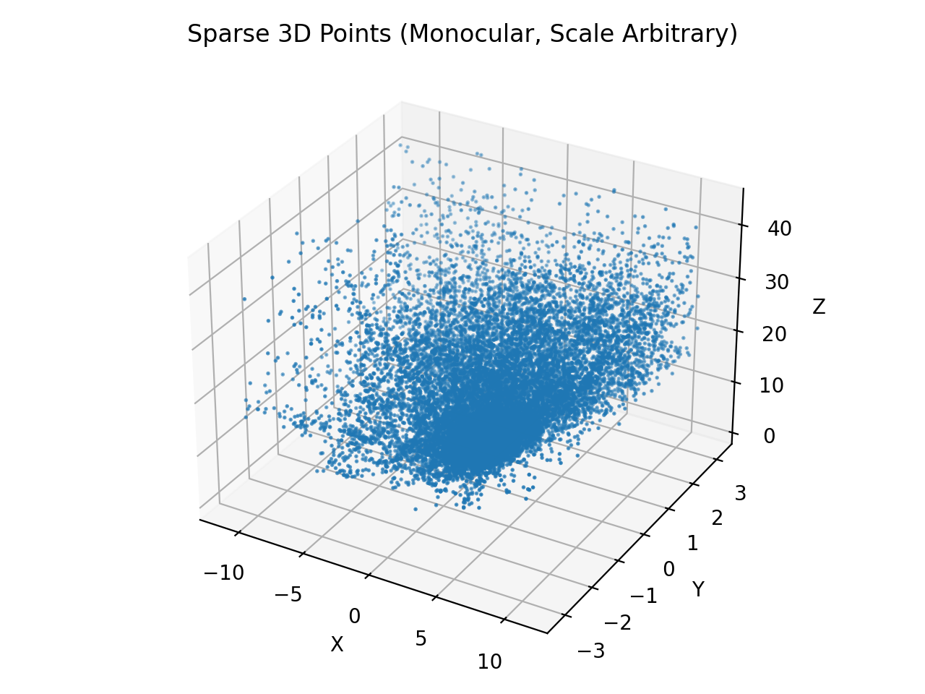
Results: Sparse 3D Reconstruction
Sparse 3D Points
3D points triangulated from matched feature correspondences
Reconstruction demonstrates consistent scene structure
Scale is arbitrary due to monocular setup
Observation
Depth ordering is preserved across the point cloud
No catastrophic reconstruction failure
Higher point density near the camera trajectory

Slide 11
Success & Failure Cases
Success Cases
Texture-rich environments with visible edges and corners
Moderate and smooth camera motion
Stable indoor lighting conditions
Structured scenes such as building facades and road markings
Consecutive frames with sufficient feature overlap
Failure / Limitations
Scale ambiguity inherent to monocular vision
Drift accumulation over long trajectories
Sensitivity to rapid camera motion and motion blur
Reduced performance in low-texture or repetitive scenes
No loop closure to correct accumulated error

Slide 12
Project Task Assignment
Team Member | Responsibility
Surya | VO pipeline design, essential matrix estimation, pose recovery, trajectory integration
Venkat | Data collection using ARCPro robot, feature matching visualization, experiment setup
Soumith | Evaluation and analysis, plotting tracking statistics, sparse 3D reconstruction

Slide 13
Conclusion & Future Work
Conclusion
Successfully implemented a monocular visual odometry pipeline on real robot data
Demonstrated stable feature tracking and smooth trajectory estimation
Verified results through quantitative tracking statistics and visual analysis
Highlighted fundamental limitations of monocular VO such as scale ambiguity and drift
Future Work
Integrate loop closure to reduce long-term drift
Recover metric scale using additional sensors such as IMU or stereo cameras
Optimize the pipeline for real-time onboard deployment
Extend the system toward a full SLAM framework
Potential continuation toward a conference-level research project

Slide 14
References
[1]R. Mur-Artal, J. M. M. Montiel, and J. D. Tardos, “ORB-SLAM: A Versatile and Accurate Monocular SLAM System,” IEEE Transactions on Robotics, vol. 31, no. 5, pp. 1147–1163, Oct. 2015, doi: https://doi.org/10.1109/tro.2015.2463671.
[2]R. Mur-Artal and J. D. Tardos, “ORB-SLAM2: An Open-Source SLAM System for Monocular, Stereo, and RGB-D Cameras,” IEEE Transactions on Robotics, vol. 33, no. 5, pp. 1255–1262, Oct. 2017, doi: https://doi.org/10.1109/tro.2017.2705103.
[3]“What Is SLAM (Simultaneous Localization and Mapping) – MATLAB & Simulink,” www.mathworks.com. https://www.mathworks.com/discovery/slam.html#section-2
[4] D. Scaramuzza and F. Fraundorfer, “Visual Odometry,” IEEE Robotics & Automation Magazine, vol. 18, no. 4, pp. 80–92, 2011.
[5] R. Hartley and A. Zisserman, Multiple View Geometry in Computer Vision, Cambridge University Press, 2nd ed., 2004.
[6] OpenCV Documentation, https://docs.opencv.org

