Slide 1
Hackathon 5 May 2024- CyberProtector * Surya Uppuluri * Pratika Vipin * linara Abdyzhaparova * brent cleary

Slide 2
Goal
Protecting AI against AI
Understanding Cyber Threats
Building a Resilient Defense
Empowering Digital Citizens

Slide 3
Societal Impact Combat
Disruption of emergency services => Loss of lives
Economic and financial losses
Social media manipulation -> Political instability
Understanding the vulnerabilities and motivations of attackers.
Financial gains
Political or strategic goals
Intention of causing harm

Slide 4
Types of AI Cyberattacks
Offensive AI Cyberattacks | Defensive AI Cyberattacks | Adverse AI Cyberattacks
Audio and Video impersonation(deepfakes) | Threat Detection | Data poisoning; Disruption of AI controlled systems
Tailored fishing | Threat Response and Mitigation | AI driven spoofing
AI-Driven malware | Vulnerability Management | Integrity attacks
Forgery | Malware Defense | Unintended outcomes
Social network attack, replay attack, spoofing attack |  | Evasion Attacks

Slide 5
Where can AI be helpful in defending against AI?
Threat Detection and Analysis
Vulnerability Management
Malware Detection and Prevention
Adversarial Machine Learning

Slide 6
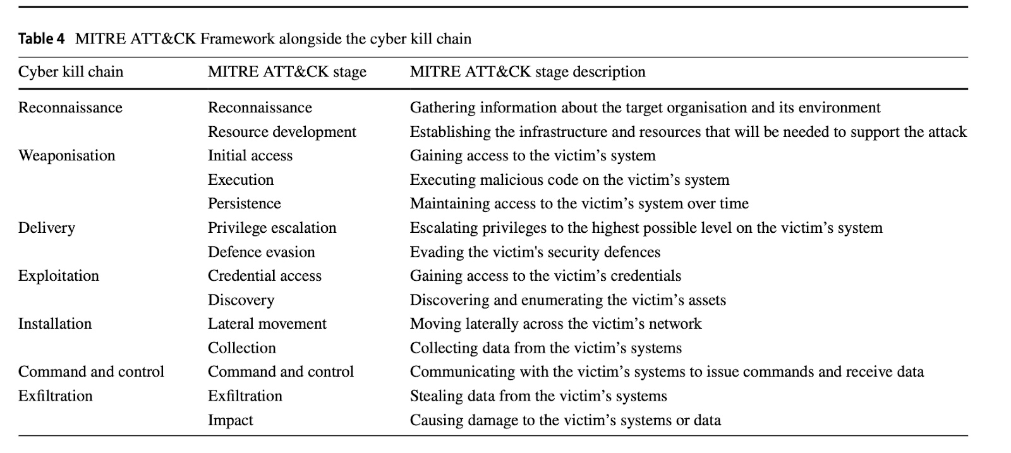




Slide 7
DEmo

Slide 8

Thank you

